Slide 1
Banking Today
Quick look at our Banking system

Slide 2

S E C T I O N 3
Banking Today
How do economists measure the U.S. money supply?
What services do banks provide?
How do banks make a profit?
What are the different types of financial institutions?
How has electronic banking affected the banking world?
1
2
Chapter 10, Section 3

Slide 3
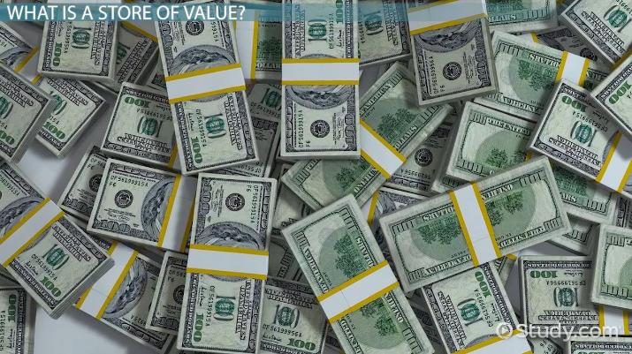
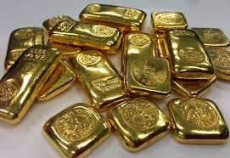
Functions of Money?
Barter: exchange (goods or services) for other goods or services without using money.
Medium of exchange (an intermediary instrument or system used to facilitate the purchase and sale of goods and services between parties).
Measure of Value (any item that is widely acceptable in exchange for goods and services.).
Store of Value (an asset that maintains its value, rather than depreciating).

Slide 4
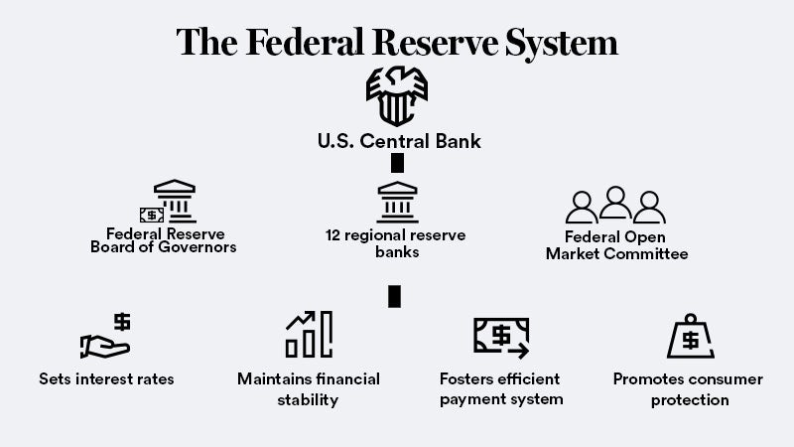
Leaving the Gold Standard and the FED
The Gold Standard (a system under which nearly all countries fixed the value of their currencies in terms of a specified amount of gold, or linked their currency to that of a country which did so).
Central Bank (The Fed) is the most powerful economic institution in the United States, perhaps the world. Its core responsibilities include setting interest rates, managing the money supply, and regulating financial markets.
FDIC Insured Where the U.. Government insures up to 250k in deposits for each account holder in a bank if it closes.

Slide 5
Measuring the Money Supply
The money supply is all the money available in the United States economy.
M1
M1 consists of assets that have liquidity, or the ability to be used as, or easily converted into, cash.
Components of M1 include all currency, traveler’s checks, and demand deposits.
Demand deposits are the money in checking accounts.
M2
M2 consists of all of the assets in M1, plus deposits in savings accounts and money market mutual funds.
A money market mutual fund is a fund that pools money from small investors to purchase government or corporate bonds.
1
2
Chapter 10, Section 3

Slide 6
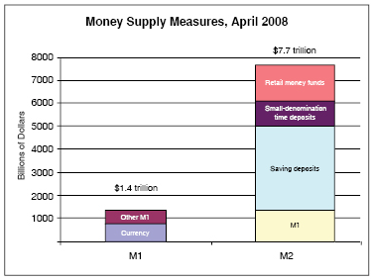
MONEY SUPPLY (M1 & M2)

Slide 7
Banking Services
Banks perform many functions and offer a wide range of services to consumers.
1
2
Chapter 10, Section 3

Slide 8

How Banks Make a Profit
The largest source of income for banks is the interest they receive from customers who have taken loans.
Interest is the price paid for the use of borrowed money.
How Banks Make a Profit
Money enters bank
Money leaves bank
Interest and withdrawals to customers
Deposits from customers
BANK
Money loaned to borrowers:
• business loans
• home mortgages
• personal loans
Interest from borrowers
Fees for services
Bank’s cost of doing business:
• salaries
• taxes
• other costs
Bank retains required reserves
1
2
Chapter 10, Section 3

Slide 9
Types of Financial Institutions
Commercial Banks
  Commercial banks offer checking services, accept deposits, and make loans.
Savings and Loan Associations
  Savings and Loan Associations were originally chartered to lend money for home-building in the mid-1800s.
Savings Banks
  Savings banks traditionally served people who made smaller deposits and transactions than commercial banks wished to handle.
Credit Unions
  Credit unions are cooperative lending associations for particular groups, usually employees of a specific firm or government agency.
Finance Companies
  Finance companies make installment loans to consumers.
1
2
Chapter 10, Section 3

Slide 10
Electronic Banking
The role of computers in banking has increased dramatically.
1
2
Chapter 10, Section 3

