Slide 1
Civil Rights
Textbook Chapter 6
Coach Flu

Slide 2
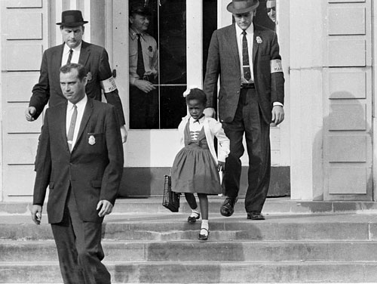
What are civil rights?
Civil rights: protections granted by the government to prevent discrimination against certain groups
Civil liberties: constitutional protections for individuals against government action

Slide 3
Introduction to Civil Rights in America
Civil Rights
  Definition: policies designed to protect people against arbitrary or discriminatory treatment by government officials or individuals
Racial Discrimination
Gender Discrimination
Discrimination based on age, disability, sexual orientation, and other factors

Slide 4
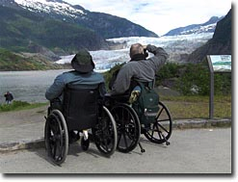
What are civil rights?
Claims are raised when a group is denied access to facilities, opportunities, or services available to other groups

Slide 5

The Americans With Disabilities Act (1990)
Requires employers to make reasonable accommodations for disabled employees.
This has given rise to two issues:
  What constitutes a disability?
  What is meant by a reasonable accommodation?

Slide 6
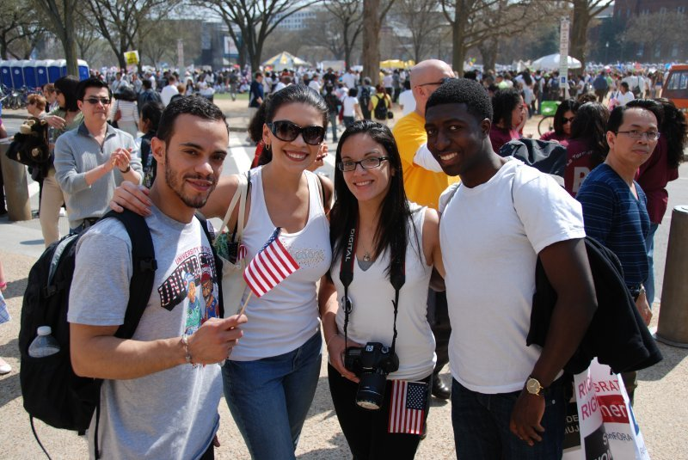
Protected Class
People protected from discrimination include ethnic minorities, women, those over 40, and disabled persons.
What do these groups have in common?

Slide 7
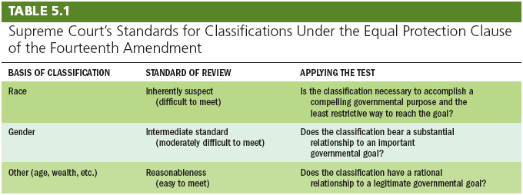
Two Centuries of Struggle

Slide 8
Two Centuries of Struggle
Conceptions of Equality
  Equal opportunity: same chances
  Equal results: same rewards
Early American Views of Equality
The Constitution and Inequality
  Equality is not in the original Constitution.
  First mention of equality in the 14th Amendment: “…equal protection of the laws”

Slide 9
Race, the Constitution, and Public Policy
The Era of Reconstruction and Resegregation
  Jim Crow or segregation laws
    Relegated African Americans to separate facilities
  Plessy v. Ferguson (1896)
    Case about white only train cars.
    Upheld the constitutionality of “equal but separate accommodations”

Slide 10
Race, the Constitution, and Public Policy
The Era of Civil Rights
  Brown v. Board of Education (1954)
    Overturned Plessy
    School segregation inherently unconstitutional
    Integrate schools “with all deliberate speed”
  Busing of students solution for two kinds of segregation:
    de jure, “by law” (meaning segregation by law)
    de facto, “in reality” (happens in practice)

Slide 11
Race, the Constitution, and Public Policy
The Era of Civil Rights (continued)
  Civil Rights Act of 1964
    Made racial discrimination illegal in hotels, restaurants, and other public accommodation
    Forbade employment discrimination based on race
    Created Equal Employment Opportunity Commission (EEOC)
    Strengthened voting right legislation (but was weak hence the passing of the Voting Rights Act in 1965)

Slide 12
Separate but Equal
NAACP strategy went through a series of stages:
Step 1: 1938-48 Supreme Court ruled “for education to be equal, it must be equally available.” (Gaines and Sipuel cases)
Step 2: 1950 Supreme Court ruled “racial barriers created unequal educational opportunities.” (Sweatt and McLaurin cases)
Step 3: 1954 Supreme Court ruled that “separate educational facilities are inherently unequal.” (Brown)

Slide 13
Desegregation mandated by the court, yet still ignored by many
The Southern Manifesto (1954)
Non-violent civil disobedience from SCLC and SNCC
The Montgomery Bus Boycott (1955-56)
The Little Rock Nine (1957)
The Freedom Riders and sit-ins at lunch counters (1961)
“Bombing”ham, Alabama—Chief Bull Connor, German Shepherds, and fire hoses vs. the Children’s Crusade (1963)
The March on Washington (1963)
Still no widespread compliance
Leads to the “Long, Hot Summers”—periods of violent protests and rise of the Black Panthers, Malcolm X and the Nation of Islam (1964-1968)

Slide 14

Desegregation v. Integration
Swann v. Charlotte Mecklenburg (1971): remedies may include racial quotas, redrawn district lines, and court-ordered busing
Inter-city busing could be authorized only if both the city and the suburbs had practiced segregation

Slide 15

Heart of Atlanta Motel v. U.S. (1964)
A hotel owner refused to rent rooms to African Americans.
He claimed the Civil Rights Act of 1964 infringed on his rights as a private property owner.
The Court upheld Congressional authority to pass the Civil Rights Act under the Commerce Clause.
Congress has the right to regulate “interstate commerce.”

Slide 16
Have Things Improved?
The 2013 State of Black America report reported:
1963 to 2013 Blacks graduation rate rose from 25% to 85%
Poverty rate for blacks dropped from 48% to 28%
Black homeownership rose by 14%
Some notable gaps:
Black unemployment still almost 2x that of whites
1/3rd of black children still live in poverty
Black wage gap still exist

Slide 17

Gender-Based Discrimination
Arbitrary differences are not allowed.
Some gender-based differences, such as the all-male draft, are allowed by courts

Slide 18
Women, the Constitution, and Public Policy
The Second Feminist Wave
  Reed v. Reed (1971) (law giving assets to men)
    “Arbitrary” gender discrimination violated 14th Amendment’s Equal Protection Clause
  Craig v. Boren (1976) (Statute allowing different ages for male and female to buy beer)
    “Medium scrutiny” standard established for gender discrimination
  Equal Rights Amendment fails ratification by states (1982) (was a proposed amendment to the United States Constitution designed to guarantee equal rights for women. The ERA was originally written by Alice Paul and, in 1923, it was introduced in the Congress for the first time. In 1972, it passed both houses of Congress and went to the state legislatures for ratification. The ERA failed to receive the requisite number of ratifications before the final deadline mandated by Congress of June 30, 1982 expired and so it was not adopted).

Slide 19
Women, the Constitution, and Public Policy
Women in the Workplace
  The Civil Rights Act of 1964 banned gender discrimination in employment.
Wage Discrimination and Comparable Worth
  The Supreme Court has not ruled on this issue.
Women in the Military
  Only men may be drafted or serve in ground combat.
Sexual Harassment
  Prohibited by Title VII of Civil Rights Act of 1964

Slide 20
Illegal Discrimination
A state can not set different ages for men or women to become adults.
Same ages to buy things (like Beer)
Women can not be barred from jobs because of arbitrary weight and height requirements
Women can not be forced to take mandatory pregnancy leave

Slide 21
Newly Active Groups Under the Civil Rights Umbrella
Gay and Lesbian Rights
  Bowers v. Hardwick (1986) (United States Supreme Court decision that upheld, in a 5-4 ruling, the constitutionality of a Georgia sodomy law criminalizing oral and anal sex in private between consenting adults when applied to homosexuals).
  Lawrence v. Texas (2003)
    Overturned Bowers (landmark decision by the United States Supreme Court. In the 6-3 ruling, the Court struck down the sodomy law in Texas and, by extension, invalidated sodomy laws in thirteen other states, making same-sex sexual activity legal in every U.S. state and territory).
    Private homosexual acts are protected by the Constitution
  Obergfell v. Hodges (2015) Gay marriage case
  fundamental right to marry is guaranteed to same-sex couples by both the Due Process Clause and the Equal Protection Clause of the Fourteenth Amendment to the United States Constitution.

Slide 22
Affirmative Action
Definition: a policy designed to give special attention to or compensatory treatment of members of some previously disadvantaged group
In education
  Regents of the University of California v. Bakke (1978)
    Racial set asides unconstitutional
    Race could be considered in admissions
  Grutter v. Bollinger (2003)
    Race could be considered a “plus” in admissions

Slide 23
Understanding Civil Rights and Public Policy
Civil Rights and Democracy
  Equality favors majority rule.
  Suffrage gave many groups political power.
Civil Rights and the Scope of Government
  Civil rights laws increase the size and power of government.
  Civil rights protect individuals against collective discrimination.

