Slide 1
Civil Liberties & Civil Rights
Textbook Chapter 5 & 6
Coach Flu

Slide 2
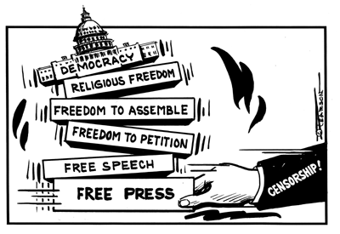
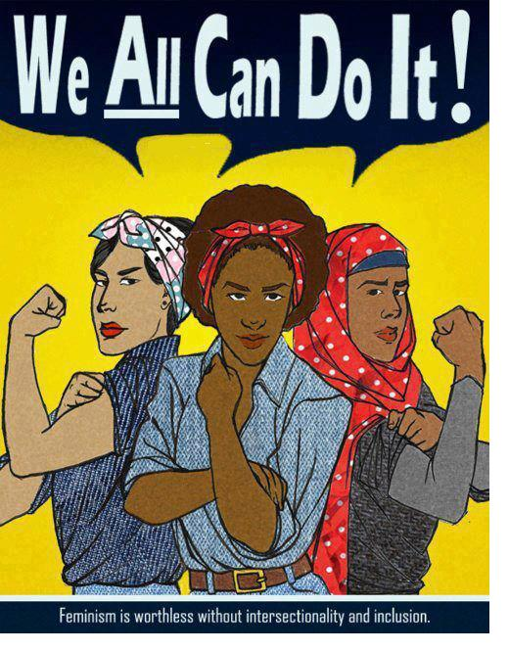
Civil Liberties vs. Civil Rights
Civil liberties
Civil rights
Place limits on government
Give the individual "liberty" from the actions of the government
Provide “due process” of the laws
Bill of Rights
Deliberate actions taken by government to create equal conditions for all
Provide equal protection of groups in the minority
14th Amendment
“equal protection”

Slide 3
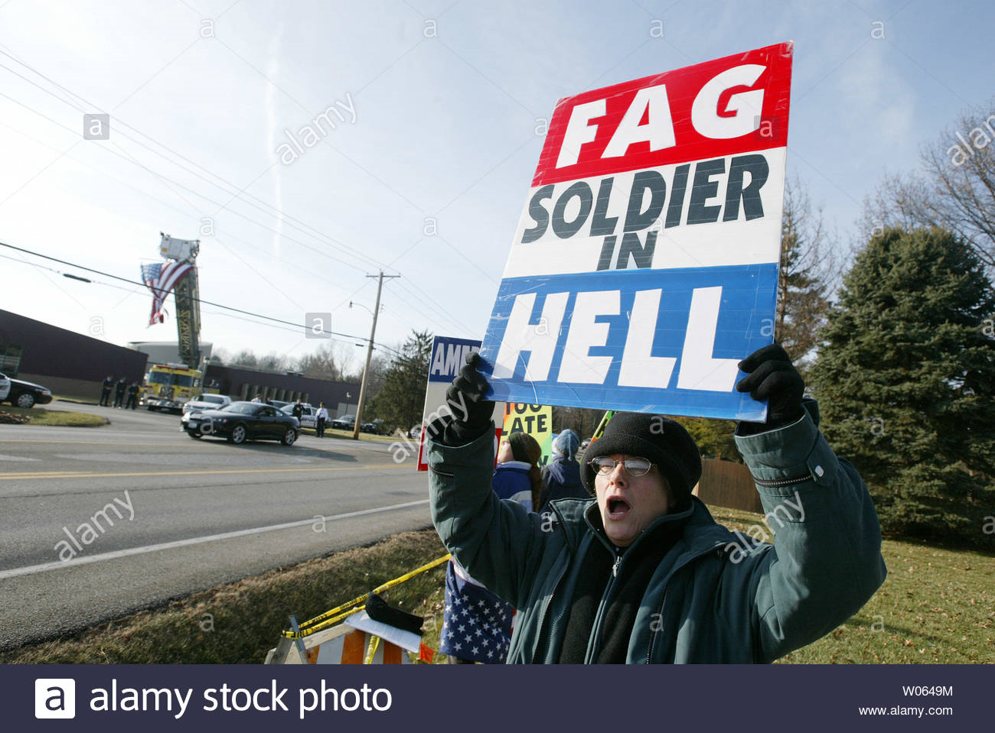
The Courts and Conflicts over Civil Liberties
Civil Liberties and the courts are in constant struggles over individual freedoms that citizens have and what limits exists on those freedoms.
Conflicts occur when one person asserts one constitutional right or duty and another person asserts a different one.
Should groups like the Westboro Baptist Church be able to protest at funerals against things like gay rights?

Slide 4
Restricted Liberty
Conflicts (war) have brought restrictions on peoples liberty over our history.
Sedition Act of 1798: The sweeping language of the Sedition Act made it illegal, among other actions, to “write, print, utter or publish...any false, scandalous and malicious writing...with intent to defame the...government” or “to stir up sedition within the United States.” The acts were set to expire on March 3, 1801.
Espionage and Sedition Acts of 1917-1918: restricted the activities of foreign residents in the country and limited freedom of speech and of the press.
The Smith Act 1940, Internal Security Act in (1950), & Communist Control Act (1954): (just think McCarthy)

Slide 5
The Bill of Rights then and Now
The Bill of Rights is the first 10 amendments to the U.S. Constitution which defines the basic civil liberties that are protected for the people from the government.

Slide 6
The Need to Apply the Bill of Rights onto the States
Incorporation (Selective Incorporation)
use of the 14th amendment in case decisions to make the Bill of Rights apply to actions of the states. This is done through selective cases by the SCOTUS.
Barron v. Baltimore: 1833 Supreme court decision holding that the Bill of Rights restrained only the national government, not the states and cities.
Gitlow v. New York: 1925 Supreme court decision holding that freedoms of press and speech are “fundamental personal rights and liberties protected by the due process clause and fourteenth amendment from impairment by the states” as well as by federal government.
What is in the 14th Amendment ?
Due process
a legal understanding that you are owed certain rights from the government (5th and 14th Amendments) Denies the government the right, without due process, to deprive people of life, liberty, and property.
Equal protection
a constitutional guarantee that no person or class of persons shall be denied the same protection of the laws that is enjoyed by other persons or other classes of people (14th Amendment)

Slide 7
The Bill Of Rights: 1st Amendment
First Amendment rights include:
Freedom of Expression
Freedom of speech
Freedom of the press
Freedom to assemble peaceably
Freedom to petition the government for a redress of grievances
Freedom of Religion
Establishment clause
Free exercise clause

Slide 8
Freedom of Religion
The Free Exercise Clause
Free Exercise Clause: A 1st Amendment provision that prohibits government from interfering with the practice of religion.
What if something interfered with your religious belief? (Military, drugs, transfusions)
*you still have to abide by the laws of states and national government*
Religious restoration act 1993: right to perform their religious rituals unless the government can show that the law or regulation in question is narrowly tailored and in pursuit of a “compelling interest.”
The restoration act, however, was deemed unconstitutional in 1997 but, it a few parts still applies to the federal government today but most protections in the 1993 Act do not apply to the states or local government.

Slide 9
Freedom of Religion
Establishment Clause: Part of 1st Amendment stating “Congress shall make no law respecting an establishment of religion.”
There can be no established national religion nor can government promote or discriminate against religion.
1984 Equal Access Act made it so all people, even students, from Parochial schools could use another public schools facilities.
Neutrality when it comes to religion is not easy for people or the Government since the two are so woven into American society.
Zelman v. Simmons-Harris: 2002 court decision that upheld a state providing familes with vouchers that could be used to pay for tuition at religious schools.
(R) Engle v. Vitale: 1962 court decision holding that state officials violated the 1st Amendment when they wrote a prayer to be recited by New York’s schoolchildren. Can not hold prayers in school.
School District Abington v. Schempp: 1963 court decision holding that Pennsylvania law requiring Bible reading in schools violated 1st Amendment.
Lee v. Weisman (1992) No inviting clergy to recite prayers at graduation ceremonies
(R) Wisconsin v. Yoder, case in which the U.S. Supreme Court on May 15, 1972, ruled (7–0) that Wisconsin's compulsory school attendance law was unconstitutional when applied to the Amish, because it violated their rights under the First Amendment, which guaranteed the free exercise of religion.
* Required Case (R)

Slide 10
Religious Freedom
Does the government assist religious schools with tax dollars today?
Yes.
Courts have ruled that it is ok for tax dollars to be spent on: school lunch, transportation, speech/hearing support, standardized tests, computer purchases and internet access, vouchers; subject to Lemon test restrictions (Lemon v. Kurtzman 1971)
Lemon Test three pronged test
It has a strict secular purpose
Its primary effect neither advances nor inhibits religion.
It does not foster an excessive government entanglement with religion.

Slide 11
Religious Freedom
Are these Constitutional?
A company not wanting to pay for plan B contraceptives for their employees because of religious beliefs?
A city council meeting starting with a prayer?
Moment of silent prayer?
Moment of silence for non-religious reasons?
Prayer at a High School graduation okay?
Yes, Burwell v. Hobby Lobby (2014)
Yes, Town of Greece v. Galloway (2014)
No. Wallace v. Jaffree (1985)
Yes. Brown v. Gwinnett County S.D. (1997)
No, Lee v. Weisman (1992)

Slide 12
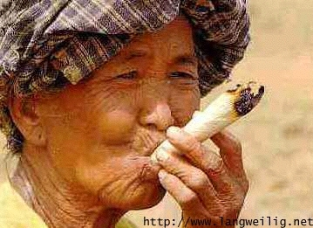
Religious Freedom
Free Exercise
Distinction between belief and practice
Courts have upheld state intervention in religious practices
Drug Use be banned if someone makes the argument
It is part of their religion?
No. Oregon v. Smith (1990) state unemployment
benefits were denied even though peyote was
used as a religious ritual.
Restrictions can be made if the restrictions are for all people and not directed at a specific group (religious).

Slide 13
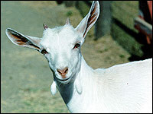
Religious Freedom
Free Exercise
Is animal sacrifice permissible?
Yes.
Church of the Lukumi Babalu Aye (Santeria) v. City of Hialeah (1993)

Slide 14
Recent Landmark Cases
Santa Fe Independent School Dist. v. Doe,(2000),
Case heard before the United States Supreme Court. It ruled that a policy permitting student-led, student-initiated prayer at high school football games violates the Establishment Clause of the First Amendment. The court announced its decision on June 19, holding the policy unconstitutional in a 6–3 decision.

Slide 15
Freedom of Expression
Is this protected speech?
No. Morse v. Frederick (2007)
Court made three legal determinations:
First, that "school speech" doctrine should apply because Frederick's speech occurred "at a school event";
Second, that the speech was "reasonably viewed as promoting illegal drug use";
Third, that a principal may legally restrict that speech
Based on the three existing First Amendment school speech precedents, other Constitutional jurisprudence relating to schools, and a school's "important, indeed, perhaps compelling interest" in deterring drug use by students.

Slide 16
Symbolic Speech
Is this protected speech?
Can you burn the flag in peaceful protest?
Yes.
Texas v. Johnson (1989)

Slide 17
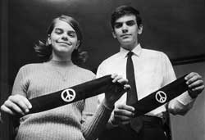
Symbolic Speech
Is this protected speech?
Can kids wear protest armbands in school, if they do not disrupt the educational process?
Students do have free speech rights.
Student rights can be more restrictive based on learning
environment and student safety.
Yes.
(R) Tinker v. Des Moines School District (1969)

Slide 18
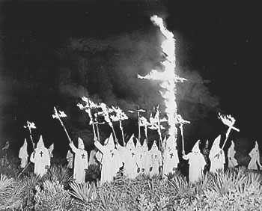
Freedom of Expression
Are these both protected speech?
Yes.

Slide 19
Freedom of Expression
When is speech NOT protected?
(R) Schenck v. United States (1919) – not if it demonstrates a “clear and present danger”
Gitlow v. New York (1925) – not if it “advocated the violent overthrow of the government” (also created concept of Incorporation Doctrine)
Brandenburg v. Ohio (1969) – not if the speaker caused “incitement to imminent lawlessness”
“fighting words”--words which would likely make the person to whom they are addressed commit an act of violence (intended to cause the hearer to react toward the speaker)

Slide 20
Freedom of Expression
When is speech NOT protected?
Obscenity is not Protected Roth v. United States (1957)
A legal definition
Pornography ≠ obscenity
Miller v. California (1973)
Average person finds it violates
contemporary community standards
Work taken as a whole appeals to a prurient interest in sex
Work depicts patently offensive sexual conduct
Work lacks serious redeeming literary, artistic, political, or scientific value
A community-based standard
Almost all internet speech is unregulated in America because there is no “community standard” on the worldwide web
(Reno v. ACLU, 1997)

Slide 21
Freedom of the Press
Does the media have unlimited free speech?
Print media enjoys freedom from “prior restraint”
Broadcast media must obey certain restrictions enforced by the FCC

Slide 22
Freedom of Expression
Most forms are protected under the constitution.
Prior Restraint: A government preventing material from being published. Limits press.
Near v. Minnesota: 1931 court decision holding that 1st Amendment protects newspapers from prior restraint. (Selective Incorporation case)

Slide 23
(R) New York Times Co. v. United States (1971)
Landmark decision by the United States Supreme Court on the First Amendment. The ruling made it possible for the New York Times and Washington Post newspapers to publish the then-classified Pentagon Papers without risk of government censorship or punishment.
President Richard Nixon had claimed executive authority to force the Times to suspend publication of classified information in its possession. The question before the court was whether the constitutional freedom of the press, guaranteed by the First Amendment, was subordinate to a claimed need of the executive branch of government to maintain the secrecy of information. The Supreme Court ruled that the First Amendment did protect the right of the New York Times to print the materials.

Slide 24
Freedom of Expression
Libel and Slander:
Another restriction that still can not be banned.
There are many cases against it, but it’s hard to say what is right or wrong because of the grey area of opinion and facts and what the intentions of the accused where when they write or say it.
Libel: The publication of false or malicious statements that damage someone’s reputation.
New York Times v. Sullivan: 1964 case that established the guidelines for determining whether public officials and public figures could win damage suits for libel. To win the case the victim must prove that the statements were made with “malicious intent” and reckless disregard for the truth.

Slide 25
Freedom of Expression (Press and Courts)
Free Press and Fair Trials:
Press usually has freedoms when it comes to reporting on court cases because the public has a right to know what goes on.
Fair trials are also protected so press can be limited if it interferes with a fair trial.
Shield laws were created to protect reporters during court cases.
Zurcher v. Stanford Daily: 1978 court decision holding that a proper search warrant could be applied to a newspaper as well as anyone else without necessarily violating the 1st Amendment rights to freedom of press.

Slide 26
Commercial Speech
Commercial Speech: Communication in the form of advertising. Can be restricted more so than other types of speech.
Advertising is regulated by Federal Trade Commission (FTC) and it makes sure advertisements are truthful.
Regulation of Public Airwaves:
Federal Communications Commission (FCC) regulate what goes on TV or radio. Restrictions are not unconstitutional.
Miami Herald Publishing Co. v. Tornillo: 1974 case that held that a state could not force a newspaper to print replies from candidates it had criticized, illustrating the limited power of government to restrict the print media.
Red Lion Broadcasting co. v. FCC: 1969 case that upheld restrictions on radio and TV broadcasting. They are less restrictive than those on print media because there are less broadcasting frequencies available.

Slide 27
Freedom to Peaceably Assemble
Balance right to free association with right for public order
Permissible for localities to require permits in order to protest
Can a predominantly-Jewish town withhold a permit allowing the NAZIs to hold a rally?
No. National Socialist Party of America v. Village of Skokie (1977)

Slide 28
Freedom of Assembly
Basis for forming interest groups, political parties etc.
Right to Assemble:
People are allowed to assemble and protest as long as it’s on private property and they demonstrate during times when police can come if needed.
Right to Associate:
Everyone has the right to associate with people who share a common interest.
NAACP v. Alabama: The Supreme court protected the right to assemble peaceably in this 1958 case when it decided the NAACP did not have to reveal its membership list and thus subject its members to harassment.

Slide 29
Recent Landmark Cases
(R) McDonald v. Chicago (2010)
Determined whether the Second Amendment applies to the individual states. The Court held that the right of an individual to "keep and bear arms" protected by the Second Amendment is incorporated by the Due Process Clause of the Fourteenth Amendment and applies to the states.
Simple English: States and cities can not take away a persons 2nd Amendment rights. Except:"prohibit...the possession of firearms by felons or mentally ill" and "laws forbidding the carrying of firearms in sensitive places such as schools and government buildings, or laws imposing conditions and qualifications on the commercial sale of arms"

Slide 30
Defendant's Rights
Crime followed by arrest, followed by prosecution, followed by trail, followed by verdict. (Stages of criminal justice system)
Courts apply the protections of the accused in the 4th, 5th, 6th, 7th, 8th amendments. (Procedural Due Process is the following of these rights to protect people’s rights from being overrun by the government)

Slide 31
Stages of Criminal Justice System

Slide 32
Defendant's Rights
Searches and Seizures:
Must have a probable cause to search and/or seize from a search warrant.
Probable Cause: The situation occurring when the police have a reason to believe that a person should be arrested.
Most searches/seizures take place with no warrant.
You can not be searched unannounced with out probably cause.
Patriot Act is a new limit on privacy.
Unreasonable Searches and Seizures: Obtaining evidence in a haphazard or random manner, a practice prohibited by the 4th Amendment.
Search Warrant: A written authorization from a court specifying the area to be searched and what the police are searching for.
Exclusionary Rule: The rule that evidence, no matter how incriminating, cannot be introduced into trial if it was not constitutionally obtained.
Mapp v. Ohio: 1961 decision ruling that the 4th amendment’s protection against unreasonable searches and seizures must be extended to the states as well as to the federal government. (overturns Wolf v. Colorado that stated the rule did not apply to states 1949)
United States v Leon (1984) “good Faith” exception to the exclusionary rule allowing the introduction of illegally obtained evidence where police officers can prove that the evidence was obtained without violating due process principles of Mapp v Ohio
Public safety exception allows into evidence an otherwise suppressible statement made by a defendant relating to information that the police needed at the time it was made in order to protect the public Example case U.S. v Talley
Inevitable discovery: Police can use information gathered in interview if it would have been discovered eventually.

Slide 33
Terry v. Ohio (1968)
Landmark decision by the United States Supreme Court which held that the Fourth Amendment prohibition on unreasonable searches and seizures is not violated when a police officer stops a suspect on the street and frisks him or her without probable cause to arrest, if the police officer has a reasonable suspicion that the person has committed, is committing, or is about to commit a crime and has a reasonable belief that the person "may be armed and presently dangerous.
For their own protection, police may perform a quick surface search of the person’s outer clothing for weapons if they have reasonable suspicion that the person stopped is armed. This reasonable suspicion must be based on "specific and articulable facts" and not merely upon an officer's hunch.
The meaning of the rule is to protect persons from unreasonable searches and seizures aimed at gathering evidence, not searches and seizures for other purposes (like prevention of crime or personal protection of police officers).

Slide 34
Defendant's Rights
Self-Incrimination:
You have a set of Miranda Rights when arrested:
1. Right to remain silent
2. Right to an attorney (One will be provided to those who cant afford one)
3. Anything you say can and will be used against you in a court of law.
Fifth Amendment: Designed to protect the rights of persons accused of crimes, Including prosecutions against double jeopardy, self-incrimination, and punishment without due process of law.
Self-Incrimination: Occurs when an individual accused of a crime is compelled to be a witness against himself or herself in court.
(R) Miranda v. Arizona: 1966 decision that sets guidelines for police questioning of accused persons to protect them against self-incrimination and to protect their right to counsel.

Slide 35
Defendant's Rights
Right to Counsel:
Everyone has a right to counsel; used mostly in capital crimes and then later extended to state courts on felonies (Gideon v. Wainwright)
Sixth Amendment: Designed to protect individuals accused of crimes. Includes right to counsel, right to confront witnesses, and right to a speedy and public trial.
(R) Gideon v. Wainwright: 1963 decision holding that anyone accused of a felony where imprisonment may be imposed, however poor he or she might be, has a right to a lawyer.

Slide 36
Defendant's Rights
Trials:
Most court cases don’t have hearings, just a plea bargaining.
Jury can have from 1-100 jurors chosen by lawyers from both sides. Traditional size=12. (Most juries are granted sentencing)
The only time names were withheld, reducing detainees rights for access to courts and to counsel was terrorist cases after September 11, 2001.
Plea Bargaining: a bargain struck between the defendant’s lawyer and the prosecutor to the effect that the defendant will plead guilty to a lesser crime in exchange for the state’s promise not to prosecute the defendant for a more serious crime.

Slide 37
Defendant's Rights
Cruel and Unusual Punishment:
Death penalty does not fit under cruel and unusual punishment.
Punishment has a range from mild being probation and severe being death.
States decide the type of punishment the criminal will receive.
Eighth Amendment: Forbids cruel and unusual punishment, although it does not define the phrase. Through the 14th amendment this decision is decided by states.
Cruel and Unusual Punishment: Court sentences prohibited by the 8th amendment. The court has ruled the death penalty for some offenses as unconstitutional, but the sentence itself is not considered cruel and unusual.
Gregg v. Georgia: 1976 decision that upheld the constitutionality of the death penalty. It was decided that it is an extreme punishment for extreme crimes.
McCleskey v. Kemp: 1987 decision that upheld the constitutionality of death penalty against charges that it violated the 14th amendment because minority defendants were more likely to receive the sentence over whites.

Slide 38
Right to Privacy
Bill of Rights cast “Penumbras” (Shadows)-unstated liberties implied by explicitly stated rights-protecting a right to privacy. (ex:3rd and
Right to Privacy: The right to a private personal life free from the intrusion of government.er Abortion:
(R) Roe v. Wade: 1973 decision holding that a state ban on all abortions was unconstitutional. Made 3 rules: women were free from state intrusion in first trimester, states could limit abortions in second trimester, and it was illegal to get an abortion the third trimester.
Planned Parenthood v. Casey: 1992 case that loosened its standard for evaluating restrictions on abortion from one of “strict scrutiny” of any restraints on a “fundamental right” to one of “undue burden” that permits considerably more regulation.
Griswold v Connecticut (1965) Struck down a law that prohibited the use of contraceptives. (people have the right to privacy in their sex lives)

Slide 39
Right to Privacy
Terrorism & Civil Liberties
USA Patriot Act. (2001)
-telephone taps
-internet taps
-Voice mail
-Grand Jury Information (can now share info with the government)
-Immigration holds (up to 7 days and longer if considered a potential threat)
--Money Laundering
-O statue of limitations on terrorist acts.

Slide 40
Other Amendments in the Bill of Rights
3rd: no quartering during peacetime
9th: the people retain any rights not listed in the constitution
10th: any rights not granted to the federal government reserved for states

Slide 41
Understanding Civil Liberties
American government is democratic and constitutional. Democratic by the officials that run the government being elected by the people they govern, and constitutional by having a constitution that limits the ultimate power of the government.
Majority rule is part of the democracy, but civil liberties are still protected from majority rule.
Civil liberties are the foundation for our nations reflection on individualism, thus they limit the scope of government
Expansion of freedom requires expansion of government.

Slide 42
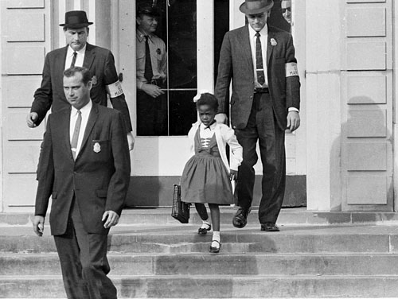
What are civil rights?
Civil rights: protections granted by the government to prevent discrimination against certain groups
Civil liberties: constitutional protections for individuals against government action

Slide 43
Introduction to Civil Rights in America
Civil Rights
Definition: policies designed to protect people against arbitrary or discriminatory treatment by government officials or individuals
Racial Discrimination
Gender Discrimination
Discrimination based on age, disability, sexual orientation, and other factors

Slide 44
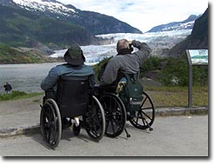
What are civil rights?
Claims are raised when a group is denied access to facilities, opportunities, or services available to other groups

Slide 45
The Americans With Disabilities Act (1990)
Requires employers to make reasonable accommodations for disabled employees.
This has given rise to two issues:
What constitutes a disability?
What is meant by a reasonable accommodation?

Slide 46
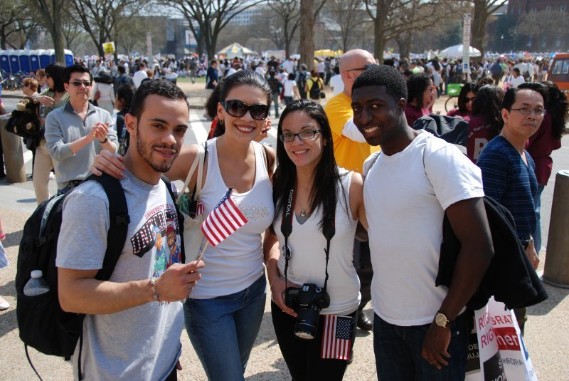
Protected Class
People protected from discrimination include ethnic minorities, women, those over 40, and disabled persons.
What do these groups have in common?

Slide 47
Two Centuries of Struggle

Slide 48
Two Centuries of Struggle
Conceptions of Equality
Equal opportunity: same chances
Equal results: same rewards
Early American Views of Equality
The Constitution and Inequality
Equality is not in the original Constitution.
First mention of equality in the 14th Amendment: “…equal protection of the laws”

Slide 49
Race, the Constitution, and Public Policy
The Era of Reconstruction and Resegregation
Jim Crow or segregation laws
Relegated African Americans to separate facilities
Plessy v. Ferguson (1896)
Case about white only train cars.
Upheld the constitutionality of “equal but separate accommodations”

Slide 50
Race, the Constitution, and Public Policy
The Era of Civil Rights
(R) Brown v. Board of Education (1954)
Overturned Plessy
School segregation inherently unconstitutional
Integrate schools “with all deliberate speed”
Busing of students solution for two kinds of segregation:
de jure, “by law” (meaning segregation by law)
de facto, “in reality” (happens in practice)

Slide 51
Race, the Constitution, and Public Policy
The Era of Civil Rights (continued)
Civil Rights Act of 1964
Made racial discrimination illegal in hotels, restaurants, and other public accommodation
Forbade employment discrimination based on race
Created Equal Employment Opportunity Commission (EEOC)
Strengthened voting right legislation (but was weak hence the passing of the Voting Rights Act in 1965)

Slide 52
Separate but Equal
NAACP strategy went through a series of stages:
Step 1: 1938-48 Supreme Court ruled “for education to be equal, it must be equally available.” (Gaines and Sipuel cases)
Step 2: 1950 Supreme Court ruled “racial barriers created unequal educational opportunities.” (Sweatt and McLaurin cases)
Step 3: 1954 Supreme Court ruled that “separate educational facilities are inherently unequal.” (Brown)

Slide 53
Desegregation mandated by the court, yet still ignored by many
The Southern Manifesto (1954)
Non-violent civil disobedience from SCLC and SNCC
The Montgomery Bus Boycott (1955-56)
The Little Rock Nine (1957)
The Freedom Riders and sit-ins at lunch counters (1961)
“Bombing”ham, Alabama—Chief Bull Connor, German Shepherds, and fire hoses vs. the Children’s Crusade (1963)
The March on Washington (1963)
Still no widespread compliance
Leads to the “Long, Hot Summers”—periods of violent protests and rise of the Black Panthers, Malcolm X and the Nation of Islam (1964-1968)

Slide 54
Desegregation v. Integration
Swann v. Charlotte Mecklenburg (1971): remedies may include racial quotas, redrawn district lines, and court-ordered busing
Inter-city busing could be authorized only if both the city and the suburbs had practiced segregation

Slide 55
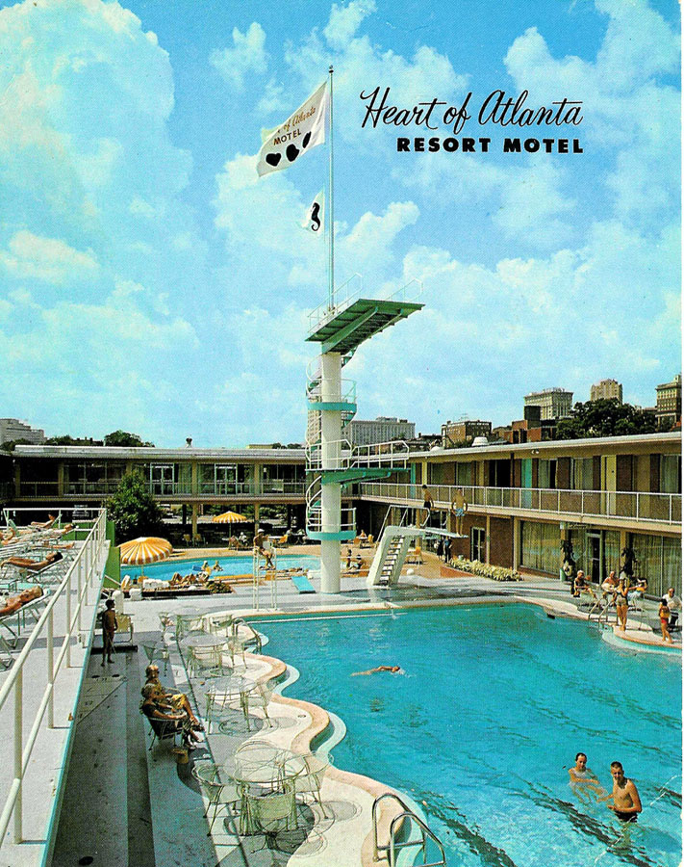
Heart of Atlanta Motel v. U.S. (1964)
A hotel owner refused to rent rooms to African Americans.
He claimed the Civil Rights Act of 1964 infringed on his rights as a private property owner.
The Court upheld Congressional authority to pass the Civil Rights Act under the Commerce Clause.
Congress has the right to regulate “interstate commerce.”

Slide 56
Have Things Improved?
The 2013 State of Black America report reported:
1963 to 2013 Blacks graduation rate rose from 25% to 85%
Poverty rate for blacks dropped from 48% to 28%
Black homeownership rose by 14%
Some notable gaps:
Black unemployment still almost 2x that of whites
1/3rd of black children still live in poverty
Black wage gap still exist

Slide 57
Gender-Based Discrimination
Arbitrary differences are not allowed.
Some gender-based differences, such as the all-male draft, are allowed by courts

Slide 58
Women, the Constitution, and Public Policy
The Second Feminist Wave
Reed v. Reed (1971) (law giving assets to men)
“Arbitrary” gender discrimination violated 14th Amendment’s Equal Protection Clause
Craig v. Boren (1976) (Statute allowing different ages for male and female to buy beer)
“Medium scrutiny” standard established for gender discrimination
Equal Rights Amendment fails ratification by states (1982) (was a proposed amendment to the United States Constitution designed to guarantee equal rights for women. The ERA was originally written by Alice Paul and, in 1923, it was introduced in the Congress for the first time. In 1972, it passed both houses of Congress and went to the state legislatures for ratification. The ERA failed to receive the requisite number of ratifications before the final deadline mandated by Congress of June 30, 1982 expired and so it was not adopted).

Slide 59
Women, the Constitution, and Public Policy
Women in the Workplace
The Civil Rights Act of 1964 banned gender discrimination in employment.
Wage Discrimination and Comparable Worth
The Supreme Court has not ruled on this issue.
Women in the Military
Only men may be drafted or serve in ground combat.
Sexual Harassment
Prohibited by Title VII of Civil Rights Act of 1964

Slide 60
Illegal Discrimination
A state can not set different ages for men or women to become adults.
Same ages to buy things (like Beer)
Women can not be barred from jobs because of arbitrary weight and height requirements
Women can not be forced to take mandatory pregnancy leave

Slide 61
Newly Active Groups Under the Civil Rights Umbrella
Gay and Lesbian Rights
Bowers v. Hardwick (1986) (United States Supreme Court decision that upheld, in a 5-4 ruling, the constitutionality of a Georgia sodomy law criminalizing oral and anal sex in private between consenting adults when applied to homosexuals).
Lawrence v. Texas (2003)
Overturned Bowers (landmark decision by the United States Supreme Court. In the 6-3 ruling, the Court struck down the sodomy law in Texas and, by extension, invalidated sodomy laws in thirteen other states, making same-sex sexual activity legal in every U.S. state and territory).
Private homosexual acts are protected by the Constitution
Obergfell v. Hodges (2015) Gay marriage case
fundamental right to marry is guaranteed to same-sex couples by both the Due Process Clause and the Equal Protection Clause of the Fourteenth Amendment to the United States Constitution.

Slide 62
Affirmative Action
Definition: a policy designed to give special attention to or compensatory treatment of members of some previously disadvantaged group
In education
Regents of the University of California v. Bakke (1978)
Racial set asides unconstitutional
Race could be considered in admissions
Grutter v. Bollinger (2003)
Race could be considered a “plus” in admissions

Slide 63
Understanding Civil Rights and Public Policy
Civil Rights and Democracy
Equality favors majority rule.
Suffrage gave many groups political power.
Civil Rights and the Scope of Government
Civil rights laws increase the size and power of government.
Civil rights protect individuals against collective discrimination.

Slide 64
Other Required Cases
(R) Marbury v Madison (1803): Marbury v. Madison is important because it established the power of Judicial Review for the U.S. Supreme Court and lower federal courts with respect to the Constitution and eventually for parallel state courts with respect to state constitutions. The exercise of judicial review would help to ensure that the judiciary remained a coequal branch of government alongside the legislative and executive branches.

Slide 65
Other Required Cases
(R) McCulloch v Maryland (1819): affirmed the constitutional doctrine of Congress’ “implied powers.” It determined that Congress had not only the powers expressly conferred upon it by the Constitution but also all authority “appropriate” to carry out such powers. In the specific case the court held that Congress had the power to incorporate a national bank, despite the Constitution’s silence on both the creation of corporations and the chartering of banks. It was concluded that since a national bank would facilitate the accomplishment of purposes expressly confided to the federal government, such as the collection of taxes and the maintenance of armed forces, Congress had a choice of means to achieve these proper ends. The doctrine of implied powers became a powerful force in the steady growth of federal power.

Slide 66
Other Required Cases
(R) United States v Lopez (1995): U.S. Supreme Court on April 26, 1995, ruled (5–4) that the Gun-Free School Zones Act of 1990 was unconstitutional because the U.S. Congress, in enacting the legislation, had exceeded its authority under the commerce clause.
(R) Baker v. Carr (1961): the court held that each vote should carry equal weight regardless of the voter’s place of residence. Thus the legislature of Tennessee had violated the constitutionally guaranteed right of equal protection
Term “one man one vote” comes from this case
(R) Shaw v. Reno (1993): the Supreme Court ruling that race cannot be the predominant factor in creating districts.
Rucho v. Common Cause (2019) & Lamone v. Benisek (2019): Gerrymandering cases. ruled that the Constitution does not bar extreme partisan gerrymandering.

Slide 67
Other Required Cases
(R) Citizens United v. Federal Election Commission (FEC) (2010)

