Slide 1
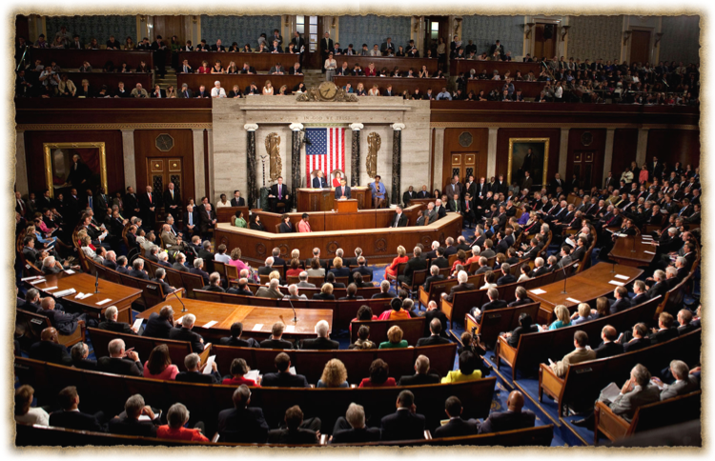
Congress (117th )

Slide 2
House of Representatives
Must be 25 years or older.
American citizen for seven years.
Must live or at least own a home in the district they represent.

Slide 3
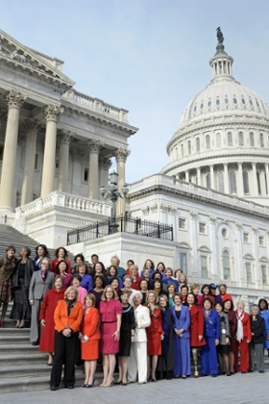
The House Of Rep's
435 Members
2 years per term
institutionalized (lots of rules and procedures)
party loyalty is King
Led by the House Rules Committee (Traffic Cop)
Daily procedures led by the speaker of the house.
Focus on domestic issues
“Power of the Purse”

Slide 4
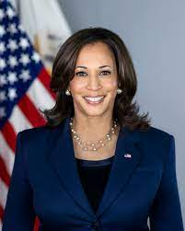

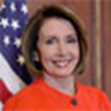
The make up of Congress
Senate President: Kamala Harris (D)
Senate President Pro-Tempore: Patrick Leahy (D)
House Speaker: Nancy Pelosi (D)
Total members of Congress: 535
100 senators
435 members of the House of the Representatives.

Slide 5
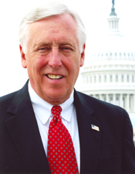





Other House Leadership
(Minority Leadrer)
Rep. Kevin McCarthy (R)
Democratic (Minority) Whip
Rep. Steve Scalise (R)
Republican Conference Chair
Rep. Elise Stefanik (R)
Majority Leader
Rep. Steny Hoyer (D)
Majority Whip
Rep. James Clyburn (D)
Democratic Caucus Chair
Rep. Hakeem Jeffries (D)
Notes:
https://ballotpedia.org/115th_United_States_Congress

Slide 6
Senate
Must be 30 years of age.
Citizen of the United States for at least 9 years.
Must live in the state in which they serve.

Slide 7
The Senate
100 Members (2 per state)
6 year terms
Meant to protect the elites interests and play the role of watchdog of the House and of the Presidency.
Gives “advice & consent”
Very influential on foreign affairs.
Unlimited debate
Filibuster
Cloture

Slide 8
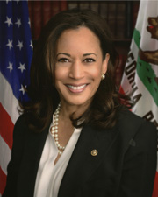
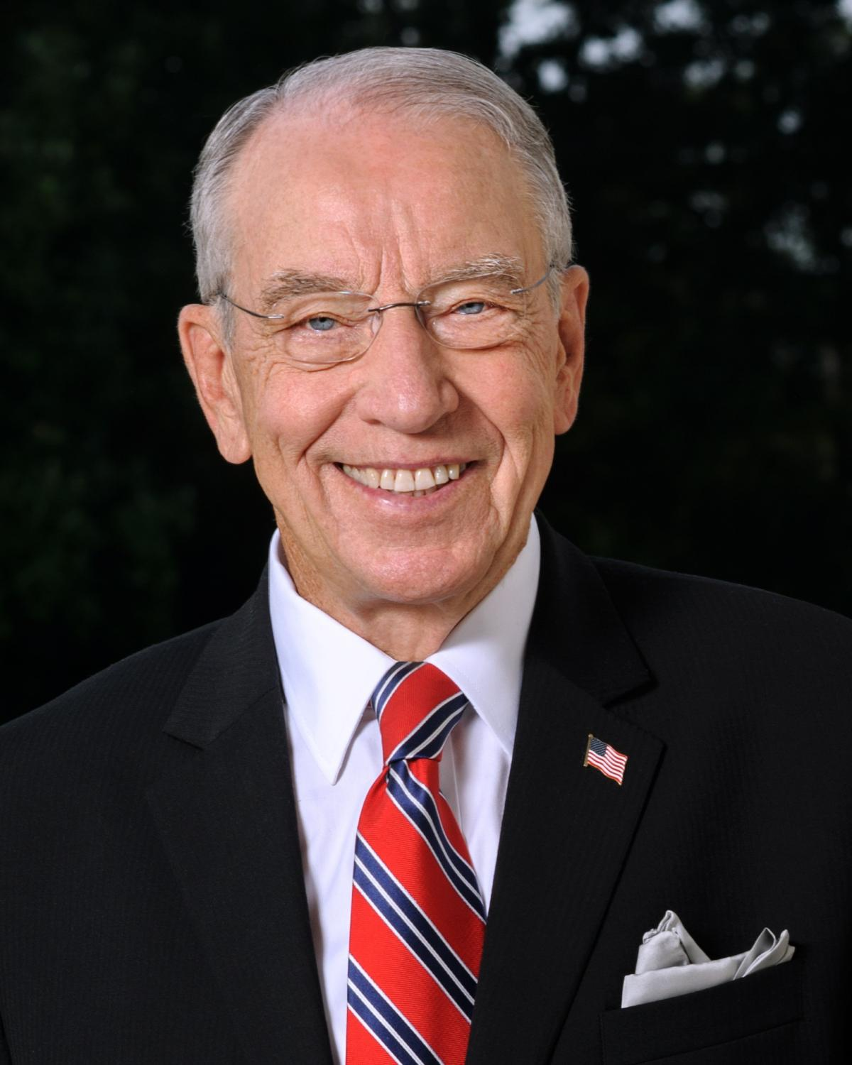
Senate Leadership
Constitutionally Mandated Officers
Vice President
Kamala Harris (D)
President Pro Tempore
Patrick Leahy (D)

Slide 9
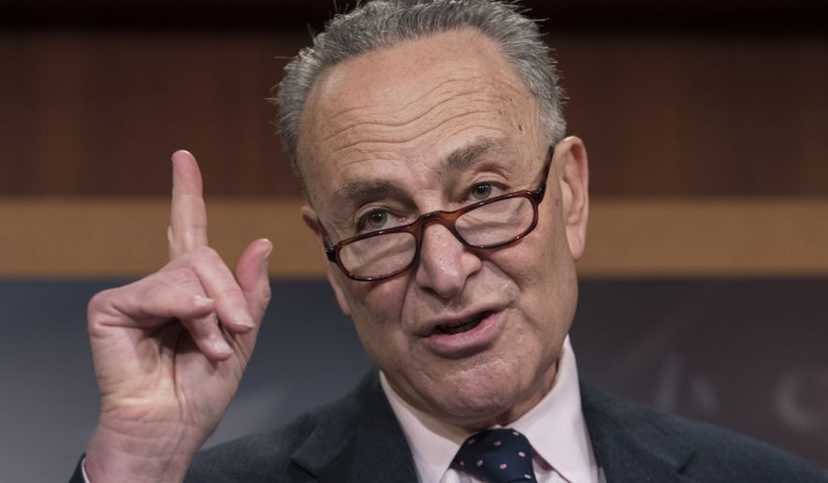
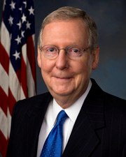
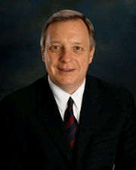
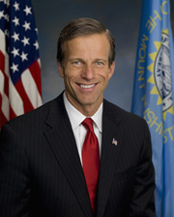
Other Senate Leadership
Majority Leader
Charles Schumer (D)
Minority Leader
Mitch McConnell (R)
Minority Whip
Richard Durbin (D)
Majority Whip
John Thune (R)

Slide 10
117th Congressional Make up
House Of Representatives
220 Dems and 213 GOP
2 Vacancies
Senate
48 Dems
2 Independents
50 GOP

Slide 11
117th Congressional Make up
The average age of Members of the House at the beginning of the 117th Congress was 58.4 years; of
Senators, 64.3 years.
• The overwhelming majority, 96%, ofMembers of Congress have a college education.
• The dominant professions of Members are public service/politics, business, and law.
• Most Members identify as Christians, and the collective majority of these affiliate with a Protestant
denomination. Roman Catholics account for the largest single religious denomination, and numerous other
affiliations are represented, including Jewish, Mormon, Buddhist, Muslim, Hindu, Greek Orthodox,
Pentecostal Christian, Unitarian Universalist, and Adventist.
• The average length of service for Representatives at the beginning of the 117thCongress was 8.9 years (4.5
House terms); for Senators, 11.0 years (1.8 Senate terms).
• One hundred forty-sevenwomen serve in the 117thCongress: 123 in the House, including 3Delegates and
the Resident Commissioner, and 24 in the Senate.
• There are 57 African American Members of the House and 3 in the Senate. This House number includes
two Delegates.
• There are 54 Hispanic or Latino Members (a record number) serving: 47 in the House, including 2
Delegates and the Resident Commissioner, and 7 in the Senate.
• There are 21 Members (16Representatives, 3 Delegates, and 2 Senators) who are Asian Americans or
Pacific Islander Americans.
• A record five Native Americans(American Indians or Native Hawaiians) serve in the House.

Slide 12

Characteristics of members
Members are not able to claim descriptive representation. Meaning they do not look like the USA in a snapshot.
They do, however, engage in substantive representation. Meaning they fight for certain groups, so that all groups have a voice.

Slide 13
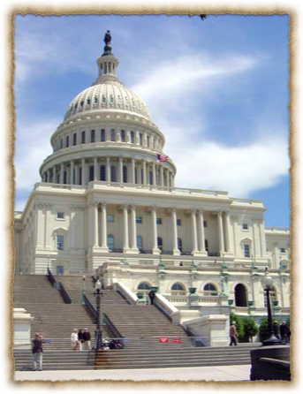
Being a Congressmen (Women)
The average salary of a congressmen is approx. $174.000 per year.
Some leadership positions make more as example: the Speaker of the House makes $223,500 a year.
Great benefits including retirement for all members who serve.
58% of all members are millionaires

Slide 14
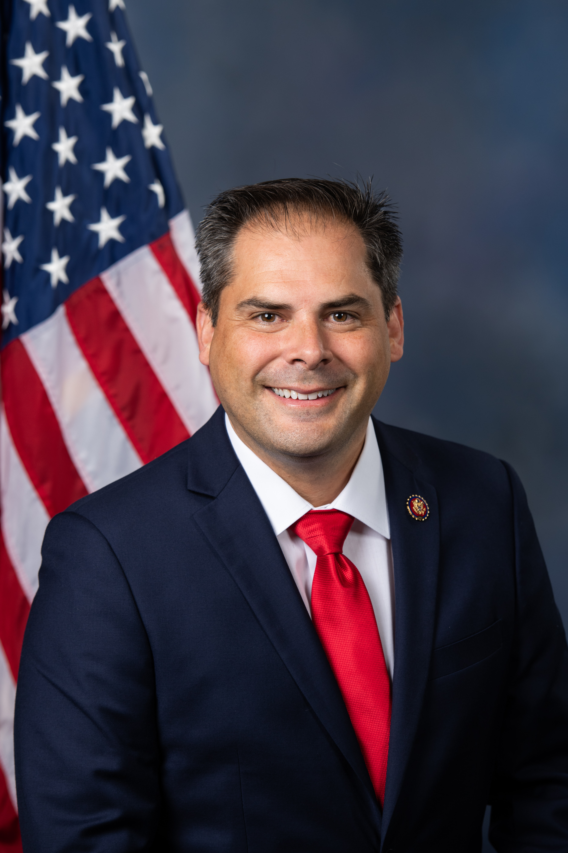
Being a Congressmen (Women)
Main job is to serve their Constituents
Office space in Washington as well as in the community or state the serve.
Travel allowances and the use of "junkets".
Franking privileges (free use of the federal mail system)
Free flowers from National Botanical Gardens.
Research services from Library of Congress.
Rep. Mike Garcia

Slide 15
Serving Constituents
Party Views. (Organizational View) Congress is organized primarily along party lines, so party membership is an important determinant of a member’s vote.
Delegate (Representational View) – An official who is expected to represent the views of his or her constituents even when personally holding different views; one interpretation of the role of legislator.
Trustee (Attitudinal View) An official who is expected to vote independently based on his or her judgment of the circumstances; one interpretation of the role of the legislator.

Slide 16
How Members Make Decisions
Interest Groups
Colleagues
Caucuses
Party &
President
Representative
Constituents
Staff
Political Action Committees

Slide 17
Powers of Congress
To lay and collect taxes, duties, imposts, and excises
To borrow money
To regulate commerce with foreign nations/among states
To establish rules for naturalization and bankruptcy
To coin money, set its value, and punish counterfeiting
To fix the standard of weights and measures
To establish a post office and post roads
To issue patents and copyrights to inventors/authors
To create courts inferior to the Supreme Court
To define/punish piracies, felonies on high seas, and crimes against law of nations
To declare war
To raise and support an army and navy; make rules for their governance
To provide for a militia
To exercise exclusive legislative powers over seat of government, federal facilities
To “make all laws which shall be necessary and proper for carrying into execution the fore-going powers, and all other powers vested by this Constitution in the government of the United States.”

Slide 18
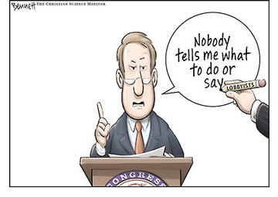
The Congressional Process
Lobbyists and Interest Groups
  There are over 26 lobbyists for every member of Congress- the bigger the issue, the more lobbyists will be working on it.
  Lobbyists can be ignored, shunned and even regulated by Congress.
  Ultimately, it is a combination of lobbyists and others that influence members of Congress.

Slide 19
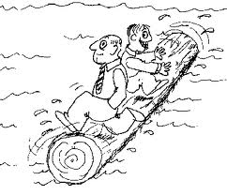
Logrolling
Logrolling means exchanging votes for favors.
“I’ll vote for your bill if you vote for my bill.”

Slide 20
How Congress is Organized to Make Policy
Committees and Subcommittees
  Standing committees: subject matter committees that handle bills in different policy areas
  Joint committees: a few subject-matter areas—membership drawn from House and Senate (example: Printing and Taxation committiees.
  Conference committees: resolve differences in House and Senate bills
  Select committees: created for a specific purpose, such as the Watergate investigation
  Seniority rule – A legislative practice that assigns the chair of the committee or subcommittee to the member of the majority party with the longest continuous service on the committee.

Slide 21
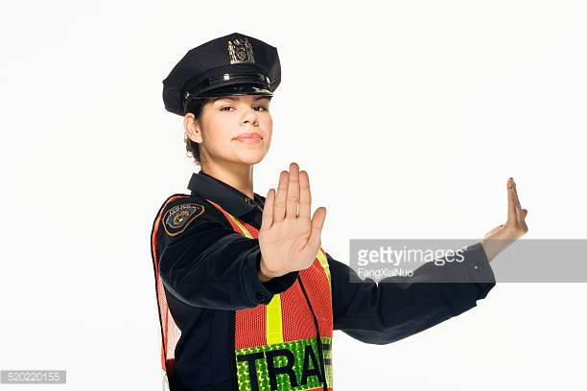
Rules Committee
Why is it important?
  The rules committee is like the “traffic cop”

Slide 22
Some other important Committees
House Appropriations Committee: sets funds for specific projects and programs.
House Ways and Means Committee: considers tax bills
Senate Finance Committee: considers tax bills

Slide 23
The Congressional Process
Legislation:
  Bill: a proposed law
  Anyone can draft a bill, but only members of Congress can introduce them.
  More rules in the House than in the Senate
  Party leaders play a vital role in steering bills through both houses, but less in the Senate
  Countless influences on the legislative process

Slide 24
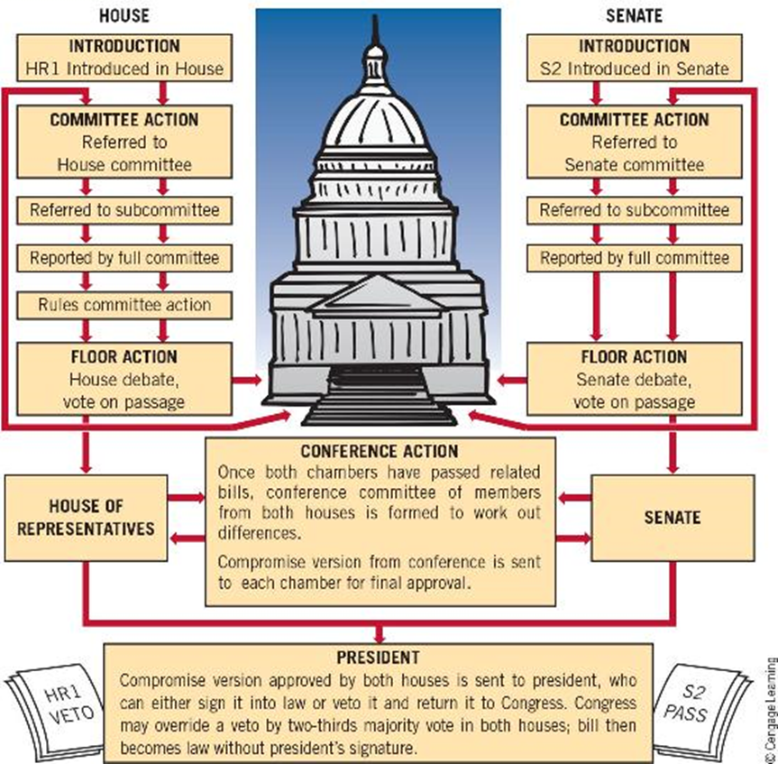
The Congressional Process

Slide 25
Some key Terms
Committee of the Whole: 100 members needed to have a quorum where the bill would be discussed on the floor. The bill then goes onto the full floor.
Germane: means that a amendment to the bill must be relevant to the bill being considered.
Super majority when one party holds 60 votes in the Senate.
Rider: In legislative procedure, a rider is an additional provision added to a bill or other measure under the consideration by a legislature, having little connection with the subject matter of the bill. Riders are usually created as a tactic to pass a controversial provision that would not pass as its own
Christmas-tree bill: A bill with many riders.

Slide 26
Types of Resolutions
Simple Resolution: if passed establishes rules, regulations or practices that do not have the force of law.
Concurrent resolution: comes from both houses, and often settles housekeeping and procedural matters that affect both chambers of Congress.
Joint Resolution: requires approval of both chambers and the signature of the president. (Law)

Slide 27
Congressional Procedure Terms
Hold – A procedural practice in the Senate whereby a senator temporarily blocks the consideration of the bill or nomination. (sometimes called Pigeon Hold)
Filibuster – A procedural practice in the Senate whereby a senator refuses to relinquish the floor and thereby delays proceedings and prevents a vote on a controversial issue.
Cloture – A procedure for terminating debate, especially filibusters, in the Senate.
Double Tracking: A procedure that allows the Senate to move onto other business but still keep a bill debate open for a future time.

