Slide 1

Chapter Two
The Nature and extent of crime
This Photo by Unknown Author is licensed under CC BY-NC-ND

Slide 2
How Crime is Defined
Consensus View
  The view that certain behaviors must be outlawed or controlled, and that criminal law is designed to protect citizens from social harm. Criminal acts are acts that conflict with these values and beliefs and that are deemed to society.

Slide 3
Conflict View
The law is the instrument that enables the wealthy to maintain their position of power and control the behavior of those who oppose their ideas and values or who might rebel against the unequal distribution of wealth

Slide 4
Interactionist View
  Criminal law is structured to reflect the preferences and opinions of people who hold social power in a particular legal jurisdiction
  People in power can make decisions of what is legal and what is not within a society.

Slide 5
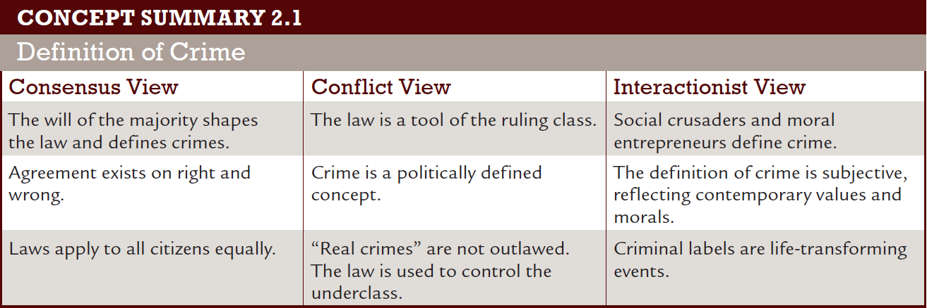
Definition of Crime
Notes:
Learning Objective 1

Slide 6
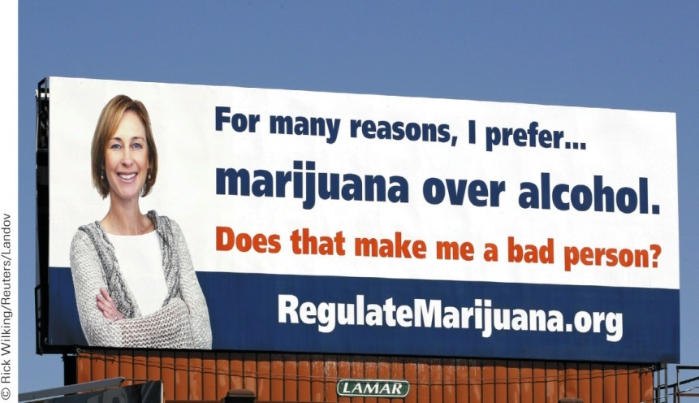
Thinking Point
According to the interactionist view of crime, acts are illegal because they are defined that way by law. The issue on this Denver billboard is whether or not the state legalize marijuana for recreational use, regulating it like alcohol products.
  Why is smoking pot illegal and the consumption of alcohol legal?
  Are they really so different?
  Is it merely a matter of
  definition and labeling?

Slide 7

How Crime is Defined
Though consensus, conflict, and interactionist views of crime differ, they generally agree that:
  Criminal law defines crime
  The definition of crime is constantly changing and evolving
  Social forces mold the definition of crimes
  Criminal law has a social control function
Notes:
Learning Objective 1

Slide 8

Thinking Point
Pair up and answer the following questions on paper to be turned in:
In 2012 Adam Lanza killed 20 children and 6 adults at Sandy Hook Elementary School in Newtown, CT. This is one of many school shootings that have taken place in the U.S. in the past 15 years.
  How was the crime covered by the media? (What was to blame for the horrific act?)
  How was the crime defined?
  What was the general consensus by the public in terms of Lanza’s mental state?
  Did he have any mental issues?
  Did he get any treatment for any issues he had?
Notes:
Learning Objective 1

Slide 9
What are the Different Categories of Crime?
Violent Crimes
  Gang violence
  Multiple murder
    Mass murders the act of murdering a number of people, typically simultaneously or over a relatively short period of time and in close geographic proximity.
    Spree killers someone who kills two or more victims in a short time in multiple locations. The U.S. Bureau of Justice Statistics defines a spree killing as "killings at two or more locations with almost no time break between murders"
    Serial killers typically a person who murders three or more people, usually in service of abnormal psychological gratification, with the murders taking place over more than a month and including a significant break (a "cooling off period") between them
  Intimate violence Intimate partner violence is domestic violence by a spouse or partner in an intimate relationship against the other spouse or partner.
  Hate crimes
Notes:
Learning Objective 2

Slide 10
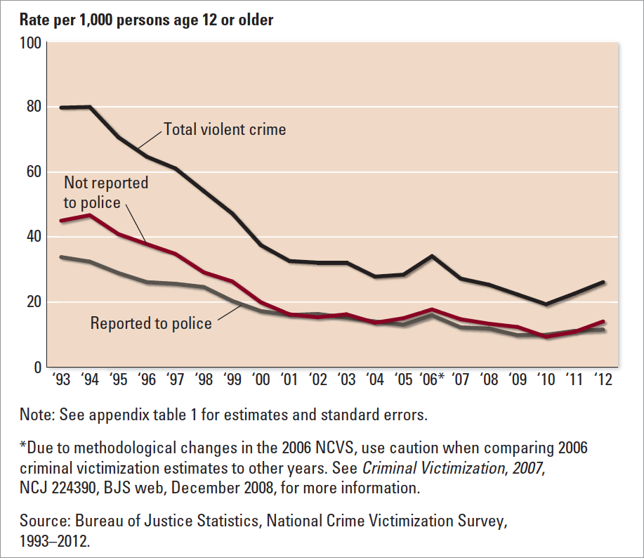
Violent Victimization Reported and Not Reported to Police
Notes:
Learning Objective 2
FIGURE 2.2 Violent Victimization Reported and Not Reported to Police, 1993–2012
Source: Jennifer Truman, Lynn Langton, and Michael Planty, Criminal Victimization, 2012 (Washington, DC: Bureau of Justice Statistics, 2013), p. 1.

Slide 11
Thinking Point
Pair up and able to answer the following questions:
Typically fear of victimization far exceeds one’s actual victimization potential.
  What are some of the factors that influence the gap between fear of crime and the reality of crime?
  How does the media influence our fear of crime?
  What influences your personal fear (or lack of fear) of crime?

Slide 12
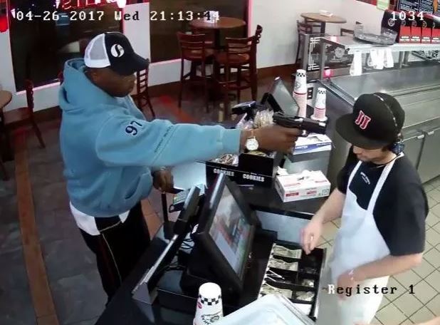


What are the Different Categories of Crime?
Property Crime – outnumbers violent crime by a margin of 7 to 1
  Burglary
  Larceny (theft)
Notes:
Learning Objective 2

Slide 13
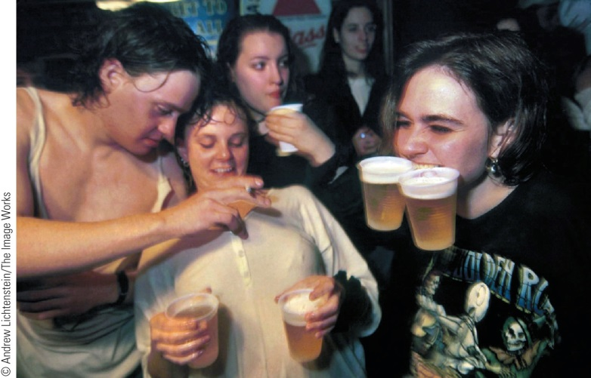
What are the Different Categories of Crime?
Public Order Crimes
  Prostitution
  Substance abuse
Economic Crimes
  White collar crime
  Organized crime
Notes:
Learning Objective 2

Slide 14
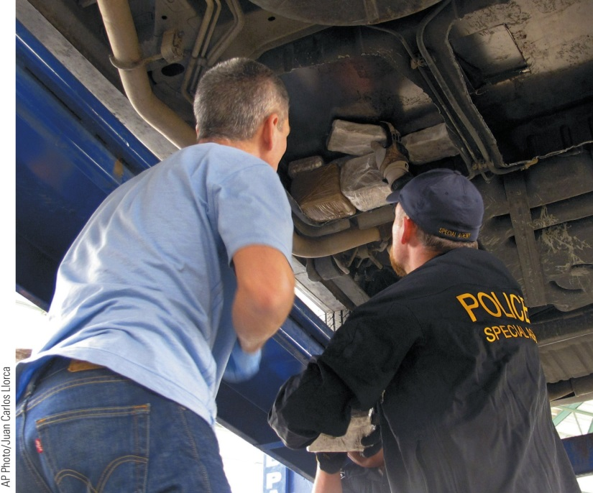
Sources of Crime Data
The Uniform Crime Reports (UCR)
  Compiled by the FBI, this national survey compiles criminal acts reported to local police
  Part I crimes include:
    Murder
    Rape
    Burglary
    Robbery
    Assault
    Larceny-theft
    Motor vehicle theft
Notes:
Learning Objective 3
Organized crime is now a transnational phenomenon. Here, British and U.S. agents watch the search of a car that was seized with marijuana at the Paso del Norte Bridge, in El Paso, Texas. Three undercover agents from the U.K. Serious Organised Crime Agency visited the Immigration and Customs Enforcement-Homeland Security Investigations Office in El Paso to learn about techniques for fighting drug cartels.

Slide 15
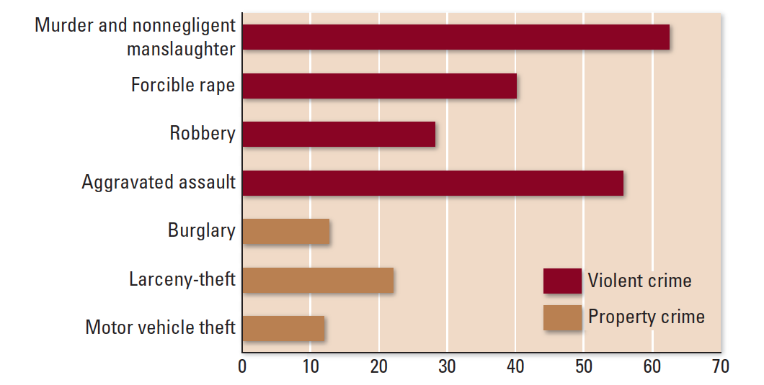
Percentage of Crimes Cleared by Arrest
Notes:
Learning Objective 3
FIGURE 2.1 Percentage of Crimes Cleared by Arrest
Source: Federal Bureau of Investigation, Crime in the United States, 2012 , http://www.fbi.gov/about-us/cjis/ucr/crime-in-the-u.s/2012/crime-in-the-u.s.-2012/offenses-known-to-law-enforcement/2012-clearance.gif (accessed May 2014).

Slide 16
Sources of Crime Data
National Incident-Based Reporting System (NIBRS)
  Requires local police agencies to provide at least a brief account of each incident and arrest, including the incident, victim, and offender information
  There are expanded crime categories, such as blackmail, embezzlement, drug offenses, and bribery
Notes:
Learning Objective 4

Slide 17
Sources of Crime Data
National Crime Victimization Survey (NCVS)
  Surveys victims about their experiences with law violation
Self-Report Surveys
  Asks offenders themselves to report about their criminal behaviors
Notes:
Learning Objective 3

Slide 18
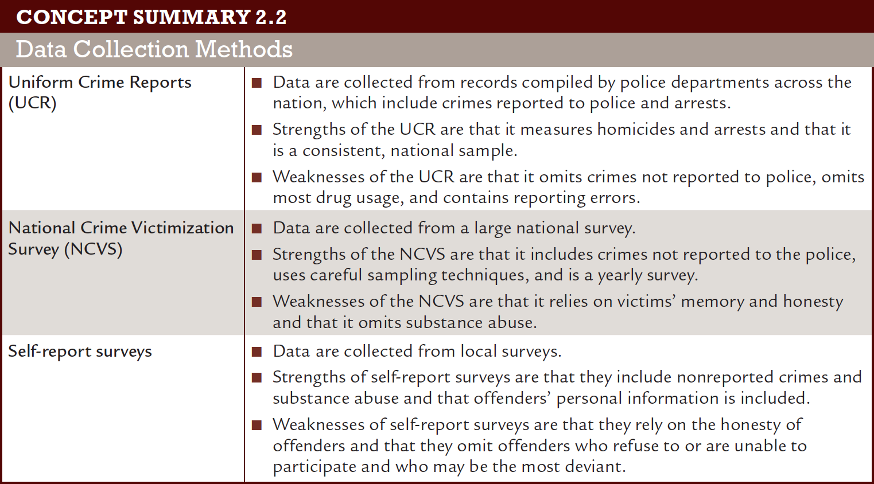
Evaluating Sources of Crime Data
Notes:
Learning Objective 5

Slide 19
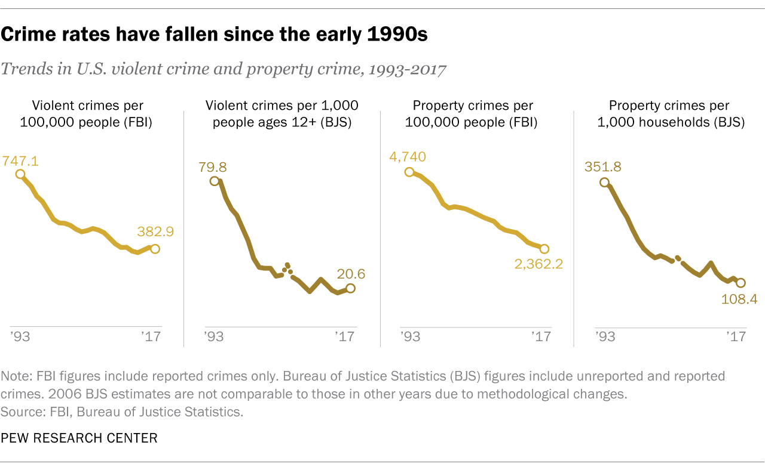
Crime Trends
Trends in Violent Crime and Property Crime
Trends in Victimization
Trends in Self-Reporting
Notes:
Learning Objective 6

Slide 20
Crime Patterns
The Ecology of Crime
  Day, season, and climate
  Regional differences
Social Class, Socioeconomic Conditions, and Crime
  Explaining the class-crime relationship
Notes:
Learning Objective 7

Slide 21
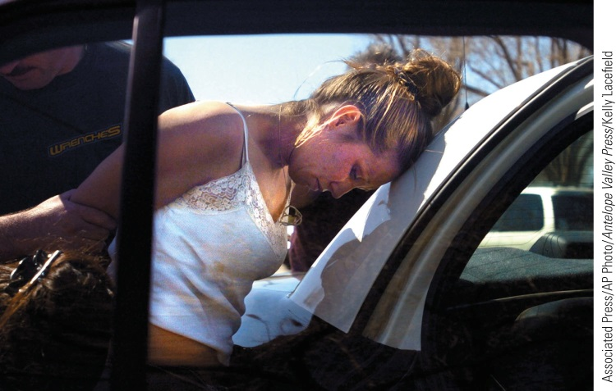
Crime Patterns
Age and Crime
Gender and Crime
Explaining Gender
Differences in the Crime Rate
  Traits
  Socialization and development
  Cognitive differences
  Feminist views
Notes:
Learning Objective 7
Robyn Ramsey, 25, is arrested after a police chase in Lancaster, California. Ramsey, detained in a car theft case, stole a sheriff’s sport utility vehicle and led deputies on a two-hour pursuit through the Antelope Valley before being captured. Bonnie Ramsey, Robyn’s mother, said her daughter had been addicted to methamphetamine but was trying to recover. Some experts say hormonal differences explain the gender gap in the crime rate, but when either males or females take drugs, their decision-making skills are impaired, and more crime ensues.

Slide 22
Crime Patterns
Race and Crime
  System bias
  Cultural bias
  Structural bias
  NY Times Article on Crime, Bias and Stats
Notes:
Learning Objective 7

Slide 23
Thinking Point
How do you explain the gender differences in the crime rate?
Are men more violent than women?
  If you believe men are more violent than women, does this mean there is a genetic component to crime?
Notes:
Learning Objective 7

Slide 24
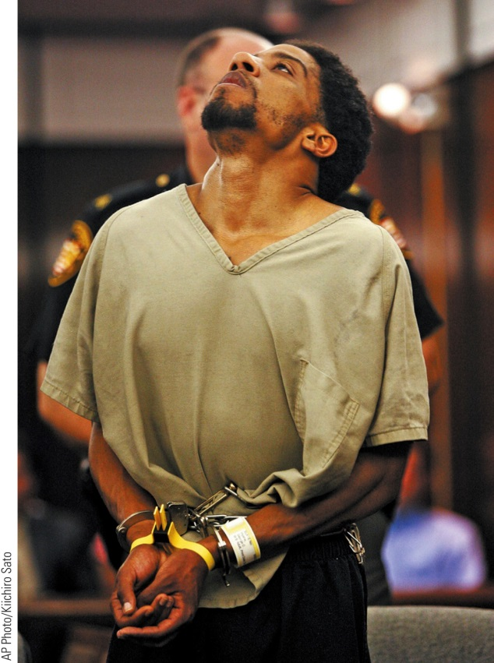
Crime Patterns
Chronic Offending and Crime
  What causes chronicity?
  Policy implications
    Three-strikes
    Truth-in-sentencing
Notes:
Learning Objective 8
Career criminals are responsible for a significant portion of the total crime rate. Here, George Hyatte appears in a courtroom for an extradition hearing in Columbus, Ohio. George and his wife, Jennifer Hyatte, were arrested at the America’s Best Value Inn in Columbus after a cab driver tipped off authorities that he had driven them there. Hyatte, a career-criminal inmate who was serving a 41-year sentence for robbery and related charges, killed a guard in the course of a daring escape attempt - a crime that brought him a sentence of life imprisonment without the possibility of parole.

Slide 25
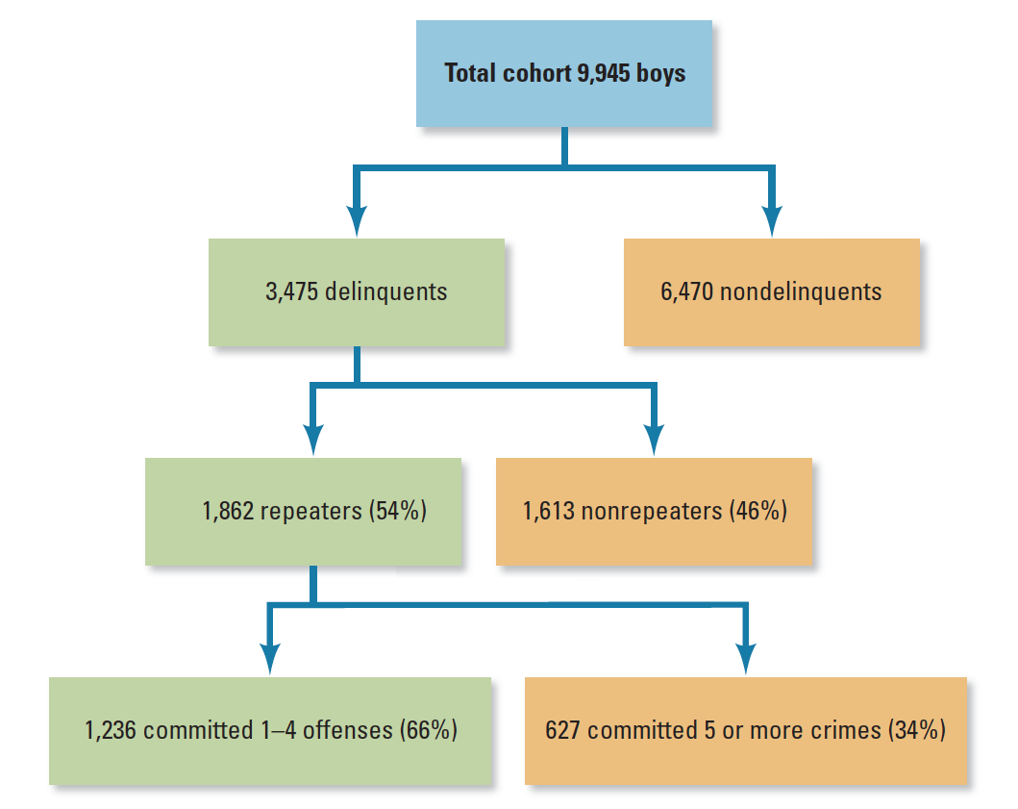
Distribution of Offenses in the Philadelphia Cohort
Notes:
FIGURE 2.3 Distribution of Offenses in the Philadelphia Cohort
Source: From Marvin Wolfgang, Robert Figlio, and Thorsten Sellin, Delinquency in a Birth Cohort . Copyright © 1972 University of Chicago Press. Reprinted with permission.

Slide 26
Thinking Point
A career criminal is by definition a persistent repeat offender who organizes their lifestyle around criminality. Policies such as three-strikes laws and truth-in-sentencing have become central crime control policies to target the career criminal, however are applied to many other offenders as well.
  Do you support these get-tough strategies? Why or why not?
  What are possible negative consequences of these crime control strategies?
Notes:
Learning Objective 8

