Slide 1
Elections
Coach Flu

Slide 2
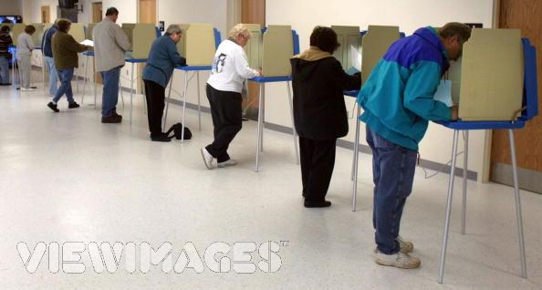
Three Types of Elections
Primary Elections- voters select party nominees
General Elections- the contest between the candidates from different parties
Initiatives and Referendums- voters engage in making or ratifying legislation at the state level only

Slide 3
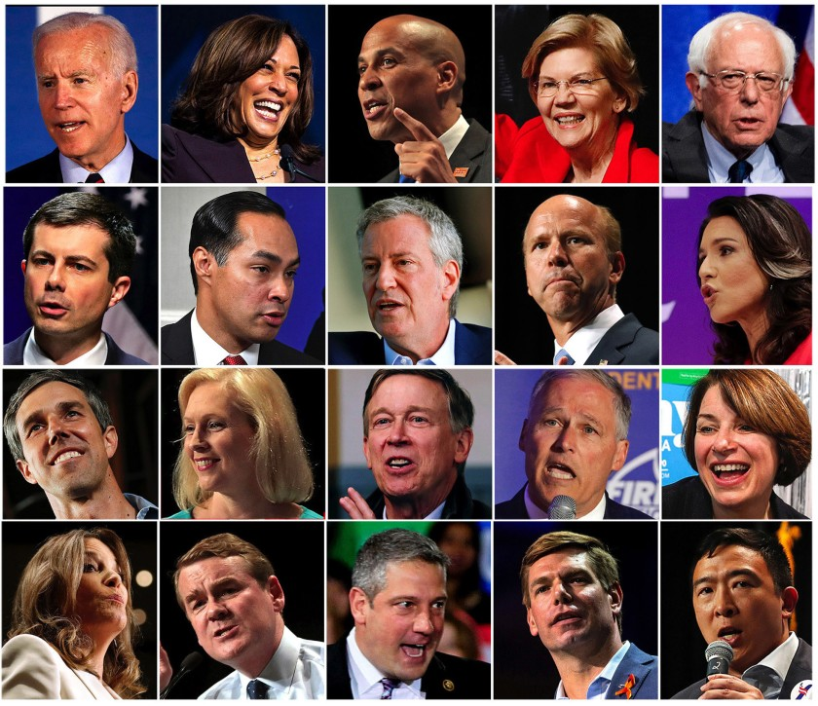
Primary Elections
Voters select party nominees

Slide 4
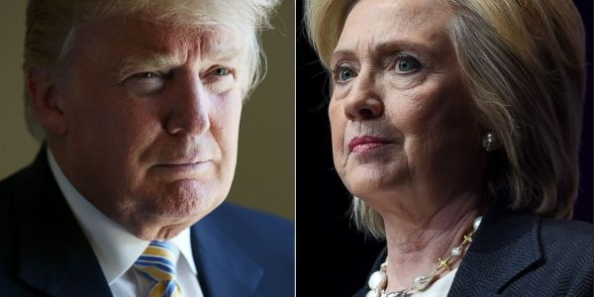
General Elections
Contested between the nominees of the parties

Slide 5
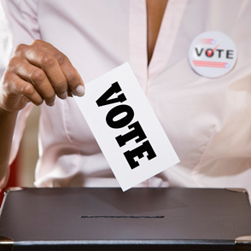
Elections on Specific Policy Questions
Voters make or ratify legislation
Ex: women’s rights

Slide 6
Specific policy elections
Many U.S. states vote on their policies
Referendum- ratifying a policy proposed by the state legislature
Initiative petition- citizens proposing legislation (usually by gaining signatures on a proposed law equal to 1/10 of number of voters in previous election)
Recall-removing a state or local official before the end of his or her term

Slide 7
The Nomination Game
Nomination:
The official endorsement of a candidate for office by a political party. Generally, success requires momentum, money, and media attention.
Campaign Strategy:
The master plan candidates lay out to guide their electoral campaign.

Slide 8
The Nomination Game
Deciding to Run
Campaigns are physically and emotionally taxing. Why would a sane person want to do it?
Other countries have short campaigns - generally less than 2 months.
U.S. campaigns (especially for President) can last 18 months or more. (Obama’s campaign in 2008 lasted 22 months)

Slide 9
The Nomination Game
Competing for Delegates
The Caucus Road
Caucus: Meetings of state party leaders. Used to select delegates.
Now organized like a pyramid from local precincts to the state’s convention.
Not used by many states.
The Iowa caucus is first and considered the most important.

Slide 10
The Nomination Game
Competing for Delegates
The Primary Road
Primary: Elections in which voters choose the nominee or delegates pledged to the nominee.
Started by turn of the century reformers.
Most states use one of the forms of a primary.
Frontloading is the tendency of states to hold primaries early - New Hampshire is first.
Generally primaries serve as elimination contests.

Slide 11
The Nomination Game
Competing for Delegates
Evaluating the Primary and Caucus System
Disproportionate attention to the early ones.
Prominent politicians find it difficult to make time to run.
Money plays too big a role.
Participation in primaries and caucuses is low and unrepresentative.
The system gives too much power to the media.

Slide 12
The Campaign Game
The High-Tech Media Campaign
Direct mail used to generate support and money for the candidate
Get media attention through ad budget and “free” coverage
Emphasis on “marketing” a candidate
News focuses on strategies and events, not on policies
Horserace Journalism: is a term given to the media focusing on the campaign battle and not the substance of the candidates policies they believe in.

Slide 13
The Mandate Theory of Elections
The Mandate Theory of Elections is the idea that the winning candidate has a mandate (widespread support) from the people to carry out his or her policies.
Policy voting is the idea that electoral choices are based on voters’ policy preferences and where the candidate stands on policy issues.
Retrospective voting is the idea that incumbents who have provided desired results are rewarded with a new term and those who fail are not reelected. “What have you done for me lately”?

Slide 14
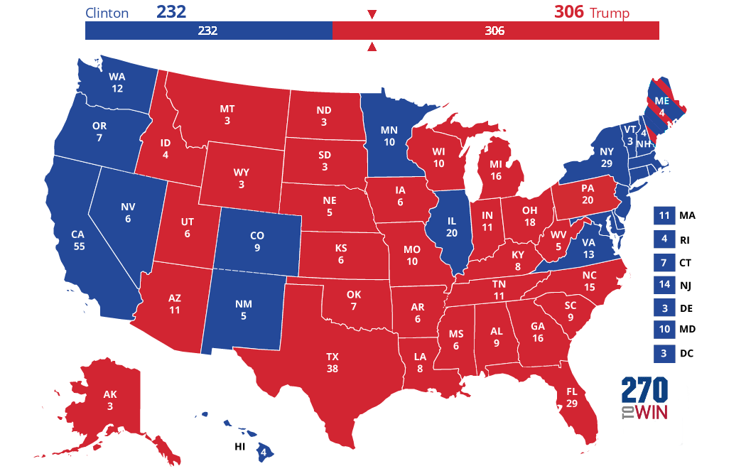
The Last Battle: The Electoral College
Electoral College actually elects the President- founders wanted him chosen by the elite of the country
States choose the electors
Winner-Take-All system gives bigger emphasis to more populated states battleground states

Slide 15
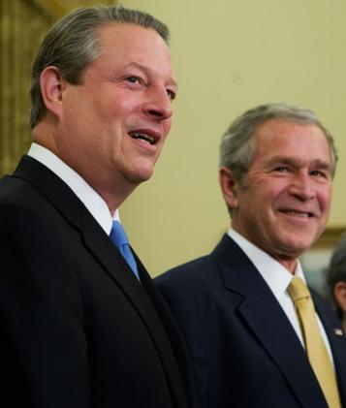
The Last Battle: The Electoral College
How it works today:
Each state has as many votes as it does Representatives and Senators.
Winner of popular vote typically gets ALL the Electoral College votes.
Electors meet in December, votes are reported by the vice president in January.
If no candidate gets 270 votes (a majority), the House of Representatives votes for president, with each state getting ONE vote.

Slide 16
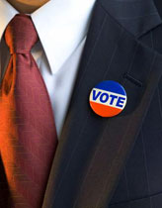
Whether to Vote: A Citizen’s First Choice
Deciding Whether to Vote
Legitimacy- the people’s belief that the government has the right to rule
High Legitimacy- when the loser of the campaign accepts the results peacefully.
Political Efficacy: The belief that one’s political participation really matters.
Civic Duty: The belief that in order to support democratic government, a citizen should always vote.

Slide 17
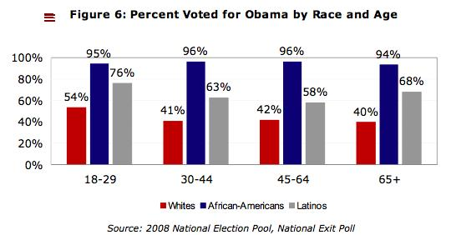
Whether to Vote: A Citizen’s First Choice
Who Votes?
These factors increase the likelihood of voting:
Age
Income
Education
Marriage
Caucasian
Female
Union Member
Government Worker
Northerner

Slide 18
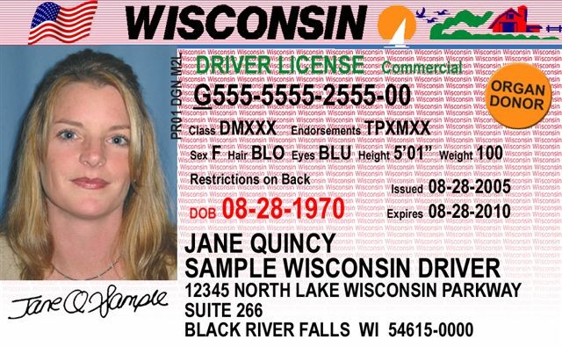
Registering to Vote
In 1888, West Virginia had 159,000 votes but only 147,000 eligible voters
States adopted voter registration to prevent fraud (North Dakota has no registration)
Biggest indicator of voting is voter registration
Motor Voter Law (1993) required states to offer voter registration when citizens obtain their driver’s licenses.
Recent proposals would require ID

Slide 19
Suffrage: Legal right to vote
15th Amendment extended suffrage to African Americans
17th Amendment changed the way that the United States Senate is elected to President.
19th Amendment extended suffrage to women
24th Amendment made poll taxes illegal
26th Amendment extended suffrage to citizens eighteen years and older

Slide 20
Mandate theory of elections
Definition: the idea that the winning candidate has a mandate from the people to carry out his or her platforms on politics
Political scientists focus on three major elements of voters decisions
Voter’s party identification
Voters evaluation of the candidates
Policy voting

Slide 21
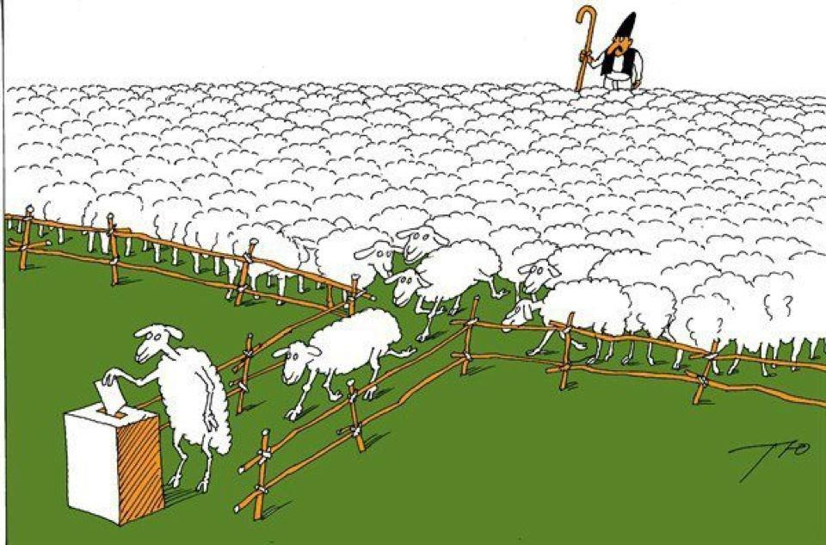
Party Identification
People vote most frequently for a party they identify with

Slide 22
Democracy and Elections
The greater the policy differences between the candidates, the more likely voters will be able to steer government policies by their choices
Retrospective voting a theory of voting in which voters essentially ask this question—what have you done for me lately?

Slide 23
The Impact of Campaigns
Campaigns have three effects on voters:
Reinforcement, Activation, Conversion
Mostly, they only reinforce & activate
Selective perception: pay attention to things we agree with.
Party identification still has an affect
Incumbents start with a substantial advantage

Slide 24
Money and Campaigning
527 Groups: A 527 group is created primarily to influence the selection, nomination, election, appointment or defeat of candidates to federal, state or local public office. They are not subject to contribution restrictions because they do not directly seek the election of a particular candidates.
501 (c) groups: groups that can not spend more than half of their funds on political activities. These groups have no actual limits on how much money that is. (also can be labeled as c3 or c4 groups)

