Slide 1
Elections
Unit 2
Textbook Chapters 9 & 10
Studyguide book chapter 7
Coach Flu
Revised 2017-2018

Slide 2
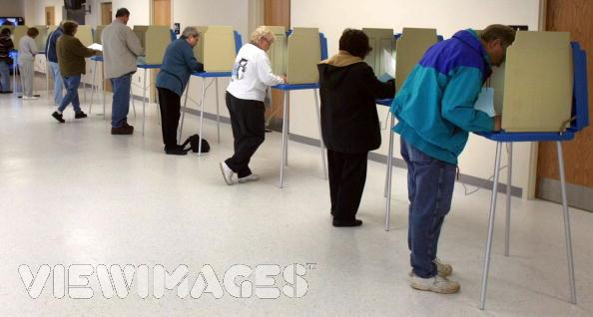
Three Types of Elections
    Primary Elections- voters select party nominees
    General Elections- the contest between the candidates from different parties
    Initiatives and Referendums- voters engage in making or ratifying legislation at the state level only

Slide 3
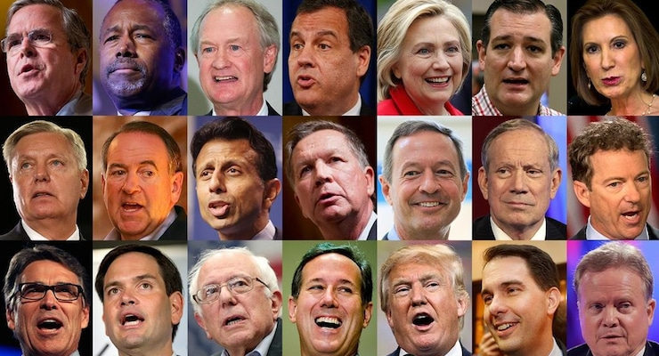
Primary Elections
Voters select party nominees

Slide 4
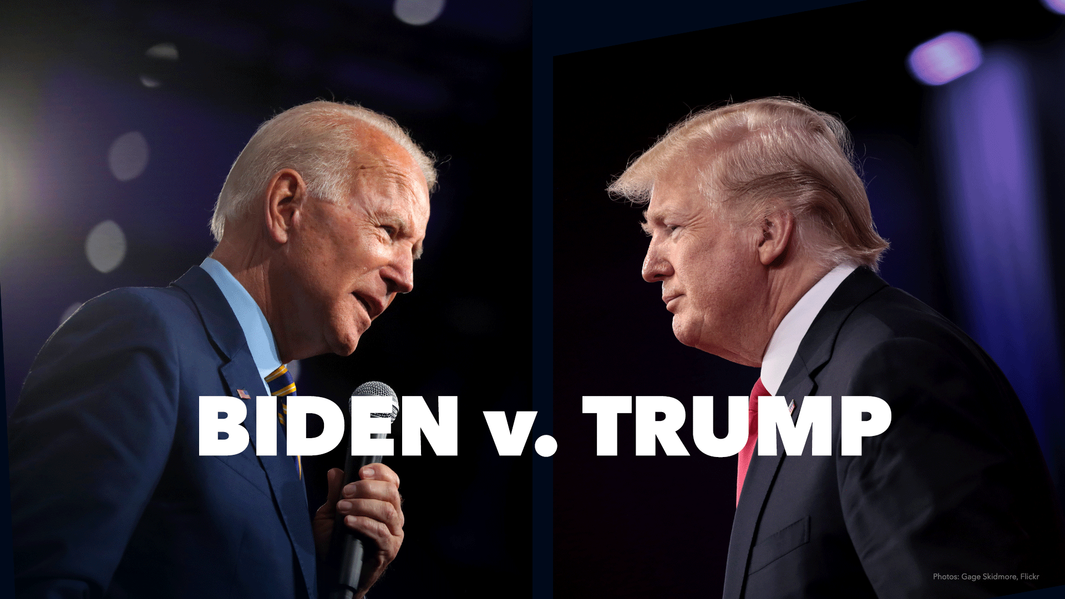
General Elections
Contested between the nominees of the parties

Slide 5

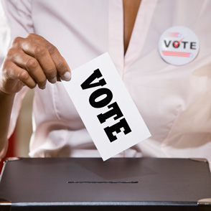
Elections on Specific Policy Questions
Voters make or ratify legislation
Ex: women’s rights

Slide 6

Specific policy elections
  Many U.S. states vote on their policies
    Referendum- ratifying a policy proposed by the state legislature
    Initiative petition- citizens proposing legislation (usually by gaining signatures on a proposed law equal to 1/10 of number of voters in previous election)
    Recall-removing a state or local official before the end of his or her term

Slide 7
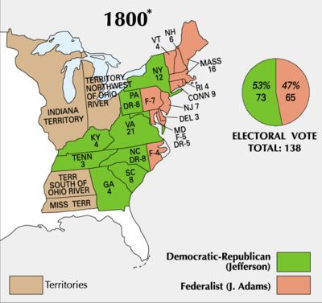
1800: The First Electoral Transition of Power
    No primaries, no nominating conventions, no candidate speeches, and no entourage of reporters
    State and local organizations promoted their causes
      Presidents were excluded from campaigns- seen as undignified for office
      Newspapers didn’t care about dignity or honesty
      Focus was on state legislatures, which chose electors
      Each elector cast two votes, and Jefferson tied with Aaron Burr
      House decided election
      Led to amendment calling for running mates (12th)
      This was the first peaceful transfer of power between parties.

Slide 8
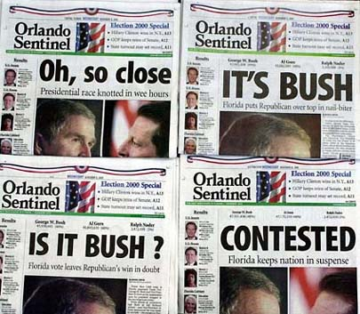
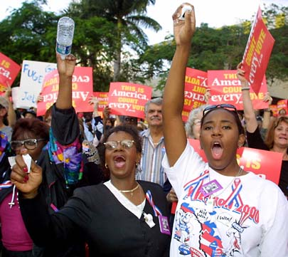
2000: Election
    Al Gore wins the popular vote, but Bush wins in the Electoral College
    Presidency decided by Florida
      Florida law mandated recount because a margin of less than 1000
      Florida Supreme court ruled in favor of the recount requested by Gore
      (Bush vs. Gore) U.S. Supreme Court rules that if one country is recounted, they all need to be recounted, but there is not enough time remaining.
      BUSH WINS

Slide 9
The Nomination Game
Nomination:
  The official endorsement of a candidate for office by a political party. Generally, success requires momentum, money, and media attention.
Campaign Strategy:
  The master plan candidates lay out to guide their electoral campaign.

Slide 10
The Nomination Game
Deciding to Run
  Campaigns are physically and emotionally taxing. Why would a sane person want to do it?
  Other countries have short campaigns - generally less than 2 months.
  U.S. campaigns (especially for President) can last 18 months or more. (Obama’s campaign in 2008 lasted 22 months)

Slide 11
The Nomination Game
Competing for Delegates
  The Caucus Road
    Caucus: Meetings of state party leaders. Used to select delegates.
    Now organized like a pyramid from local precincts to the state’s convention.
    Not used by many states.
    The Iowa caucus is first and considered the most important.

Slide 12
The Nomination Game
Competing for Delegates
  The Primary Road
    Primary: Elections in which voters choose the nominee or delegates pledged to the nominee.
    Started by turn of the century reformers.
    Most states use one of the forms of a primary.
    Frontloading is the tendency of states to hold primaries early - New Hampshire is first.
    Generally primaries serve as elimination contests.

Slide 13
The Nomination Game
Competing for Delegates
  Evaluating the Primary and Caucus System
    Disproportionate attention to the early ones.
    Prominent politicians find it difficult to make time to run.
    Money plays too big a role.
    Participation in primaries and caucuses is low and unrepresentative.
    The system gives too much power to the media.

Slide 14
National and Regional Presidential primary proposals
National Primary: A way to select party nominees by having a same day national election.
Regional Primary: This would hold a primary on separate days but done either by time zones are specific areas of the nation.

Slide 15
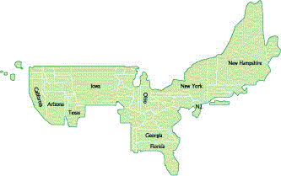
The Nomination Game
The Inflated Importance of Iowa and New Hampshire (Figure 9.1)

Slide 16
McGovern-Fraser Commission
The events at and around the Democratic national convention of 1968 left the party in disarray, unable to support its nominee and divided over matters of both substance and procedure. The 1968 convention was disastrous for the Democrats, as much because of the demonstrations and violent police responses outside the convention hall as because of the convention itself. What took place in Chicago went well beyond party leaders’ ignoring one candidate, Eugene McCarthy, who could claim to have demonstrated his appeal to voters in the primaries and nominating another, Hubert Humphrey, who had not entered a single primary.

Slide 17
Controlling the outcome of the minority votes in the democratic party
Super delegates: National party leaders who automatically get a delegates slot at the National party Convention.
Represent 19% of the total votes in the 2008 election for the Democrats.
Republicans have special delegates similar to the Democrats except in how they vote. They only get to vote in the case of no candidates earn the required votes to win the nomination.
Helps the party control the outcome of the election and protect the party from the voters

Slide 18
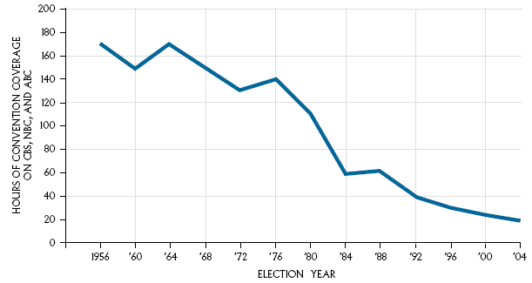
The Nomination Game
The Declining Coverage of Conventions on Network TV (Figure 9.2)

Slide 19

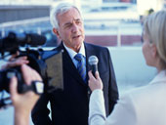
The Campaign Game
The High-Tech Media Campaign
  Direct mail used to generate support and money for the candidate
  Get media attention through ad budget and “free” coverage
  Emphasis on “marketing” a candidate
  News focuses on strategies and events, not on policies
  Horserace Journalism: is a term given to the media focusing on the campaign battle and not the substance of the candidates policies they believe in.

Slide 20
The Mandate Theory of Elections
The Mandate Theory of Elections is the idea that the winning candidate has a mandate (widespread support) from the people to carry out his or her policies.
Policy voting is the idea that electoral choices are based on voters’ policy preferences and where the candidate stands on policy issues.
Retrospective voting is the idea that incumbents who have provided desired results are rewarded with a new term and those who fail are not reelected. “What have you done for me lately”?

Slide 21
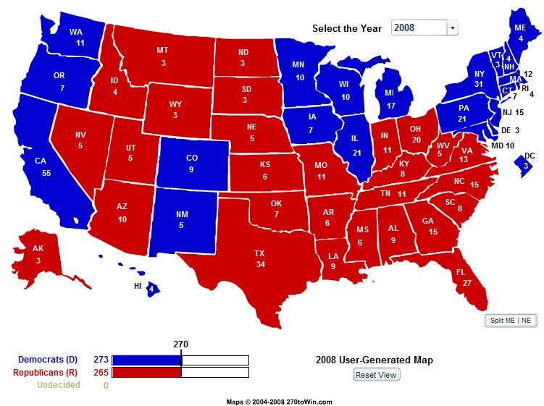
The Last Battle: The Electoral College
Electoral College actually elects the President- founders wanted him chosen by the elite of the country
States choose the electors
Winner-Take-All system gives bigger emphasis to more populated states battleground states

Slide 22
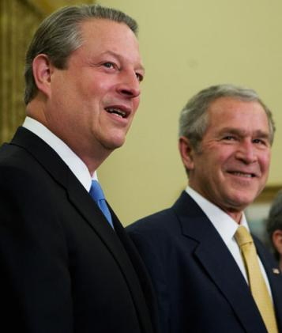
The Last Battle: The Electoral College
How it works today:
  Each state has as many votes as it does Representatives and Senators.
  Winner of popular vote typically gets ALL the Electoral College votes.
  Electors meet in December, votes are reported by the vice president in January.
  If no candidate gets 270 votes (a majority), the House of Representatives votes for president, with each state getting ONE vote.

Slide 23
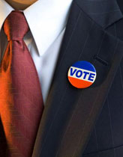
Whether to Vote: A Citizen’s First Choice
Deciding Whether to Vote
  Legitimacy- the people’s belief that the government has the right to rule
  High Legitimacy- when the loser of the campaign accepts the results peacefully.
  Political Efficacy: The belief that one’s political participation really matters.
  Civic Duty: The belief that in order to support democratic government, a citizen should always vote.

Slide 24

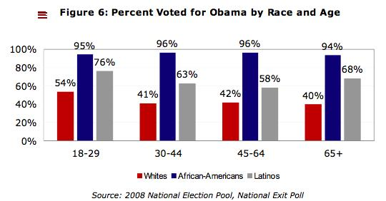

Whether to Vote: A Citizen’s First Choice
Who Votes?
These factors increase the likelihood of voting:
  Age
  Income
  Education
  Marriage
  Caucasian
  Female
  Union Member
  Government Worker
  Northerner

Slide 25
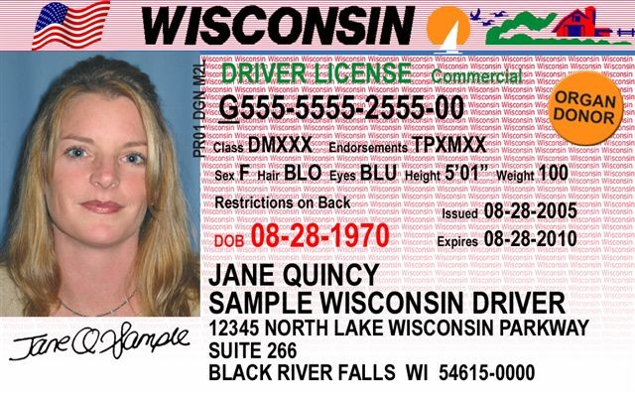
Registering to Vote
    In 1888, West Virginia had 159,000 votes but only 147,000 eligible voters
    States adopted voter registration to prevent fraud (North Dakota has no registration)
    Biggest indicator of voting is voter registration
    Motor Voter Act (1993) required states to offer voter registration when citizens obtain their driver’s licenses.
    Recent proposals would require ID

Slide 26
Suffrage: Legal right to vote
15th Amendment extended suffrage to African Americans
17th Amendment changed the way that the United States Senate is elected to President.
19th Amendment extended suffrage to women
24th Amendment made poll taxes illegal
26th Amendment extended suffrage to citizens eighteen years and older

Slide 27
Mandate theory of elections
Definition: the idea that the winning candidate has a mandate from the people to carry out his or her platforms on politics
Political scientists focus on three major elements of voters decisions
  Voter’s party identification
  Voters evaluation of the candidates
  Policy voting

Slide 28
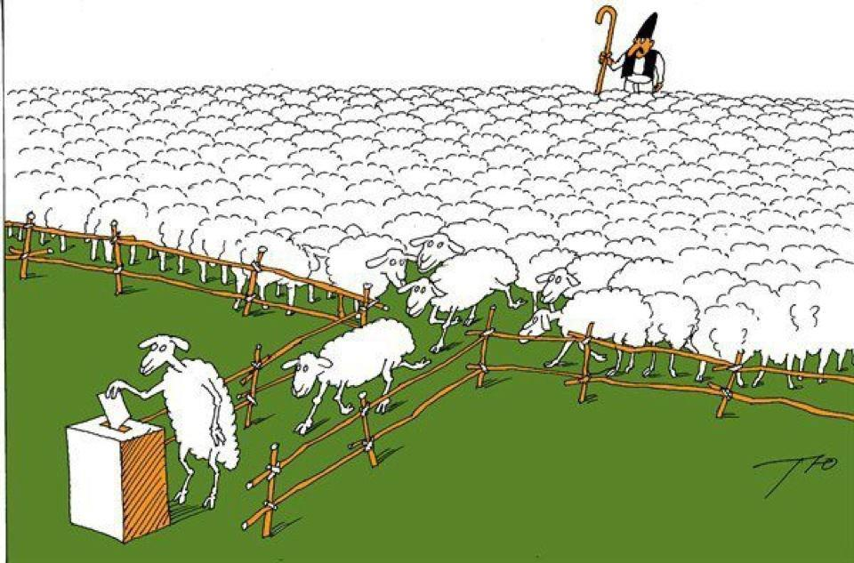
Party Identification
People vote most frequently for a party they identify with

Slide 29
Democracy and Elections
The greater the policy differences between the candidates, the more likely voters will be able to steer government policies by their choices
Retrospective voting a theory of voting in which voters essentially ask this question—what have you done for me lately?

Slide 30
The Impact of Campaigns
Campaigns have three effects on voters:
  Reinforcement, Activation, Conversion
Mostly, they only reinforce & activate
  Selective perception: pay attention to things we agree with.
  Party identification still has an affect
  Incumbents start with a substantial advantage

Slide 31
The Campaign Game
Organizing the Campaign
  Get a campaign manager
  Get a fund-raiser & campaign counsel
  Hire media and campaign consultants
  Assemble staff / plan the logistics
  Get research staff, policy advisors & pollsters
  Get a good press secretary
  Establish a website

Slide 32

Money and Campaigning
The Maze of Campaign Finance Reforms
  Federal Election Campaign Act (1974)
    Created the FEC to administer campaign finance laws for federal elections.
    Created the Presidential Election Campaign Fund.
    Provided partial public financing for presidential primaries (matching funds).
    Provided full public financing for major party candidates in the general election.
    Required full disclosure.
    Limited Contributions. (current limit is $2400)

Slide 33
Federal Election Commission
Purpose
In 1975, Congress created the Federal
Election Commission (FEC) to administer and
enforce the Federal Election Campaign Act (FECA)
the statute that governs the financing of federal
elections.
The duties of the FEC, which is an
independent regulatory agency, are to
disclose campaign finance information
enforce the provisions of the law such as the
limits and prohibitions on contributions,
oversee the public funding of Presidential
elections. .

Slide 34
Money and Campaigning
  Soft Money
    Contributions (with no limits) used for party-building expenses or generic party advertising
  McCain-Feingold Act (BCRA)(2002) banned soft money, increased amount individuals can contribute, and limited “issue ads.” Helped create the “ I approve of this message” ads.

Slide 35
Citizens United v. Federal election commission (2010)
A case challenging the Federal Election Commission's ruling that the documentary film entitled Hilary produced by a non profit corporation and funded by for-profit corporations constituted a violation of the ban on corporate contributions to federal campaigns. The Supreme Court ruled that corporate funding of independent political ads in candidate elections cannot be limited under the first amendment

Slide 36
Citizens United v. Federal election commission (2010)
U.S. Supreme Court on January 21, 2010, ruled (5–4) that laws preventing corporations and unions from using general treasury funds for independent electioneering communications violate the First Amendment’s guarantee of freedom of speech. In so doing the court invalidated Section 203 of the federal Bipartisan Campaign Reform Act of 2002 (BCRA)—also known as the McCain-Feingold Act

Slide 37
Challenge to the BCRA
McConnell v. FEC: Case that upheld a majority of the BCRA.
Federal Elections Laws regulate the financing of federal elections.
Specifically the disclosure of financial activity: Contributions, Receiving and Giving money, Expenditures, Candidate support activities and all other Federal election activities

Slide 38
Money and Campaigning
527 Groups: A 527 group is created primarily to influence the selection, nomination, election, appointment or defeat of candidates to federal, state or local public office. They are not subject to contribution restrictions because they do not directly seek the election of a particular candidates.
501 (c) groups: groups that can not spend more than half of their funds on political activities. These groups have no actual limits on how much money that is. (not in your book)

Slide 39
Money and Campaigning
The Proliferation of PACs
  Definition: Created by law in 1974 to allow corporations, labor unions and others to donate money to campaigns.
  As of 2004 there were 3,868 PACs.
  PACs contributed over $258 million to congressional candidates in 2002.
  Donate to candidates who support their issue, regardless of party affiliation
  Not sufficient data that PACs “buy” candidates

Slide 40
Bundling (Bush)
Bundling: Large donors tap their friends for maximum individual donations
then give in a ‘bundle’ to the candidate committee.
$500K bundles used to support Bush’s primary campaign
Also practiced by Unions to donate money to campaigns.
While there are disclosure requirements for bundling, they only go into effect when a bundler personally hands over checks. Most campaigns get around the disclosure provision by not having the bundler ever touch the checks

Slide 41
Money and Campaigning
Are Campaigns Too Expensive?
  Fund raising takes up lots of time.
  Incumbents do worse when they spend more money because they need it when they face tough challengers.
  The doctrine of sufficiency suggests that candidates need just “enough” money to win, not necessarily “more.”

Slide 42
Campaign Limits
Buckley v. Valeo, (1976), was a case in which the Supreme Court of the United States upheld a federal law which set limits on campaign contributions, but ruled that spending money to influence elections is a form of constitutionally protected free speech, and struck down portions of the law. The court also stated candidates can give unlimited amounts of money to their own campaigns.
Original Provision | Impact of Buckley v. Valeo
Expenditure Limits
Overall Spending Limits (Congress and President) | Struck Down Partially (Freedom of Speech)
Limits on the use of candidates’ own resources | Struck down entirely (Freedom of Speech)
Limits on Media Expenditures | Struck Down entirely (Freedom of Speech)
Independent expenditure limits | Struck Down entirely (Freedom of Speech)

Slide 43
How has money impacted our electoral process?
It gives wealthy people and groups an unfair advantage in influencing the
election outcomes
It affects who votes and how they vote;
It becomes a condition for who runs for office and who does not;
It affects information that the electorate receives about the candidates and their issue positions;
It affects public perceptions of how the system is working and whether it is fair and for the people.

