Slide 1
Federalism
Unit One
Textbook Chapter 3
Coach Flu

Slide 2
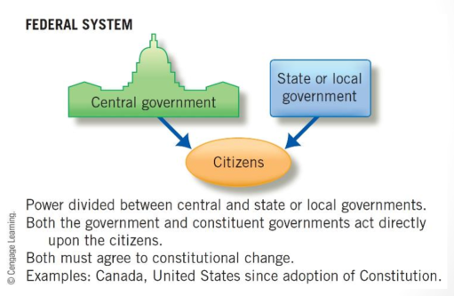
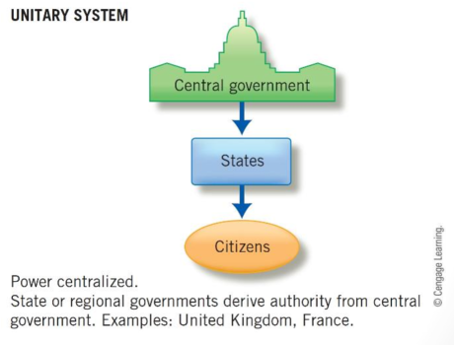
Lines of Power in Three Systems of Government

Slide 3
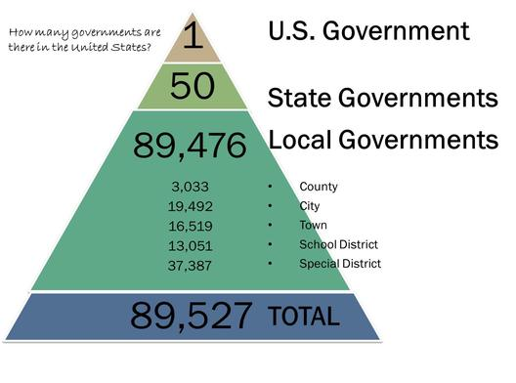
Governmental Structure
Federalism: a political system where local government units can make final decisions regarding some governmental activities and whose existence is protected
Unitary System: local governments are subservient to the national government

Slide 4
Federalism
The basis of federalism is that the federal government should take care of the big blanket issues of the country, and state government should resolve local issues.
State and local governments can act as a experiment to try out new ideas.
Intergovernmental relations: refers to the entire set of interactions among national, state, and local governments, including regulations, the transfers of funds, and sharing of information.

Slide 5


Federal and State Powers
In general, the federal government has power over economic issues, the military and defense.
In general, state governments have power over social, moral, and family issues.

Slide 6
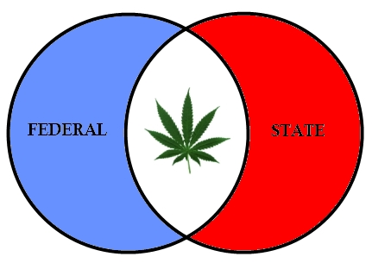
Hot Issues
Some of the hottest issues in American politics are, at their core, disputes over federalism.
Early conflicts resulted in nullification laws passed by states which also helped lead us to civil war.
Some hot issues involving federalism today are
  Gay marriage
  Marijuana
  Obamacare
  Immigration enforcement

Slide 7
Gonzalez v. Raich (2005)
Commerce clause quiz!!! Medicinal Marijuana
Controlled Substance Act (1970) – US gov regulates the manufacture, importation, possession, and distribution of certain drugs
Medicinal marijuana was legalized in California, but illegal to US government. Raich argued commerce clause should not take effect because 1) there was no business transactions and 2) there were no state border issues.
Supreme Court ruled 6-3 against Raich saying that the federal government could trump state laws that permitted medicinal marijuana

Slide 8
Positives and Negatives of Federalism
Negative view: Federalism blocks progress and protects powerful local interests.
Positive view: Federalism contributes to governmental strength, political flexibility, and fosters individual liberty and the development of leaders.
Federalist #10: small political units allow all relevant interests to be heard.

Slide 9

Relationships Between States
The Full Faith and Credit Clause requires states to recognize the public acts and legal judgments of other states.
The Privileges and Immunities Clause requires states to offer out-of-state citizens the same treatment as in-state residents.
Extradition is a process where a state must return a person when he or she has been charged with a crime in another state.

Slide 10
Federalism and the Constitution
The Tenth Amendment states that all power not delegated to the national government, nor prohibited to the states, is reserved to the states and the people
But, Article I, Section 8, allows Congress to make all laws necessary and proper for carrying out its enumerated powers (the Elastic Clause).

Slide 11
Elastic Clause
Aka – “Necessary and Proper Clause”
Art. I, Sec. 8, Cl. 18 - "The Congress shall have Power - To make all Laws which shall be necessary and proper for carrying into Execution the foregoing Powers, and all other Powers vested by this Constitution in the Government of the United States, or in any Department or Officer thereof."
Impossible to predict all powers Congress will need to function, sometimes we might have to allow Congress extra powers to fulfill their delegated powers
The “Necessary and Proper Debate” is the debate between people who believe in Loose Construction and Strict Construction.

Slide 12
McCulloch v. Maryland (1819)
Background
Bank of the US operated in Maryland
Maryland did not want BoUS to operate in state, competition unwanted, unfair
Maryland taxed the bank to put it out of business
McCulloch, Bank of US employee, refused to pay the state tax

Slide 13
McCulloch v. Maryland (1819)
Is a Bank of the US Constitutional?
YES. The national gov’t has certain implied powers that go beyond delegated powers. US needs a national bank for borrowing, lending, holding minted money, etc. All of which are delegated powers.

Slide 14
McCulloch v. Maryland (1819)
Can a state tax the federal gov’t?
-NO. The federal gov’t is supreme. Since the Bank of US is constitutional, only the feds may tax it.
-John Marshall reaffirmed Supremacy Clause and Elastic Clause
-National (Federal) Gov gets STRONGER

Slide 15
Commerce clause
Art. I, Sec. 8, Cl. 3 – ‘The Congress shall have power - To regulate commerce with foreign nations, and among the several states, and with the Indian tribes.”
Congress has used the elastic clause to stretch this power
What is commerce? “Buying and selling of goods and services.”
Congress given the power to regulate commerce between foreign countries and US as well as state to state… they control business law.

Slide 16

Increasing National Power
In Gibbons v. Ogden (1824), the Court defined commerce broadly, to include all “intercourse” between states.
In Heart of Atlanta Motel v. US, which is not technically a federalism case, the Court upheld the Civil Rights Act of 1964 using the Commerce Clause. This greatly expanded federal power.

Slide 17
Munn v. Illinois (1877)
Important case in the struggle for public regulation of private enterprise in post-Civil War America
Opened the door for states to regulate certain businesses within their borders, including railroads
Chief Justice Waite argued that the states may regulate the use of private property "when such regulation becomes necessary for the public good." Waite resurrected a latin legal doctrine to support his view: When property is affected with a public interest, it ceases to be juris privati only.
Also impacts the concept of Eminent Domain.
juris privati means "of private right; not clothed with a public interest”

Slide 18
United States v. Lopez (1995)
Commerce clause quiz!!!
1995 – “Gun Free School Zone” law banned possession of a firearm within 1000 feet of a school, 12 year old Lopez carried a gun on to the property
Declared law unconstitutional – “nothing to do with commerce” – carrying a weapon through a school zone is too much of a stretch for “commerce”
LIMITED National government power
Another example is the case United States v. Morrison (2000) which held that the 1994 Violence Against Women Act also overstepped the Constitution.

Slide 19
Same Sex Marriage Debate
United States v. Widsor (2013) issued a decision that stated that DOMA (Defense of Marriage Act 1996) was in fact restricting gay couples’ access to federal benefits that are offered other married coupes.
Obergefell v. Hodges (2015) issued a decision that the Constitution guarantees a right to same sex marriage. (based on the Equal Protection Clause of the 14th Amendment)

Slide 20

1789 -1933: Dual federalism:
Federal role limited to "enumerated" powers prescribed in Constitution; all other powers vest with the state
Also referred to as "layer cake" model, wherein each level of government (national/ state) is supreme within its domain of responsibility
Separation of powers between national and state governments; neither level interferes in the affairs of the other
Federal and state governments are competitive in their relationships
Overall, state centered form

Slide 21

1933-1964: Cooperative Federalism
Federal powers expanded to deal with the aftermath of Great Depression (using the 14th amendment)
Also referred to as "marble cake" model, where Federal role is to provide resources [for example, through the federally supported New Deal programs (e.g. social security, job welfare, infrastructure development) of Roosevelt]
Sharing of powers between the national and state governments
Federal and state governments are cooperative in their relationships
Overall, nation-centered form

Slide 22

1980-present (kind of): New Federalism (Competitive Federalism)
Federal decision on policies curtailed by converting categorical grants (i.e. special purpose) to block grants (general, fairly open-ended grants) where states and local governments have more discretionary power to use the funds
Also referred to as the "pineapple upside down cake" model (frosting on the top), wherein federal government deals directly with local governments, but state and local governments have greater degree of discretion
"Competitive" due to competition between state/ local governments for jobs (i.e. businesses) and workers
Governments are competitive in their relationships
Overall, competitive governments

Slide 23

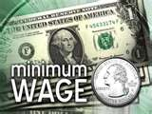
Fiscal Federalism
Fiscal Federalism
States often need funding from the federal government to implement projects and programs for citizens, but with federal funding comes the requirement of federal regulation. To use a common metaphor, the national government uses the need for fiscal assistance as both a carrot and a stick. The carrot is the federal dollars needed by the state, which come in the form of grants-in-aid. As citizens’ needs expand, the states look to the national government to assist in meeting the financial aspects of fulfilling those needs. The stick comes in the form of regulation and compliance with federal mandates to receive the money or to continue to obtain grants-in-aid. Regulations such as minimum wage, speed limits, and handicap accessibility are examples of “sticks,” or mandates, that states must comply with to receive the national funds.
Mandates: federal rules that states or localities must obey, generally have little or nothing to do with federal aid
An unfunded mandate occurs when states must comply with a federal law but are not provided with funds. (Americans With Disabilities Act).

Slide 24
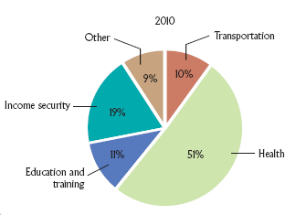
Intergovernmental Relations Today
Fiscal Federalism
  Definition: the pattern of spending, taxing, and providing grants in the federal system
  The cornerstone of the national
  government’s relations with
  state and local governments

Slide 25
Federal Grants to State and Local Governments (2015)
The federal government spent more than $624 billion on grants to states in 2015.
Among the biggest items:
Health care (including Medicaid) | $368 billion
Income security | $101 billion
Transportation | $60.8 billion
Education, training, employment, and social services | $60.5 billion
Community and regional development | $14.4 billion
Notes:
Table 3.1
Source: Office of Management and Budget, FY2016 Budget,
Table 15-1, “Trends in Federal Grants to State and Local
Governments,”
p. 267.

Slide 26
Federalism
  The Grant System: Distributing the Federal Pie
    Categorical Grants: funds targeted for specific purposes such as roads, schools, and urban development. Although they help states meet public needs, they come with many stipulations and regulations..
    Project Grants: Project grants are competitive and can create economic opportunity for the states. Examples of project grants are water projects, government facilities, and research grants. Project grants tend to be less dictatorial, giving states more discretion over how the funds are spent.
      Formula Grants: Formula grants give money according to a defined set of rules. For example, more urban development dollars go to states with higher urban populations (examples Head start, food stamp program and Medicaid).

Slide 27
Should States Adopt the Common Core National Education Standards?
Arguments for:
  All modern jobs require advanced skills in literacy, mathematics, and information technology.
  Variations in state curriculum standards leave students ill-prepared for high-paying jobs and for college.
  If a uniform school curriculum is not created now, then increased funding will be needed for remedial instruction later.

Slide 28
Should States Adopt the Common Core National Education Standards?
Arguments against:
  States are better able to determine educational standards that will prepare their diverse populations for the workforce.
  A national curriculum will stifle state and local creativity and be so basic that it will make little difference in college prep.
  The national government has a history of imposing educational mandates on states with insufficient funding.

Slide 29

Devolution of Power
Devolution occurs when the federal government gives more authority and discretion to state governments.
Block grants (the Welfare Reform Act is an example) were devoted to general purposes with few restrictions.
Revenue sharing requires no matching funds and can be spent on almost any governmental purpose.

