Slide 1
Federalism
Textbook Chapter 3
Coach Flu

Slide 2
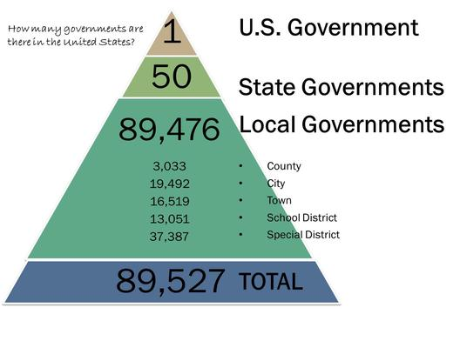
Governmental Structure
Federalism: a political system where local government units can make final decisions regarding some governmental activities and whose existence is protected
Unitary System: local governments are subservient to the national government

Slide 3
Federalism
The basis of federalism is that the federal government should take care of the big blanket issues of the country, and state government should resolve local issues.
State and local governments can act as a experiment to try out new ideas.
Intergovernmental relations: refers to the entire set of interactions among national, state, and local governments, including regulations, the transfers of funds, and sharing of information.

Slide 4
Federal and State Powers
In general, the federal government has power over economic issues, the military and defense.
In general, state governments have power over social, moral, and family issues.

Slide 5
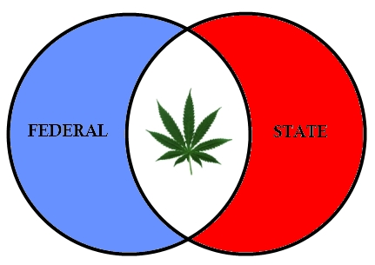
Hot Issues
Some of the hottest issues in American politics are, at their core, disputes over federalism.
Early conflicts resulted in nullification laws passed by states which also helped lead us to civil war.
Some hot issues involving federalism today are
Gay marriage
Marijuana
Obamacare
Immigration enforcement

Slide 6
Positives and Negatives of Federalism
Negative view: Federalism blocks progress and protects powerful local interests.
Positive view: Federalism contributes to governmental strength, political flexibility, and fosters individual liberty and the development of leaders.
Federalist #10: small political units allow all relevant interests to be heard.

Slide 7
Relationships Between States
The Full Faith and Credit Clause requires states to recognize the public acts and legal judgments of other states.
The Privileges and Immunities Clause requires states to offer out-of-state citizens the same treatment as in-state residents.
Extradition is a process where a state must return a person when he or she has been charged with a crime in another state.

Slide 8
Federalism and the Constitution
The Tenth Amendment states that all power not delegated to the national government, nor prohibited to the states, is reserved to the states and the people
But, Article I, Section 8, allows Congress to make all laws necessary and proper for carrying out its enumerated powers (the Elastic Clause).

Slide 9
Elastic Clause
Aka – “Necessary and Proper Clause”
Art. I, Sec. 8, Cl. 18 - "The Congress shall have Power - To make all Laws which shall be necessary and proper for carrying into Execution the foregoing Powers, and all other Powers vested by this Constitution in the Government of the United States, or in any Department or Officer thereof."
Impossible to predict all powers Congress will need to function, sometimes we might have to allow Congress extra powers to fulfill their delegated powers
The “Necessary and Proper Debate” is the debate between people who believe in Loose Construction and Strict Construction.

Slide 10
Commerce clause
Art. I, Sec. 8, Cl. 3 – ‘The Congress shall have power - To regulate commerce with foreign nations, and among the several states, and with the Indian tribes.”
Congress has used the elastic clause to stretch this power
What is commerce? “Buying and selling of goods and services.”
Congress given the power to regulate commerce between foreign countries and US as well as state to state… they control business law.

Slide 11
Increasing National Power
In Gibbons v. Ogden (1824), the Court defined commerce broadly, to include all “intercourse” between states.
In Heart of Atlanta Motel v. US, which is not technically a federalism case, the Court upheld the Civil Rights Act of 1964 using the Commerce Clause. This greatly expanded federal power.

Slide 12
Same Sex Marriage Debate
United States v. Widsor (2013) issued a decision that stated that DOMA (Defense of Marriage Act 1996) was in fact restricting gay couples’ access to federal benefits that are offered other married coupes.
Obergefell v. Hodges (2015) issued a decision that the Constitution guarantees a right to same sex marriage. (based on the Equal Protection Clause of the 14th Amendment)

Slide 13
1789 -1933: Dual federalism:
Federal role limited to "enumerated" powers prescribed in Constitution; all other powers vest with the state
Also referred to as "layer cake" model, wherein each level of government (national/ state) is supreme within its domain of responsibility
Separation of powers between national and state governments; neither level interferes in the affairs of the other
Federal and state governments are competitive in their relationships
Overall, state centered form

Slide 14
1933-1964: Cooperative Federalism
Federal powers expanded to deal with the aftermath of Great Depression (using the 14th amendment)
Also referred to as "marble cake" model, where Federal role is to provide resources [for example, through the federally supported New Deal programs (e.g. social security, job welfare, infrastructure development) of Roosevelt]
Sharing of powers between the national and state governments
Federal and state governments are cooperative in their relationships
Overall, nation-centered form

Slide 15
1980-present (kind of): New Federalism (Competitive Federalism)
Federal decision on policies curtailed by converting categorical grants (i.e. special purpose) to block grants (general, fairly open-ended grants) where states and local governments have more discretionary power to use the funds
Also referred to as the "pineapple upside down cake" model (frosting on the top), wherein federal government deals directly with local governments, but state and local governments have greater degree of discretion
"Competitive" due to competition between state/ local governments for jobs (i.e. businesses) and workers
Governments are competitive in their relationships
Overall, competitive governments

Slide 16
Intergovernmental Relations Today
Fiscal Federalism
Definition: the pattern of spending, taxing, and providing grants in the federal system
The cornerstone of the national government’s relations with state and local governments

Slide 17
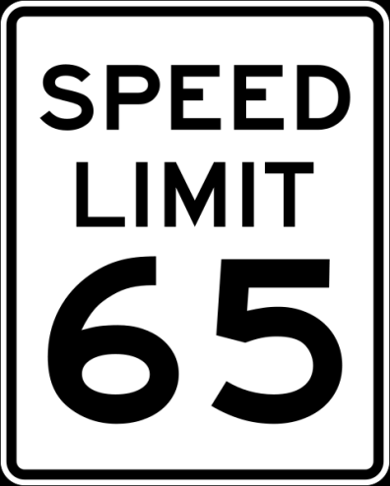
Fiscal Federalism
Fiscal Federalism
States often need funding from the federal government to implement projects and programs for citizens, but with federal funding comes the requirement of federal regulation. To use a common metaphor, the national government uses the need for fiscal assistance as both a carrot and a stick. The carrot is the federal dollars needed by the state, which come in the form of grants-in-aid. As citizens’ needs expand, the states look to the national government to assist in meeting the financial aspects of fulfilling those needs. The stick comes in the form of regulation and compliance with federal mandates to receive the money or to continue to obtain grants-in-aid. Regulations such as minimum wage, speed limits, and handicap accessibility are examples of “sticks,” or mandates, that states must comply with to receive the national funds.
Mandates: federal rules that states or localities must obey, generally have little or nothing to do with federal aid
An unfunded mandate occurs when states must comply with a federal law but are not provided with funds. (Americans With Disabilities Act).

Slide 18
Devolution of Power
Devolution occurs when the federal government gives more authority and discretion to state governments.
Block grants (the Welfare Reform Act is an example) were devoted to general purposes with few restrictions.
Revenue sharing requires no matching funds and can be spent on almost any governmental purpose.

