Slide 1
Political Parties & Political Ideology
Coach Flu
Revised 2019-2020

Slide 2
Political Ideology
A political ideology is a certain set of ethical ideals, principles, doctrines, myths or symbols of a social movement, institution, class or large group that explains how society should work and offers some political and cultural blueprint for a certain social order.
In simple language it is how you believe about a political issue.

Slide 3
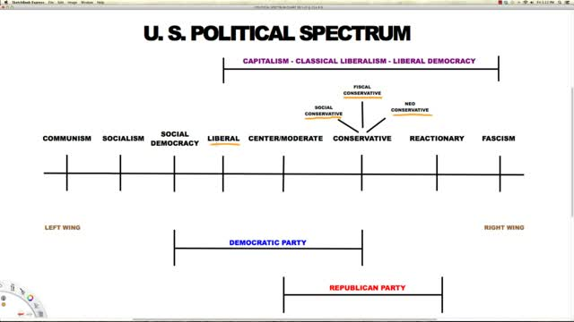

Slide 4
Meaning of Party
Anthony Downs notes these two similarities about parties, voters, and policy:
1. Voters want to maximize the chance that policies they favor will be adopted by government.
2. Parties want to win office.
Major difference between Democrats and Republicans is that Republicans favor lower taxes and less domestic spending, whereas Democrats favor more government programs to help the people the deem as less advantaged Americans.

Slide 5
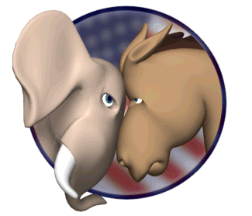
Political Parties
Alternating of power and influence between two major parties is one of the most important elements in American policy.
Without competition there would be no choice, without choice there is no democracy.
      Party Competition: battle between Democrats and Republicans for control
      of public office.

Slide 6
Political Parties
Political Party- organization of individuals with broad, common interest who organize to win elections, operate in government, and influence government policy
Two-party system- US party system with 2 main parties: Democrats and Republicans

Slide 7
Meaning of Party
A Party Team consists of three parts:
    Party in the Electorate: consists of members of the party. Does not necessarily have to be top ranking officials, just everyday Americans
    Party as an organization: has a national office, full time staff, rules, bylaws and budget.
    Party in Government: consists of elected officials who call themselves members of the party.

Slide 8
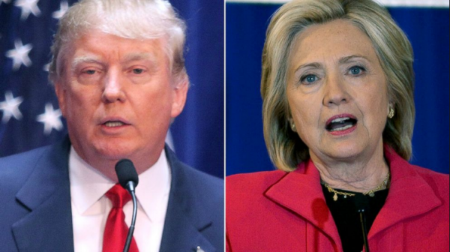
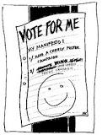
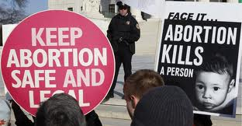
The Meaning of Party
The parties have tasks they must complete.
Candidate Recruitment
Almost no one above the local level gets elected to a public office without winning a party’s endorsement. A party’s endorsement is a nomination. (this has been weakened over the past few decades)
Campaign Management
Through there national, state, and local organizations parties coordinate political campaigns. However T.V. makes it easier for candidates to campaign on their own.
Mobilization and education of voters
Just simply knowing whether the candidate is Democratic or Republican provides crucial information for many voters. Letting voters know the preference of the party on who or what to vote for helps the party win.
Parties Articulate Policies
Within the electorate and within the government, each political party advocates specific policy alternatives.
Parties Coordinate Policymaking in government
In America’s fragmented government, parties are essential for coordination among the branches of government. When they need support to get something done, they first place they look is to their fellow party members.

Slide 9
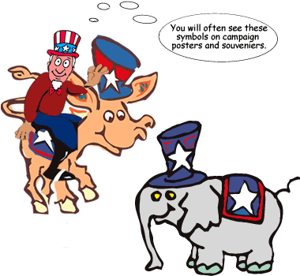
Meaning of Party
Parties compete like a marketplace. A party is in the market for voters; its products are candidates and policies.
Rational- Choice Theory: explains the actions of voters as well as politicians. It assumes that individuals act in their own best interest, carefully weighing the costs and benefits of possible alternatives.
There are few liberals (13%) and few conservatives (18%). The majority are in the middle.

Slide 10
The Party in the Electorate
In most European nations, being a party members means formally joining a political party. It includes: membership cards, and you must pay dues etc.
Most voters have a party image of each party.
Party Image: Voter’s perception of what the Republicans or Democrats stand for, such as conservatism or liberalism.

Slide 11
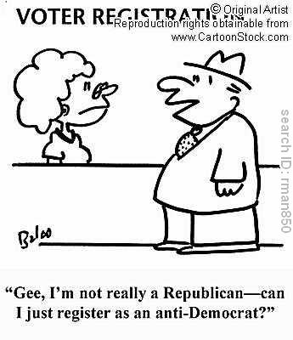
Party in the Electorate
Party images help shape people’s party identification.
Party Identification: a citizens self proclaimed preference for one party or the other.
People routinely vote for the party they identify with.

Slide 12
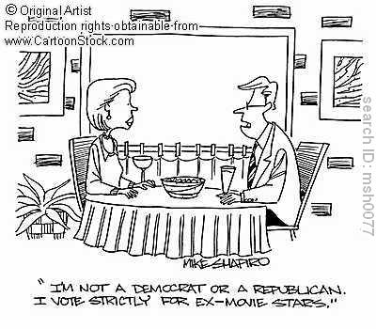
Party in the Electorate
The younger one is the more likely they are to be a political independent.
When one is independent they most likely engage in ticket splitting.
Ticket Splitting: voting with one party for one issue and the other party for another office.

Slide 13
Party Organizations: From the Grass Roots to Washington
From the late 19th cent. Through the New Deal of the 1930’s many cities were dominated by party machines.
Party Machines: political party organization that relies heavily on material inducements, such as patronage, to win votes.
Patronage: one of the key inducements used by party machines. A patronage job is one that is awarded for political reasons rather that for merit or competence alone.
        There were party machines in Albany, Chicago, Philadelphia, Kansas City, and elsewhere. They mostly relied on ethnic groups.

Slide 14
Party Organizations: From the Grass Roots to Washington
American national parties are a loose aggregation of state parties, which are themselves a fluid association of individuals, groups, and local organization.
There are 50 state party systems in the U.S., none of them are exactly alike.
States are allowed wide discretion in the regulation of party activities, and how they choose to organize elections influences the strength of the parties profoundly.

Slide 15
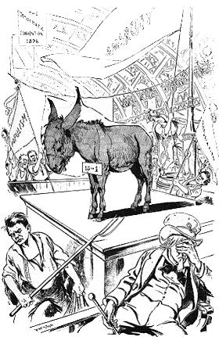
The Party in Government: Promises and Policy
Although many people don’t read the party platforms, they are one of the best written sources for what party’s believe in.
Party’s, for the most part, have done a good job of sticking to the promises they made in the party platforms.

Slide 16
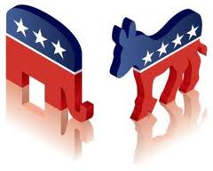
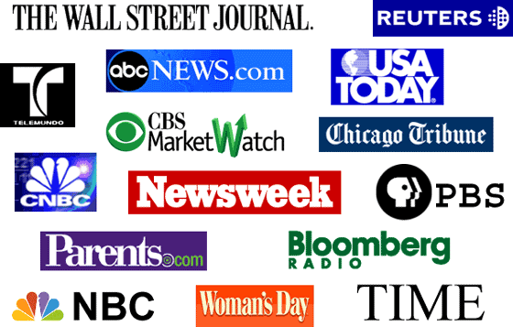
Meaning of Party
The road from public opinion to public policy is a long winding road.
    Linkage Institution: translates input from the public into outputs from the policymakers.
    -They help make sure that publics opinion are heard loud and clear.

Slide 17
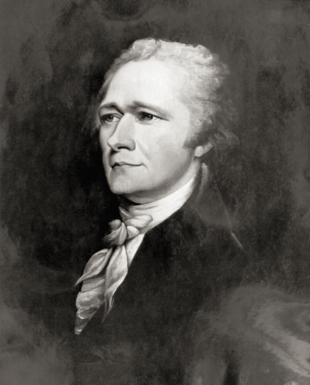
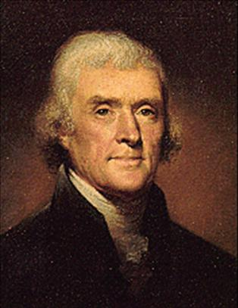
Political Parties
George Washington warned against political parties in his farewell address from office
First two political parties: Federalists and Democratic Republicans
  Federalists- Alexander Hamilton and
  John Adams, wanted a strong federal
  government, party eventually faded out
  DR’s- Thomas Jefferson and James
  Madison, thought the federal government
  was getting too much power, party split
  into Democrats and Whigs

Slide 18
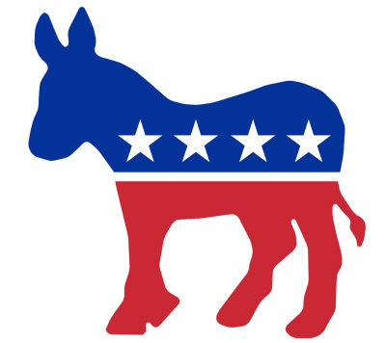
Democrats
1828 formed in support
of Andrew Jackson
Stressed their ties to the
common people
Whigs split to compete
with Democrats
Democrats and Whigs remained the two major political parties until the 1850s

Slide 19
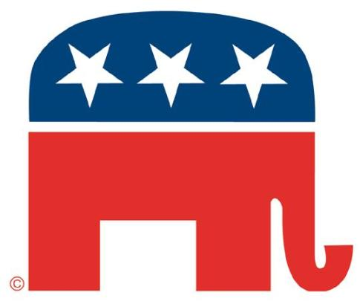
Republicans
Formed in 1854 with Abraham Lincoln to oppose slavery
Also known as “Grand Ole Party” (GOP)

Slide 20
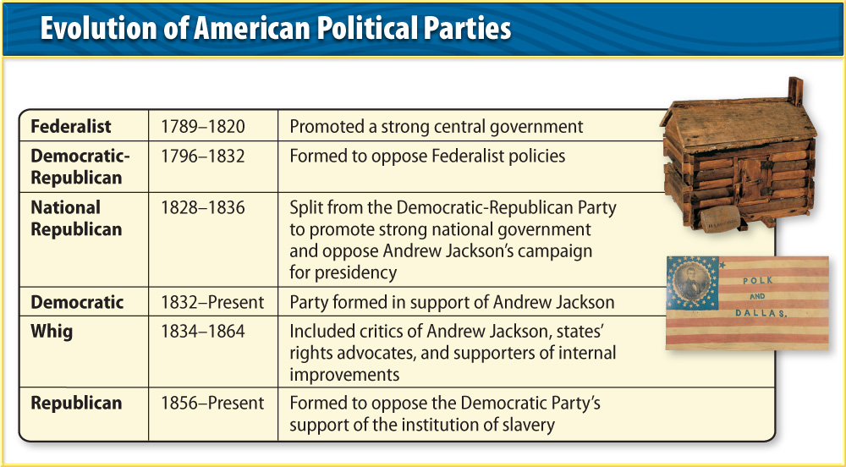
Democrats and Republicans
Around the turn of the 20th century the ideals of both parties began to change
Parties adjust their platforms to attract voters based on the public opinion on political issues.

Slide 21
Republicans vs. Democrats
It is not as simple as one side vs the other.
Only about 35% of the country actual aligns with one party or the other.
Rino Republican: Republicans In Name Only. Get elected as a one but vote and pursue policies favored by the Democrats. (This definition has chased many moderate Republicans from the GOP)
Blue Dog Democrats: Fiscally conservative Democrats who are mostly from the south and or rural areas of the United States.

Slide 22
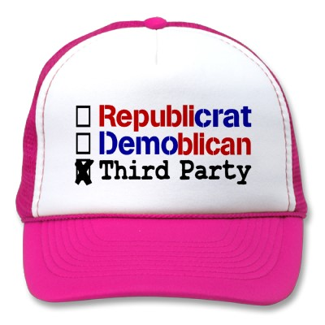
Third Parties
Third Parties- smaller minor parties
Influenced politics by promoting ideas that were at first unpopular
They have never won
Presidency, but Democrats
and Republicans adopted
their ideas

Slide 23
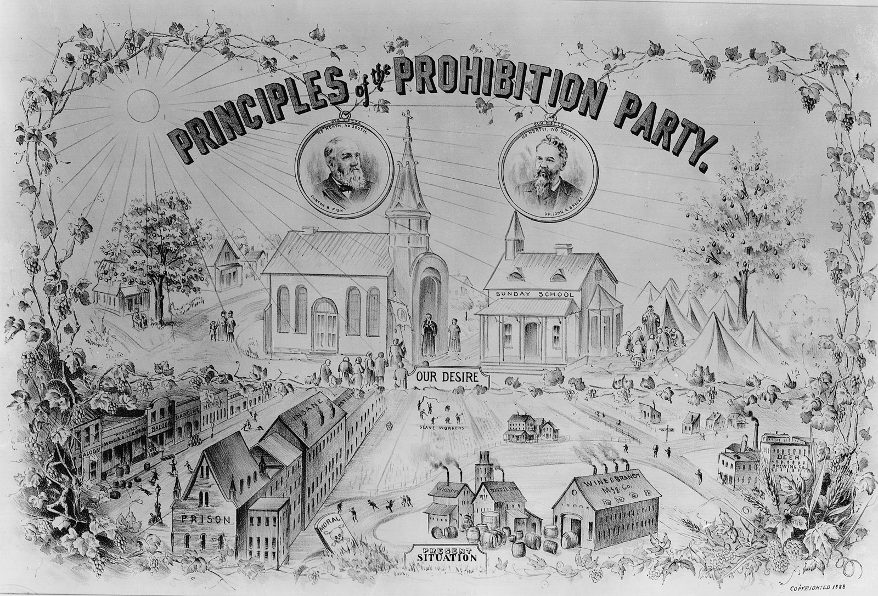
Third Parties cont.
Single Issue Parties- form to promote a social, economic, or moral issue (usually don’t last long)
  Prohibitionists Party formed in 1872 to ban alcohol

Slide 24
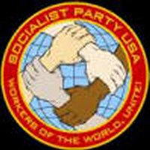
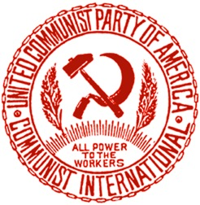
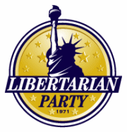
Third Parties cont.
Ideological Parties- form to support a particular philosophy or idea
  Socialists Labor Party and Communist Party USA believe that free enterprise should be replaced by one in which the government owns business
  Libertarian Party want to cut the size of the federal government and increase personal freedoms

Slide 25
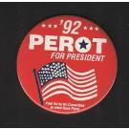
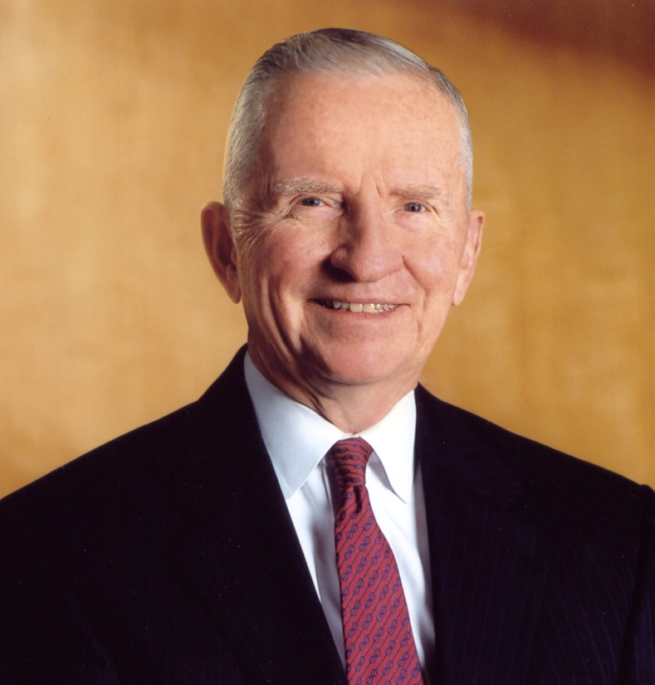
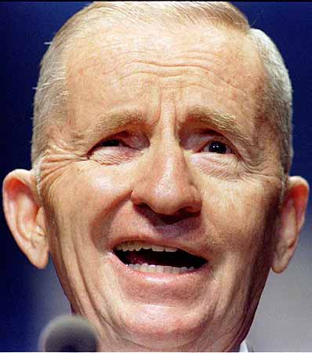
Third Parties cont.
Independent Candidates- form around leaders with strong personalities (usually don’t last long)
  H. Ross Perot ran for President in 1992 and 1996

Slide 26
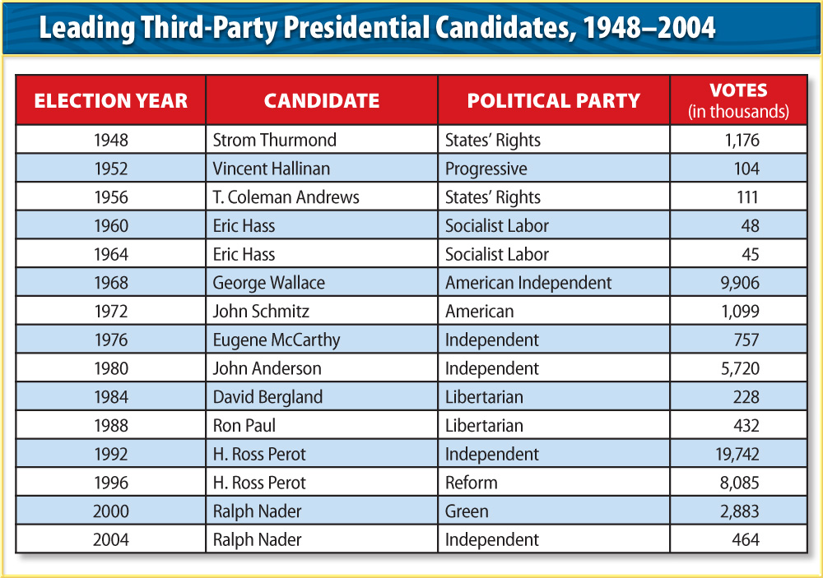
Third Parties cont.
Obstacles
  Third party candidates must obtain a large number of voter signatures to be placed on the ballot
  Trouble raising enough money

Slide 27
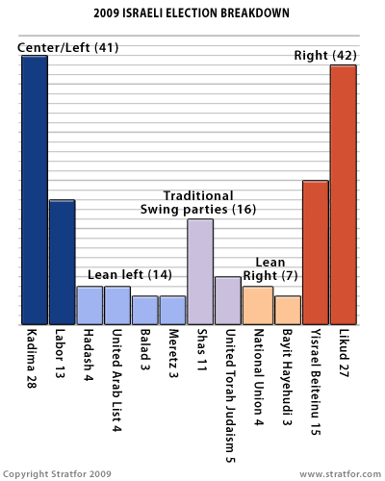
Other Party Systems
Multiparty System- one party rarely wins enough support to completely control government
  Many countries have this: Germany has over 5 political parties, Israel has over 20
One-Party System- the party and government are the same
  People’s Republic of China has 1 party: The Communist Party

Slide 28
Multiparty Systems in Other Countries
America has only two parties represented in government and has a winner-take- all system.
Winner-take- all system: electoral system in which legislative sears are awarded only to the candidates who come in first in their constituencies. In American presidential elections, the system in which the winner of popular vote in a state receives all the electoral votes of that state.
Most European countries have proportional legislation.
Proportional legislation: an electoral system used throughout most of Europe that awards legislative sears to political parties in proportion to the number of votes won in an election.
After the 2002 German election they formed a coalition government along with German’s Social Democratic Party.
Coalition government: When two or more parties joining together to form a majority in a national legislature. This form of government is quite common in the multiparty systems of Europe.

Slide 29
Party Eras in American History
Throughout American History, one party has been the dominant majority party for long periods of time.
Party Eras: Historical periods in which a majority of voters cling to the party in power, which tends to win a majority of the elections.
Punctuating each party era is a critical election.
Critical Election: an electoral “earthquake: where new issues emerge, new coalitions replace old ones, and the majority party is often displaced by the minority party. Critical election periods are sometimes marked by a national crisis and may require more than one election to bring about a new party era.
A critical election period may require more than one lection before change is apparent, but in the end, the party system will be transformed.
Party Realignment: the displacement of the majority party by the minority party, usually during a critical election period.

Slide 30
Party Eras in American History
1796-1824: The First Party System
In the Federalist Papers James Madison warned against “factions,” or parties.
Alexander Hamilton, co-writer of the Federalist Papers created the first party, The Federalists. He needed support for the federal bank.
The Federalist were also the shortest lived party. After Federalist candidate John Adams was defeated in 1800 the party faded.
Due to poor organization and by 1820 they did not offer up any candidates for political elections.
The party that crushed the Federalists was led by Virginians Jefferson, Madison, and Monroe. They were known as Democratic Republicans or Jeffersonians.

Slide 31
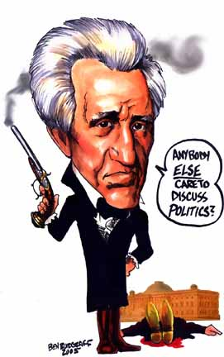
Party Eras in American History
1828-1856: Jackson and the Democrats vs. the Whigs
Gen. Andrew Jackson founded the modern American political party.
In the election of 1828, he forged a coalition with both the Westerners, Immigrants, Southerners, and Settled Americans.
He was initially a Democratic-Republican, but after his presidency the party became known as Democratic. The true architect of this party was Van Buren.
The opposition of this party was the Whig Party, it was only successful when they nominated popular military heroes: William Henry Harrison (1840);Zachary Taylor (1848).
The Whigs had to distinct wings: Northern Industrialists and Southern Planters. And attempted to motivate the masses against the elite.

Slide 32
Party Eras in American History
1860-1928: The Two Republican Eras
In the 1850’s, the issue of slavery dominated American politics and split both the Whigs and the Democrats.
In Dred Scott v. Sanford, decision sharpened the divisions in public opinion, making civil war increasingly likely.
The Republicans rose in the 1850’s as the antislavery party. They elected Abraham Lincoln .
After the Civil War the Republicans Party thrived for more than 60 years. But the Democrats still controlled the South.
The 2nd Republican era started with the election of 1896. The Democrats nominated William Jennings Bryan, who was a proponent of “free silver”. The Republicans favored gold standard.
This election is considered to be realigning, because it shifted the party coalitions and entrenched the Republicans for another generation.
For the next three decades Republicans continued as the nation’s majority party, until the stock market crash of 1929.

Slide 33
Party Eras in American History
1932- 1964: The New Deal Coalition
President Hoover proved disastrous for the Republicans and for the nation in his handling of the Great Depression. The nation elected Democrat Franklin Delano Roosevelt to solve the failing economy.
In his first 100 days he passed scores of Anti-depression measures.
Immigrant groups as well as African Americans became attracted and became Democrats. The partisanship of these groups forged the New Deal Coalition.
New Deal Coalition: a coalition forged by the Democrats who dominated Democrats, who dominated American politics from the 1930s to the 1960s. Its basic elements were the urban working class, labor unions, ethnic groups, Caltholics and Jews, the poor, Southerners, and African Americans.

Slide 34
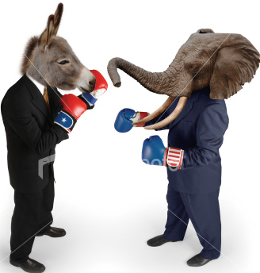
Party Eras in American History
1932- 1964: The New Deal Coalition cont.
The New Deal coalition made the Democratic party the clear majority for decades.
Harry S. Truman, who succeed Roosevelt in 1945, promised a Fair Deal. Republican Dwight D. Eisenhower broke Democratic grip and was elected twice during the 1950s. Democrats regained presidency in 1960 with John F. Kennedy.
Lyndon B. Johnson became president after JFK’s assassination. Johnson’s Great Society programs seemed promising. Johnson’s Vietnam War policies tore the Democratic Party apart in 1968, leaving for Republican candidate Richard M. Nixon.

Slide 35
Party Eras in American History
1968-Present: Southern Realignment and The Era of Divided Party Government.
Richard Nixon emphasized his support for states’ rights, law
and order, and a strong military policy. Through this
method he won Southern conservatives to the Republican
party.
The Southern Realignment occurs slowly.
1948 Democratic party reverses their view on Civil rights. Supporting them now. This alienates many white southerners.
Harry Truman signed Executive Order 9981 (integrating the armed forces)
Supreme court (with Democratic Party public support) ended prayer in school.
Many factory workers started moving south for jobs bringing the conservative views of government with them.

Slide 36
Party Eras in American History
1968-Present: Southern Realignment and The Era of Divided Party Government
Divided government is frequently seen in the federal and state level.
Pattern of divided government has caused a belief that the party system is dealigning.
Party Dealignment: the gradual disengagement of people and politicians from the parties, as seen in part by shrinking party identification.

