Slide 1
The Presidency
Textbook Chapter 14
Coach Flu
Revised 2017-2018

Slide 2
The Presidents
Great Expectations
  Americans want a president who is powerful and who can do good like Washington, Jefferson, Lincoln, Roosevelt, and Kennedy.
  Yet Americans do not like a concentration of power because they are individualistic and skeptical of authority.

Slide 3
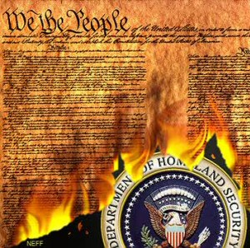
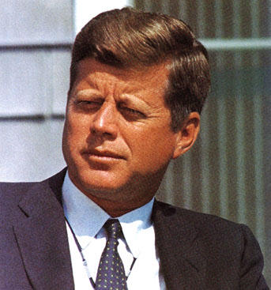
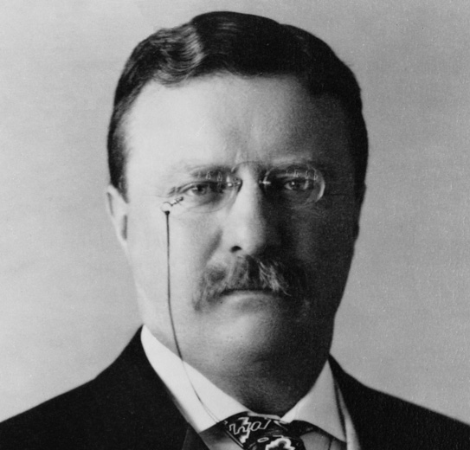
The Presidents
Formal Requirements:
    Must be 35 years old
    Must have resided in U.S. for 14 years
    Natural born citizen
  Informal “Requirements”:
    White (except Barack Obama)
    Male
    Protestant (except two)
  All manner of professions, but mostly political ones (former state governors, for example)

Slide 4
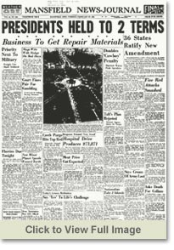
The Presidents
  Elections: The Normal Road to the White House
    Once elected, the president serves a term of four years.
    In 1951, the 22nd Amendment limited the number of terms to two.
    Most Presidents have been elected to office.

Slide 5

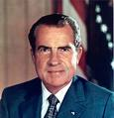
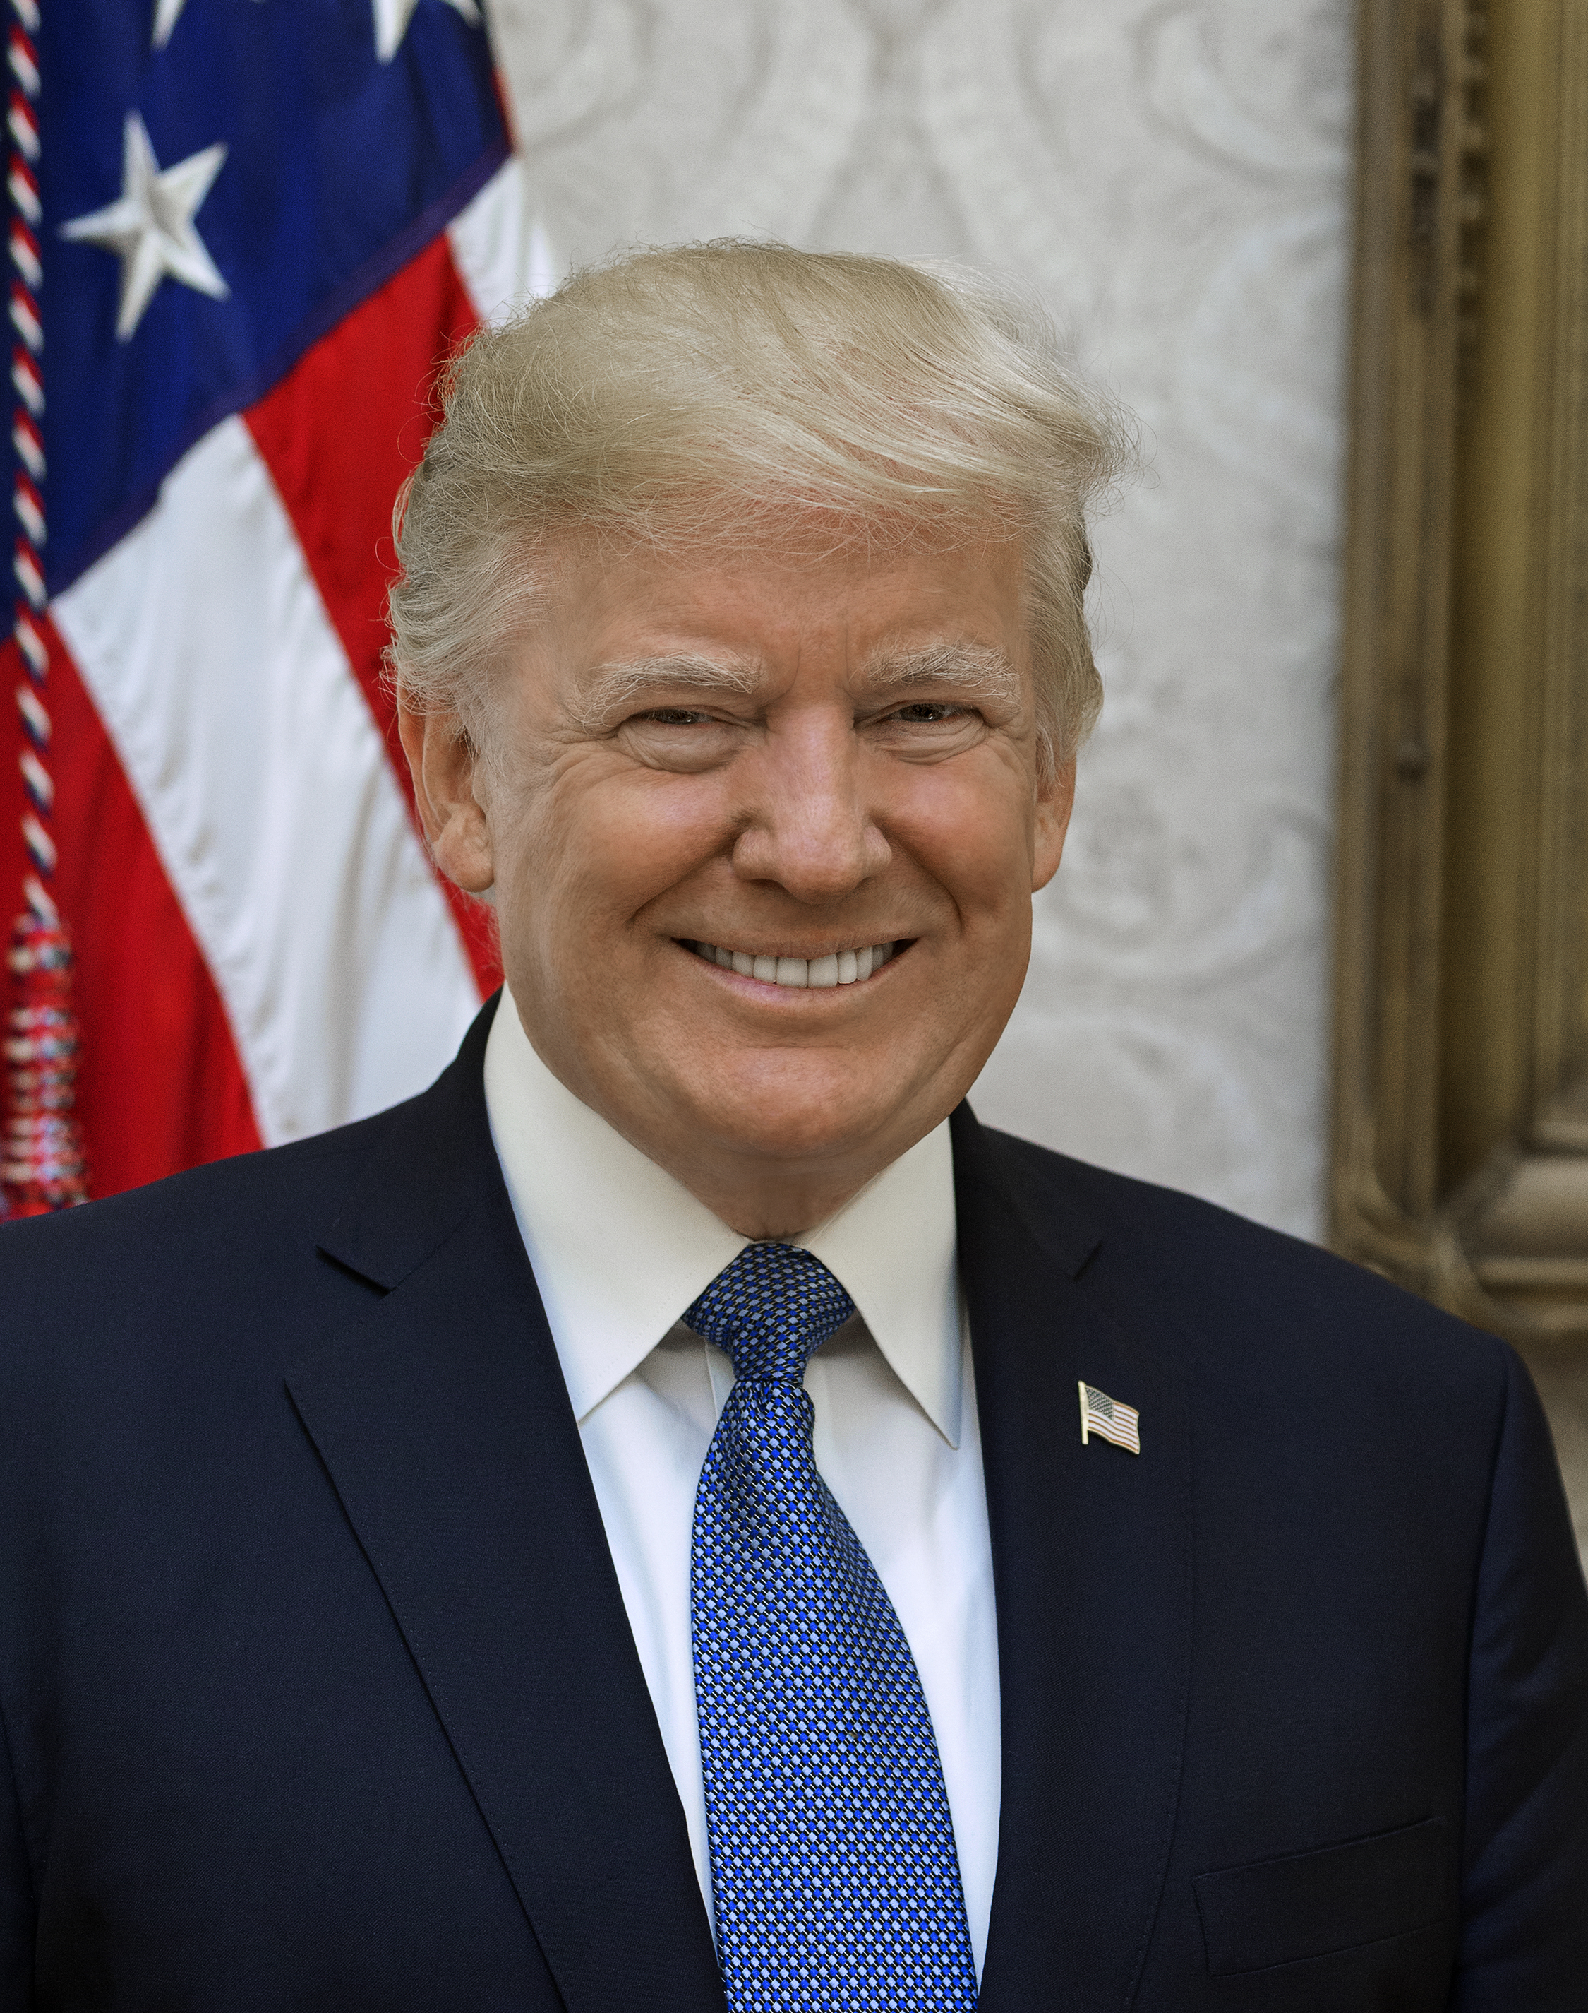
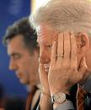
The Presidents
Secession and Impeachment
The vice-President secedes if the president leaves office due to death or resignation or convicted of impeachment
    Impeachment is investigated by the House, tried by the Senate with the Chief Justice presiding.
    3 Presidents have been impeached: A. Johnson & Clinton and Donald Trump (twice)- none were convicted.
resigned

Slide 6
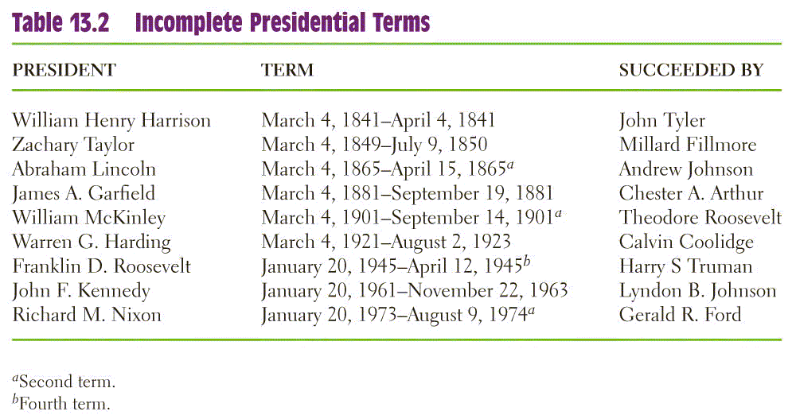
Incomplete Terms

Slide 7
The Presidents

Slide 8
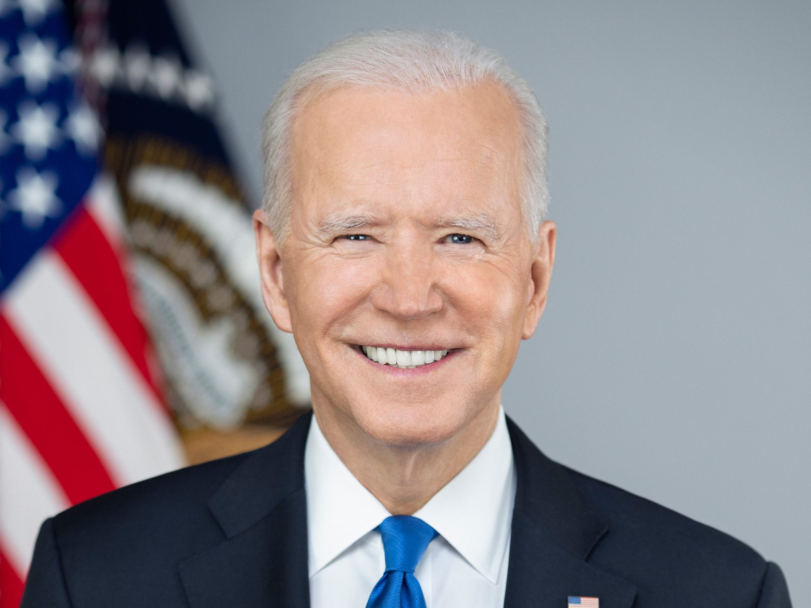
United States President (46)
Joe Biden (D)

Slide 9
Constitutional Powers of the President
National Security Powers—commander in chief of armed forces, treaty-maker with other nations (with Senate confirmation), nomination of ambassadors, receiving ambassadors from other nations
Legislative Powers—presenting information in the State of the Union, recommending legislation to Congress, convene both houses of Congress, adjourn Congress, veto legislation
Administrative Powers— execute the laws, nominate certain government officials, request opinions of officials, fill administrative vacancies
Judicial Powers—grant reprieves and pardons for federal offences, nominate federal judges (with Senate confirmation)

Slide 10
Presidential Powers

Slide 11
Running the Government:
The Chief Executive
As Chief Executive, the president presides over the administration of government.
  Constitution: “take care that the laws be faithfully executed”
  Today, federal bureaucracy spends $2.8 trillion a year and numbers more than 4 million employees.
  Presidents appoint 500 high-level positions and 2,500 lesser jobs.

Slide 12
Running the Government:
The Chief Executive
The Vice President
  Basically just “waits” for things to do
  Power has grown over time, as recent presidents have given their VPs important jobs
The Cabinet
  Presidential advisors, not in Constitution
  Made up of 14 cabinet secretaries and one Attorney General, confirmed by the Senate

Slide 13
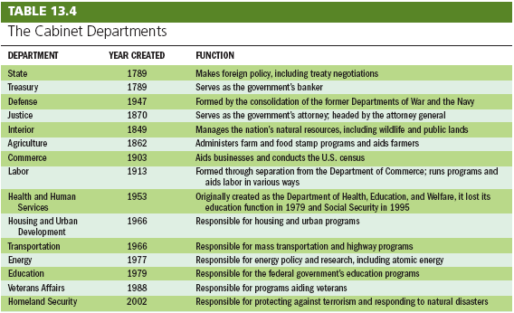
Running the Government:
The Chief Executive

Slide 14
Running the Government:
The Chief Executive
The Executive Office
  Made up of policymaking and advisory bodies
  Three principle groups: NSC, CEA, OMB

Slide 15
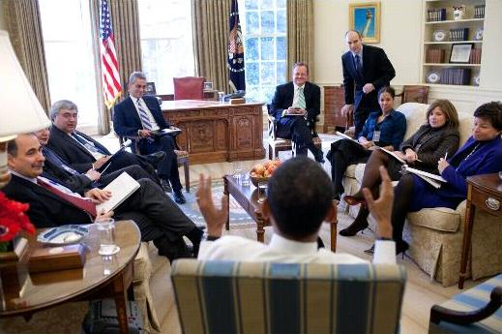
Running the Government:
The Chief Executive
The White House Office
  The White House Staff are the chief aides and staff for the president.
  They are chosen on the basis of their loyalty to the president
  Need not be confirmed
  The national security advisor is an example.

Slide 16
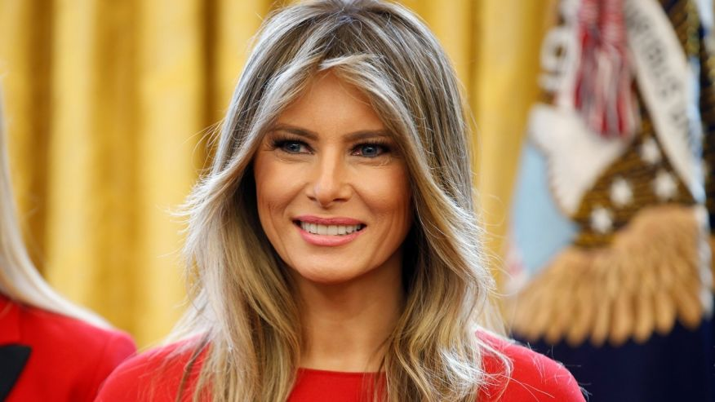
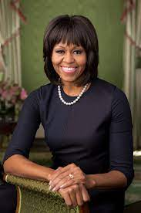
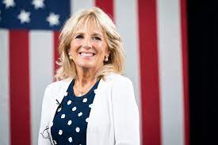
First Lady
  No official government position, but many get involved politically
  Recent ones focus on a single issue

Slide 17
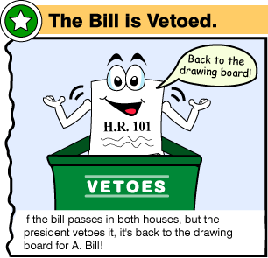
Presidential Leadership of Congress: The Politics of Shared Powers
Chief Legislator
  Veto: Sending a bill back to Congress with the reasons for rejecting it. Can be overridden.
  Pocket Veto: Letting a bill die by not signing it in 10 days when Congress is adjourned.
  Line Item Veto: The ability to veto parts of a bill. Some state governors have it, but not the president. The president must sign or veto all of a bill.

Slide 18
Signing Statements
A signing statement is a written message issued by the president upon signing a bill into law that states objectives to some of the provisions in the bill.
They are not provided for in the Constitution.
George W. Bush increased their use, and Obama has continued this trend.
They usually are statements on how the president believes a new laws should or should not be enforced. (Congress tends to not like this as it could impact the laws success)

Slide 19
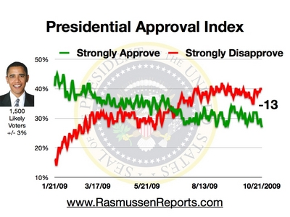
Presidential Leadership of Congress: The Politics of Shared Powers
Mandates
    Perception that the voters strongly support the president’s leadership and policies
    Mandates are infrequent, but presidents may claim a mandate anyway

Slide 20
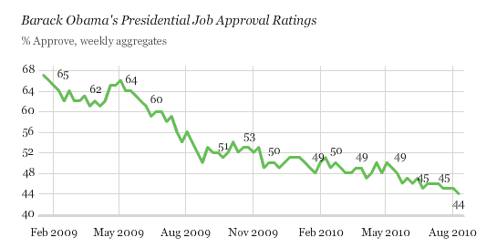
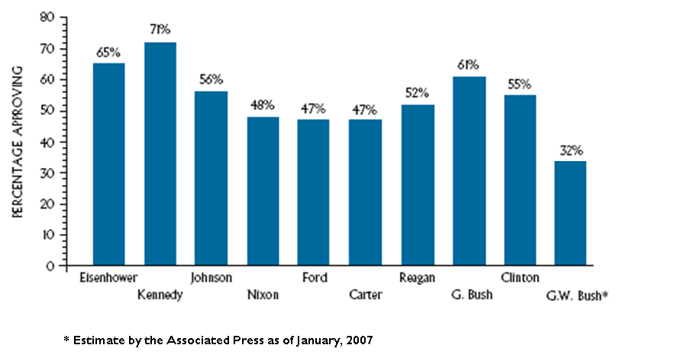
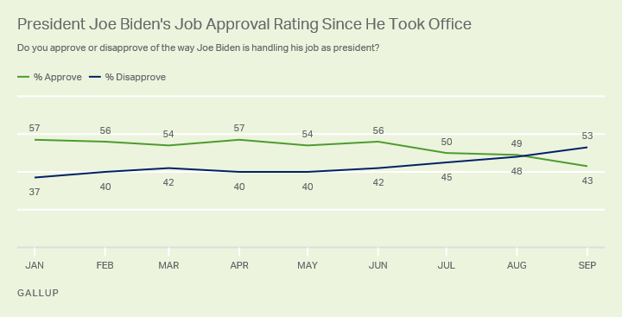
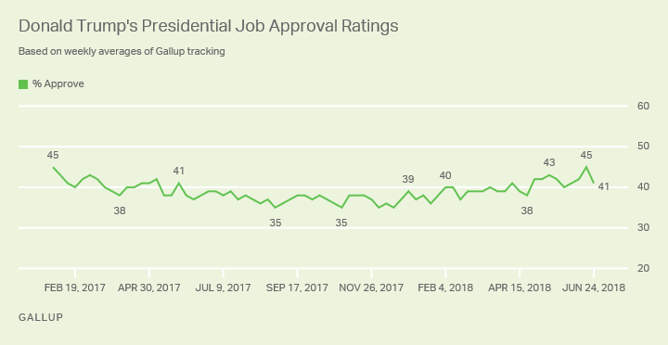
Approval Ratings

Slide 21
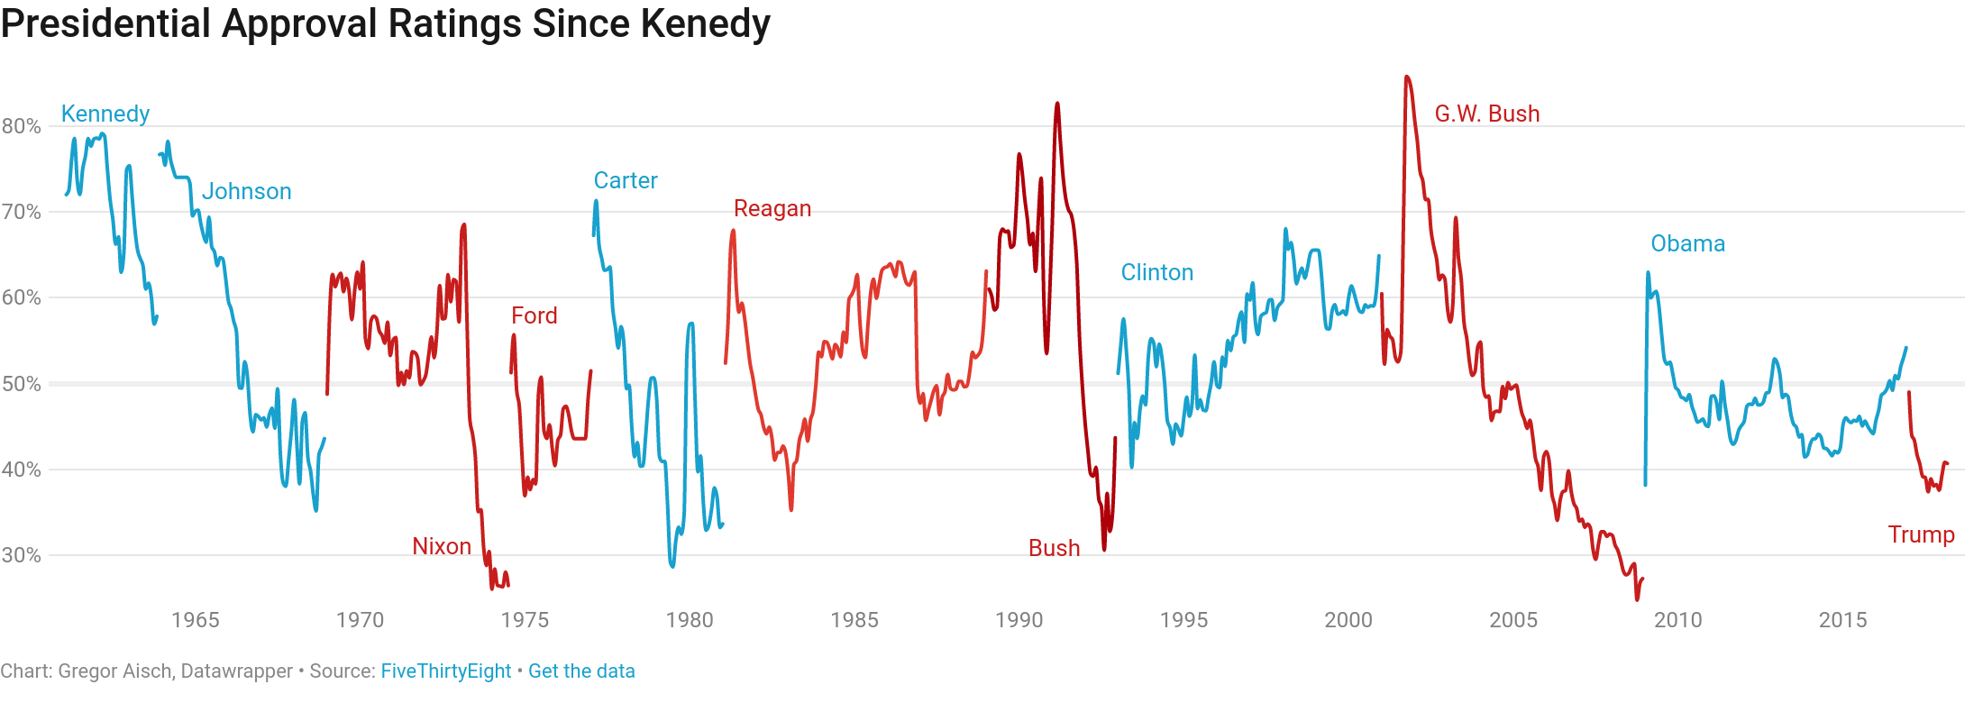
Approval Ratings

Slide 22
Power from the People:
The Public Presidency
Presidents have three audiences they must communicate with.
  Politicians in D.C.
  Party members and leaders.
  The public
Presidential Approval
  Receives much effort by the White House
  Product of many factors: war, the economy, the “honeymoon” period
  Changes can highlight good / bad decisions

Slide 23
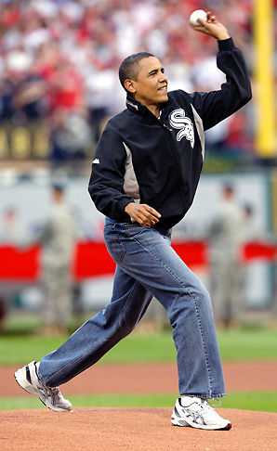
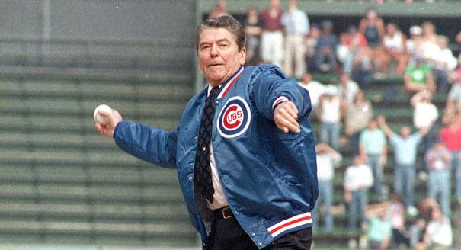
Power from the People:
The Public Presidency
Going Public
  Public support is perhaps the greatest source of influence a president has.
  Presidential appearances are staged to get the public’s attention.
  As head of state, presidents often perform many ceremonial functions- which usually result in favorable press coverage.

Slide 24
Power from the People:
The Public Presidency
Going Public
  Public support is perhaps the greatest source of influence a president has.
  Presidential appearances are staged to get the public’s attention.
  As head of state, presidents often perform many ceremonial functions, which usually result in favorable press coverage.

Slide 25
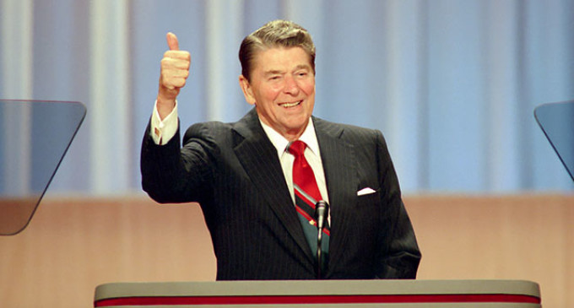
Bully Pulpit
Manage a crisis
Demonstrate leadership
Announce appointment of cabinet members and Supreme Court Justices
Set and clarify the national agenda
Achieve a legislative agenda
Announce foreign policy initiatives

Slide 26
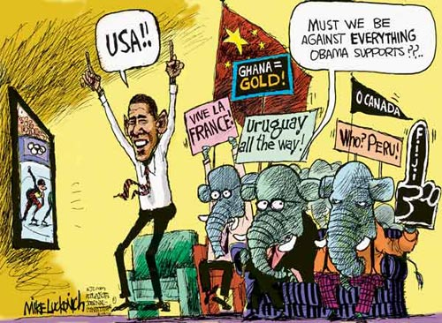
Presidential Leadership of Congress: The Politics of Shared Powers
Legislative Skills
  Variety of forms: bargaining, making personal appeals, consulting with Congress, setting priorities in the State of the Union address.
  Most important is bargaining with Congress.
  Presidents should use their “honeymoon” period
  Nation’s key agenda builder

Slide 27
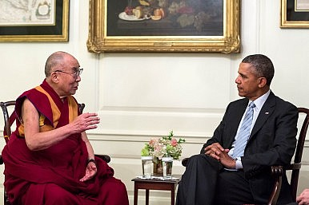
The President and National Security Policy
Chief Diplomat
  Negotiates treaties with other countries
  Treaties must be ratified by the Senate
  Signs executive agreements to take care of routine matters with other countries
  May negotiate for peace between other countries
  Leads U.S. allies in defense & economic issues

Slide 28
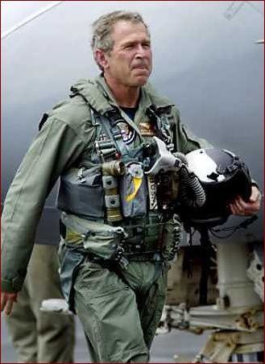
The President and National Security Policy
Commander in Chief
  Writers of the Constitution wanted civilian control of the military
  Presidents often make important military decisions
  Presidents command a standing military and nuclear arsenal
  Presidents can deploy troops without congressional consent.

Slide 29
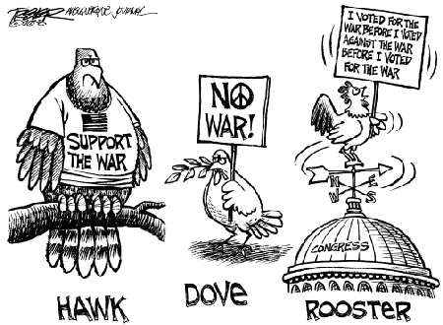
The President and National Security Policy
War Powers Resolution
  Constitution gives Congress the power to declare war, but presidents can commit troops and equipment in conflicts
  War Powers Resolution requires the president to consult with Congress before sending troops, when possible
  It requires that Congress approve of any troop commitment beyond 60 days. (then 30 days to remove troops)
  Most presidents have ignored it.
  Supreme Court avoided it using the political questions doctrine.

Slide 30
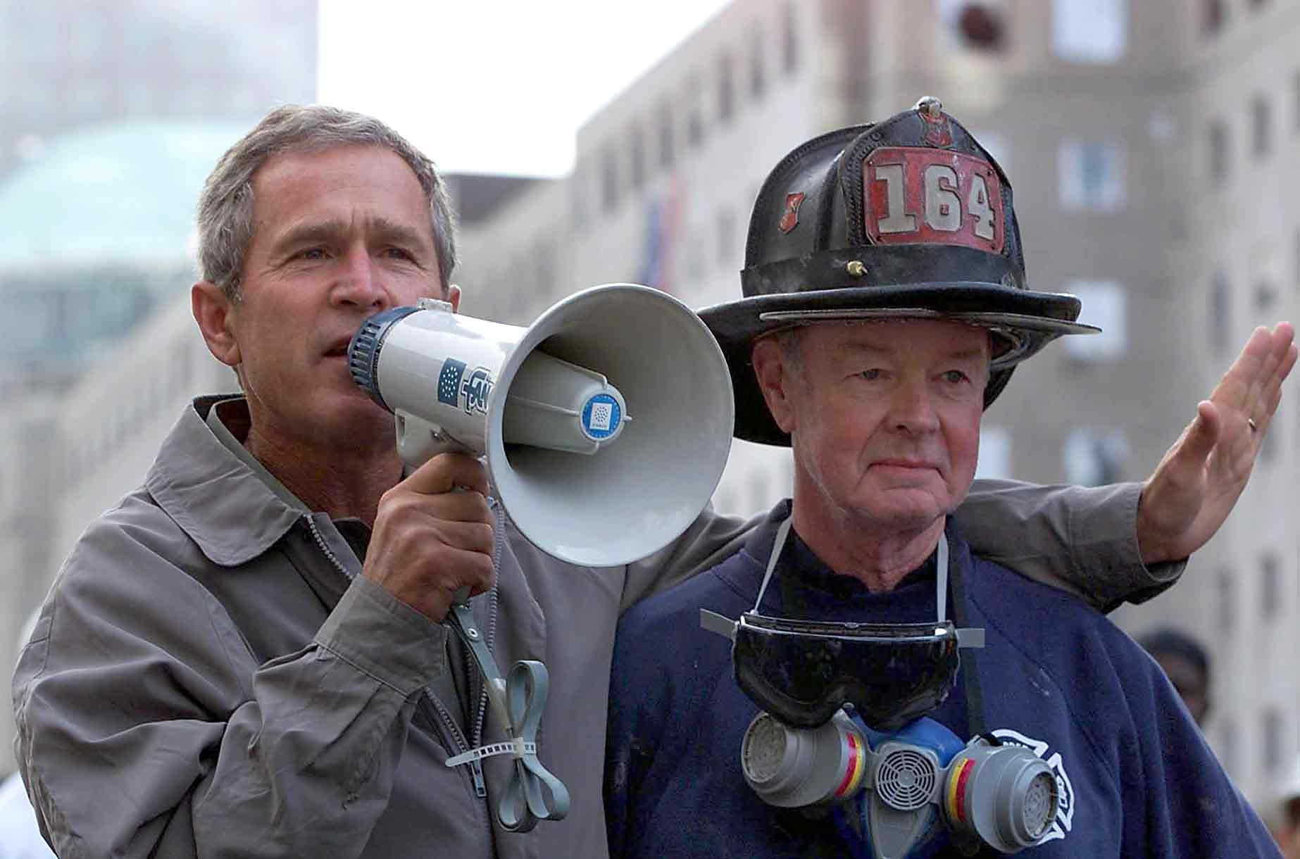
The President and National Security Policy
Crisis Manager
  The role the president plays can help or hurt the presidential image.
  With current technology, the president can act much faster than Congress to resolve a crisis.
Working with Congress
  President has lead role in foreign affairs.
  Presidents still have to work with Congress for support and funding of foreign policies.
Link to Bullhorn Speech

Slide 31
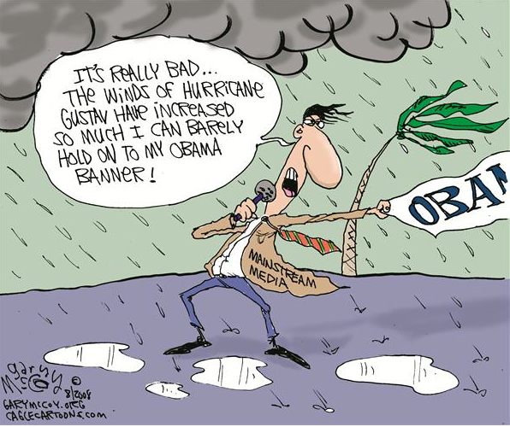
The President and the Press
Presidents and media are often adversaries.
Many people in the White House deal with the media, but the press secretary is the main contact person
Media is often more interested in the person, not the policies
News coverage has become more negative

Slide 32
Organization of the White House Staff
There are three ways that presidential staff has been organized to function:
As a pyramid
Circular (
Ad hoc (heavy use of task forces, committees and informal group of friends that answer to the president directly)

Slide 33
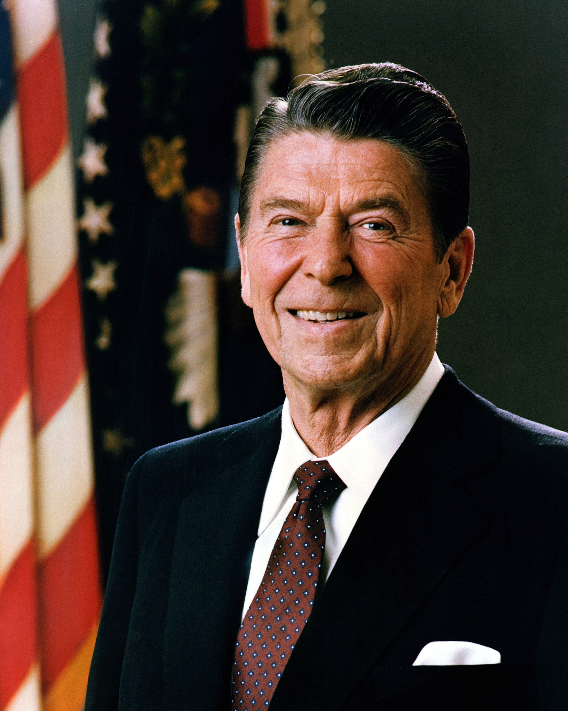
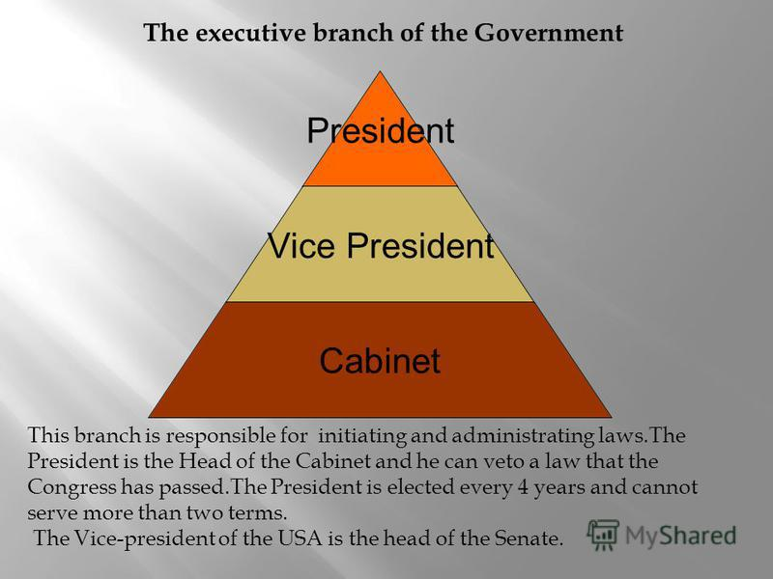
Organization of the White House Staff
Pyramid Model
like chain of command that emphasizes a powerful Chief of Staff, who in most cases is highly visible and accessible to the press. In this model, the president can be viewed as sitting atop a pyramid, removed from advisors and interests below him. Under the president, the Chief of Staff runs the White House staff with a great deal of authority and acts as a clearinghouse for information and access to the president.

Slide 34
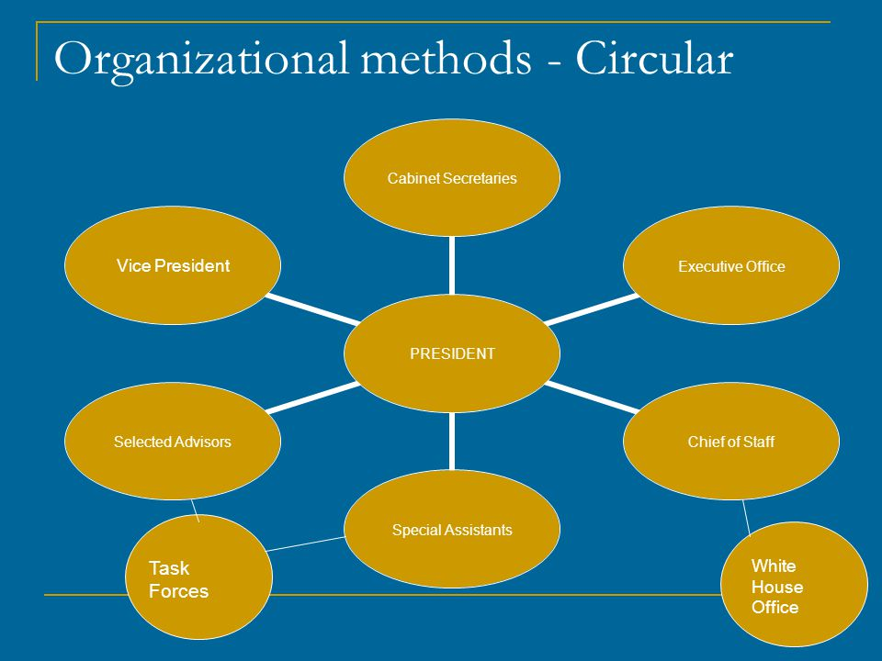
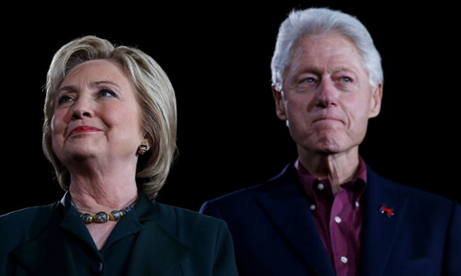
Organization of the White House Staff
Circular Model
staff and advisors reported directly
to the Oval Office. (Clinton 2nd term)

Slide 35
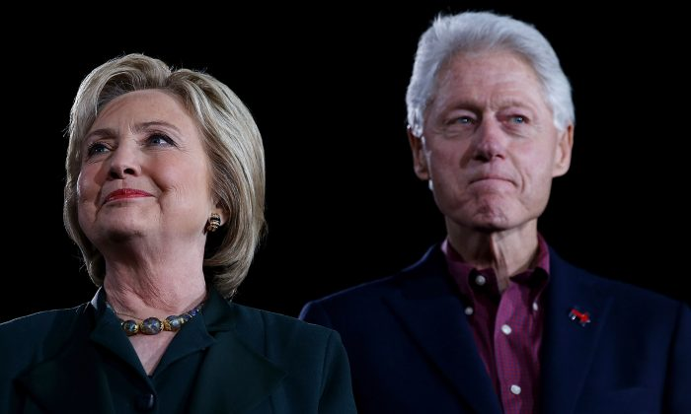
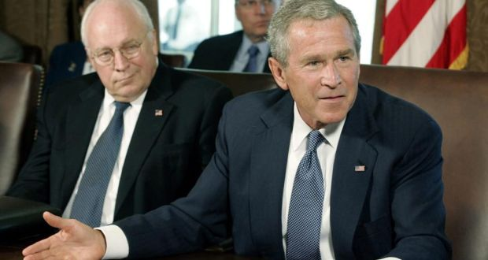
Organization of the White House Staff
Ad Hoc Model
combines leadership and management tactics that the CEO of a large corporation might use. President Clinton (1st Term) and President George W. Bush have used this style, which employs committees, task forces, and special advisors to help develop and implement policy.

Slide 36
Important Court Cases
United States v. Nixon (1973) held that the presidential privilege does not cover all circumstances
Nixon v. Fitzgerald (1982) held that a president can not be sued for damages for the decisions they make as president.
Clinton v. Jones (1997) held that a civil lawsuit against the president are not a distraction keeping the president from doing their job.

