Slide 1
The Presidency
Textbook Chapter 14
Coach Flu
Revised 2017-2018

Slide 2
The Presidents
Great Expectations
  Americans want a president who is powerful and who can do good like Washington, Jefferson, Lincoln, Roosevelt, and Kennedy.
  Yet Americans do not like a concentration of power because they are individualistic and skeptical of authority.

Slide 3
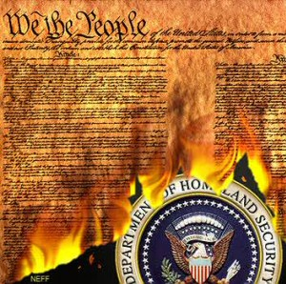
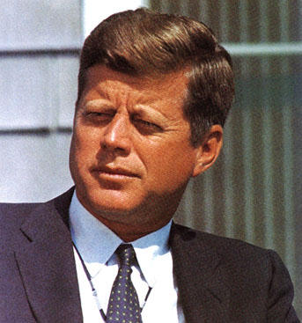
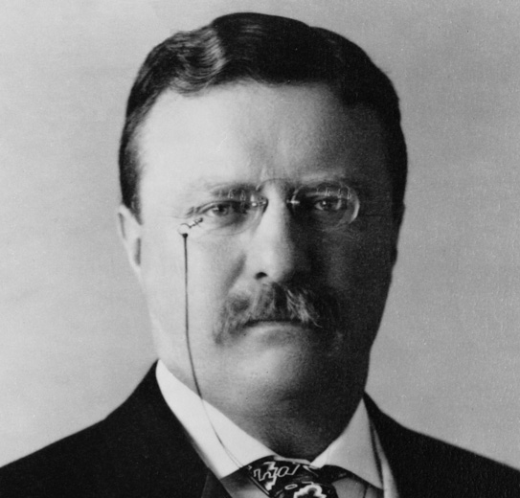
The Presidents
Formal Requirements:
    Must be 35 years old
    Must have resided in U.S. for 14 years
    Natural born citizen
  Informal “Requirements”:
    White (except Barack Obama)
    Male
    Protestant (except one)
  All manner of professions, but mostly political ones (former state governors, for example)

Slide 4
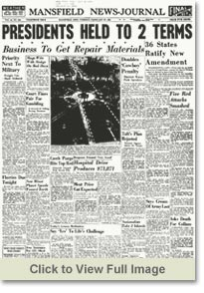
The Presidents
  Elections: The Normal Road to the White House
    Once elected, the president serves a term of four years.
    In 1951, the 22nd Amendment limited the number of terms to two.
    Most Presidents have been elected to office.

Slide 5

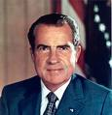
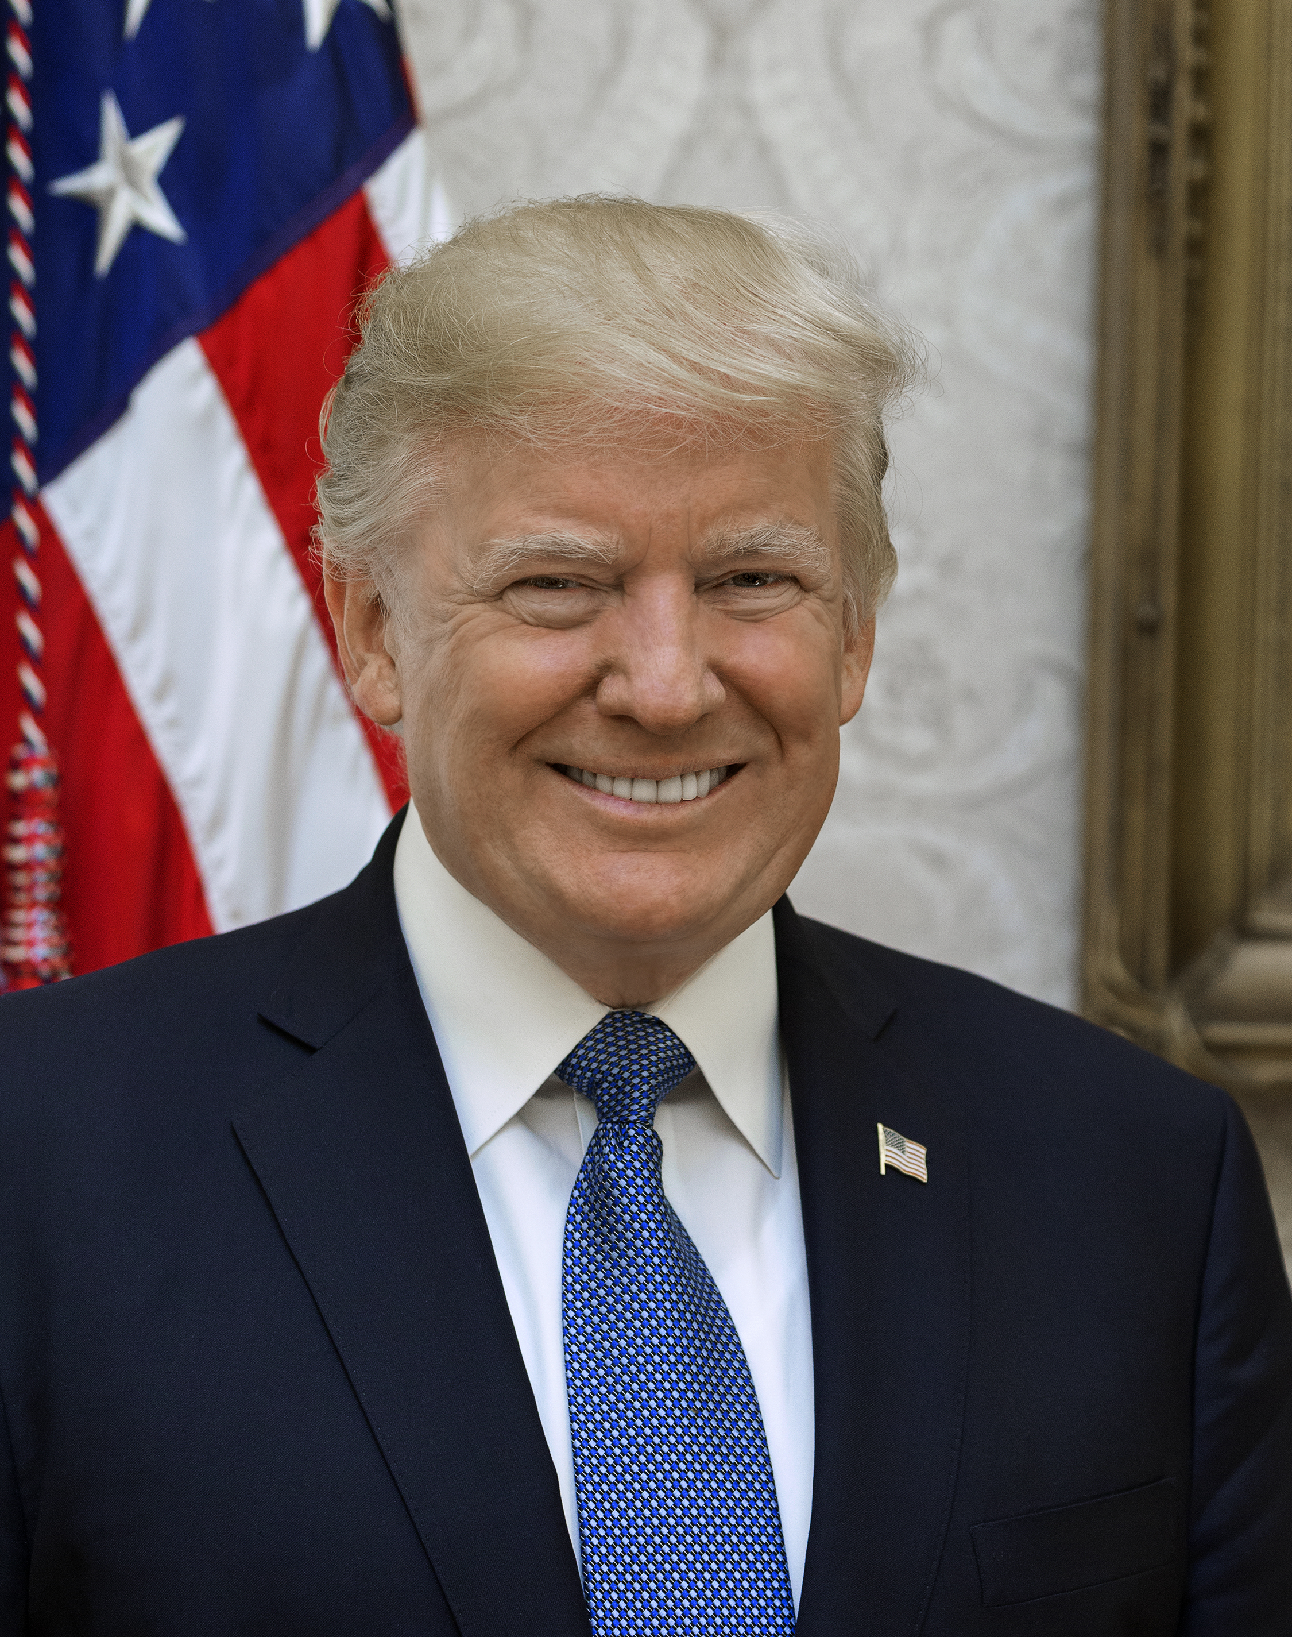
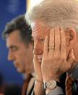
The Presidents
Secession and Impeachment
The vice-President secedes if the president leaves office due to death or resignation or convicted of impeachment
    Impeachment is investigated by the House, tried by the Senate with the Chief Justice presiding.
    Only two presidents have been impeached: A. Johnson & Clinton- neither was convicted.
resigned

Slide 6
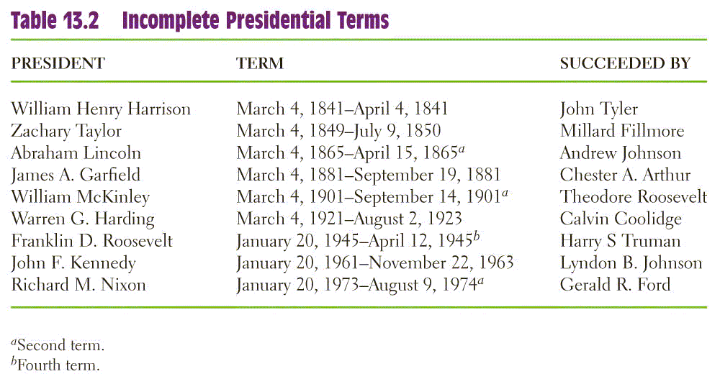
Incomplete Terms

Slide 7
The Presidents

Slide 8
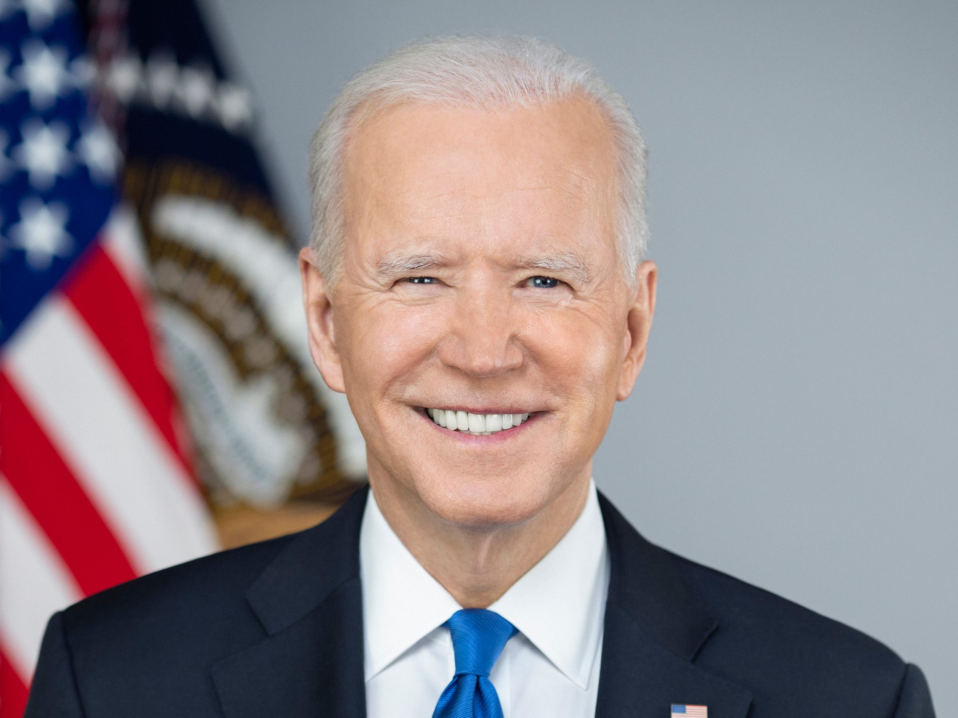
United States President (46)
Joe Biden (D)

Slide 9
Constitutional Powers of the President
National Security Powers—commander in chief of armed forces, treaty-maker with other nations (with Senate confirmation), nomination of ambassadors, receiving ambassadors from other nations
Legislative Powers—presenting information in the State of the Union, recommending legislation to Congress, convene both houses of Congress, adjourn Congress, veto legislation
Administrative Powers— execute the laws, nominate certain government officials, request opinions of officials, fill administrative vacancies
Judicial Powers—grant reprieves and pardons for federal offences, nominate federal judges (with Senate confirmation)

Slide 10
Running the Government:
The Chief Executive
As Chief Executive, the president presides over the administration of government.
  Constitution: “take care that the laws be faithfully executed”
  Today, federal bureaucracy spends $2.8 trillion a year and numbers more than 4 million employees.
  Presidents appoint 500 high-level positions and 2,500 lesser jobs.

Slide 11
Running the Government:
The Chief Executive
The Vice President
  Basically just “waits” for things to do
  Power has grown over time, as recent presidents have given their VPs important jobs
The Cabinet
  Presidential advisors, not in Constitution
  Made up of 14 cabinet secretaries and one Attorney General, confirmed by the Senate

Slide 12
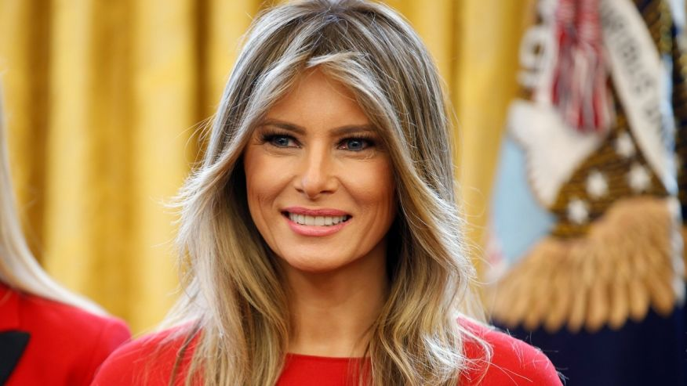
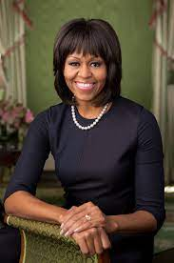
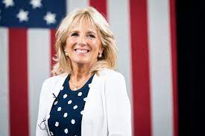
First Lady
  No official government position, but many get involved politically
  Recent ones focus on a single issue

Slide 13
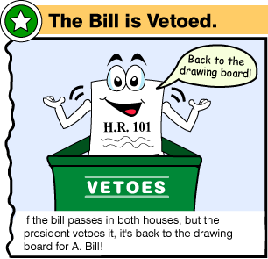
Presidential Leadership of Congress: The Politics of Shared Powers
Chief Legislator
  Veto: Sending a bill back to Congress with the reasons for rejecting it. Can be overridden.
  Pocket Veto: Letting a bill die by not signing it in 10 days when Congress is adjourned.
  Line Item Veto: The ability to veto parts of a bill. Some state governors have it, but not the president. The president must sign or veto all of a bill.

Slide 14
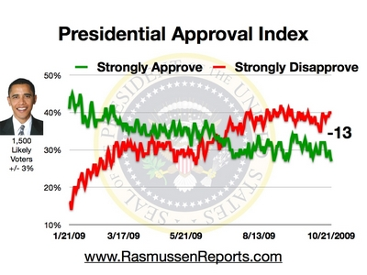
Presidential Leadership of Congress: The Politics of Shared Powers
Mandates
    Perception that the voters strongly support the president’s leadership and policies
    Mandates are infrequent, but presidents may claim a mandate anyway

Slide 15
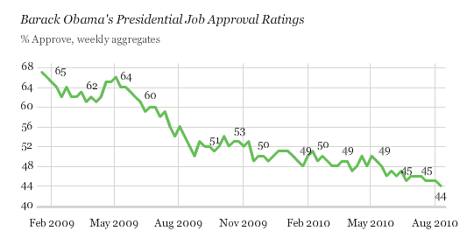
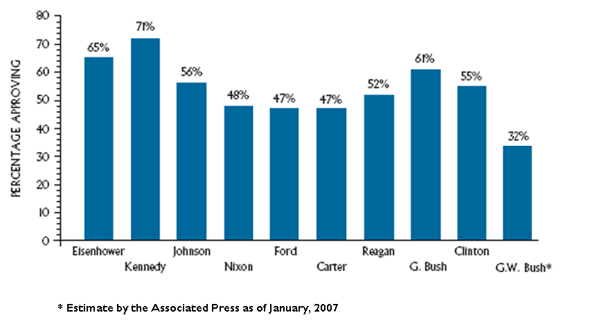
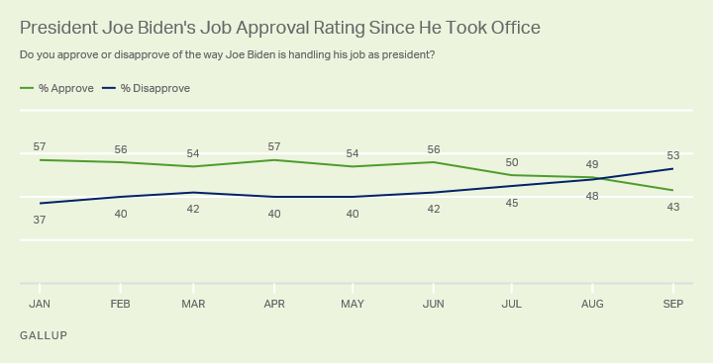
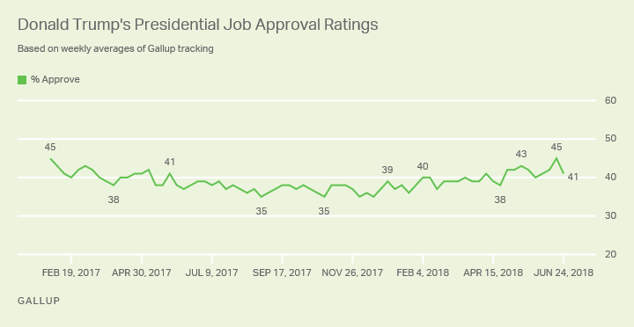
Approval Ratings

Slide 16
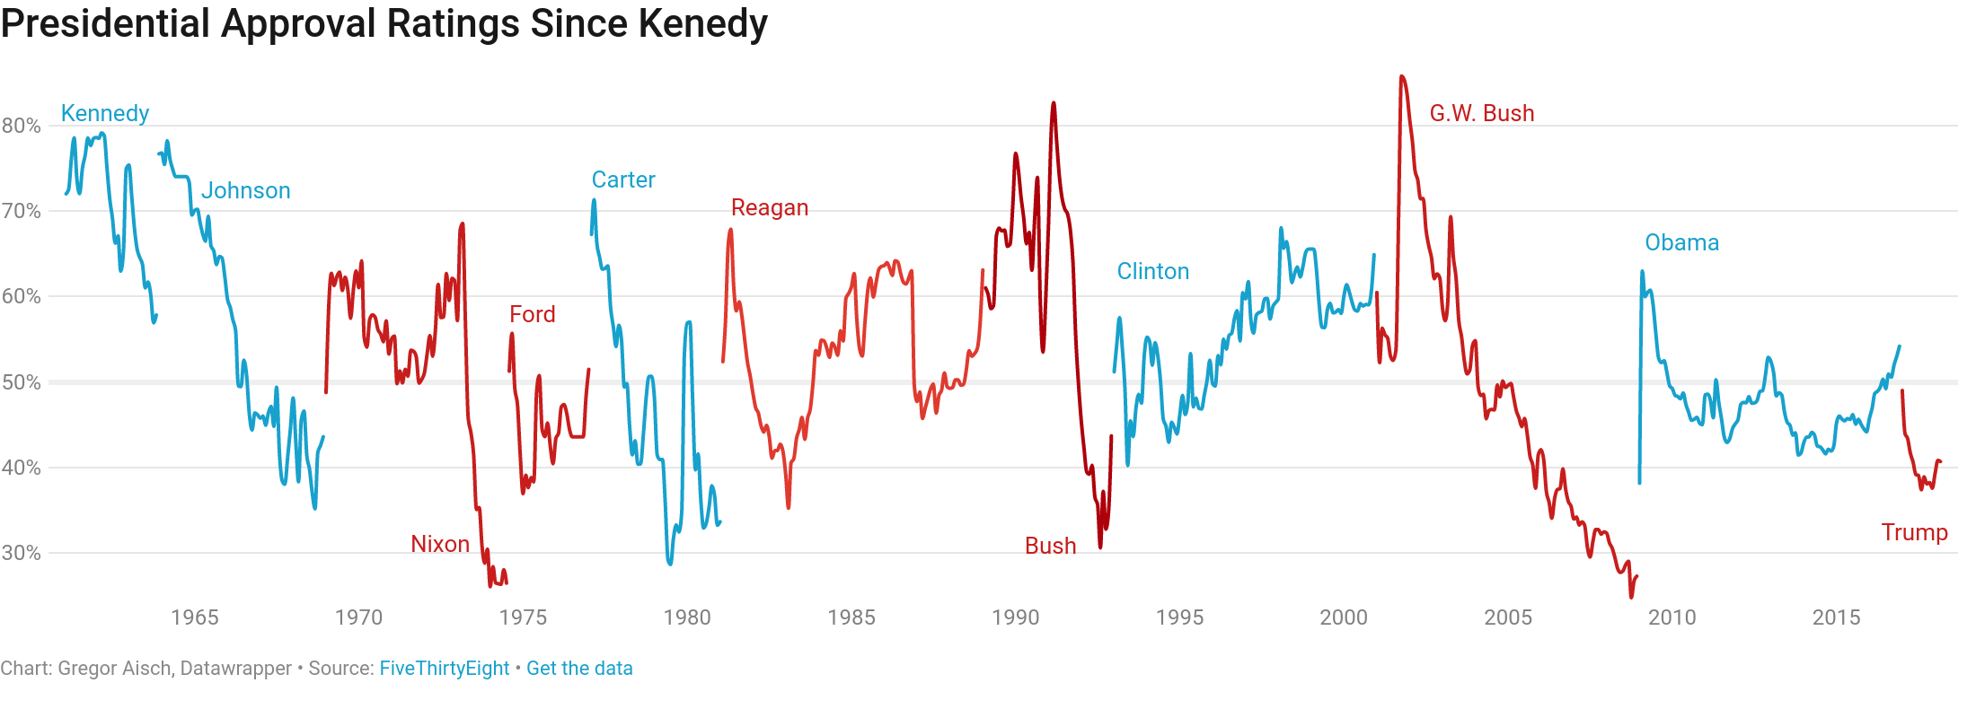
Approval Ratings

Slide 17
Power from the People:
The Public Presidency
Presidents have three audiences they must communicate with.
  Politicians in D.C.
  Party members and leaders.
  The public
Presidential Approval
  Receives much effort by the White House
  Product of many factors: war, the economy, the “honeymoon” period
  Changes can highlight good / bad decisions

Slide 18
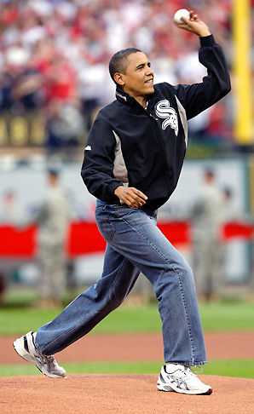
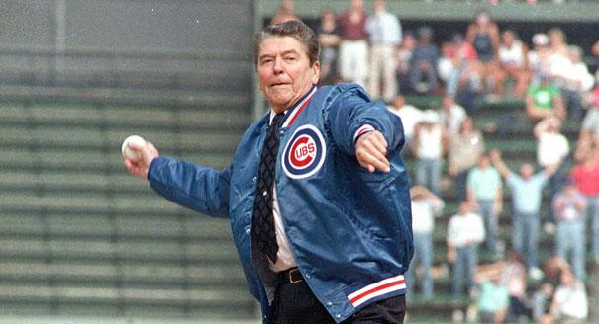
Power from the People:
The Public Presidency
Going Public
  Public support is perhaps the greatest source of influence a president has.
  Presidential appearances are staged to get the public’s attention.
  As head of state, presidents often perform many ceremonial functions- which usually result in favorable press coverage.

Slide 19
Power from the People:
The Public Presidency
Going Public
  Public support is perhaps the greatest source of influence a president has.
  Presidential appearances are staged to get the public’s attention.
  As head of state, presidents often perform many ceremonial functions, which usually result in favorable press coverage.

Slide 20
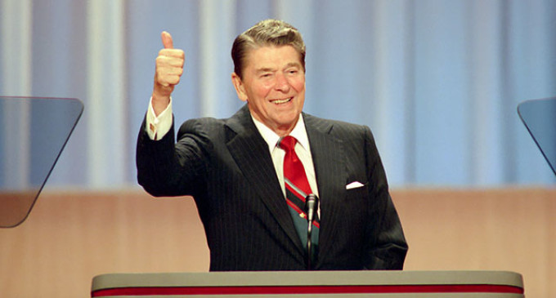
Bully Pulpit
Manage a crisis
Demonstrate leadership
Announce appointment of cabinet members and Supreme Court Justices
Set and clarify the national agenda
Achieve a legislative agenda
Announce foreign policy initiatives

Slide 21
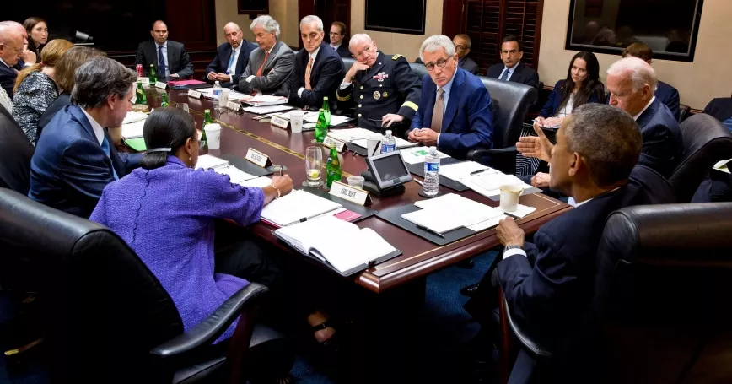
The President and National Security Policy
Commander in Chief
  Writers of the Constitution wanted civilian control of the military
  Presidents often make important military decisions
  Presidents command a standing military and nuclear arsenal
  Presidents can deploy troops without congressional consent.

Slide 22
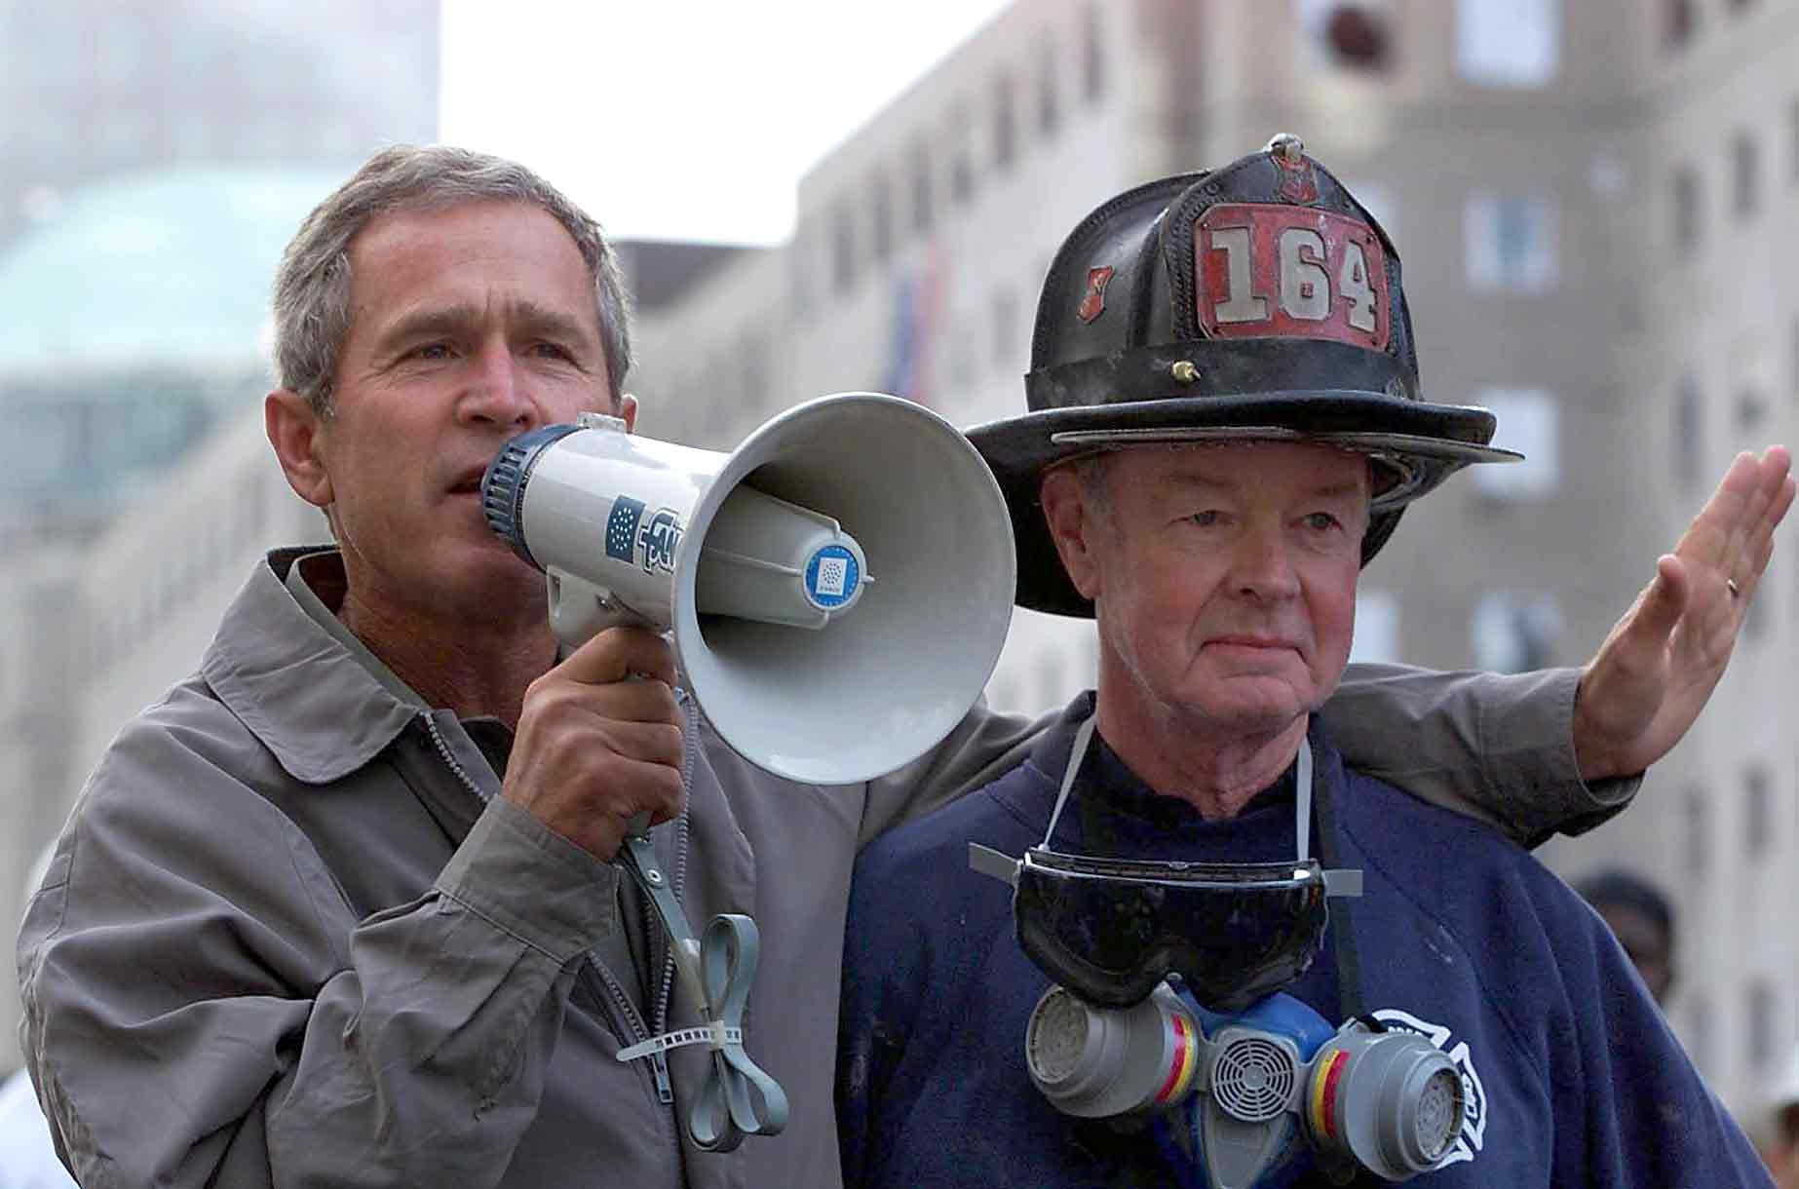
The President and National Security Policy
Crisis Manager
  The role the president plays can help or hurt the presidential image.
  With current technology, the president can act much faster than Congress to resolve a crisis.
Working with Congress
  President has lead role in foreign affairs.
  Presidents still have to work with Congress for support and funding of foreign policies.
Link to Bullhorn Speech

