Slide 1
Foreign Policy
Mr. Morales

Slide 2
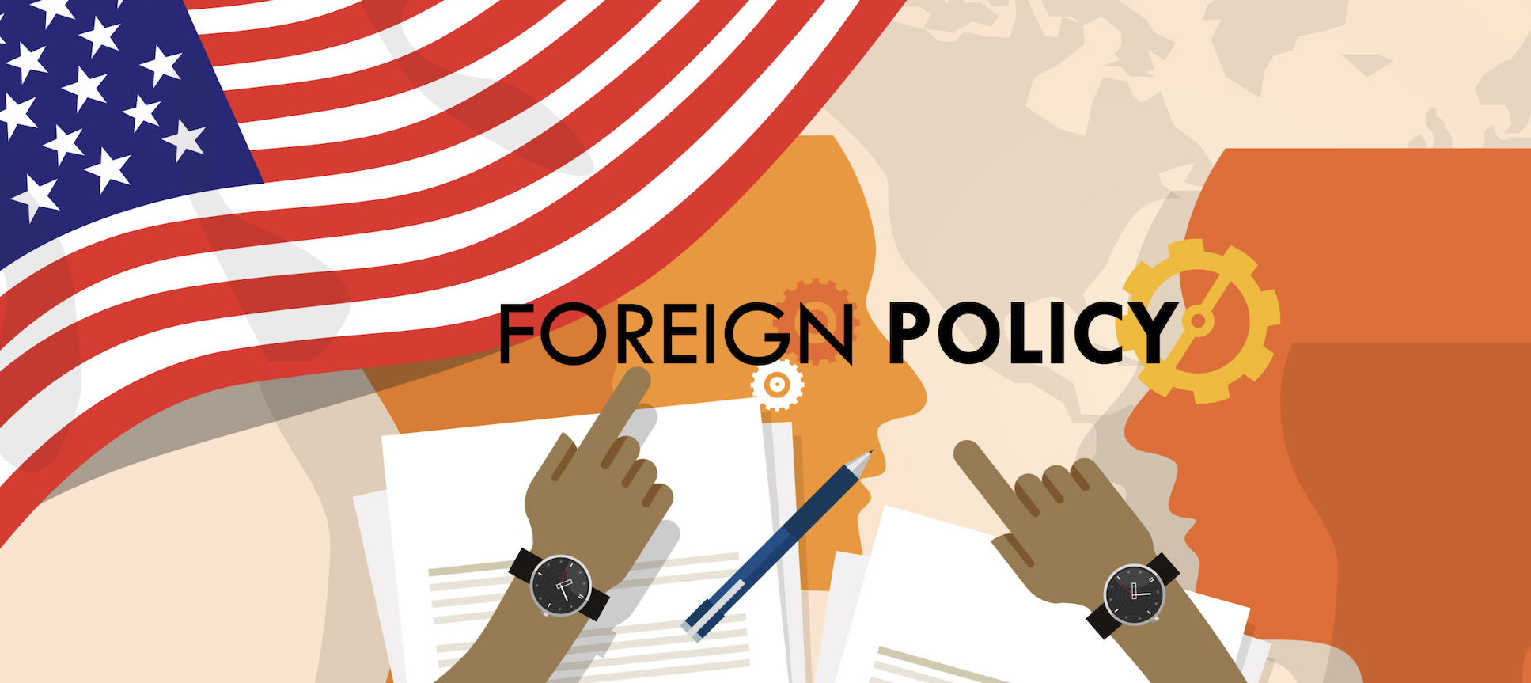
Instruments of Foreign Policy
Instruments of Foreign Policy
Military
Economic
Diplomacy
Foreign policy: The general plan followed by a nation in defending and advancing its national interests, especially its security against foreign threats
Is often directed for the purpose of ensuring national security
The four main objectives of U.S. foreign policy are:
The protection of the United States and its citizens and allies
The assurance of continuing access to international resources and markets
The preservation of a balance of power in the world
The protection of human rights and democracy

Slide 3
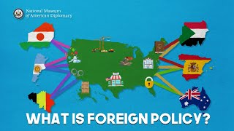
What Is Foreign Policy?
Notes:
https://youtu.be/oSHIICl_AkY?si=rVPMSLiDPhFUGpC0

Slide 5
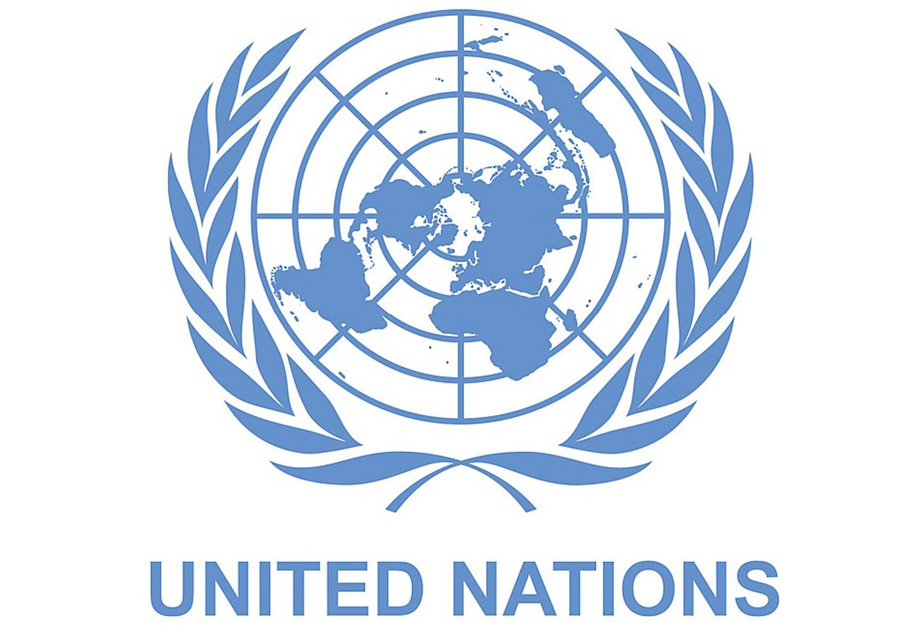
Military
United Nations: An international organization formed after WWII to promote international peace, security, and co operation
Governments forming military alliances with foreign states in order to deter and show stronger resistance to attack.
Foreign policy also focuses on combating adversarial states through:
Soft power
International isolation
War
Military Diplomacy: is the organization of working visits of the representatives of the defence authorities

Slide 6
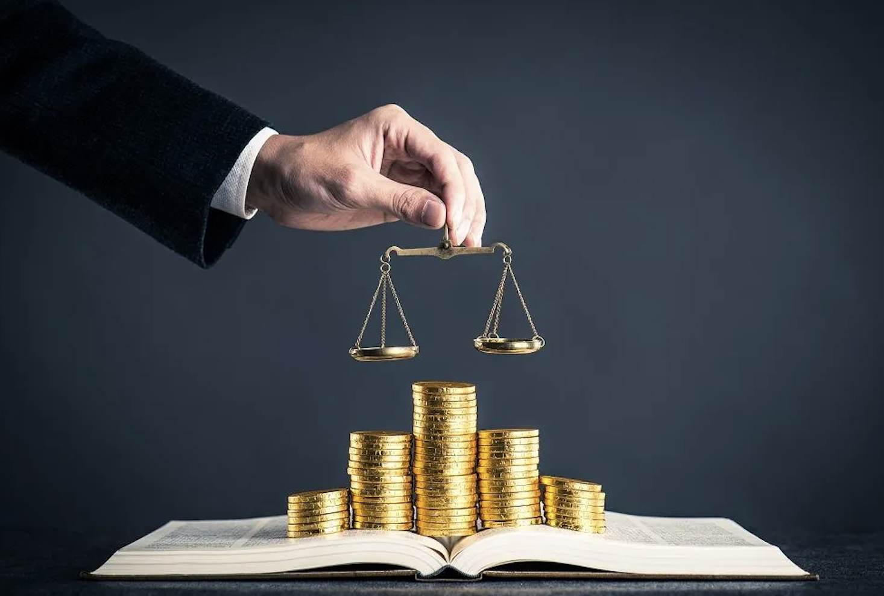
Economic
Foreign policy is central for a country's role within the world economy and international trade
Foreign economic policy involves the mediation and management of economic flows across borders
One of the major goals of the U.S. economic foreign policy is to create Trade Agreements
The economic foreign policy of the United States through the years has been to promote free trade in the world
Economic foreign policy issues may include:
The establishment of trade agreements
The distribution of foreign aid
The management of imports and exports

Slide 7
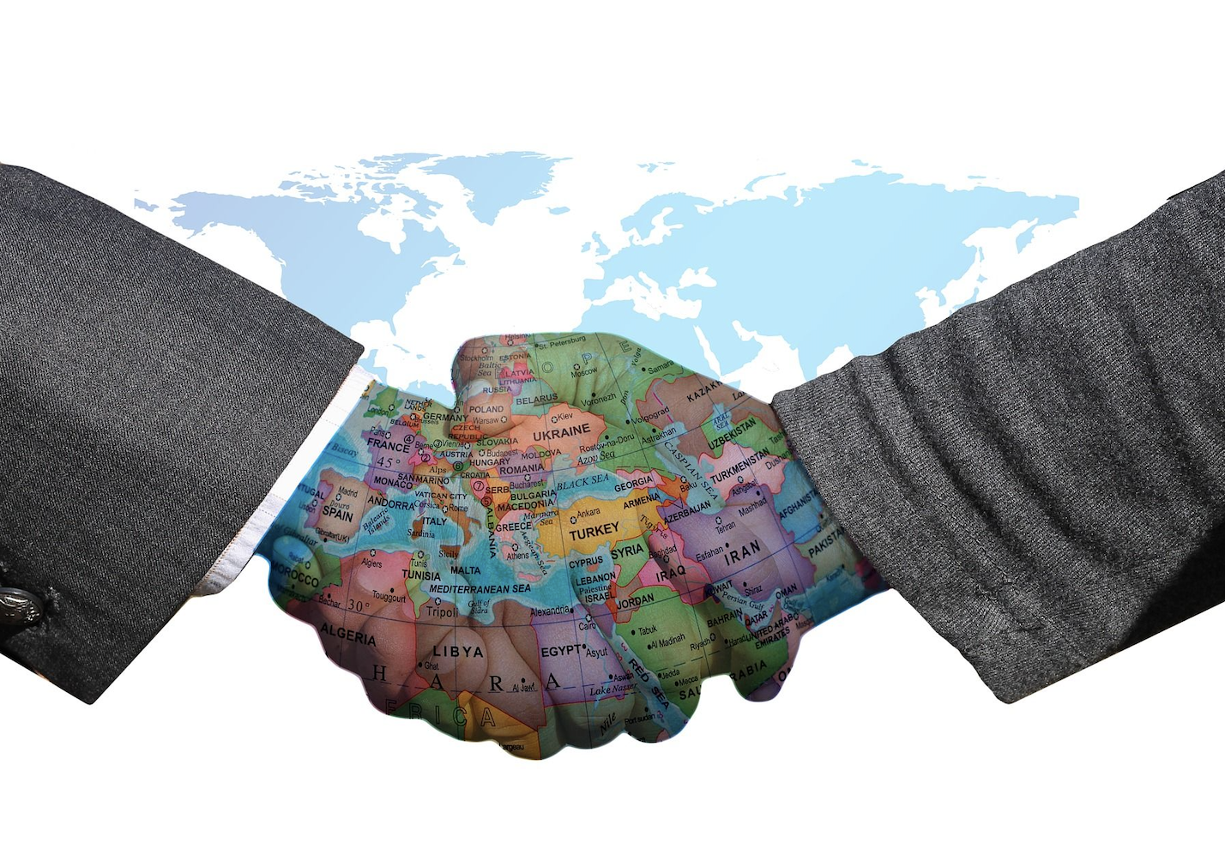
Diplomacy
Diplomacy is maintaining peaceful relationships between Nations, Groups, or Individuals
Diplomacy refers to representatives of different groups discussing such issues as:
Conflict
Trade
The environment
Technology
Security
Why is diplomacy important in foreign policy?
They conduct negotiations between representatives
It’s an important tool of foreign policy to influence the decisions through dialogue, negotiation, and other nonviolent means

Slide 8
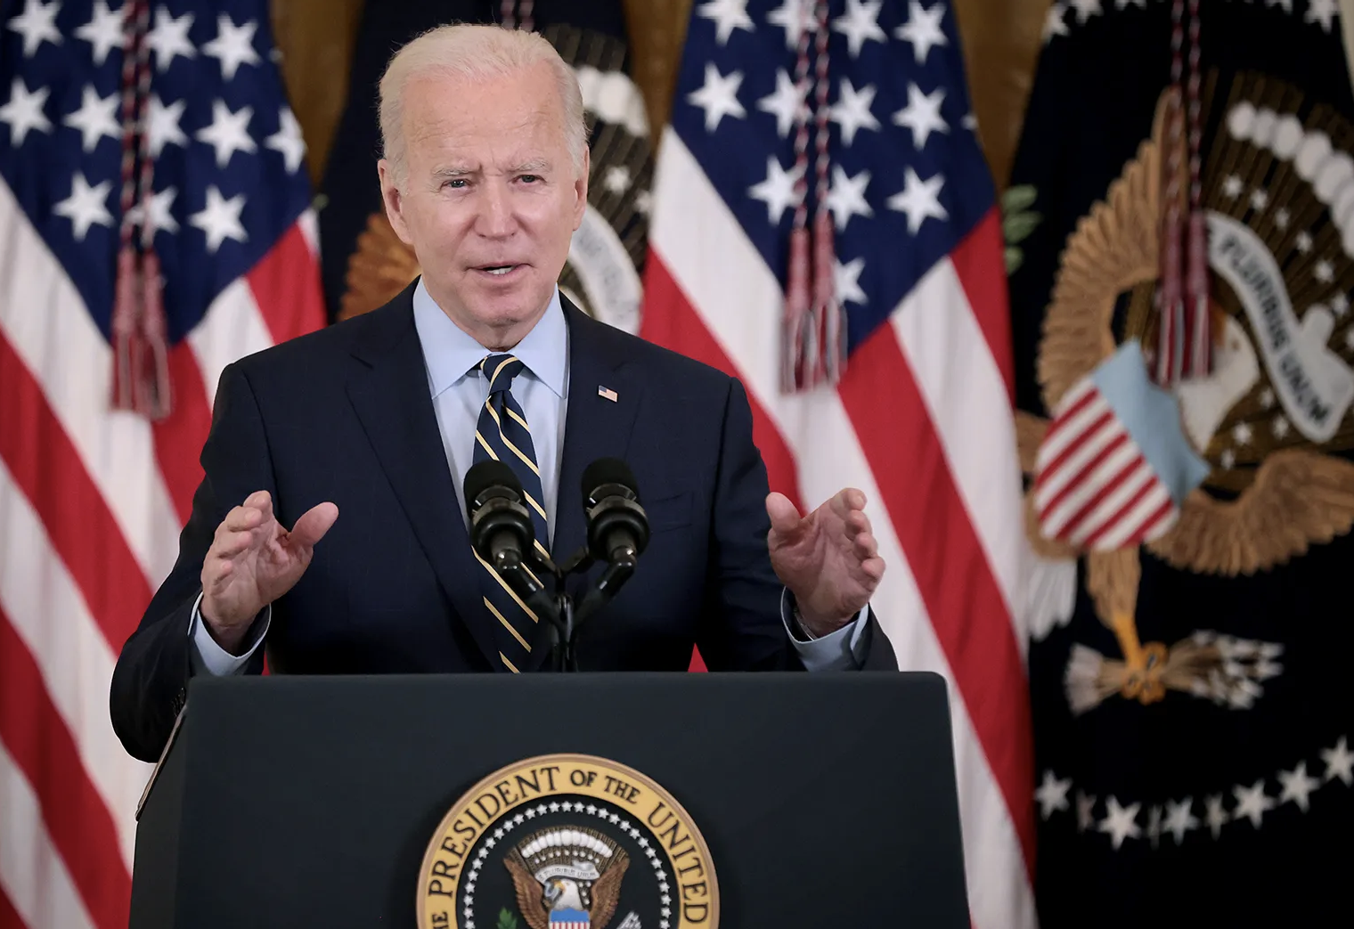
Presidential authority in Foreign Policy
Commander-in-chief of the armed forces
Power to make treaties (with advice and consent of the Senate)
Appoint U.S. ambassadors and the heads of executive departments (also with advice and consent of the Senate)
Receive (or refuse) ambassadors from other countries
When the President seeks congressional approval for foreign policy issues, they tend to win more often than when they ask about domestic issues

Slide 9
Presidential authority in Foreign Policy
Diplomats (including advisors to the President)
Are responsible for overseeing international relations regarding:
Peace deals
Trade and economics
Culture
Human rights
The environment
Their work also includes:
Negotiating treaties and international agreements, long before politicians endorse them.
Roles involved:
President
Secretary of Defense
Joint Chiefs of Staff (Made up of the top leader of each branch of the military)
CIA and FBI
Congress

Slide 10
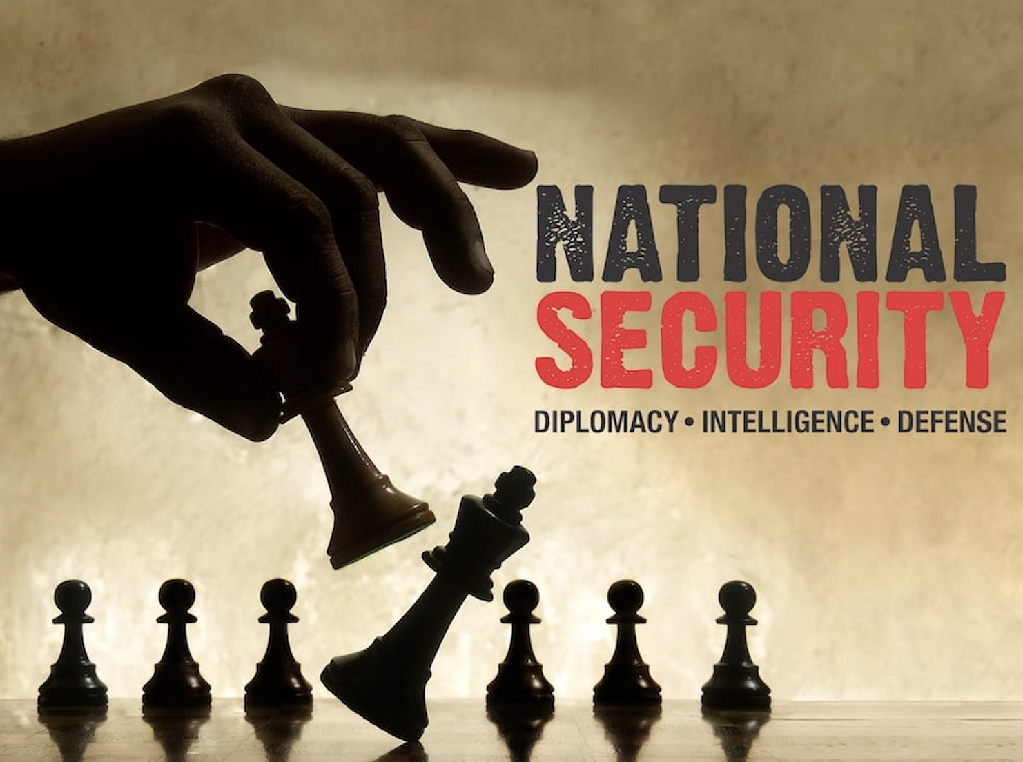
National Security Establishment
The National Security Act of 1947: mandated a major reorganization of the foreign policy and military establishments of the U.S. Government
The act created many of the institutions that Presidents found useful when formulating and implementing foreign policy, including the National Security Council (NSC).
National Security Council (NSC): functions as an advisory group to the president and works to serve as the president's principal arm for coordinating policies among various government agencies.

Slide 11
National Security
United States as Actors on the World Stage
The major actors in foreign policy are:
The President and Congress
Although the Supreme Court, interest groups, and public opinion all influence foreign policy decisions to a degree
The president's advantage over Congress lies in the ambiguity in the Constitution

Slide 12
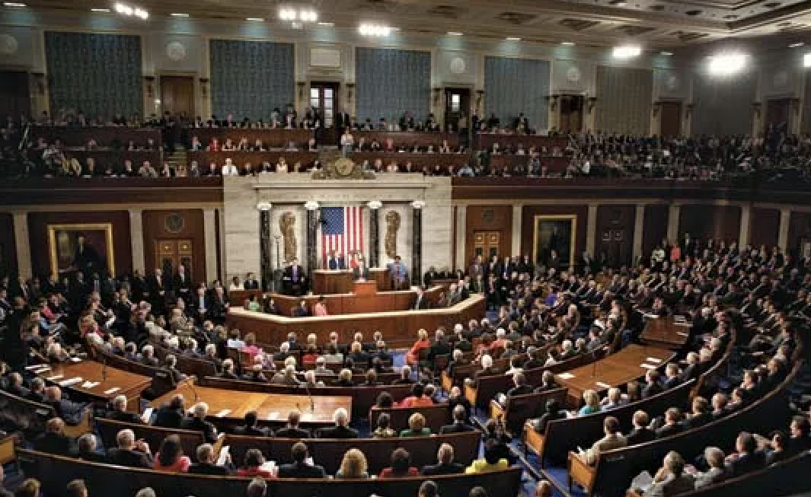
Congressional authority in Foreign Policy
Legislate
Declare war
Raise revenue and dispense funds
Support, maintain, govern, and regulate the army and navy
Call out state militias to repel invasions
Regulate international commerce
Define and punish piracy and offenses against the law of nations
When interest groups are involved, Congress plays a larger role

Slide 13
The War Powers Act
The War Powers Act: Passed in 1973 over a Presidential veto
This law placed restrictions on the President’s ability to use military force:
The President must report in writing to Congress within 48 hrs after introducing U.S. troops into hostile areas
Within 60 days after troops are in hostile situations, Congress must provide for the continuation of hostile action by U.S. troops
If Congress fails to provide, the President must withdraw the troops
If Congress passes a concurrent resolution (President cannot veto) directing the removal of U.S. troops, the President must comply

Slide 14
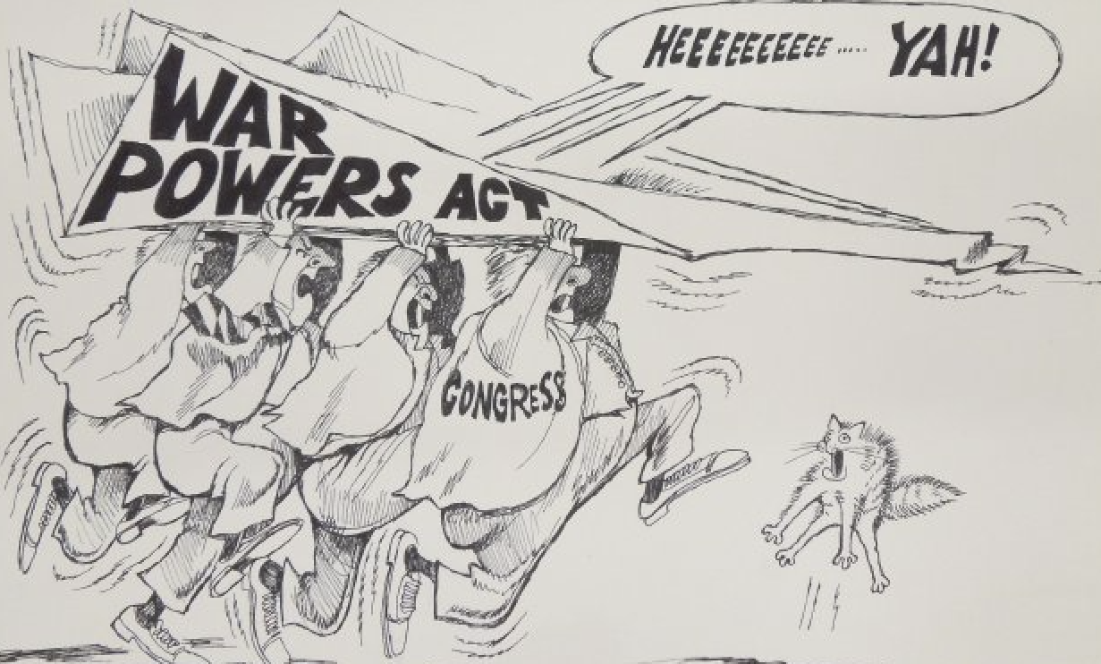
The War Powers Act
Since its passage, every President has sent American forces abroad without any explicit congressional authorization:
Ford
Carter
Reagan
George H. W. Bush
Clinton
George W. Bush
Obama

Slide 15
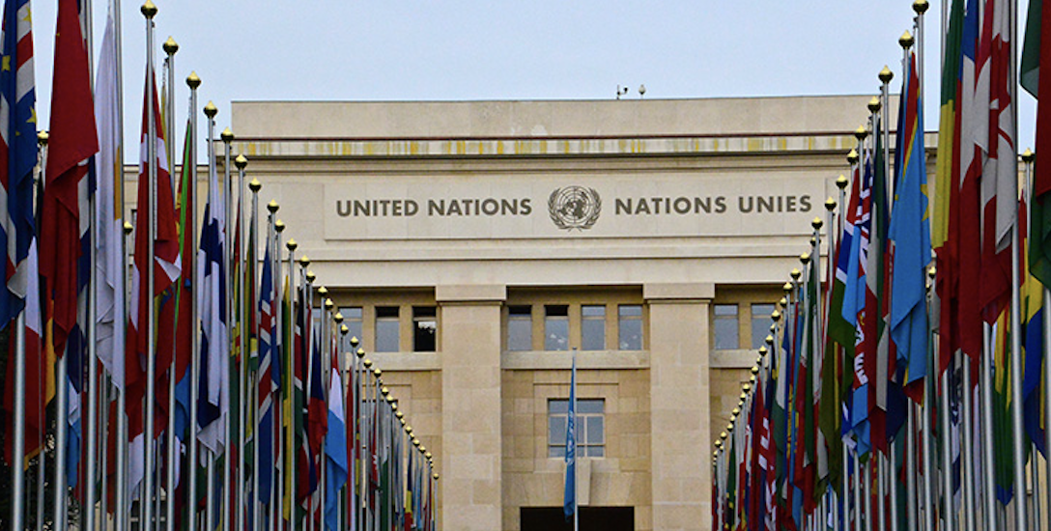
United Nations
What is the role of the United Nations in policy?
Maintain International Peace and Security
Protect Human Rights
Deliver Humanitarian Aid
Support Sustainable Development
Climate Action
Created in 1945, an organization whose members agree to renounce war and to respect certain human and economic freedoms
The seat of real power in the United Nations is the Security Council
Security Council has the power to make decisions that member states are then obligated to implement

Slide 16
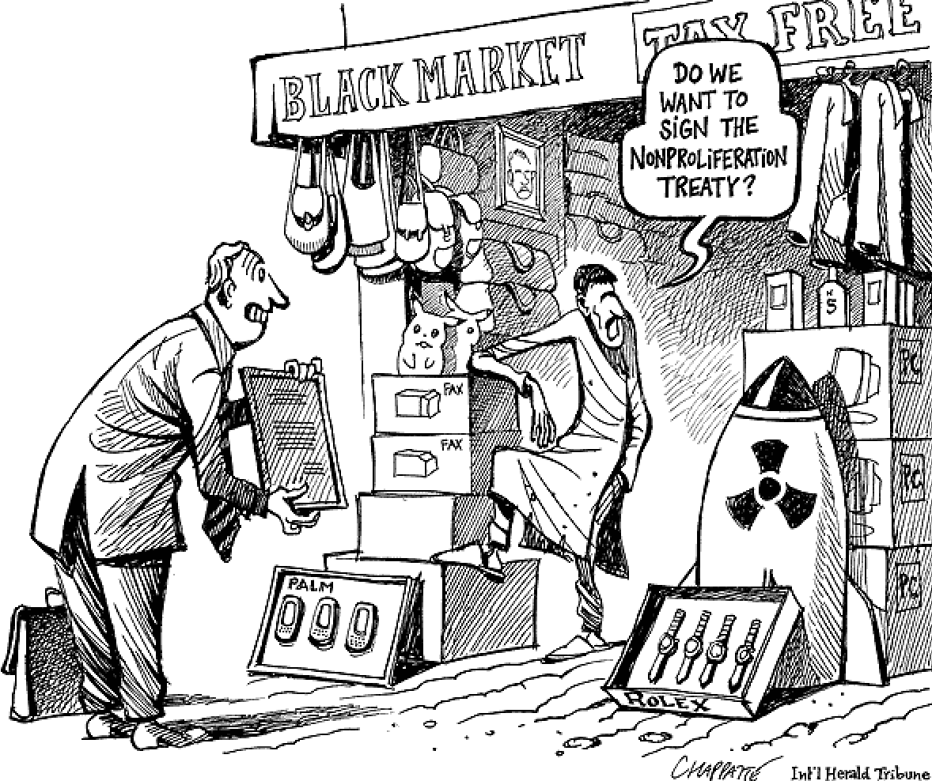
Nuclear Proliferation
Nuclear Proliferation: the spread of nuclear weapons, nuclear weapons technology, or fissile material to countries that do not already possess them
Only a few countries have known nuclear weapon capabilities
Fear that other “rogue” countries will have nuclear weapons capabilities and use them against their neighbors or the U.S.
The U.S. will focus on discouraging the deployment of developed nuclear weapons

Slide 17
The International Economy
Interdependency: a situation, brought by specialization and/or limited resources, in which nation-states rely on one another for economic resources, goods, and services and political assets such as security and stability
International trade: is an exchange involving a good or service conducted between at least two different countries
The exchanges can be imports or exports
Since World War II, U.S. trade policy has generally sought to advance U.S. economic growth and competitiveness by reducing international trade and investment barriers

Slide 18
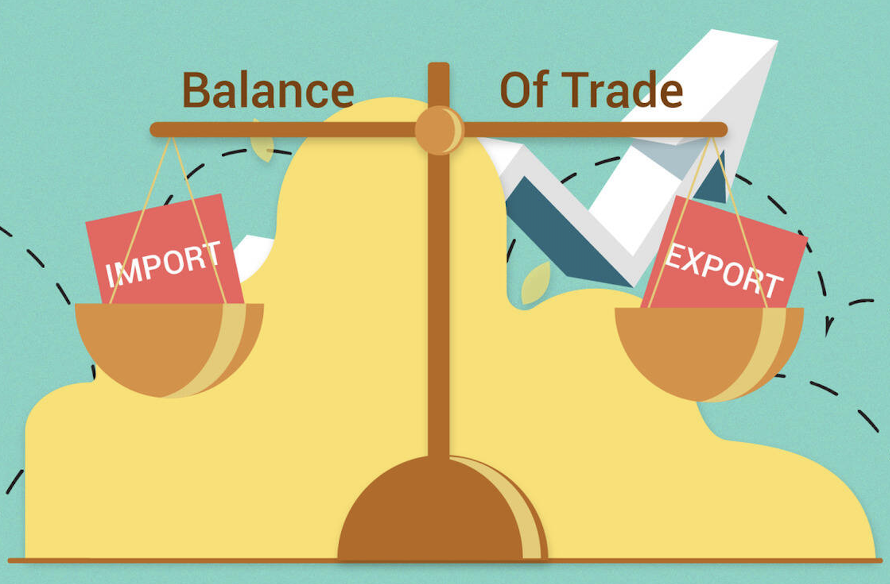
The International Economy
Tariffs: a tax on imported goods to raise the price, thereby protecting American businesses and workers
Congress approved the Central American-Dominican Republic Free Trade agreement in 2005
Balance of Trade: This is the difference between the value of exports and imports to a specific country's economic output over a set period of time
Ratio of what is paid for imports to what is earned for exports

Slide 19
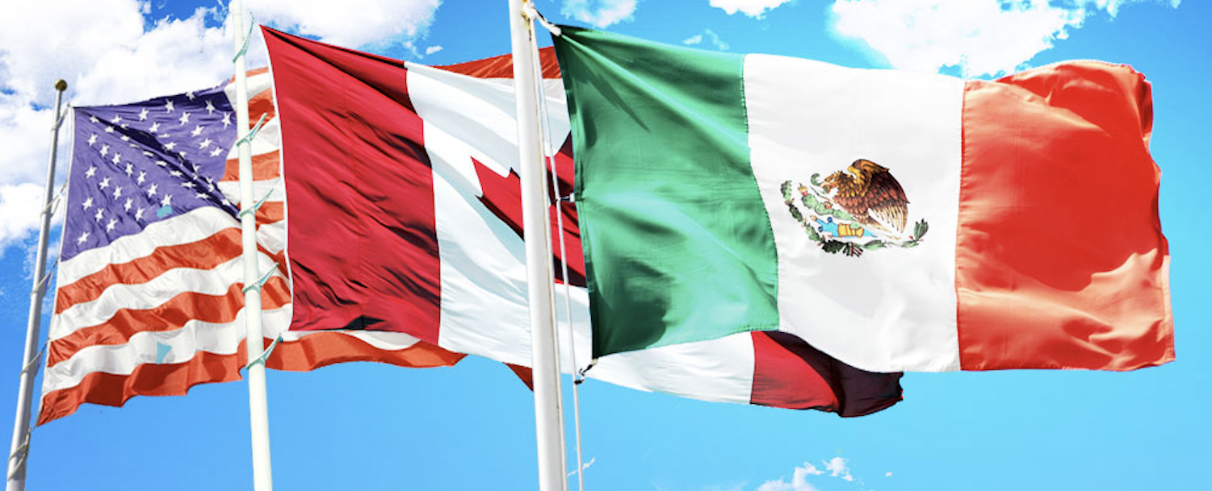
North American Free Trade Agreement
North American Free Trade Agreement (NAFTA): established a free-trade zone in North America
It was signed in 1992 by Canada, Mexico, and the United States and took effect on Jan. 1, 1994
NAFTA immediately lifted tariffs on the majority of goods produced by the signatory nations
The goal of NAFTA is to eliminate all tariff and non-tariff barriers of trade and investment between the United States, Canada and Mexico

Slide 20
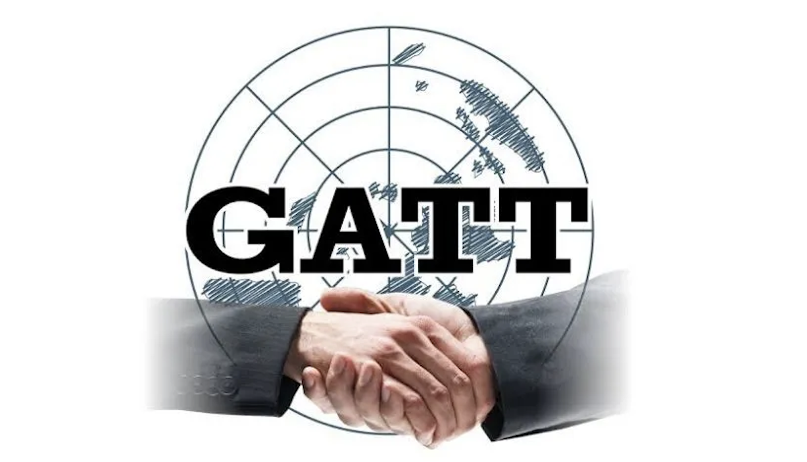
General Agreement on Tariffs and Trade
General Agreement on Tariffs and Trade (GATT): which was signed in 1947, is a multilateral agreement regulating trade among 153 countries
Was setup to eliminate protectionism
Get countries trading freely among themselves
Help restore economic prosperity following World War II
NAFTA and GATT are ways to lower tariffs and increase trade

Slide 21
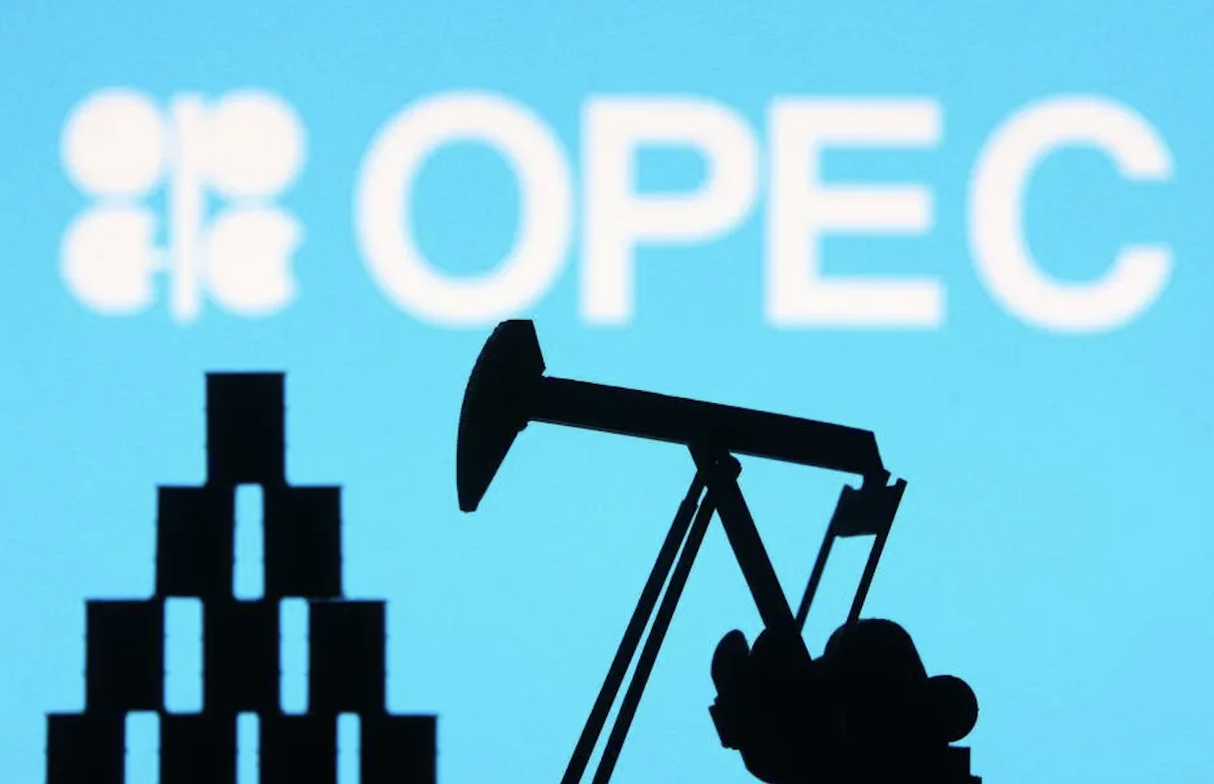
Energy
America depends on imported oil, about 60 percent, but not as much as other countries like Japan
Much of the recoverable oil is in the Middle East which is often the site of military and economic conflicts.
Organization of Petroleum Exporting Countries (OPEC): controls the price of oil and amount its members produce and sell to other nations
Is a permanent intergovernmental organization of 12 oil-exporting developing nations that coordinates and unifies the petroleum policies of its Member Countries

Slide 22
Foreign Aid
Foreign aid is used to stabilize nations friendly to the United States.
A substantial percentage of foreign aid is military.
Foreign aid has never been very popular with Americans and is typically cut by Congress

Slide 23
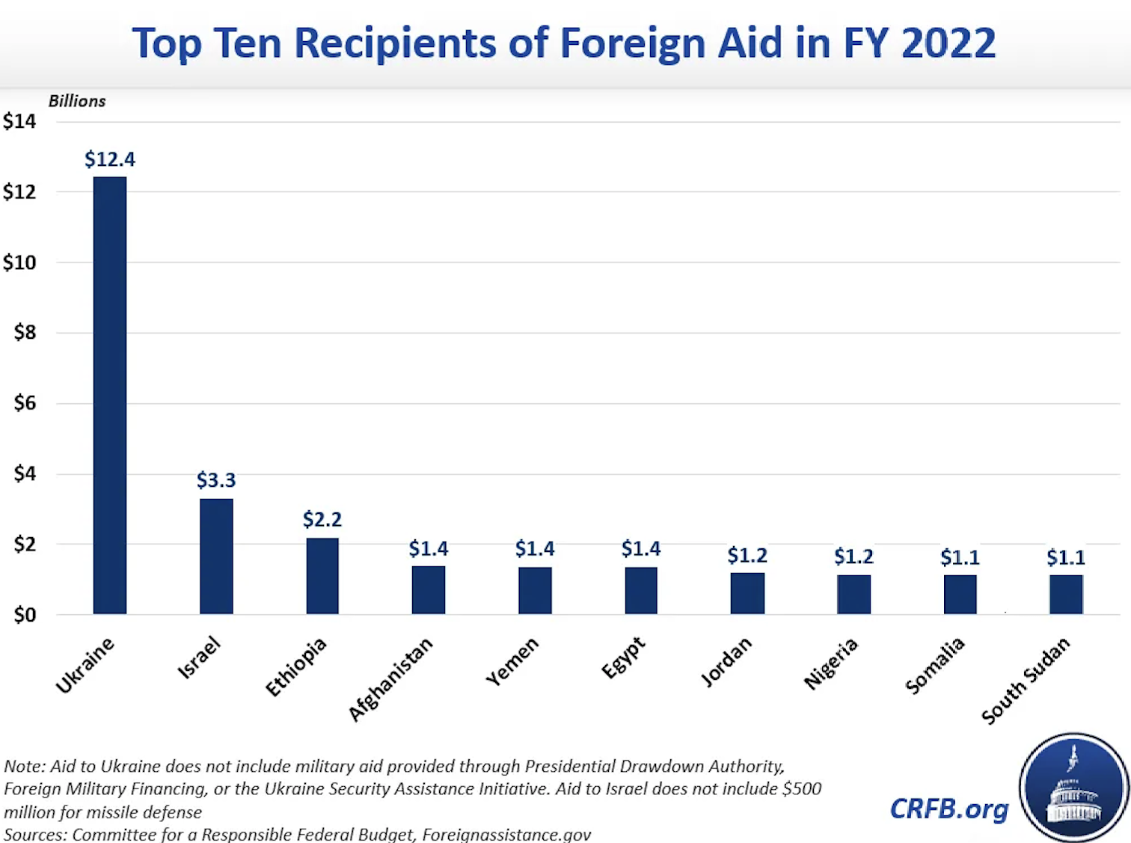

Slide 24
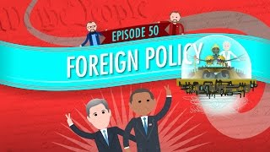
Foreign Policy: Crash Course Government and Politics #50
Notes:
https://youtu.be/PMhIQNkO_Y0?si=oopmemikgLQAZsK_

Slide 25
Exit Ticket
After learning about the Economic, Social Welfare, Environmental, and Foreign Policies, write one paragraph about what you’ve learned from each policy.

