Slide 1
Unit 4:
Political Ideology
Spring 2020

Slide 2
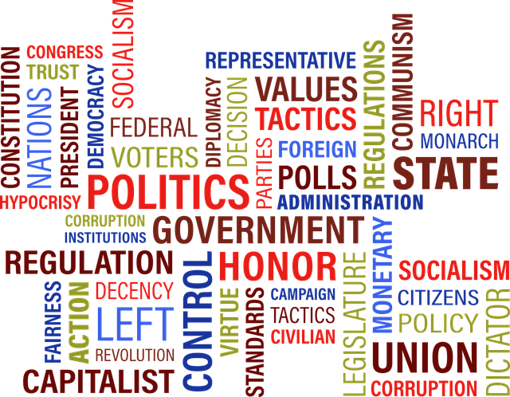
Vocabulary
Political Ideology: A more or less consistent set of beliefs about what policies the government ought to pursue.

Slide 3
Vocabulary - Cont.
Liberal: Support for greater government control/regulation in economic matters and less government control/regulation of individual matters.
Libertarian: Support for minimal government control of both economic and social issues.
Conservative: Support for less government control/regulation in economic matters and greater government control/regulation of individual matters.
Authoritarian: Support for greater government control of economic and social issues.

Slide 4
Vocabulary - Cont.
Anarchy: Absence of government. A state of lawlessness or political disorder due to the absence of governmental authority.
Theocracy: Government of a state by immediate divine guidance or by officials who are regarded as divinely guided.
Fascism: A political philosophy, movement, or regime (such as that of the Fascisti) that exalts nation and often race above the individual and that stands for a centralized autocratic government headed by a dictatorial leader, severe economic and social regimentation, and forcible suppression of opposition.

Slide 5
Vocabulary - Cont.
Socialism: A form of rule in which the central government plays a strong role in regulating existing private industry and directing the economy, although it does allow some private ownership of productive capacity.
Communism: A political system in which, in theory, ownership of all land and productive facilities is in the hands of the people and all goods are equally shared; the production and distribution of goods are controlled by an authoritarian government public goods.

Slide 6
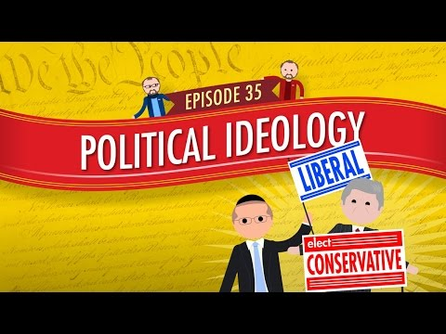
Political Ideology: Crash Course #35

Slide 7
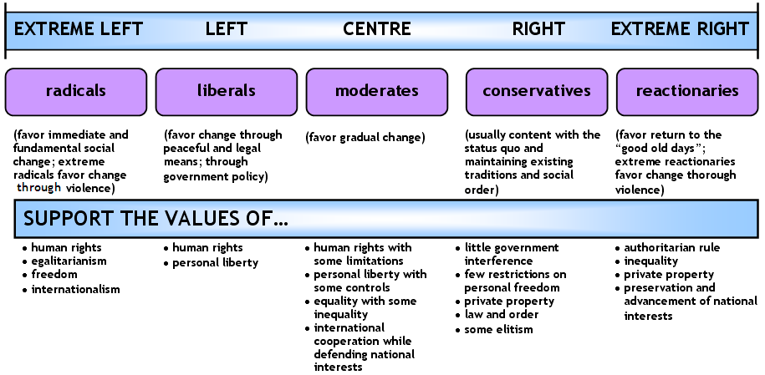
The Political Spectrum as a Straight Line

Slide 8
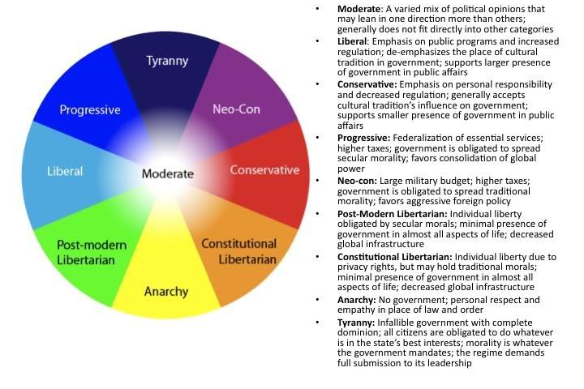
The Poticical Wheel

Slide 9
Social/Political Spectrum
Extreme: Anarchy
Social and political liberals favor limited government regulation of individual behavior.
Examples:
  Favor protection of offensive language.
  Oppose censorship of film, music, etc.
  Pro-choice abortion stance.
  Oppose government sponsored religious activity.
  Favor protection of homosexual rights.
  Favor affirmative action programs.
Extreme: Fascism, Theocracy
Social and political conservatives favor broad government regulation of individual behavior
Examples:
  Oppose protection of offensive language.
  Favor regulation of film, music, etc.
  Pro-life abortion stance.
  Favor government-facilitated religious activity, particularly in school.
  Oppose protection of homosexual rights.
  Oppose affirmative action programs.

Slide 10
Economic Spectrum
Extreme: Socialism, Communism
Economic liberals favor broad government involvement in economic policymaking and regulation of business.
Favor higher taxes, particularly progressive (based on income level).
Programs assisting the poor such as Medicaid and Head Start.
Redistribution of income (welfare; social security).
Anti-trust legislation.
Sympathize with labor in Labor-Management issues.
Extreme: Laissez-Faire, Monopoly
Economic conservatives favor limited government involvement in economic policymaking and regulation of business.
Favor lower taxes, particularly regressive (flat tax, sales taxes).
Fewer programs with the goal of redistributing income (private charitable assistance; invest own money for retirement).
Oppose government regulation of market choices.
Sympathize with business in Labor-Management issues.

Slide 11
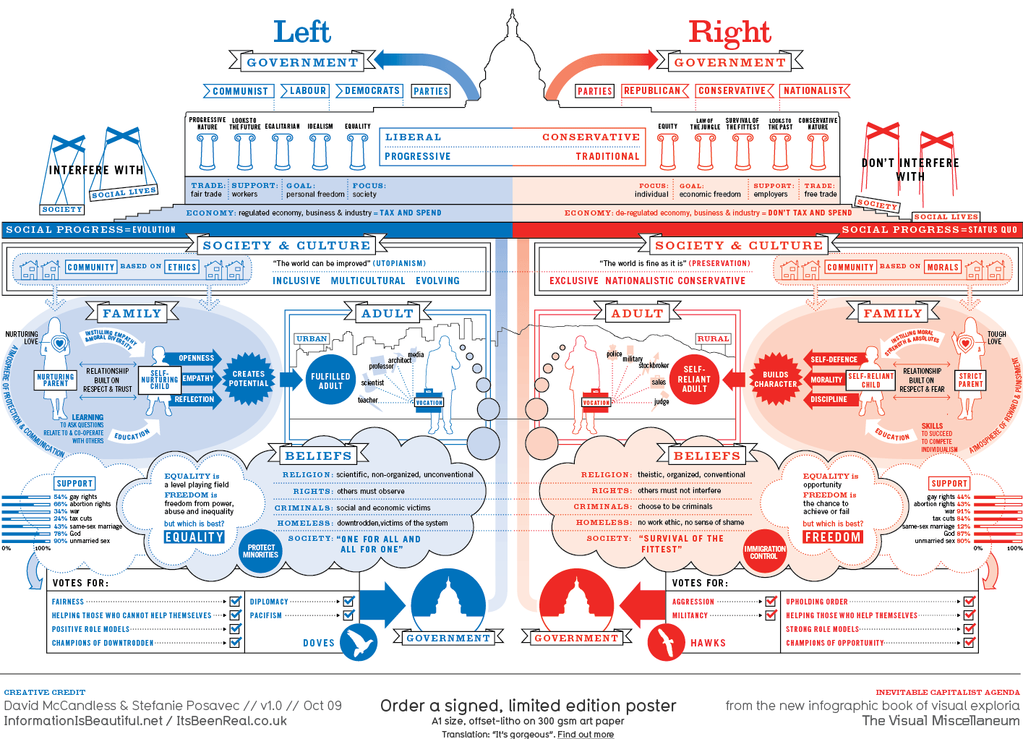
So, Where Do You Fit?

Slide 12
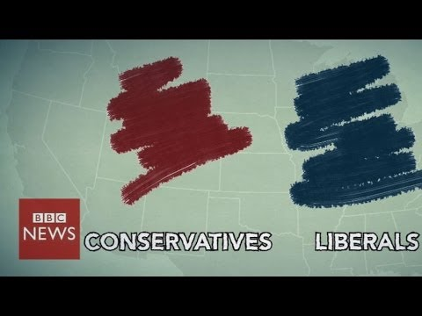

Slide 13
Ideology Grid
Govt.
Control
Liberal
Authoritarian
Economic Issues
Libertarian
Conservative
Govt.
Control
Freedom
Social Political Issues

Slide 14
Definitions
Liberal: Support for greater government control/regulation in economic matters and less government control/regulation of individual matters.
Libertarian: Support for minimal government control of both economic and social issues.
Authoritarian: Support for greater government control of economic and social issues.
Conservative: Support for less government control/regulation in economic matters and greater government control/regulation of individual matters.

Slide 15
View of the Constitution
Liberal
Favor loose construction – a broad interpretation.
Constitutional interpretation may change as modern society evolves.
What are our standards today?
Conservative
Favor strict construction – a narrow interpretation.
Constitutional interpretation should remain constant through the years.
What did the founders mean?

Slide 16
Tradition vs. Change
Community vs. Individual
Favor change over status quo
Favor tradition over change
Liberal
Conservative
Rights of the community are more important
Rights of the Individual are more important

Slide 17
Putting It Together
Label your grid with these voters in the appropriate places.
Ideology?
Voter A: “I worked my way up from poverty to become the successful business owner I am today. I get frustrated when I think that my tax money goes to support people who won’t help themselves. I think part of the blame belongs with the media – they promote all the wrong values.”
Govt.
Control
Liberal
Authoritarian
Economic Issues
Libertarian
Conservative
Govt.
Control
Freedom
Social Political Issues

Slide 18
Putting It Together - Cont.
Label your grid with these voters in the appropriate places.
Ideology?
Voter B: “I really don’t care what other people do in their free time, as long as they don’t bother me. I sure don’t like it when the government tells me what to do with my money or in my own home – I’m certainly not going to turn around and do the same thing to my neighbors.”
Govt.
Control
Liberal
Authoritarian
Economic Issues
Libertarian
Conservative
Govt.
Control
Freedom
Social Political Issues

Slide 19
Putting It Together - Cont.
Label your grid with these voters in the appropriate places.
Ideology?
Voter C: “I really worry about the state of the world today. It seems like more and more kids are growing up in poverty and there’s no one there to help them. I think we need to do more toward providing healthcare and education programs for our young people.”
Govt.
Control
Liberal
Authoritarian
Economic Issues
Libertarian
Conservative
Govt.
Control
Freedom
Social Political Issues

Slide 20
Putting It Together - Cont.
Label your grid with these voters in the appropriate places.
Ideology?
Voter D: “These days, you can’t be too careful. I think we need to spend a lot more money on the national defense. I wish there was a police officer on every corner! The police could search my car all they want, since I don’t break the law. I also think the government should crack down on the media – their reporting gives our enemies an inside look at all our military preparations.”
Govt.
Control
Liberal
Authoritarian
Economic Issues
Libertarian
Conservative
Govt.
Control
Freedom
Social Political Issues

Slide 21
Ideology Grid
Govt.
Control
Liberal
Authoritarian
Most people will fit somewhere within the parameters of this circle.
Economic Issues
Libertarian
Conservative
Govt.
Control
Freedom
Social Political Issues

Slide 22
Let’s Look at America
You will look at a series of charts and graphs on the following slides.
Your task will be to identify the trend you see in each graph and try to think of reasons why those trends exist.
Note to Teacher: You may have students work on this skill using a separate worksheet and then use the slides as review: That assignment is found here.

Slide 23
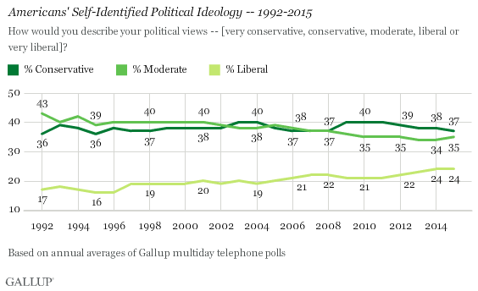

Slide 24
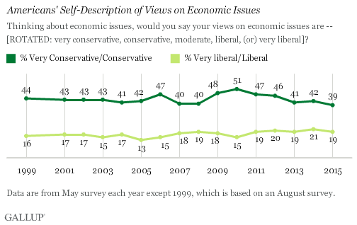

Slide 25
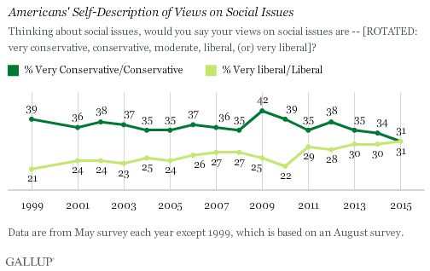

Slide 26
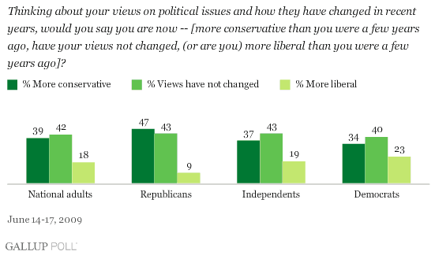

Slide 27
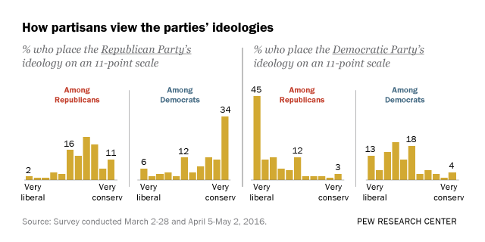

Slide 28
Why Does this Matter?
Ideology affects your perceptions of government and its appropriate role in a society.
As a result, it will affect how you act in the voting booth and outside the voting booth.
Elections have consequences!
Perceptions also affect our ability to act civilly to one another.

Slide 29
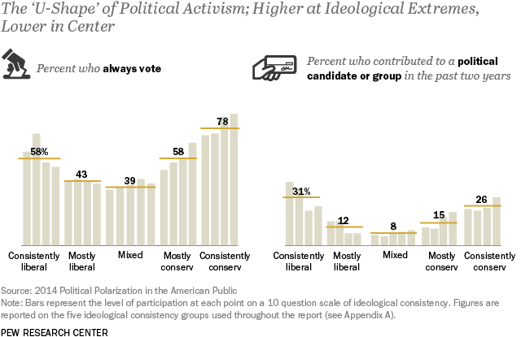

Slide 30
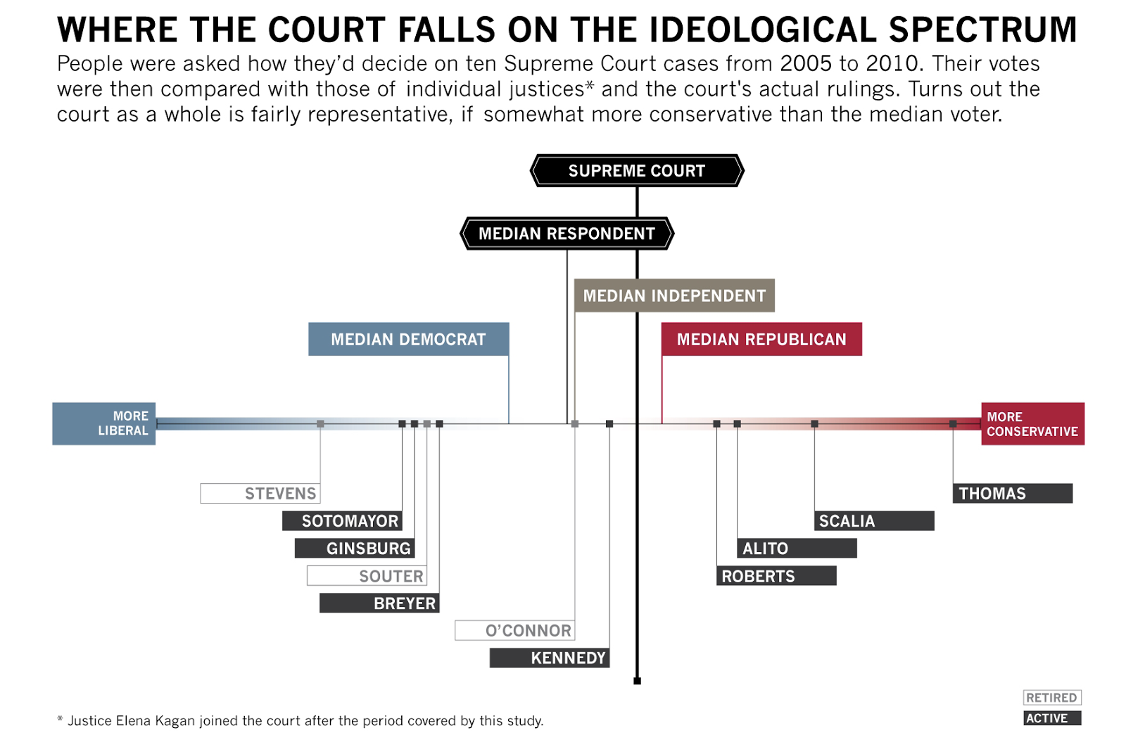

Slide 31
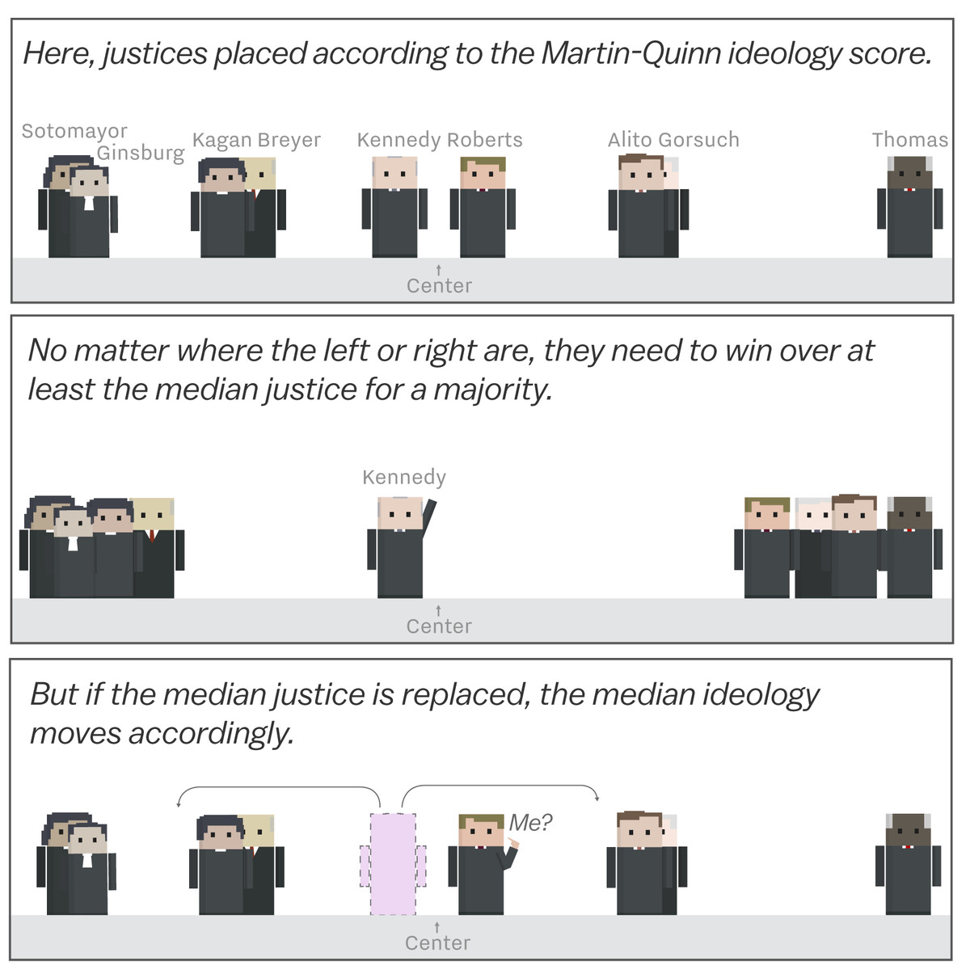

Slide 32
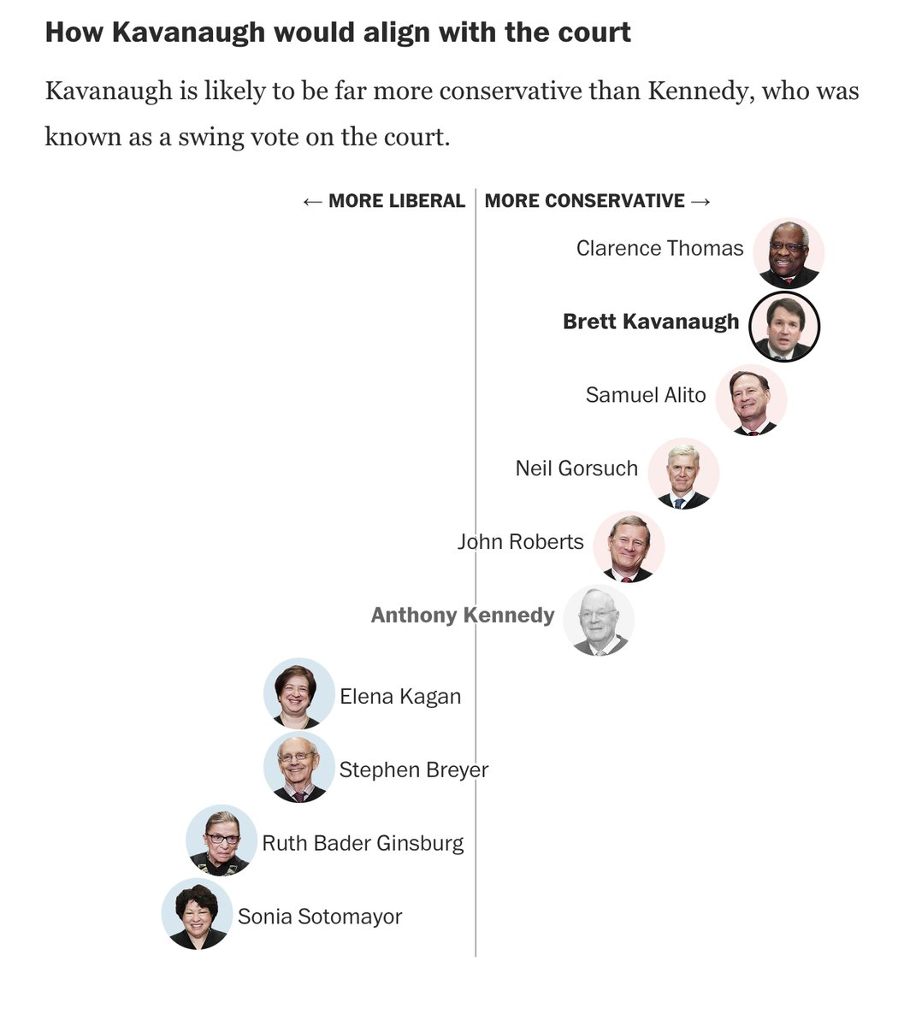

Slide 33
