Slide 1
Unit 4: Public Opinion & Political Participation
Spring 2020
Chapters 7 & 8

Slide 2
Vocabulary
Demography: The study of patterns and rates of population change, including birth and death rates, migration trends, and evolving population distribution patterns.
Census: A periodic and official count of a country's population.
Melting Pot: The mixing of cultures, ideas, and peoples that has changed the American nation.
Minority Majority: That America will eventually cease to have a White, generally Anglo-Saxon majority.

Slide 3
Vocabulary - Cont.
Political Culture: The widely shared beliefs, values, and norms about how citizens relate to governments and to one another.
Political Socialization: The process through which an individual's learn a set of political attitudes and form opinions about social issues.
Public Opinion: How people think or feel about particular things.
Political Participation: The many different ways that people take part in politics and government.

Slide 4
Vocabulary - Cont.
Poll: A survey of public opinion.
Opinion Poll: The most basic type of poll, asking citizens how they feel about a particular issue or person.
Scientific Polling: Polls conducted by professionals with strict statistical standards to ensure accuracy.
Exit Polls: Polls based on interviews conducted on election day with random selected voters.
Straw Poll: Unscientific survey used to gauge public opinion on a variety of issues and policies.

Slide 5
Vocabulary - Cont.
Sampling Error: Mistakes made in the process of taking a sample that could lead to inaccurate information about the population.
Mass Survey: A survey given to a large number of people that usually consists of closed-ended questions. Ir provides a lot of data points, but little detail.
Sample: A subset of the whole population selected to be questioned for the purpose of prediction of gauging opinion.
Random Sampling: Method of selecting from a population in which each person has an equal probability of being selected.

Slide 6
Vocabulary - Cont.
Protest: A form of political participation designed to achieve policy change through dramatic and unconventional tactics.
Civil Disobedience: A form of political participation that reflects a conscious decision to break a law believed to be immoral and to suffer the consequences.
Random-Digit Dialing: A technique used by pollsters to place telephone calls randomly to both listed and unlisted numbers when conducting a survey.
Activists: People who tend to participate in all forms of politics.

Slide 7
Vocabulary - Cont.
Political Efficacy: The extent to which an individual believes that her or his vote will have an impact on the result of an election. A low sense of efficacy often discourages one from voting.
Gender Gap: Difference in political views between men and women.
Gerrymandering: Drawing a district with boundaries that favor one or more groups of voters or some candidates over another.

Slide 8
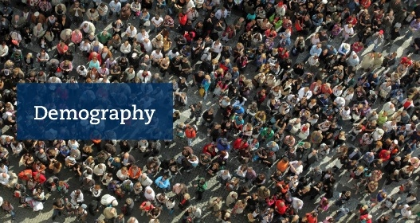
Introduction
Some Basics:
Demography
The science of population changes.
Census
A valuable tool for understanding population changes- required every 10 years.

Slide 9
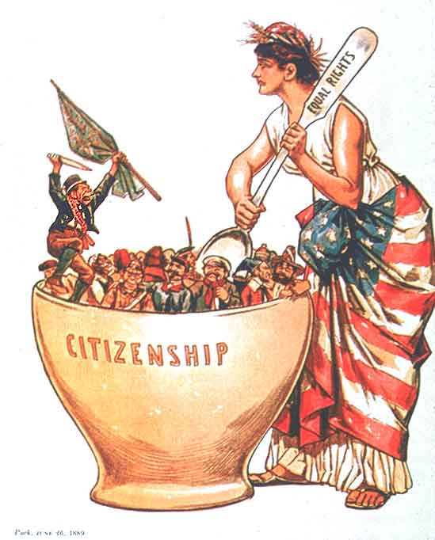
The American Melting Pot
Melting Pot: The mixing of cultures, ideas, and peoples that has changed the American nation.
Minority Majority: That America will eventually cease to have a White, generally Anglo-Saxon majority.
Political Culture: Overall set of values widely shared within a society.

Slide 10
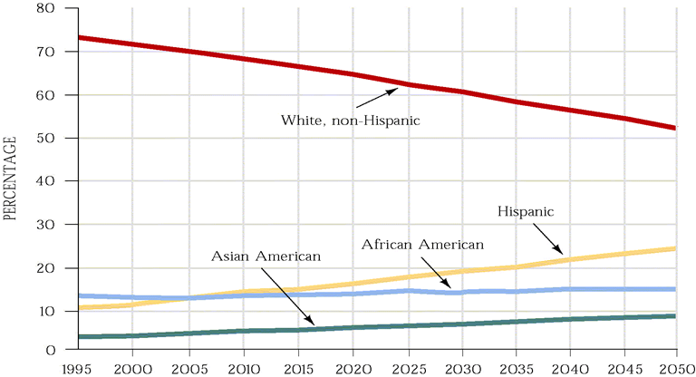
The American Melting Pot - Cont.
Figure 6.1

Slide 11
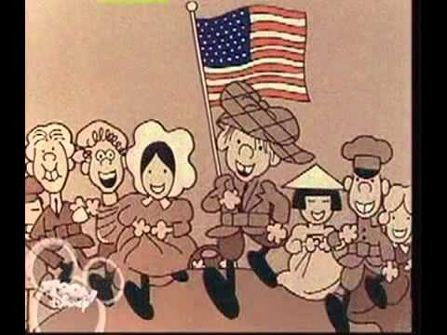
The American Melting Pot - Cont.

Slide 12
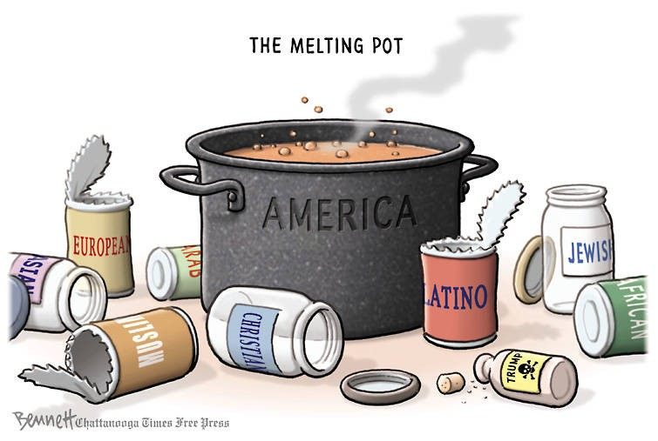
Think-Pair-Share : The American Melting Pot
Think: What do you think the American Melting Pot is?
Pair: Group up with 3 or 4 other students and discuss your views on The American Melting Pot. Come up with a group view on The American Melting Pot.
Share: Share your view of The American Melting Pot with the class.

Slide 13
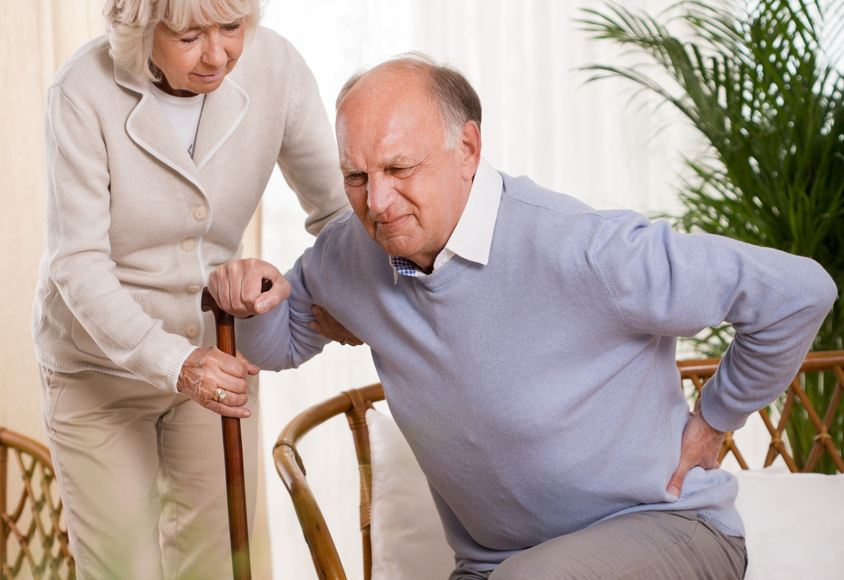
The Graying of America
Nationwide, the fastest-growing age-group in America is composed of citizens over 65.
Social Security is structured as a pay-as-you-go system
Today’s workers pay the benefits for today’s retirees.
In 1940, there were 42 workers per retiree; by 2034 there will be 2.3 workers per retiree.

Slide 14
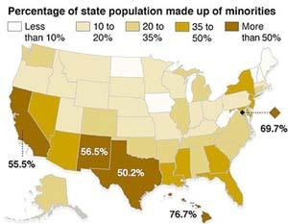
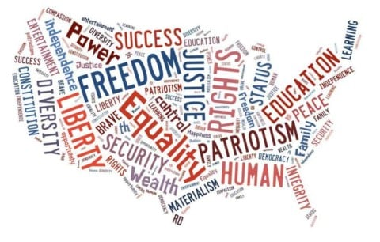
The American People
Political Culture: An overall set of values widely shared within a society. How will this change as the country changes?
Which party will benefit from the minority majority?

Slide 15
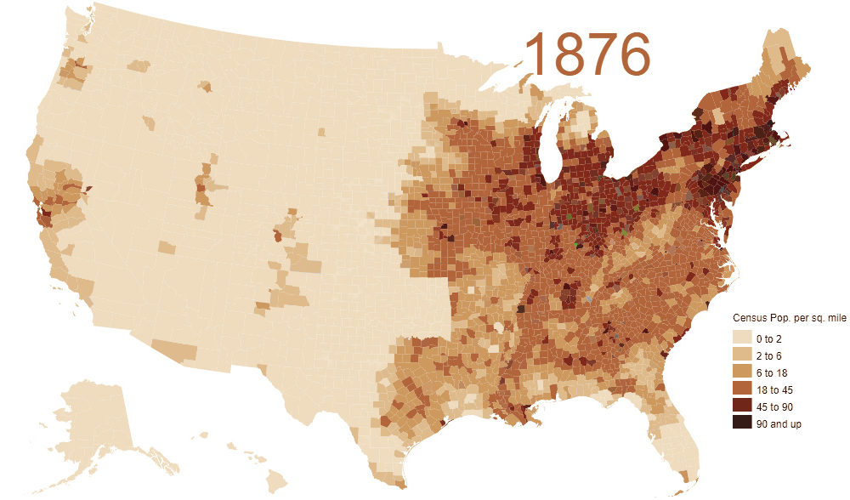
The American People - Cont.
The Regional Shift
Reapportionment: The process of reallocating seats in the House of Representatives every 10 years on the basis of the results of the census.
Redistricting is done by state legislatures.
Historically has led to Gerrymandering.

Slide 16
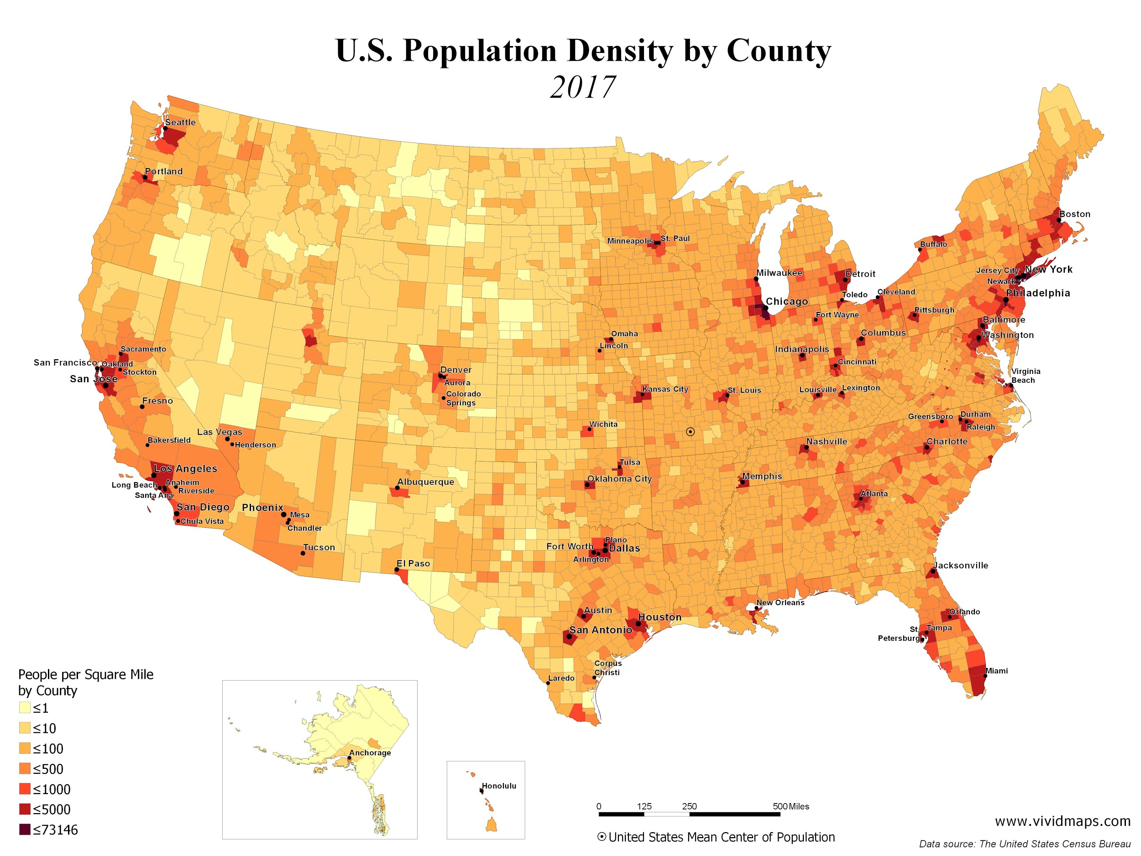
The American People - Cont.

Slide 17
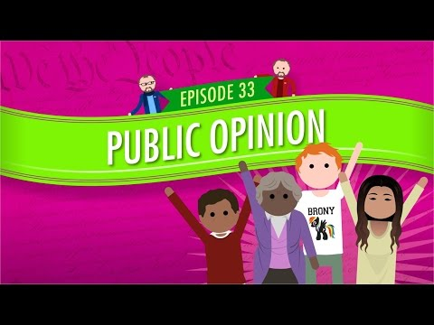

Slide 18
Exit Ticket
Name two new things you learned in your The American Melting Pot group.

Slide 19
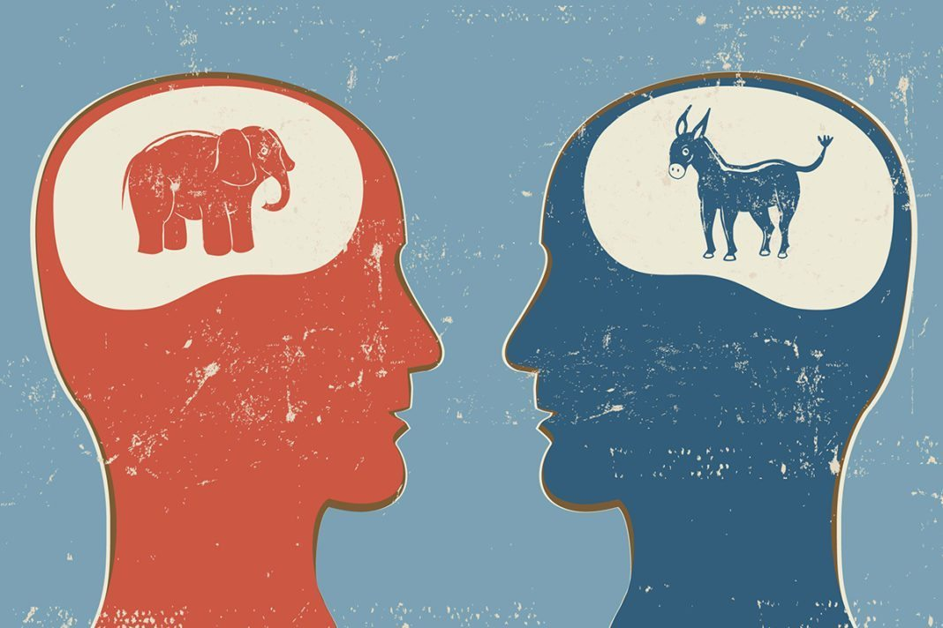
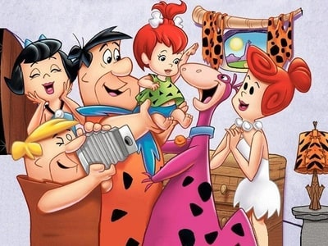
How Americans Learn About Politics:
Political Socialization
Political Socialization: The process through which an individual acquires his or her political orientation.
The Process of Political Socialization
The Family
Time & Emotional Commitment
Political leanings of children often mirror their parent’s leanings.

Slide 20
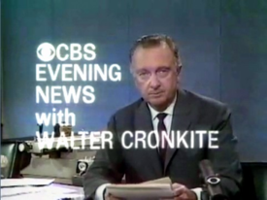
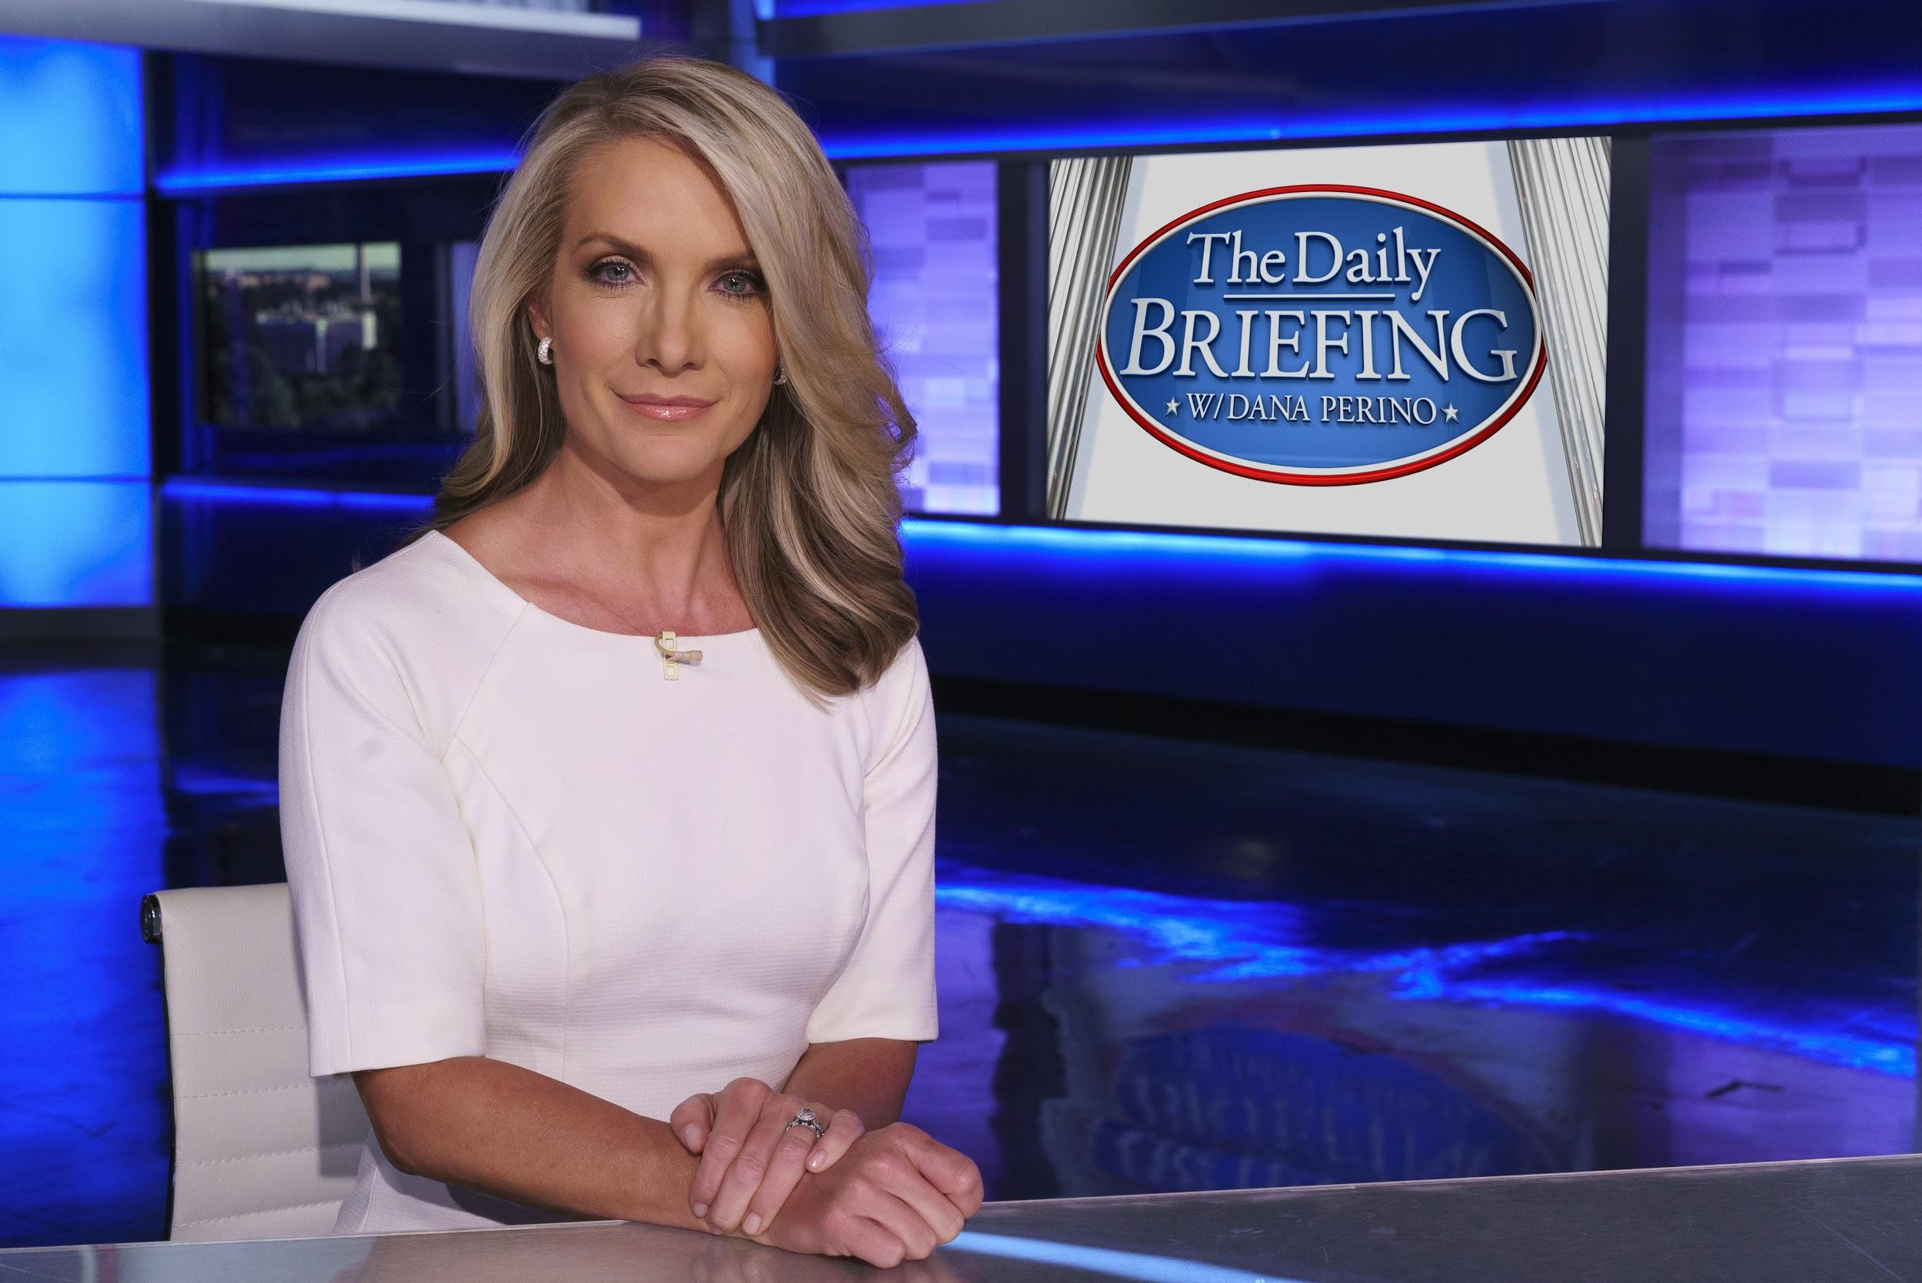
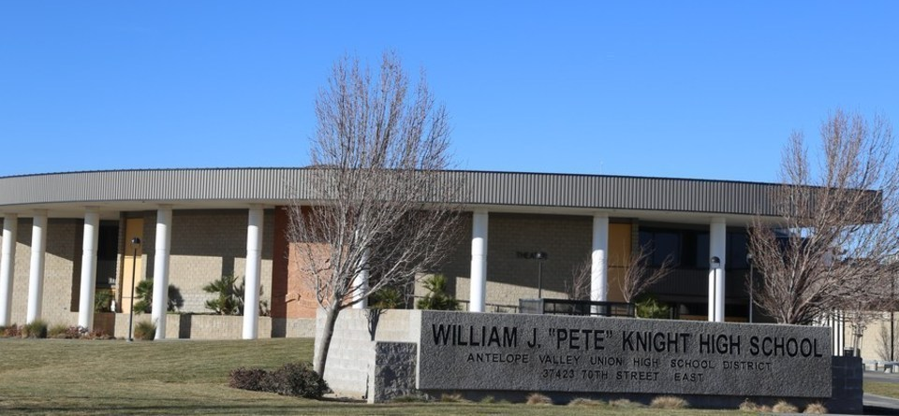
How Americans Learn About Politics:
Political Socialization - Cont.
The Process of Political Socialization:
The Mass Media
Generation gap in TV news viewing
School / Education
Used by government to socialize the young into the culture and government

Slide 21
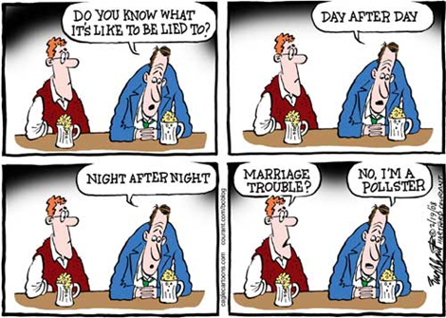
Measuring Public Opinion and Political Information
How Polls Are Conducted
Random Sampling: The key technique employed by sophisticated survey researchers; operates on the principle that everyone should have an equal probability of being selected for the sample
Representative Sample: Draws from all groups
Sample Size: 1500
Sampling Error: The level of confidence in the findings of a public opinion poll, +/-3%

Slide 22
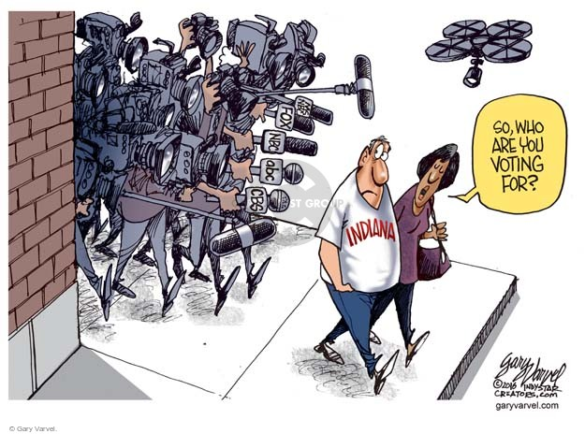
Measuring Public Opinion and Political Information - Cont.
Role of Polls in American Democracy
Help politicians figure out public preferences.
Exit Polls: Used by the media to predict election day winners.
Straw Poll: An unofficial ballot conducted as a test of opinion.
Wording of the question makes a difference.
Polls reflect the policy agenda - problems the people inside and outside of the government believe must be addressed.

Slide 23
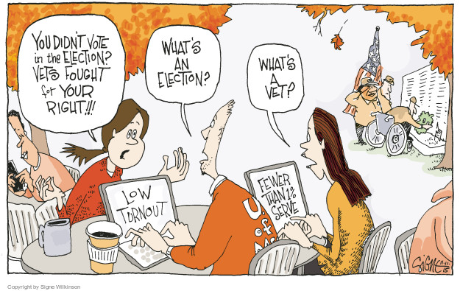
What Polls Reveal About Americans’ Political Information
Americans don’t know as much as they should know about politics.
American political system works as well as it does given the discomforting lack of public knowledge about politics.

Slide 24
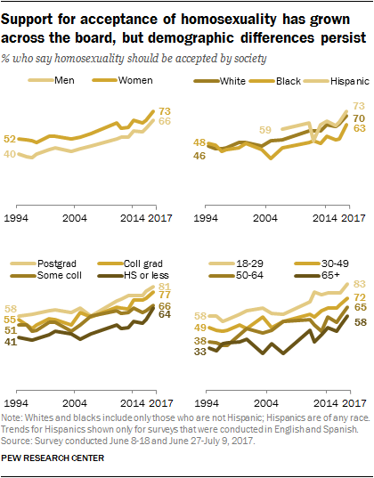
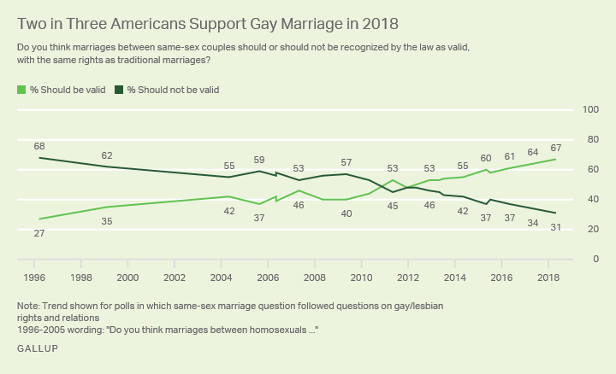
Attitudes Toward Gays and Lesbians

Slide 25
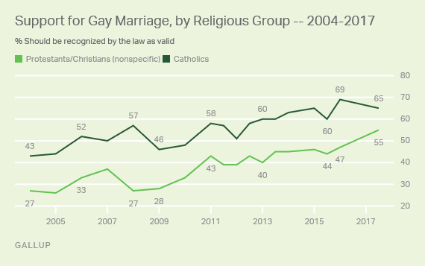
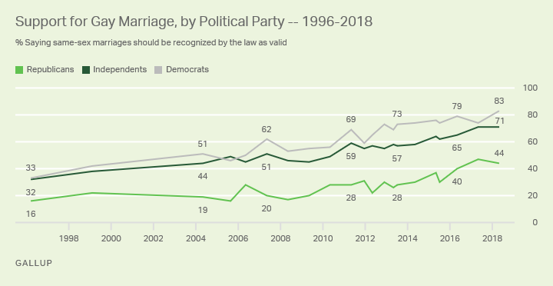
Attitudes Toward Gays and Lesbians - Cont.

Slide 26
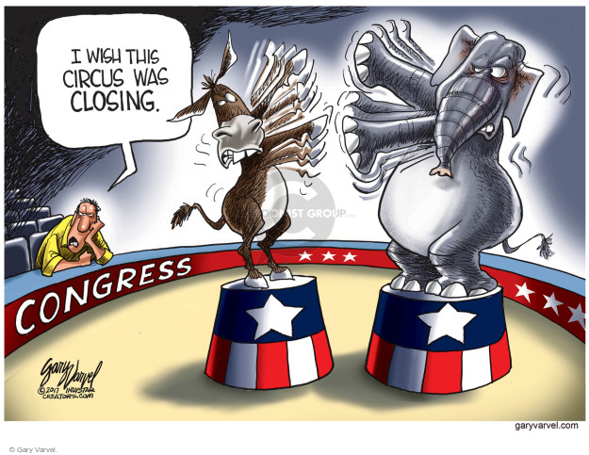
Understanding Public Opinion and Political Action
There are many limits on the role public opinion plays in the American political system.
The average person is not well informed about political issues.
The fact that public opinion is often contradictory in this respect sometimes leads to policy gridlock because it is hard for politicians to know which aspect of the public’s attitudes to respond to.

Slide 27
Demographic Factors
Education: People with higher than average educational levels have a higher rate of voting than the less educated.
Age: Older people are more likely to vote.
Race: African Americans and Hispanics are underrepresented among voters relative to their share.
Gender: Today women actually participate in elections at a slightly higher rate than men.
Marital Status: Married people are more likely.
Union Members: Unions are able to mobilize voters to go to the polls.
Government Employee: Having something at stake and being in a position to know more about the government impels higher level of participation.
Religion: As people become religious they tend to be engaged more in politics.
Two Party Competition: In states where either party could win, voter turnout goes way up. Why does California have a poor voter turnout? We already know who won.

Slide 28
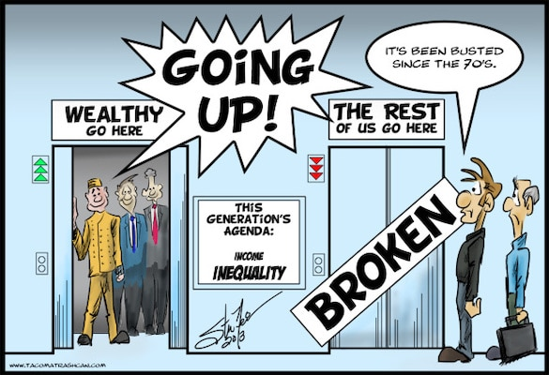
Class, Inequality, and Participation
The rates of political participation are unequal among Americans.
“citizens of higher socioeconomic status participate more in politics…”
People of lower socioeconomic tend to believe the system is against them.

Slide 29
Types of Political Participation
12% - Attended a rally or speech.
32% - Signed a petition.
24% - Attended a political meeting on local town affairs.
30% - Contacted a national, state, or local government official about an issue.
28% - Worked with others to solve a problem in their community .
32% - Of internet users communicated with group members using a website.
24% - Of social networkers communicated with members using a social network site.
18% - Gave money to a candidate, party or group.
55-57% - Voted in the last presidential election.

Slide 30
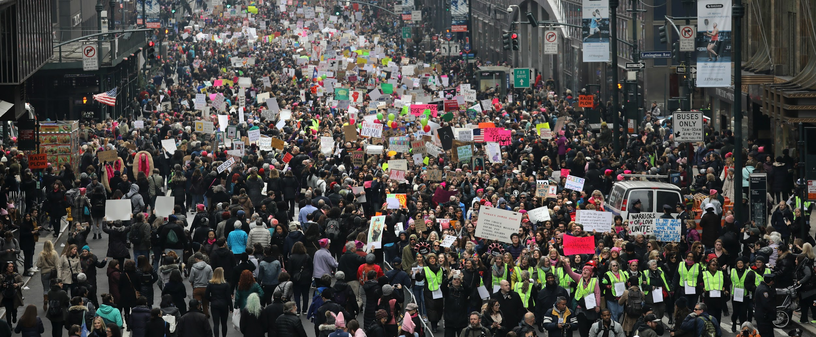
Protest as Participation
Protest: Designed to achieve policy change through dramatic and unconventional tactics
Civil Disobedience: Reflects a conscious decision to break a law believed to be immoral and to suffer the consequences.

