Slide 2
SCOTUS Cases By Topic
Judicial Review | Marbury v. Madison
Federalism | McCulloch v. Maryland United States v. Lopez
Civil Liberties-1 | Engel v. Vitale Wisconsin v. Yoder Tinker v. Des Moines School District New York Times Co. v. United States Schenck v. United States
Civil Liberties-2 | Gideon v. Wainwright Roe v. Wade McDonald v. Chicago
Towards Equality | Brown v. Board of Education of Topeka
Campaign Finance | Citizens United v. FEC
Congressional Elections | Baker v. Carr Shaw v. Reno

Slide 4
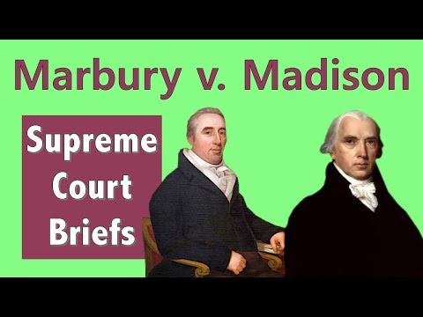
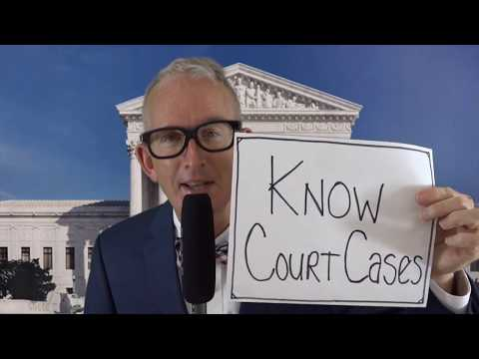
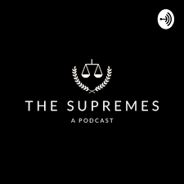
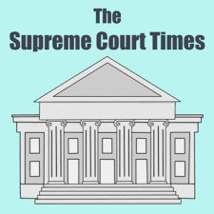
Street Law Summary
Landmark Cases Summary (chose reading level)

Slide 6
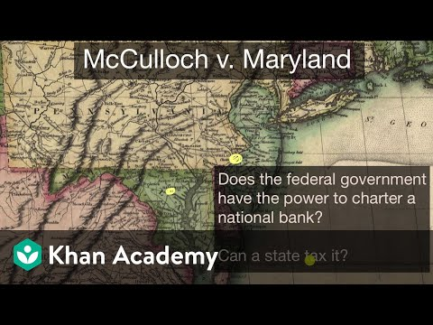
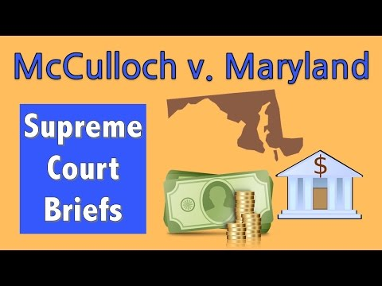
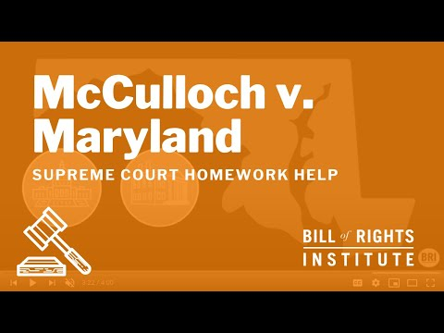
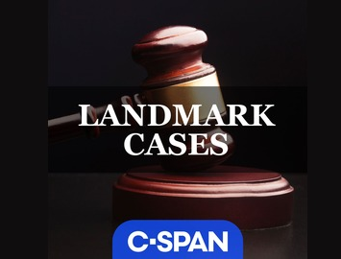
Street Law Summary
Landmark Cases Summary (chose reading level)

Slide 7
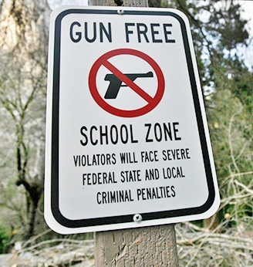
United States v. Lopez (1995)
In 1992, Alfonso Lopez, a high school senior, walked into his San Antonio high school with a concealed weapon. He was arrested for violating a Texas law that prohibited firearm possession on school grounds. At first, Lopez was charged in a court in Texas, but he was later charged with violating the Gun-Free Schools Act, a federal offense.
Lopez was found guilty and appealed to the Supreme Court, arguing that this law was an overreach of congressional power because schools were supposed to be controlled at the state level, not the federal level. The court agreed with him and overturned the conviction.
US v. Lopez was a landmark case as ruled that the federal government had exceeded its authority under the commerce clause.
“The possession of a gun in a local school zone is in no sense an economic activity that might, through repetition elsewhere, substantially affect any sort of interstate commerce. Respondent was a local student at a local school; there is no indication that he had recently moved in interstate commerce, and there is no requirement that his possession of the firearm have any concrete tie to interstate commerce.” -Chief Justice Rehnquist
Notes:
Summary from : https://www.khanacademy.org/humanities/ap-us-government-and-politics/foundations-of-american-democracy/constitutional-interpretations-of-federalism/a/us-v-lopez-1995

Slide 8
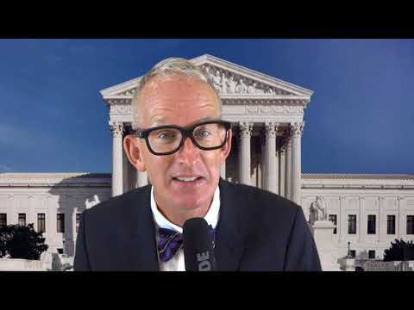
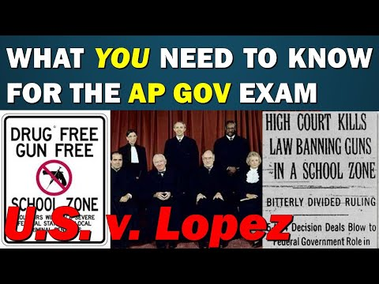
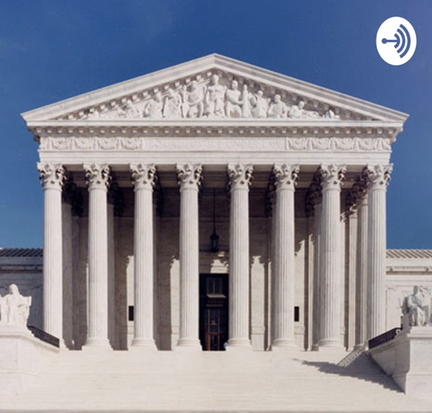
Street Law Summary
Oyez Case Facts
Khan Academy Summary

Slide 9
Civil Liberties- 1

Slide 10
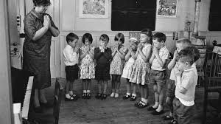
Engel v. Vitale (1962)
In the 1950s, New York schools encouraged teachers to lead students in a non-denominational prayer each morning. A group of parents, including Steven Engel, challenged this school prayer as a violation of the establishment clause of the First Amendment.
The Supreme Court ruled that the school-led prayer violated the First Amendment, citing the importance of separating government and religion.
“The First Amendment was added to the Constitution to stand as a guarantee that neither the power nor the prestige of the Federal Government would be used to control, support or influence the kinds of prayer the American people can say . . . Under that Amendment's prohibition against governmental establishment of religion, as reinforced by the provisions of the Fourteenth Amendment, government in this country, be it state or federal, is without power to prescribe by law any particular form of prayer which is to be used as an official prayer in carrying on any program of governmentally sponsored religious activity.” - Justice Hugo Black
Notes:
Summary from : https://www.khanacademy.org/humanities/ap-us-government-and-politics/civil-liberties-and-civil-rights/first-amendment-religion/a/engel-v-vitale

Slide 11
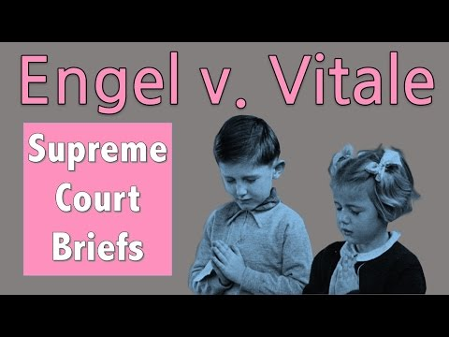
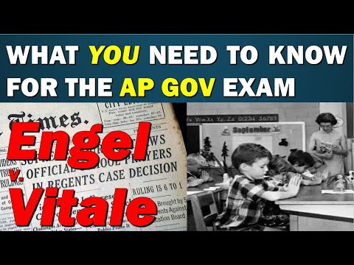
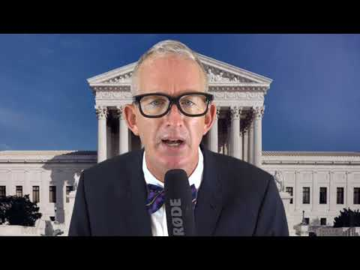
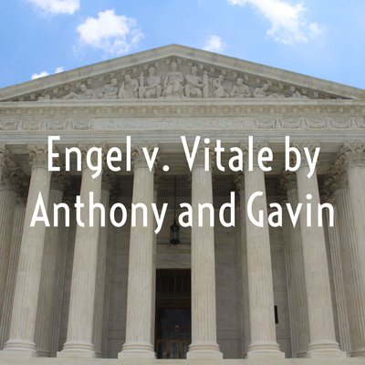
Street Law Summary
Oyez Case Facts
Khan Academy Summary

Slide 12
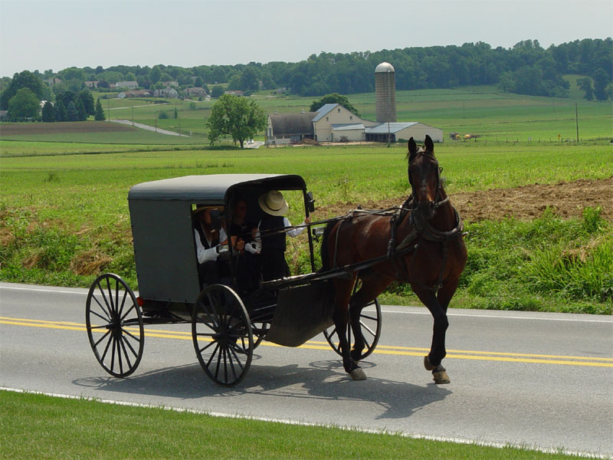
Wisconsin v. Yoder (1972)
In 1971, the state of Wisconsin fined three Amish families for refusing to send their children to school beyond the eighth grade. Wisconsin law stipulated that all children had to attend school until age 16, but the Yoder, Miller, and Yutzy families believed that further education for their children would damage their religious beliefs. The Amish believe in simplicity, and the families considered worldly education harmful to maintaining their way of life.
The Amish families’ case went to the Supreme Court, which ruled that the Wisconsin law violated their right to free exercise of religion. The Court agreed that mandatory high school education was likely to damage the religious upbringing of the Amish students. Since the Amish community is well-established, the Court believed its children were unlikely to become a burden on society.
“The conclusion is inescapable that secondary schooling, by exposing Amish children to worldly influences in terms of attitudes, goals, and values contrary to beliefs, and by substantially interfering with the religious development of the Amish child and his integration into the way of life of the Amish faith community at the crucial adolescent stage of development, contravenes the basic religious tenets and practice of the Amish faith, both as to the parent and the child.” - Chief Justice Warren Burger
Notes:
Summary from: https://www.khanacademy.org/humanities/ap-us-government-and-politics/civil-liberties-and-civil-rights/first-amendment-religion/a/wisconsin-v-yoder

Slide 13
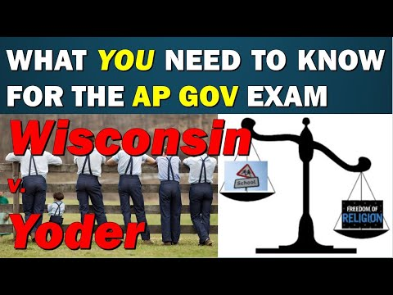
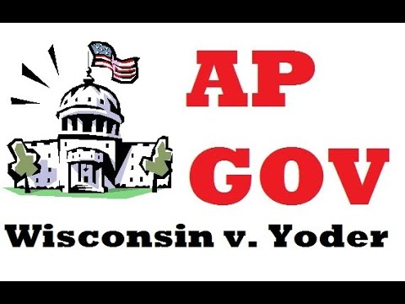
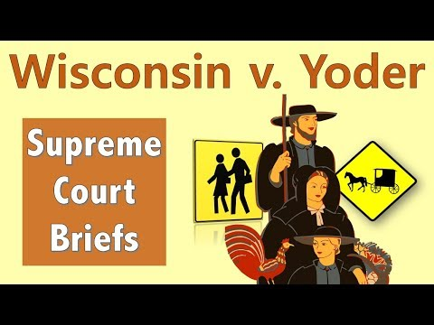
Street Law Summary
Oyez Case Facts
Khan Academy Summary

Slide 14
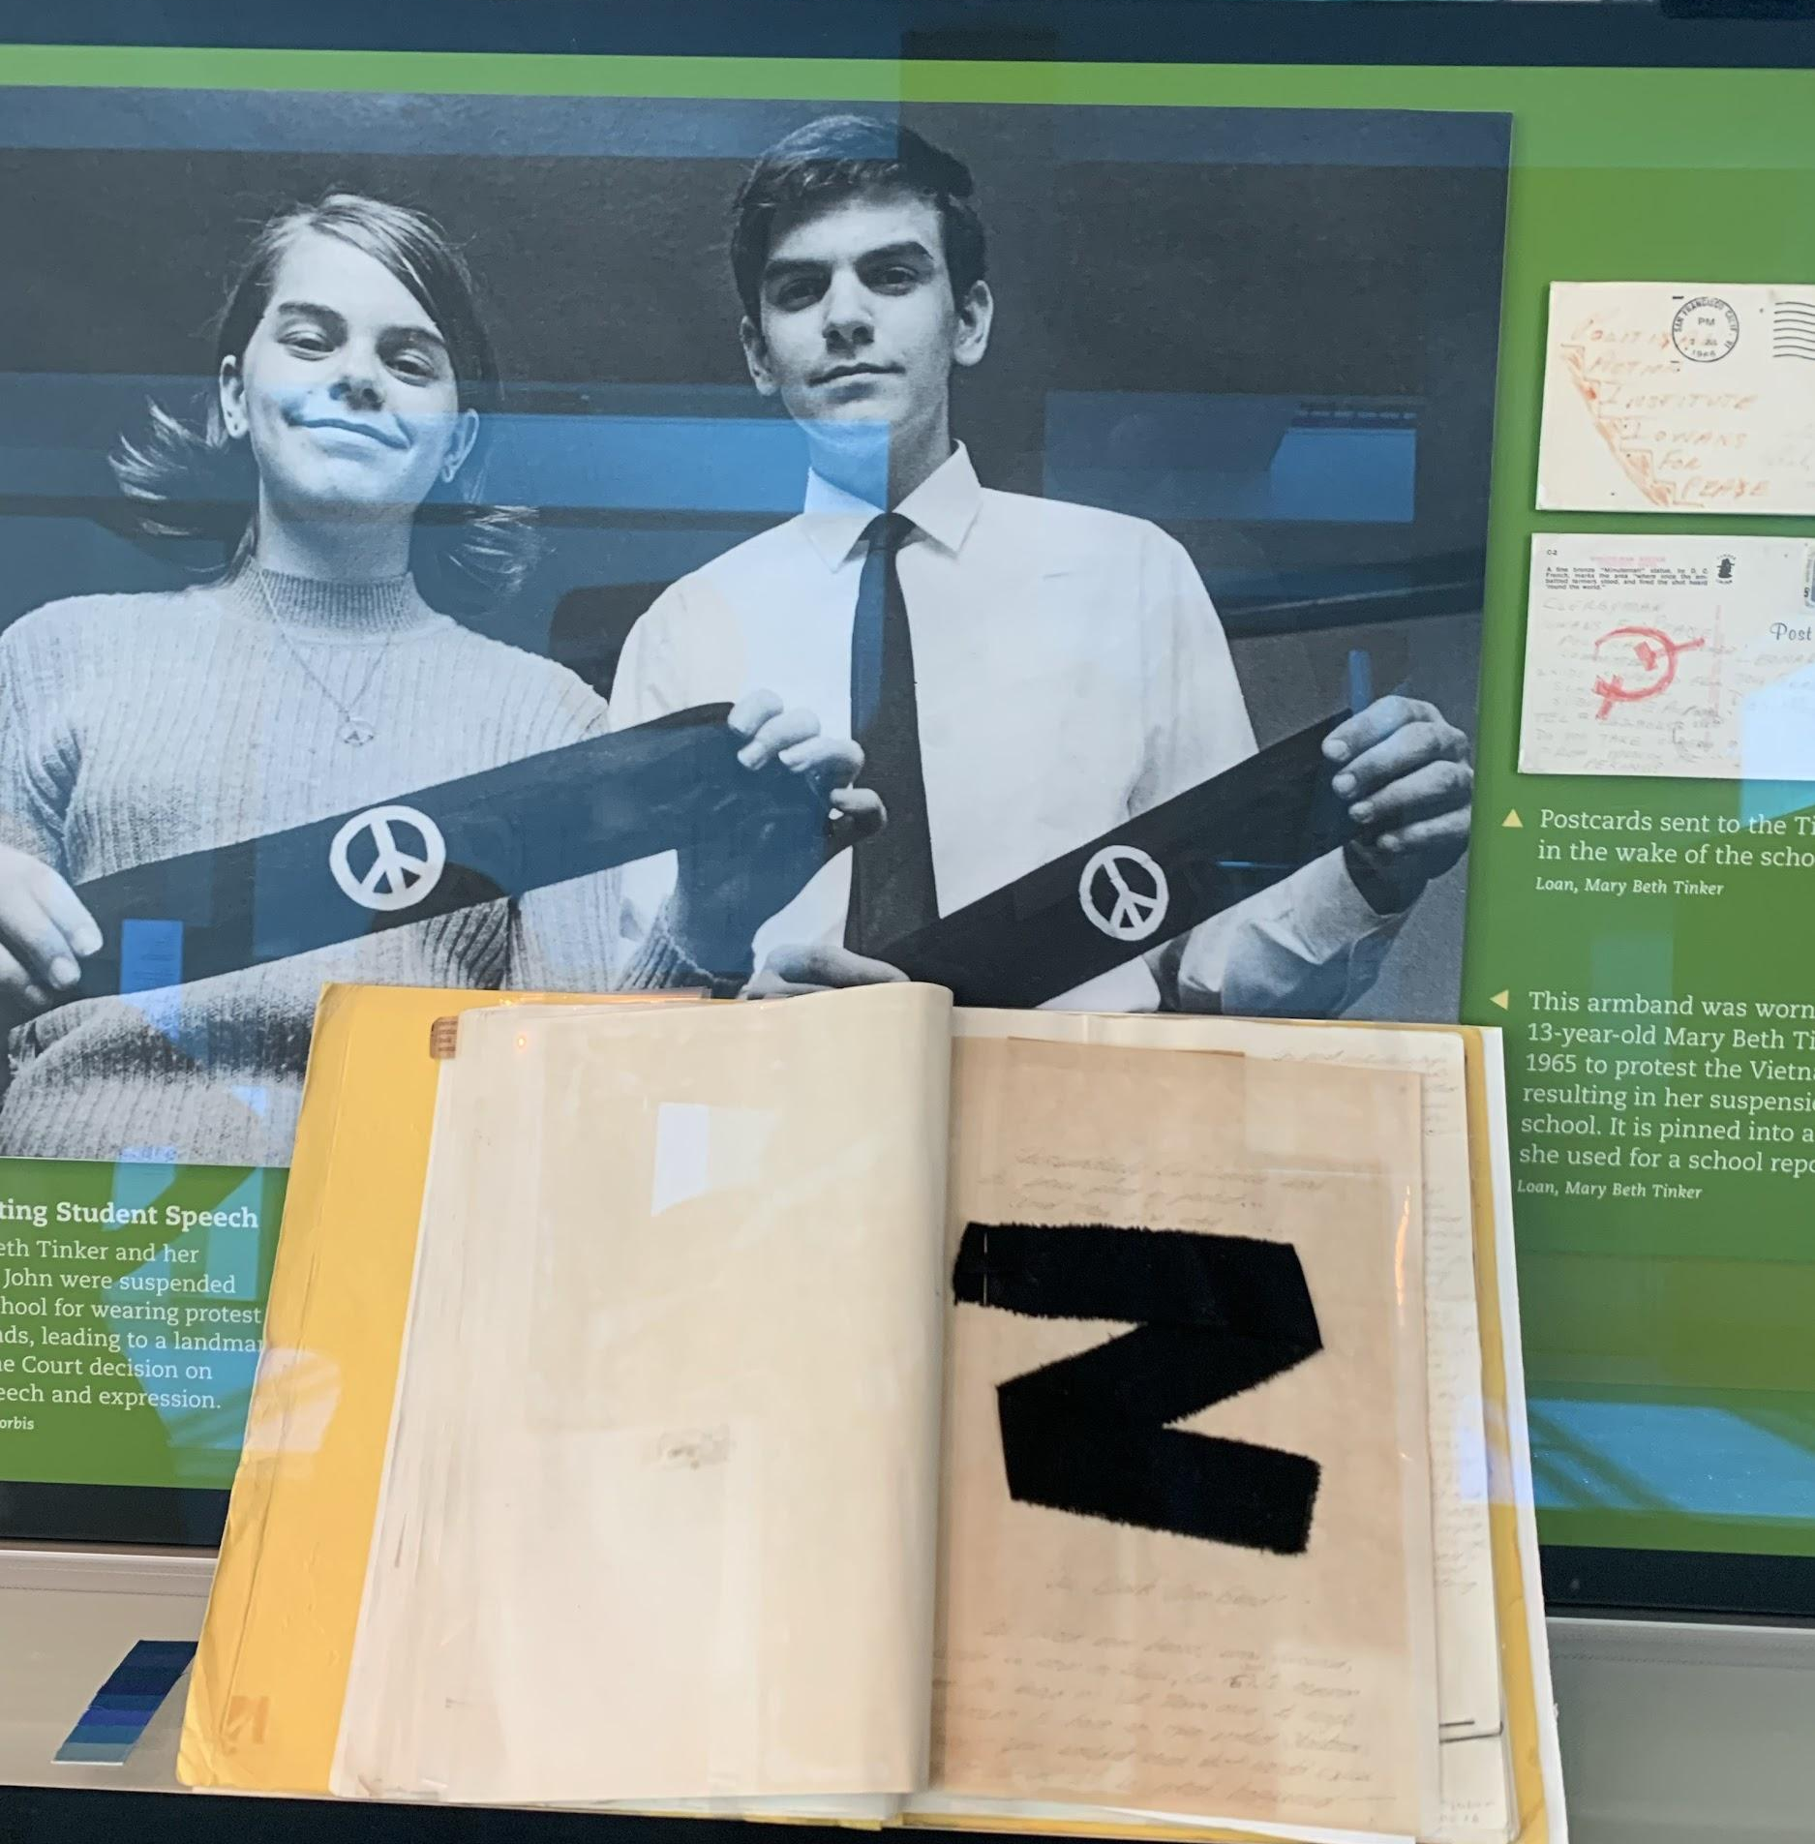
Tinker v. Des Moines (1969)
John and Mary Beth Tinker of Des Moines, Iowa, wore black armbands to their public school as a symbol of protest against American involvement in the Vietnam War. When school authorities asked that the Tinkers remove their armbands, they refused and were subsequently suspended. The Supreme Court decided that the Tinkers had the right to wear the armbands, with Justice Abe Fortas stating that no one expects students to “shed their constitutional rights to freedom of speech or expression at the schoolhouse gate.”
". . . In the absence of a specific showing of constitutionally valid reasons to regulate their speech, students are entitled to freedom of expression of their views." — Justice Fortas, speaking for the majority
Notes:
Summary from: https://www.landmarkcases.org/cases/tinker-v-des-moines

Slide 15
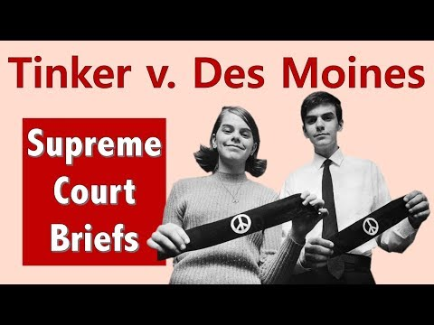
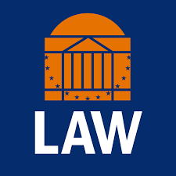
Street Law Summary
Landmark Cases Summary (chose reading level)

Slide 16
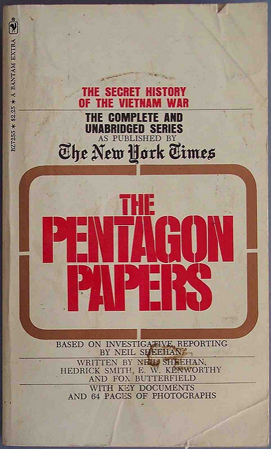
New York Times v. US (1971)
In 1971, the administration of President Richard Nixon attempted to suppress the publication of a top-secret history of US military involvement in Vietnam, claiming that its publication endangered national security.
In the resulting case, the Supreme Court found that this injunction against publication was a violation of the First Amendment’s guarantee of freedom of the press.
“Only a free and unrestrained press can effectively expose deception in government…In revealing the workings of government that led to the Vietnam War, the newspapers nobly did that which the Founders hoped and trusted they would do.”
Notes:
Summary from: https://www.khanacademy.org/humanities/ap-us-government-and-politics/civil-liberties-and-civil-rights/first-amendment-press/a/new-york-times-co-v-united-states-1971
And https://billofrightsinstitute.org/educate/educator-resources/lessons-plans/landmark-supreme-court-cases-elessons/new-york-times-v-united-states-1971/

Slide 17
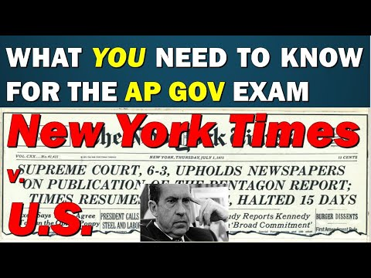
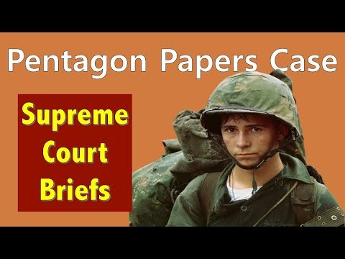
Street Law Summary
Oyez Case Facts
Khan Academy Summary

Slide 18
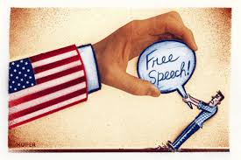
Schenck v. United States (1919)
Charles Schenck and Elizabeth Baer were convicted under the 1917 Espionage Act for mailing leaflets encouraging men to resist the military draft. They appealed to the Supreme Court on the grounds that the conviction violated their free speech rights.
The Supreme Court upheld their convictions, ruling that speech that creates a “clear and present danger” (by encouraging violence or insurrection, or endangering national security) is not protected by the First Amendment.
“The most stringent protection of free speech would not protect a man in falsely shouting fire in a theatre and causing a panic . . . The question in every case is whether the words used are used in such circumstances and are of such a nature as to create a clear and present danger that they will bring about the substantive evils that Congress has a right to prevent . . .” - Justice Oliver Wendell Holmes, Jr.
Notes:
Summary from: https://www.khanacademy.org/humanities/ap-us-government-and-politics/civil-liberties-and-civil-rights/first-amendment-speech/a/schenck-v-united-states-1919

Slide 19
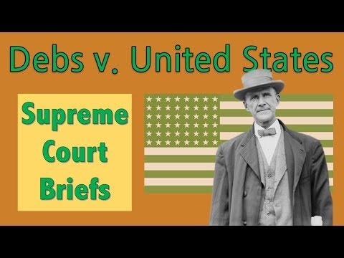
Street Law Summary
Oyez Case Facts
Khan Academy Summary

Slide 20
Civil Liberties- 2
Protections of the Bill of Rights have been selectively incorporated by way of the Fourteenth
Amendment’s due process clause to prevent state infringement of basic liberties.
BIG IDEA:
Liberty and Order

Slide 21
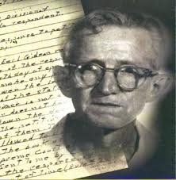
Gideon v. Wainwright (1963)
In June 1961, a burglary occurred at the Bay Harbor Pool Room in Panama City, FL. Police arrested Clarence Earl Gideon after he was found nearby with a pint of wine and some change in his pockets. Gideon, who could not afford a lawyer, asked a Florida Circuit Court judge to appoint one for him arguing that the Sixth Amendment entitles everyone to a lawyer. The judge denied his request and Gideon was left to represent himself. He did a poor job of defending himself and was found guilty of breaking and entering and petty larceny. While serving his sentence in a Florida state prison, Gideon began studying law, which reaffirmed his belief his rights were violated when the Florida Circuit Court refused his request for counsel. From his prison cell, he handwrote a petition asking the U.S. Supreme Court to hear his case and it agreed. The Court unanimously ruled in Gideon’s favor, stating that the Sixth Amendment requires state courts to provide attorneys for criminal defendants who cannot otherwise afford counsel.
"If an obscure Florida convict named Clarence Earl Gideon had not sat down in his prison cell . . . to write a letter to the Supreme Court . . . the vast machinery of American law would have gone on functioning undisturbed. But Gideon did write that letter, the Court did look into his case . . . and the whole course of American legal history has been changed." —Robert F. Kennedy
Notes:
Summary from: https://www.landmarkcases.org/cases/gideon-v-wainwright

Slide 22
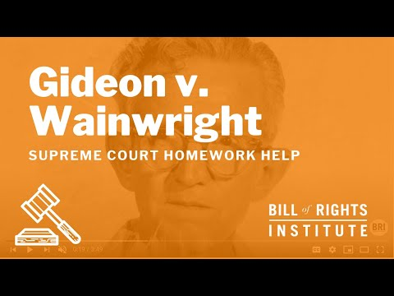
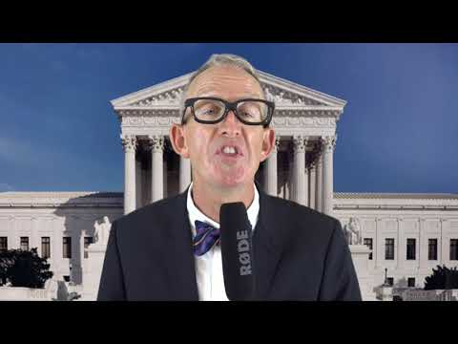
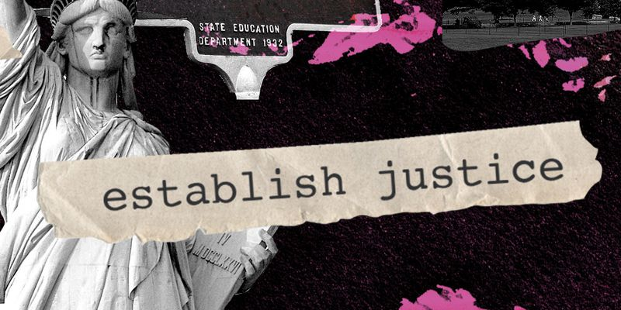
Street Law Summary
Landmark Cases Summary (chose reading level)

Slide 23
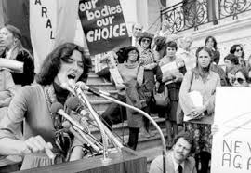
Roe v. Wade (1973)
Jane Roe was an unmarried and pregnant Texas resident in 1970. Texas law made it a felony to abort a fetus unless “on medical advice for the purpose of saving the life of the mother.” Roe filed suit against Wade, the district attorney of Dallas County, contesting the statue on the grounds that it violated the guarantee of personal liberty and the right to privacy implicitly guaranteed in the First, Fourth, Fifth, Ninth, and 14th Amendments. In deciding for Roe, the Supreme Court invalidated any state laws that prohibited first trimester abortions.
“We … acknowledge our awareness of the sensitive and emotional nature of the abortion controversy, of the vigorous opposing views, even among physicians, and of the deep and seemingly absolute convictions that the subject inspires.” — Justice Blackmun (1973), majority opinion in Roe v. Wade
Notes:
Summary from: https://www.landmarkcases.org/cases/roe-v-wade

Slide 24
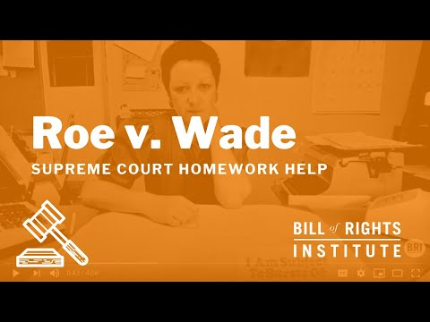
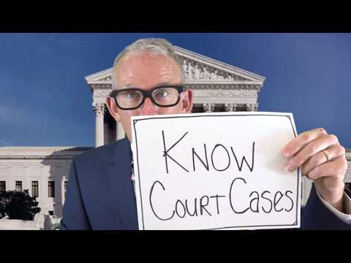
Street Law Summary
Landmark Cases Summary (chose reading level)

Slide 25
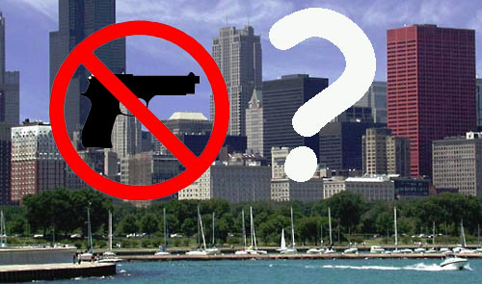
McDonald v. Chicago (2010)
The U.S. Supreme Court ruled in the 2008 case of D.C. v. Heller that the Second Amendment protected an individual right to keep weapons at home for self-defense. Since the case involved the District of Columbia’s handgun ban, the right found in the Second Amendment applied only to the national government. Two years later, the Court struck down a similar gun ban in Chicago, incorporating the Second Amendment right to own guns for self-defense to state and local governments.
“Heller points unmistakably to the answer. Self-defense is a basic right, recognized by many legal systems from ancient times to the present, and the Heller Court held that individual self-defense is ‘the central component’ of the Second Amendment right.”
Notes:
Summary from: https://billofrightsinstitute.org/educate/educator-resources/lessons-plans/landmark-supreme-court-cases-elessons/2715-2/

Slide 26
Street Law Summary
Oyez Case Facts

Slide 27
Towards Equality
The Fourteenth Amendment’s equal protection clause as well as other constitutional provisions have often been used to support the advancement of equality.
BIG IDEA:
Civic Participation in a Representative Democracy

Slide 28
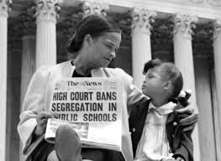
Brown v. Board of Education (1954)
In Topeka, Kansas in the 1950s, schools were segregated by race. Each day, Linda Brown and her sister had to walk through a dangerous railroad switchyard to get to the bus stop for the ride to their all-black elementary school. There was a school closer to the Brown's house, but it was only for white students. Linda Brown and her family believed that the segregated school system violated the 14th Amendment and took their case to court. Federal district court decided that segregation in public education was harmful to black children, but because all-black schools and all-white schools had similar buildings, transportation, curricula, and teachers, the segregation was legal. The Browns appealed their case to the Supreme Court, stating that even if the facilities were similar, segregated schools could never be equal to one another. The Court decided that state laws requiring separate but equal schools violated the Equal Protection Clause of the Fourteenth Amendment.
"We conclude that the doctrine of 'separate but equal' has no place. Separate educational facilities are inherently unequal." —Chief Justice Earl Warren
Notes:
Summary from: https://www.landmarkcases.org/cases/brown-v-board-of-education

Slide 29
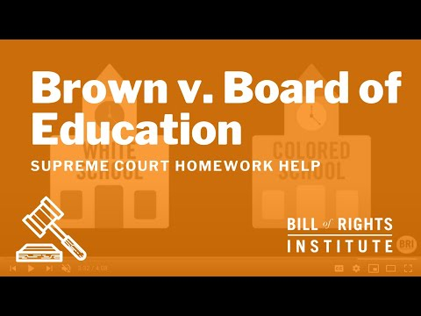
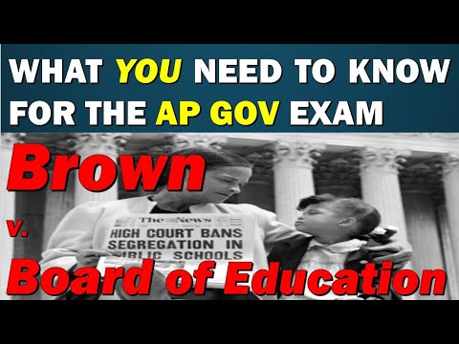
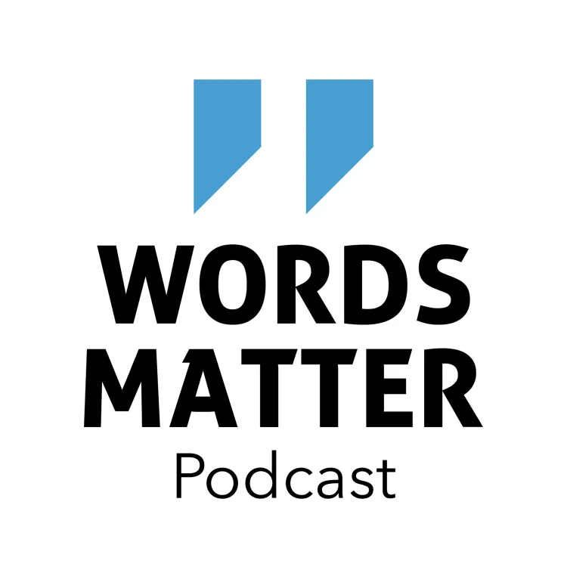
Street Law Summary
Landmark Cases Summary (chose reading level)
Khan Academy Summary

Slide 30
Campaign Finance
The impact of federal policies on campaigning and electoral rules continues to be contested by both sides of the political spectrum.
BIG IDEA:
Civic Participation in a Representative Democracy

Slide 31
Citizens United v. FEC (2010)
On January 21, 2010, the Supreme Court issued what is certain to become a landmark ruling in the case of Citizens United v. Federal Election Commission. In a 5-4 ruling, the Court struck down federal limits on what organizations (including non-profit organizations, unions, and for-profit corporations) may say during elections. A ban on direct contributions to candidates was left in place. The majority reasoned that the speech limits violated the First Amendment and chilled political expression. With this ruling, the Court seemed to reverse the trend of the last century, which brought greater limits to corporate political speech and activity.
Notes:
Summary from: https://billofrightsinstitute.org/educate/educator-resources/lessons-plans/landmark-supreme-court-cases-elessons/landmark-supreme-court-cases-citizens-united-v-fec-2010/

Slide 32
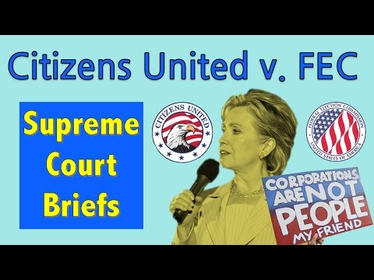
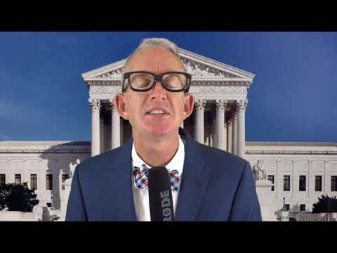
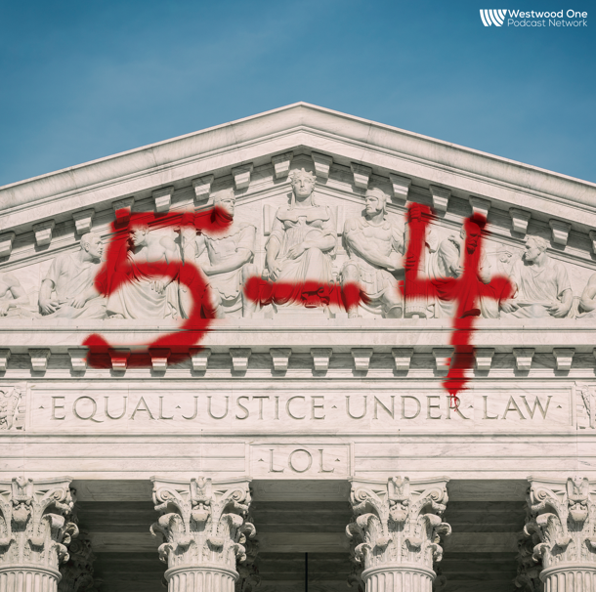
Street Law Summary
Oyez Case Facts

Slide 33
Congress Elections
The republican ideal in the U.S. is manifested in the structure and operation of the legislative branch.
BIG IDEA:
Constitutionalism

Slide 34
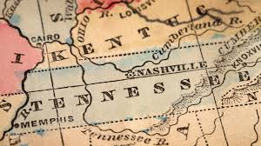
Baker v. Carr (1962)
Charles Baker, a resident of an urban neighborhood in Tennessee, filed suit in federal court against Joe Carr, then Secretary of State of Tennessee. Baker sought a court injunction to postpone elections until the State had fulfilled its duty to reapportion its legislative districts, which it had not done since 1901 (over 60 years). Though the Tennessee Constitution required that reapportionment be carried out every ten years, Baker’s claim was based on the 14th Amendment’s Equal Protection Clause. Baker argued that because of population changes in the state, specifically migration to cities, his vote in an urban area had much less weight than that of a voter in a rural district, thus constituting a “debasement of [his] votes.”
Baker v. Carr opened the door to judicial review of the redistricting process, prompted a cascade of subsequent lawsuits, and sent shockwaves through the redistricting community. Though the opinion stopped short of addressing the shape relief should take in malapportionment cases, by recognizing unequal districts as creating real and justiciable injuries, it laid the groundwork for the rapid development of the “one-person one-vote” principle.
Notes:
Summary from: https://roseinstitute.org/redistricting/baker/

Slide 35
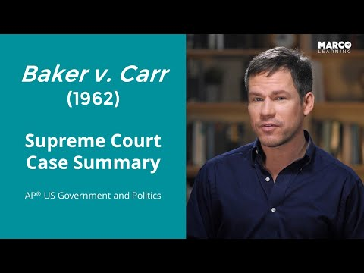
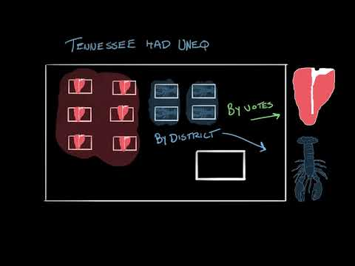
Street Law Summary
Oyez Case Facts

Slide 36
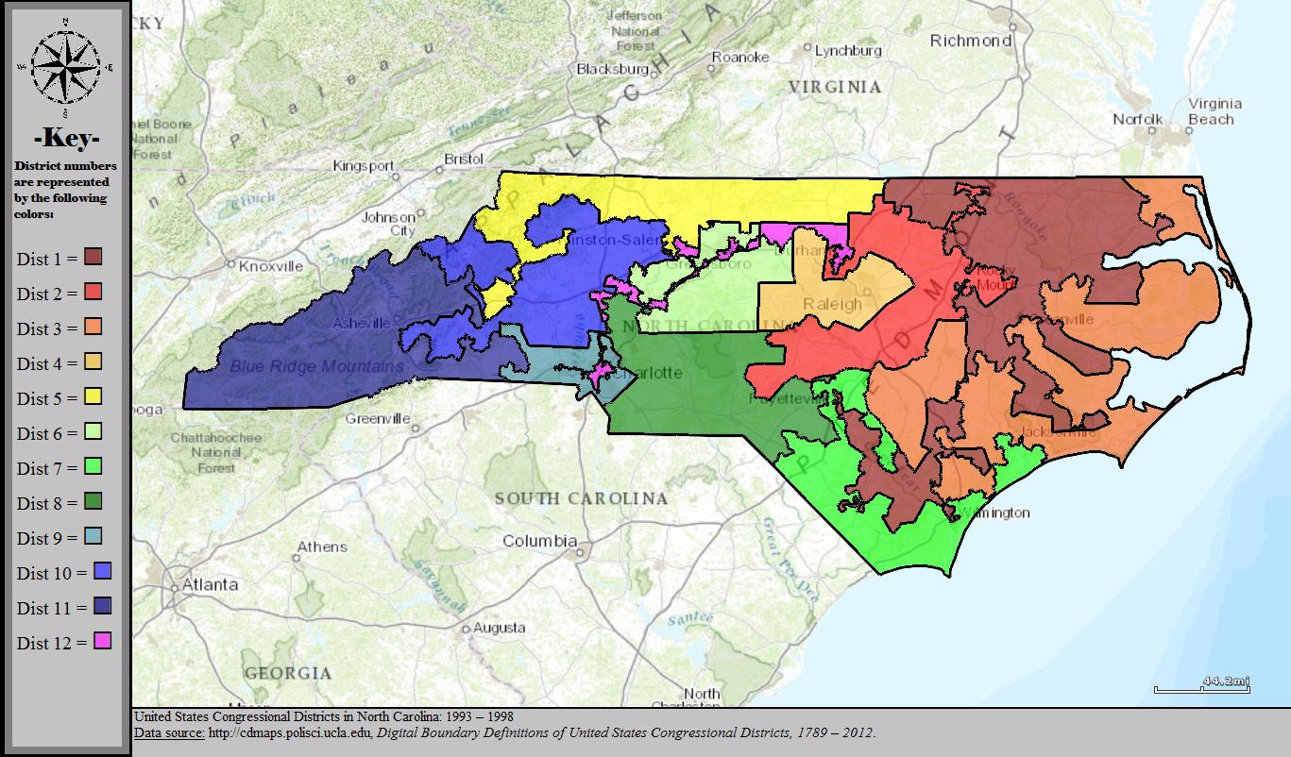
Shaw v. Reno (1993)
In 1991, a group of white voters in North Carolina challenged the state's new congressional district map, which had two “majority-minority” districts. The group claimed that the districts were racial gerrymanders that violated the equal protection clause of the Fourteenth Amendment.
In its 1993 decision, the Supreme Court agreed, ruling that race cannot be the predominant factor in creating districts.
Notes:
Summary from: https://www.khanacademy.org/humanities/ap-us-government-and-politics/interactions-among-branches-of-government/congressional-behavior/a/shaw-v-reno

Slide 37
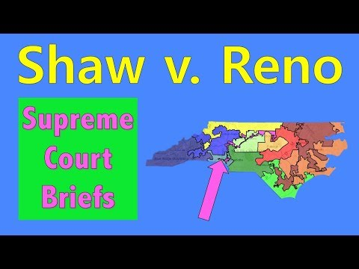
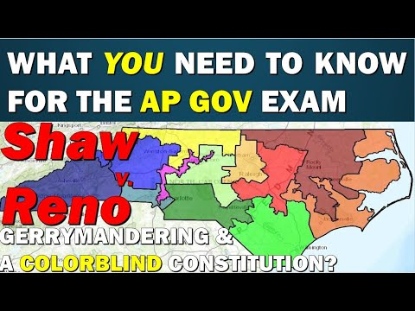
Street Law Summary
Oyez Case Facts
Khan Academy Summary

Slide 38
Additional Notes

