Slide 1
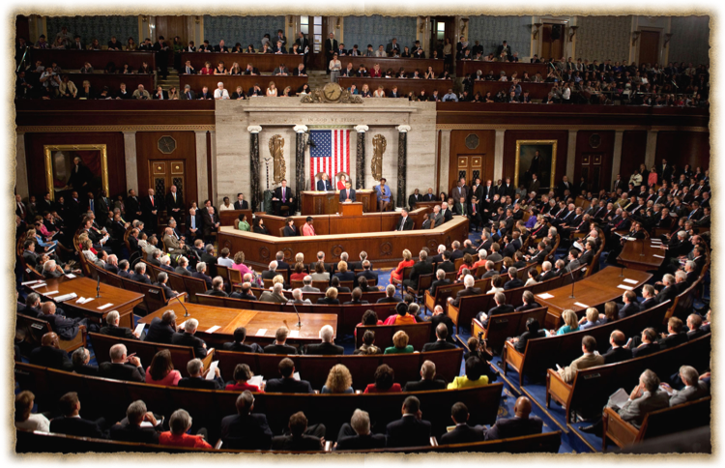
Congress (118th )
Textbook Chapter 12
A.P. Government

Slide 2
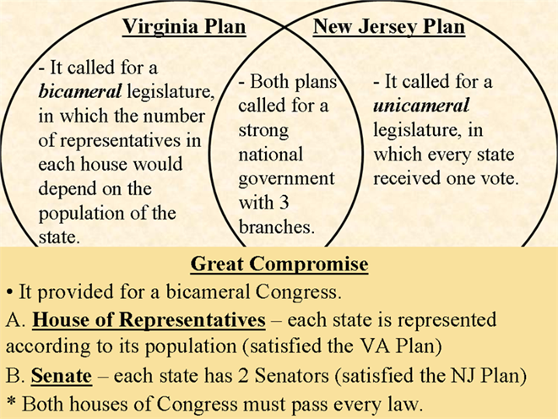
Origins of Congress
Apportionment: a census done every ten years to determine the number of representatives for each state based on population
http://bkushistory.pbworks.com/w/page/109255357/The%20Great%20Compromise

Slide 3
House of Representatives
Must be 25 years or older.
American citizen for seven years.
Must live or at least own a home in the district they represent.

Slide 4
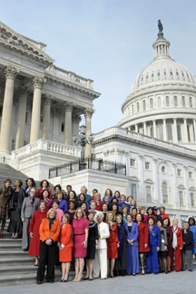
The House Of Rep's
435 Members
2 years per term
institutionalized (lots of rules and procedures)
party loyalty is King
Led by the House Rules Committee (Traffic Cop)
Daily procedures led by the speaker of the house.
Focus on domestic issues
“Power of the Purse”

Slide 5
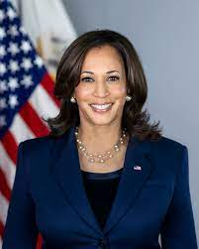

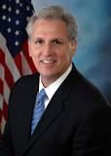
The make up of Congress
Senate President: Kamala Harris (D)
Senate President Pro-Tempore: Patty Murray (D)
House Speaker: Kevin McCarthy (R)
Total members of Congress: 535
100 senators
435 members of the House of the Representatives.

Slide 6





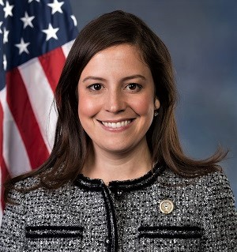
Other House Leadership
(Majority Leadrer)
Rep. Steve Scalise (R)
Democratic (Majority) Whip
Rep. Tom Emmer (R)
Republican Conference Chair
Rep. Elise Stefanik (R)
Minority Leader
Rep. Hakeem Jeffries (D)
Majority Whip
Rep. Katherine Clark (D)
Democratic Caucus Chair
Rep. Pete Aguilar (D)
Notes:
https://ballotpedia.org/115th_United_States_Congress

Slide 7
Senate
Must be 30 years of age.
Citizen of the United States for at least 9 years.
Must live in the state in which they serve.

Slide 8
The Senate
100 Members (2 per state)
6 year terms
Meant to protect the elites interests and play the role of watchdog of the House and of the Presidency.
Gives “advice & consent”
Very influential on foreign affairs.
Unlimited debate
Filibuster
Cloture

Slide 9
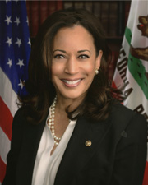
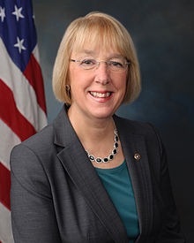
Senate Leadership
Constitutionally Mandated Officers
Vice President
Kamala Harris (D)
President Pro Tempore
Patty Murry (D)

Slide 10
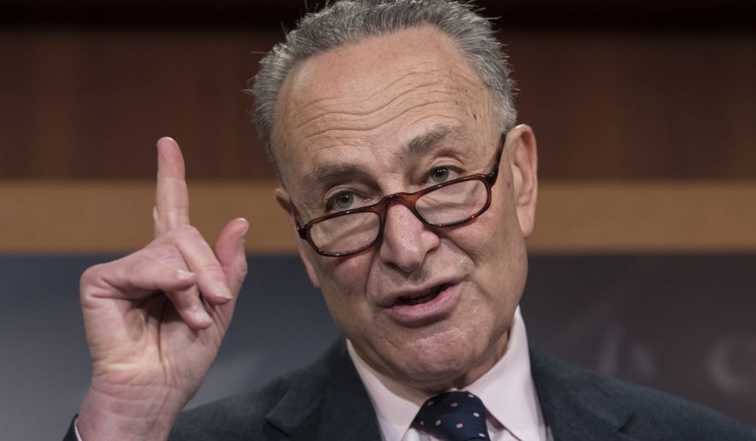
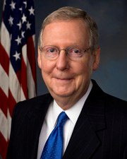
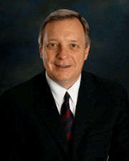
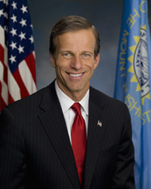
Other Senate Leadership
Majority Leader
Charles Schumer (D)
Minority Leader
Mitch McConnell (R)
Majority Whip
Richard Durbin (D)
Minority Whip
John Thune (R)

Slide 11
118th Congressional Make up
House Of Representatives
212 Dems and 221 GOP
2 Vacancies
Senate
48 Dems
3 Independents (all work with Democrats)
49 GOP

Slide 12
118th Congressional Make up
The average age of Members of the House at the beginning of the 118th Congress was 57.9 years; of
Senators, 64.0 years.
• The overwhelming majority, 96%, of Members of Congress have a college education.
• The dominant professions of Members are public service/politics, business, and law.
• Most Members identify as Christians, and the collective majority of these affiliate with a Protestant
denomination. Roman Catholics account for the largest single religious denomination, and numerous other
affiliations are represented, including Jewish, Mormon, Buddhist, Muslim, Hindu, Greek and Russian
Orthodox, Pentecostal Christian, Unitarian Universalist, and Adventist.
• The average length of service for Representatives at the beginning of the 118th Congress was 8.5 years (4.3
House terms); for Senators, 11.2 years (1.9 Senate terms).
• One hundred fifty-four women serve in the 118th Congress: 129 in the House, including 3 Delegates and the
Resident Commissioner, and 25 in the Senate.
• There are 60 African American Members of the House and 3 in the Senate. This House number includes 2
Delegates.
• There are 62 Hispanic or Latino Members serving: 56 in the House, including 2 Delegates and the Resident
Commissioner, and 6 in the Senate.
• There are 21 Members (16 Representatives, 3 Delegates, and 2 Senators) who are Asian Americans or
Pacific Islander Americans.
• Five Native Americans (American Indians or Alaska Natives) serve in the 118th Congress (4 in the House,
1 in the Senate).

Slide 13

Characteristics of members
Members are not able to claim descriptive representation. Meaning they do not look like the USA in a snapshot.
They do, however, engage in substantive representation. Meaning they fight for certain groups, so that all groups have a voice.

Slide 14
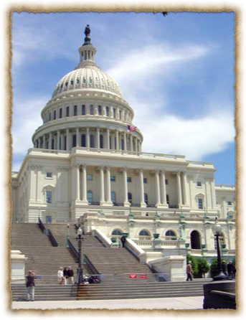
Being a Congressmen (Women)
The average salary of a congressmen is approx. $174.000 per year.
Some leadership positions make more as example: the Speaker of the House makes $223,500 a year.
Great benefits including retirement for all members who serve.
58% of all members are millionaires

Slide 15
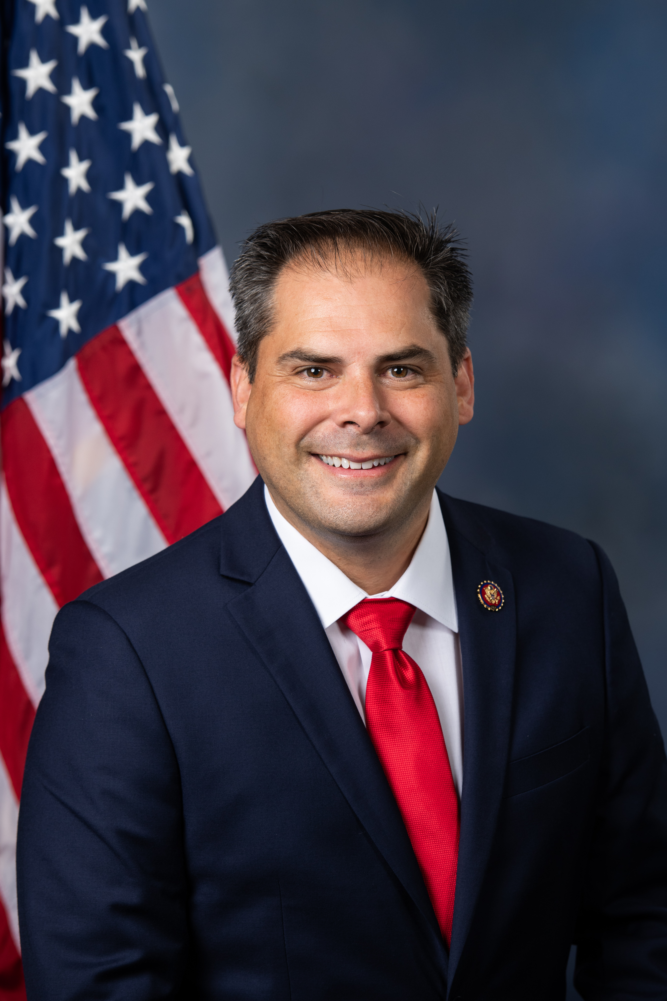
Being a Congressmen (Women)
Main job is to serve their Constituents
Office space in Washington as well as in the community or state the serve.
Travel allowances and the use of "junkets".
Franking privileges (free use of the federal mail system)
Free flowers from National Botanical Gardens.
Research services from Library of Congress.
Rep. Mike Garcia

Slide 16
Serving Constituents
Party Views. (Organizational View) Congress is organized primarily along party lines, so party membership is an important determinant of a member’s vote.
Delegate (Representational View) – An official who is expected to represent the views of his or her constituents even when personally holding different views; one interpretation of the role of legislator.
Trustee (Attitudinal View) An official who is expected to vote independently based on his or her judgment of the circumstances; one interpretation of the role of the legislator.

Slide 17
Incumbency in the House and Senate
The House (90% approx.) has a higher rate of incumbency reelection than the Senate (80% approx.)
  House members serve in small, often safe districts
  House members serve two year terms.
  House members run for reelection almost all of the time.
  Only 38 of 378 Incumbents lost in the 2018 Elections

Slide 18

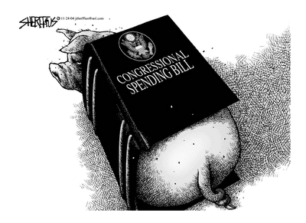
The Incumbency Advantage
  Advertising:
    The goal is to be visible to voters.
    Frequent trips home & newsletters are used.
  Credit Claiming:
    Casework: providing help to individual constituents.
    Pork Barrel: federal projects and grants that benefit a congressional district or state.
    Earmark: a provision in a bill that benefits a particular group.

Slide 19
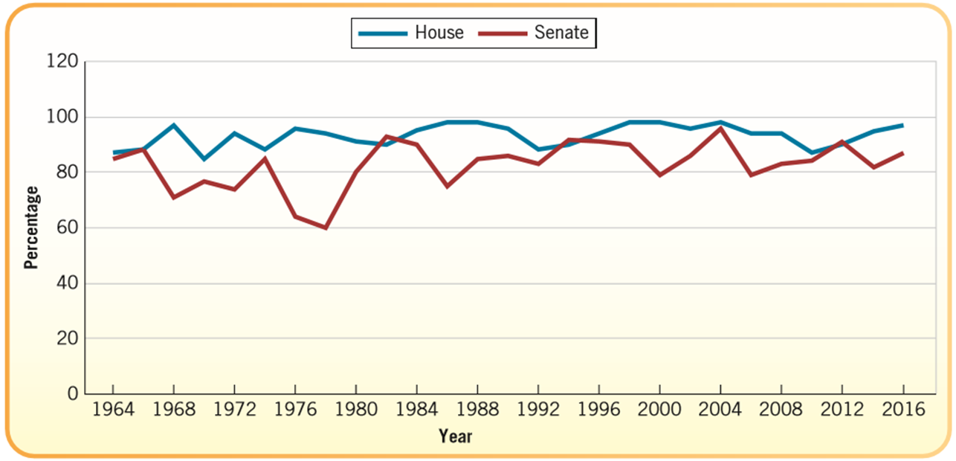
The Incumbency Advantage
  Position Taking:
    Portray themselves as hard working, dedicated individuals.
    Occasionally take a partisan stand on an issue.
  Weak Opponents:
    Most opponents are inexperienced in politics.
    Most opponents are unorganized and underfunded.

Slide 20
Why Incumbents Sometimes Lose
Incumbents may become involved in a scandal.
Incumbents may be redistricted out of their seat and may face another incumbent in their new district.
Redistricting may cause a seat to become competitive but usually does not happen this way.
There might be a “throw the bums out” sentiment.

Slide 21

The Role of Party Identification
Most members of Congress come from a district that is a majority of the party that they represent.
Malapportionment: When districts in a state are unequal in size and population.
Promotes the concept of gerrymandering
Districts can change over time as people move in or out and also as the community ages.
Partisan Polarization has become the new normal in voting in Congress. Not new to politics though.
Marginal districts
Safe Districts
Key Cases:
Baker v. Carr (malapportionment)
Wesberry v. Sanders (districts of different size)
League of United Latin American Citizens (LULAC) v. Perry (gerrymandering)
Governor of Texas

Slide 22
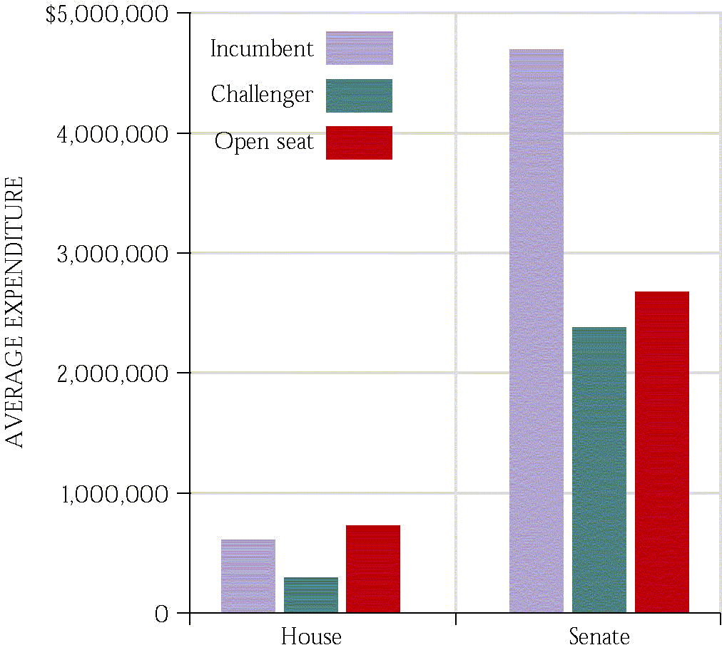
Spending in Congressional Elections
  Open seats are expensive.
  PACs contribute directly to candidates.
  527s and 501(c)(3)s spend independently.
  Spending lots of money does not guarantee a win.

Slide 23
How Members Make Decisions
Interest Groups
Colleagues
Caucuses
Party &
President
Representative
Constituents
Staff
Political Action Committees

Slide 24
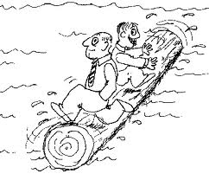
Logrolling
Logrolling means exchanging votes for favors.
“I’ll vote for your bill if you vote for my bill.”

Slide 25


Slide 26
Powers of Congress
To lay and collect taxes, duties, imposts, and excises
To borrow money
To regulate commerce with foreign nations/among states
To establish rules for naturalization and bankruptcy
To coin money, set its value, and punish counterfeiting
To fix the standard of weights and measures
To establish a post office and post roads
To issue patents and copyrights to inventors/authors
To create courts inferior to the Supreme Court
To define/punish piracies, felonies on high seas, and crimes against law of nations
To declare war
To raise and support an army and navy; make rules for their governance
To provide for a militia
To exercise exclusive legislative powers over seat of government, federal facilities
To “make all laws which shall be necessary and proper for carrying into execution the fore-going powers, and all other powers vested by this Constitution in the government of the United States.”

Slide 27
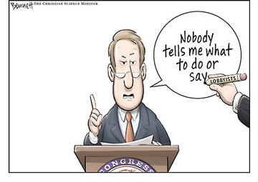
The Congressional Process
Lobbyists and Interest Groups
  There are over 26 lobbyists for every member of Congress- the bigger the issue, the more lobbyists will be working on it.
  Lobbyists can be ignored, shunned and even regulated by Congress.
  Ultimately, it is a combination of lobbyists and others that influence members of Congress.

Slide 28
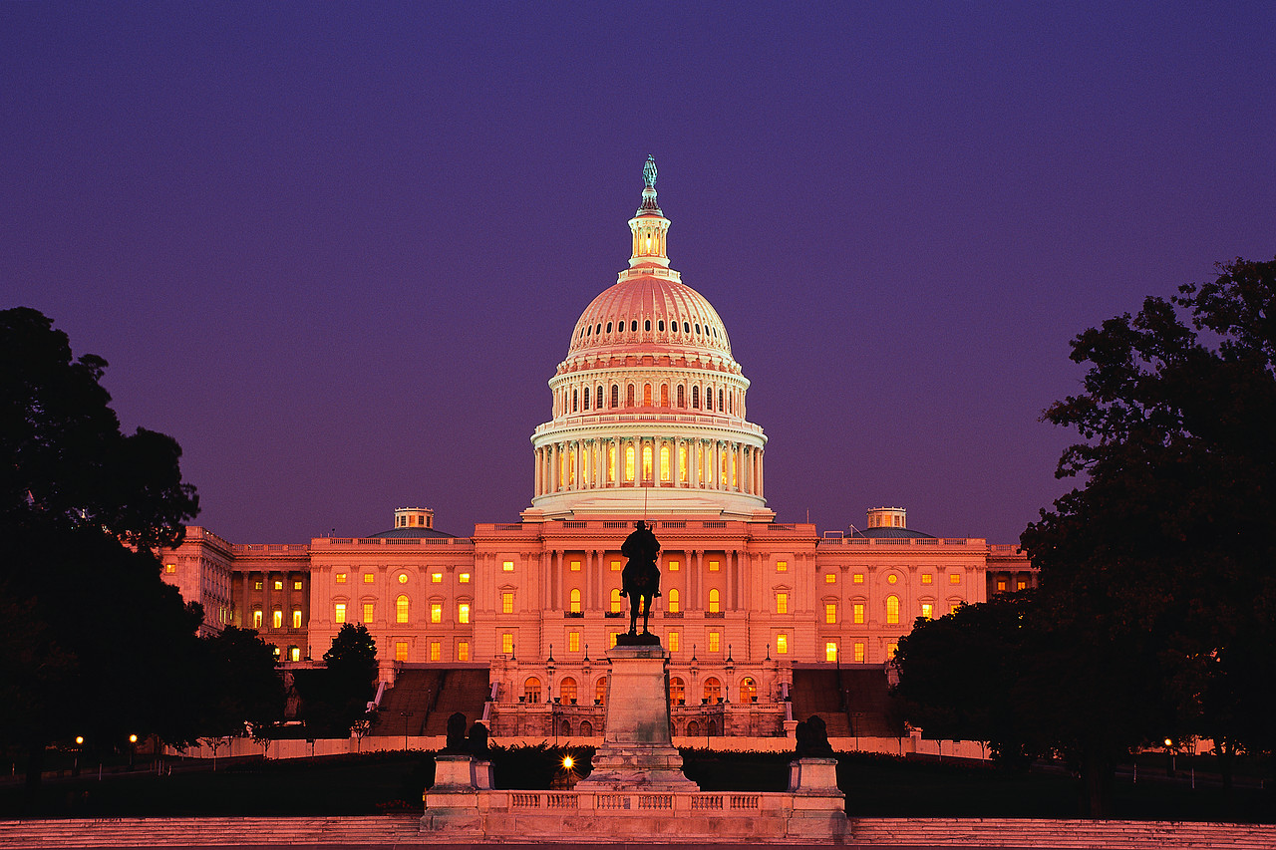
“Congress in session is Congress on public exhibition, whilst Congress in its committee-rooms is Congress at work.” –Woodrow Wilson

Slide 29
How Congress is Organized to Make Policy
Committees and Subcommittees
  Standing committees: subject matter committees that handle bills in different policy areas
  Joint committees: a few subject-matter areas—membership drawn from House and Senate (example: Printing and Taxation committiees.
  Conference committees: resolve differences in House and Senate bills
  Select committees: created for a specific purpose, such as the Watergate investigation
  Seniority rule – A legislative practice that assigns the chair of the committee or subcommittee to the member of the majority party with the longest continuous service on the committee.

Slide 30
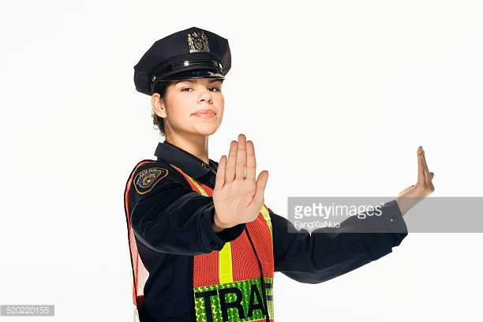
Rules Committee
Why is it important?
  The rules committee is like the “traffic cop”

Slide 31
Some other important Committees
House Appropriations Committee: sets funds for specific projects and programs.
House Ways and Means Committee: considers tax bills
Senate Finance Committee: considers tax bills

Slide 32
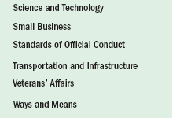
How Congress is Organized to Make Policy

Slide 33
The Committees at Work: Legislation and Oversight
How Congress is Organized to Make Policy
  Legislation
    Committees work on the 11,000 bills every session
    Some hold hearings and “mark up” meetings
    Pigeonholed: when a bill is forgotten, delayed or dead in committee.
    Discharge Petition: a way that if a committee holds a bill for longer than 30days any member can file for this and if 218 members sign it, then the bill comes to floor for debate.
  Legislative oversight
    Monitoring of the bureaucracy and its administration of policy through committee hearings
    As publicity value of receiving credit for controlling spending has increase, so too has oversight grown

Slide 34
How Congress is Organized to Make Policy
Getting Ahead on the Committee
  Committee chair: the most important influencer of congressional agenda
    Dominant role in scheduling hearings, hiring staff, appointing subcommittees, and managing committee bills when they are brought before the full house
  Most chairs selected according to seniority system.
    Members who have served on the committee the longest and whose party controlled Congress become chair

Slide 35
How Congress is Organized to Make Policy
Caucuses: The Informal Organization of Congress
  Caucus: a group of members of Congress sharing some interest or characteristic
  About 300 caucuses
  Caucuses pressure for committee meetings and hearings and for votes on bills.
  Caucuses can be more effective than lobbyists.

Slide 36
How Congress is Organized to Make Policy
Congressional Staff
  Personal staff: They work for the member, mainly providing constituent service, but help with legislation too.
  Committee staff: organize hearings, research and write legislation, target of lobbyists
  Staff Agencies: (CRS) Congressional Research Service, (GAO) Government Accountability Office, (CBO) Congressional Budget Office provide specific information to Congress

Slide 37
The Congressional Process
Legislation:
  Bill: a proposed law
  Anyone can draft a bill, but only members of Congress can introduce them.
  More rules in the House than in the Senate
  Party leaders play a vital role in steering bills through both houses, but less in the Senate
  Countless influences on the legislative process

Slide 38
How Voting Occurs in Congress
Teller Vote: in which members file past the clerk stating their “yeas” and “nays”
Voice Vote: members shout “yea” or “nay”
Division Vote: members stand to be counted
Roll Call Vote: Members answer “yea” and “nay” when name is called.
Electronic Voting: using a plastic card in a machine to place vote: (like in the movie)

Slide 39
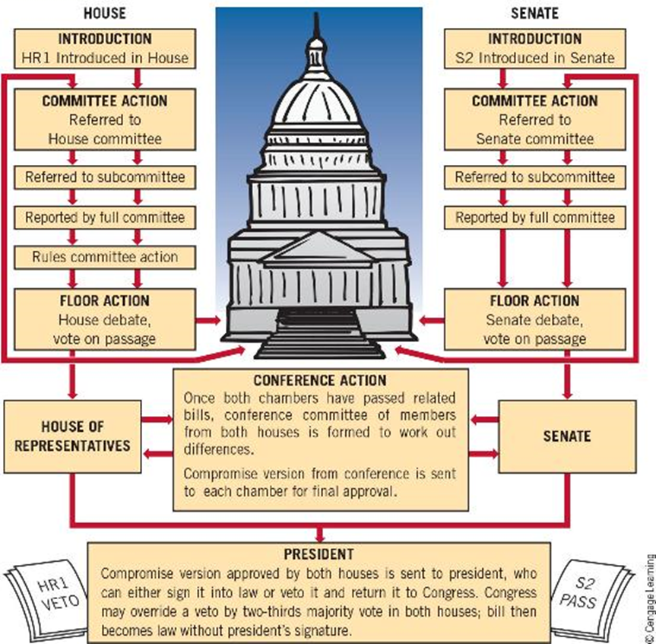
The Congressional Process

Slide 40
Some key Terms
Committee of the Whole: 100 members needed to have a quorum where the bill would be discussed on the floor. The bill then goes onto the full floor.
Germane: means that a amendment to the bill must be relevant to the bill being considered.
Super majority when one party holds 60 votes in the Senate.
Rider: In legislative procedure, a rider is an additional provision added to a bill or other measure under the consideration by a legislature, having little connection with the subject matter of the bill. Riders are usually created as a tactic to pass a controversial provision that would not pass as its own
Christmas-tree bill: A bill with many riders.

Slide 41
Types of Resolutions
Simple Resolution: if passed establishes rules, regulations or practices that do not have the force of law.
Concurrent resolution: comes from both houses, and often settles housekeeping and procedural matters that affect both chambers of Congress.
Joint Resolution: requires approval of both chambers and the signature of the president. (Law)

Slide 42
Congressional Procedure Terms
Closed rule – A procedural rule in the House of Representatives that prohibits any amendments to bills or provides that only members of the committee reporting the bill may offer amendments.
Open rule – A procedural rule in the House of Representatives that permits floor amendments within the overall time allocated to the bill. (bills must be germane which means they must have to deal with the subject of the bill)
Restrictive rule: An order from the House Rules Committee that permits certain kinds of amendments but not others.

Slide 43
Congressional Procedure Terms
Hold – A procedural practice in the Senate whereby a senator temporarily blocks the consideration of the bill or nomination. (sometimes called Pigeon Hold)
Filibuster – A procedural practice in the Senate whereby a senator refuses to relinquish the floor and thereby delays proceedings and prevents a vote on a controversial issue.
Cloture – A procedure for terminating debate, especially filibusters, in the Senate.
Double Tracking: A procedure that allows the Senate to move onto other business but still keep a bill debate open for a future time.

Slide 44
Congressional Procedure Terms
Pork Barrel: (ear marks) the use of government funds for projects designed to please voters or legislators and win votes.
Example: Bridge to Nowhere:
Hidden Earmarks- Are Pork that are placed in bills that are not seen by Congress as a whole so they are not actually voted on.

Slide 45
The Congressional Process
Presidents and Congress: Partners and Protagonists
  Presidents attempt to persuade Congress that what they want is what Congress wants.
  Presidents have many resources to influence Congress.
  But to succeed, the president must win at least 10 times.
  Ultimately, residential leadership of Congress is at the margins.

Slide 46
Understanding Congress
Congress and Democracy
Representation versus Effectiveness
  Supporters claim that Congress is:
  a forum in which many interests compete for policy
  is decentralized, so there is no oligarchy to prevent comprehensive action
  Critics argue that Congress:
  is responsive to so many interests that policy is uncoordinated, fragmented, and decentralized
  is so representative that it is incapable of taking decisive action to deal with difficult problems

