Slide 1

Discovering the
Golden Mean
In Mass Communication

Slide 2

`
Journalism
Fake News
Making an honest and compelling report
Boring the Audience
Extreme 1
Golden Mean
Extreme 2

Slide 3

Extreme 1: Fake News
Fake News:
Communicators that exhibit this extreme will lie, twist, and even fabricate entire stories in order to increase viewership. Some writers, with this framework, may craft misleading headlines in order to boost clickthrough rates. In other words, false claims don’t just take place over the course of a full broadcast. In fact, most of the dishonesty comes in the headline or just before the commercial break.

Slide 4

Extreme 2: Boring the Audience
Boring the Audience:
A dull delivery is sure to deter viewers from consuming any real news that might occur in the future. Writing the story in a bland fashion will decrease readership, a monotone news anchor will move people to turn off the TV, and an unaesthetic interface could cause users to delete an app. Therefore, if news and information is presented too plainly, our public could become more and more out-of-touch with current and important events.

Slide 5

The Golden Mean : honest and compelling reports
Making honest and compelling reports:
Journalists can stick to the news while still bringing a personal flare to their craft. Some editorializing is good — but reporters shouldn’t overdo it. Instead, when a personal opinion is injected, it might serve everyone to let it be known.

Slide 6

Advertising
Lying about your product
and its capabilities.
Helpful ads that meet consumer needs.
Mundane product
descriptions.
Extreme 1
Golden Mean
Extreme 2

Slide 7


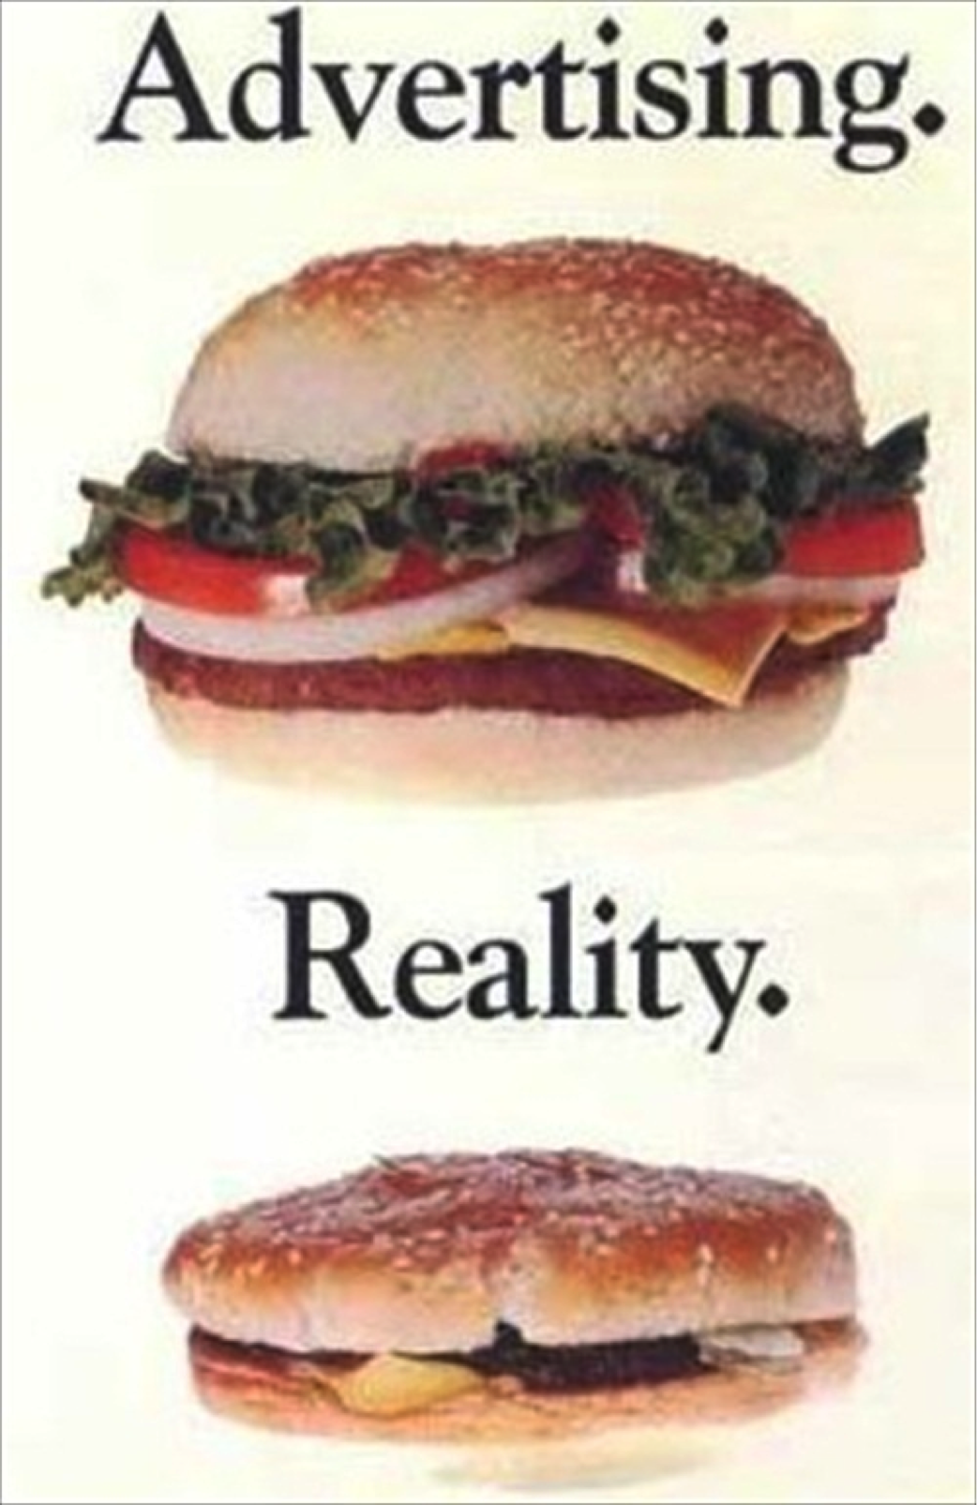
Extreme 1: Lying about a product
Lying about a product:
People are losing trust in traditional advertising. Consumers are tired of the false promises that ads can sometimes bring. Not only is it unethical for a brand to lie about its product, it’s also a bad business decision (we’ll get into that later). But some CEO’s, who chase after extra dollars and cents, resort to the shameful method of making ridiculous, unfulfillable claims.

Slide 8

Extreme 2: Describing your product in mundane language.
Boring product descriptions:
Some ads are just begging to be skipped; they don’t offer anything of value to the viewer. Avoid being so honest that all you do is list the technological jargon associated with your product. For instance, people don’t buy a car because it has “carbon fiber side skirts” (or some other complicated feature)…They buy it because it’s reliable or because they’ll look good in it. So, instead of an endless list of irrelevant features, the beginnings of an ad campaign should tell stories about how consumers will benefit from the purchase.

Slide 9

The Golden Mean : Helpful ads that meet consumer needs
Telling consumers about the value and benefits of a product:
In the long run, it pays to be honest. When you’re realistic about the capabilities of your brand, people will buy with high (but realistic expectations). Then, when your product delivers, you gain credibility. Telling a story about how the product can solve a problem is an easy way to be honest but interesting enough to capture attention and gain credibility.

Slide 10

Social Media
Committing
Social Media
faux pas.
Standing out from the pack
while also meeting the
standards for each platform
Being too transparent.
Extreme 1
Golden Mean
Extreme 2

Slide 11

Extreme 1: Internet Faux Pas
Faux Pas:
Each social media platform has written and unwritten rules of conduct. Sending identical DMs to a large list of people, for instance, is not acceptable on Twitter. It’s unethical to expect (or force) entire outlets to accommodate strange online behaviors. But violating community guidelines isn’t the only way to be unethical across social media. Here are some other ways:
                • Copyright law infringement/plagiarism
                • Communicating over the internet inappropriately. (i.e. Firing personnel)
                • Posting vulgar texts and images or spreading false information
                • Sharing someone else’s personal information.

Slide 12

Extreme 2: Being too transparent
Being too transparent:
Honesty is great…but not every client, employee, or colleague wants you to share their information. Many brands wish to leverage positive internet reviews. But it may be best to consult with that client before quoting them in your next post. For personal accounts, factor in your friends’, family, and coworkers’ willingness to be filmed/shared online. If someone doesn’t want to be on your page, keep them off of it.

Slide 13





The Golden Mean : Standing Out from the Pack
Standing out:
If too much transparency and rewriting the social media rules are unethical, then how can a brand or influencer stand out. First, a pages should appear personal and honest — the tick is to not overdo it. Don’t crowd timelines by posting every one of your flaws or mistakes. And don’t share certain information without explicit information. However, your posts should reflect that people, real humans, actually work at your firm. People connect better when with anthropomorphized brands. Plus, the information that you share should make attempts to have followers feel like insiders. For instance, your Facebook followers should be some of the first to know about a holiday sale.

Slide 14

Cinema-Television
Raunchy Material
Relatable and entertaining content
Unrealistic scripting
Extreme 1
Golden Mean
Extreme 2

Slide 15

Extreme 1: Raunchy Material
Raunchy Material:
Sometimes TV and movies overdo it on sexual innuendos, swearing, and violence. It can often seem like they’re trying to set the record for the most sinful movie ever (think Wolf of Wall Street).

Slide 16

Extreme 2: Unrealistic Screenwriting
Unrealistic scripts:
If we’re honest, vulgar language, sexual affairs, and acts of violence happen every day all over the world. Therefore, a screenplay, where none of this ever happened, might appear fake, impersonal, or unrealistic. Now, this doesn’t give us an excuse to compromise our values in the name of entertainment…because there are films and sitcoms that accomplished great feats without using explicit content.

Slide 17

The Golden Mean : producing relatable, entertaining content
Realistic and quality entertainment:
Writers may utilize some unethical behavior on-screen, in order to depict authentic scenarios, without endorsing the actions of characters. However, this does not give anyone a license to overdo it. There’s a fine line between reasonable dialogue and off-putting amounts of suggestive themes.

