Slide 1

An Overview of:
Trademarks, Copyrights, & Patents

Slide 2


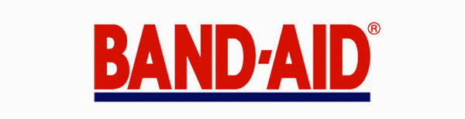
Trademarks
A word, name, symbol, or device used to indicate the source, quality, and ownership of a product or service.

Slide 3
Trademark Search
Reasons
- Before deciding on a product or brand name, it is imperative to search the online federal database (USPTO).
- Then, have an attorney research each of the 50 states’ trademarks and any “common law” (or un-registered) marks.
- Failure to do so could lead you into a confusing or illegal name choice.
Benefits
- Helps in avoiding accidental infringement
- Save time and money by staying out of legal trouble and eliminating possible mark choices.

Slide 4
Risks of not searching
Even unregistered mark owners can revoke your application if your mark is too similar, and their’s is in use.
Improper or negligent searches fail to catch slight similarities like plays on words, intentional misspellings, and the use of homophones and homonyms. If these similarities go unrecognized in a name selection process, it could cause legal trouble later on.

Slide 5
Trademark Application Process
Choose a mark
Verify that it is available be searching the federal database, the state registrations, and on a search engine to find any unregistered marks.
Identify the mark’s format: standard character, sound, or design.
Select the proper uses for the mark (whether goods or services).
Finalize a TEAS (Trademark Electronic Application System) form.
Seek the services of an attorney to review the application or clarify any questions about the overall process.

Slide 6
References:
Bouchoux, D. E. (2018). Intellectual property: The law of trademarks, copyrights, patents, and trade secrets.
Boston, MA: Delmar Cenage Learning.
Josh Gerben, E. (2020, February 10). Should I Conduct A Trademark Search Before Using My Trademark?
Retrieved December 14, 2020, from https://www.gerbenlaw.com/blog/should-i-conduct-a-trademark-search-before-using-my-trademark/
Trademark process. (2020, December 10). Retrieved December 14, 2020, from
https://www.uspto.gov/trademarks-getting-started/trademark-process.

Slide 7
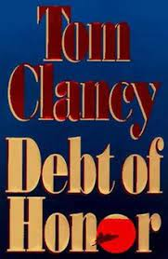
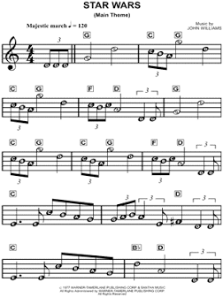

Copyrights
A federal protection covering original works of authorship. Instated from the time that a work exists in fixed form. No actual registration is required, but such registration comes with many benefits.
Examples:
Advertising copy
Literary Works Musical works

Slide 8
Copyright Searching
Purpose
Through a USCO database search, one can find information on:
The owner of a copyright.
transfers of ownership.
The date that a copyright was filed.
Discover a work’s status as public domain.
Establish key point of contact.
etc.

Slide 9
Risks of not searching
Accidental wrong use of a work. For example: permissions granted, from the original owner, will not necessarily remain with the new owner.
Plagiarism.
Paying damages to copyright owners for the above incidents.

Slide 10
Copyright Registration Process
Create a work.
Gather money for registration fees and a copy of the work in question.
Fill out an online ‘eCO’ form.

Slide 11
References:
Haskins, J. (2020, November 20). Understanding the Copyright Registration Process. Retrieved December 14,
2020, from https://www.legalzoom.com/articles/understanding-the-copyright-registration-process
Registering a Work. (n.d.). Retrieved December 14, 2020, from https://www.copyright.gov/help/faq/faq-
register.html

Slide 12
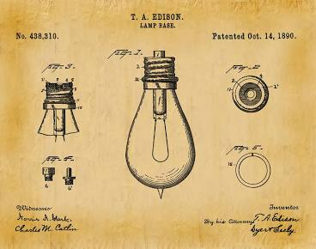
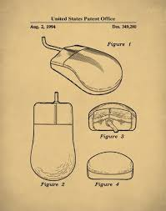
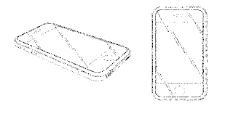
Patents
Federal government protection that grants one entity with the exclusive rights to create a new, non-obvious, and useful invention. While the patent is active, parties other than those featured on the registration will be prohibited from creating a similar item.
Patents through time…

Slide 13
Patent Search
Reasons
- The best reason to conduct a patent search is because it could save you thousands of dollars.

Slide 14
Risks of not searching
The biggest risk of not searching is erroneously spending thousands of dollars.
That’s the typical cost of obtaining a patent in the U.S. — and some applicants don’t realize that their idea or invention is not patentable. A better search process could be the solution to a better understanding of eligibility.

Slide 15
Patent Application Process
Decide on which type of patent to apply for. (utility, design, or plant)
Raise money to cover application or attorney fees.
Submit application on EFS-Web.

Slide 16
References:
Patent process overview. (2020, May 15). Retrieved December 14, 2020, from https://www.uspto.gov/patents-
getting-started/patent-process-overview
2020 How Much Does A Patent Cost?: Cost To File & Patent An Idea. (n.d.). Retrieved December 14, 2020, from
https://thervo.com/costs/how-much-does-a-patent-cost

