Slide 1
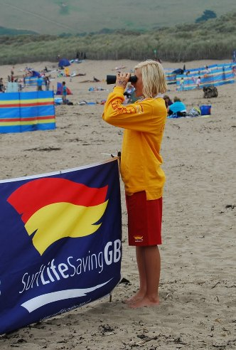
SLSGB Lifeguard Awards
Unit - Beach Patrolling
Notes:
Trainer Assessor’s Please note:
This powerpoint is the basic information that needs to be covered for this unit. The majority of the slides need further explanation (notes have been included on each slide to help you). As a competent Trainer Assessor you need to ensure that you are inserting learning activities, group work, quizzes etc. Where you see appropriate, in order to ensure that we are delivering quality teaching practice. You should be encouraging active learning that is learner led, see the resource bank section of moodle if you want inspiration for activities! This will be monitored during quality assurance visits to ensure that this is happening!

Slide 2
Learning Outcomes
1.1. Demonstrate a thorough knowledge of beach patrolling.
1.2. Explain the Roles and Responsibilities of the Lifeguard

Slide 3
1.1. Demonstrate a thorough knowledge of beach patrolling.

Slide 4
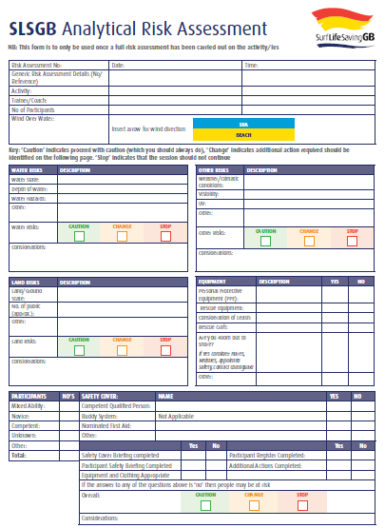
Analytical Risk Assessment Form
(Completed for patrol once a full risk assessment has been done)
Analytical Risk Assessment Activity
Complete an Analytical risk assessment of the training location you are currently at
Notes:
Tutor Notes:
Learners to consider all risks associated with patrol – Outline clearly that there must be a full risk assessment done for patrolling that is relevant to the specific environment that training is happening at e.g. where are the rips
Explain the purpose of analytical risk assessment, and that they should be completed for each patrol day.
Get learners to complete an analytical risk assessment of the location you are at now.
*This needs to be done at the start of patrol

Slide 5
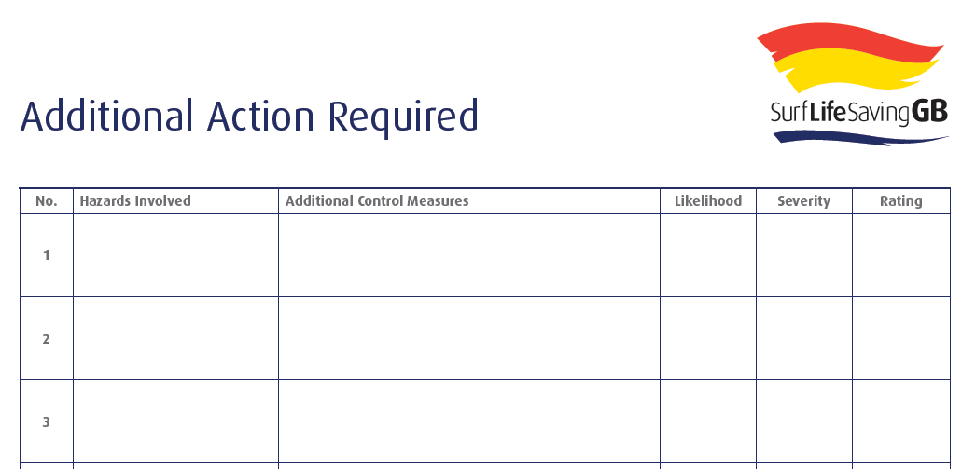
Analytical Risk Assessment Evaluation
If any of the ‘change’ boxes were ticked on the analytical risk assessment then the following needs to be completed using the same risk rating as the full risk assessment:
  LO 1.3.
Notes:
Discuss additional actions if needed…

Slide 6
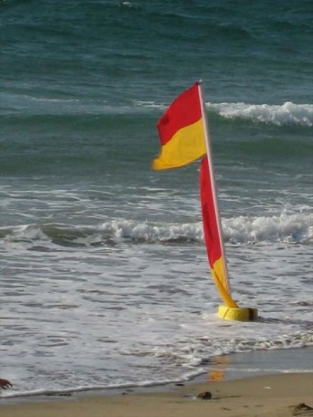
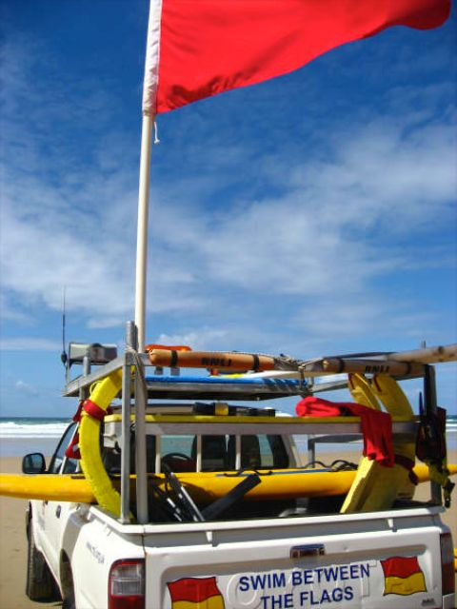
Patrol Methods
Traditional
Roving
Outpost
Open
Surveillance
Patrol Strength
What is the minimum number of lifeguards to have on patrol?
Two
Notes:
Trainer Assessor Notes: Use these notes to help you deliver the session (if needed)
Increased access to coastal areas has lead to increased requirements for patrol activities and methods.
Traditional (between the flags)
This is the most commonly used method and simply requires the setting of flags at the safest place on the beach
Roving
This is used in conjunction with any other patrol method. The flagged area is set and manned, as with the
traditional method. The Head Lifeguard then designates lifeguards, in pairs, who move back and forth along the
beach maintaining surveillance outside flagged areas. This method of patrol can utilise IRBs and beach vehicles and
extends the boundaries of the patrol.
Outpost
This involves the traditional method at a popular swimming area unable to have bathing area flags but
allows a minimum patrol (outpost) to be set up.
Open beach
This method involves the erection of lifeguard towers at intervals along the beach. These towers have an
overlapping rescue capability to the tower on either side. There are no bathing area flags placed.
Surveillance
This method requires the minimum patrol size (that is two SLSGB Beach Lifeguard holders with one being
experienced). It is a method that ensures an adequate patrol is present at those periods when water safety requirements are fulfilled by this minimum patrol (for example, periods where it is normal for only small numbers to attend the beach – early mornings, late afternoons).
6

Slide 7
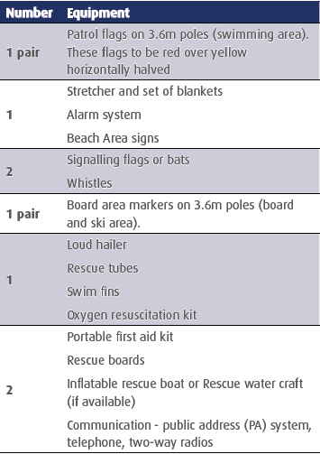
In groups list all of the equipment that you think a patrol would need?
Patrol Equipment
For each of the following equipment…List the safety checks that need to be done
Notes:
Trainer Assessor Notes: Use these notes to help you deliver the session (if needed)
The preceding section set out the major equipment available to the lifeguard. The following is a list of the
minimum recommended equipment to be used on a patrol or by a beach lifeguard unit.
Number Equipment
1 pair
Patrol flags on 3.6m poles (swimming area). These flags to be red over yellow horizontally halved
1
Stretcher and set of blankets
Alarm system
Beach Area signs
2
Signalling flags or bats
Whistles
1 pair
Board area markers on 3.6m poles (board and ski area).
1
Loud hailer
Rescue tubes
Swim fins
Oxygen resuscitation kit
2
Portable first aid kit
Rescue boards
Inflatable rescue boat or Rescue water craft (if available)
Communication - public address (PA) system, telephone, two-way radios

Slide 8




Flag Systems
Signal flags - Used by lifeguards to signal messages to each other.
Signifies danger! The lifeguard is advising that it is too dangerous to bathe.
Board area (For hard craft such as windsurfers, kayaks, paddle boards). It is not safe to swim in this area.
Bathing areas that are patrolled by lifeguards. This is the safest area to swim (for bathers)
Notes:
8

Slide 9
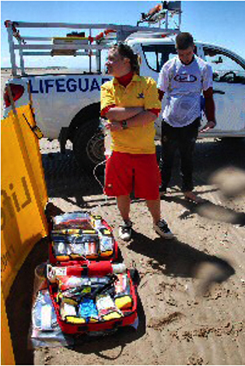
Setting up a patrol
Patrol Captain is in charge
Equipment checks
Radio check
Check first aid kit is stocked
Select safest swimming area for patrol
Put up the patrol flags
Place additional rescue equipment in non patrolled areas
Consider whether the beach has a hard craft (surfing) area
Notes:
Trainer Assessor Notes: Use these notes to help you deliver the session (if needed)
The Senior Lifeguard is in charge of all operations. Prior to the commencement of duty, equipment should be
checked for efficiency of operation. All the patrol members need to be aware of how to use it.
When selecting the safest area of the beach for swimmers and the position of equipment, the patrol should be in an
elevated area to gain a true picture of the beach conditions. Also, patrol members should physically test,
that is swim, the selected safe area before the patrol flags are placed. A lifeguard should be positioned in an
elevated tower where he can clearly observe the overall area and watch for bathers in difficulty.
Remembering that the flagged area is the safest location for swimming, minimum amounts of equipment are
needed in the flagged area. Equipment needs to be placed in other areas of the beach where its use may be required, such as rips and popular swimming spots. Attention should be given to suitable areas for surfboard riding,
clear of the bathing public. Board riders are a part of the surfing environment and should receive consideration
from the patrol.
9

Slide 10
1.2. Explain the Roles and Responsibilities of the Lifeguard

Slide 11
What is a ‘Lifeguard’?
Someone that is…
‘Qualified and employed to fulfil the requirements of the role of a lifeguard whilst on duty’
Notes:
Trainer Assessor Notes: Use these notes to help you deliver the session (if needed)
Where constant supervision is required, lifeguards should be sufficient in number, adequately trained and effectively
organised and supervised. The lifeguard’s duties on the beach are to:
1. maintain concentrated observation of the beach, sea and beach users in order to anticipate problems (for example, rowdy behaviour or someone swimming into a dangerous area) and to identify any emergency quickly
2. supervise the use of other beach equipment when allocated to these duties
3. carry out rescues and initiate other emergency action as and when necessary
4. give immediate first aid in the event of injury to a bather or other emergency
5. communicate with bathers (and with any other lifeguards or lifesavers on duty) to fulfil the above tasks.
6. Complete relevant paperwork and administration required for the role
Lifeguards must not only be physically fit (including good vision and hearing) but also mentally alert, sensible and
self disciplined. Effective leadership and example can foster the necessary commitment by management and supervisors. Lifeguards can also be encouraged to take a broad view of their duties, for example, by undertaking ancillary duties such as checking and maintaining safety and rescue equipment and reporting incidents that may require improved safety arrangements.
Identify key aspects of relevant statutory requirements and codes of practice within SLSGB

Slide 12
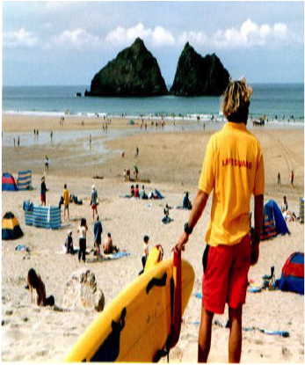
Responsibility of patrols
Prevent
Recognise
Rescue
Notes:
Trainer Assessor Notes: Use these notes to help you deliver the session (if needed)
The day-to-day responsibilities of a lifeguard unit would normally be covered in the NOPs. However, supplementary
responsibilities abound and the following sections serve to highlight the diversity of the lifeguard’s duties.
In general, a lifeguard must practise three important concepts:
• prevention
• recognition
• rescue.
Lifeguards should avoid performing excessive patrol duties on any one day, taking into account extreme cold or hot
conditions. Movement of the patrol flags and equipment, as close to the water’s edge as practical when the tide
ebbs, is an important function of a patrol’s operation. All patrols should be encouraged to ensure the deployment of
patrolling lifeguards at the water’s edge. Beware when there are no bathers in the water (no
matter what flags are flying); the water must always be under close supervision. When the red flag is flying and
there are members of the public on the beach, a lifeguard should be at the water’s edge. A dangerous condition is
described as one, in the opinion of the lifeguards on duty, where bathers, by entering the water, will place
themselves and others in a life-threatening situation. It should be the responsibility of the Head Lifeguard, or
appointee, to record the required information in the logbook during hours of operation. All incidents, including rescue, first aid or lost children must be logged on the relevant incident form.
12

Slide 13
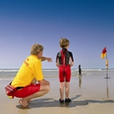
Roles and Responsibilities
Observe the beach, ensuring all users remain safe
Identify emergencies and respond as appropriate
Supervise the use of beach equipment
Communication with all beach users (bathers, other lifeguards etc.)
Carry out rescues
Give immediate first aid
Complete paperwork and administration as required e.g. incident report forms
Notes:
Trainer Assessor Notes: Use these notes to help you deliver the session (if needed)
Where constant supervision is required, lifeguards should be sufficient in number, adequately trained and effectively
organised and supervised. The lifeguard’s duties on the beach are to:
1. maintain concentrated observation of the beach, sea and beach users in order to anticipate problems (for example, rowdy behaviour or someone swimming into a dangerous area) and to identify any emergency quickly
2. supervise the use of other beach equipment when allocated to these duties
3. carry out rescues and initiate other emergency action as and when necessary
4. give immediate first aid in the event of injury to a bather or other emergency
5. communicate with bathers (and with any other lifeguards or lifesavers on duty) to fulfil the above tasks.
6. Complete relevant paperwork and administration required for the role
Lifeguards must not only be physically fit (including good vision and hearing) but also mentally alert, sensible and
self disciplined. Effective leadership and example can foster the necessary commitment by management and supervisors. Lifeguards can also be encouraged to take a broad view of their duties, for example, by undertaking ancillary duties such as checking and maintaining safety and rescue equipment and reporting incidents that may require improved safety arrangements.
Identify key aspects of relevant statutory requirements and codes of practice within SLSGB

Slide 14
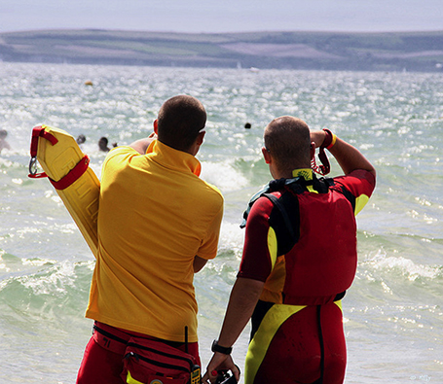
Patrol Uniform
PPE; Sunglasses,
Hat to protect from UV rays
Yellow t-shirt
Red shorts or tracksuit bottoms
If at waters edge or on craft;
Wetsuit
Trunks/swimming costume
Rash vest
If away from station;
Whistle
Rescue Tube
First aid kit
Remember…You are portraying an image; efficient, disciplined, tidy, alert!
Notes:
Trainer Assessor Notes: Use these notes to help you deliver the session (if needed)
When on duty, wear your red/yellow uniform. This allows identification to the public and can help other lifeguards
identify you, so helping with backup procedures. When at the water’s edge or on craft wear a rash vest or wetsuit.
Lifeguard uniform should be worn in conjunction with a swimming garment (such as trunks). Lifeguards neatly
attired, who can be readily identified by members of the public, portray an image of efficiency and discipline. Clean
and tidy kit shows you off, your Club, sponsors and surf lifesaving in general. Look and be alert. Lifeguards should
not have a casual manner near rescue equipment because this reflects on how the public will respond to a lifeguard’s instructions.
Lifeguards, on duty and away from the station (in lifeguard uniform), should carry a whistle and radio, tube, and 1st aid kit. All lifeguards should be aware of beach dangers and exposure to the Sun’s rays. Necessary precautions should be taken by wearing protective clothing.
14

Slide 15
Personal Protection
Keeping warm
C | Clean | Have clean clothes that can trap the air, dirt can block these spaces
O | Overheat | Open or remove clothes while exercising to prevent perspiration build up
L | Loose, Layered, Light | Several light layers are more efficient than one heavy item, which can restrict blood circulation
D | Dry | Outer clothing layers should be waterproof, inner layers should ‘breathe’ to let internal moisture escape

Slide 16

Personal Care
Reduce Body Stress
Fitness
What else can I do to ensure I remain an effective member of patrol?
Physical
Conditioning
Lifestyle
Diet
Teamwork

Slide 17
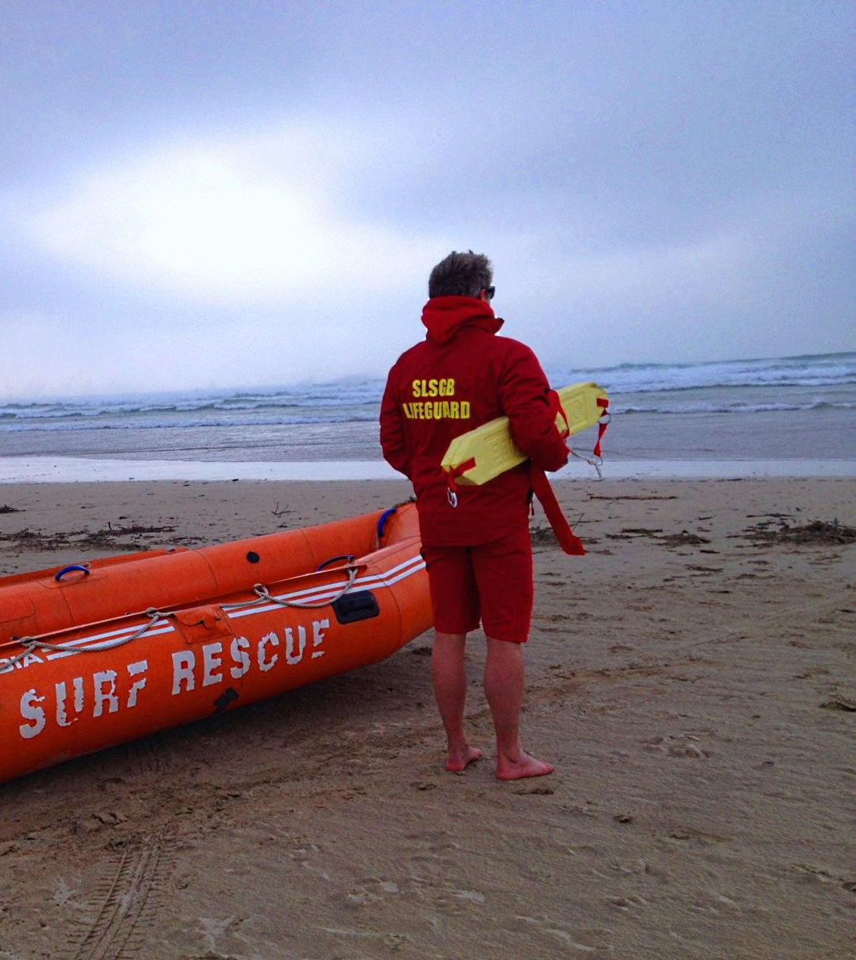
PPE – Personal Protective Equipment
Wearing sunglasses and clothing that protects the skin
Use of pocket mask
Safe disposal of all first aid equipment used
Positive Aid
Wearing gloves
Wash hands with soap and water after contacting blood / body fluids, even if gloves are worn
Use re-usable resuscitation masks
Notes:
Trainer Assessor Notes: Use these notes to help you deliver the session (if needed)
Lifeguard exposure to infections is most likely through mouth-to-mouth or bleeding wounds. The most effective
way of avoiding contact is through the use of a face shield or pocket mask. These can be attached to a belt, rescue
tube or rescue board. It is only of use if kept available at all times by the lifeguard.
Recommendations on exposure to blood
during rescue
• Avoid skin contact with the casualty if possible – wetsuit/gloves.
• Avoid contact with bleeding areas when moving the casualty from water.
• Wash off any blood as soon as possible
• During deep water EAV, wash any blood or bodily fluids away from the casualty’s mouth before contact. Lifeguard’s mouth to be washed out after contact.
• If possible, move the casualty to dry sand to prevent further in-water exposure.
Recommendations on exposure to blood during medical treatment ashore
• Assume all blood and bodily fluid is infected and treat as such.
• Use reusable resuscitation masks with a system that prevents bodily fluids from passing through mask and thoroughly wash and sterilise after use.
• Wear gloves for handling any casualty who is/has been bleeding or any other bodily fluids that may be present.
• If the casualty is bleeding profusely, for example from an artery, also ensure your eyes are protected (shades)
and that you are wearing your patrol uniform. Keep your mouth closed.
• Wash hands with soap and water after contacting blood/bodily fluids, even if gloves are worn.
• Wear gloves. Clean up blood and bodily fluids on equipment with a germicide containing bleach then air dry
17

Slide 18

Patient movement and handling
33% of all reported accidents in the UK are due to manual handling.
Principles of patient moving & handling
STOP
• How else can the load be moved? Is it essential?
• "TILE O" Assessment (Task, Individual capacity, Load, Environment, Other factors)
• Plan
• Prepare
• Position
• Perform
Notes:
Trainer Assessor Notes: Use these notes to help you deliver the session (if needed)
Handling and moving
33% of all reported accidents in the UK are due to manual handling. It has been costed at £3 billion. Beach operators and lifeguards are under legal obligation to follow the Manual Handling Operations Regulations 1992 to avoid injury.
Preventing musculoskeletal injury
• Avoid lifting or apply approved moving techniques.
• Decide on own individual capability.
• Keep fit and exercise.
• Avoid constant standing or sitting in one position.
• Use warm up exercises whenever possible.
The nature of lifeguard work on one of the roughest and inaccessible coastlines in Europe means that there is great
risk of back injury and every effort must made to avoid the risks. Any technique taught should bear in mind the principles of good moving. For some operations, such as inshore rescue boat (IRB) use, it may not be possible to follow all the principles due to the operating conditions. However, known situations such as taking casualties/patients from the water can be planned for (for example, once ‘contact and control’ has taken place, the rescuer has time to decide on the most appropriate method of extraction).
The Handling of Patients states:
‘There are four situations that can be described as emergencies. In these situations the victim must be moved to safety immediately and there is no time to get equipment or plan the move. Risks may have to be taken. These situations are where a person is:
• in water in imminent danger of drowning
• in an area that is actually on fire or filling with smoke
• in danger from bomb or bullet
• in danger from a collapsing building or other structure.
These situations are extremely rare even for the emergency services.’ Clearly if the casualty has buoyancy, is breathing and is in a secure position they are not in imminent danger.
Principles of handling and moving casualties
Stop:
• how else can the load be moved? Is it essential?
• TILE O assessment (Task, Individual capability, Load, Environment, Other
factors)
• Four P’s (Plan, Prepare, Position, Perform)
• use the minimum of movement and tell casualty to keep still
• always explain before doing movement
• use equipment for the job (longboard, straps) or hold clothing
• move carefully to avoid stooping, twisting or bending back.
A person’s centre of gravity is just in front of the base of the spine. The feet bound an area called the base. When
the body moves from the area of the base the body is no longer at balance and will fall. A good base is one
shoulder-width apart. The base is maintained while moving by keeping the back foot pointing outwards.
Preparing to move
• Clear the area before starting.
• Plan a route that is clear of obstacles.
• Explain to the casualty what you will do. Beware if they are incapable of understanding.
• Use the whole hand to hold: fingers are very weak.
• When moving as a team, the person at the casualty’s head gives the lift instructions.
• The instructions must be clear, authoritative, rhythmical and easily understood.
Don’t use numbers. Instructions such as ‘Ready, steady, lift’ or ‘Prepare to lift, lift’ are common.
Check local protocols.
18

Slide 19
What is drowning?
The process of experiencing respiratory impairment from submersion or immersion in a liquid such that normal breathing is prevented
Immersion implies that at least the airway and face are under
the water, though the rest of the body may be floating.
Submersion requires that the whole body be below the
surface of the fluid.
Aspiration is the process of solids or fluids entering the lungs.

Slide 20
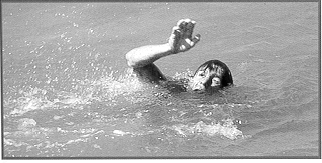
The Drowning Process
What characteristics do you think someone who is drowning will display?
1). Distress
2). Panic
3). Submersion
Sudden Drowning Syndrome
Existing medical conditions
e.g. heart attack/epilepsy/spinal
No process, instant submersion
Water Patrol at all times!!
Notes:
Trainer Assessor Notes: Use these notes to help you deliver the session (if needed)
Three distinct stages:
1). Distress
This is where a person has difficulty in getting to safety but has enough skill or buoyancy to stay afloat. They can wave or call for help. Some people may not know they are in trouble, for example someone swimming against a current, which could mean they present the ‘distress’ for seconds or minutes. Often in such cases, lifeguards can see the danger yet casualties complain they do not need rescuing because they do not feel helpless (distressed). Lifeguard should intervene at this early stage and often do where swimmers drift towards known rip currents.
2). Panic
This follows on from the distress stage as swimmers lose strength or panic on sudden water entry or depth increase. This is the classic ‘climbing the ladder’ stage, as the casualty just concentrates on getting air and cannot call for help
3). Submersion
Most drowning's occur due to victims sinking and rarely floating face down. Once submersion occurs it is incredibly difficult to discover or rescue a casualty due to water visibility, currents and breaking surf. Successful recoveries also rely on getting the casualty out quickly to medical attention although cold freshwater rescues have occurred up to an hour after submersion. The ‘window of success’ is likely to be as little as 2 minutes. It is essential that rescues occur at the distress and panic stages.
Sudden Drowning Syndrome
This occurs because of existing injuries or illnesses, unrelated to drowning conditions, occurring while casualties are in the water. Someone may have cardiac arrest (falling into cold water), epilepsy, spinal injury, severe trauma, too much alcohol/drugs and other illnesses. No struggle may be present or indications shown, nor hazards near. Hence, for a lifeguard it may be extremely difficult to spot before submersion. Therefore there must be a waterline patrol at all times people are in the water.
Secondary Drowning
This is where a casualty has inhaled water into their lungs. They will usually get a burning sensation in their nose, throat or chest. Once the water is in the lungs the body tries to flush out the salt in the water and results in you drowning internally. This can occur 72 hours after inhalation, therefore as a lifeguard it is imperative that if you think someone has inhaled water you advise them to seek medical attention.
20

Slide 21

Cold Water Immersion/Shock
= 15° or lower
Sudden immersion or submersion in cold water can have
profound effects on the way the human body operates.
Cold Water Shock has four characteristic phases;
Gasp Reflex 3. Impairment of Muscle Control
Rapid Breathing 4. Hypothermia & Dehydration
Notes:
Cold Water Immersion
Cold water has been defined as 15°C or lower*. The majority of inland bodies of water will only be warmer than this during the summer months. Some areas of the United Kingdom will have bodies of water that never elevate above this level. It is a commonly held misconception that casualties falling
into cold water die from “sudden hypothermia”. This is untrue and in fact it takes a relatively long period of time for casualties to become hypothermic.
Sudden death in cold water has many potential causes, some of which are discussed below.
Sudden immersion or submersion in cold water can have profound effects on the way the human body operates. These adverse effects are reduced in people who regularly expose themselves to cold water. This habituation is seen in open water swimmers, kayakers, surfers and other water uses who are immersed or submersed as part of their activity.
Immersion into cold water causes four characteristic phases known as cold shock:
Gasp reflex – an initial sharp uncontrolled intake of breath occurs. If the casualty’s face is under water they will aspirate water and may drown. Entering the water gradually will reduce the magnitude of this effect.
2. Rapid breathing follows which removes carbon dioxide from the body causing the casualty to blackout. There is also an increase in heart rate and blood pressure. These dramatic changes may lead to cardiac arrest. In addition the casualty may aspirate cold water increasing the rate of cooling and causing respiratory distress.
3. Muscle control is impaired by the cold water. Shivering will prevent efficient use of muscles to maintain position in the water and potential lead to swim
failure.
4. Water is more efficient than air at removing heat from the body resulting in hypothermia and dehydration. If an individuals’ face comes into contact with cold water it may initiate a reflex which causes a slowing of the heart rate, a drop in blood pressure and breath holding. This is
known as the ”dive reflex”. If the two opposing responses of the dive reflex and cold shock occur together it is known as “Autonomic conflict”
which may result in cardiac arrest. Successful resuscitation has occurred following prolonged submersion in cold water, however if the casualty has had
their face (and hence their airway) submerged for more than 90 minutes resuscitation is likely to be unsuccessful. In this situation attempts at resuscitation should be avoided other than in exceptional circumstances.

Slide 22
Drowning Event
A casualty that has experienced any part of the drowning
process from distress to submersion has had a “drowning
event”
Symptoms;
Coughing
Shortness of breath,
“foaming” at the mouth
Vomiting,
Delayed infections,
Respiratory distress
Psychological responses.
REMEMBER;
Even if a casualty is rescued and feels “well” after a drowning event
Issues can occur up to 72 hours after the event
Casualties demonstrating any symptoms should go to hospital to get checked out

Slide 23
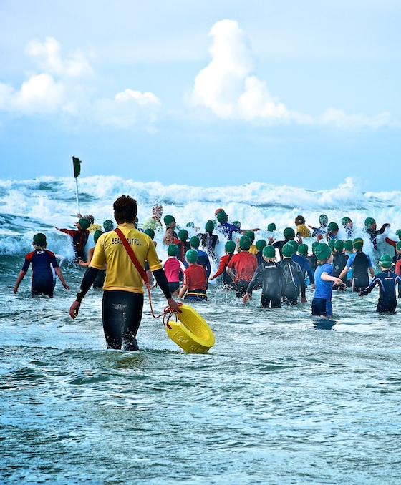
Casualty recognition
Which members of the public are most likely to put themselves in danger/vulnerable on a beach environment?
Age extremities –Young and elderly
Unstable or intoxicated people
Overweight
Float users
Inflatable users
Improper dress for beach conditions
Notes:
Trainer Assessor Notes: Use these notes to help you deliver the session (if needed)
In scanning the area of responsibility the lifeguard should pay particular attention to areas of crowd concentration. Dissect those areas,
carefully watch and predict water conditions and the resultant action of the swimmers.
Anticipate and understand behaviour patterns of people to prevent rescue, for example:
Age extremities – very young and very old people should always be observed with suspicion on a beach. Young children should be intercepted if they approach the water without adult supervision
Unstable/Intoxicated – Those who display behaviour pattern that exhibits lack of co-ordination should be viewed as possible rescue candidates
Overweight – These people are lacking in physical condition
Float users – Should be observed continually and assumed to be non-swimmers. Floats are often used by weak or non-swimmers to get to deep water. They also given to children by parents who believe they need to pay less attention to them as a result. When separated from the float, it is a matter of seconds to submersion and death
Inflatables – Have the same hazard as body boards except they are less robust and don’t have leashes. Inflatables are normally banned from the sea during off shore winds
Improper dress – Be wary of people who attempt to swim in clothing that is unsuitable for the surf, e.g. jeans and bodyboarders without fins. The wearing of street clothes is a sign of poor water knowledge as are poorly fitting wetsuits or those badly put on and swimmers wearing only swimming costumes when the weather is cold

Slide 24

Knowledge Check

