Slide 1
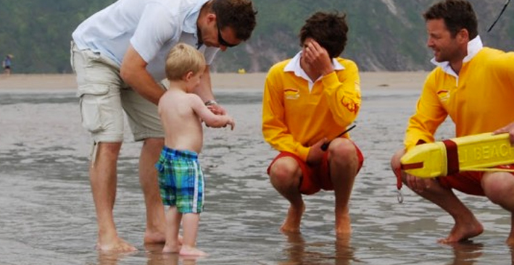
SLSGB Lifeguard Awards Unit - Communications
Notes:
Trainer Assessor’s Please note:
This powerpoint is the basic information that needs to be covered for this unit. The majority of the slides need further explanation (notes have been included on each slide to help you). As a competent Trainer Assessor you need to ensure that you are inserting learning activities, group work, quizzes etc. Where you see appropriate, in order to ensure that we are delivering quality teaching practice. You should be encouraging active learning that is learner led, see the resource bank section of moodle if you want inspiration for activities! This will be monitored during quality assurance visits to ensure that this is happening!

Slide 2
Learning Outcomes
1.1. Describe the different communication methods available to communicate from Lifeguard to Lifeguard
1.2. Describe the different communication methods available to communicate from Lifeguard to public.

Slide 3
1.1. Describe the different communication methods available to communicate from Lifeguard to Lifeguard

Slide 4
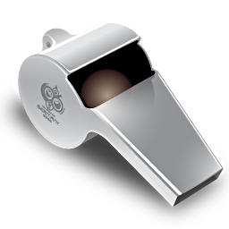
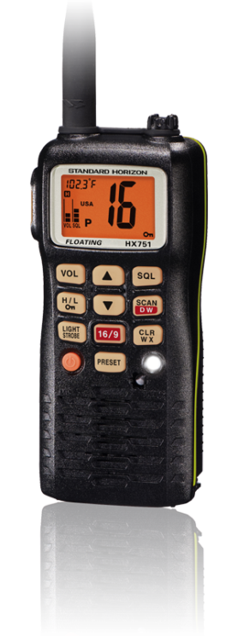
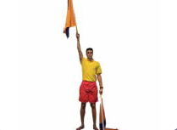
Communication Methods
Signal flags
What methods are there for Lifeguards to communicate with each other during patrols?
Whistles
Hand Signals
Radios
Notes:
Trainer Assessor Notes: Use these notes to help you deliver the session (if needed)
4

Slide 5
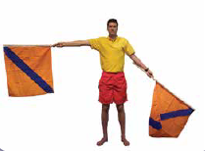
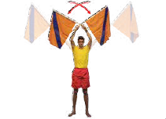
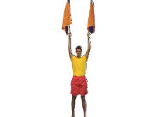
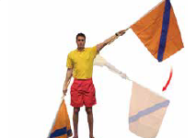
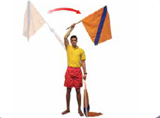
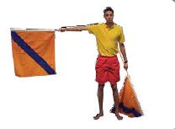
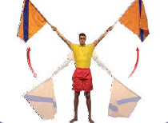
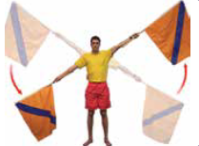
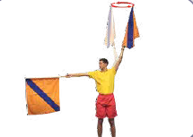
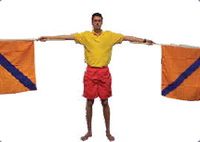
Hand and Flag Signals; From the beach
Return to shore
Investigate submerged object
Attract attention
Proceed further out to sea
Message understood
Message NOT clear – please repeat
Go left! (reverse this for go right)
Pick up buoys
Adjust buoys
Pick up swimmers
Remain stationary
Notes:
Trainer Assessor Notes: Use these notes to help you deliver the session (if needed)
Signal flags are still an important part of equipment for the modern lifeguard. These signals can be used when the radio has failed or increased noise due to heavy surf. As with all forms of communication it needs to be clear and precise, where possible a raised position (on a 4WD) should be used.
5

Slide 6
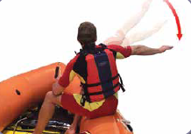
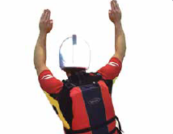
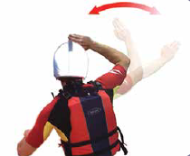
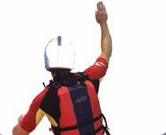
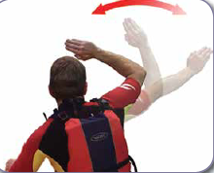
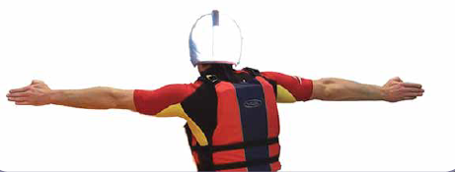
Hand and Flag Signals; From boat to beach
Craft wishes to return to shore
Hand signal by lifeguard or casualty
From craft to beach
DANGER!
Assistance required
Swimmer required
Assistance required
All Clear
Notes:
Trainer Assessor Notes: Use these notes to help you deliver the session (if needed)
A practical demonstration of each hand signal is expected here and a practical activity that allows learners to practice their hand signals on a daily basis.
Signal flags are still an important part of equipment for the modern lifeguard. These signals can be used when the radio has failed or increased noise due to heavy surf. As with all forms of communication it needs to be clear and precise, where possible a raised position (on a 4WD) should be used.
6

Slide 7
Signal Flags
When do you think signal flags are used?
Radio failure
Increased noise due to heavy surf
No other communication methods available
Notes:
Trainer Assessor Notes: Use these notes to help you deliver the session (if needed)
Signal flags are still an important part of equipment for the modern lifeguard. These signals can be used when the radio has failed or increased noise due to heavy surf. As with all forms of communication it needs to be clear and precise, where possible a raised position (on a 4WD) should be used.
Signal flags are usually orange with a blue stripe diagonally across
7

Slide 8
Whistle Signals;
1 Blast - Attract attention of bathers!
2 Blasts - Attract attention of another lifeguard
3 Blasts - Lifeguard taking emergency action
4 Blasts – Mass Rescue (2 or more casualties)
Notes:
Trainer Assessor Notes: Use these notes to help you deliver the session (if needed)
A practical demonstration of whistle signals should be displayed, e.g. how many whistle blasts to attract the attention of another lifeguard?
Learners to hold up fingers for how many whistle blasts
8

Slide 9
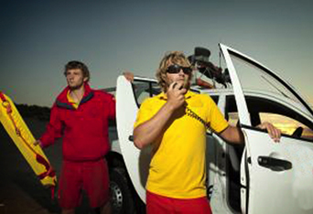
Radios
Good to communicate over distance
Language used needs to be appropriate
Always identify yourself first
Use Call Signs
Use the phonetic alphabet
Notes:
Trainer Assessor Notes: Use these notes to help you deliver the session (if needed)
Remember call signs must be given first. The Radio Telecommunications Agency is listening!
Be aware of the situation of the call sign you are addressing. They may be unable to hear due to motor or
surf noise, or unable to answer you because they are carrying out first aid.
• Words unevenly spaced – preserve the rhythm of normal conversation; do not join words together or separate by abnormal intervals.
• Speed of speech – can you receive the message at the speed that you are sending it?
• Too weak or strong – do not shout or whisper – normal conversation level is ideal.
• Sentences trailing off – end with certainty, not allowing voice to drop at the end of the sentence.
• Fluctuating voice – keep consistent voice by remaining calm and businesslike.
• Mispronounced words – pronounce correctly and give each syllable full value.
• Mumbling – speak clearly and distinctly.
• Breathing noise – never blow into a microphone, keep it 10cm away.
• Unnecessary Words – think before you speak – no ‘ums’ and ‘ers’.
• General avoid jargon, avoid pleasantries and familiarity, avoid long-winded transmissions keep transmissions short.
Basic rules
Language – remember that many other radio users can hear what you are saying. Do not use abusive language.
The Radio Telecommunications Agency monitors radio channels to check they are being used properly.
Always identify yourself – the rules of the airways are that the transmitter always identifies themselves before
each transmission.
9

Slide 10
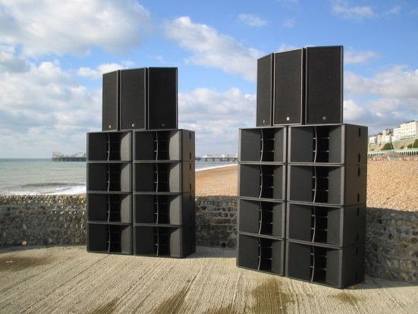
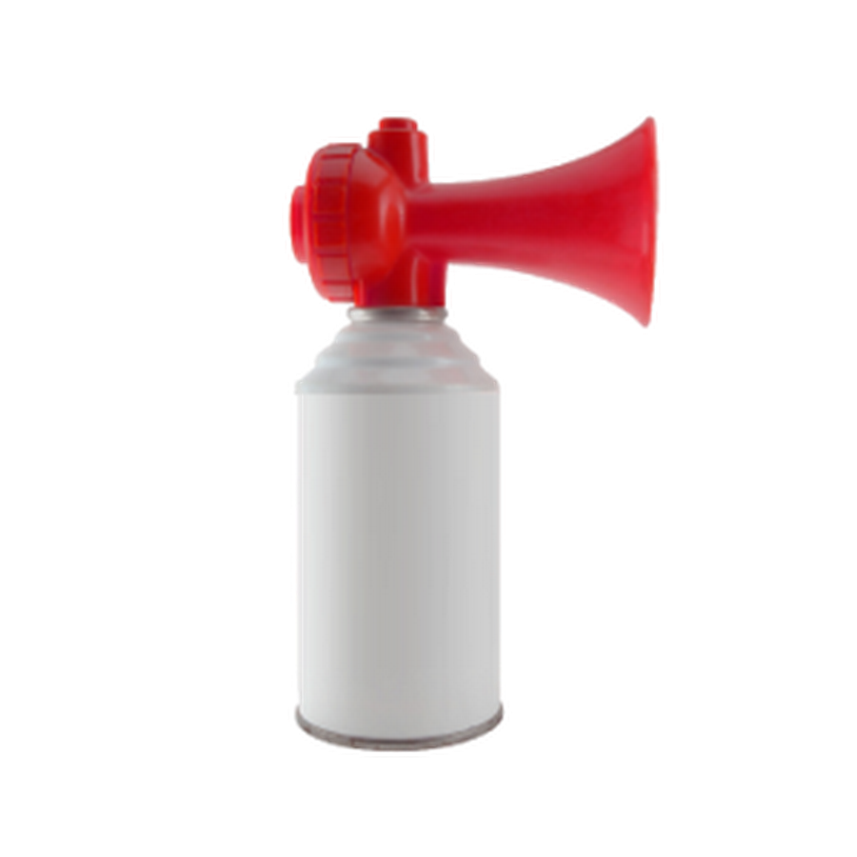
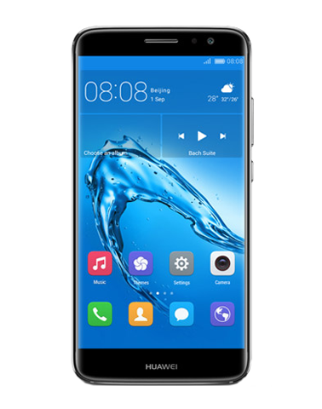
Other Methods
Flares
PA System
Loud Halers
Phones
Klaxon/air horn
Notes:
Trainer Assessor Notes: Use these notes to help you deliver the session (if needed)
Highlight other methods of communication available to lifeguards on the beach
10

Slide 11
1.2. Describe the different communication methods available to communicate from Lifeguard to public.

Slide 12
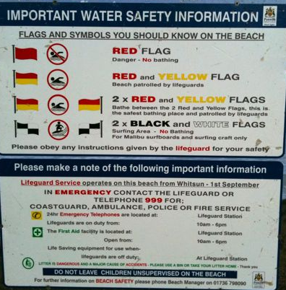
Safety Messages
What safety information needs to be displayed?
Dangers e.g. rips, rock falls
Safe zones e.g. flags; bathing area/hard craft area
Tide times
Lifeguard operating times/season
Emergency numbers
Location of first aiders/emergency phones
Notes:
Trainer Assessor Notes: Use these notes to help you deliver the session (if needed)
Methods e.g. signs, boards, flags, loud haler

Slide 13
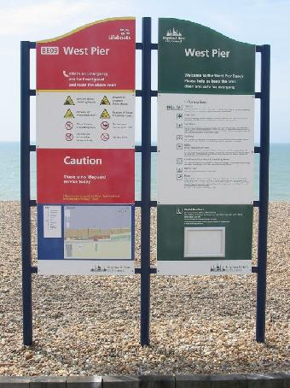
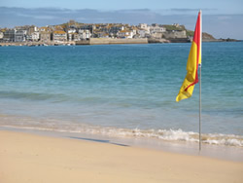
Safety Messages
How can this safety information be portrayed to the public?
Signs
Boards
Flags
Loud Haler
What are the key safety messages that need to be relayed to the public?

Slide 14
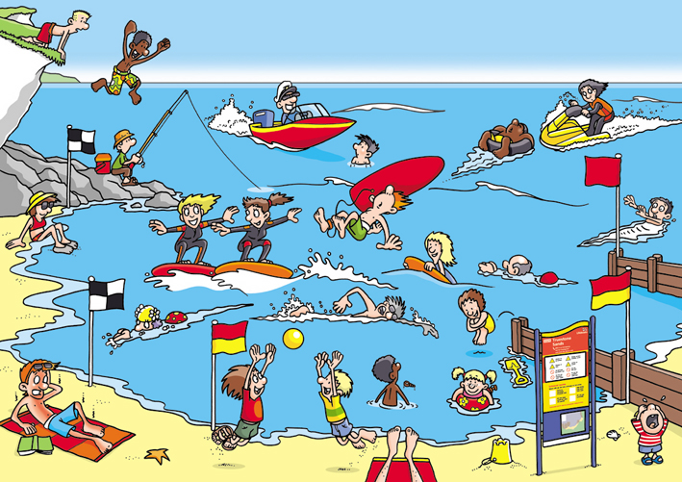
Spot everything to do with safety on the beach….

Slide 15
Effective Communication Skills
Eye contact & visible mouth
Some questions
Body language
Effective
Communication skills
Encouragement
to continue
Silence
Smiling face
Summarising
what has been said
Checking
for understanding
Notes:
Encourage participants to think about a situation where they must communicate with someone who is hard of hearing; anxious; has been put down in the past; doesn’t know who you are – what are some of the things you can do to help communication?

Slide 16
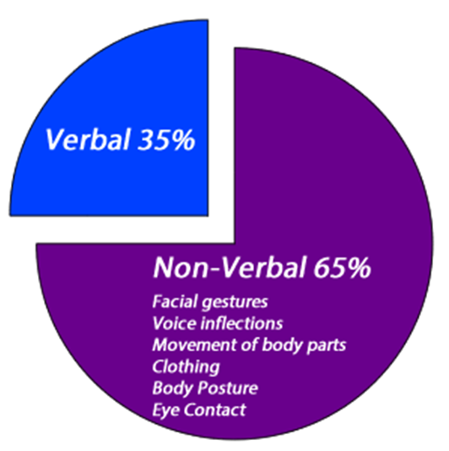
Non-Verbal Communication
What methods of non-verbal communication do we have?
Gestures
Posture or Body language
Facial expressions
Eye contact
Emblems
Haptics
Appearance & Object
What effect can our non-verbal communication skills have on other people? And in what scenarios?

Slide 17
Causes of Aggression
What reasons can cause beach users to become aggressive towards a lifeguard?
People unwilling to heed advice
People thinking they have more knowledge than the lifeguard
Being aware of a lifeguards lack of power
Alcohol and drug abusers
Youths with injured friends or family
Ill people reacting to authority
Medical states: e.g. Diabetics after surfing and changing sugar levels
Head injuries, Epilepsy and Lack of Oxygen
Mental Health Patients
Lifeguards not being sympathetic
Notes:
Trainer Assessor Notes: Use these notes to help you deliver the session (if needed)
Causes of violence
• anyone stressed/provoked enough, for example, in incidents
• alcohol and drug abusers
• youths with injured friends or family
• ill people reacting to authority
• medical conditions: for example, diabetics after surfing and changing sugar levels
• head injuries, epilepsy and lack of oxygen
• Individuals with mental illness
• moving injured person
• lifeguards not being sympathetic.
How to avoid confrontation
Take time to listen and think; hear all that is said. Watch terms used (do not use jargon). Repeat their demands to
show understanding. Ask questions if unsure. Let them suggest solutions. Use soft relaxed tone and the same
phrases each time. Explain position clearly. Be honest. Don’t take sides.
Create space:
Go back/to the side. Keep a barrier between you and aggressor (for example, rescue tube) and make sure there
is an escape route.
Body language:
Remove sunglasses. Do not stare. Blink. Turn eyes away to shoulder. No crossed arms or hands on hips. Watch reply.
Safety factors:
Always let colleagues know where you are. Be alert. Anger (adrenaline) rushes do not last long. Don’t wear
jewellery and don’t let equipment get into hands of the aggressor. Avoid confrontation: it’s not worth it and could lead to legal action against you. Inform colleagues in non-inflammatory radio code, for example: TSB (Time Space Body) to initiate EAP procedure. (Call police!)
Where violence is likely to occur, for example, beaches near sources of alcohol or where lifeguards are used to
enforce byelaws, beach operators should train staff in conflict management. There should be a reporting technique and any incident
17

Slide 18
Cycle of Aggression
Normal behaviour
Trigger changes this
Escalation away from normal behaviour
‘crisis phase’ – violence can occur
Plateau/recovery
Post crisis
Notes:
Trainer Assessor Notes: Use these notes to help you deliver the session (if needed)
normal behaviour
a trigger then changes this
there is escalation away from normal behaviour. Calming methods can prevent violence here
violence is likely to occur in the ‘crisis phase’ – a short term risk
plateau/recovery – further assaults can occur. Methods can be effective but reoccurrence of violence can occur
post crisis – aggressors can regret their actions and become depressed. Self harm can occur here.
18

Slide 19
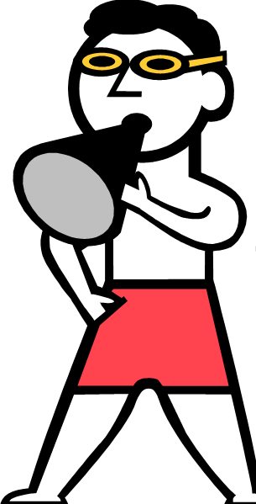
Aggression Avoidance
AVOIDING AGGRESSION
DEALING WITH
AGGRESSION
Take time to listen and think.
Watch terms used (don’t use jargon).
Maintain eye contact and use a relaxed tone of voice.
Explain position but be honest, don’t take sides!
Create space.
Body Language. (No crossed arms or hands on hips.)
Avoid Confrontation.
Safety Factors. Always let colleagues know where you are.
Stay Calm
Use diplomacy & tact
Inform colleagues in non-inflammatory radio code e.g. TSB - Time Space Body to initiate EAP procedure. (Call police!)
DON’T get cornered!
Notes:
Trainer Assessor Notes: Use these notes to help you deliver the session (if needed)
Polite and courteous answers to queries helps public relations and the public’s reaction to lifeguards in general. Introduce yourself by first name to the enquirer. The public may seek information from lifeguards at any time; casual conversations detracting from beach management requirements should be avoided. Every effort should be made to encourage bathers to swim between the patrol flags. Use of a loudhailer, in a polite manner, is to be encouraged. Use diplomacy and tact. However, if they still continue to swim outside of the patrol area they should still be watched. Most lifeguards for one reason or another will come across people who are unwilling to heed their advice. Some people may not know of their capabilities, endangering themselves and their family while knowing the limited powers of lifeguards in enforcing byelaws. Lifeguards getting into arguments rarely prevent determined people from entering the sea, and at worst could result in people becoming violent and the lifeguard
getting injured. Definition of violence: ‘non-consenting physical assault or any threat of assault or harassment that definitely suggests a future act of aggression.’
19

Slide 20
5 Top Pieces of Safety Advice
Display the tide times
Highlight the tidal cut off areas
Clearly signpost the First Aid Point
Show the save places to swim
Let people know how to signal for assistance
Notes:
Trainer Assessor Notes: Use these notes to help you deliver the session (if needed)
normal behaviour
a trigger then changes this
there is escalation away from normal behaviour. Calming methods can prevent violence here
violence is likely to occur in the ‘crisis phase’ – a short term risk
plateau/recovery – further assaults can occur. Methods can be effective but reoccurrence of violence can occur
post crisis – aggressors can regret their actions and become depressed. Self harm can occur here.
20

Slide 21
Knowledge Check

