Slide 1
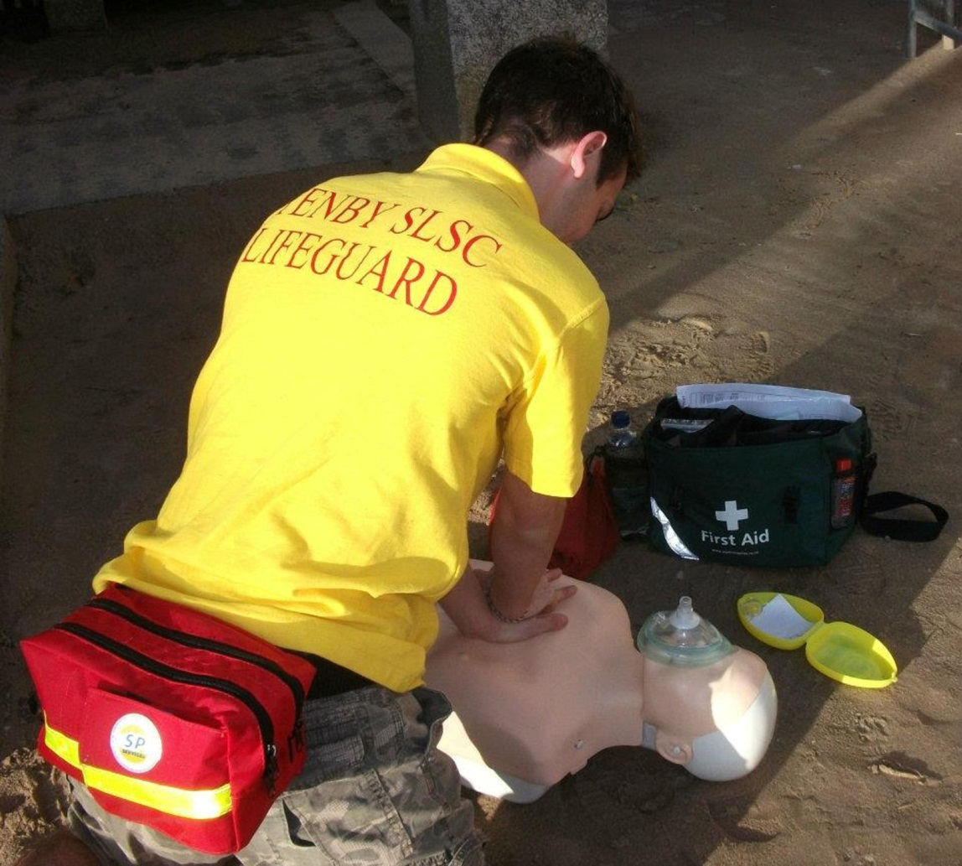
SLSGB Lifeguard Awards Level 1 Basic First Aid
Notes:
Trainer Assessor’s Please note:
Please note that this is a practical based unit that should be evidenced through practical scenarios and questioning.
This power point is the basic information that needs to be covered for this unit. The majority of the slides need further explanation (notes have been included on each slide to help you). As a competent Trainer Assessor you need to ensure that you are inserting learning activities, group work, quizzes etc. Where you see appropriate, in order to ensure that we are delivering quality teaching practice. You should be encouraging active learning that is learner led, see the resource bank section of moodle if you want inspiration for activities! This will be monitored during quality assurance visits to ensure that this is happening!

Slide 2
Unit Learning Outcomes
Explain the aims of administering First Aid
Identify the key components of a First Aid Kit
Demonstrate how to administer first aid to a casualty who is wounded and bleeding
Demonstrate how to administer first aid to a casualty who is suffering from shock
Demonstrate how to provide appropriate first aid for minor injuries
Explain the importance of recording and reporting incidents

Slide 3
Learning Outcome
1. Explain the aims of administering First Aid

Slide 4
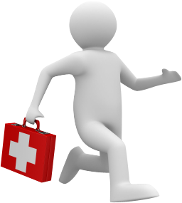
The Aims of First Aid
Preserve
Prevent
Promote
1. Explain the aims of administering First Aid

Slide 5
Learning Outcome
2. Identify the key components of a First
Aid Kit

Slide 6
First Aid Kits
Gloves
Face Shield
Safety Pins
Adhesive Tape
Foil Blanket
Eye wash
Scissors
Plasters
Wound Dressings
Eye Pad
Finger dressing
Burn Dressing
Triangular Bandage
What needs to be included in a standard first aid kit?
2. Identify the key components of a First Aid Kit
Notes:
Easily accessible
White cross on green background
Only contain dressings
Gloves
No medication

Slide 7
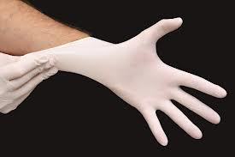
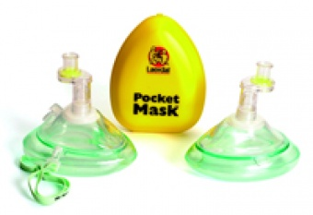
Minimising Infection
What personal protective equipment can you use to protect yourselves when doing first aid?
Consider the different scenarios where different PPE would be needed.
2. Identify the key components of a First Aid Kit
Notes:
Tutor Notes:
As first aiders we must, at all times, protect ourselves and the casualties in our care, we can do the following to minimise the chances of infection;
Always wear gloves
Use a pocket mask/face shield
You must ensure that you establish consent from the casualty to provide first aid.

Slide 8
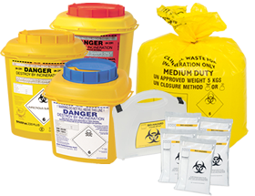
Disposal
Any medical waste must be disposed off in a yellow or orange clinical waste bag
Any sharps must be disposed off in a sharps container
All waste must then be given to facility that accepts clinical waste e.g. hospitals, doctors surgeries, some pharmacies
This CANNOT go in normal bins
2. Identify the key components of a First Aid Kit

Slide 9
Learning Outcome
3. Demonstrate how to administer first aid to a casualty who is wounded and bleeding

Slide 10
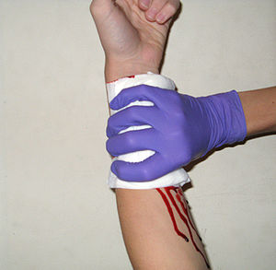
Types of Bleeding
Arterial
Venous
Capillary
3. Demonstrate how to administer first aid to a casualty who is wounded and bleeding
Notes:
TYPES OF BLEEDING
Capillary - Superficial bleeding of the blood vessels, minor injury e.g. graze
Venous – Bleeding from the veins, usually a darker red as it is de-oxygenated and a slow flowing bleed
Arterial – High pressure bleed from the heart, would be spurting in time with the rhythm of the heart, bright red in colour as it is oxygenated and can potentially be life threatening
TREATMENT
Sit or Lay
Examine
Elevate
Pressure
The objectives when treating a wound are to:
Control the bleeding
Reduce Infection
Prevent further complications
Direct and Indirect Pressure
Direct pressure
Apply direct pressure to the wound using hands or cloth (ensure you wear gloves)
Maintain pressure for a continuous 10 minutes
Indirect pressure
Pressure can be applied to the artery supplying the limb
Apply indirect pressure for a maximum of 10 minutes
The two main indirect pressure points are:
Brachial – inside of upper arm
Femoral – Thigh bone crosses bikini line
DRESSINGS
Sterile
Large enough to cover the wound
Non-stick
If the dressing becomes saturated in blood, keep in place and put another larger dressing on top
If this doesn’t work take the dressings off and start again
10

Slide 11
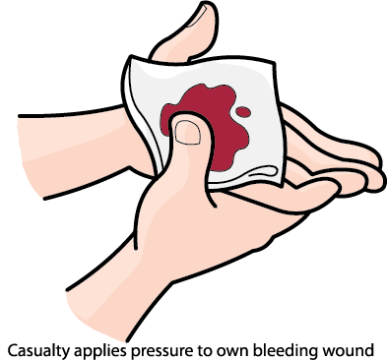
Treatment of Bleeding
S
Sit or Lay
E
Examine
P
Pressure
D
Dress
3. Demonstrate how to administer first aid to a casualty who is wounded and bleeding
Notes:
TREATMENT
Sit or Lay
Examine
Elevate
Pressure
The objectives when treating a wound are to:
Control the bleeding
Reduce Infection
Prevent further complications
Direct and Indirect Pressure
Direct pressure
Apply direct pressure to the wound using hands or cloth (ensure you wear gloves)
Maintain pressure for a continuous 10 minutes
Indirect pressure
Pressure can be applied to the artery supplying the limb
Apply indirect pressure for a maximum of 10 minutes
The two main indirect pressure points are:
Brachial – inside of upper arm
Femoral – Thigh bone crosses bikini line
DRESSINGS
Sterile
Large enough to cover the wound
Non-stick
If the dressing becomes saturated in blood, keep in place and put another larger dressing on top
If this doesn’t work take the dressings off and start again
11

Slide 12
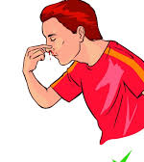
Nosebleed
S
Sit casualty down, head tipped forward
N
Nip soft part of nose for around 10 minutes
If it bleeds for more than 30 minutes take them to hospital
3. Demonstrate how to administer first aid to a casualty who is wounded and bleeding
Notes:
TREATMENT
Sit or Lay
Examine
Elevate
Pressure
The objectives when treating a wound are to:
Control the bleeding
Reduce Infection
Prevent further complications
Direct and Indirect Pressure
Direct pressure
Apply direct pressure to the wound using hands or cloth (ensure you wear gloves)
Maintain pressure for a continuous 10 minutes
Indirect pressure
Pressure can be applied to the artery supplying the limb
Apply indirect pressure for a maximum of 10 minutes
The two main indirect pressure points are:
Brachial – inside of upper arm
Femoral – Thigh bone crosses bikini line
DRESSINGS
Sterile
Large enough to cover the wound
Non-stick
If the dressing becomes saturated in blood, keep in place and put another larger dressing on top
If this doesn’t work take the dressings off and start again
12

Slide 13
Dressings
Must be sterile
Consider…Is it a ‘catastrophic bleed’?
Shouldn’t restrict blood flow
Practice how to dress various types of wounds
Support arm injuries with an elevated sling
Low adherent
3. Demonstrate how to administer first aid to a casualty who is wounded and bleeding
Notes:
Trainer Assessor Notes;
LEARNER TASK – Ask learners to think about what they think makes a casualties condition ‘life threatening’
Talk them through each of the points
Refer to page 4 and 5 of the SLSGB First Aid Manual for further information to build on the content slide.

Slide 14
Learning Outcome
4. Demonstrate how to administer first aid to a casualty who is suffering from shock

Slide 15
Shock
What is shock?
“A fall in the level of blood volume or blood pressure, resulting in poor oxygen supply to the body’s tissues”.
4. Demonstrate how to administer first aid to a casualty who is suffering from shock
Notes:
There are three types of shock:
Hypovolaemic
A loss of bodily fluids
Typical Causes include:
Open wounds (Bleeding)
Internal bleeding
Crush injuries
Burns
Vomiting/Diarrhoea
Excessive sweating
Signs and Symptoms
Fast pulse rate
Pale, clammy skin
Cyanosis
Nausea or vomiting
Sweating
Treatment
Treat the cause of the shock
Lay casualty down and raise the legs
Call 999/112
Anaphylactic
Serious medical condition
Causes a fall in blood pressure/swelling of airway due to a severe allergic reaction
Typical Causes include:
Penicillin
Shellfish
Stings/animals
CARDIOGENIC
Ineffective pumping of the heart
Causes a fall in blood pressure and inhibition of hearts pumping
Typical Causes:
Heart attack
Cardiac failure
Cardiac arrest
General RECOGNITION
Slow at first, getting progressively faster
Cold and Clammy skin
Pale and ashen, cyanosis at extremities
Fast, shallow, gasping breathing
Faint
Nausea and vomiting
Blurred vision
General TREATMENT
If conscious lay casualty down with legs raised
If unconscious place casualty in recovery position
Treat cause of shock e.g. bleeding
Administer Oxygen
Assist with medication if anaphylactic
Loosen any tight clothing
WRR
Call 999 if needed
15

Slide 16
Types of Shock
Hypovolemic Shock
Loss of bodily fluids
Fall in blood pressure, due to heart not pumping effectively
Cardiogenic Shock
Anaphylactic Shock
Severe allergic reaction
4. Demonstrate how to administer first aid to a casualty who is suffering from shock
Notes:
There are three types of shock:
Hypovolaemic
A loss of bodily fluids
Typical Causes include:
Open wounds (Bleeding)
Internal bleeding
Crush injuries
Burns
Vomiting/Diarrhoea
Excessive sweating
Signs and Symptoms
Fast pulse rate
Pale, clammy skin
Cyanosis
Nausea or vomiting
Sweating
Treatment
Treat the cause of the shock
Lay casualty down and raise the legs
Call 999/112
Anaphylactic
Serious medical condition
Causes a fall in blood pressure/swelling of airway due to a severe allergic reaction
Typical Causes include:
Penicillin
Shellfish
Stings/animals
CARDIOGENIC
Ineffective pumping of the heart
Causes a fall in blood pressure and inhibition of hearts pumping
Typical Causes:
Heart attack
Cardiac failure
Cardiac arrest
General RECOGNITION
Slow at first, getting progressively faster
Cold and Clammy skin
Pale and ashen, cyanosis at extremities
Fast, shallow, gasping breathing
Faint
Nausea and vomiting
Blurred vision
General TREATMENT
If conscious lay casualty down with legs raised
If unconscious place casualty in recovery position
Treat cause of shock e.g. bleeding
Administer Oxygen
Assist with medication if anaphylactic
Loosen any tight clothing
WRR
Call 999 if needed
16

Slide 17
Fainting
Caused by a temporary reduction of blood flow to the brain. Causing a partial or complete loss of consciousness.
What do you think can cause somebody to faint?
4. Demonstrate how to administer first aid to a casualty who is suffering from shock
Notes:
Caused by a temporary reduction of blood flow to the brain. Causing a partial or complete loss of consciousness.
What do you think can cause somebody to faint?
Emotional shock
Pain
Sight of blood
Over-exertion
Lack of food
Standing in the one position too long in the heat
Signs and Symptoms
Feeling light headed
Dizziness
Pale, cool, moist skin
Nausea
Numbness or tingling in fingers or toes.
Treatment
Assist the casualty to the ground
If the casualty is responding, leave them lying flat and elevate their legs 20-30cms
If the casualty is not responding immediately place them into the Recovery position, observe ABC
Loosen tight clothing at the waist and neck
Do not give anything to eat or drink
Advise the casualty to seek medical attention to determine the cause
17

Slide 18
Learning Outcome
5. Demonstrate how to provide appropriate first aid for minor injuries

Slide 19
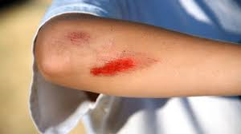
Minor Injuries – Cuts & Grazes
Irrigate wound
Pat the wound dry with a sterile swab
Cover with a plaster or low-adherent dressing
If immunisations aren't up to date seek medical advice
5. Demonstrate how to provide appropriate first aid for minor injuries
Notes:
Caused by a temporary reduction of blood flow to the brain. Causing a partial or complete loss of consciousness.
What do you think can cause somebody to faint?
Emotional shock
Pain
Sight of blood
Over-exertion
Lack of food
Standing in the one position too long in the heat
Signs and Symptoms
Feeling light headed
Dizziness
Pale, cool, moist skin
Nausea
Numbness or tingling in fingers or toes.
Treatment
Assist the casualty to the ground
If the casualty is responding, leave them lying flat and elevate their legs 20-30cms
If the casualty is not responding immediately place them into the Recovery position, observe ABC
Loosen tight clothing at the waist and neck
Do not give anything to eat or drink
Advise the casualty to seek medical attention to determine the cause
19

Slide 20
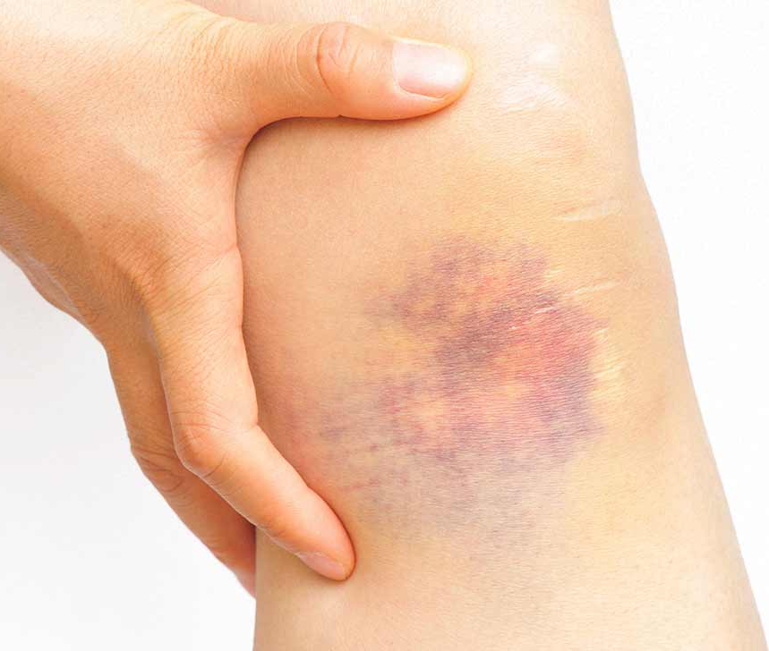
Minor Injuries – Bruises
Reduce Swelling
Place ice pack on the bruising for 10 minutes
If you don’t have an ice pack, run it under cold running water
5. Demonstrate how to provide appropriate first aid for minor injuries
Notes:
Caused by a temporary reduction of blood flow to the brain. Causing a partial or complete loss of consciousness.
What do you think can cause somebody to faint?
Emotional shock
Pain
Sight of blood
Over-exertion
Lack of food
Standing in the one position too long in the heat
Signs and Symptoms
Feeling light headed
Dizziness
Pale, cool, moist skin
Nausea
Numbness or tingling in fingers or toes.
Treatment
Assist the casualty to the ground
If the casualty is responding, leave them lying flat and elevate their legs 20-30cms
If the casualty is not responding immediately place them into the Recovery position, observe ABC
Loosen tight clothing at the waist and neck
Do not give anything to eat or drink
Advise the casualty to seek medical attention to determine the cause
20

Slide 21
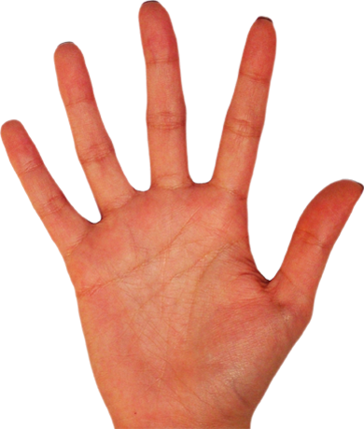
Minor Burns & Scalds
Estimating the severity of a burn
5 factors;
Size
S
Cause
C
1%
Age
A
L
Location
D
Depth
5. Demonstrate how to provide appropriate first aid for minor injuries
Notes:
Estimating the severity of a burn
5 factors;
Size – Compare size of the burn to the casualties hand, 1 side of the casualties open hand is 1% of the body area. The larger the area the more severe Cause – Cause of the burn can affect the severity e.g. chemicals and electrical burns
Age – This can affect the recovery rate and severity e.g. the old and very young
Location – Location of the burn can affect severity e.g. anything that can interrupt with bodily functions e.g. breathing, airway, vision, blood flow
Depth– The Deeper the burn the more severe (see next slide)
Depth of burns
3 layers of skin;
1). The epidermis (the outside)
2). The dermis (Beneath)
3). Subcutaneous (fat)
Superficial - Involved the epidermis and mainly occurs from scalds. Burn looks red, sore and swollen
Intermediate – This affects both the epidermis and the dermis. Burn will look raw and blisters will form
Full Thickness – All layers of skin are burnt away to the fat layer. Burn will look pale, charred or waxy. May be absent from pain as nerve endings are burnt away
Treatment for Minor Burns & Scalds
Scalds – Usually wet heat
Cool burn with cold running water for a minimum of 10 minutes
Remove watches/rings
Dress the burn with sterile non-stick dressing/cling film
Call 999/112 if you deem it severe
Radiation Burn – sunburn
Remove casualty from the sun
Give frequent sips of water to avoid heat exhaustion
Cool burn with cool water for minimum of 10 minutes
Chemical Burn
Cool water for minimum of 20 minutes
21

Slide 22
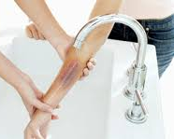
Minor Burns & Scalds
Treatment of burns
1
Cool the burn – Running water for 10 minutes
Remove jewellery and loose clothing
Dress the burn – Non-stick
2
3
5. Demonstrate how to provide appropriate first aid for minor injuries
Notes:
Estimating the severity of a burn
5 factors;
Size – Compare size of the burn to the casualties hand, 1 side of the casualties open hand is 1% of the body area. The larger the area the more severe Cause – Cause of the burn can affect the severity e.g. chemicals and electrical burns
Age – This can affect the recovery rate and severity e.g. the old and very young
Location – Location of the burn can affect severity e.g. anything that can interrupt with bodily functions e.g. breathing, airway, vision, blood flow
Depth– The Deeper the burn the more severe (see next slide)
Depth of burns
3 layers of skin;
1). The epidermis (the outside)
2). The dermis (Beneath)
3). Subcutaneous (fat)
Superficial - Involved the epidermis and mainly occurs from scalds. Burn looks red, sore and swollen
Intermediate – This affects both the epidermis and the dermis. Burn will look raw and blisters will form
Full Thickness – All layers of skin are burnt away to the fat layer. Burn will look pale, charred or waxy. May be absent from pain as nerve endings are burnt away
Treatment for Minor Burns & Scalds
Scalds – Usually wet heat
Cool burn with cold running water for a minimum of 10 minutes
Remove watches/rings
Dress the burn with sterile non-stick dressing/cling film
Call 999/112 if you deem it severe
Radiation Burn – sunburn
Remove casualty from the sun
Give frequent sips of water to avoid heat exhaustion
Cool burn with cool water for minimum of 10 minutes
Chemical Burn
Cool water for minimum of 20 minutes
22

Slide 23
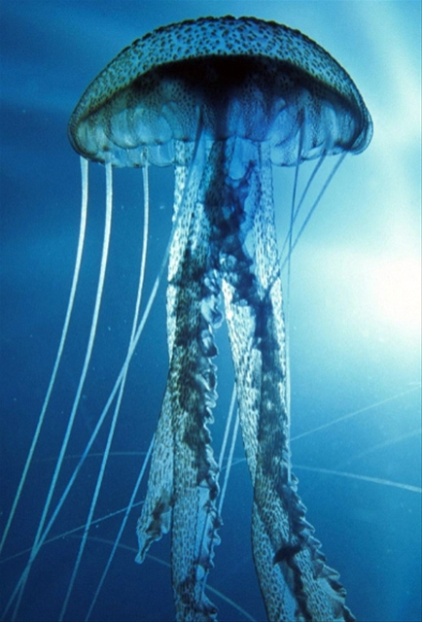
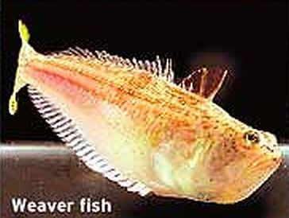
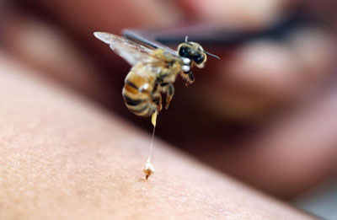
Bites and Stings
Jellyfish
FOR ALL STINGS BE AWARE OF ANAPHYLACTIC SHOCK!
Weaver Fish
Bee/Wasp
5. Demonstrate how to provide appropriate first aid for minor injuries
Notes:
JELLYFISH
Can cause a nettle rash, or larger ones can cause very painful rashes
Reassure patient, sit them down, allergy advise
Brush off remaining tentacles
Pour large amounts of cold seawater (or vinegar) onto sting in copious amounts to incapacitate sting
Avoid rubbing the area
WEEVER FISH – Marine Puncture Wound
Will cause severe pain the casualties injured limb
Minimise movement and sit casualty down, allergy advise
Place injured limb in hot water(as hot as casualty can bear) for a minimum of 30-60 minutes, this draws the sting out of the limb. Keep topping up hot water when it cools.
If all spines cant be removed send patient to hospital
BEE/WASP STING
Can cause irritation and a slight red rash
Sit casualty down and give allergy advise
If you can see the sting, try to scrape away, making sure not to squeeze the sting sac
Wash the area with soap and water
If in mouth can give casualty ice to suck on
23

Slide 24
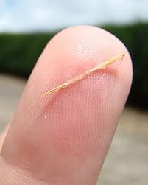
Minor Injuries – Splinters
Clean the area with warm soapy water
Pat dry
Using tweezers, grip splinter, gently pull at angle it entered skin
Gently squeeze around the wound to encourage bleeding
Dry and cover with a dressing
5. Demonstrate how to provide appropriate first aid for minor injuries
Notes:
Caused by a temporary reduction of blood flow to the brain. Causing a partial or complete loss of consciousness.
What do you think can cause somebody to faint?
Emotional shock
Pain
Sight of blood
Over-exertion
Lack of food
Standing in the one position too long in the heat
Signs and Symptoms
Feeling light headed
Dizziness
Pale, cool, moist skin
Nausea
Numbness or tingling in fingers or toes.
Treatment
Assist the casualty to the ground
If the casualty is responding, leave them lying flat and elevate their legs 20-30cms
If the casualty is not responding immediately place them into the Recovery position, observe ABC
Loosen tight clothing at the waist and neck
Do not give anything to eat or drink
Advise the casualty to seek medical attention to determine the cause
24

Slide 25
Learning Outcome
6. Explain the importance of recording and reporting incidents

Slide 26
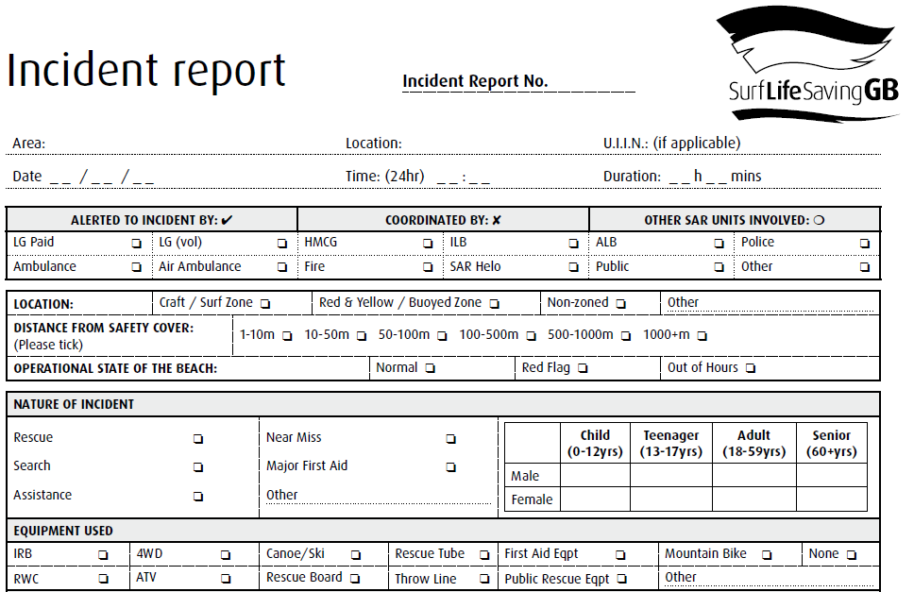
Incident Report
6. Explain the importance of recording and reporting incidents
Notes:
Tutor Notes:
Basic details will include;
Date & Time
Full Name & Address
Occupation
Nature of Injury
Where it Happened
Description of Circumstances
The minimal legal requirement to keep accidents is 3 years.
Why is recording important?
Legislative purposes
Prevention of similar incidents
Identifies equipment and training needs

Slide 27
Knowledge Check

