Slide 1
SLSGB Lifeguard Awards Supplementary Oxygen Administration
Notes:
Supplementary oxygen can be used in one of two ways;
1. To enrich inhaled air for the casualty who is breathing.
2. To increase oxygen concentration in artificial ventilation.

Slide 2
Learning Outcomes
Explain why we use supplementary Oxygen
Explain the indications and contra-indications for administering supplementary oxygen
Demonstrate and explain the different ways to administer supplementary Oxygen
Explain the documentation you need to keep a record of when administering supplementary oxygen
Explain the safety precautions to consider when administering supplementary oxygen

Slide 3
Learning Outcome 1
Explain why we use Supplementary Oxygen

Slide 4
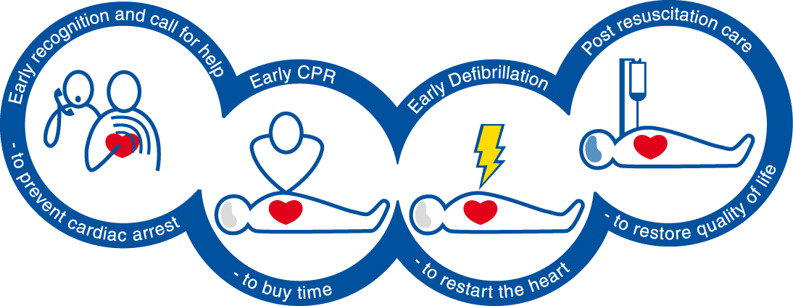
Reminder!

Slide 5
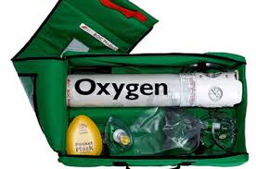
Oxygen
Is essential for life
Notes:
Air contains 21-22% oxygen. It is carried into the lungs by ventilation (breathing). It then binds with haemoglobin in the blood which is carried to the tissues of the body where it is i

Slide 6
Oxygen
Is essential for life
Supplemental oxygen can be beneficial in certain circumstances

Slide 7
Casualties die from a lack of oxygen
Use it and turn it off if instructed by a healthcare professional
Impossible to reverse the brain damage caused due to hypoxia when not used.

Slide 8
Learning Outcome 2
Explain the indications and contra-indications for administering supplementary oxygen

Slide 9
Indications for use
Airway obstruction.
Respiratory rate less than 8 or greater than 30 breaths per minute.
Life threatening bleeding or central capillary refill time 3 seconds or greater.
V, P or U on the AVPU scale.
Hypothermia/ Trauma

Slide 10
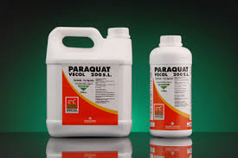
Absolute contraindication
✖ Poisoning with Paraquat
Notes:
Paraquat was used as a weedkiller – no longer commercially available without licence.
VERY RARE – if oxygen is given it speeds up the destructive process in the lungs. However the chances of survival are incredibly low regardless of oxygen use.

Slide 11
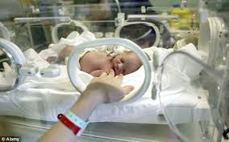
Relative contraindications
✖ Very premature babies
- Not breathing or in respiratory distress they need oxygen.

Slide 12
Relative contraindications
✖ Very premature babies
- Not breathing or respiratory distress they need oxygen.
✖ History of Bronchitis or Emphysema.
[Chronic Obstructive Pulmonary Disease (COPD)]
Can become sleepy due to a rise in the CO₂ level in the blood as a result of supplemental oxygen.
If indicated as per guidance;
GIVE OXYGEN

Slide 13
Learning Outcome 3
Demonstrate and explain the different ways to administer supplementary oxygen

Slide 14
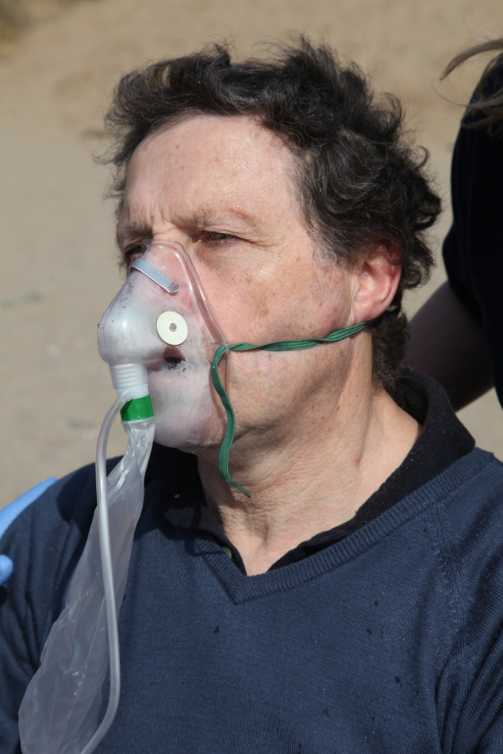
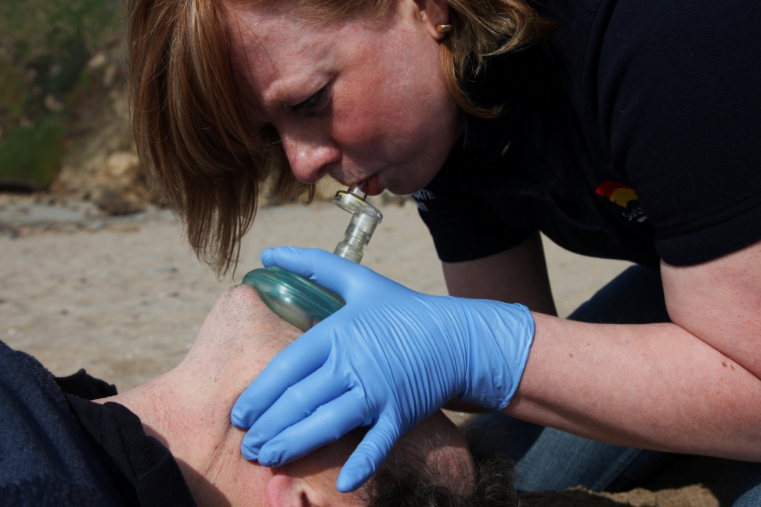
Two ways to administer
Conscious, Breathing Casualty
Oxygen Therapy Mask with reservoir bag
Unconscious, Non-breathing casualty
Resuscitation Pocket Mask

Slide 15
Turning the cylinder on
Practical demonstration
Notes:
Demonstrate or use SLSGB video clip “oxygen”
1. Request oxygen set But don’t delay resuscitation!
2. turn on at the regulator The flow rate is usually on a separate control.
3. Select highest flow rate briefly. Clears any debris that may have collected in the outlet.
Audible hiss with no odour (odour suggests contamination – DO NOT USE).
4. Attach relevant mask
a. Resuscitation face mask.
b. Face mask with reservoir bag.
For the unconscious non-breathing casualty. Use 15 litres per min.
For the casualty who is breathing. Use 12–15 litres per min. Inflate reservoir bag by
obstructing the one way valve. Place mask onto patients face ensure ties are pulled tight and
nose piece pinched. Observe for misting of the mask and deflation of the bag with breathing.
5. Ensure cylinder is safe at all times. Preferably lying on its’ side, and unable to roll away.
6. Document time commenced. Required for handover to emergency medical services
Know when cylinder runs out (e.g. ‘CD’ sized cylinder holds 460 litres therefore 30 minutes
duration at a flow rate of 15 litres per minute).

Slide 16
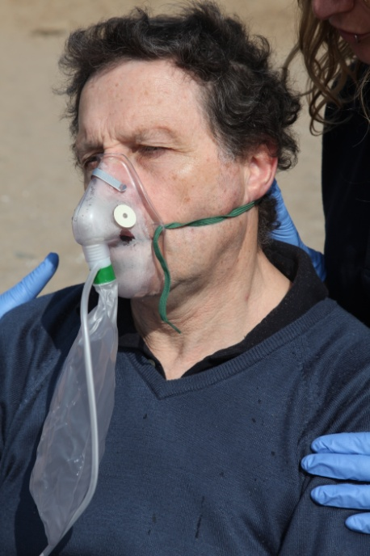
Place mask onto the casualty’s face
Create “seal” around the mask
Pinch the nose piece
Pull ties
Observe misting and movement of reservoir with breathing

Slide 17
Learning Outcome 4
Explain the documentation you need to keep a record of when administering supplementary oxygen

Slide 18
Documentation
Reason for oxygen use
Time of administration
Hand over to emergency medical services
Notes:
Documentation important:
Informs you how long you have left of the oxygen
Informs the Emergency medical services when and how much has been administered, and subsequently the effect it has had on the casualty.

Slide 19
Learning Outcome 5
Explain the safety precautions to consider when administering supplementary oxygen

Slide 20
Safety precautions
No smoking
Avoid contact with combustible materials
Including grease/ oil/ petrol
Switch off at regulator after use
Store in a dry, clean, accessible place
Secured when not in use
Transport carefully
Replace when ¾ full
Warning notices at place of storage
Comply with suppliers regulations

Slide 21
Summary
“Too fast or too slow” – give oxygen
If in doubt give oxygen – 15 litres
Respect the cylinders - store safely
Notes:
If breathing “Too fast or too slow” – give oxygen, remember the other indications (ABCDE)
If in doubt give oxygen – 15l via resuscitation facemask or mask with reservoir bag
Respect the cylinders - store safely.

Slide 22
Any Questions?

Slide 23
Knowledge Check

