Slide 1
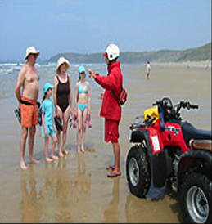
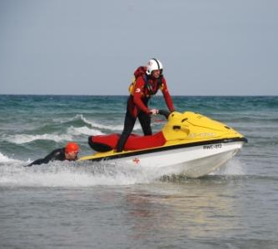
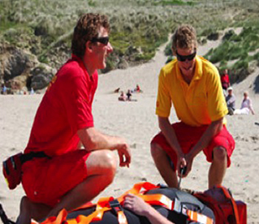
SLSGB Lifeguard Awards Working Practices
Notes:
Trainer Assessor’s Please note:
This powerpoint is the basic information that needs to be covered for this unit. The majority of the slides need further explanation (notes have been included on each slide to help you). As a competent Trainer Assessor you need to ensure that you are inserting learning activities, group work, quizzes etc. Where you see appropriate, in order to ensure that we are delivering quality teaching practice. You should be encouraging active learning that is learner led, see the resource bank section of moodle if you want inspiration for activities! This will be monitored during quality assurance visits to ensure that this is happening!

Slide 2
Learning Outcomes
1.1. Explain the duties of a lifeguard
1.2. Demonstrate an understanding of a Normal Operating Plan (NOP) including its suggested content
1.3. Demonstrate an understanding of an Emergency Action Plan (EAP) including its suggested content
1.4. Describe the importance of Working with others
1.5. Describe the Recording and reporting procedures when acting as a Lifeguard

Slide 3
1.1. Explain the duties of a lifeguard

Slide 4
The Role of a Lifeguard
Prevention
Reporting
Recognition
Rescue
Notes:
Trainer Assessor Notes;
In groups get candidates to consider what they think the role of a Lifeguard is?
Discuss with class and go through the following;
To prevent
To Recognise
To Rescue
To Report

Slide 5
Duty of care
What is a duty of care?
A person owes a duty of care to any other persons who are closely and directly affected by their acts to such an extent that if they are negligent they may be expected to suffer loss.
What Duty of Care does a Lifeguard have?

Slide 6
1.2. Demonstrate an understanding of a (NOP) including its suggested content

Slide 7
What is an NOP?
Normal Operating Procedure
What do you think the purpose of this document is?
A written document that clearly underpins the day to day running of the patrol.

Slide 8
NOP - Contents
This document includes important details about a specific beach e.g.
permanent structures that cause currents to form and a plan of the
beach layout;
Potential risk factors
Communication methods/back up systems
Zoning
First aid supplies and training
Alarm/emergency equipment
Incident reporting
Lifeguards duties
Systems of work e.g. chain of command, call outs, work rotation
Notes:
Trainer Assessor Notes: Use these notes to help you deliver the session (if needed)
Details of the beach, including, for example, permanent structures that cause currents to form and a plan of the
beach layout:
a. potential risk factors
b. dealing with the public (safety education, controlling access and others)
c. zoning and the uses
d. first aid supplies and training
e. details of alarm systems and any emergency equipment together with maintenance arrangements
f. communication, back-up systems
g. call-out procedure for other emergency services
h. incident reporting procedures
i. the lifeguard’s duties as well as any special supervision requirements for equipment
j. systems of work, including:
• lines of supervision
• call-out procedures
• work rotation (if applicable)
• maximum observation and scanning working times
• lifeguard training
• numbers of lifeguards for particular activities.
8

Slide 9
NOP Implementation
This should be a written document
Accessible to all
All Lifeguards must read and understand document
Systems and processes used must match what is stipulated in the NOP
Notes:
Trainer Assessor Notes: Use these notes to help you deliver the session (if needed)
Details of the beach, including, for example, permanent structures that cause currents to form and a plan of the
beach layout:
a. potential risk factors
b. dealing with the public (safety education, controlling access and others)
c. zoning and the uses
d. first aid supplies and training
e. details of alarm systems and any emergency equipment together with maintenance arrangements
f. communication, back-up systems
g. call-out procedure for other emergency services
h. incident reporting procedures
i. the lifeguard’s duties as well as any special supervision requirements for equipment
j. systems of work, including:
• lines of supervision
• call-out procedures
• work rotation (if applicable)
• maximum observation and scanning working times
• lifeguard training
• numbers of lifeguards for particular activities.
9

Slide 10
What is an LOP?
Local Operating Procedure
What do you think the purpose of this document is?
A written document that clearly underpins hazards & problems on that particular beach

Slide 11
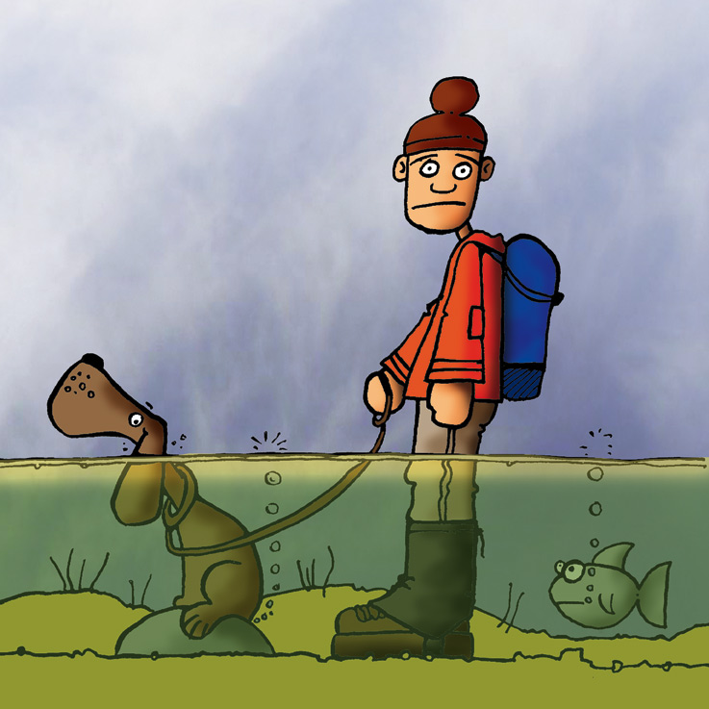
LOP - Contents
The LOP can include:
Tidal Cut Offs
Location of Rip currents
When visiting a new beach you should assess the hazards, read
NOP’s and EAP’s, Speak to the patrol captains and familiarise
yourself with the LOP.
There is a legal obligation to have written operating policies and
they are vital to ensure that all Lifeguards understand their role in
everyday and emergency situations.
Notes:
11

Slide 12
1.3. Demonstrate an understanding of an (EAP) including its suggested content

Slide 13
What is an EAP?
Emergency Action Plan
What do you think the purpose of this document is?
To ensure that in the case of an emergency the right processes are followed and the hazards/issues you could have to deal with are detailed

Slide 14
EAP - Contents
The EAP details what to do in the
event of: a foreseeable emergency;
Casualty in the water
First Aid Scenario
Overcrowding
Incorrect usage of zoned
areas
Disorderly behaviour
Lost person
Procedures should be explicit and if it is necessary to clear the water or evacuate the casualty, how this should be done
Notes:
Trainer Assessor Notes: Use these notes to help you deliver the session (if needed)
Action to be taken in the event of a foreseeable
emergency, for example:
• discovery of a casualty in the water
• first aid scenario
• overcrowding/incorrect usage of zoned areas
• disorderly behaviour
• lost person.
The procedure should be explicit and, if it is necessary to clear the water or to evacuate the casualty, how this
should be done.
14

Slide 15
1.4. Describe the importance of Working with others

Slide 16
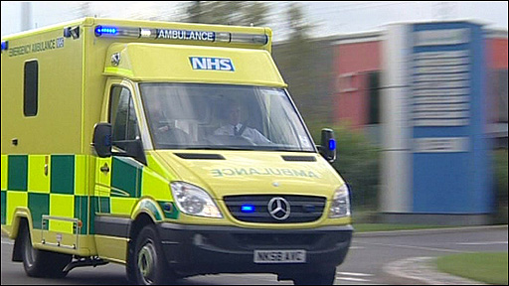
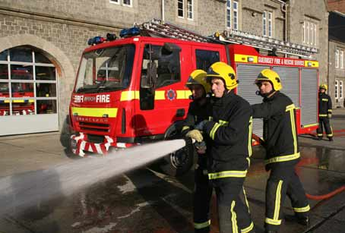
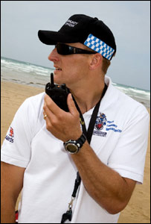
The Emergency Services
Notes:
Trainer Assessor Notes: Use these notes to help you deliver the session (if needed)
The Maritime and Coastguard Agency (MCA)
The Maritime and Coastguard Agency (previously HM Coastguard) coordinates rescue services around the whole
coastline of the UK. It is responsible for the ‘initiation and coordination of civil maritime search and rescue within the UK’. This includes ‘the mobilisation, organisation and tasking of adequate resources to respond to persons either in distress at sea, or to persons at risk of injury or death on the cliffs or shoreline of the UK’. The Coastguard is therefore the ‘official’ controlling body for all lifeguard units. An effective working relationship with the local Maritime Rescue Centre (MRC) will ensure the lifeguards are used to their maximum potential, as they have become a vital link in the national search and rescue network.
Royal National Lifeboat Institution (RNLI)
The Royal National Lifeboat Institution is a charity that saves lives at sea. It provides, on call, 24-hour lifeboat
search and rescue service to 100 nautical miles out from the coast of the UK and Republic of Ireland. It also
provides a seasonal lifeguard service on beaches throughout the UK.
Ambulance Service
In all cases of resuscitation, drowning event or loss of consciousness, the casualty should go by ambulance to
the Accident and Emergency department. The Ambulance Service in the UK is now divided into separate trusts and,
as such, each authority operates slightly differently. It is important to know what the response time of a road
ambulance is and the type of equipment that you may expect to accompany an ambulance tasked to your beach.
Fire Service
Incidents involving fire on the beach are rare, however many beaches are backed by cafes and beach huts. The
modern Fire Service has a wider role, including dealing with hazardous materials that may have washed up,
removing stuck or trapped persons as well as general support to any emergency situation.
Police
Unfortunately aggression on the beach is not uncommon, in all instances of disorderly behaviour, aggression or
suspicious behaviour the Police should be notified immediately. It is worth having the local Police non emergency number in the Beach Lifeguard Unit. Police can also be used to assist in removing or keeping people out of the water, particularly if the individual is intoxicated.
16

Slide 17
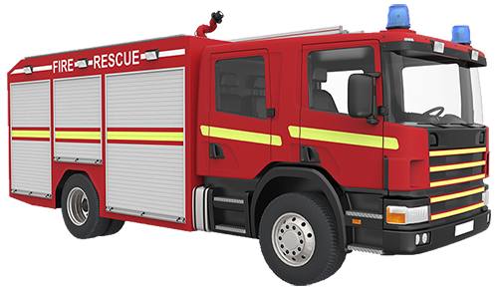
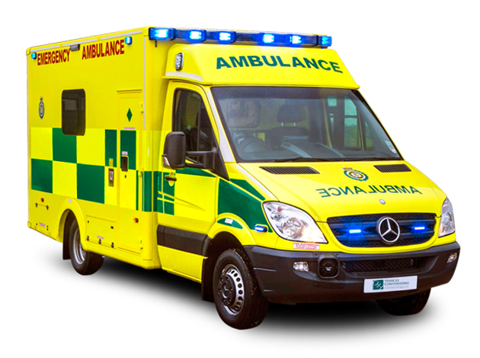
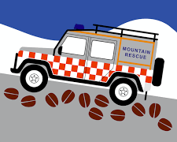
Emergency Services – Responsibilities
Responsibilities from the tide mark with HMCG to the beach
Police have all land overall responsibility with Fire and Ambulance working in conjunction with
All other SAR volunteers are called as Relevant Voluntary Organisations (RVOs) that assist the statutory services
Notes:
17

Slide 18
Summoning the Emergency Services
Emergency services and cost?
999 or 112 – FREE!
Lifeboat or air rescue?
Call the coastguard, they will then call
The lifeboat or air rescue if needed
What information do you need to give to summon emergency services?
P – Position – Where you are?
P – Problem – What's wrong?
P – People – How many casualties?
Notes:
18

Slide 19
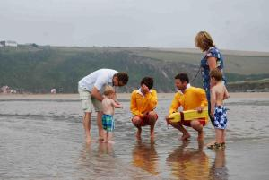
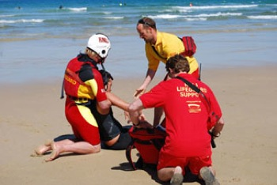
Incident Management
What incidents could occur?
Lost Persons
Water based incident
Land based incident
Cliff incidents/falls
Road Traffic Incidents
Crowd control
Closing of beaches
Major Incidents (stress & media interest)
Notes:
Trainer Assessor Notes: Use these notes to help you deliver the session (if needed)
Lost Persons
Most lost people are children. Most situations are unlikely to lead to emergencies. In the event of searching for a lost a child, no public reference should be made to the fact that the child is lost, due to its vulnerability. A well strategized search is what is needed:
• adult member to stay with the patrol, whilst another is sent to check that the child has returned to their “base”.
• The adult with patrol should be given binoculars and a vantage point whilst giving a description of the child
for the Lifeguard/Life Saver to pass on via VHF including hair colour, name, age, clothing, last known location/activity and how long they have been missing.
• Reassure the panicking person that if anything were to have happened in the water the patrol would have
spotted it.
• If P/A announcements are to be made, they should be directed at the missing child i.e. would Joe Smith please come to the lifeguard patrol at water’s edge/at the top of the beach, and should at no point refer to a missing child
Follow the EAP. Missing persons in the sea according to MCA, says any missing persons should be reported immediately that the coastal/beach patrol receives word that there is someone missing. On dry land there maybe a
30 minute delay, in which the patrol may conduct their own search, but must inform the Coastguard after 30 minutes. If a child contacts a lifeguard, every effort must be made to find the child’s parent or guardian. Arrange for the child to be taken to the station by another lifeguard (if possible). Do not allow the child in the lifeguard station with only one lifeguard present. If possible, have a female and male present when dealing with a lost child in the lifeguard station. All incidents of lost children should be logged on the Incident Report and a Lost Child report filled in.
Water or land?
Once a person has been discovered missing, the relations, particularly if a small child is involved, inevitably fear the
person has drowned. ASK: ‘Did you see the person submerge? Did anyone else see them go under/in the water?’
Water
• Immediately initiate a water search in the area last seen.
• Obtain details that are required to complete the appropriate form.
• Radio the Coastguard giving the details you know.
• Keep the first informant with you.
Land
• If uncertain that the missing person is on land, do a rapid search around the bathing area. The first
informant should stay close to the lifeguard (for radio contact) at all times.
• The first informant to visually check the bathing area with a lifeguard.
• Make sure a relation stays at the towel area.
• Check the child did not go to the car, accommodation, ice cream van, or any other known place.
• Get a group member to phone their accommodation or check it, and return.
Remember to tell all involved in the search if the person is found.
Water-based incident
In the case of a water rescue, one lifeguard should stay at the station to radio help while the other responds. Sound the alarm to alert all lifeguards. All possible assistance should be summoned and sent to assist a lifeguard in the water, taking necessary equipment required. Other bathers in the water must continue to be observed or the water cleared. The lifeguard coordinating the rescue should decide whether to call the Coastguard. The Coastguard
must be called if the situation is likely to deteriorate or if an ambulance/search and rescue (SAR) helicopter might be required. Backup lifeguards/lifesavers take over the management of bathing areas. They should be prepared to
enter the water only if the situation necessitates.
Land-based incident
If the lifeguard is accessible to the casualty, and in no danger (from things such as rock falls or cars), call for an
ambulance immediately and then assist, remembering safety first, then priorities of treatment and to treat for shock. Any serious land-based incident caused by a fall should be treated as a possible spinal injury.
Cliff incidents/falls
The Coastguard should be contacted immediately with falls over cliffs in tide-affected zones/inaccessible areas.
They will automatically call an ambulance. In the case of a serious wound, fracture or spinal injury (multi-system
trauma), do not move the casualty unless absolutely necessary. Wait for the emergency services.
Road Traffic Incidents
There have been instances where lifeguards have come across coastal Road Traffic Incidents (RTI) or have been
asked to help.
Call for the Police and Ambulance service immediately. If persons are trapped or the vehicle is on fire or leaking fuel also request the Fire Service.
Your safety is paramount; make doubly sure traffic is not going to affect you. All road traffic incidents are possible
spinal injuries or multi-system trauma. Likewise do not move casualty unless life threatening. Wait for the
emergency services.
Crowd control
On crowded beaches, control of the public is essential when a rescue is being performed. Unintentional interference by onlookers may endanger the life of the rescuer and prevent the smooth conduct of the operation. It is natural when an accident occurs for people to mill around the scene. The Head Lifeguard should allocate one of the lifeguards to organise the public and, with the assistance of the PA system and the use of a loud hailer, keep the crowds away from the centre of the activity.
Closing of beaches
The patrol is responsible for the safety of the bathers using the beach. Should the sea conditions, in the opinion
of the Senior Lifeguard, become dangerous for the majority of sea users then they should close the beach for bathing. This means that, in the opinion of the lifeguards, the bather puts his life at risk by entering the water. Normally, the public cannot be physically stopped from entering the water. When the beach is closed, at least two patrol lifeguards must remain at the water’s edge and keep constant observation on the beach.
Major incidents (stress and media interest)
In the event of a serious injury or death, lifeguards are likely to be emotionally involved, the level of which
determines the psychological trauma involved. Considering their commitment to preventative lifesaving,
lifeguards may perceive their response as a terrible failure and so feel guilty. This may become overwhelming.
This is well documented and is termed as Post Traumatic Stress Disorder (PTSD). Lifeguard units should be receptive and have procedures in place for lifeguards to come to terms with incidents. It should be noted that the
performance of lifeguards during an incident can be affected and is termed Critical Incident Stress. Supervisors
are likely to debrief lifeguards after such incidents and should be prepared to relieve lifeguards should it be
necessary. PTSD may not be instantaneous, so those affected need sensitive monitoring. PTSD support is available from SLSGB or you employer. Given a lifeguard’s likely emotional state, no statement
should be made to any person. The exception to this would be a police officer. The senior unit/local authority official
should be advised as a matter of priority and the lifeguard debriefed. The news media should be told politely: ‘Please contact the senior unit (or local authority) official as they will have all the details.’ ‘No comment’ can be used but is unhelpful and may encourage further questions.
19

Slide 20
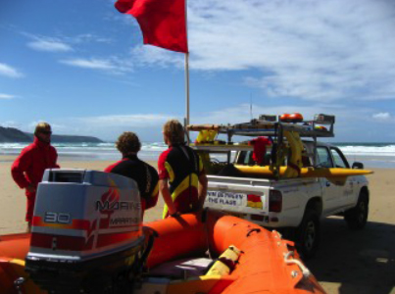
Incident size up
“CHALET”
Casualties
Hazards
Access
Location
Emergency Services
Type of incident
Notes:
Trainer Assessor Notes: Use these notes to help you deliver the session (if needed)
Upon arrival at an incident, a scene assessment needs to take place. This is known as a “Size-up”. The priority on
arrival at an incident is to establish what has happened, who is involved where and how and what the risks are.
A tool to aid in this process is
“CHALET”.
Casualties
Hazards
Access
Location
Emergency Services
Type of incident
20

Slide 21
Helicopter Landing
Cordon off a 40m x 40m square
Each corner should have a flag or be roped off
Helicopter should be able to approach over water to a shore-side incident
Patrol members to face the crowd
Ensure all beach users secure down belongings and shield eyes.
Ensure no one approaches helicopter
Notes:
Trainer Assessor Notes: Use these notes to help you deliver the session (if needed)
There are a variety of helicopter operators in the UK:
• Royal Air Force and Royal Navy Search and Rescue
(SAR)
• Ambulance
• Police
• Coastguard.
An emergency landing area can be defined in advance of incidents by preparing emergency action plans (EAP) with local emergency service providers. The minimum area to be cordoned off is 40m x 40m with one
lifeguard in uniform to each corner holding a flag or roped area. The area should be flat with no power cables nearby. Ideally the helicopter can approach over water to a shoreside incident. Each patrol member is to face the crowd (away from area) on landing and take off. No one is to enter the area. All helicopters on landing cause sandstorms at over 100mph so:
• the public is to be warned of the helicopter, to hold loose objects and to keep clear
• keep windsurfers, umbrellas, and windbreaks from blowing into area
• beware of people approaching the helicopter from the rear
• if blinded by dust or objects, stop and sit down
• do not go toward or away from helicopter
• shield eyes.
21

Slide 22
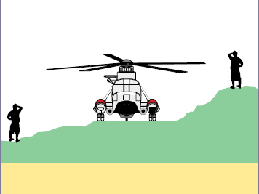
Helicopter Approach
One person communication with helicopter
NEVER approach unless given permission by the pilot
Approach only from the front of the helicopter at a 10 to 2 o’clock angle
Face pilot and raise right arm horizontally to the side with ‘thumb ups’
You will usually be signalled to approach from the left
Notes:
Trainer Assessor Notes: Use these notes to help you deliver the session (if needed)
One person is to be in charge of responding to signals from the helicopter crew. Never approach unless given
permission by the helicopter pilot. The hazard areas are:
Tail rotor High speed hence unseen, 1m height, 3.5m unprotected arc.
Main rotor Tilts below head height normally, clearance decreased when gusty winds or on uneven/sloping ground. Rotors slowing down on shutdown tilt to minimum height.
Radio antennae/radome
Contact not permitted. Capable of giving radiation injury and can be damaged when handled. Lifeguards should always follow the flight crews instructions when approaching a helicopter.
Particle separator This outlet can expel debris forcefully.
Pitot Tubes These tubes stick out from he aircraft and measure wind speed and altitude. Do not touch these
as they are sensitive instruments and may become very hot.
Air ambulance
• Keep in pilot’s field of vision: 10–2 o’clock.
• Face Pilot and extend the right arm horizontally to the side with a thumb up.
• Crew or pilot will indicate where to approach. This is usually their left side.
Slopes
• Enter and depart under rotor from the downhill side to avoid main rotor.
• If you have to move around the helicopter to avoid the point of lowest clearance always walk around the front, never the rear.
• Watch the path of moving rotor blades.
• When carrying equipment, always carry it horizontally, below waist level.
• Always carry long objects between two people.
In uneven terrain, approach and depart on the low side
Loose Objects
• Caps to be worn only if tied around chin. Hold onto loose objects.
• If loose objects are blown away do not reach up after them.
• Never remove clothing under rotor in case arms stray upwards.
Vehicles
• No vehicle to approach into the emergency area unless pilot authorises it.
• Do so only when navigation lights are switched off.
Casualties
• Protect them by shielding, keeping clear of landing area and blanketing if possible.
22

Slide 23
1.5. Describe the Recording and reporting procedures when acting as a Lifeguard

Slide 24
Why is recording important?
Legislative purposes
Prevention of similar incidents
Identifies potential ‘Black Spots’
Identifies equipment and training needs
Involvement of volunteers patrols
Recognition for Lifeguards in Search & Rescue Network

Slide 25
Daily Logs
Gives details of;
General beach information,
Individuals on duty,
Operational equipment,
Environmental conditions
An hourly log of events.
It also provides details of inspections carried out by relevant individuals.
In groups complete a ‘pretend’ SLSGB Daily Log for a patrol

Slide 26
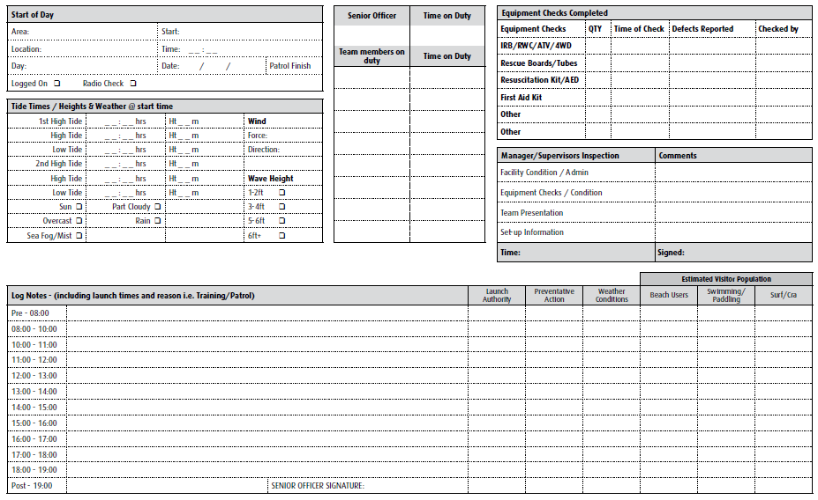
Daily Log Example…

Slide 27
Incident Reporting
Gives details of the conditions that led to the incident, the nature of the incident itself and all the SAR organisations involved.
This form should be filled in for every Major First Aid, Assistance, Search and Near Miss:
• Rescue – where a Lifesaver or water safety cover responds to a person at risk, and physically returns them to shore or transfers them to another rescue craft
• Major First Aid – where a Lifesaver or water safety cover treats a patient who is at risk due to sickness or injury, and has called in external assistance
• Assistance – where a Lifesaver or water safety cover aids a person in the sea who is at very little risk, but if left, would be at risk later
• Search – An organised search with other SAR units for a missing person either at sea or on land - includes body recovery
• Near miss – Any occurrence where a person might have been injured by watercraft i.e. powered or otherwise

Slide 28
Incident Report Form
We will complete an incident report for an incident later on

Slide 29
RIDDOR 1995
(Reporting of Injuries, Diseases and Dangerous Occurrences Regulation)
Puts duties on employers, the self-employed and people in control of work premises (the Responsible Person) to report:
serious accidents/injury
occupational diseases
specified dangerous occurrences (near misses).
Death
Loss of consciousness from lack of oxygen
Poisoning requiring medical treatment
Hospitalisation for over 24 hours
Notes:
Trainer Assessor Notes: Use these notes to help you deliver the session (if needed)
Reporting of injuries, disease and dangerous occurrence regulations 1995 (RIDDOR).
These regulations require:
• any serious work-related or public accident to be
reported within 7 days
• the report to be sent to the nearest Health and Safety
Inspector or Department of Environment
• a report to be made if an accident results in being off
work for more than 3 consecutive working days
• records of reported incidents to be kept.
Serious work-related accidents that need to be reported are:
• death
• serious injury
• loss of consciousness from lack of oxygen
• poisoning requiring medical treatment
• hospitalisation for over 24 hours.

Slide 30
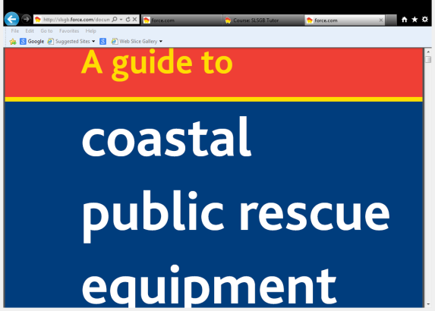
SLSGB Safety Documents
National Safety Guide – Training and Coaching
A guide to coastal public rescue equipment
SLSGB training and Safety guide
SLSGB Patrol, LOP/NOP Toolkit
Notes:
Trainer Assessor Notes: Use these notes to help you deliver the session (if needed)
All of the above documents are available on the document store and should be read. Highlight the importance of being aware of all of these documents.

Slide 31
Knowledge Check

