Slide 1
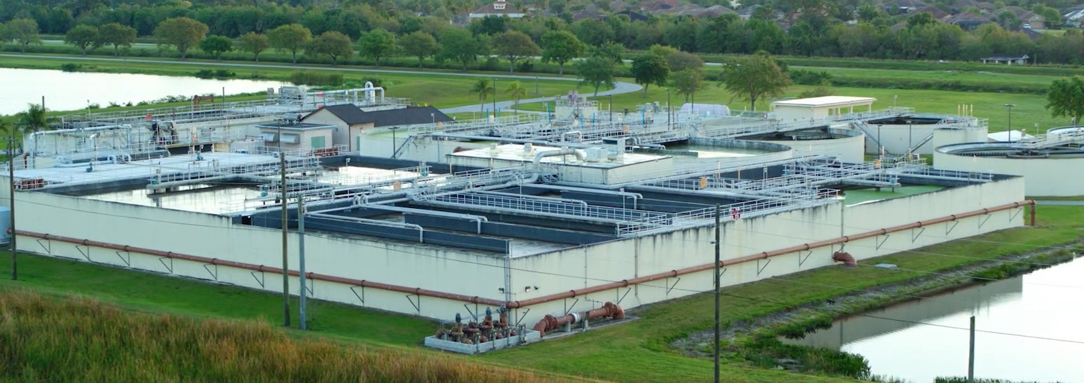

Indian River County Department of Utility Services
Comprehensive Rate Study
August 22, 2024

Slide 2
Rate Study Overview
IRCDUS operates as an enterprise fund = self-supported by user rates
Continuous evaluation of utility operating and infrastructure needs is essential to provide safe and reliable service for residents and businesses
Proactive financial and rate management is critical
Revenue Requirements
Cost Allocation
Rates and Fees
How Much?
From Whom?
How to Collect?
Objective: Develop a multi-year rate plan to ensure IRCDUS’ financial sustainability

Slide 3
Historical Rate Perspective
No IRCDUS rate increase between 1999 to 2019
Avg. annual increases of 3.25% from 2021 to 2024
Notes:
Based on September (last month of prior fiscal year) for comparison purposes

Slide 4
Residential Monthly Bill Comparison

Slide 5
Funding Needs
Operating Expenses
Capital Improvements
Recurring costs to operate and maintain the system
$43M in FY 2025
4% avg. annual increase assumed
$148M FY 24- FY 29
$25M annual spending thru FY 29
Potential capacity expansions by FY 32
Financial Sustainability
Maintain adequate reserves = 9 months of expenses
Preserve borrowing capacity
Balance cash flows

Slide 6
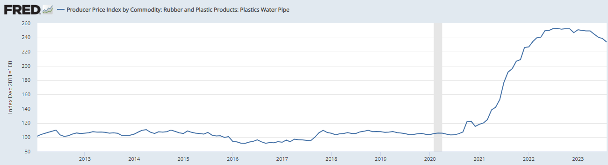
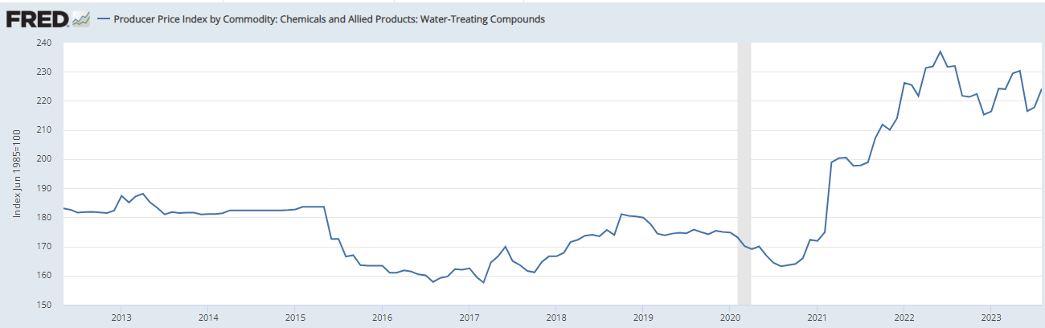
Operations/Material Cost Inflation: 2020-2024
National Commodity Index – Plastic Water Pipe
Up 132% from Jan 2020 to June 2023
National Water Treatment Chemical Index
Up 31% from Jan 2020 to June 2023
Notes:
FRED – BLS forecasting

Slide 7
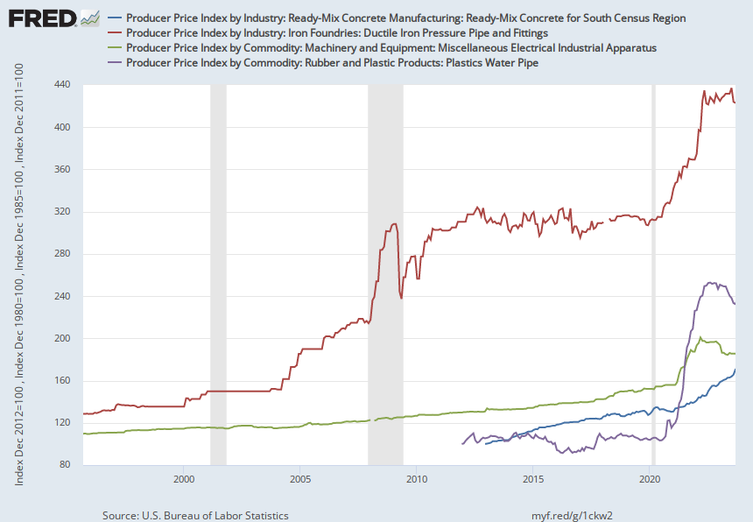

Water / Wastewater Construction Materials Increases
Producer Price Index:
Ductile Iron = 229%
Plastics Water Pipe = 120%
Electrical Machinery & Equipment = 69%
Concrete = 65%

Slide 8
Financial Results: Existing Rates
Annual cash flow deficits beginning in FY 24
Rates don’t fund operating expenses by FY 26
Reserves are exhausted in FY 27
Existing rates are insufficient to fund annual operating expenses and capital needs

Slide 9
Cost Allocation Results
  “Snapshot” of revenues and costs
  Common for some variance
  Supports the higher rate adjustment in FY 25 for sewer to “catch-up”
Notes:
Reclaimed included in sewer

Slide 10
Financial Plan Results: Recommended Rate Plan
“Catch-up” Rate Increases to Stabilize Cash Flow
Rate Indexing in FY 27
Potential Increases to Fund Capacity Expansions
Achieve Target Reserves by FY 27
Potential Debt for Capacity Expansions

Slide 11
User Rate Recommendations
  Implement a 2-yr. plan of retail rate increases
  Customer Bill Impact:
  Evaluate future rates with annual revenue sufficiency updates to reflect master plan identified future capital needs, changes in growth, and costs
  Preserves IRCDUS’ borrowing capacity for future system expansions
 | Current | FY 25 | FY 26
Monthly Water & Sewer Bill (4 kgal): | $50.67 | $60.44 | $67.70
Total $ Increase |  | $9.77 | $7.26

Slide 12
Residential Monthly Bill Comparison
Remain lowest after 2-year rate plan

Slide 13
Residential Monthly Bill Comparison
Water only bills remain favorable

Slide 14

Expense of Potable Water
Compare cost of filling an average size swimming pool (10,000 gallons) with IRCDUS potable water with many other commodities in the marketplace
$124 to fill with IRCDUS water
$15,600 to fill with Publix bottled water from the grocery store
$30,500 to fill with milk
$34,000 to fill with gasoline
$56,600 to fill with Coca-Cola or Pepsi from a 2L bottle
$124,350 to fill with bottled beer
$276,000 to fill with Starbucks coffee
$5,350 with topsoil from Home Depot in 40-pound bags
  IRCDUS Potable Water is in fact cheaper than dirt
Notes:
IRCDUS top tier rate of $12.42 (water use above 12,000 gallons), no sewer (above cap) = $124.20
Topsoil is 1,783 bags at $3 / bag = $5,349
Coffee @ $3.45 for grande for 16 ounces; 1,280,000 ounces in 10,000 gallons = $276,000
Yuengling 12 pack @ $13.99 for 1,280,000 ounces = $124,350
Gasoline prices @ $3.40 (avg per Gas Buddy on 7/18) = $34,000
Milk @ $3.05 per state survey on Zippa per gallon = $30,500
Coca or Pepsi = 18,927 bottle @ $2.99 = $56,592
Publix = 24 pack of 17 ounce bottles @ 4.97 = $15,590

Slide 15






Putting the Cost and Value of Water in Perspective
1 gallon of milk = $3.05
1 loaf of bread = $4.29
Large pizza = $7.99
1,000 gallons of IRC Water = $2.80
Starbucks coffee = $3.45
Box of cereal = $6.42
Notes:
IRC Water is first tier rate (up to 4,000 gallons). Second tier rate is $3.27 from (4 – 7 TGAL). Third tier is 7 -12 @ $6.31 and 4th is $12.42.
Bread = Nature’s Own @ Publix = $4.29
Starbucks = cost of grande coffee = $3.45
Life/Captain Crunch (14 – to 18 oz box) @ $6.42
Gallon of milk per statewide survey @ $3.05
Large pepperoni pizza at Little Ceaser’s (thincrust) per website @ $7.99

Slide 16
Other User Rates
Fire Protection Charges
Standby service for private fire protection facilities
Bulk Service
Water and sewer service to other utility systems
Reclaimed water to golf courses
  Septage/Sludge Disposal
  Non-domestic waste treated by IRCDUS
  Current: $17.05/wet ton
  Proposed: $26.06/wet ton
Description | IRCDUS Customer Count | Existing | Proposed FY 25 | Local Comparison Range
Fire Line Size
4" | 254 | $17.23 | $36.57 | $11.50 - $106.50
6" |  |  |  | $22.83 - $134.73
Bulk Service | Existing | Proposed FY 25
Water: $/kgal | $2.99 | $4.14
Sewer:
Volumetric $/kgal | $3.39 | $4.02
Customer: $/bill | $1.47 | $1.82
Service Availability: $/ERU | $15.24 | $14.62
Reclaimed Water: $/kgal | $0.24 | $0.30

Slide 17
Customer Deposits
One-time initial deposit for new service
Minimizes Utility’s risks of non-payment
Returned to customer 24 months (owner) or 60 months (tenant) of good payment history
Calculated based on proposed rates and average usage

Slide 18

Miscellaneous Fees
New accounts, turn-on/off, meter installations, meter testing, service calls, delinquency, tampering
Equitably recover costs for specific services from benefitting customers
Represents 3-5% of overall system revenues and reduce pressure on rates
Fees periodically updated to reflect current cost to provide the service
Vehicles & Equipment
=
+
+
Labor
Materials
Cost

Slide 19
Miscellaneous Fees Results
Most haven’t been updated in 6+ years
Updated fees align with costs and are comparable
Approximately 35 fees
Notable Fees | FY 23 Count | Existing FY 24 | Proposed FY 25
New Account Fee | 7,751 | $28.41 | $25.00
Service Call | 4,716 | $85.23 | $90.00
Meter Installation 5/8” | 1,666 | $130.69 | $500.00
Service Connection | 82 | $2,785 | $3,625
New Fee: Fire Hydrant Flow |  | N/A | $340
New Fee: Force Main Pressure Testing |  | N/A | $340

Slide 20
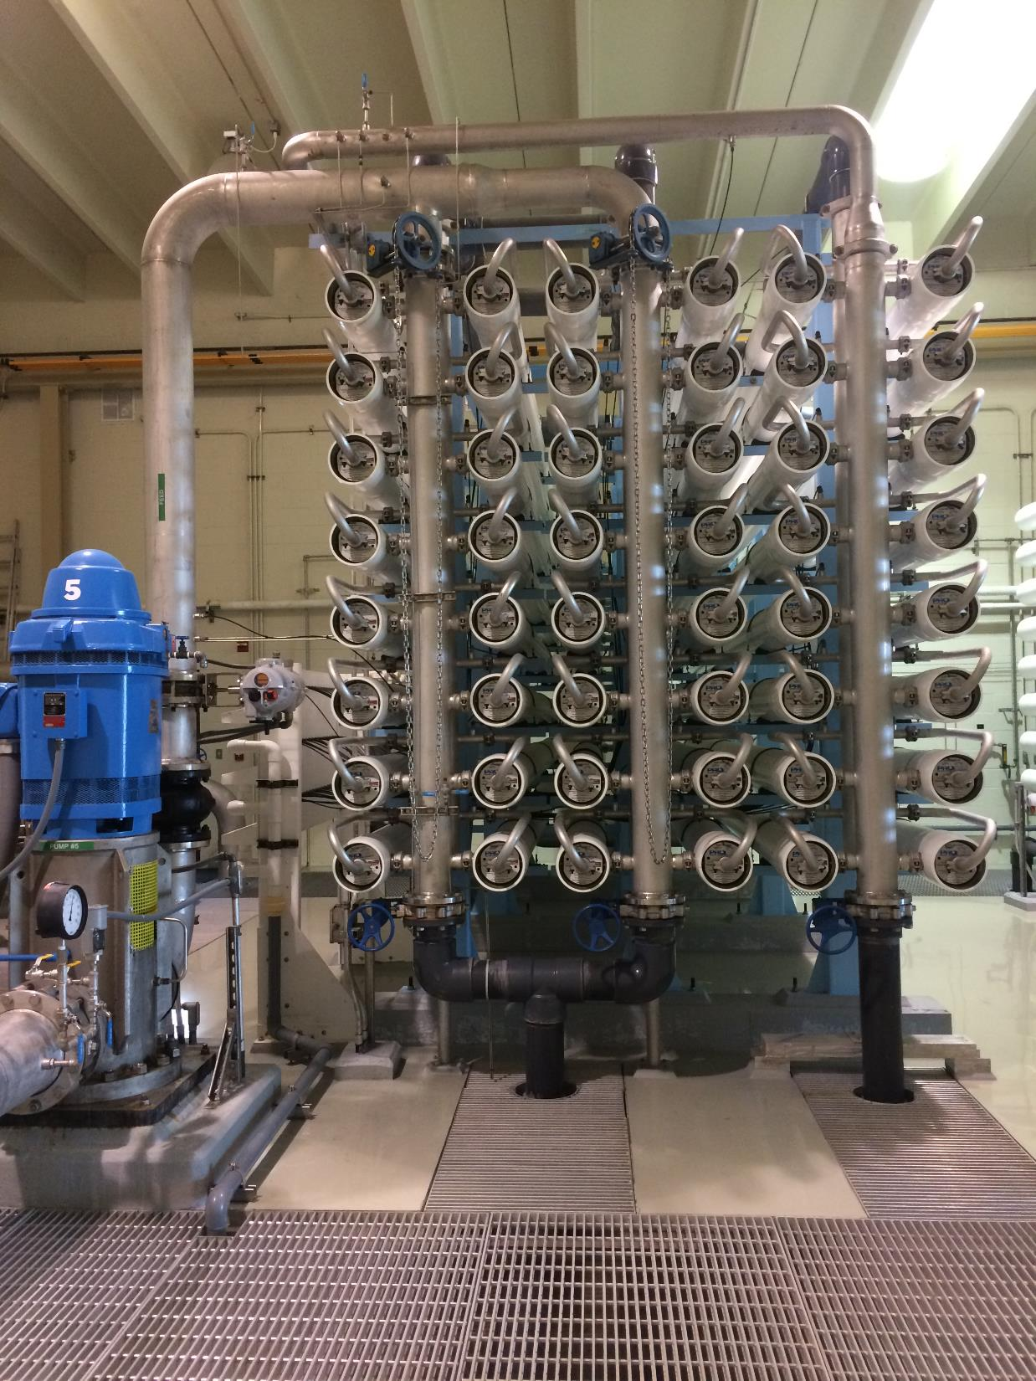
Impact Fees
Different names: capacity fees, impact fees, capital charges, connection fees, system development fees
Purpose: one-time fees for capacity costs of new development (“growth pays for growth”)
Uses: expansion-related capital
Approach: Reconstruction cost new less depreciation of existing assets
Fees have been in-place since at least 1999

Slide 21
Impact Fee Results
Florida Impact Fee Act:
  Phasing and increase limitations (4-Years and Maximum 50% increase)

Slide 22
FY 2024 Impact Fee Comparison

Slide 23
Findings & Recommendations
Existing rates not sufficient to meet the cost of providing safe & reliable services
Update miscellaneous fees and customer deposits
Annual financial reviews to ensure rate sufficiency and future rate needs
Rate adjustments in FY 25 and FY 26 - bills expected to remain lowest in region
Update Impact Fees: 4 yr. phase-in for water and decrease for sewer

Slide 24
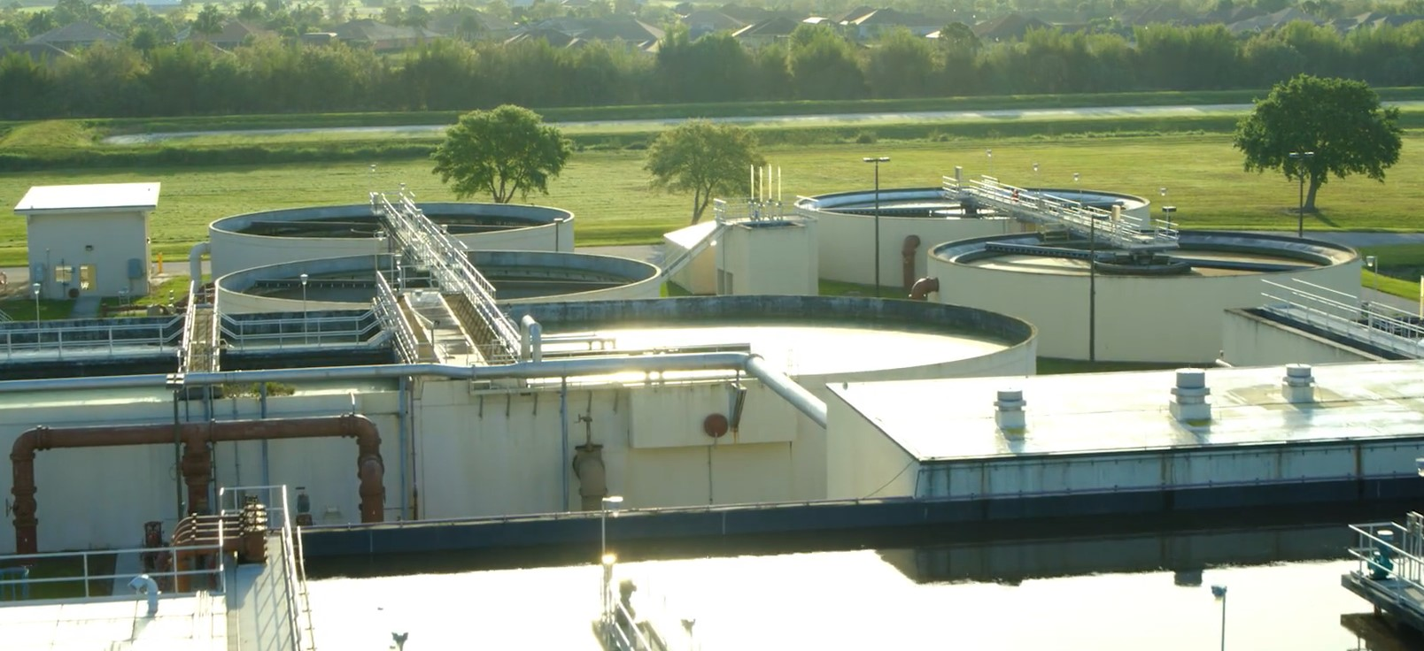

Questions & Discussion
Andy Burnham
Vice President
andrew.burnham@stantec.com

