Slide 1

Breaking the Stalemate
A Workshop to Overcome Inertia
Inertia can quietly take hold in teams, delaying decisions, dulling enthusiasm, and blocking progress.
This 60-minute workshop is designed to help teams recognise where inertia exists, understand what's causing it, and co-create simple, practical actions to re-energize and move forward. It's not about blame, it's about clarity, choice, and momentum.

Slide 2

Workshop Overview
Section
Time
Purpose
1. Welcome and Framing
10 mins
Set context, build safety, and define inertia
2. Identifying Inertia
15 mins
Surface where and how inertia shows up in the team
3. Exploring Root Causes
15 mins
Dig into what's driving inertia (e.g. fear, misalignment, overload)
4. Shifting the System
15 mins
Generate ideas and identify small wins to create momentum
5. Wrap-up and Actions
5 mins
Confirm ownership and next steps
Facilitator Notes

Slide 3

Welcome and Framing (10 mins)
Objectives
Create psychological safety
Establish shared understanding of inertia
Script
"Today is about spotting where we're a bit stuck, and looking at what's in our control to move forward. This isn't a blame game, inertia happens to the best of teams. Let's get curious about it and work through it together."
Activity
Ask: "What does inertia mean to you?"
Share definition: Inertia is the resistance to change or movement. In teams, this can look like decision delays, avoidance of key issues, repeated cycles, or low initiative.
Invite examples of how this might show up in a team.

Slide 4

Identifying Inertia (15 mins)
Objectives
Make the invisible visible
Encourage honest reflection
Activity
Provide post-it notes or an online board (Miro/Mural)
Ask: "Where do you see inertia in our team right now? Be specific – behaviours, habits, decisions, projects."
Group responses into themes:
Decisions we're avoiding
Projects that are stalling
Conversations we're not having
Habits that no longer serve us
Facilitator Tips: Encourage candour, make it OK to name "the stuck stuff". Watch for overlap between themes.

Slide 5




Exploring Root Causes (15 mins)
Discussion Questions
Small Groups or Whole Team:
What's causing this inertia?
Is it fear of failure? Unclear direction? Overload? Lack of ownership? Power dynamics? Something else?
Deeper Exploration
Where are we "waiting for permission"?
What assumptions might we be making?
Optional Tool
Use the "5 Whys" to go deeper into root causes of 1–2 key items.

Slide 6
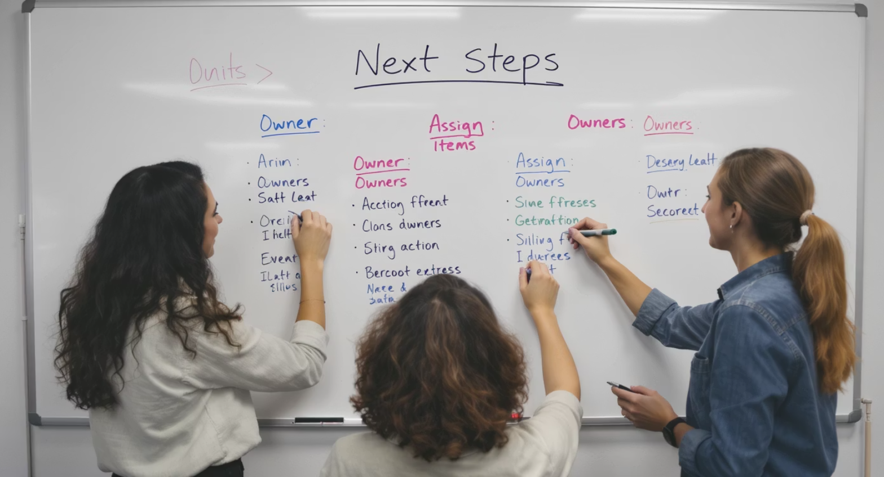
Shifting the System (15 mins)
Objectives
Find agency
Co-create momentum
Activity
Pick 2–3 areas of inertia
For each, ask:
  What's one small step we can take this week to shift this?
  Who will take ownership or sponsor this shift?
  How will we keep each other accountable?
"You don't need to solve everything. You just need to move the system enough to change the energy."

Slide 7

Wrap-Up and Actions (5 mins)
Objectives
Build commitment
Close on energy
Close-Out Prompts
What's one insight you're leaving with?
What one thing will you do differently from today?

Slide 8
Facilitator Resources
Materials Needed
Facilitator Guidance
Flipchart or digital board (Miro, MURAL, Jamboard)
This workshop is designed to be practical, reflective, and energizing. You don't need to fix everything — your job is to hold space for honest conversation and help the team find simple, doable ways to move forward.
Sticky notes or digital equivalent
Markers
Timer or clock
Optional: Pre-created inertia theme boards
Capture next steps on a visible board and confirm who will follow up.
The aim is not perfection — it's momentum.

Slide 9

Understanding the 5 Whys Technique
The 5 Whys is a problem-solving method. It helps identify the root cause of an issue.
Ask 'Why?' five times to drill down into the problem.
It encourages critical thinking and deeper insights.

Slide 10
5 Whys Example: Delayed Project
Identify the project delay as the main issue.
Why was the project delayed? Lack of resources.
Why were there insufficient resources? Unexpected team member absence.
Why did the team member miss work? Illness.
Why wasn't there a backup plan? Lack of foresight.
Why didn't we plan for absences? Inadequate project management.

Slide 11

5 Whys Example: Delayed Project
Identify the project delay as the main issue.
Why was the project delayed? Lack of resources.
Why were there insufficient resources? Unexpected team member absence.
Why did the team member miss work? Illness.
Why wasn't there a backup plan? Lack of foresight.
Why didn't we plan for absences? Inadequate project management.
Notes:
In this example, we explore a project delay using the 5 Whys technique. Each 'Why' helps us drill down to the root cause of the issue, revealing the importance of planning and resource management. This exercise illustrates how critical thinking can uncover underlying problems that may not be immediately apparent.

