Slide 1
Exploring Anxiety: Open Questions to Teams Unpack Rising Stress Levels
In today's high-pressure work environments, team anxiety and stress have become increasingly common challenges. Left unaddressed, these issues can impact well-being, creativity, and overall performance.
Use these questions to explore and facilitate meaningful conversations about stress and anxiety. By creating space for honest dialogue, you can identify underlying causes and develop targeted strategies to support your team’s wellbeing and performance.
MS
by Mark Simpson

Slide 2
Why These Questions Matter
Uncovers Root Causes
Promotes Open Dialogue
Focuses on Shared Experiences
These questions help teams go beyond surface-level symptoms to identify the underlying factors contributing to workplace stress and anxiety. By understanding these deeper causes, you can address problems at their source.
Creating a non-judgmental space for conversation encourages team members to share honestly about their experiences. This psychological safety is essential for meaningful discussion about sensitive topics such as anxiety and causes of challenge.
By examining team culture and collective behaviours, these questions shift the focus from individual struggles to shared challenges, fostering a sense of solidarity and collective responsibility.

Slide 3
General Landscape
Identifying Challenges
Daily Pressure Points
Stress Patterns
What's been feeling most challenging or overwhelming about work lately?
This open-ended question invites team members to name their specific pain points without feeling constrained to certain topics.
What tends to create the most stress or pressure day-to-day?
This helps identify recurring stressors that might be flying under the radar but significantly impact overall well-being.
Are there moments in the week where stress spikes? Why might this be?
Looking for patterns helps spot systemic issues related to deadlines, meetings, or other recurring events.

Slide 4
Team Dynamics & Culture
Behavioral Impact
What behaviours reduce or increase anxiety in the team?
Psychological Safety
How\ safe do you feel raising concerns or admitting when you're struggling?
Team Support
How well does it feel like we've got each other's backs?
These questions explore the interpersonal dynamics that shape team culture. Research shows that psychological safety is a critical factor in team performance and well-being. By examining how team members interact and support each other, you can identify both protective factors and potential sources of tension.

Slide 5
Communication & Clarity
Role Clarity
How clear do you feel about what's expected of you?
Ambiguity around responsibilities and expectations is a significant source of workplace anxiety.
Change Management
How well do you feel changes are communicated in ways that are helpful?
Poor communication during times of change can amplify feelings of uncertainty and stress.
Support During Uncertainty
When things are uncertain, to what extent do we feel supported? If less supported, in what ways?
This reveals gaps in the support system during challenging periods.

Slide 6
Leadership & Support
Empathetic Response
How does leadership respond when people are under pressure?
Meaningful Support
What support would make the biggest difference?
Concrete Examples
What recent examples do we have of supportive or unsupportive experiences
Leadership behavior sets the tone for how stress is handled throughout the organisation. Ask team members about their experiences with leadership during high-pressure situations.
Understanding what specific support would make the biggest difference allows you to prioritize interventions that will have the most impact.
Collecting concrete examples provides valuable context for understanding what's working and what could be improved.

Slide 7
Workload & Boundaries
Workloads
Always On
How realistic are your workloads?
How easy is it to switch off from work?
Burnout Risk
Are there unspoken rules that add pressure?
Workload management and boundary setting are critical factors in preventing burnout. Ask your team: "How realistic are your workloads?" This question addresses whether expectations align with available resources and capacity.
Also explore:
"How easy is it to switch off from work?" and
"Are there unspoken rules that add pressure?"
These questions help identify invisible factors that may be contributing to an always-on culture.

Slide 8
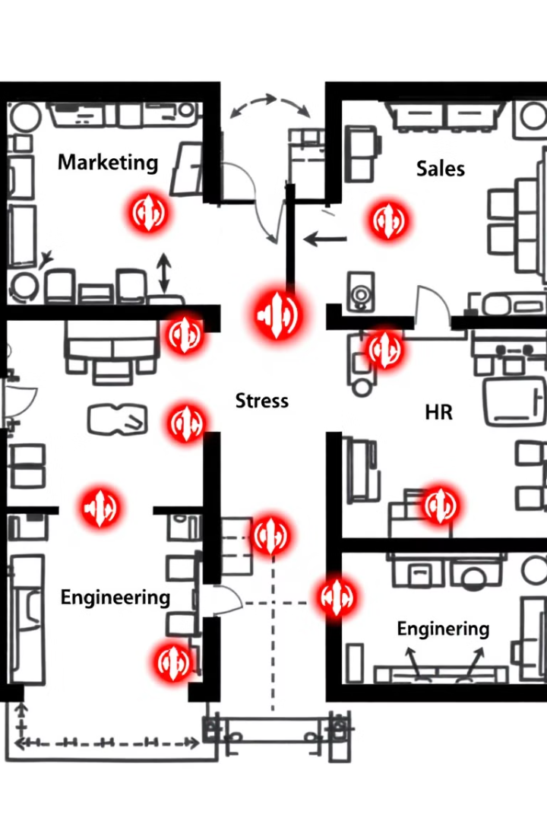
Organisational Impact
Delivery
Question Focus
What to Ask
Why It Matters
Unintended Consequences
"What is the organisation unintentionally doing that adds stress?"
Reveals blind spots in policies and processes
Priority Changes
"If you could change one thing to reduce anxiety, what would it be?"
Identifies highest-impact intervention points
Exec
Operations
Normalised Stress
"Is stress becoming normalised? What might we be overlooking?"
Surfaces unhealthy patterns that have become invisible
Product
These questions help teams step back and examine how organizational structures, policies, and cultural norms might be contributing to anxiety. By looking at the system rather than just individual experiences, you can identify more sustainable solutions.

Slide 9
Summary & Next Steps
Create Dialogue Space
Schedule dedicated time for these conversations, ensuring all team members have an opportunity to share their perspectives in a psychologically safe environment.
Identify Patterns
Look for common themes across responses and validate shared experiences. This helps team members see that they're not alone in their challenges.
Take Meaningful Action
Commit to addressing at least some of the insights gathered, even if the changes seem small. Small, consistent improvements build trust in the process.
Ensure Ongoing Safety
Continue to strengthen psychological safety in all team interactions, reinforcing that vulnerability is welcomed and concerns are taken seriously.

