Slide 1
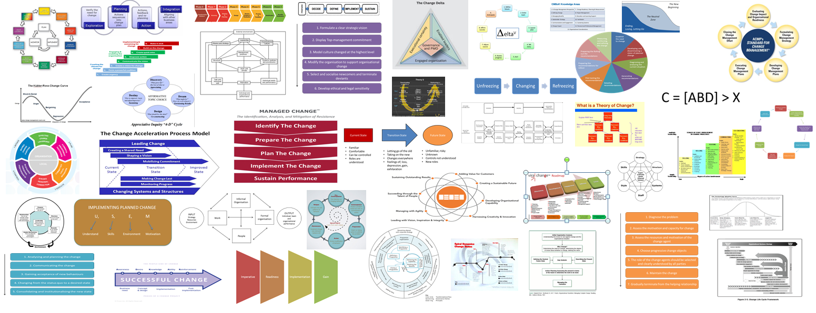
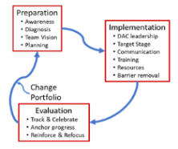
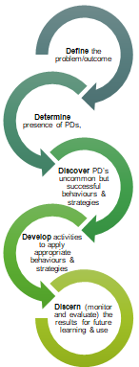
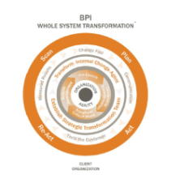
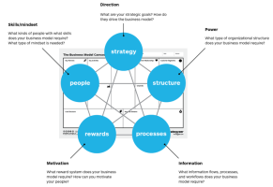
Taxonomy of Change Management Models
Version 3.1 June 2020
Mark Simpson
E. mark.Simpson@resilientchanging.com

Slide 2
Introduction – Change Taxonomy V4.0
Having worked in change environments for many years and used a wide range of change models for many different types of change we found it useful to collate and categorise models for ease of reference. We have used four types of classification:
broader strategic or macro models that can be helpful in understand a context of change, or support for change - Nadler and Tushman, congruence model being an example
High level change model – change specific models, but at a broader, sometimes even conceptual model - Carnall, change management model as an example
Actionable Model detailed, with defined stages and actions, for example Accelerating Implementation Methodology (AIM) Change Management Methodology
Supporting models that underpin our approach to change, they can apply to specific elements of change or help to understand certain elements, for example - Beckhard and Harris, change formula
In compiling this taxonomy the sheer volume of change related models was a surprise, in some ways a testament to the view that change can be challenging, and the argument a purely formulaic approach is not possible given that humans are wonderfully unique and change situations can be highly varied. Our view is that understanding, appreciation, empathy, flexibility and resilience coupled with a desire to learn are foundational capabilities to enable those delivering change. Firstly, to be in a resourceful state themselves, in order that they support others and deliver effective change. Methods are much like tools, the right one, in the right hands, at the right time can be hugely benefits, and the wrong tools in the wrong hands, at the wrong time…..
This taxonomy is in no way complete, in this third version we have added: Change Rx, Galbraith Star Model, Positive Deviance and Whole System Transformation; further enhancements are welcomed.
In June we will publish version 4, we’d welcome your thoughts on any missing models. In the meantime hope you find this version of the taxonomy of use.
Mark Simpson
Contextual
High-Level
Actionable
Supporting

Slide 3
Taxonomy Contents
Accelerating Implementation Methodology (AIM) Change Management Methodology | ACMP Standard for Change Management
Change Delta Framework | Beckhard and Harris, Change Formula
Beckhard and Harris, Change Management Process | Beckhard's Transition Model
Bullock and Batten's Planned Change Model | Burke & Litwin Model
Carnall, Change Management Model | CHAMPS2
Change Leaders Roadmap Methodology | CMI Body of Knowledge & Maturity Model
Conner Partners' Change Execution Methodology (CEM) | Cooperrider's Appreciative Inquiry (AI)
Cummings and Worley's Model for Managing Change | Decipher Delta^{V}
Edwin Cornelius - Implementing a Planned Change | EFQM Excellence Model & RADAR
Galpin's Wheel of Nine Wedges | GE Change Acceleration Process
Judson's Five-Phase Model | Kotter's Eight-Stage Change Model
Kübler-Ross Change Model | LaMarsh Global Managed Change™ Methodology
Lewin's Change Management Model (three-step model) | Lippitt, Watson and Westley Model
Managing Successful Programmes (MSP) | McKinsey's Seven-Step Model
Nadler and Tushman, Congruence Model | People Centred Implementation (PCI)
PMI's Change Management methodology | Pritchett's Change Management Model
Prochaska and DiClemente Model | Prosci’s ADKAR™ Change
Rogers Technology Adoption | Senge, systemic model & the Fifth Discipline
SPIRAL DYNAMICS® CHANGE STATE INDICATOR | Stacey and Shaw, Complex Responsive Processes
Viral Change | Weisbord 6 Box Model
William Bridges, Managing the Transition | Teece- Dynamic Capabilities
Theories of Change | Theory U
Change Rx - Change Management Project Methodology | BPI - Whole System Transformation
Galbraith Star Model | Positive Deviance
Contextual
High-Level
Actionable
Supporting

Slide 4
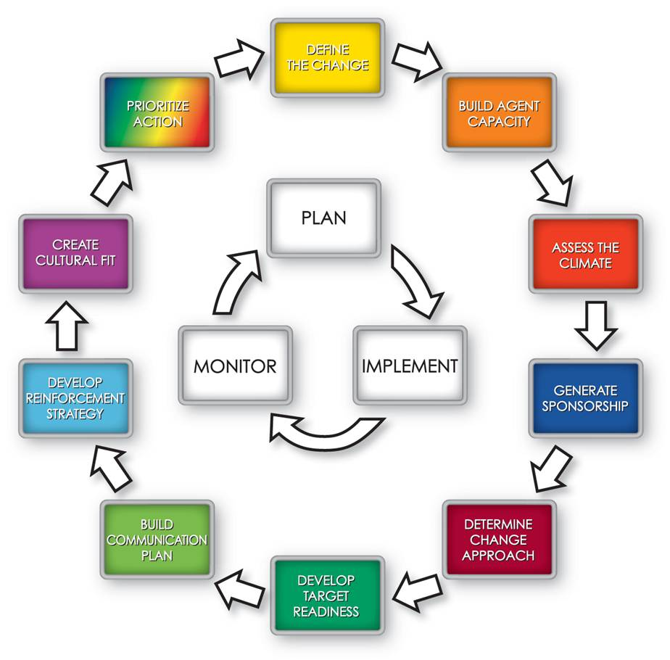
1- Accelerating Implementation Methodology (AIM) Change Management Methodology
Description:
A process for implementing strategic change that helps identify and manage risks such as different opinions on the scope of the change, resistance, cultural differences, lack of active change leadership at all levels, ineffective communication, no reinforcement. Systematic approach that translates behavioural research into operational tactics and strategies that apply to implement projects faster/ successfully. Full set of learning programmes, tools, measurement diagnostics and action principles that work together to drives changes on time, on budget with all business, technical and human objectives met

Slide 5
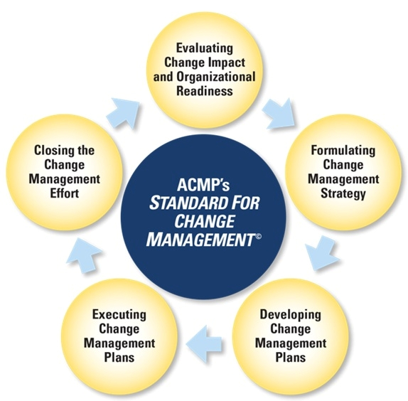
2- ACMP Standard for Change Management
Description:
The ACMP Standard for Change Management is the collection of generally accepted practices in change management. Released in September 2014.
ACMP’s approach is a consistent global definition of Change management and the elements that are “standard” to its practice provides.
. The Standard establishes five key Change management areas that will enhance practice proficiency, quality and credibility across multiple industries, organisations and roles: 1. Evaluating change impact and organisational readiness 2. Formulating change management strategy
3. Developing change Management plans 4. Executing change management plans 5. Closing the change management effort

Slide 6
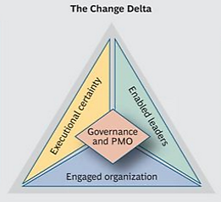
3- Change Delta Framework
Description:
The Change Delta is a comprehensive, holistic approach that focuses energy and resources on the change elements that it considers the most impactful. It has a focus on leadership and structure as a foundation.
Its key areas are:
Executional Certainty; a portfolio approach to management all elements of a large change initiative, leading to transparency about their current status and progress against targets, and helping leaders take early and decisive action to correct problems
Sponsorship, Governance, and Program Management Office (PMO); a clear governance structure with explicit roles, processes, and decision rights, led by an activist PMO
Enable Leaders; extended leadership team with the tools to sponsor and manage change efforts effectively, and who are held directly accountable for success
Engaged Organisation; employees at every level who not only understand the change, but are ready, willing and able to manage it

Slide 7
4- Beckhard and Harris, Change Formula
Description:
Whilst not an actionable model, the change formula is a concise way of capturing the process of change, and identifying the factors that need to be strongly in place for change to happen. C=[ABD] > X
C = Change A = Level of dissatisfaction with the status quo B = Desirability of the proposed change or end state D = Practicality of the change (minimal risk and disruption)
X = ‘Cost’ of changing
Factors A, B, and D must outweigh the perceived costs [X] for the change to occur.
Resistance is normal and to be expected in any change effort.
Resistance to change takes many forms; change managers need to analyse the type of resistance in order to work with it, reduce it, and secure the need for commitment from the resistant party. Beckhard and Harris emphasized the need to design interventions that allow these three factors to surface in the organization.

Slide 8
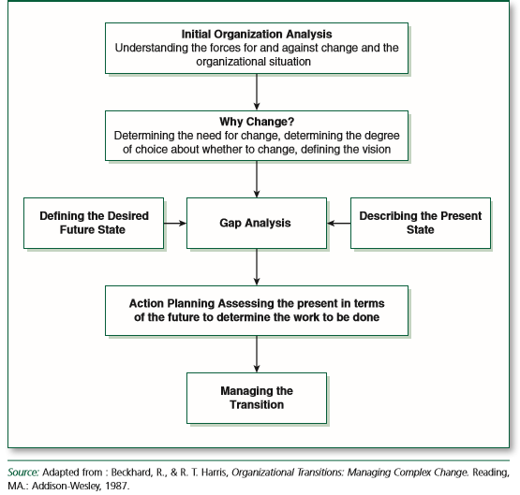
5- Beckhard and Harris, Change Management Process
Description:
A linear five stage process for managing change:
Internal Organizational Analysis - Identifying the forces for and against the change and the current organizational situation.
Why Change? - Determining the need for change, determining the degree of choice of whether to change and defining the vision.
Gap Analysis - Defining the current state of the organization versus the desired state.
Action Planning - Assessing the present in terms of the future to determine the work to be done.
Managing the Transition - Implementing the plan through effective collaboration and role assignment.
This is a person centric change and outcome focused, but with a high-level view.
It recognises the challenges of change and the impact for individuals (loss centred) and leaders.
It considers the paradoxes of Change:
The need for leaders to balance driving & enabling change,
Viewing resistance to change as a problem and an opportunity.
Focus on outcomes, with attention to process.
Moving ahead with changing directions.
Patience and impatience.

Slide 9
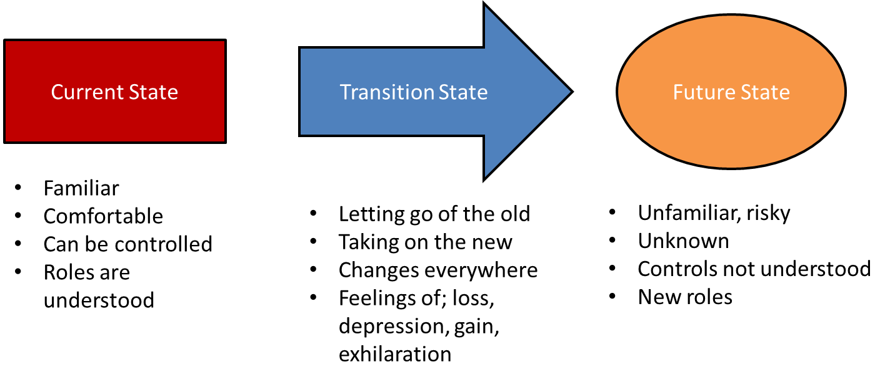
6- Beckhard's Transition Model
Description:
Richard Beckhard’s change Model is a high-level framework for the stages of change
Determining the need for change
Articulating a desired future
Assessing the present and what needs to be changed in order to move to the desired future
Getting to the desired future by managing the transition
Beckhard's Transition Model focus on states and the emotions of these states:
Current State: -familiar, comfortable, can be controlled, roles are understood
Transition State: -letting go of the old, taking on the new, changes everywhere, feelings of loss, depression, gain, exhilaration
Future State unfamiliar, risky, unknown, controls not understood, new roles

Slide 10
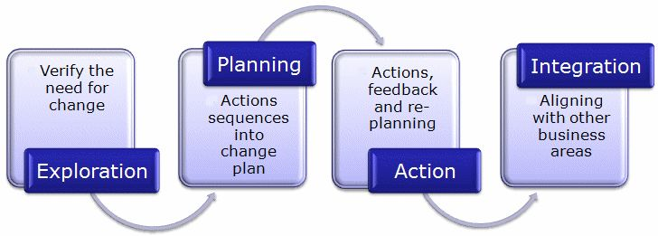
7- Bullock and Batten's Planned Change Model
Description:
Bullock and Batten’s (1985) phases of planned change draw on the disciplines of project management. A number of models have similar ‘steps to changing your organization’.
Bullock and Batten describe four key stages in a linear approach:
Exploration; involves verifying the need for change, and acquiring any specific resources necessary for the change to go ahead
Planning; an activity involving key decision makers and technical experts. A diagnosis is completed and actions are sequenced in a change plan
Action; these are completed according to plan, with feedback mechanisms which allow some re-planning if things go off track
Integration; started once the change plan has been fully actioned, involves aligning the change with other areas in the organisation and formalizing them in some way via established mechanisms such as policies, reward and company updates.
The approach appears to take the view that the organisational change is a technical problem that can be solved with a definable technical solution.

Slide 11
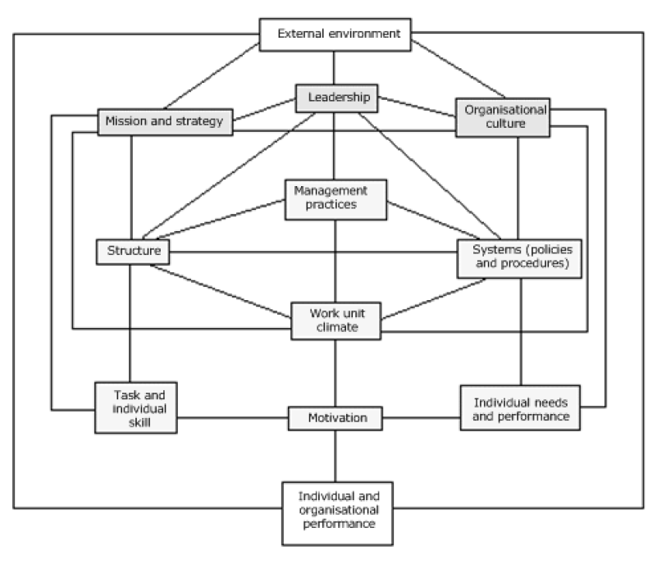
8- Burke & Litwin Model
Description:
Whilst no a “pure change management model” the Burke-Litwin model helpfully shows the various drivers of change and ranks them in terms of importance.
The model is expressed diagrammatically, with the most important factors featuring at the top. The lower layers become gradually less important. The model argues that all of the factors are integrated (to greater or lesser degrees). Therefore, a change in one will eventually affect all other factors.
The Burke-Litwin Drivers of Change being :
1. External Environment
2. Mission and Strategy
3. Leadership
4. Organisation Culture
5. Structure
6. Work Unit Climate
7. Task Requirements and Individual Skills/Abilities
8. Individual Needs and Values
9. Employee Motivation
Burke-Litwin believe environmental factors to be the most important driver for change. Indeed, most change can be traced back to external drivers for change. However, in successfully managing change our experience is that internal factors and especially people are the most critical aspects in reacting to external factors – in simple terms the external environmental drives, but the internal delivers..

Slide 12
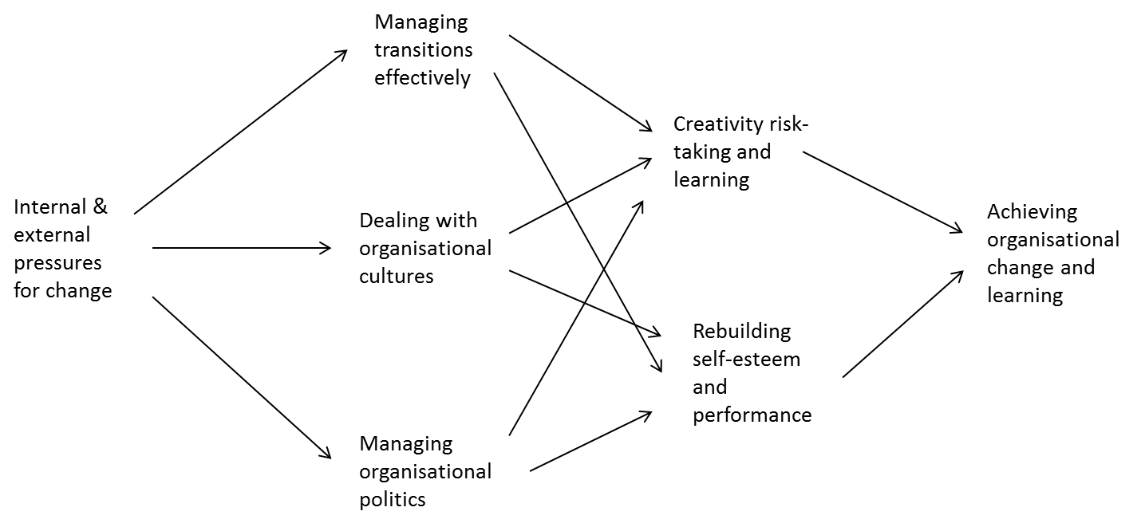
9- Carnall, Change Management Model
Description:
Colin Carnall (1990) says that the effective management of change depends on the level of management skill in the following areas:
Managing transitions effectively
Dealing with organizational cultures
Managing organizational politic
Carnall makes the point that ‘only by synthesising the management of transition, dealing with organisational cultures and handling organisational politics constructively, can we create the environment in which creativity, risk-taking and the rebuilding of self-esteem and performance can be achieved’.

Slide 13
10- CHAMPS2
Description:
CHAMPS2 has a broad scope across the business change journey from identifying the business need, to achieving the desired outcomes.
This linear stage actionable model is supported by detailed “how-to” guides, document templates and best practice examples online.
CHAMPS2 divides transformational change into eight phases from the beginning (the strategic need) to the end (the strategic Outcome).
The eight phases are broken down into stages, each one of which will achieve a specific objective; for example, determining strategic needs.
Within the stages are a varying number of activities that can be followed to complete the stage.
Phase 0- Transformation Initiation
Phase 1- Visioning
Phase 2- Shaping and Planning
Phase 3- Design
Phase 4- Service Creation and Realisation
Phase 5- Providing and Transition
Phase 6- Stabilisation
Phase 7- Benefits Realisation

Slide 14
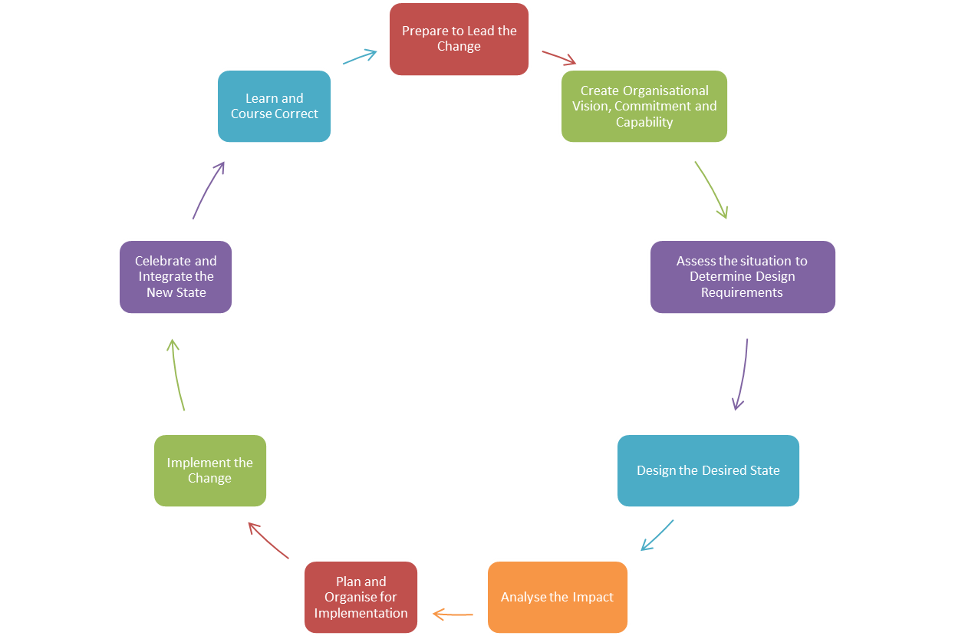
11- Change Leaders Roadmap Methodology
Description:
The Change Leader’s Roadmap Methodology (CLRM) is a change process methodology, providing strategic guidance and change
CLRM provides guidance and tools for how to change, and how to engage stakeholders throughout the change effort to ensure commitment and buy-in.
The aim is to provide support for change teams to consciously design change process so it integrates all the “content” work (e.g., desired outcomes, design requirements, design, impact analysis, implementation planning, etc.) with the “people” work (e.g., mind-set, behaviour and culture change, communications, engagement, politics, etc.).

Slide 15
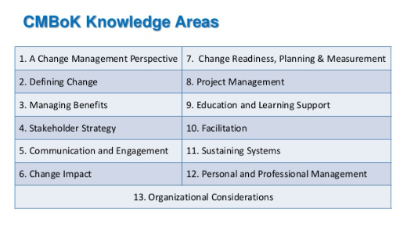
12- CMI Body of Knowledge & Maturity Model
Description:
The Change Management Institute (CMI) has developed a Body of Knowledge - a framework and toolkit which covers a broad and platform and spectrum of change related areas.
It includes
Overarching theories behind change
Defining change
Managing benefits
Stakeholder strategies
Communication and engagement
Change impact
Change readiness, planning and measurement
Project management
Education, learning and support
Facilitation
Sustaining systems
Personal and professional management
Organisational considerations
The CMI has also created its own organisational change maturity model (OCMM). The model is used to describe the behaviours, practices and processes of an organisation that enable reliable and sustainable outcomes. The OCMM has 5 levels of maturity across 3 key organisational change categories (Strategic Change Leadership, Business Change Readiness and Project Change Management)

Slide 16
13- Conner Partners' Change Execution Methodology (CEM)
Description:
A systematic process for managing change initiatives from inception through successful realisation of business results
CEM takes a metric approach to assess the major execution risks and provides guidance on how to mitigate them as part of its change execution framework.
It is a four phase process comprising on
Decide
Define
Implement
Sustain
Each phase takes an integrated consideration of Intent, People, and Delivery.
The methodology includes tools such as activity guides, application modules, articles, examples, mind maps, project plans, questionnaires, reference materials, and templates.

Slide 17
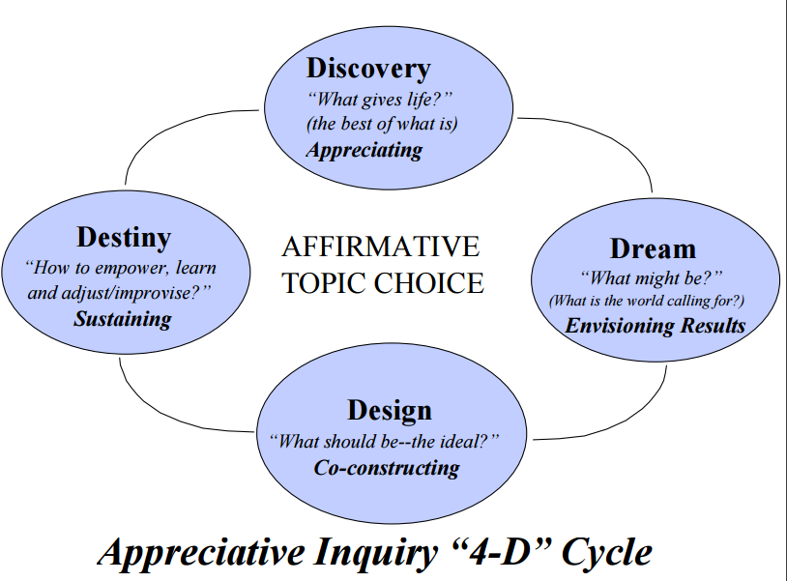
14- Cooperrider's Appreciative Inquiry (AI)
Description:
Appreciative Inquiry (AI) is a theory and practice for approaching change from a holistic framework. Based on the belief that human systems are made and imagined by those who live and work within them, AI leads systems to move toward the generative and creative images that reside in their most positive core – their values, visions, achievements, and best practices. AI is both a world view and a practical process with an application beyond change management.
In theory. AI is a perspective, a set of principles and beliefs about how human systems function, a departure from the past metaphor of human systems as machines. Appreciative Inquiry is set of core processes, practices, and ‘models’.
In practice, AI can be used to co-create the transformative processes and practices appropriate to the culture of a particular organization.” “Grounded in the theory of ‘social constructionism,’ AI recognizes that human systems are constructions of the imagination and are, therefore, capable of change at the speed of imagination. Once organization members shift their perspective, they can begin to invent their most desired future.
In practice, AI can be used to co-create the transformative processes and practices appropriate to the culture of a particular organization.
From a model perspective The 4-D cycle has four key stages:
Discovery: mobilising a whole system inquiry into the positive change core;
Dream: creating a clear results-oriented vision in relation to discovered potential and in relation to questions of higher purpose, i.e., “What is the world calling us to become?”
Design: creating possibility propositions of the ideal organization, an organization Design which people feel is capable of magnifying or eclipsing the positive core and realizing the articulated new dream;
Destiny: strengthening the affirmative capability of the whole system enabling it to build hope and momentum around a deep purpose and creating processes for learning, adjustment, and improvisation

Slide 18
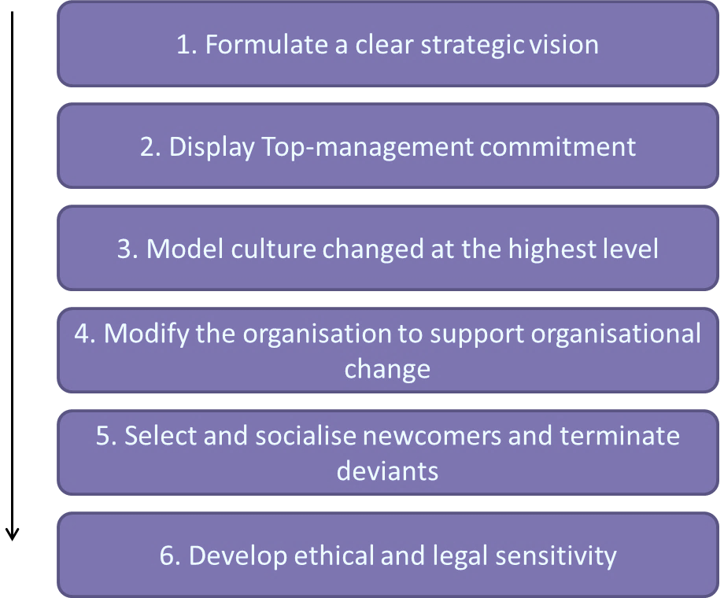
15- Cummings and Worley's Model for Managing Change
Description:
Cummings & Worley (C&W) provide six guidelines for cultural change (which are in line with Kotter's eight-step strategy) y. The steps are as follows:
Formulate a clear strategic vision (stage 1,2 & 3 of Kotter)In order to make a cultural change effective a clear vision of the firm’s new strategy, shared values and behaviours is needed. This vision provides the intention and direction for the culture change
Display Top-management commitment (stage 4 of Kotter)It is very important to keep in mind that culture change must be managed from the top of the organization, as willingness to change of the senior management is an important indicator.
Model culture change at the highest level (stage 5 of Kotter)In order to show that the management team is in favour of the change, the change has to be notable at first at this level. The behaviour of the management needs to symbolize the kinds of values and behaviours that should be realized in the rest of the company. It is important that the management shows the strengths of the current culture as well; it must be made clear that the current organizational does not need radical changes, but just a few adjustments.
Modify the organization to support organizational change
Select and socialize newcomers and terminate deviants (stage 7 & 8 of Kotter). Whilst it may sound harsh C&W believe the way to implement a culture is to connect it to organisational membership, people can be selected and terminated in terms of their fit with the new culture
Develop ethical and legal sensitivity. Changes in culture can lead to tensions between organisational and individual interests, which can result in ethical and legal problems for practitioners. This is particularly relevant for changes in employee integrity, control, equitable treatment and job security

Slide 19
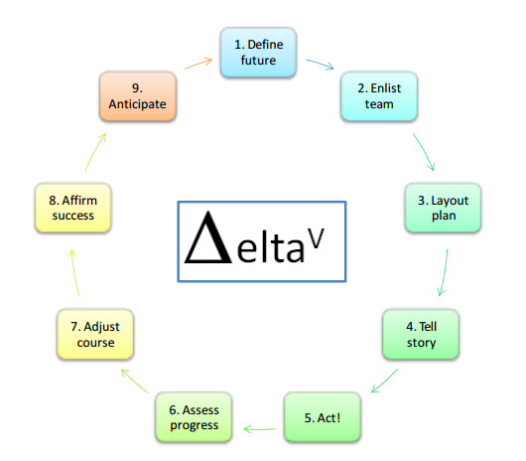
16- Decipher Delta^{V}
Description:
Decipher provides an integrated nine-element process, called DeltaV, to better describe successful organisational change.
DeltaV (pronounced ‘delta five’ where delta is a general label for “change” used in science/engineering/maths) has the following elements:
Define the future (some mystical story-tellers would say “Divine the future”!)
Enlist the change leadership team
Layout the roadmap for the journey
Tell the story!
Act! - Assess progress - Adjust course as necessary - Affirm progress - Anticipate next wave!

Slide 20
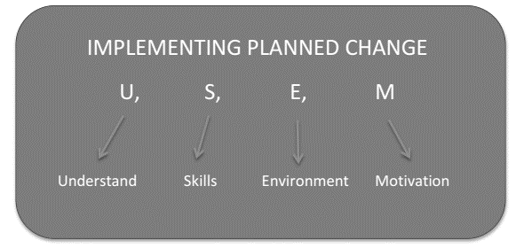
17- Edwin Cornelius - Implementing a Planned Change
Description:
In implementing a planned change, Cornelius and associates describe four key macro-level ingredients for successful change management:
Understand - what the change is about and why it’s being carried out.
Skills - that will be required to make a successful change.
Environment - remove the barriers to implementing a successful change
Motivation - building and sustaining motivated people who share the vision, passion, and the energy to help the transformation succeed
Cornelius also produced a snapshot of Change Readiness that he believes “renewable leaders” should institutionalise:
A workforce that is business literate
A workforce that has permission to act
A workforce that will challenge the status quo
Leadership that encourages a 'readiness for change' culture.

Slide 21
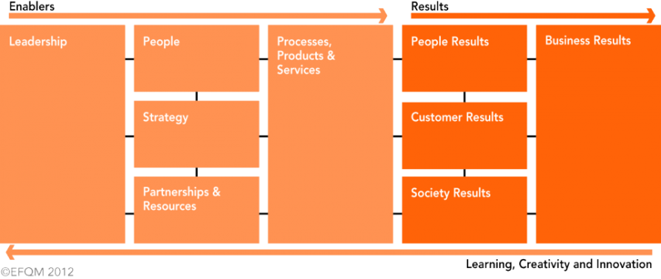
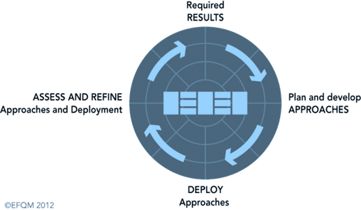
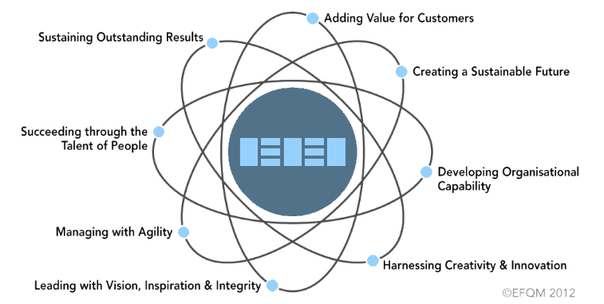
18- EFQM Excellence Model & RADAR
Description:
Again, whilst not change specific the EFQM Excellence Model allows people to understand the cause and effect relationships between what their organisation does and the results it achieves. The Model comprises of a set of three integrated components:
The Fundamental Concepts define the underlying principles that form the foundation for achieving sustainable excellence in any organisation.
The Criteria provide a framework to help organisations to convert the Fundamental Concepts and RADAR thinking into practice.
RADAR is a simple but powerful tool for driving systematic improvement in all areas of the organisation.
At the highest level, RADAR logic states that an organisation needs to:
Determine the Results it is aiming to achieve as part of its strategy
What are we trying to achieve?
Plan and develop an integrated set of sound Approaches to deliver the required results both now and in the future
How do we try to achieve this?
Deploy the approaches in a systematic way to ensure implementation
How / Where / When was this implemented?
Assess and Refine the deployed approaches based on monitoring and analysis of the results achieved and ongoing learning activities.
How do we measure whether it is working?
What have we learning and what improvements can be made?

Slide 22
19- Galpin's Wheel of Nine Wedges
Description:
Galpin (1996) proposes a model comprised of nine wedges in the form a wheel for change as a linear process.
As a foundation for each wedge in the model, Galpin (1996) stressed the importance of understanding an organisation’s culture as reflected in its rules and policies, customs and norms, ceremonies and events, and rewards and recognition.
The Galpin wheel consists of the following wedges:
Establishing the need to change
Developing and disseminating a vision of planned change
Diagnosing and analysing the current situation
Generating recommendations
Detailing the recommendations
Pilot testing the recommendations
Preparing the recommendations for rollout
Rolling out the recommendations
Measuring, reinforcing, and refining the change
Establish the need to change
Preparing the rolling out the recommendations
Developing and disseminating a vision of planned change
Diagnosing and analysing the current situation
Generating recommendations
Detailing recommendations

Slide 23
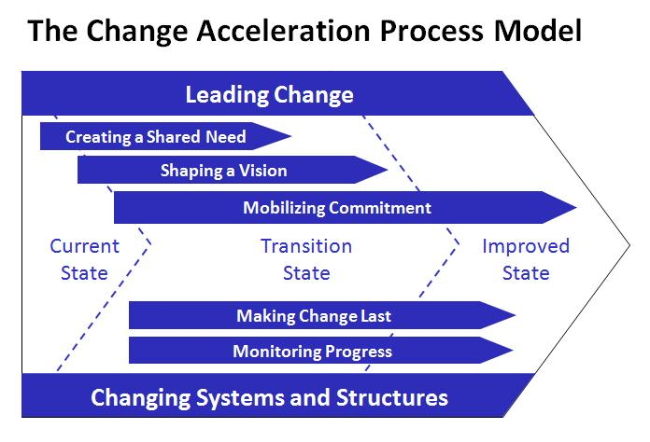
20- GE Change Acceleration Process
Description:
Ge describe the Change Acceleration Process (CAP) as a 'Pilot's Checklist' for change leadership.
Unlike a number of other models it is a flexible non-linear model used throughout a change process.
It applies strategic thinking to the influencing of others with tools to help change teams identify ways to achieve behavioural change.
CAP: A Model for Change:
Leading Change - Having a sponsor/champion and team members who demonstrate visible, active, public commitment and support of the change.
Creating A Shared Need - The reason to change, whether driven by threat or opportunity, is instilled within the organization and widely shared through data, demonstration or demand. The need for change must exceed its resistance.
Shaping A Vision - The desired outcome of change is clear, legitimate, widely understood and shared; the vision is shaped in behavioural terms.
Mobilising Commitment - There is a strong commitment from constituents to invest in the change, make it work, and demand and receive management attention; Constituents agree to change their own actions and behaviours to support the change.
Making Change Last - Once change is started, it endures, and learnings are transferred throughout the organization. Change is integrated with other key initiatives; early wins are encouraged to build momentum for the change.
Monitoring Progress - Progress is real; benchmarks set and realized; indicators established to guarantee accountability. Changing Making sure that the management practices (Staffing, Development,

Slide 24
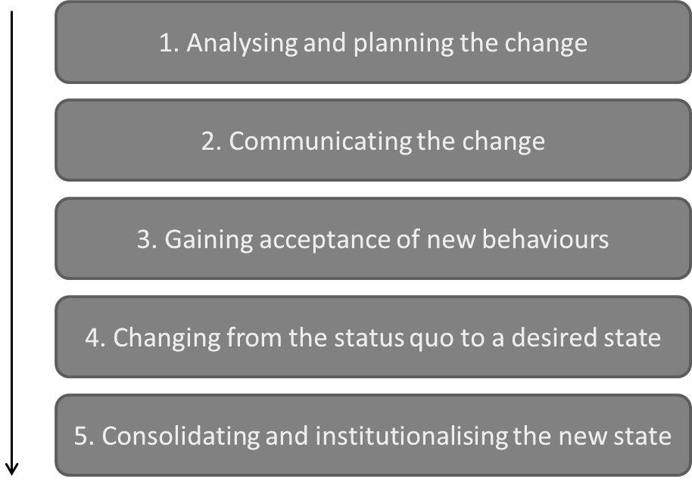
21- Judson's Five-Phase Model
Description:
The Judson (1991) model of implementing a change is comprised of five linear phases:
Analysing and planning the change
Communicating the change
Gaining acceptance of new behaviours
Changing from the status quo to a desired state
Consolidating and institutionalising the new state

Slide 25
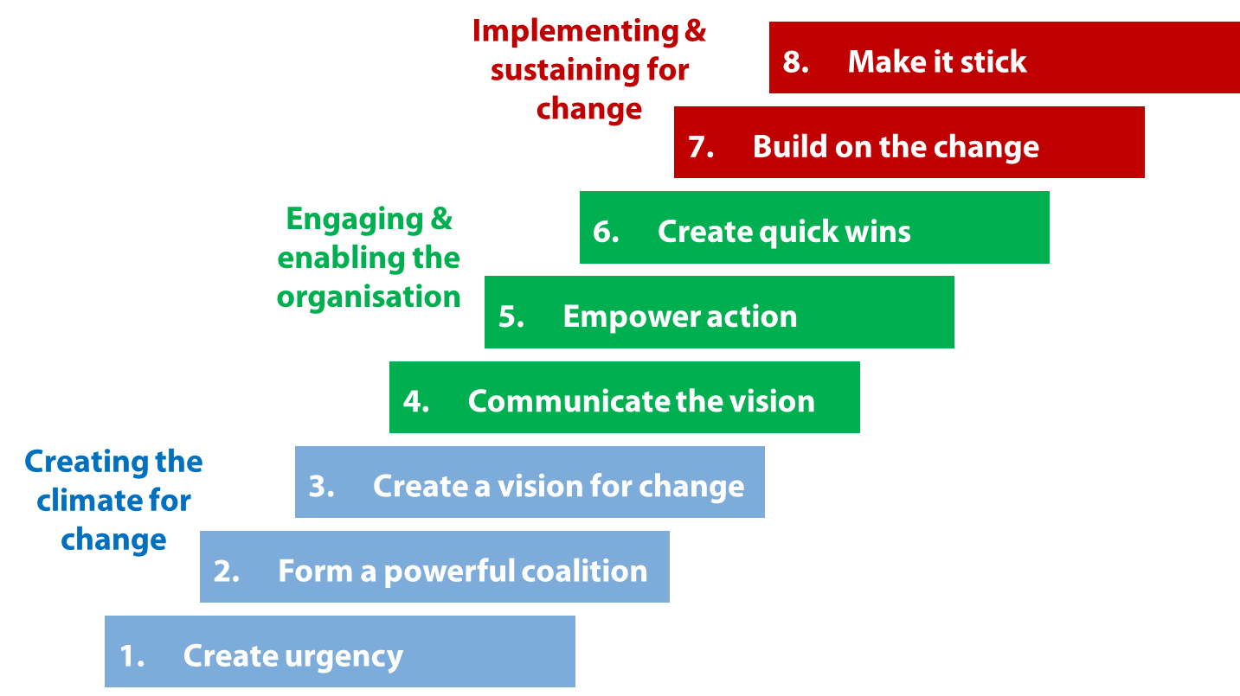
22- Kotter's Eight-Stage Change Model
Description:
John Kotter, often synonymous with change and change models cautions that the change process takes time and goes through several different phases in a successful change effort and that a mistake made during any phase of he change effort can have a negative impact on the organisation.
Strategy for change includes following eight (linear) steps:
1. Increase Urgency
2. Build The Guiding Team
3. Get The Vision Right
4. Communicate For Buy-In
5. Empowering Action
6. Create Short-Term Wins
7. Do Not Let Up
8. Make Change Stick

Slide 26
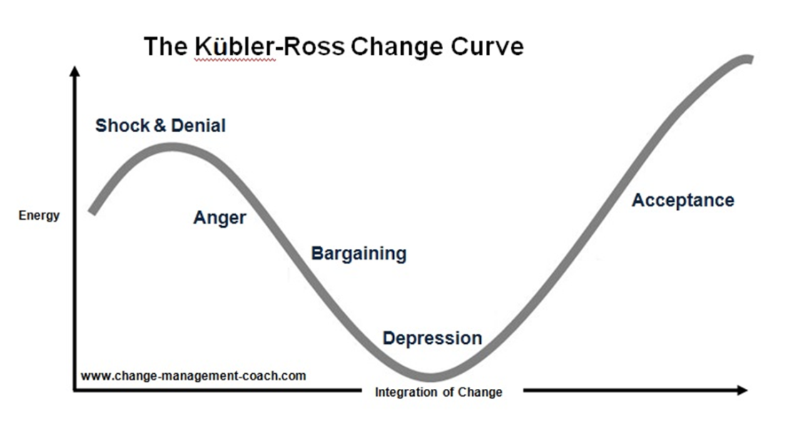
23- Kübler-Ross Change Model
Description:
The Kübler- Ross Five Stage Model; the change curve is a cornerstone theory for many change practioners.
The change curve is based on a model originally developed in the 1960s by Elisabeth Kübler-Ross to explain the grieving process. She proposed that a terminally ill patient would progress through 5 stages of grief when informed of their illness. By the 1980s, the Change Curve was a firm fixture in change management circles. The curve, and its associated emotions, can be used to predict how performance is likely to be affected by the announcement and subsequent implementation of a significant change.
The model identifies the human emotional response to change over time that includes denial, anger, bargaining, depression and acceptance and provides suggestions to over come these responses.
Two very important factors in handling the process of change are “Counselling” and “Compassionate Support”. Many logic based models either neglect, or skim over the person centred aspects in “driving-change”

Slide 27
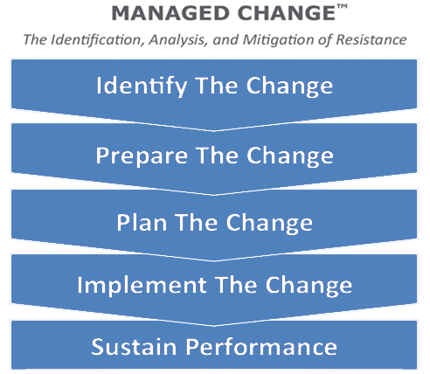
24- LaMarsh Global Managed Change™ Methodology
Description:
The Managed Change™ approach focusses on the people side of change to accurately identify and reduce employee resistance.
The Managed Change™ Model is the custom visual representation of the LaMarsh Global proprietary change management process.
Overall, it’s the integrated whole of the resources & tools, that are the methodology, organised as a roadmap for successful change management by expert change management thought leaders.
The roadmap consists of the following stages:
1. Identify the change
2. Prepare the change
3. Plan the change
4. Implement the change
5. Sustain the change

Slide 28
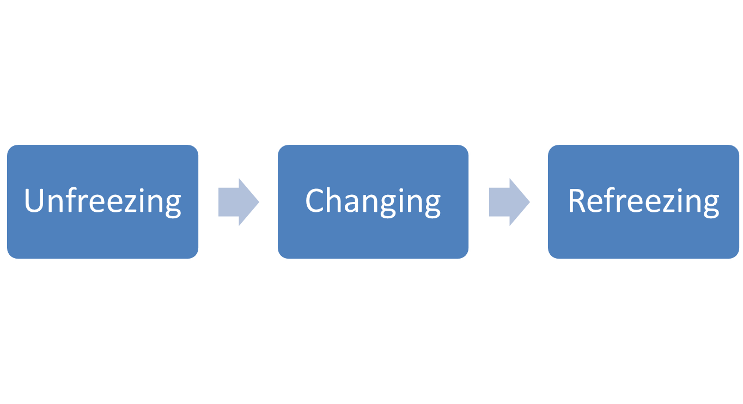
25- Lewin's Change Management Model (three-step model)
Description:
Kurt Lewin developed a ‘force field analysis’ model (1951), which describes any current level of performance or being as a state of equilibrium between the driving forces that encourage upward movement (positive, reasonable, logical, conscious and economic) and the restraining forces that discourage it (negative, emotional, illogical, unconscious and social/psychological).
Strategy for change includes three steps:
Unfreezing, reducing strength of forces, which maintain current equilibrium
Moving, developing new organisational values, attitudes and behaviours to help move the organisation on.
Refreezing, stabilizing after the changes have been made so that there’s a new equilibrium
Sometimes used as a planning tool, rather than as an organisational development process. The unfreeze becomes a planning session. The move translates to implementation. The refreeze is a post-implementation review.

Slide 29
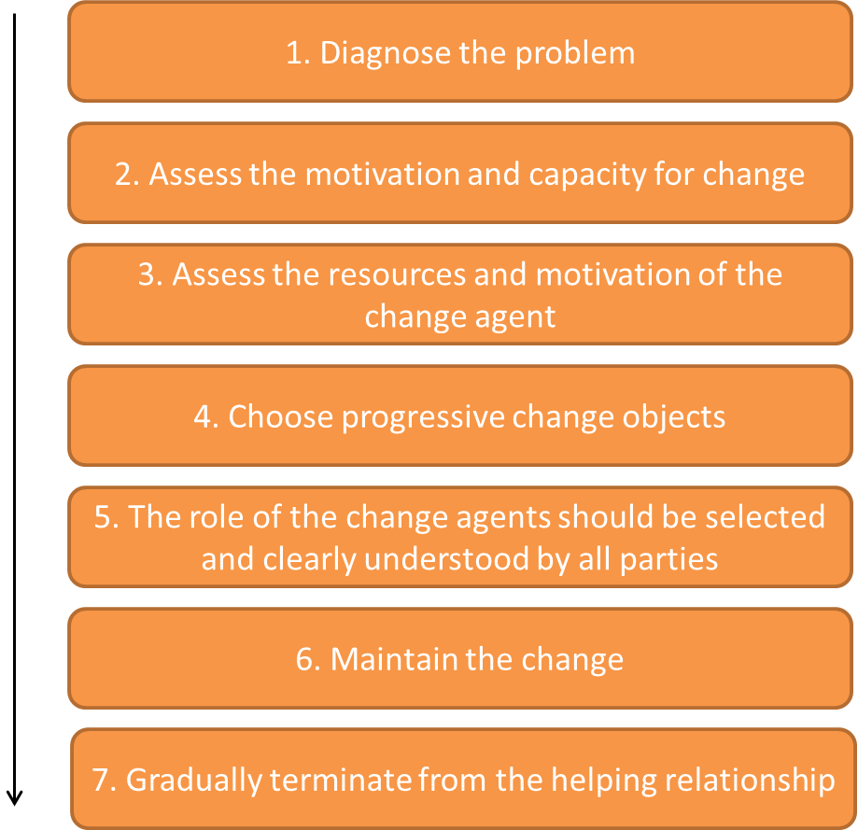
26- Lippitt, Watson and Westley Model
Description:
An extension of Lewin's Three-Step Change Theory. Lippitt, Watson, and Westley created a seven-step theory that focuses more on the role and responsibility of the change agent than on the evolution of the change itself.
Information is continuously exchanged throughout the process.
The seven steps are
Diagnose the problem.
Assess the motivation and capacity for change.
Assess the resources and motivation of the change agent. This includes the change agent’s commitment to change, power, and stamina.
Choose progressive change objects. In this step, action plans are developed and strategies are established.
The role of the change agents should be selected and clearly understood by all parties so that expectations are clear. Examples of roles are: cheerleader, facilitator, and expert.
Maintain the change. Communication, feedback, and group coordination are essential elements in this step of the change process.
Gradually terminate from the helping relationship. The change agent should gradually withdraw from their role over time. This will occur when the change becomes part of the organizational culture

Slide 30
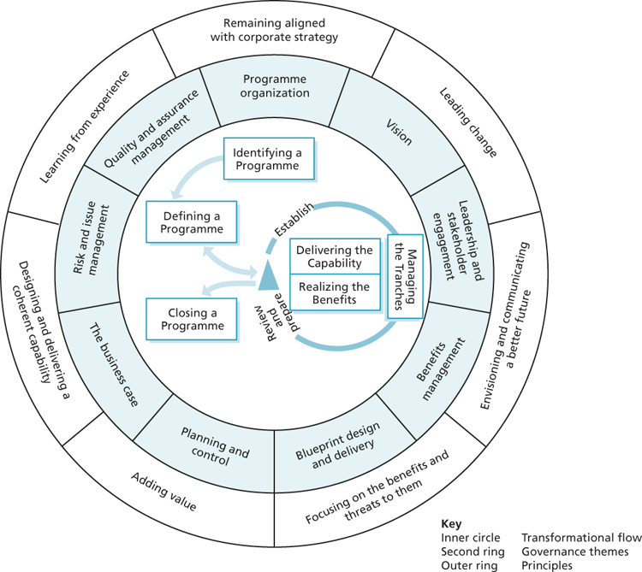
27- Managing Successful Programmes (MSP)
Description:
There is an increasingly tighter coupling between the disciplines of change management with project and programme management.
For completeness we include a reference to programme management and its role in managing business change, whether within parts of an organisation, across the whole organisation or involving a group of organisations.
Managing Successful Programmes (MSP) focusses on successful delivery of transformational change through the application of programme management. It is a structured yet flexible framework. It allows you to manage and control all the activities involved in managing a programme through providing advice on organisation, processes, communication and ways of thinking. There is a close link between MSP and PRINCE2™
The MSP framework is based on three core concepts:
MSP Principles. These are derived from positive and negative lessons learned from programme experiences. They are the common factors that underpin the success of any transformational change.
MSP Governance Themes. These define an organization’s approach to programme management. They allow an organization to put in place the right leadership, delivery team, organization structures and controls, giving the best chance for success.
MSP Transformational Flow. This provides a route through the lifecycle of a programme from its conception through to the delivery of the new capability, outcomes and benefits.

Slide 31
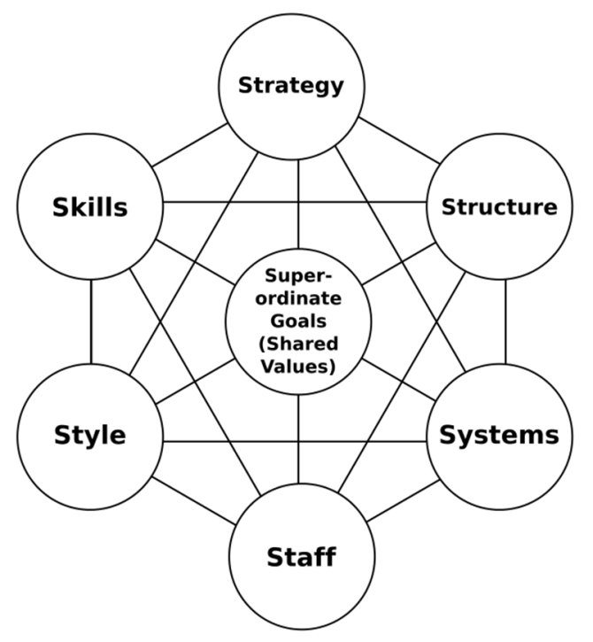
28- McKinsey's Seven-Step Model
Description:
The model is based on the theory that, for an organization to perform well, seven elements need to be aligned and mutually reinforcing.
The model can be used to help identify what needs to be realigned to improve performance, or to maintain alignment (and performance) during other types of change.
The Seven Interdependent Elements are:
Strategy - Purpose of the business and the way the organization seeks to enhance its competitive advantage.
Structure - Division of activities; integration and coordination mechanisms.
Systems - Formal procedures for measurement, reward and resource allocation.
Shared Values
Skills - The organization's core competencies and distinctive capabilities
Staff - Organization's human resources, demographic, educational and attitudinal characteristics.
Style - Typical behaviour patterns of key groups, such as managers, and other professionals.

Slide 32
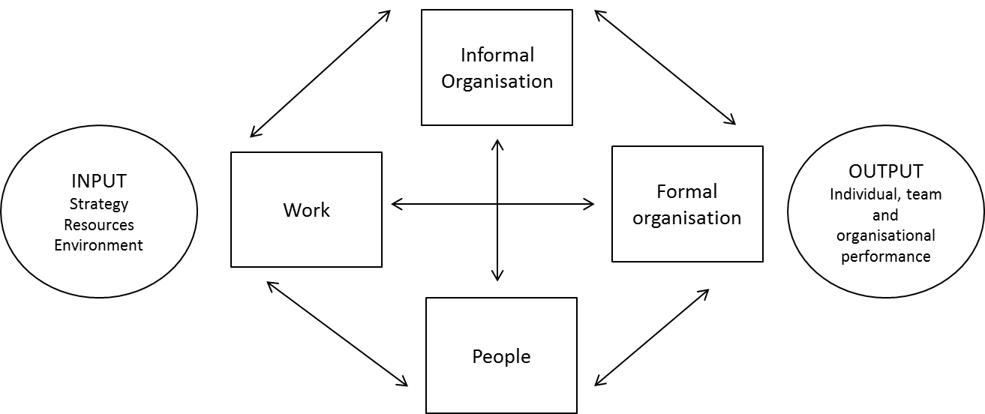
29- Nadler and Tushman, Congruence Model
Description:
This model aims to help the understanding of the dynamics of an organization when we try to change it.
This model views the organization as a system that draws inputs from both internal and external sources (strategy, resources, environment) and transforms them into outputs (activities, behaviour and performance of the system at three levels: individual, group and total).
It emphasizes the assumption that everything relies on everything else meaning that the different elements of the total system have to be aligned to achieve high performance as a whole system. Therefore the higher the congruence the higher the performance.
In this model of the transformation process, the organization is composed of four components, or sub-systems, which are all dependent on each other. These are:
The work. This is the actual day-to-day activities carried out by individuals. Process design, pressures on the individual and available rewards must all be considered under this element.
The people. This is about the skills and characteristics of the people who work in an organization. What are their expectations, what are their backgrounds?
The formal organization. This refers to the structure, systems and policies in place. How things are formally organised?
The informal organization. This consists of all the unplanned, unwritten activities that emerge over time such as power, influence, values and norms.
This model proposes that effective management of change means attending to all four components. If alignment work is not done, then organizational ‘homeostasis’ will result in a return to the old equilibrium and change will fizzle out. The fizzling out results from forces that arise in the system as a direct result of lack of congruence.
When a lack of congruence occurs, energy builds in the system in the form of resistance, control and power.

Slide 33
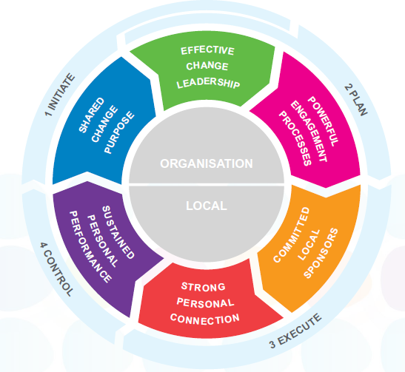
30- People Centred Implementation (PCI)
Description:
ChangeFirst is has developed e-change delivered through their Enterprise Change Management platform. The IT platform enables organisations to create, deploy and manage change programmes.
The platform is unpinned by a People Centred Implementation (PCI). The method hinges around 6 critical success factors:
1. Effective change leadership
2. Powerful engagement processes
3. Committed local sponsors
4. Strong personal connection
5. Sustained personal connection
6. Shared change purpose
That operate within a 4 phase process of
1. Initiation
2. Planning
3. Execution
4. Control

Slide 34
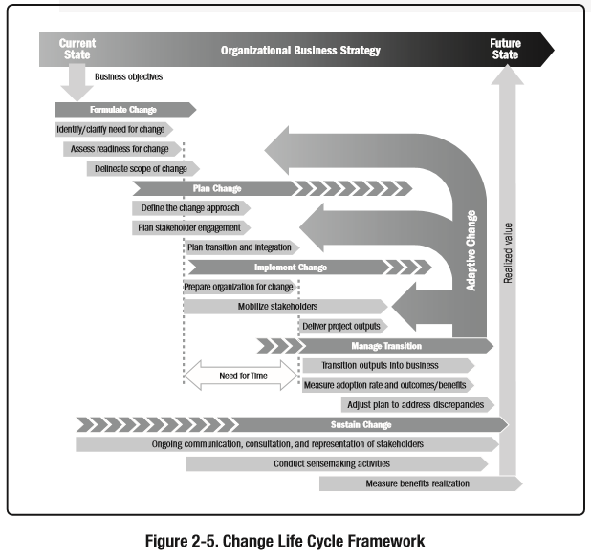
31- PMI's Change Management Methodology
Description:
The Project Management Institute (PMI) developed a change methodology that sits alongside PMI’s project, programme and portfolio management processes to assist in successfully designing, creating, implementing and sustaining organisational change.
The method is encapsulated in the Managing Change: A Practice Guide publication which begins by providing the reader with a framework for creating organisational agility and judging change readiness.
Managing Change explores organisational change from three different management perspectives:
Portfolio,
Programme
Project.
Using the tested principles found in the latest editions PMI s The Standard for Portfolio Management, The Standard for Program Management and A Guide to the Project Management Body of Knowledge (PMBOK® Guide), and this practice provides practical techniques on successfully designing, creating, implementing and sustaining organisational change.

Slide 35
32- Pritchett's Change Management Model
Description:
Founded in 1974 by Price Pritchett, Ph.D., PRITCHETT’s Change Management Model provides a simple phased approach for managing both the project and people sides of change initiatives.
Their methodology consists of four phases
Imperative
Readiness
Implementation
Gain
Imperative
Readiness
Implementation
Gain

Slide 36
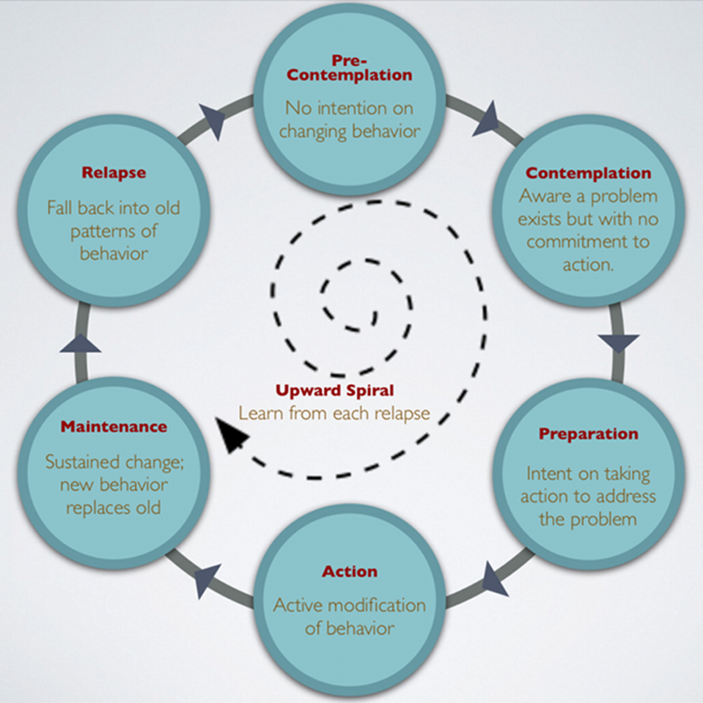
33- Prochaska and DiClemente Model
Description:
Prochaska and DiClemente found that people pass through a series of stages when change occurs. The stages discussed in their change theory are:
Pre-contemplation
Contemplation
Preparation
Action
Maintenance
Relapse
Progression through the stages is cyclical, not linear. This is because initially many individuals relapse on their change efforts and do not successfully maintain their gains the first time around
In the case of relapses, many individuals do not let up. They can revisit the contemplation stage and prepare for action in the future.
The spiral pattern of the model suggests that many individuals learn from their relapses instead of circling around the issue.

Slide 37
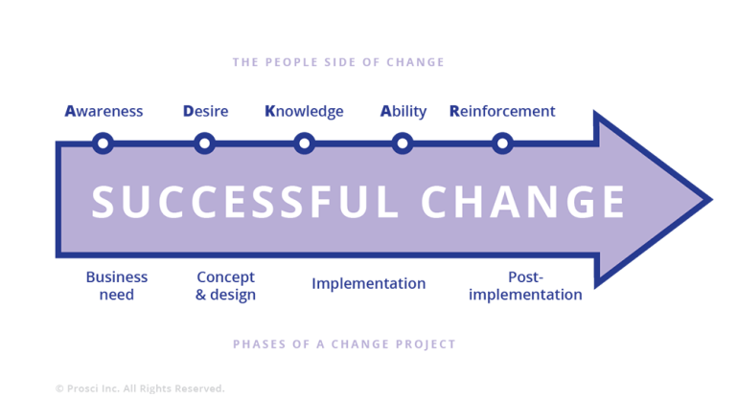
34- Prosci’s ADKAR™ Change
Description:
ADKAR (Awareness, Desire, Knowledge, Ability, and Reinforcement) is a goal-oriented change management (linear) model that allows change management teams to focus their activities on specific business results.
The key elements of the strategy include:
Diagnose employee resistance to change
Help employees transition through the change process
Create a successful action plan for personal and professional advancement during change
Develop a change management plan for your employees
In identifying the required outcomes or goals of change management, ADKAR becomes a useful framework for change management teams in planning and execution of their work.

Slide 38
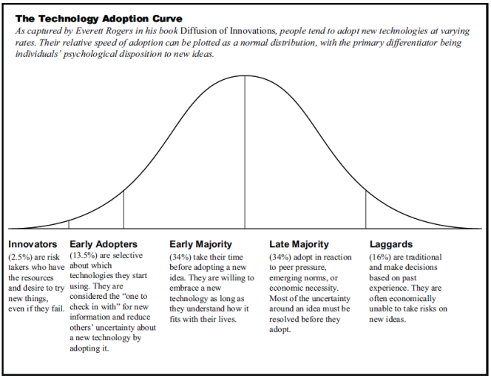
35- Rogers Technology Adoption
Description:
Given technology is such stimulus or part of change we felt in import to reference appropriate theory. Whilst the theory is over 50 years old, we believe it is still hugely relevant.
The technology adaption lifecycle model, based on the theory of diffusion of innovation (1962), describes the adoption or acceptance of a new product or innovation, according to the demographic and psychological characteristics of defined adopter groups. The process of adoption over time is typically illustrated as a classical normal distribution or “bell curve”.
The model categorises the groups in adoption order as
“innovators”
“early adopters”.
“early majority”
“late majority”
“laggards”.
The curve creates the foundation of a 5 step process of technology adoption:
Knowledge,
Persuasion,
Decision,
Implementation,
Confirmation.

Slide 39
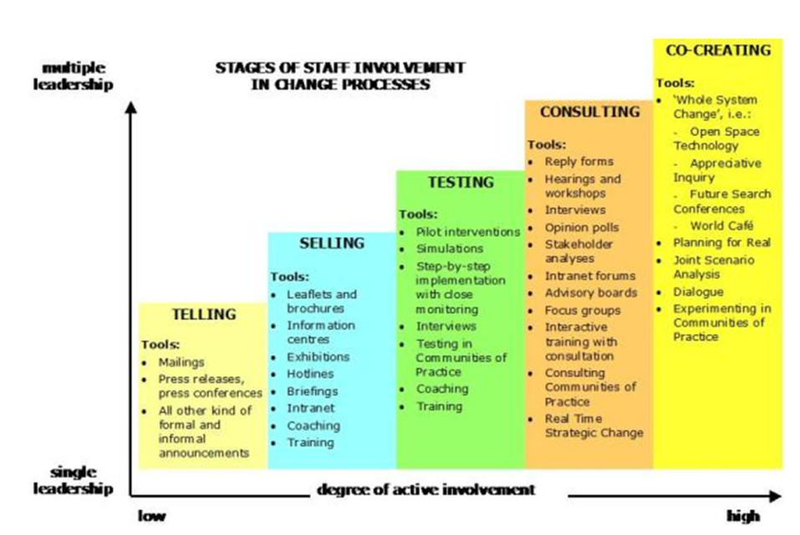
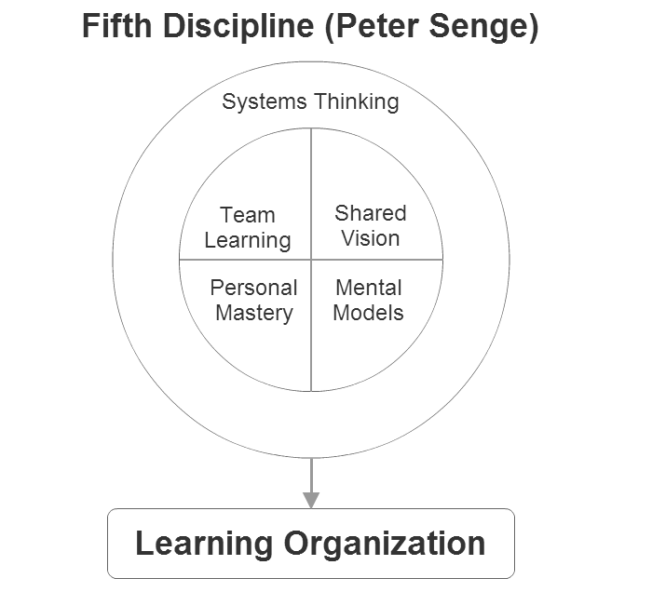
36- Senge, Systemic Model & the Fifth Discipline
Description:
Senge et al discuss the myriad of ‘balancing processes’ or forces of homeostasis which act to preserve the status quo in any organization.
Senge et al considers the longer-term issues of sustaining and renewing organizational change. They examine the challenges of first initiating, second sustaining and third redesigning and rethinking change. In the high-level model there are ideas and suggestions for dealing with the balancing forces of equilibrium in organizational systems (resistance).
Senge et al say that the key challenges of initiating change are the balancing forces that arise when any group of people starts to do things differently
Challenges of sustaining change come to the fore when the pilot group (those who start the change) becomes successful and the change begins to touch the rest of the organization
The challenges of redesigning and rethinking change appear when the change achieves some visible measure of success and starts to impact on ingrained organizational habits Senge recommends - Start small; grow steadily; don't plan everything; expect challenges.
Senge further developed this approach in the Fifth Discipline - how to organize the "learning organization". Such organizations improve their capability to share and create new knowledge. The following core disciplines should be integrated:
Systems thinking - this is the fifth discipline that integrates all others.
Personal mastery - every expert and manager learn individually, thus making organization "knowledgeable".
Mental models - understand "assumptions" in mental model and making them explicit to improve the mutual understanding. Building shared vision - for team to eagerly learn and cooperate to achieve a challenging goal.
Team learning - co-workers should be sincere in communication and explicit in coordination.

Slide 40
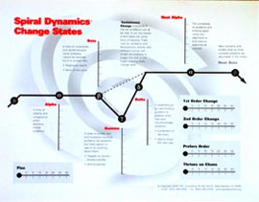
37- SPIRAL DYNAMICS® CHANGE STATE INDICATOR
Description:
The Change State Indicator (CSI) is a versatile tool with a total of ten scales.
Five scales evaluate the “states of change” experienced by people as they migrate from one Gravesian Value System to another. These range from stability through turbulence and back to stability.
Other dimensions include readiness to accept and incorporate new methods, approaches and ideas, and five scales which convey preferences for other aspects of change: incremental or dramatic, order or chaos, plus flexibility.
These findings translate into a variety of workplace behaviours and preferences impacting group cohesion, management, culture, ability to innovate and learn, forms of communication, training and support needs, leadership preferences, strategy implementation, etc.

Slide 41
38- Stacey and Shaw, Complex Responsive Processes
Description:
Stacey and Shaw (S&S) present the metaphor of flux and transformation to view organizations.
They assert:
Change, or a new order of things, will emerge naturally from clean communication, conflict and tension (not too much).
As a manager, you are not outside of the system, controlling it, or planning to alter it, you are part of the whole environment.
In complex change, the leader’s role is to:
Decide what business the organization is in, and stretch people’s thinking on how to get there.
Ensure that there is a high level of connectivity between different parts of the organization, encouraging feedback, optimizing information flow, enabling learning.
Focus people’s attention on important differences: between current and desired performance, between style of working, between past and present results.
In Patricia Shaw’s book Changing Conversations in Organizations, rather than address the traditional questions of ‘How do we manage change?’ she addresses the question, ‘How do we participate in the ways things change over time?’
This writing deals with the paradox that ‘our interaction, no matter how considered or passionate, is always evolving in ways that we cannot control or predict in the longer term, no matter how sophisticated our planning tools’.
We like this reference as we see change as a constant, for sure with variability, but as human beings we are constantly changing.
“How do we participate in the way things change over time?”

Slide 42
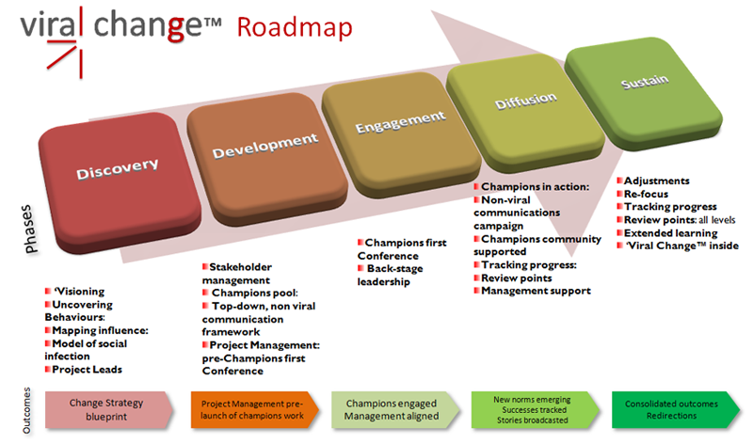
39- Viral Change
Description:
Viral Change™ proposes a “journey” divided into five phases, not all of them are as sequential as represented by the illustration.
The key focus for each phase is described below. The duration of each phase varies depending on where the change process starts.
Discovery - creating or revisiting a vision, uncovering and articulating non-negotiable behaviours; mapping the networks of change, uncovering the real influence within the organisation.
Development - identifying peer groups and visualizing peer-to-peer influence, aligning management, calling selected people to participate
Engagement - creation of a community of change agents with a particular profile and enlisting them, helping them with their role; aligning further leaders and managers
Diffusion - behaviours spread, the community of champions is supported; peer to peer influence is orchestrated and supported; progress is tracked and evaluated; stories of success are spread; the social movement is in action
Sustain - key behaviours are now embedded, new directions are evaluated, and the agents community ends as such, re-directions and re-focus may make a new journey restart.

Slide 43
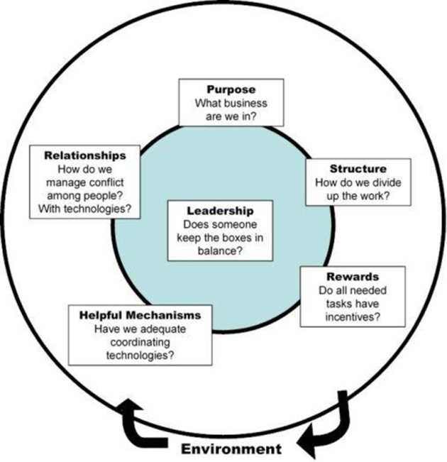
40- Weisbord 6 Box Model
Description:
Weisboard ‘s (1978) model represents a particular way of looking at organizational structure and design and provides a helpful backdrop to the aspects that impact change.
It gives attention to issues such as planning, incentives and rewards, the role of support functions such as personnel, internal competitions among organizational units, standards for remuneration, partnerships, hierarchies and the delegation of authority, organizational control, accountability and performance assessment.
The model also follows the basic 'systems' approach to organizational functioning including the well-known inputs and 'outputs' categories. The six-box model is comprised of the following components:
Purposes: What 'businesses' are we in?
Structure: How do we divide up the work?
Relationships: How do we manage conflict (coordinate) among people? With our technologies?
Rewards: Is there an incentive for doing all that needs doing?
Leadership: Is someone keeping the boxes in balance?
Helpful mechanisms: e.g. have we adequate coordinating technologies?

Slide 44
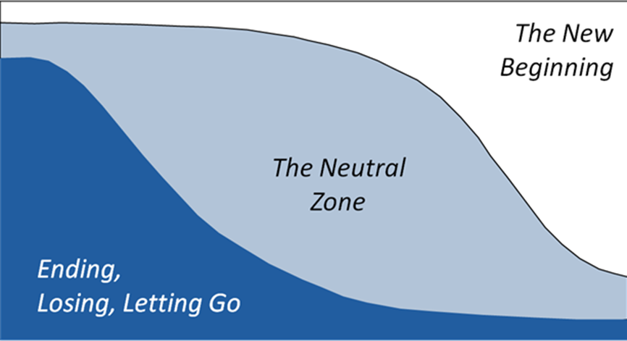
41- William Bridges, Managing the Transition
Description:
Bridges (1991) makes a clear distinction between planned change and transition. Transition is about letting go of the past and taking up new behaviours or ways of thinking. Planned change is about physically moving office, or installing new equipment, or restructuring.
Change is situational and can be planned, whereas transition is psychological and less easy to manage.
Transition consists of three phases:
Ending; Before you can begin something new, you have to end what used to be. You need to identify who is losing what, expect a reaction and acknowledge the losses openly.
Neutral zone; In the neutral zone, people feel disoriented. Motivation falls and anxiety rises. Consensus may break down as attitudes become polarized. It can also be quite a creative time. The manager’s job is to ensure that people recognize the neutral zone and treat it as part of the process. Temporary structures may be needed – possibly task forces and smaller teams.
New beginning; New beginnings cannot be planned and predicted, but they can be encouraged, supported and reinforced.
Bridges suggests that people need four key elements to help them make a new beginning:
The purpose behind the change;
A picture of how this new organization will look and feel;
A step by step plan to get there;
A part to play in the outcome.
The beginning is reached when people feel they can make the emotional commitment to doing something in a new way.

Slide 45
42- Teece- Dynamic Capabilities
Description:
Dynamic capability is “the firm’s ability to integrate, build, and reconfigure internal and external competences to address rapidly changing environments” (David J. Teece, Gary Pisano, and Amy Shuen).
The basic assumption of the dynamic capabilities framework is that core competencies should be used to modify short-term competitive positions that can be used to build longer-term competitive advantage.
Teece’s concept of dynamic capabilities essentially says that what matters for business is corporate agility: the capacity to (1) sense and shape opportunities and threats, (2) seize opportunities, and (3) maintain competitiveness through enhancing, combining, protecting, and, when necessary, reconfiguring the business enterprise’s intangible and tangible assets.
Key concepts:
Learning
New assets
Transformation of existing asset
Co-specialisation
Asset orchestration

Slide 46
43- Theories of Change
Description:
Theories of Change (ToC) link outcomes and activities to explain HOW and WHY the desired change is expected to come about.
Toc link outcomes and activities to explain HOW and WHY the desired change is expected to come about
ToC is a planning process for community based change. The “Theory of Change” is for the specific change initiative
ToC works back from the desired change outcomes, mapping the process through which the group identifies all the preconditions that will be needed to deliver the desired outcome. This produces “Causal pathways” - complete and add reference to measures.

Slide 47
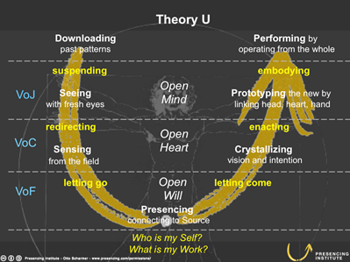
44- Theory U
Description:
Theory U proposes that the quality of the results that we create in any kind of social system is a function of the quality of awareness, attention, or consciousness that the participants in the system operate from.
Principles:
Energy follows attention. Wherever you place your attention, that is where the energy of the system will go.
Follow the three movements of the U.
Going down the U: “Observe, observe, observe.”
At the bottom of the U: “Retreat and reflect, allow the inner knowing to emerge.”
Going up the U: “Act in an instant.”
Go to the edges of the self. To apply this process in the context of institutions, we have to power it with a new leadership technology. The core of this new leadership technology focuses on tuning three instruments: the open mind, the open heart, and the open will.
Pass through the eye of the needle. At the deepest point of each U journey is a threshold. Crossing that threshold, passing through the eye of the needle, can feel like dying and being reborn.
Transform the three enemies; Voice of judgment (VoJ: shutting down the open mind), the voice of cynicism (VoC: shutting down the open heart), and the voice of fear (VoF: shutting down the open will).
Always start by “attending to the crack.” Where do we meet the future first? “Seek it with your hands, don't think about it, feel it”
Transform the fields of conversation from downloading and debate to dialogue and collective creativity. Each social field needs a container. Higher-level conversation like dialogue and collective creativity require higher-quality containers and holding spaces. “Transforming the quality of conversation” in a system means to transform the quality of relationship and thought—that is, the quality of tomorrow’s results.
Strengthen the sources of presencing in order to avoid the destructive dynamics of absencing. Modern society emerges from the interplay of two powerful social fields: presencing and absencing. The field of presencing works through the opening of the mind, the heart, and the will. Absencing is characterized by getting stuck with the idea that there is only One Truth rather than operating with an open mind, by getting stuck in One Us vs. Them rather than operating from an open heart, and by being frozen inside one rigid identity rather than operating from an open will.

Slide 48
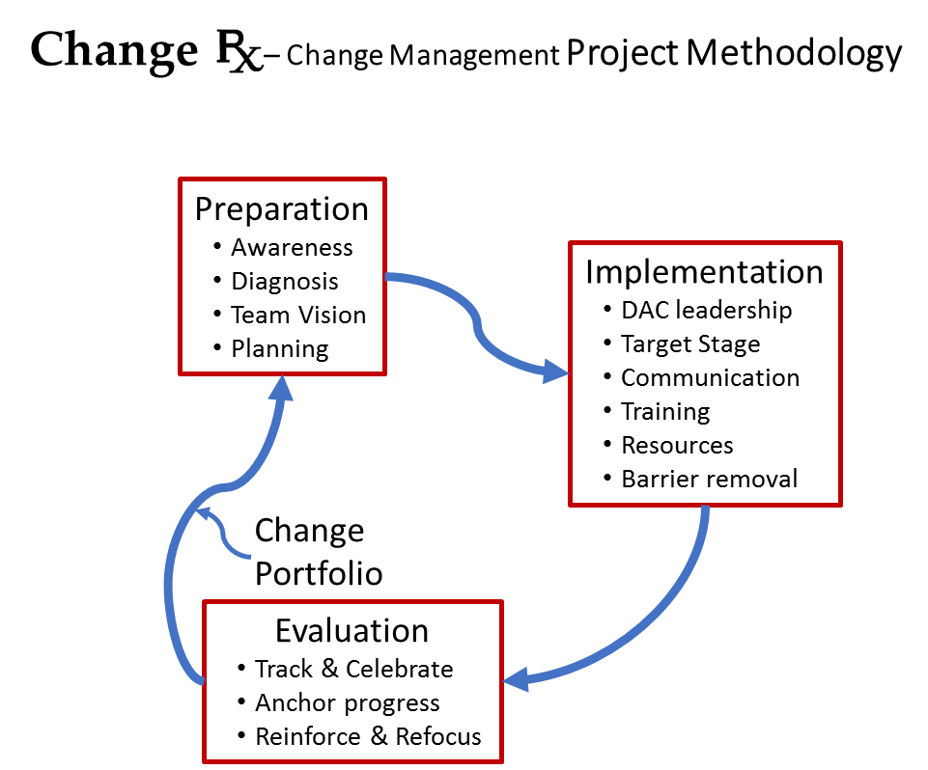
45- Change Rx - Change Management Project Methodology
Description:
Dr. Ross Wirth of The Org-Change Doctor, produced a multi-model synthesis for managing change:
1. Preparation
Ambulance – raise awareness (context) and establish Urgency about the problem
Emotional & rational response to the situation
Diagnosis – clarify the root problem (deeper than symptoms)
Involve others to gain diverse perspectives
Cause-effect drivers (often complex in nature)
Surgical Team – Assemble Change Leadership
Cross-organization, multiple stakeholder groups with specialists as needed
Prescription – develop a Vision for Change (Change Objective)
Collaborate and synthesize a solution
Identify Keystone Habit to leverage
Identify sub-goals & their inter-dependencies (sequence)
Assess organizational Readiness to Change
Change Resistance plan - anticipate & mitigate
Treatment plan – develop Change Management plan
Establish SMART targets for intermediate change goals
Determine structural & system changes that are needed
Determine stakeholders’ Stage of Change (SoC) – Align training & communication plan
2. Implementation
Treatment Implementation – Planned Change
DAC (direction-alignment-commitment) Leadership
SoC Change Intervention Processes & Aligned Communication Plan
Training plan for new processes
Change Enablement – Emergent Change
Provide needed resources (especially time) for those involved
Address and Remove barriers to change
Encourage independent action that is aligned with the Change Objective
3. Evaluation
Track and Celebrate Progress – tie to the change objective & intermediate goals
Recognize (reward) change enablers and role models
Recovery – anchor progress – stabilize & rest
Formalize new structure and systems
Culturally embed new behavior (habits)
Reevaluate – Reinforce or Refocus efforts to expand change reach
Roll process forward to next sub-goal or
Rework what is not meeting expectations

Slide 49
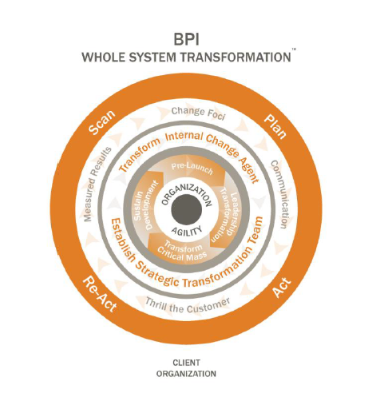
46- BPI - Whole System Transformation
Description:
Whilst based on the profession of Organisational Development Whole System Transformation (WST) as the name suggests takes a holistic approach looking at all parts of the system.
Rather than the conventional view of Organisational Development , with a need to understand the systems making up the organisation, and change them according to a predetermined plan. WST suggests exactly the opposite; with an approach that reinvents the organization itself.
Whole Systems Transformation Model and Steps in the Process
Leadership Transformation - starting with leadership alignment and agreement establishing essential leadership commitment to change. Unity and commitment that is emotional and intellectual with a shared common vision, strategy, and agreement to actions and commitments
Critical Mass Transformation - achieved by employees of an organization. It is essential that critical mass is fully informed and is actively engaged in the implementation of changes taking place in the company.
Sustained Development. After the initial efforts of WST, a new culture will emerge. This culture has to be supported and built on. Internal change agents are chosen and developed to advocate, practice and grow the new culture until it is sustained and institutionalised.
Change Foci. It is critical to change the focus. For example, customer service, a new strategy, increasing profitability, or a merger and acquisition. Leaders must communicate the focus with employees; transparent and meaningful dialogue increases organization effectiveness.
Communication – must be sustained throughout the transformation, multi-channel, multi-directional communication is essential to share success stories, decisions, data, and results with leaders truly listening to employee feedback In other words, to inform, listen and engage with staff throughout the process
Thrill the customer. Go the extra mile, show commitment, and role model how the company should treat its customers (internal and external). Be innovative and show you care. This becomes the new standard of excellence.
Measured Results. While large and dramatic changes will be apparent, it is strongly recommended that cost effectiveness and efficiency are measured regularly. These evaluations will reinforce change momentum, show areas that need more work, and will determine future steps.
Action Research - scanning, planning, acting, and re-acting. In the scanning process, an overview is completed of the current state. At the planning stage, the organization involves top executives and professionals to design the action plan. During the acting stage, planned steps are integrated into the design of the new system. And at the re-acting stage, the process is repeated in order to evaluate what has happened. During the Action Research process it is critical for top leadership to be involved, since they are the ones who have the power to influence, and become role models for what is expected of people from the company.

Slide 50
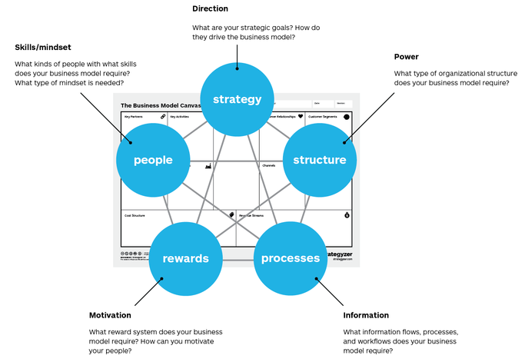
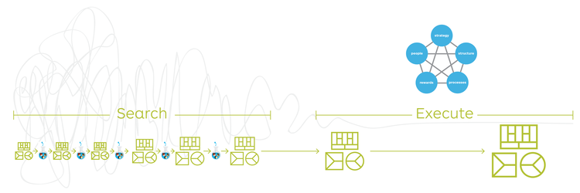
47- Galbraith Star Model
Description:
Developed by Jay Galbraith, The Star Model is an organisational design framework consisting of five interconnected aspects : Strategy, Structure, Processes, Rewards, and People. It acknowledges the necessity to adapt to changes in strategy, business environment and/or market forces, which in turn stimulates change.
Strategy
Defined by its vision, mission, and values, goals and objectives. Strategy sets out the direction of the organisation. It comes first in the Star Model because it establishes useful criteria to select options in the remaining four elements or organizational design.
Structure
Determines the required types and numbers of job specialties as well as how they are organised (number/size of departments, centralised/decentralised, etc.). It dictates the formal placement and movement of power and authority and is the basis for forming departments..
Processes
Defined by the flow of information and decisions – be that vertically with aspects such as allocating resources via budgeting and planning or horizontally such as workflows carried out through across departments.
Rewards
Align the goals of employees with the organization’s goal. Effective systems use appropriate incentives to motivate workers to behave in ways that fulfil the strategic direction of the organization. The reward system must be congruent with the other design areas to influence strategic direction.
People
Supported by resource policies to govern recruitment, promotion, rotation, training and development. Designed to develop talent with the capabilities necessary to execute the strategic direction of the organization. People aspects must be in harmony with the other design areas.
Designing the organisation
A temporary (lean, flexible, loosely based) organization is designed to 'search' for a repeatable and scalable business model. This allows for faster decision making in response to market feedback. Maturing - a permanent organization is designed to 'execute' a repeatable and scalable business model." This formal organization aims to scale up growth and drive efficiencies. It must remain malleable in order to meet changes in strategy, in market forces, and in the rest of the external business environment.

Slide 51
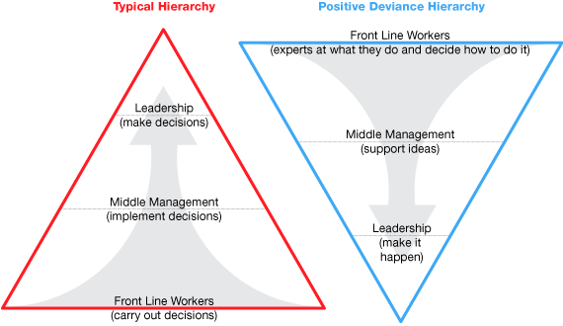
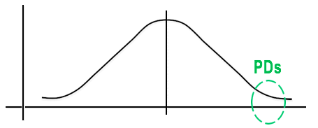
48- Positive Deviance
Description:
Positive Deviance is based on the observation that in every community there are certain individuals or groups (the positive deviants), whose uncommon but successful behaviours or strategies enable them to find better solutions to a problem than their peers. These individuals or groups have access to exactly the same resources and face the same challenges and obstacles as their peers.
Using a problem solving, asset-based approach to utilise untapped assets or resources, led by the community or organization member themselves, the approach enables them to discover , then to leverage uncommon but successful behaviours or strategies from within the community to solve a perceived problem that requires behaviour and social change. The Positive Deviance (PD) approach brings about sustainable behavioural and social change by identifying solutions already existing within the system.
Five basic steps which serve as the backbone of the approach. The 5 D's are:
Define the problem, its causes and common practices, and articulate desired outcome.
Determine presence of PDs,
Discover their uncommon but successful behaviours & strategies through PD inquiries,
Develop activities based on the inquiry findings
Discern (monitor and evaluate) the results.
Guiding Principles
The People are the Experts
Community ownership at all stages
Involvement of ALL stakeholders
Discovery of existing uncommon but successful behaviours & strategies
Emphasis on PRACTICE and action
Expansion of existing & creation of new networks
Community created monitoring & evaluation to further promote change
Define the problem/outcome
Determine presence of PDs,
Discover PD’s uncommon but successful behaviours & strategies
Discern (monitor and evaluate) the results for future learning & use
Develop activities to apply appropriate behaviours & strategies
Performance
Low
Average
High

Slide 52
Resilient Changing - Supporting Effective Change Building capabilities, confidence and commitment with care

Slide 53
About us
Our purpose: to help clients optimise the performance of people, process and technology by delivering effective and sustainable change and improvement. We believe in delivering change with/for clients, not “to-them”.
Experience
Change - 30 Years+ supporting clients in people, process and technology change in a variety of ways.
Business transformation– including multi-$m, global, organisational wide change – e.g. enterprise software implementation, M&A integration and disposal, off-shore/on-shore process relocation, improving shared service centre performance, design and delivery of new operating models to improve productivity and increase cost efficiency of 20%+
Building the new- Start-ups and consortia – desirability, feasibility and viability testing of not only the solution, but the team and its approach. Supporting Proof of Concept, Minimum Viable Product, business case, funding, shareholder relations, partner building and coaching the leadership teams – providing objectivity, accountability and an outside-in view. Start-ups have not only survived but have delivered solutions and secured further funding
Team and individual coaching and performance improvement – increasing capabilities, productivity and resilience using a range of measures to gain attention and ownership of the current and future state with execution and coaching support that builds competencies, confidence and commitment to change. Individuals, Leaders and Teams report not only an increased performance but have demonstrated an ability for future change

Slide 54
Service Catalogue Principles
Project Management
Process Improvement
Change Management
Team & Individual Development
Resilience Building
Services
Strategic Advisory
Principles and capabilities
Increasing client capability and future self-sufficiency
Delivering change with the client
Agnostic and flexible with technology and methods
Execution and outcome focused

Slide 55
For more information
Building Capabilities, Confidence and Commitment, with Care
Understanding needs
Developing strategic responses
Delivering transformation
Building self-reliance
Mark Simpson,
E: mark.simpson@resilientchanging.com
M. +44 7931 942 794
W: resilientchanging.com

