Slide 1
Dealing With Conflict

Slide 2
6 Steps to Resolve Conflict
Set the Stage
Describe the Conflict
Gain Perspective
Seek Agreement
Identify Solutions
Develop an Action Plan

Slide 3
3 Things YOU can do to Reduce Conflict
Practice Reflective Thinking
Delay responding
Commit to “adapting behavior”

Slide 4
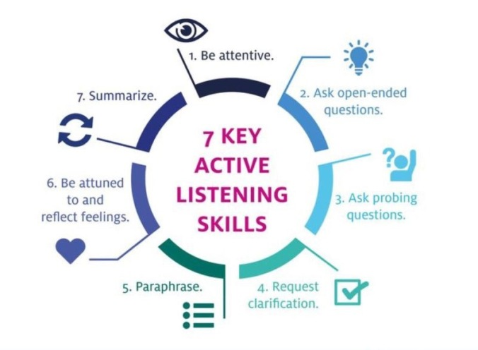
Active Listening Skills

Slide 5
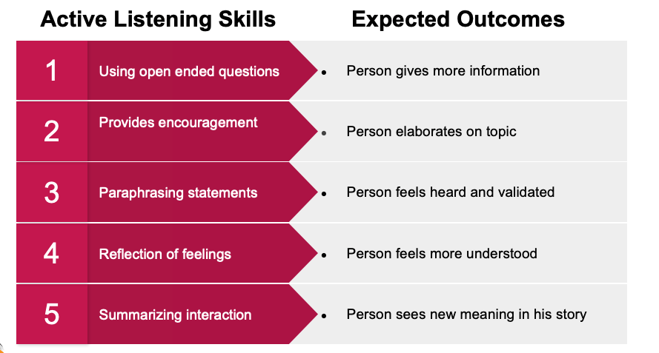
Image: McMains, M. J., & Mullins, W. C. (2014). Crisis negotiations: Managing critical incidents and hostage situations in law enforcement and corrections. New York: Routledge.

Slide 6
Active Listening Skills
Continue using active listening skills and express empathy and a desire to understand.
“I can see how that made you feel offended”
“I understand how that made things worse for you”
“I can see why you feel that way”

Slide 7
Do’s and Don’t When Using
De-escalation Techniques
Do intervene early.
Show genuine concern for the person and adopt a non-authoritarian manner.
Speak in a calm and gentle voice.
Be aware of your own body, how you’re looking at the other person and how you’re moving.
Avoid being passive or indifferent.
Avoid touching and coming too close to the person.
Do not show anger or take offense.
Do not make judgmental comments.

