Slide 1
Magna Carta and the Rule of Law in the United States
How a 13th-century document helped shape American constitutional principles
David Schultz, Professor

Slide 2
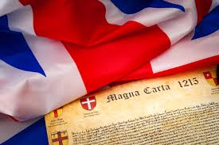
Introduction
The Magna Carta, signed in 1215 by King John of England, laid the groundwork for modern constitutional governance. Its influence on the development of the rule of law in the United States is profound and lasting.

Slide 3
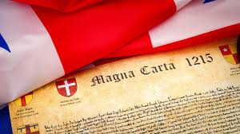
What does the Magna Carta Represent?
“The history of the Magna Carta is the history not only of the document but also of an argument.”
  J.C. Holt, Magna Carta (2014).
It is an argument about limited government, respect for rights, and recognition for rule of law and the importance of procedures and process.

Slide 4

It’s All About Fear (of abuse of power)
Magna Carta, due process, rule of law, and constitutionalism are all about fear of abuse of government power by one person, department, agency, branch, or the government and the need to restrain it.

Slide 5
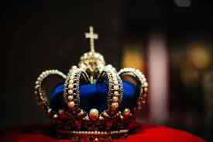
Context of the Magna Carta
How to control and check tyranny and an abusive king
King John’s refusal to cooperate or work with nobles and aristocrats

Slide 6
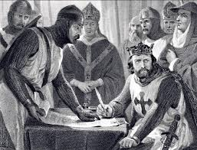
No One Is Above the Law
Section 39 “No free man shall be seized or imprisoned, or dispossessed, or outlawed, exiled, or in any way destroyed, nor will we proceed against or prosecute him, except by the lawful judgment of his peers or by the law of the land.”
This section is the origin of the concept “due process.”

Slide 7
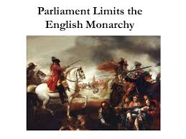
Limiting Arbitrary Power
- First written limitation on ruler's power
- Influenced U.S. system of checks and balances
- Supports separation of powers
- Enshrines rule of law: Even leaders are bound by law

Slide 8
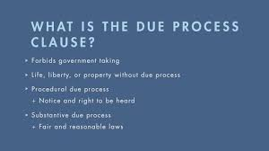
Due Process
Due process as a concept originates in the Magna Carta as a mandate to require the crown to follow rules or procedures (rule of law) when acting
Meant to constrain arbitrary action by the government

Slide 9
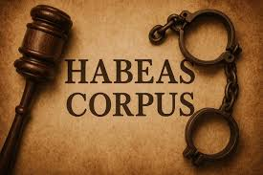
Habeas Corpus
Emerged indirectly out of the Magna Carta as a check upon arbitrary arrest.
The origins of habeas corpus can be traced back to English common law, with roots in the concept of due process and the protection against unlawful imprisonment. While the writ existed in various forms for centuries, the Habeas Corpus Act of 1679 is a key milestone, solidifying its role in English liberties and influencing the US Constitution

Slide 10

Linking Three Concepts
Rule of law, due process, and habeas corpus all interconnected as concepts to limit the power of the British crown and government

Slide 11
British Legal Legacy of Magna Carta
- Magna Carta influenced later English documents like the Petition of Right (1628) and the English Bill of Rights (1689).
- Established precedent for parliamentary limits on monarchy.
- Contributed to the development of common law traditions and the concept of constitutional monarchy.

Slide 12
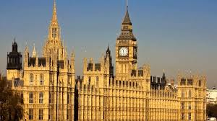
Magna Carta as the Supreme
Law of the Land
In England Magna Carta was seen as sacrosanct still in the fourteenth century and statutes that conflicted with it were ruled invalid, which as a norm was confirmed by a statute enacted by Edward III in 1369 who further developed what was to be called ‘a due process of law.’
  Dorota Pietrzyk-Reeves, Magna Carta and the Rise of Anglo-American Constitutionalism

Slide 13
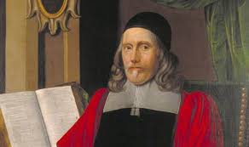
Sir Edward Coke (1552–1634)
- Major Work: Second Part of the Institutes of the Laws of England (1642)
- Magna Carta = timeless liberties, especially due process and trial by jury.
- Famous Quote: “Magna Carta is such a fellow, that he will have no sovereign.”
- Influenced American legal traditions (e.g., due process clause).

Slide 14
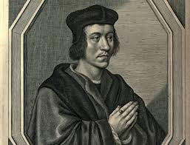
Sir John Fortescue (c. 1394–c. 1476)
- Major Work: De Laudibus Legum Angliae
- Praised English common law and protections for individual liberty.
- Referenced Magna Carta as limiting royal power.
- Early champion of "rule of law" concept.

Slide 15
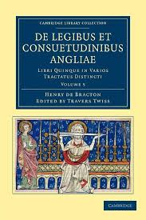
Sir Henry de Bracton (c. 1210–1268)
- Major Work: De Legibus et Consuetudinibus Angliae
- Wrote shortly after Magna Carta's issuance.
- Emphasized: "The king is under the law."
- Supported principles of legal accountability.

Slide 16
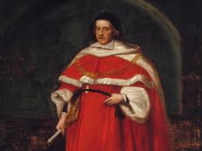
Sir Matthew Hale (1609–1676)
- Major Work: History of the Common Law of England (1713, posthumous)
- Viewed Magna Carta as a pillar of ancient English liberty.
- Advocated continuity of legal traditions and rights.

Slide 17
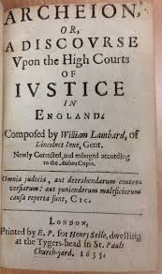
William Lambarde (1536–1601)
- Compiler of early English laws.
- Work: Archeion (published 1635)
- Promoted Magna Carta as part of the English legal and historical heritage.

Slide 18
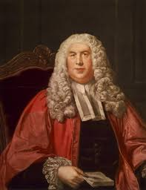
Who Was William Blackstone?
- English jurist, judge, and legal scholar (1723–1780)
- Author of Commentaries on the Laws of England (1765–1769)
- Cornerstone of legal education in England and colonial America
- Influential in shaping U.S. constitutional principles

Slide 19
Blackstone's View of Magna Carta
"The great charter of liberties, which was obtained, sword in hand, from King John... yet hath it been, and still is, the cornerstone of the British constitution."
  — Commentaries on the Laws of England, Vol. I, Introduction, § 3

Slide 20

Legal Principles Blackstone Emphasized
- Rule of law: even kings are subject to the law
- Right to due process and fair trial
- Trial by jury and protection of property
- Constitutional limits on royal power

Slide 21
Direct Quotation from Magna Carta
"No man shall be taken, or imprisoned... but by the lawful judgment of his peers, or by the law of the land."
— Magna Carta, Chapter 29 (quoted by Blackstone in Commentaries, Book 1, Ch. 1)

Slide 22
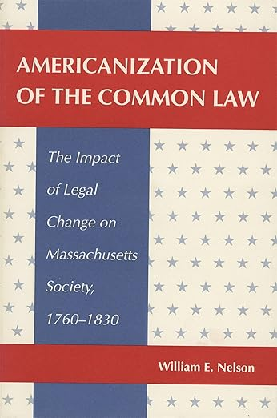
Creating American Constitutional Law
US inherits British Common Law and Legal Principles
Bernard Bailyn’s The Ideological Origins of the American Revolution
  Constitutionalism
  Sovereignty
  Representation
William Nelson’s Americanization of the Common Law

Slide 23
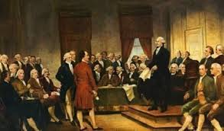
Influence on the American Founders
- Blackstone’s Commentaries were the most cited legal authority in colonial America
Cited in arguments against British tyranny
- Inspired early American legal philosophy
- Studied by Jefferson, Adams, Hamilton, Madison
- Helped embed Magna Carta principles in U.S. Constitution and Bill of Rights

Slide 24
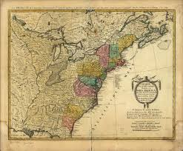
Magna Carta in Colonial America
- Colonists believed they retained the rights of Englishmen, including those from Magna Carta.
- Used as a legal justification for resistance to British rule.
- Cited in colonial charters and legal arguments against taxation without representation.

Slide 25
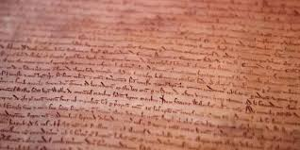
The Magna Carta Inspires the American Colonies
“But it was especially in America that Magna Carta became a symbol of a limited government in legal and political thought. It influenced American constitution even more greatly than European constitutionalism for it was taken by English colonists as the most cherished part of the legal tradition of their homeland that they still (until 1776) belonged to.”
  Dorota Pietrzyk-Reeves, Magna Carta and the Rise of Anglo-American Constitutionalism

Slide 26
Influence on U.S. Founding Documents
- Declaration of Independence echoed Magna Carta's emphasis on rights and justice.
- U.S. Constitution embedded checks and balances inspired by Magna Carta.
- Bill of Rights reflects Magna Carta's protections for due process (Fifth and Fourteenth Amendments) and fair trials.
Article I, Section 9 of the Constitution (The Suspension Clause) only allows Congress to suspend Habeas Corpus

Slide 27
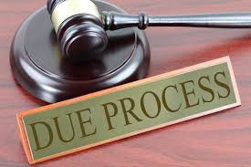
Due Process & Habeas Corpus
- Magna Carta laid groundwork for habeas corpus
- U.S. Constitution, Article I, Section 9: Protects right to challenge unlawful detention

Slide 28
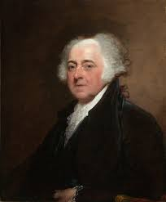
John Adams
Quote:
"The liberty of the people of England is a legacy of their ancestors, extorted from their kings under the name of Magna Charta."
Context:
In 1765, Adams praised Magna Carta as a symbol of English liberty won through struggle. He argued that its legacy was directly inherited by American colonists.

Slide 29
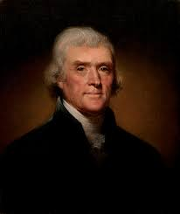
Thomas Jefferson
Quote:
"Our ancestors, the British, were free... until the Norman conquest introduced the feudal system... Our Saxon ancestors held rights under the laws of nature and of Magna Carta."
Context:
In his Notes on the State of Virginia (1785), Jefferson emphasized Magna Carta's role in preserving natural rights and resisting tyranny.

Slide 30
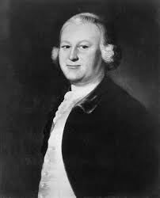
James Otis Jr.
Quote:
"The British Constitution is grounded upon Magna Charta, the Petition of Right, and the Bill of Rights. These are the fountains of liberty."
Context:
Otis was an early revolutionary thinker who argued in 1764 that American colonists were entitled to the same rights enshrined in Magna Carta.

Slide 31
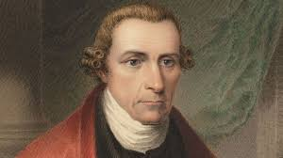
Patrick Henry
Quote:
"We are descended from a people whose government was founded on liberty, and the rights of Magna Carta."
Context:
In a 1775 speech, Henry directly connected the American quest for liberty to the ancient rights asserted in Magna Carta.

Slide 32
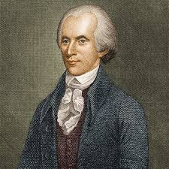
Richard Henry Lee
Quote:
"A free people claim their rights as derived from the laws of nature, and not as the gift of their chief magistrate."
Context:
Lee's 1776 letter echoes Magna Carta's principle that liberty is inherent, not granted by rulers, even if he doesn't name the Charter directly.

Slide 33
Representative Government
- Magna Carta required monarch to consult barons
- Basis for 'no taxation without representation'
- Influenced creation of U.S. Congress

Slide 34
Summary Table
Magna Carta Concept | U.S. Legal Principle | U.S. Document/Clause
---------------------------------------------------------------
Rule of law | No one above the law | Constitution; Bill of Rights
Due process | Fair legal procedures | 5th & 14th Amendments
Habeas corpus | Protection against detention | Article I, Sec. 9
Consent to taxation | Representative gov. | Constitution; Dec. of Independence
Limit power | Checks & balances | Articles I–III

Slide 35
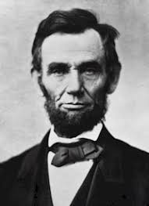
Habeas Corpus Suspended
Four times in US History
Lincoln suspends during Civil War ( but then secures congressional support
Reconstruction in South Carolina to fight the Klan
In the Philippines colony in 1905 to address an insurrection
In the Hawaii territory after Pearl Harbor

Slide 36
Magna Carta in U.S. Legal Tradition
- Cited 170 times by Supreme Court justices in key rulings (as of April 16, 2025)
- Symbol of resistance to tyranny and arbitrary authority.
- Influenced American views on liberty, justice, and the social contract.

Slide 37
Boumediene v. Bush (2008)
Issue: Habeas corpus rights of Guantanamo detainees.
Quote: "Magna Carta decreed that no man would be imprisoned contrary to the law of the land..."
- Justice Kennedy cited it to affirm the ancient origins of habeas corpus.

Slide 38
Roe v. Wade (1973)
Issue: Right to privacy and abortion access.
Quote: "The roots of privacy rights stretch back to Magna Carta and beyond."
- Justice Blackmun invoked Magna Carta in discussing personal liberty.

Slide 39
Duncan v. Louisiana (1968)
Issue: Right to jury trial in state cases.
Quote: "The guarantees of Magna Carta were carried into the American constitutional tradition."
- The Court upheld jury trials as fundamental.

Slide 40
United States v. Windsor (2013)
Issue: DOMA and equal protection.
Quote: "Our traditions, rooted in Magna Carta, affirm the dignity of the individual."
- Magna Carta cited to support liberty and equality.

Slide 41
Hurtado v. California (1884)
Issue: Grand jury and due process.
Quote (dissent): "The principles of Magna Carta form the bedrock of our liberties."
- Used to argue for procedural protections.

Slide 42
Zadvydas v. Davis (2001)
Issue: Indefinite detention of non-citizens.
Quote: "Freedom from imprisonment – from government custody, detention, or other forms of physical restraint – lies at the heart of the liberty protected by the Due Process Clause... traced to Magna Carta."
- The Court referenced Magna Carta’s enduring influence.

Slide 43
Hamdi v. Rumsfeld (2004)
Issue: Detention of U.S. citizens as enemy combatants.
Quote: "A state of war is not a blank check for the President when it comes to the rights of the Nation’s citizens... These rights have roots deep in history, including Magna Carta."
- Justice O’Connor affirmed due process even during war.

Slide 44
Ex parte Milligan (1866)
Issue: Use of military tribunals on civilians.
Quote: "The Constitution of the United States is a law for rulers and people, equally in war and in peace... This principle was first clearly expressed in Magna Carta."
- Asserted civil liberties under all conditions.

Slide 45
Global Legacy of Magna Carta
- Seen as a cornerstone of liberal democracy and human rights.
- Influenced international legal norms, including the Universal Declaration of Human Rights.
- Celebrated globally as a foundation of modern rule of law.

Slide 46
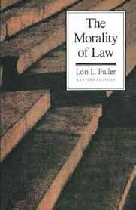
The Magna Carta and the
Inner Morality of the Law
Rule of law is more than sheer legality.
It is an internalization of values and a respect for process and procedure.
It is respect for limits and not about what you can do but what you should do.
Lon Fuller, The Morality
of Law

Slide 47
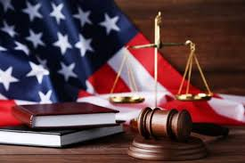
The Magna Carta and the
American Legal Tradition
“A legal tradition is not a set of rules of law about contracts, corporations, and crimes, but a set of deeply rooted, historically conditioned attitudes about the nature of law, the role of law in the society and the polity, the proper organization and operation of a legal system, and the way law is or should be made, applied, studied, perfected, and taught.”
— John Henry Merryman, The Civil Law Tradition, 1969, p. 2

Slide 48
Justice William Brennan on Magna Carta
“The Magna Carta, although over 750 years old, still lives as a potent symbol of liberty and the supremacy of law over arbitrary power.”
  Brennan, W. J., Jr. (1985, October 12). Why Have a Bill of Rights? Speech delivered at Georgetown University. Reprinted in Public Law and Contemporary Problems, 44(1), 1–13.

Slide 49
Lawyers as Guardians of Legal Order
“A more learned, a more witty, and a more subtle body of men cannot be imagined. They are strongly interested in the stability of the law, and they exert their influence in favor of order and repression of violent passions.”
— Alexis DeTocqueville, Democracy in America, Vol. I, Part II, Ch. XVI

Slide 50
Questions?
Thank you!

