Slide 1
How to Write Flash Fiction
(and the organic writing method)
Jerry Guarino

Slide 2
Resources
This presentation can be downloaded from my website at: https://cafestories.net/write-in-the-harbor-2019
At the end of our session, you will have a flash fiction story started.
Follow up questions can be sent to me at: jgauthor@icloud.com
My website is: http://cafestories.net There you can find hundreds of resources for writing fiction.
Your handouts: session overview and resource links, worksheet questions, Vegan Dog and Stoned Cat, The Old Fisherman, UFO and The Waiting Room

Slide 4
What is a Story?
Story World + Characters + Obstacles
————————— PLOT —————————

Slide 5
Story World
A story world is more than the setting; although it includes the time and place of your story, it is so much more.
How does it effect the senses; what smells, sounds, touches can you describe? Immerse yourself there.
Not just a beach. Is the sand fine or coarse? What do you smell? What sounds do you hear? What is the temperature?
Maybe it’s in another country, another planet or sometime in the past or future.
Worksheet: describe one or two story worlds.

Slide 6
Elements
A good flash fiction story will have a beginning, middle and ending.
Word count between 300 to 1000 words.
Your first paragraph should set up the story world (setting), main character(s) and the problem (conflict).
Your character(s) must be changed in some significant way by the end of the story.
Flash fiction is not a ‘slice of life story’ without any conflict or structure.

Slide 7
Flash Fiction Sections
A strong beginning paragraph that places the reader into the story world, introduces the main character and sets up the conflict or problem the character will face.
A middle section which shows how the character faces the conflict and one or more attempts to solve it.
An ending that resolves the conflict and shows that the character has changed as a result.

Slide 8
Openings
Tommy was a happy man. Tall, athletic and with surfer looks, the sophomore was breezing through college in the carefree San Diego lifestyle. He thought he had it all, until he met Hannah. Hannah was gorgeous, perhaps the woman of his dreams, except for one fact. Hannah didn’t like the Beatles. (from “Can’t Buy Me Love”)
Hanging out near a pond in the Pacific Northwest, Marley and Jeri were commiserating about how their life had changed, and not for the better. While their owners were living the progressive lifestyle, the pets were suffering. Marley’s owners were vegans and Jeri’s owners were stoners.
(from “Vegan Dog and Stoned Cat”)
Mario and Luigi worked from five until ten, twice a day in a brand name hotel in San Diego. First, they worked from 5:00am until 10:00am making breakfast and then they worked secretly from 5:00pm until 10:00pm making take out for guests in the hotel and others. I need to explain.
(from “Buon Cibo”)
Alex was suave and polished, the type of man women long for. Prepped and pampered since he was a child, he grew up in a fine New England home to parents of distinction. He attended the finest private schools and vacationed in Europe. His hobbies were magic and tennis, in fact he was professionally acclaimed at both of them. Alex was just about perfect for any refined woman looking for a mate, except for one fact. Alex was a thief.
(from The Cat Burglar)

Slide 9
Ending the Story
A good ending for your flash fiction shows how the main character has been changed by resolving the conflict or problem they have confronted.
A good ending can be ironic, funny, uplifting or dramatic.
A twist, or surprise ending can be very effective.
Positive endings are usually more publishable than sad or negative ones.
An ending may solve one problem and introduce another problem the character has to face next.

Slide 12
Character Types
Types of characters in fiction at: http://learn.lexiconic.net/characters.htm
Archetypal characters at: http://bit.ly/1eBYZ9v
Flat characters are two-dimensional in that they are relatively uncomplicated and do not change throughout the course of a work. By contrast, round characters are complex and undergo development, sometimes sufficiently to surprise the reader.
Stock characters: A stock character is a stereotypical fictional character in a work of art such as a novel, play, or film, whom audiences recognize from frequent recurrences in a particular literary tradition. Stock characters are archetypal characters distinguished by their flatness.
Character http://bit.ly/2hKkEHd An excellent video about the highly structured method of screenwriting and how characters are created. Watch this at home.
Pebble people do not change in response to circumstances (they are flat characters). Putty people change in response to circumstances. You want to create putty people. They are round characters
Worksheet: describe one or two characters for your story.

Slide 14
Types of Conflict
Internal - the character is fighting some internal pain or anxiety that prevents them from their goal.
External - the character is confronted with an external force or person that is preventing them from their goal.
Interpersonal - the character is involved in an emotional battle with another character(s).
Man vs man, man vs technology, man vs environment, man vs law, ….
You can also think of conflicts as problems or obstacles.
Worksheet: describe one or two conflicts for your story.

Slide 16
Theme
The theme in a story is the big idea, or underlying message. What critical belief is the author trying to convey? It is usually universal, not specific to any person or culture.
Some themes you might like include: alienation, ambition, betrayal, death, deception, escape, fear, freedom, good vs evil, jealousy, justice, loss, love, lust, power, prejudice, survival, spirituality and God.
Try to find the themes in the stories you like. A good theme will help you get your story published.
Worksheet: circle one or two of these themes for your story.

Slide 17
Premises
Premises are “What if” questions
What if a boy finds a treasure buried in his backyard?
What if a woman falls in love with a bad guy?
What if a man loses his job and then wins a lottery?
Worksheet: write a premise for your story.

Slide 18
One Sentence Story Concept
A key to writing flash fiction is conveying ideas in a story with less than 1000 words.
A one sentence story concept will help you focus and tighten your work; it also serves as a way to describe your story to editors and readers.
The one sentence story pairs well with a good premise.
https://www.livewritethrive.com/2016/06/13/understanding-premise-and-the-one-sentence-story-concept/ (play video clip)
Worksheet: write a one sentence story concept.

Slide 19
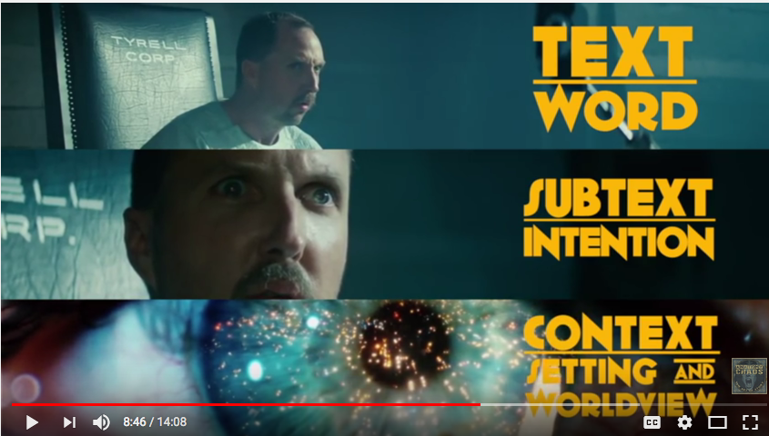
Subtext

Slide 20
Subtext
an effective way to convey feelings, thoughts and reactions without language
a sigh, an expression, body language, emotion without words
sprinkle subtext into your stories to enhance your connection with the reader

Slide 21
Subtext
Subtext is the meaning beneath the dialogue; what the speaker really means, even though he's not saying it directly. As humans, we often don't articulate our thoughts exactly.
play video https://www.youtube.com/watch?v=5EHffsZAWe0
More subtext videos at: https://www.youtube.com/watch?v=sN89XJiNLEQ and https://www.youtube.com/watch?v=yUTsh7n18_o and https://www.youtube.com/watch?v=wtanvpwGJXk
Dialogue and Subtext in movies: http://bit.ly/2zUKDRa begins at 6 minute mark

Slide 22
5 Biggest Fiction Mistakes
http://bit.ly/1dKvAci James Scott Bell
Happy People in Happy Land - Readers engage with a story when the characters have trouble, threat, change or challenge.
A World Without Fear - Readers are engaged when death hangs over the characters (either physical, psychological or professional death).
Marshmallow Dialogue - Create tension filled dialogue, with conflict. Make sure each character has a distinct voice.
Predictability - Put something unexpected in every scene.
Lost Love - Go deep into your characters, showing their emotions, fears and desires.

Slide 23
Structure
There are two ways to write: with detailed planning and structure or from the gut (also called organic writing).
Make sure the first paragraph of your story is compelling and paints a picture.
Make sure your story is advancing. Most instructors say avoid going down rabbit holes or you may lose the reader. But Steven James says follow all rabbit trails for unexpected results.
If you must use flashbacks, distinguish them with italics or another visual or wording cue. Foreshadowing is a technique that provides clues to the reader on what is to happen later in the story. It is often used in mystery/crime stories.

Slide 24
Organic Writing
To get started, you don’t need an outline; you just need a premise.
Stop trying to decide whether your story is plot driven or character driven, and focus instead on your protagonist’s unmet desires regarding his internal questions, external problems and interpersonal relationships.
Steven James, a proponent of organic writing, offers three questions to solve any plot problem: 1. What would this character do naturally in this situation? 2. How can I make things worse? 3. How can I end this in a way that is unexpected and inevitable? and two more questions: 1. How can I include a twist? 2. What promises have I made as a writer that I have not yet kept?
All stories are tension driven. A character in tension, caught between his present condition and his unmet desire for things to be different.
Vital questions: What does your character want? and What should go wrong? Characters must take on a life of their own.

Slide 25
Organic Writing cont.
To uncover the plot of your story, don’t ask what should happen, but what should go wrong. To uncover the meaning, don’t ask what the theme is, but what is discovered. Characters making choices to resolve tension, that’s your plot.
Readers want to be surprised, but they want that surprise to be logical and not come out of nowhere.
Four things keep readers flipping pages: concern, curiosity, escalation and enjoyment.
Follow rabbit trails.
“You don’t have to see where you’re going, you don’t have to see your destination or everything you will pass along the way. You just have to see two or three feet ahead of you.” - Anne Lamott in Bird by Bird
No matter which method you choose (outlining vs organic), you have to build a compelling story with engaging characters and a universal theme.

Slide 26
5 Ingredients Every Story Should Have
http://bit.ly/1jwSrMg Steven James
Orientation - Orient the reader to the setting, mood and tone of the story, and introduce them to a protagonist she will care about, even worry about, and emotionally invest time and attention into. Reveal a portrait of the main character by giving readers a glimpse of her normal life.
Crisis - This crisis that tips your character’s world upside down must be one that your protagonist cannot immediately solve. It’s an unavoidable, irrevocable challenge that sets the movement of the story into motion. Life is changed and it will never be the same.
Escalation - There are two types of characters in every story—pebble people and putty people. If you take a pebble and throw it against a wall, it’ll bounce off the wall unchanged. But if you throw a ball of putty against a wall hard enough, it will change shape. Your main character needs to be a putty person.
Discovery - At the climax of the story, the protagonist will make a discovery that changes his life. The protagonist’s discovery must come from a choice that she makes. Typically, this discovery will be made through wit (as the character cleverly pieces together clues from earlier in the story) or grit (as the character shows extraordinary perseverance or tenacity) to overcome the crisis event (or meet the calling) he’s been given.
Change - Think of a caterpillar entering a cocoon. Once he does so, one of two things will happen: He will either transform into a butterfly, or he will die. But no matter what else happens, he will never climb out of the cocoon as a caterpillar. This change marks the resolution of the crisis and the culmination of the story.

Slide 27
What Happens Next?
I prefer Organic Writing to hours of planning, outlines, character profiles and plot graphs
Sometimes I begin a story with a situation, character or story world that I like and ask “what happens next?”
Some of my best stories have happened by accident, without an outline or any idea how they should unfold
All writers should read Story Trumps Structure by Steven James, On Writing by Stephen King and The Art of Fiction by John Gardner.

Slide 28
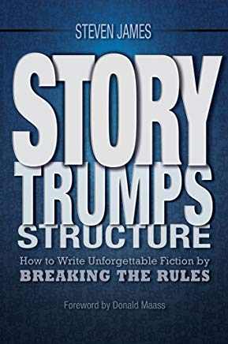
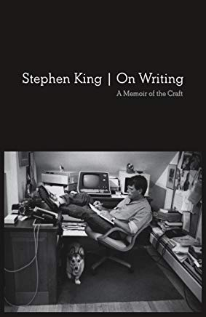

Slide 29
Story vs Discourse
ref: Anna Keesey’s essay “Making a Scene”
Story is showing, Discourse is telling
Story is advancing forward
Discourse is pausing, looking inward
Unfolding: advancing the story forward
Infolding: discourse about inner thoughts, commentary, memories and backstory (exposition)
How much unfolding and infolding is in your story?

Slide 30
Some Extra Points
Plots and Subplots: Two stories are better than one. A subplot can support or contradict the main plot. Try combining different genres as a subplot (e.g. a romance within a science fiction story).
Tension: Every scene should show tension between the characters, changes based on their actions and words. Build tension throughout your story and end it with a believable resolution.
Resolutions: You must resolve every conflict/problem/obstacle in your story. A surprise is an effective way to end your story.

Slide 31
Sources of Inspiration
Themes (alienation, ambition, betrayal, death, deception, escape, fear, freedom, good vs evil, jealousy, justice, loss, love, lust, power, prejudice, survival, spirituality and God)
English and American Proverbs at: http://bit.ly/2yyr5EM and Ben Franklin’s Maxims at: http://bit.ly/2zlWjhh
The Deadly Sins (Greed, Lust, Sloth, Gluttony, Pride, Wrath, Vanity and Sorrow/Despair), Scripture and The 8 Beatitudes of Jesus
Plot, Character and Story Generators online
Music titles and lyrics (my favorite is Billy Joel)
Television, Movies, Plays and even Advertising (you know, those annoying commercials)

Slide 32
Summary
Flash Fiction stories have a beginning, middle and ending.
Flash Fiction stories have between 300 and 1000 words.
Your first paragraph should introduce the story world (setting), main character(s), and problem(s) or conflict
Your ending should show the change that the character(s) have made as a result of solving the problem (conflict).

Slide 33
Workshop
Pick a story world (the setting and environment)
Pick a character(s) (choose a person or two)
Pick a conflict or problem (what problem will they face?)
Pick a theme and premise (what ideas will override the story?)
Write your first paragraph (include the story world, character(s) and problem
Write your ending (resolve the problem in some way, a twist?)
Fill in the middle (do this at home, then get ready to submit)

Slide 34
Challenge
Read “The Waiting Room” (handout)
Figure out the answer to the riddle (Why was she missing?)
Email me the answer: jgauthor@icloud.com
The first correct answer wins a paperback.
Hint: this isn’t easy. In all the years, my son is the only one who has figured it out.

Slide 36
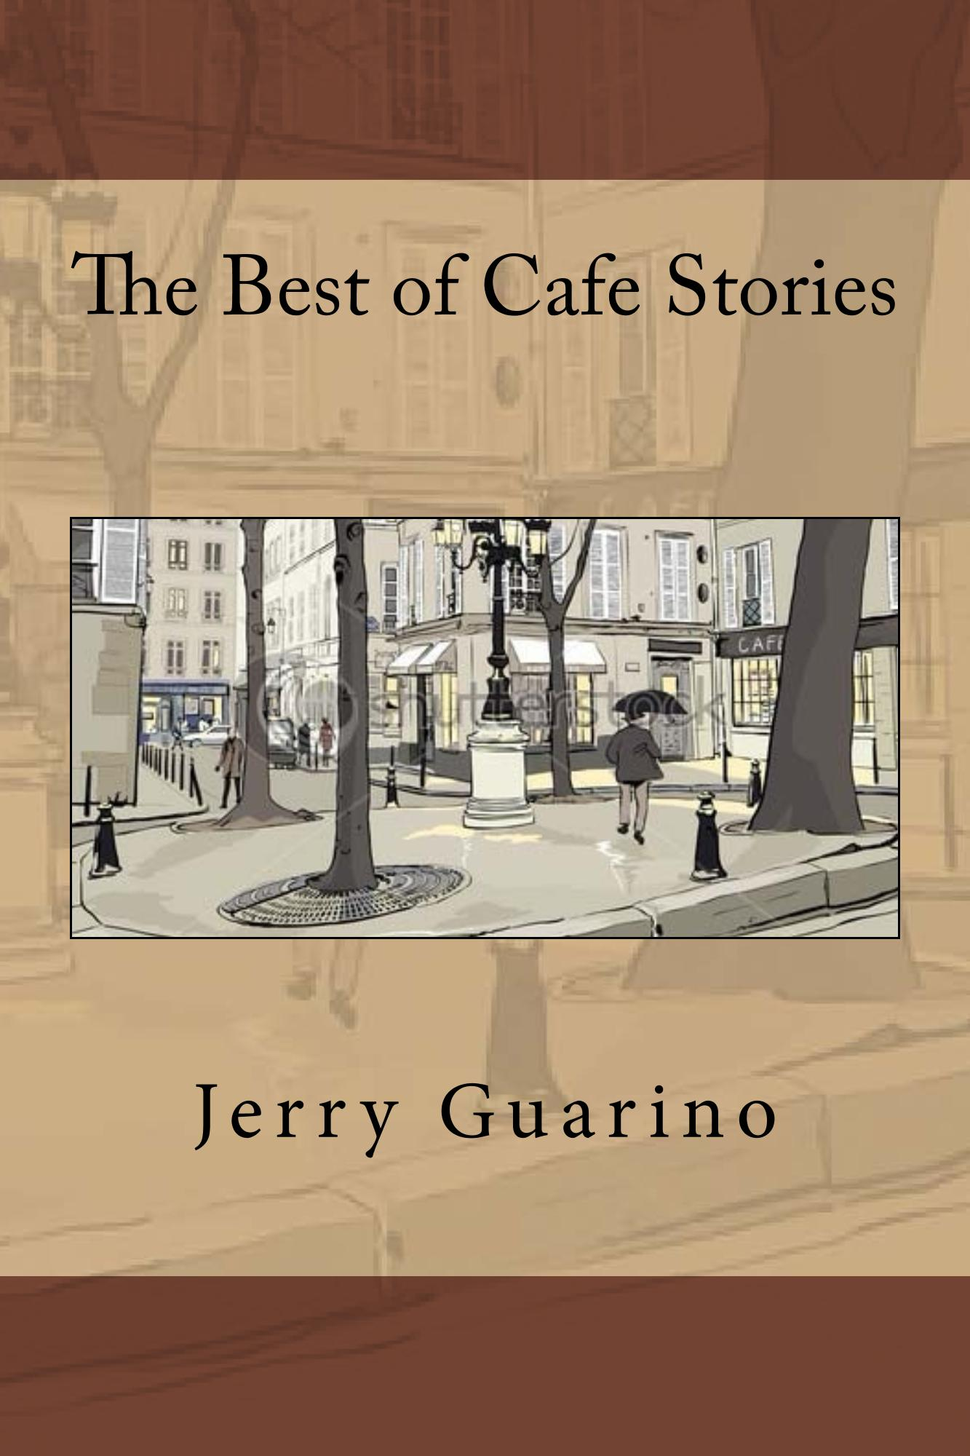
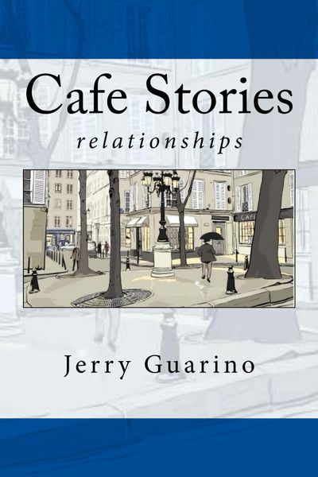
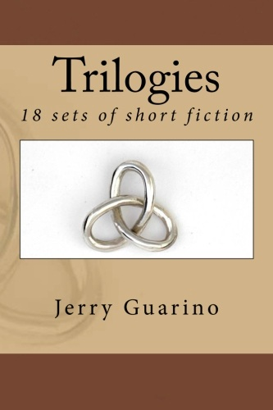
Download these books for free at: https://cafestories.net/write-in-the-harbor-2019

