Slide 1
Black History Month 2026
Introducing The Oldest Girls School in West Africa
Annie Walsh Memorial School

Slide 2


Black History Month is About Celebrating The Past while Actively Creating Better Futures for Black People
Notes:
One-line Black History Month connection: the story of African girls claiming opportunities through education
Interactive prompt:
What do you think a girls' school in Sierra Leone looked like 175 years ago?

Slide 3
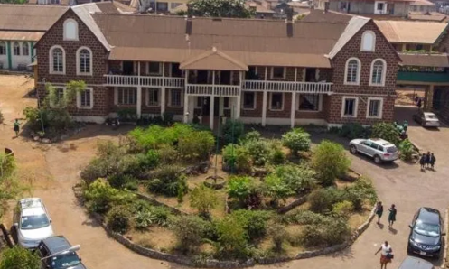
What can a school built nearly 200 years ago tell us about Black history today
Exclusively for girls; Started around 1816 in Charlotte Village with 8 girls.
Established 1849 (177yrs old) In Freetown
2 Decades before UK Universities had special exams for women (1869)
Notes:
The establishment of the school was in line with the position of women and girls .
Boys and girls had had equal opportunities.
In 1792 women as household heads already had the right to vote, while Finland was the first European country to grant women full voting rights in 1906

Slide 4
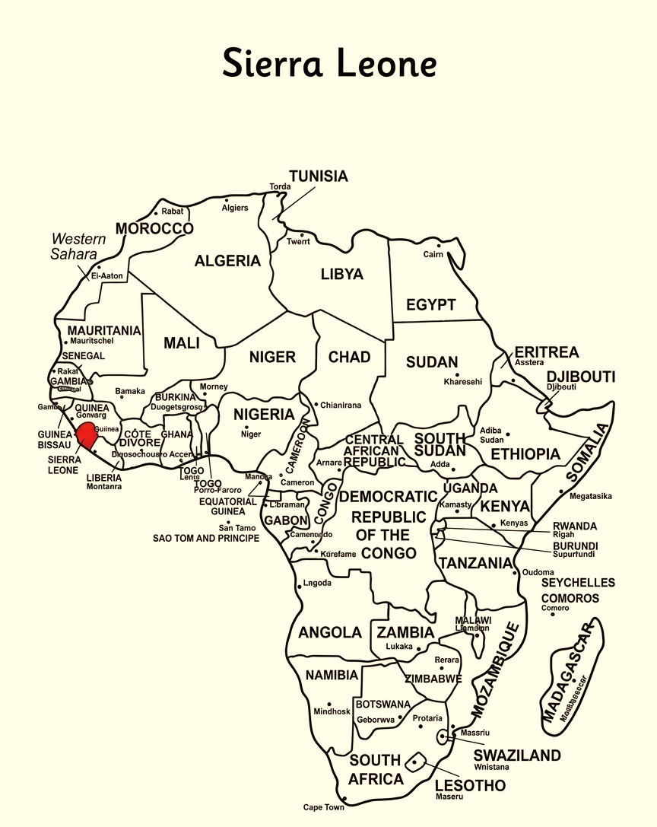
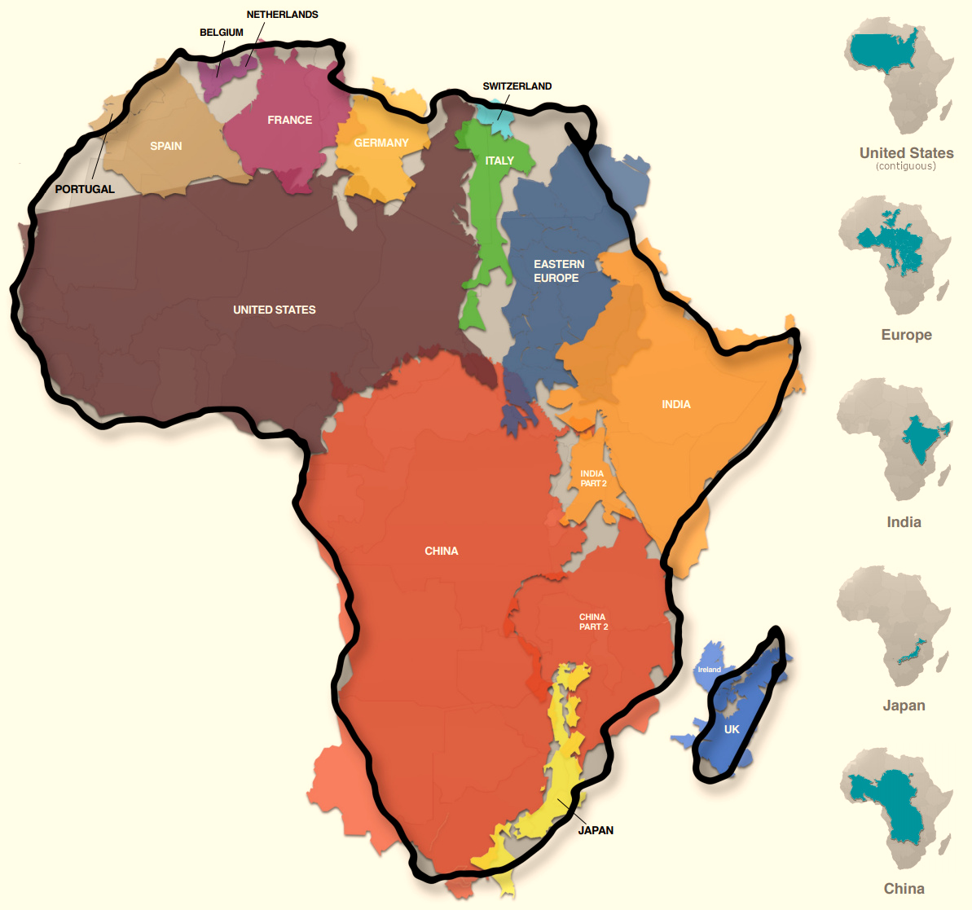
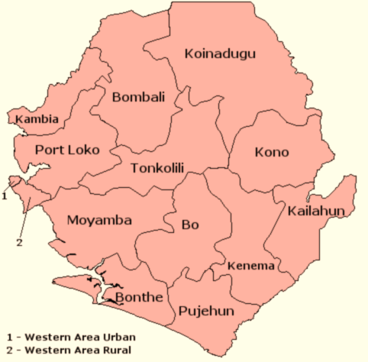
WHERE Is AWMS: in Africa (14 times the size of Greenland)
Freetown
Freetown was established for freed slaves and recaptives
Notes:
Map of Africa → West Africa → Sierra Leone → Freetown Atlantic Ocean and neighbouring countries Freetown as the capital Explain why West Africa and Britain were historically connected
ask students to think critically: Who established the school? Who attended it? What did the students themselves achieve
This is an excellent place to introduce Africa as a place of history, knowledge, cities, communities and institutions, rather than beginning with slavery

Slide 5
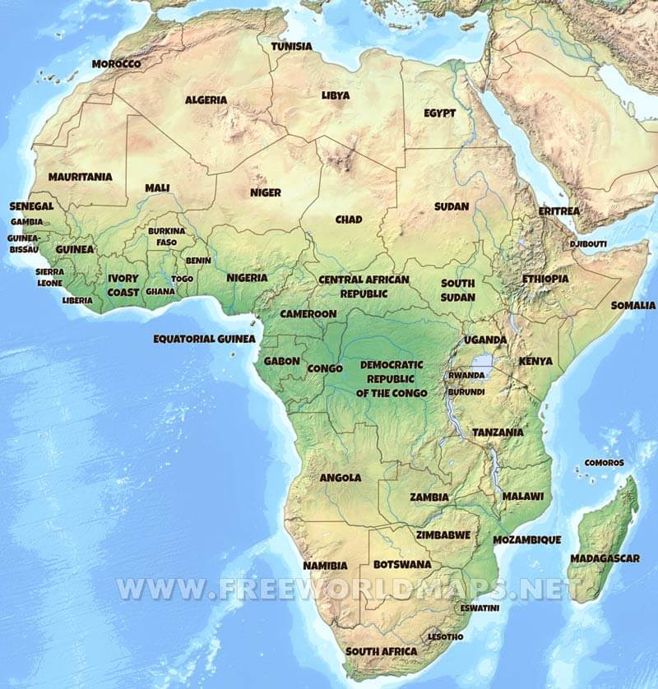
Education in Africa before the slave trade and missionaries
859 AD Morocco: University of al-Qarawiyyin
988AD Mali: University of Sankore
Guild schools
Guilds
1827 Sierra Leone: Fourah Bay College university
1829 Cape Town SA: South African College
Notes:
Guild schools
Young people were sent away their communities for months at a time to live in specialized training camps under the strict guidance of master teachers and elders.
Students were rigorously trained in civic responsibilities, military strategy, judicial law, history, engineering, pharmacology (herbal medicine), complex agricultural techniques, and the arts. Graduation was formal and highly celebrated.
Guilds
Formal apprenticeships with a lifelong commitment to learning and training. Industries like blacksmithing, weaving, boat-building, and goldsmithing were regulated by family or community guilds. – Learning by doing
Introduction of western style schooling was tailored specifically to European languages, Christian theology, and clerical administration.
It came at the same time as the Victorians were forced to send children to school free of charge. This system was built on rote learning.
Fourah Bay college part of the University of Durham was set up in 1827.
1829 saw South African College set up by Dutch and British colonialists, church leaders and white citizens; archiving university status in 1908.
CMS Grammar school for boys established in 1845

Slide 6
Who was Annie Walsh
Annie Walsh was a young English girl who hoped to become a missionary in Africa.
She died in a tragic accident at age 20, before fulfilling that ambition.
Her parents established the Annie Walsh Memorial Fund, which contributed to the development of the schoo

Slide 7
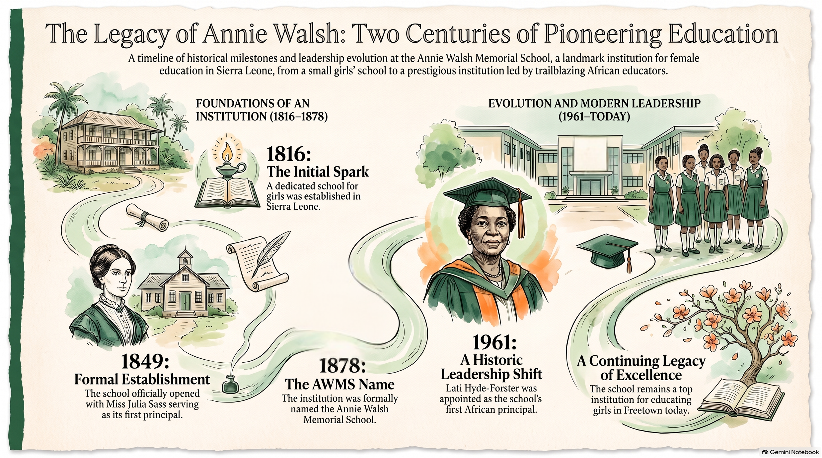


Slide 8
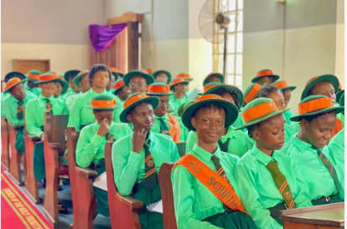
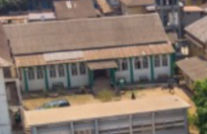
CHRISTIAN VALUES: The school maintains a deep connection to its Anglican roots, holding regular devotional services, thanksgiving celebrations, and chapel assemblies that reinforce Christian values. The school boasts its own chapel.
Chapel
Sixth form during assembly

Slide 9
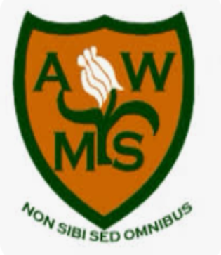
Our School Motto
Insert your own school
motto here
Talk about what the
motto means to the
children.
Reflections on the Motto
The school motto is “Non Sibi Sed Omnibus”, which translates from Latin to “Not for oneself, but for all.”
⚜
Empathy and Service
⚜
Community First
⚜
Legacy of Altruism

Slide 10
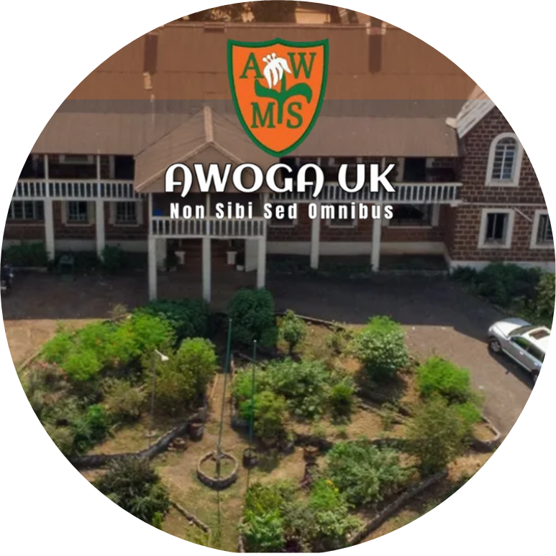
The Girls Who Became “Firsts”
Ethel Thomas - 1st girl to gain the full Cambridge School Certificate in West Africa
Lati Hyde-Forster – 1st female graduate from Fourah Bay College
Irene Ighodaro (Wellesley-Cole) - 1st female medical doctor from Sierra Leone’s
Mabel Dove – 1st female Member of Parliament in Africa
Stella Thomas – 1st female barrister, Sierra Leone
Belmont Williams – 1st female gynecologist and obstetrician in Sierra Leone
Ing Trudy Morgan -1st female Fellow and first female President of the Institution of Civil Engineers
Notes:
What does it mean to be the first?”
“And why might the second, third and hundredth women also matter?”
That gets children thinking about opening doors for others, rather than simply celebrating exceptional individuals.

Slide 11
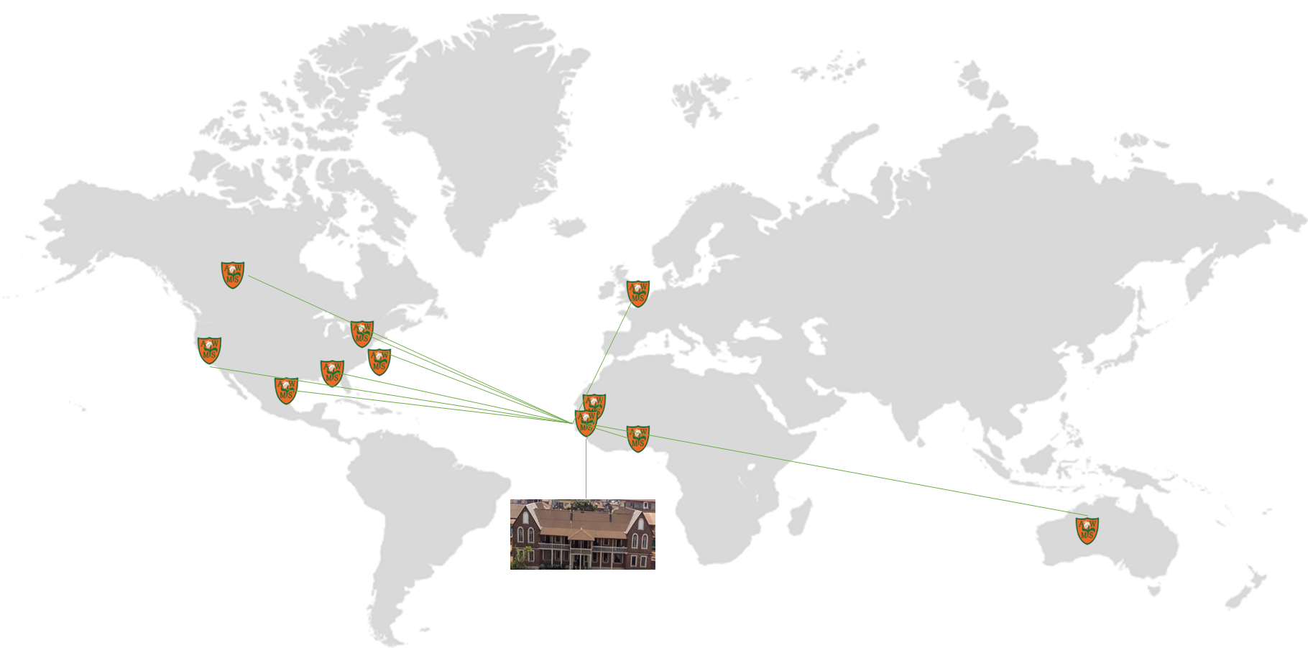
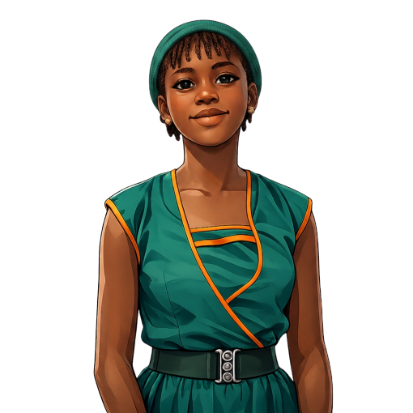
History is still being made with strong support from cross continental Alumni groups
AWOGA Network

Slide 12
“What might an AWMS student in 2026 become the ‘first’ to do?”

Slide 13
What Will Your Legacy Be?
My name: ______
Something I want to change: ______
A skill I want to develop: ______
The legacy I want to leave: ______
Notes:
Give each pupil a small “future history” card:
This makes the presentation participatory rather than simply informative.

Slide 14
If you would like more information or fundraise for us:
awoga.org.uk
@awogauk
Facebook
dtproject@awoga.org.uk
If you find this content helpful, please bolster our social media efforts by following our page, and sharing our content in forums we could never reach

