Slide 1

2019 Tech CU Emerging Markets
Business Development Plan
Indiana Ortega

Slide 2
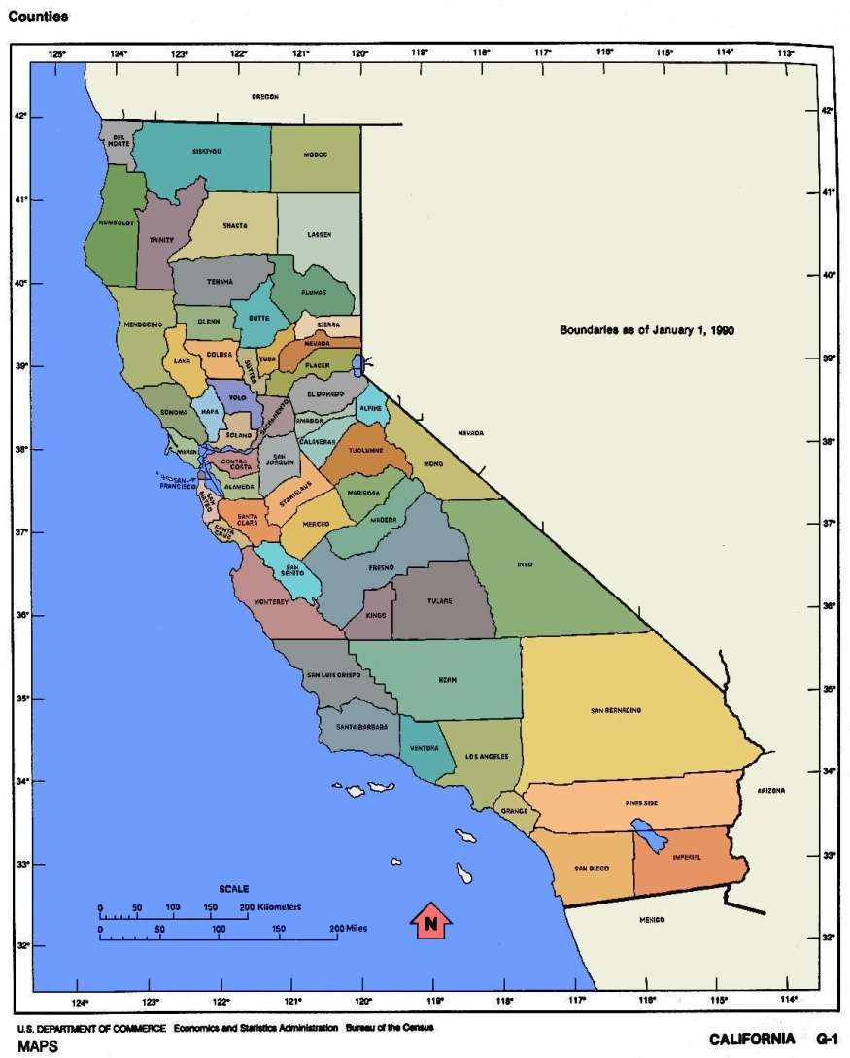
Expanded Field of Membership for New Counties
Step 1: Market Research and Comprehensive Market Analysis​
Step 2: Positioning Tech CU for the New Market
Step 3: Setting Goals and Tracking Them

Slide 3

Expanded Field of Membership for New Counties, Step 1
County demographics: age, race, family size, income, education level, religion, total population, other relevant market and demography data
  Households with children, retirees, business owners, homeownership rate
  Obtain information from city and county Chambers of Commerce
  School districts, business bureaus, tourism boards
Culture and business environment in each county
  Industrial activity? Average employer size, largest employers in the area?
Opportunities unique to every city and county
  Community and business events, other relevant attributes and opportunities for each new area
Review current SEG programs and how they fit post-analysis

Slide 4
Expanded Field of Membership for New Counties, Step 2
Targeting Potential Partners
  Community and business partners
  HR departments, C-suites, major decision-makers with local employers
Ideal Product Mix For Each Market
  What will drive demand for membership?
  Which products are most likely to develop profitable relationships to this market?
    Checking accounts, CDs, auto loans, mortgages, other
Market Need
  Who is the chief competition? Strengths and weaknesses, overall positioning?
  How does Tech CU compare to these financial institutions?
Increasing Awareness
  Business development team to prioritize partnership and strategic relationship development
  Business development must work with Marketing to raise brand awareness, why Tech CU has arrived and what we bring prospective members
New Select Employee Group Partnerships
  Build strong relationships with each employer group
  Business development team to become personal bankers for assigned SEGs
  TechCU@Work Employers and SEG relationships managed by conscientious contact
Member and Community Engagement
  Educate members and prospects on products, competitive advantage, and membership options
  Focus on long-term, profitable relationships with members and businesses in this market
  Charity events |Networking events and seminars
  Engaging Business Development and Tech CU teams with SEG activities
  Social media activity for Tech CU and SEG communities - build stories

Slide 5

Expanded Field of Membership for New Counties, Step 3
Setting Goals for Each New Market
  Goals to be based on market analysis and prior experience with new markets
  Measurable goals defined as:
    New TechCU@Work (SEGs) Employers
    New Members
    Product Penetration
Tracking Goals
  Goals tracked through monthly business development reports
    Includes all activities by employer and Business Development Consultants
  Penetration report for top companies
Profitability reports

Slide 6

3-Year Business Development Plan: Tech CU Should Be Seen as a Major Strategic Partner with Each SEG
Demographics still important for outreach and messaging, but financial institutions need to start focusing on unmet needs and psychographics like lifestyles, values, aspirations, etc.
Go beyond personalization by demography segment, and go for highly individualized personalization, as "segment of one" as technology will permit
Cluster customer base with advanced criteria aided by design-centered technology and CRM tools to deliver real-time solutions
Potential members may be willing to pay for this added value given the personalization aspects (e.g. Amazon Prime)
Beyond individual members, use "GAFA" (Google/Amazon/Facebook/Apple) approach on SEGs and business clients, leveraging data-driven insights to boost core business

Slide 7

Long-Term Business Development Goals
Deepen, strengthen and expand SEG partnerships
  Maintain and/or grow existing SEG relationships
Increase membership
Encourage product participation
Increase loan volume
Gain more partnerships (SEGs, community, chambers, etc.)
Provide and improve member education

Slide 8
Building Relationships for Effective Business Development
SEG Partnerships
Social Media
Member Engagement
HR executives
Employee onboarding
Checking account, preapprove Visa and auto loan
Relocation team and real estate department for mortgages
Facebook and Instagram stories
Community and sponsorship events
Seminars
Connect with current and prospect members
Member education
Convenience services
Push that Tech CU is the preferred financial provider for their SEG
On-site appointments
Take applications
Review credit reports
Answer financial questions about credit, mortgages, etc.

Slide 9
30-Day Plan
Observe → Understand → Evaluate → Optimize
Observe
Visit Tech CU branches and team members
Visit SEGs with business development consultants
Optimize
Setting new goals and means to measure progress
Seek new opportunities
Evaluate
Perform audit of Tech CU's current membership
Understand
Review 2019 strategic plan, goals, and objectives of Tech CU and the business development team

Slide 10
30-Day Plan: Auditing Current Membership
Observe → Understand → Evaluate → Optimize
Current MCIF reports and membership segmentation
Review business development team's current goals and directives
How are consultants educating members?
Identify trends, profitability of current product mix, and opportunities
Department and individual consultants
Tracking methods
Current training
Meet with each consultant to address challenges and needs
Seminars
New employee orientation
Job fairs
Employee intranet

Slide 11
30-Day Plan: Evaluating and Optimizing Opportunities and Progress
Observe → Understand → Evaluate → Optimize
Seeking Opportunities with Current Members
Optimizing Metrics and Tracking Progress
Increase profitability with SEG employee members in the onboarding process, then overall
How can we anticipate member needs?
Encourage product usage
Retention
Profitability
Product growth
Member growth by SEG
Keep goals achievable and flexible
Measure regularly but be willing to make adjustments as needed

Slide 12

60-Day Plan: Moving Forward with Regard and Respect
Evaluate 30-day goals
Weekly Business Development Meetings
  Discuss reports and happenings
  Review Objectives
  Evaluate growth
Interface with VPs, Managers, and Supervisors
  Align with other departments to determine their objective and goals
  Identify potential mentors
Strengthen Relationships with Business Development Consultants
  Continue SEG visits with consultants
  Address consultants' needs and challenges
    Technology and tools
    Training
    Additional resources to excel at their jobs
Start 2020 Strategic Planning Initiatives

Slide 13



90-Day Plan: Feedback and Re-evaluation
SEGs and Key Stakeholders
Meet with each key contact for every SEG
My Superior
Feedback on new processes and procedures
Re-evaluation
Business Development processes and procedures
Determine how we can strengthen and nurture our relationship with them
Assess how thoroughly we are reaching their employees
Implementation of new strategies
Consultants
Goals and Objectives
2020 Strategic Planning

Slide 14

90-Day Plan: Re-evaluation of Initiatives
Business Development processes and procedures
  What is working?
  What needs to change?
  How do we achieve that change?
Consultants
  Efficiency on current and prospective accounts?
  How can we make their jobs easier?
Goals and Objectives
  Are they achievable?
  Do they align with Tech CU's strategy and vision?
2020 Strategic Planning
  Continue and improve training
  Get to know current SEGs and business community better
  Network with interfacing departments to achieve optimum success

