Slide 1
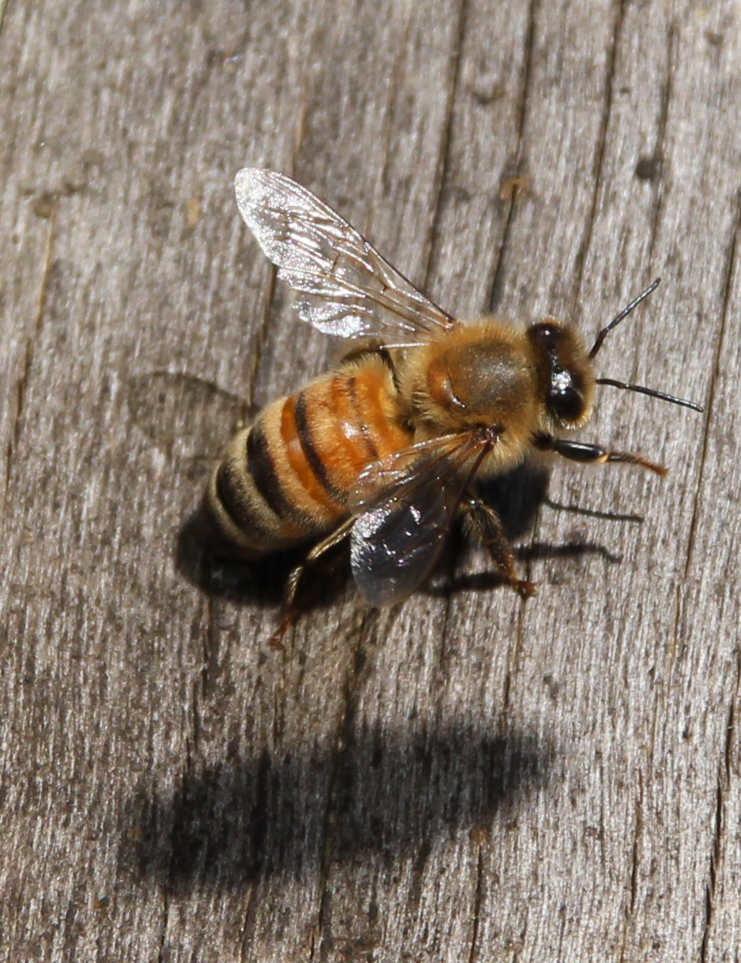
Products from the honeybee hive

Slide 2
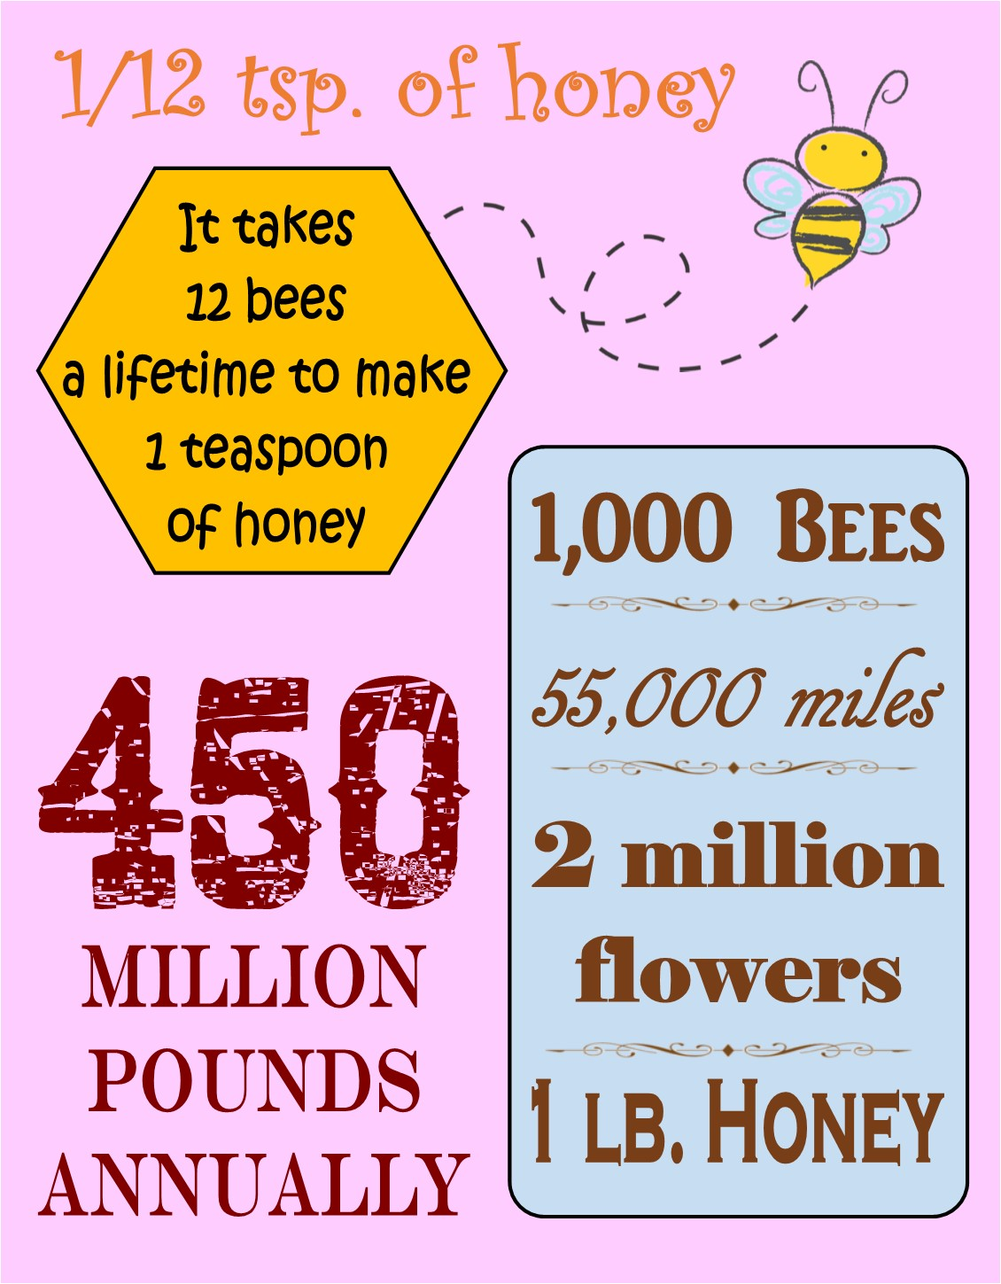
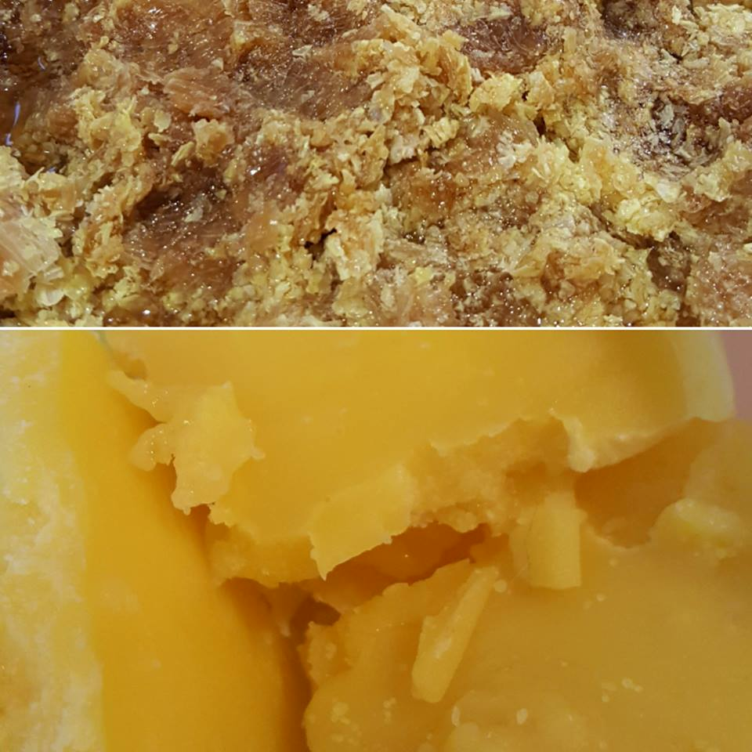
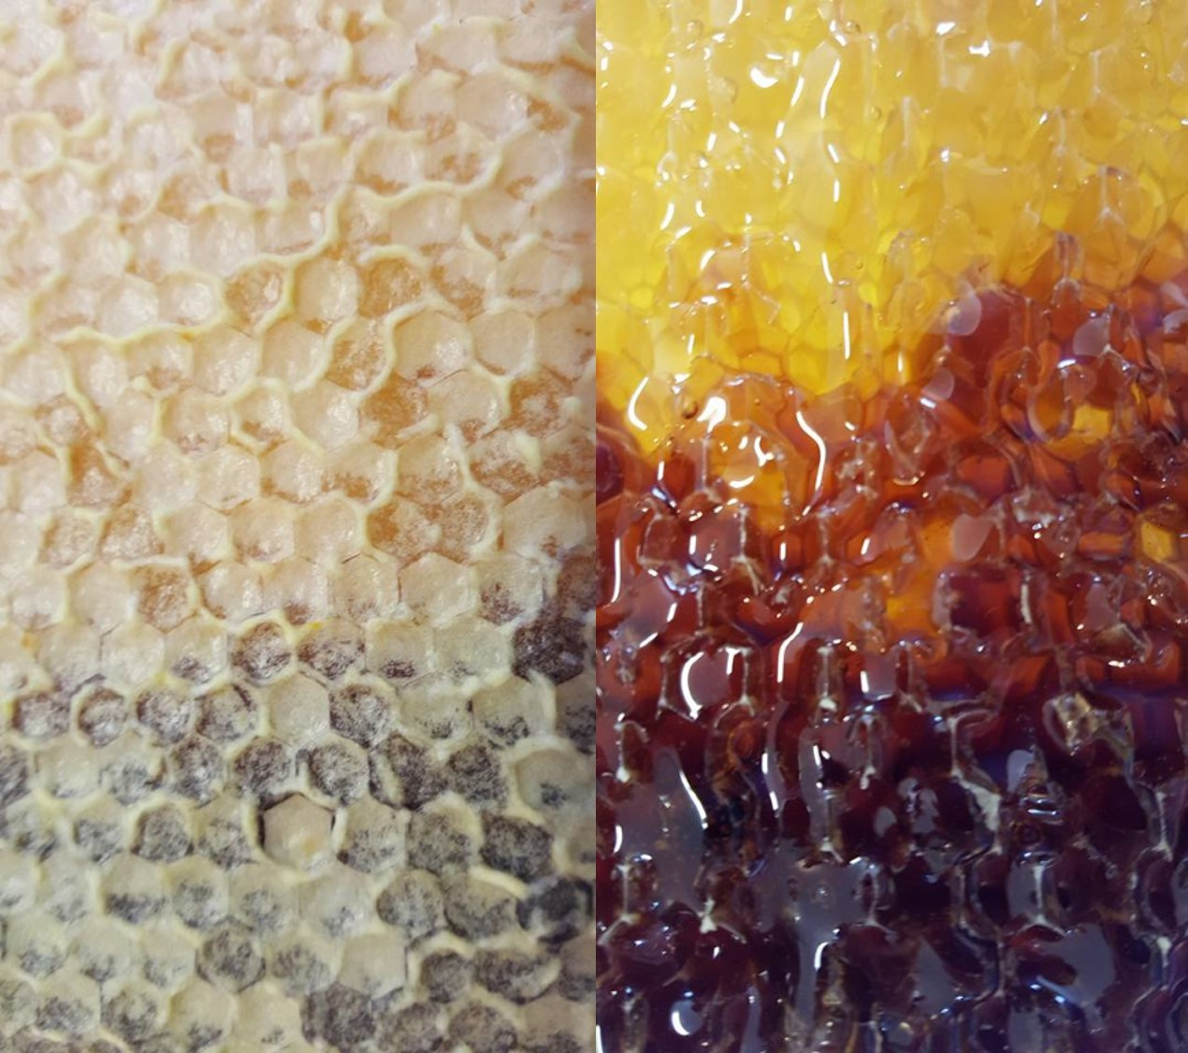
Products of the Hive
In addition to the obvious use as a sweetener for consumption, there have been studies where evidence, according to the Mayo Clinic and other trusted medical sources, can be found that honey can also be used to treat:
Cardiovascular disease
Cough
Gastrointestinal disease
Neurological disease
Wounds (burns, cuts, abrasions)
General safety guideline: Honey should NOT be given to children (infants) under the age of one (1).
Honey
Beeswax

Slide 3
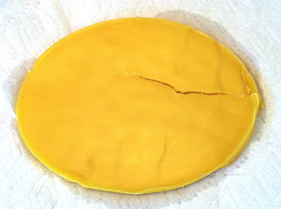
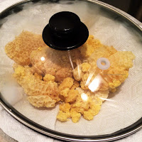
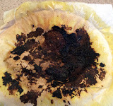
How to clean beeswax
Several methods to do this, experiment to find what works best for you.
Crockpot (good instructions can be found on the Farmwife’s Diary blog)

Slide 4
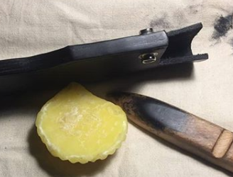
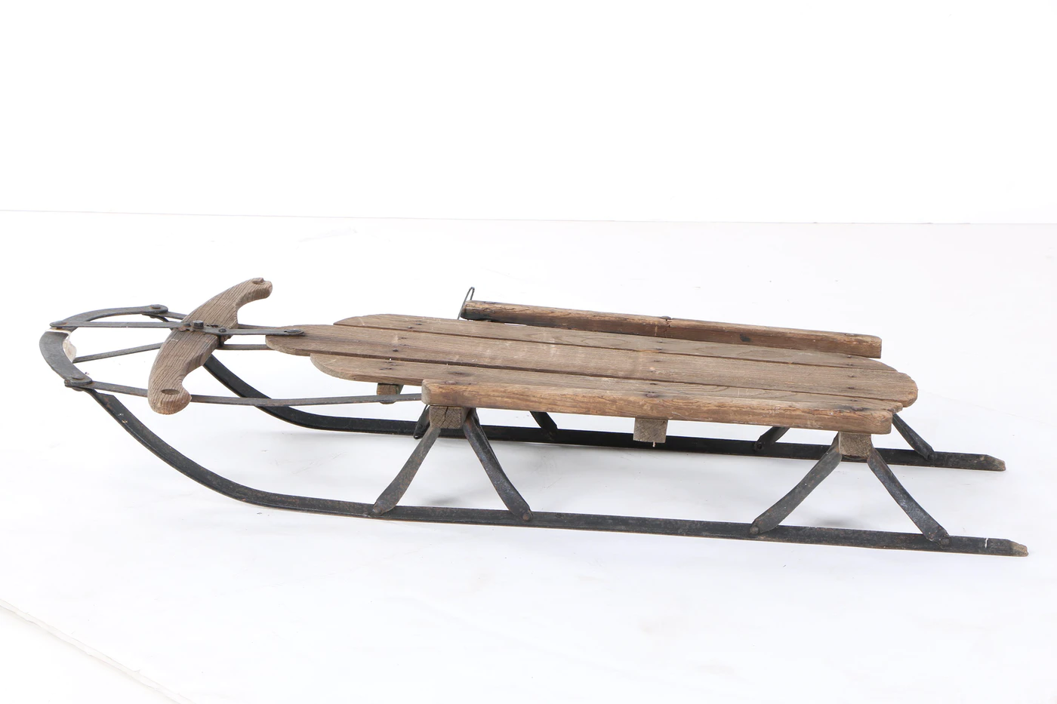
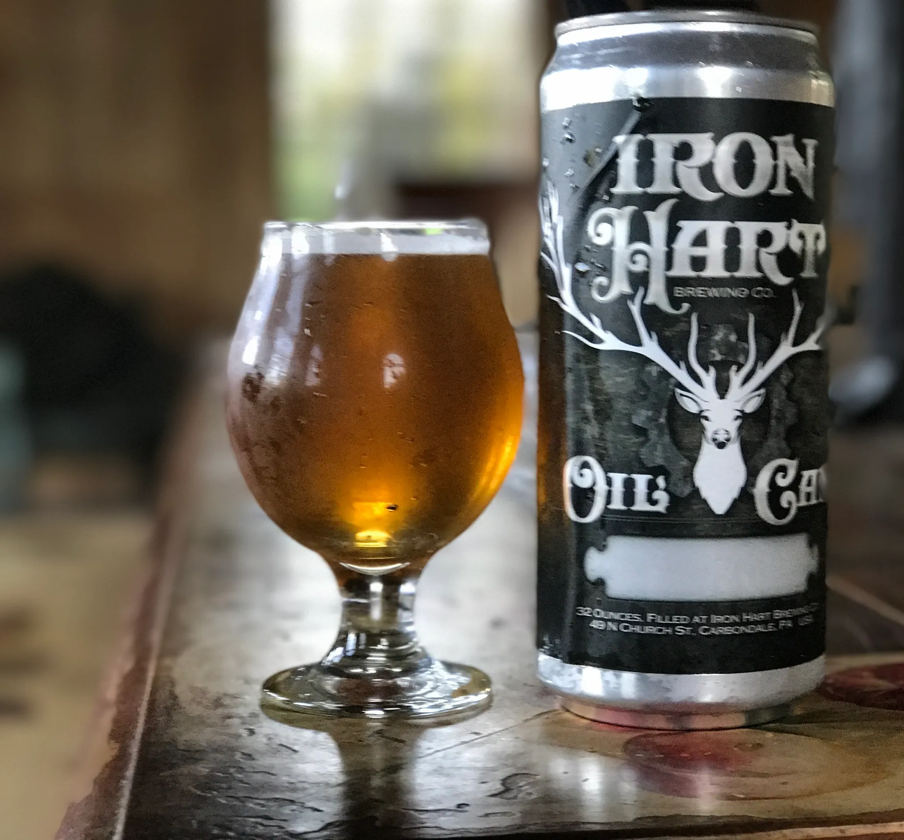
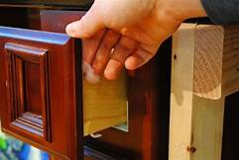
What can we do with beeswax?
Candles
Batik
Pysanki (egg decorating)
Waxed thread
Cheese waxing
Crayons
Boot and furniture polish
Food wraps
Skin and wound care
And much, much more.

Slide 5
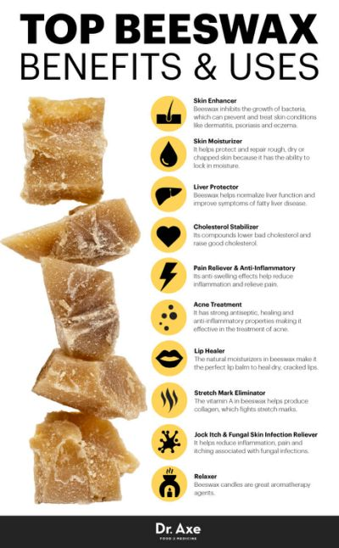
working with beeswax
Use dedicated equipment:
Non-reactive containers: stainless steel, glass, coated ceramic, plastic
Physical and beneficial properties:
All natural
Antibacterial
Antifungal
Humectant/Moisturizing
Edible
Waterproof
Eco-friendly
Never goes bad
Physical properties not hindered by heat:
High resistance to heat but should not be taken above 250°/120°C.
Quick cooling = brittle, pale, cracking
Honey is water soluble; beeswax is oil soluble:
Emulsifying agent/wax
Beeswax is NOT an emulsifying wax

Slide 6
Basic recipes
Lip Balm
3 parts liquid (carrier) oil
1 part beeswax
1 part plant-based butter (shea, cocoa, etc.)*
Vitamin E*
Essential or flavor oil*
*Optional and adjustable
Beeswax Food Wraps
4 parts beeswax*
1 part pine resin*
1 part jojoba oil*
*Adjustable

Slide 7
Basic recipes
Canelés (can-eh-lay)
500 g Milk
50 g Butter
185 g Granulated Sugar
150 g Bread Flour
3 Egg yolks
3 g Salt
1 tsp Vanilla extract
50 g Cognac
- - -
50 g Butter
50 g Beeswax
Full recipe here: Canelés de Bordeaux

Slide 8
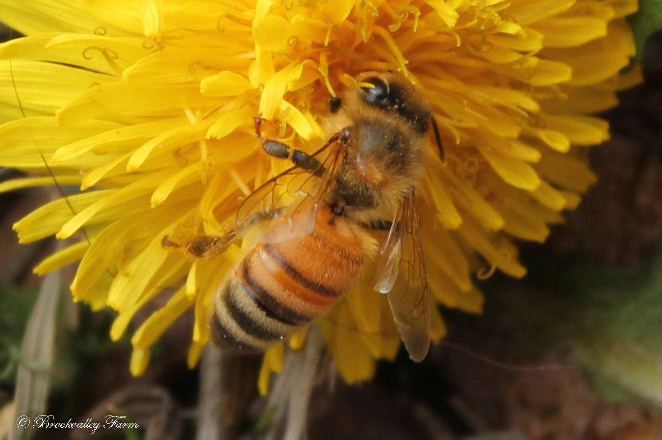
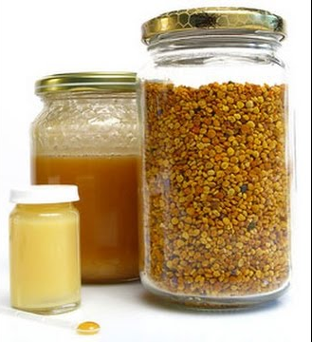
Other Products of the Hive
Propolis
Royal Jelly
Pollen
And one more…
POLLINATION
Uses:
Antioxidant/anti-aging agent, skin and hair health, improved blood health, lower cholesterol, and for treatment of the herpes simplex virus.

Slide 9
Ix. Questions?
About products from the honeybee hive

Slide 10
Resources
Mountain Rose Herbs (Essential oils, carrier oils, butters, herbs & spices, containers, etc.)
Mountain Rose Herbs Blog (recipes, body care, education, etc.)
The BEST Reusable Beeswax Wrap Recipe
Basic Lip Balm
Bulk Apothecary (Essential oils, carrier oils & raw ingredients, butters, herbs, packagain, etc.)
Bulk Apothecary Blog (recipes, product ideas, education, etc.)
Bramble Berry (Essential oils, carrier oils, kits, packaging, molds, etc.)
In the Studio: formerly Soap Queen (blog: recipes, product ideas, education, etc.)
Lye Calculator
Fragrance Calculator
A Farmwife’s Diary
How to Render Beeswax
The Honey Shop
The Effects of Temperature and Time on Beeswax and Honey
Modern Soapmaking’s Essential Oil Calculator (EOCALC)
Soap and More: Oil Properties for Soap
Huntington College of Health Sciences Smart Supplementation: Bee Pollen, Propolis & Royal Jelly

