Slide 1

Creating Stigma-Free Faith Communities
Rev. Amy Brundle, M.Div.
NAMI North Carolina

Slide 2
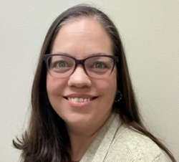
Rev. Amy Brundle, M.Div.
Marketing & Communications Manager, NAMI North Carolina
B.S.B.A. in Marketing from Meredith College
M.Div. in Worship Leadership from Southeastern Baptist Theological Seminary
Served as minister of music for over eight years in Baptist churches
Passion for advocating for mental health and those with mental illness, especially in faith communities
Notes:
Introduce myself, short story of how I discovered my mental illness and what it was like seeking help in the church
Some well meaning people told me I just needed to pray more and be more in tune with the Spirit
Some told me that my connection to Jesus must be weak if I was struggling this much
Some told me that Christians could never have suicidal ideation because Jesus gave them enough joy to endure
But some approached me with kindness and empathy – we’ll talk about how a little later

Slide 3
What is Mental Health?
What do you think of when you hear the words “mental illness”?
What are some stereotypes we think about when we learn someone is mentally ill?
Notes:
Now I want to ask you all where you are in this conversation. We are all coming from an evangelical background, which has had a complicated relationship with topics of mental health and psychology. Let’s explore some of the messaging that we may have heard and internalized when it comes to mental illness.

Slide 4

Mental illness is…
Similar to physical illness – often partially caused by biochemical processes and brain structure
Exacerbated by:
  Genetics
  Lifestyle
  Environmental Factors
  Stress
  Traumatic life events
NOT solely a result of sin or a lack of faith
Notes:
Read slide

Slide 5
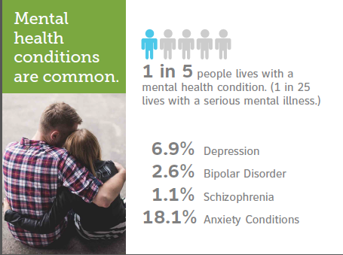
Notes:
A mental illness is a condition that affects a person's thinking, feeling or mood. Such conditions may affect someone's ability to relate to others and function each day. Each person will have different experiences, even people with the same diagnosis.
Depression and anxiety are among the most common mental health conditions. Depression is more than just feeling sad or going through a rough patch. It’s a serious mental health condition that requires understanding, treatment and a good recovery plan. With early detection, diagnosis and a treatment plan consisting of medication, psychotherapy and lifestyle choices, many people get better. But left untreated, depression can be devastating, both for the people who have it and for their families. Some people have only one episode in a lifetime, but for most people depression recurs. Without treatment, episodes may last a few months to several years. People with severe depression can feel so hopeless that they become a risk for suicide.
Bipolar disorder is a chronic mental illness that causes dramatic shifts in a person’s mood, energy and ability to think clearly. People with bipolar have high and low moods, known as mania and depression, which differ from the typical ups and downs most people experience. If left untreated, the symptoms usually get worse. However, with a strong lifestyle that includes self-management and a good treatment plan, many people live well with the condition.
Schizophrenia is a serious mental illness that interferes with a person’s ability to think clearly, manage emotions, make decisions and relate to others. It is a complex, long-term medical illness, affecting about 1% of Americans. Although schizophrenia can occur at any age, the average age of onset tends to be in the late teens to the early 20s for men, and the late 20s to early 30s for women. It is possible to live well with schizophrenia.
You can learn more about these and other mental health conditions, including watching short informational videos, by visiting NAMI.org.
We often think the worst of mental illness because that is sometimes all we have seen, all that we KNOW we have seen—people in the worst of their struggles.
The most important things to remember about mental illness?
They are common.
They are no one’s fault.
Treatment and support are essential for the promise of recovery.
People affected by mental health conditions AND their families need help and hope.

Slide 6
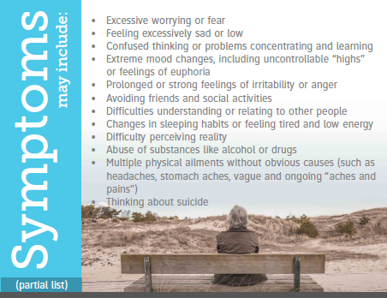
Notes:
I imagine we can agree that everyone experiences wide ranges of sadness and happiness, elation and sorrow throughout their life. Mental and emotional swings are simply part of being human. Mental health conditions are more than this.
So, how do we know when we or someone we know might be experiencing a mental health condition that may need an intervention and treatment?
Here is a partial list.
[READ SOME from the slide]
Though we shouldn’t try to diagnose anyone, it is helpful to know some of the Red Flags to watch for. It is important to learn more about the warning signs and what to do if you are concerned.
I encourage you to learn more by visiting NAMI.org.

Slide 7

The bible says…
John 9:1-3 – “As He went along, He saw a man blind from birth. His disciples asked Him, ‘Rabbi, who sinned, this man or his parents, that He was born blind?’ ‘Neither this man nor his parents sinned,’ said Jesus, ‘but this happened so that the works of God might be displayed in him.’”
Notes:
Read passage
Let’s be clear – sin’s effect on the world has corrupted everything, including our bodies and minds. We would not have illness if the world wasn’t struggling under the effects of sin and death. The Bible makes clear, too, that unrepentant sin can lead to further corruption this side of heaven. But what this passage shows us is that mental illness is not God’s direct punishment for sin, just as this man’s blindness wasn’t punishment for his or his family’s sin. All of creation labors for a new beginning, including our physical forms. And we were created to be mind, body, and spirit, fully connected.

Slide 8
Holistic Healing
Mind
Body
Spirit
Notes:
We were created to be fully connected as mind, body, and spirit. In denying that there are often physical causes and symptoms of mental illness, we are not able to treat the illness fully. Faith is a huge part of mental health, and those of us that follow Christ know that a full and engaged connection with the Holy Spirit is vital to our joy and our quality of life. However, in many cases, the church and its leaders, when confronted with someone with mental illness, assume that the spirit is the only part that needs healing.
If we are fully mind, body, and spirit, then each of these parts of us needs to be made whole. Recognizing this will help us counsel people in our congregations in a more holistic way. Sometimes Christians suffering from mental illness need to treat the body before they are in the right place to tackle their issues with faith, self-awareness, trauma, etc.

Slide 9

How to build a Stigma-Free Church
Notes:
So how can we be part of the solution and not part of the problem? We commit to becoming a stigma-free church – where those with mental illness are accepted, loved, encouraged, and supported through their recovery journey.
How do we do that?

Slide 10

What NOT to do
Notes:
Let’s brainstorm some things we should avoid doing when learning that someone has a mental illness.
(Wait for ideas)

Slide 11

What we SHOULD do
Reach out!
Ease into conversations gradually, and understand that the person is not in a place to talk. Just greeting them and extending kindness can go a long way.
Offer support!
Connect them to help if you feel they need it. Ask how you can help them. If appropriate, as to pray for them or with them. Let them know that you see them, and that you are there for them.
Notes:
Read slide

Slide 12
What we SHOULD do
Take steps to be welcoming
Keep in mind that the person living with mental illness is a PERSON first.
Check in with them or their family.
Ask them what would be the most helpful.
Invite the family to sit with you at church events.
Make an effort to talk with them and show that you care.
Offer to pray with them and for them.
Offer a place to belong, like a community group or Bible study.
Offer to cook a meal, run an errand or complete a helpful task.
Plan a home visit.
Learn about mental health.
Convey a message of acceptance and compassion.
Notes:
Read slide

Slide 13

Ideas for the church
Notes:
There are things that the church as a whole can do to help minister to those with mental illness:
Establish a counseling ministry
Create a culture around favoring helpful language (not calling people crazy or unstable, not diminishing their experiences, etc)
Establish a part of your budget to help people needing help paying for therapy or treatment
Invite experts to come speak about mental health issues
Participate in community activities (NAMIWalks, etc.)
What are some other ideas?
Resolve to
(Wait for ideas)

Slide 14
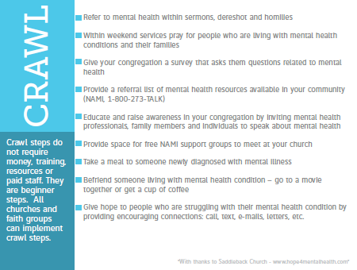
Notes:
Here are some of the suggestions for CRAWLING.
[READ SOME]
You can see too here the reference on the web where you can go to learn more. Hope4mentalhealth.com. This is also available via a link, along with other resources, from NAMI’s FaithNet page, NAMI.org/faithnet.

Slide 15
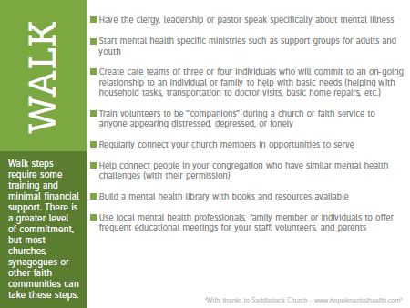
Notes:
And for those faith communities deciding they want to take it up a notch, here are some suggestions for WALKING. These may take a greater level of commitment.
[READ SOME. PAUSE FOR QUESTIONS.]

Slide 16
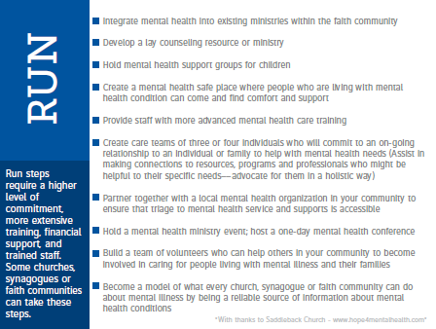
Notes:
And the third stage of suggestions would require a higher level of commitment, even some resources perhaps.
[READ SOME. PAUSE FOR QUESTIONS.]

Slide 17
Thank you!
abrundle@naminc.org
919.235.4742
www.naminc.org
Notes:
Thank you so much for having me? Any questions?

