Slide 1
Common Orthopedic shoulder problems Do I have a problem or not, doc?!
Dr. Grant Padley
Orthopedic Surgery and sports Medicine
TOCA at Banner Health

Slide 2
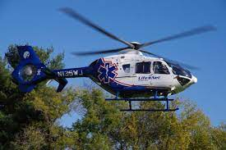
Orthopedic Shoulder problems
TOCA at Banner Health
70+ years in the Valley
All sub-specialties available
My Background
Topics covered
Impingement problems
Adhesive capsulitis
Rotator cuff tears
Arthritis

Slide 3
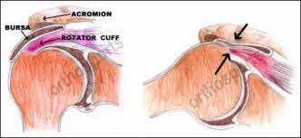
Shoulder impingement
When you raise your arm to shoulder height, the space between the acromion and rotator cuff narrows. The acromion can rub against (or impinge on) the tendon and the bursa, causing irritation and pain.

Slide 4
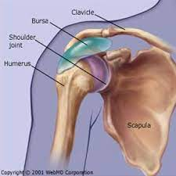
Shoulder Impingement
Tendinitis
The rotator cuff tendons can be irritated or damaged.
Bursitis
The bursa can become inflamed and swell with more fluid causing pain.

Slide 5
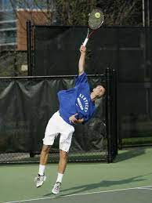
Shoulder Impingement
Beginning symptoms may be mild. Patients frequently do not seek treatment at an early stage.
These symptoms may include:
Minor pain that is present both with activity and at rest
Pain radiating from the front of the shoulder to the side of the arm
Sudden pain with lifting and reaching movements
Athletes in overhead sports may have pain when throwing a ball or serving a tennis ball

Slide 6
Shoulder Impingement
As the problem progresses, the symptoms increase:
Pain at night
Loss of strength and motion
Difficulty doing activities that place the arm behind the back, such as buttoning or zippering

Slide 7
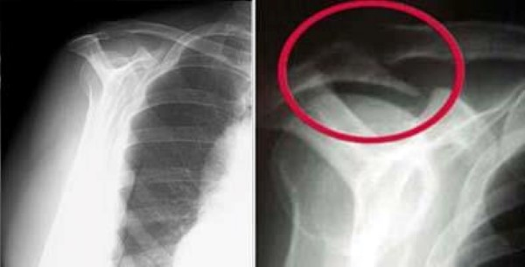
Shoulder Impingement evaluation and treatment
Physical exam
Xrays
Occasionally an MRI
Treatment
Activity modification
PT or HEP
NSAIDS
“cortisone” injection
Surgery (~20% of the time)

Slide 8
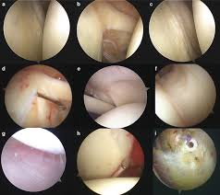
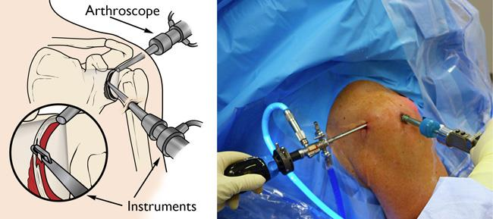
Shoulder impingement: Surgical treatment
Shoulder arthroscopy
Decompression
Debridement
Repair indicated structures
Rehab is dependent on what is done at time of surgery

Slide 9
“Frozen shoulder” Adhesive capsulitis
In frozen shoulder, the shoulder capsule thickens and becomes stiff and tight. Thick bands of tissue — called adhesions — develop. In many cases, there is less synovial fluid in the joint.
The hallmark signs of this condition are severe pain and being unable to move your shoulder -- either on your own or with the help of someone else.

Slide 10
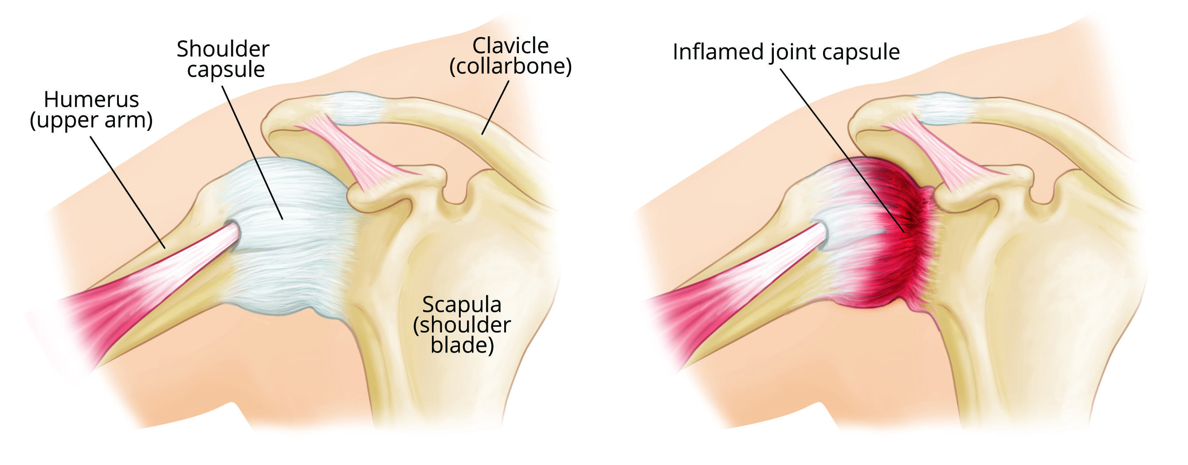
Adhesive Capsulitis
3 Phases of the disease
Freezing
Frozen
Thawing

Slide 11
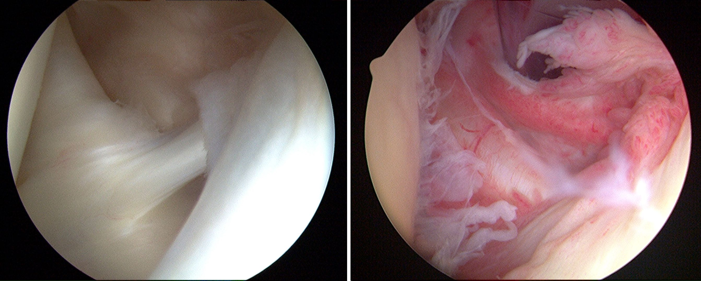
Adhesive Capsulitis
Causes
Unknown
Endocrine prevalence
Diabetes
Thyroid disorders
Immobilization
Evaluation
Clinical diagnosis
Xray
Occasionally an MRI

Slide 12
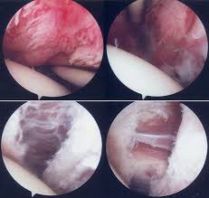
Treatment -Non-surgical is the standard -FORMAL PT -NSAIDS -IN the JOINT corticosteroid injection -Can take up to 12 months to regain normal motion -Surgical -Shoulder arthroscopy with capsular release, lysis of adhesions and MUA -AGGRESSIVE formal PT to maintain motion
Adhesive capsulitis

Slide 13
Rotator Cuff Tear
What is the rotator cuff and what does it do?
The rotator cuff is a group of four muscles that come together as tendons to form a "cuff" over the head of the humerus (upper arm bone). The four muscles—supraspinatus, infraspinatus, subscapularis and teres minor—originate from the scapula (shoulder blade). The rotator cuff tendons attach to the head of the humerus in special spots referred to as the greater and lesser tuberosities.
The rotator cuff helps to lift and rotate the arm and to stabilize the ball of the shoulder within the joint.

Slide 14
What will I feel if I have a cuff tear?
-A rotator cuff tear may result from an acute injury
-Normal age-related wear and tear with degeneration of the tendon.
SYMPTOMS:
-Pain in the front of your shoulder that radiates down the side of your arm to the deltoid area.
-Overhead activities such as lifting or reaching
-Nighttime pain
-Weakness of your arm and difficulty with routine activities such as combing your hair or reaching behind your back.

Slide 16
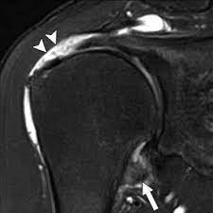
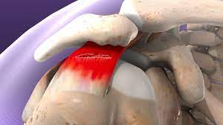
Tear Types
Partial tears
Full thickness tears
Typically treated non-operatively
Progress to surgery based on function and symptoms, not the piece of paper! (MRI report)
Typically treated with surgery
Caution with irreparable tears
Caution with arthritis

Slide 23
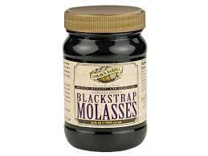
Rotator cuff surgery rehab
Lengthy!
“Typical rehab”
4-6 weeks in a sling
4-6 months of FORMAL physical therapy
No golf/pickle ball for at least 4 months
Improvement in function the first 12 months

Slide 24
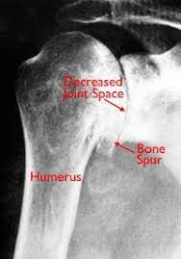
Shoulder osteoarthritis
Osteoarthritis
“wear and tear”
Rheumatoid Arthritis
Post-traumatic arthritis
Arthritis that develops after a trauma
Rotator cuff arthropathy
Develops from an irreparable RTC tear
Avascular necrosis

Slide 25
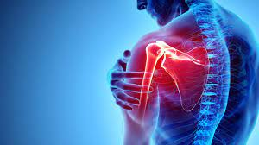
Shoulder osteoarthritis
Symptoms
Decreased ROM
PAIN
Deep, tooth achy type of pain
Crepitus (grinding noise)

Slide 26
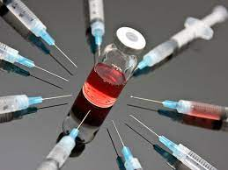
Shoulder osteoarthritis
Non-surgical treatment
Activity modification
Dietary supplements
NSAIDS
PT
Injection
Corticosteroid, PRP?, Stem cell?

Slide 27
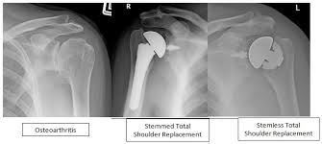
Shoulder osteoarthritis
Surgical treatment
Shoulder arthroscopy
Very limited indications
Total shoulder replacement
Requires an intact RTC

Slide 28
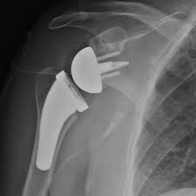
Shoulder osteoarthritis
Reverse total shoulder replacement
Ball becomes the socket, and the socket becomes the ball
Makes the deltoid work more efficiently
No RTC required

Slide 29
Shoulder Osteoarthritis
Rehabilitation
Total shoulder
Based on the RTC repair healing
Typically, 4-6 months of PT
Reverse Total shoulder
No RTC repair to heal
PT is usually quicker at 3-4 months

Slide 30
Key take a ways:
Not all “tears” require surgery
Most shoulder issues can resolve with conservative treatment
Overuse injuries with significant pain and limited ROM should be evaluated with in 3-4 weeks
Acute injuries should be evaluated with in a week

Slide 31
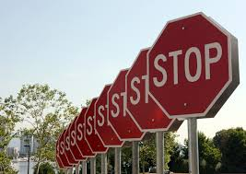
How do you avoid seeing me?!
STRETCH before you play
Do shoulder “maintenance exercises”
https://orthoinfo.aaos.org/globalassets/pdfs/2017-rehab_shoulder.pdf
Do not ignore your chronic shoulder issues or acute injuries
Address the entire kinetic chain
Utilize a holistic approach including good dietary habits and supplements
“Joint juice”, turmeric, etc…

Slide 32
Thoughts or Questions!?

