Slide 1

WELCOME TO THEOSOPHICAL SOCIETY; SECUNDERABAD LODGE
CHARTERED ON 25-1-1882
FOUNDED BY COL HENRY STEELE OLCOTT

Slide 2
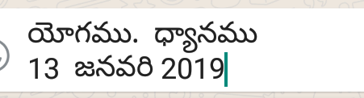

Slide 3


Slide 4
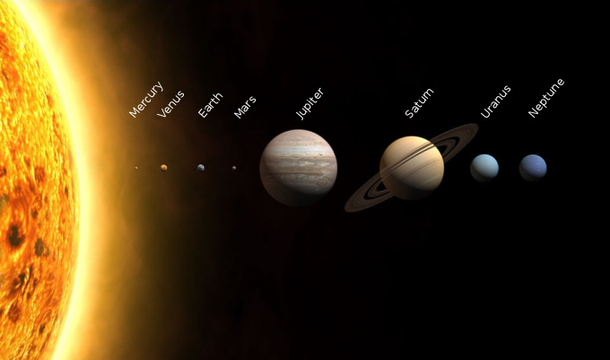


Slide 5
We are facing a tremendous crisis; a crisis which politicians can never solve because they are programmed to think in a particular way – nor can the scientists understand or solve the crisis; nor yet the business world, the world of money. The turning point, the perceptive decision, the challenge, is not in politics, in religion, in the scientific world, it is in our consciousness. One has to understand the consciousness of mankind, which has brought us to this point. One has to be very serious about this matter because we are really facing something very dangerous in the world – where there is the proliferation of the atomic bomb which some lunatic will turn on. We all must be aware of all this.”

Slide 6
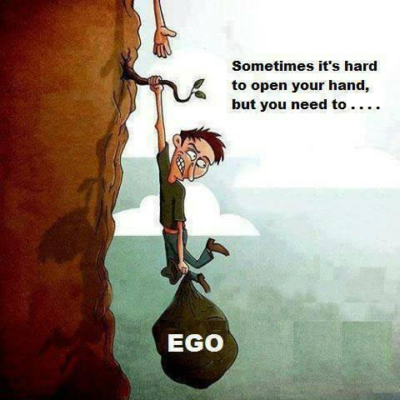

Slide 7
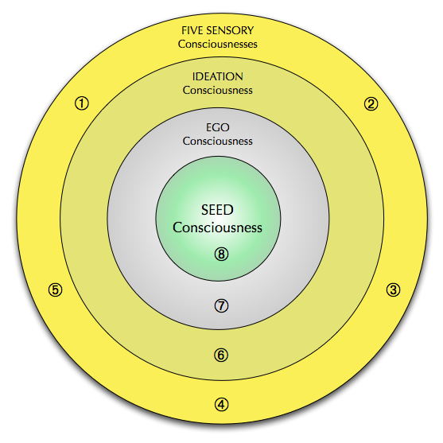

Slide 9
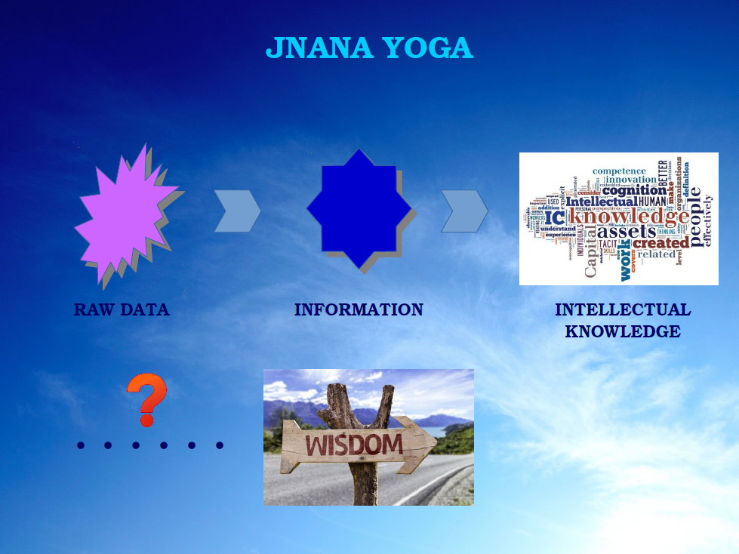

Slide 10
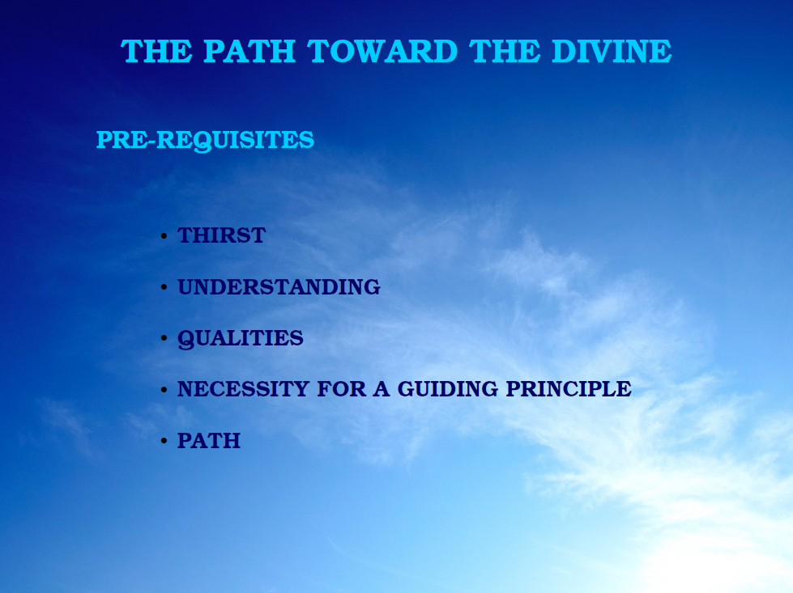

Slide 11
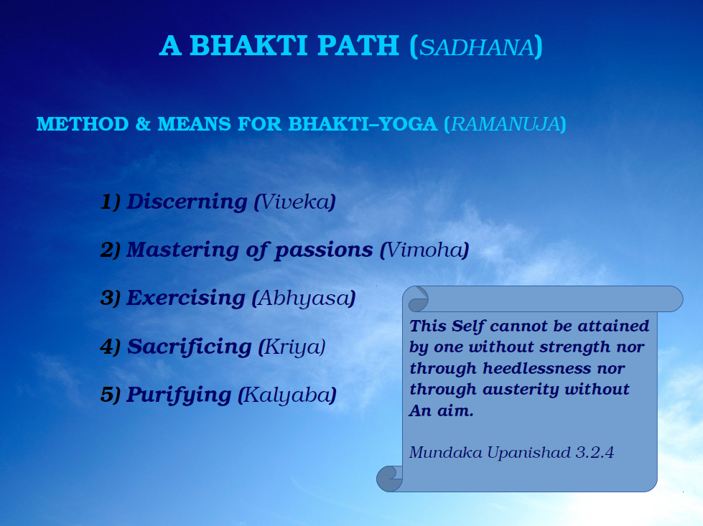

Slide 12
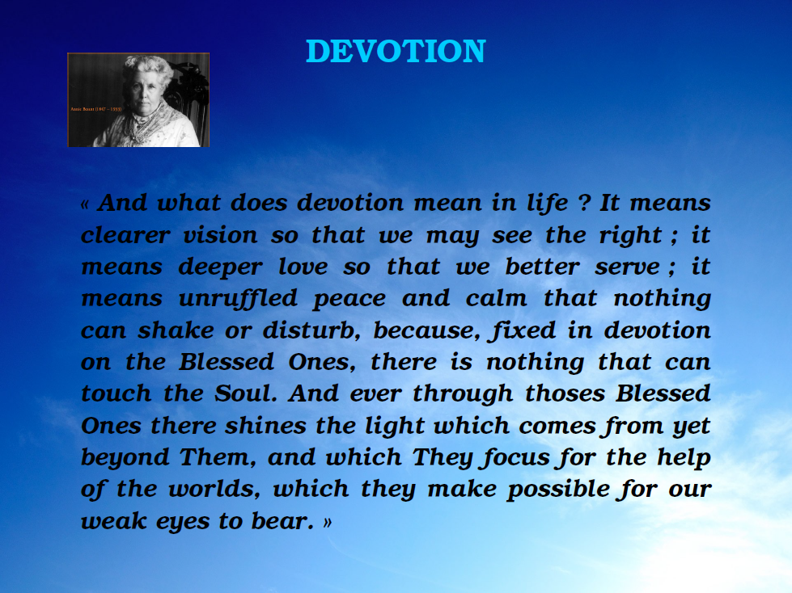

Slide 13
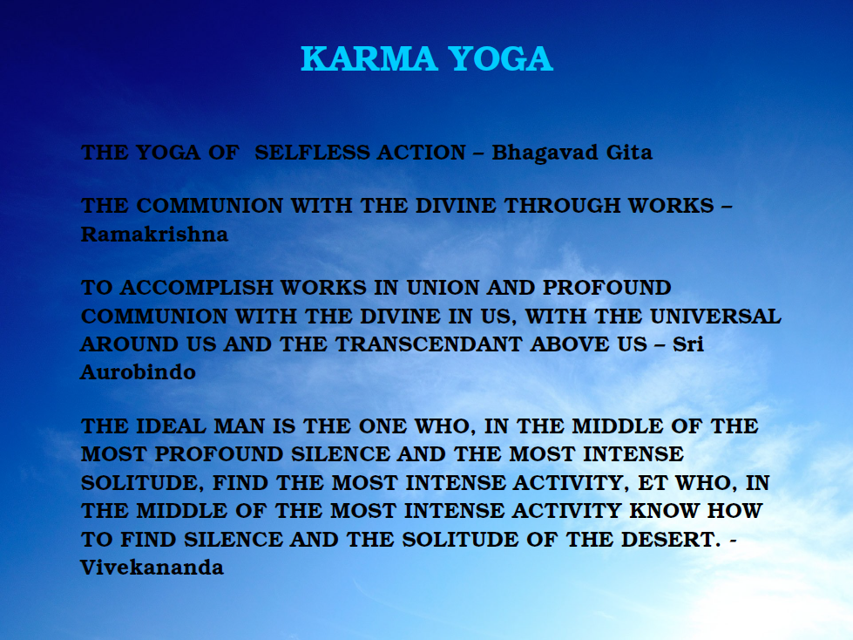

Slide 14
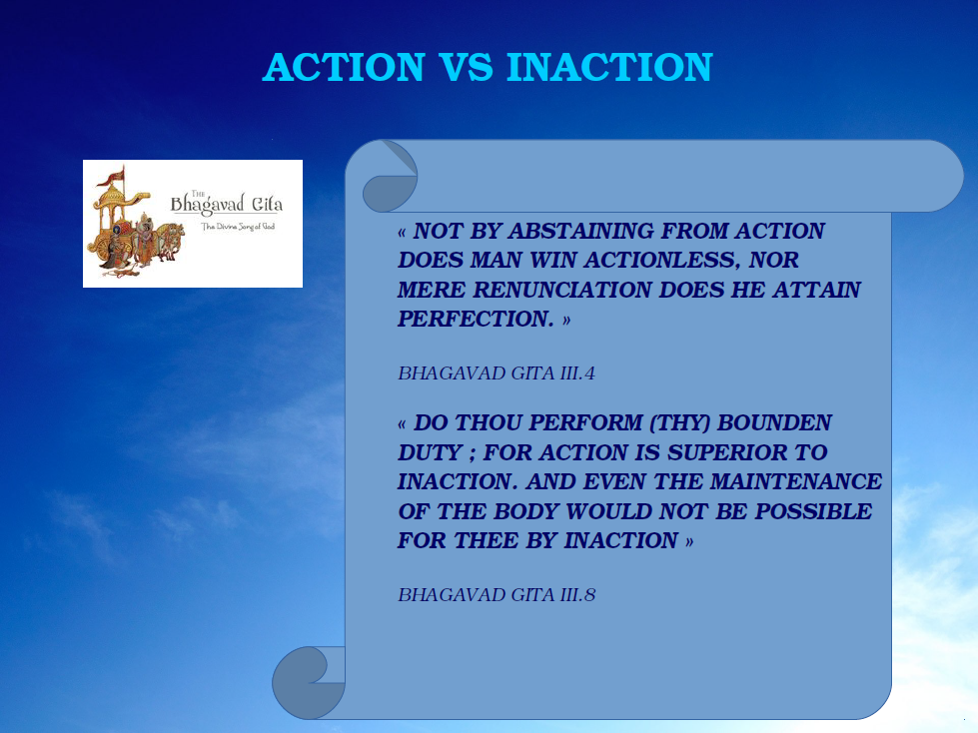

Slide 15
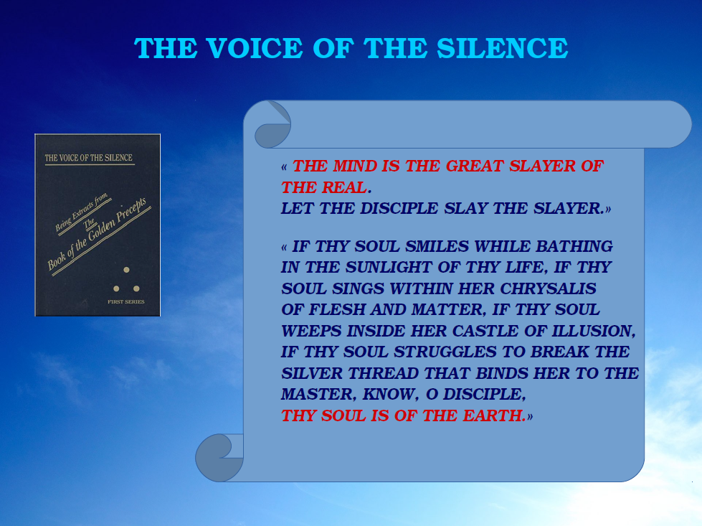

Slide 16


Slide 17
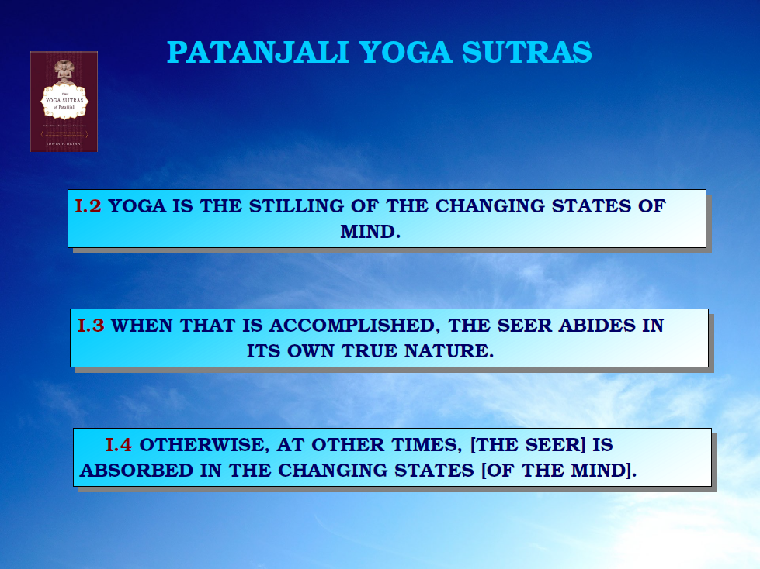

Slide 18
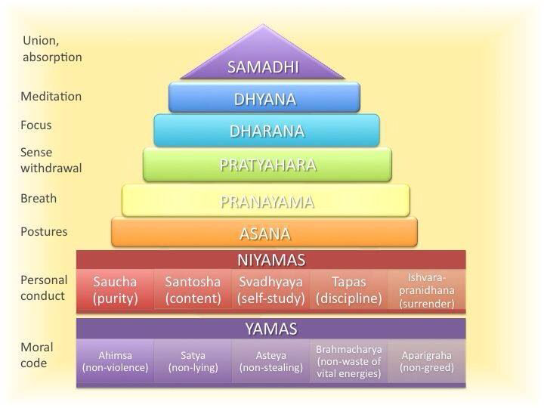

Slide 19
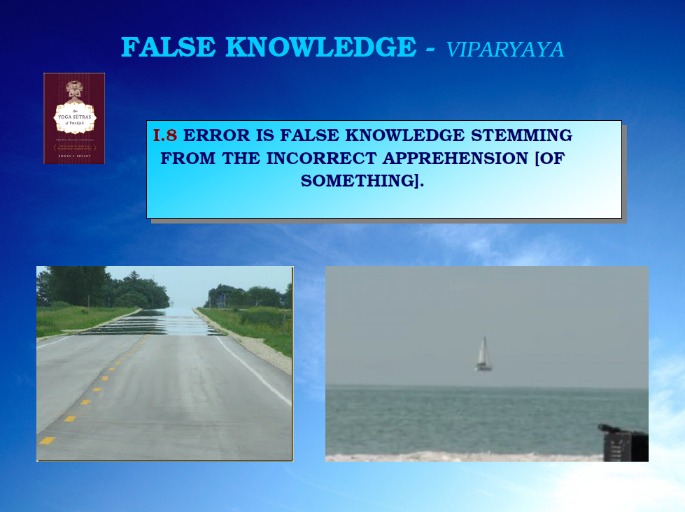

Slide 20
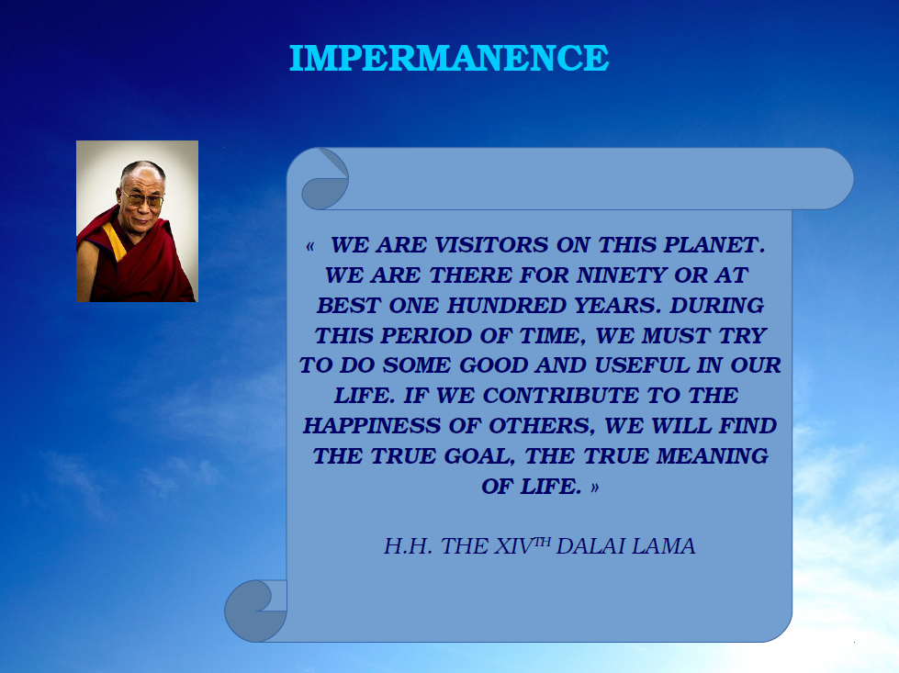

Slide 21
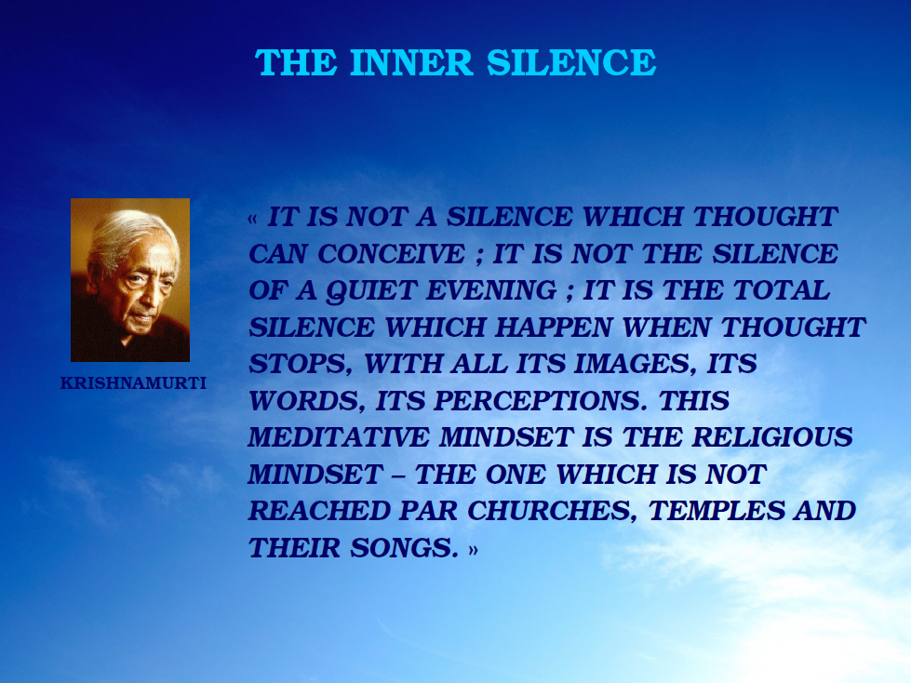

Slide 22
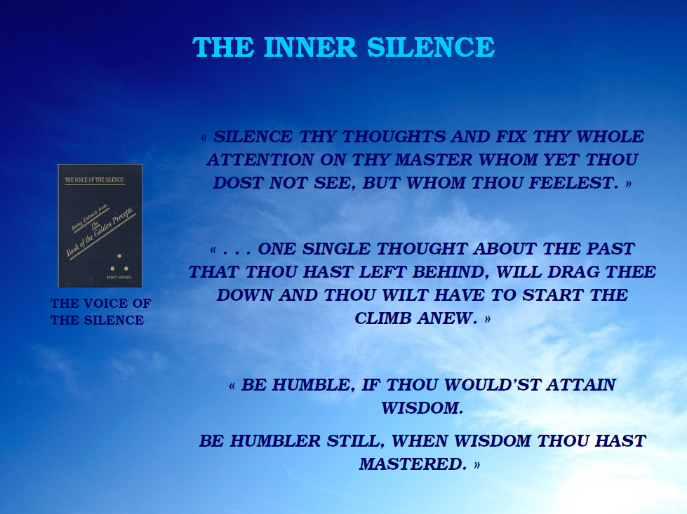

Slide 23
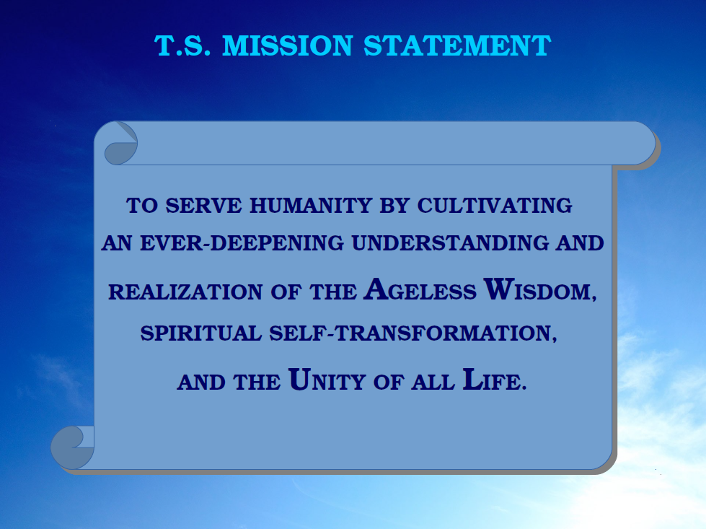

Slide 24
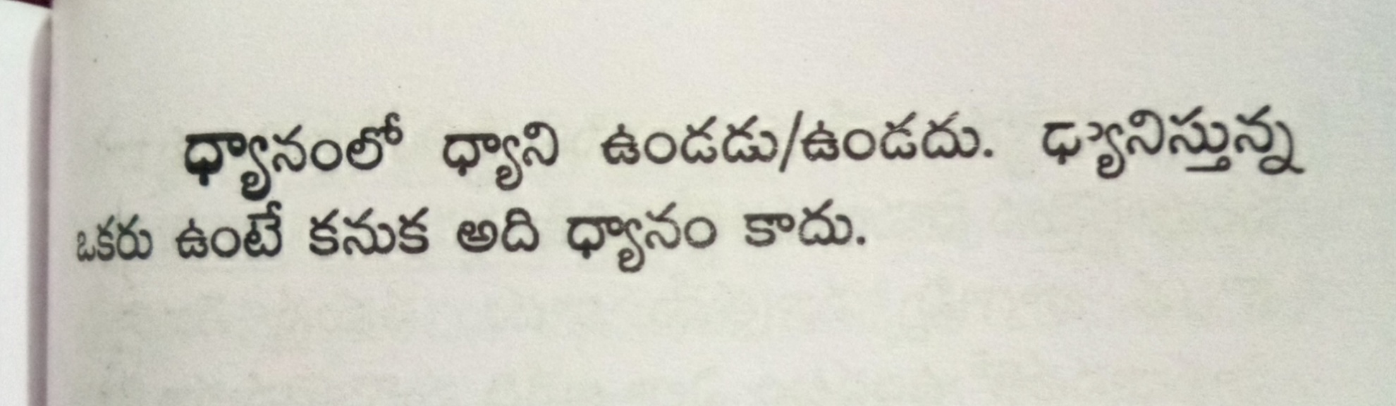

Slide 25
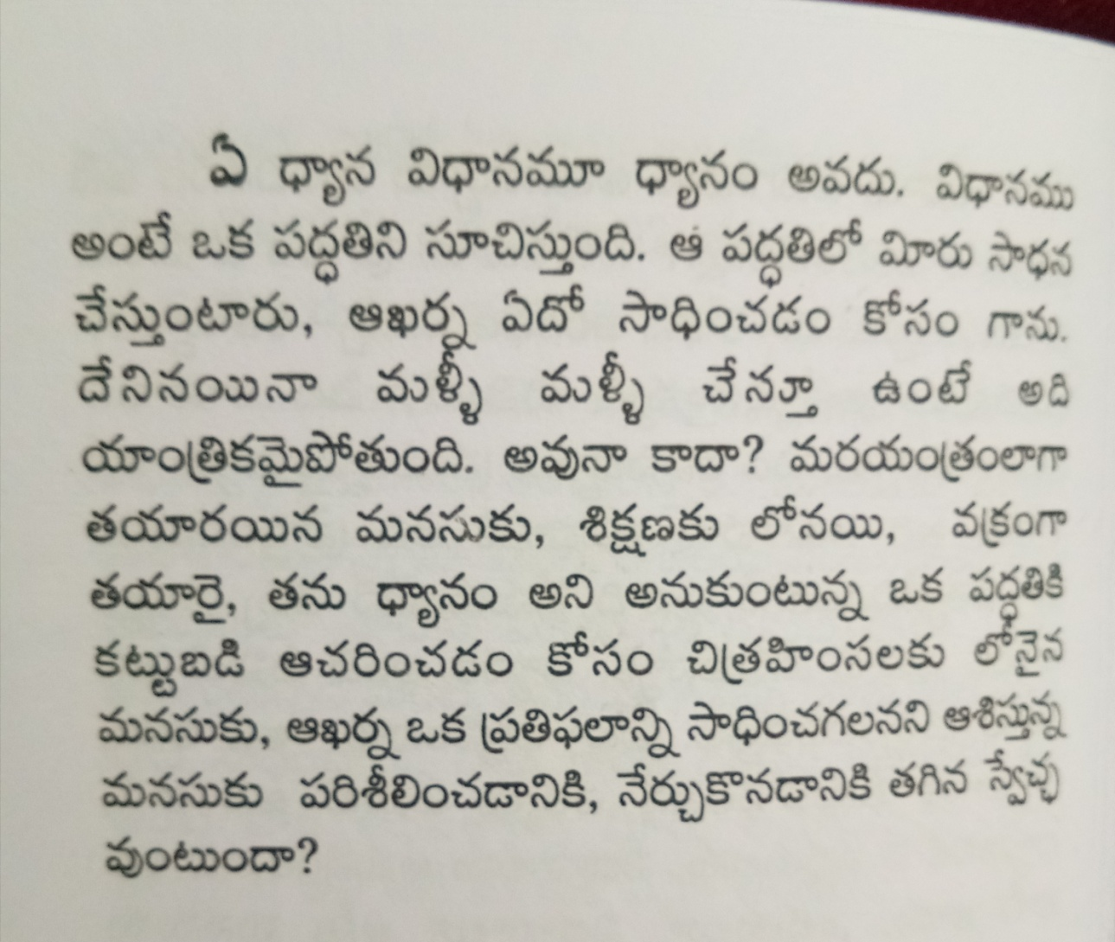

Slide 26
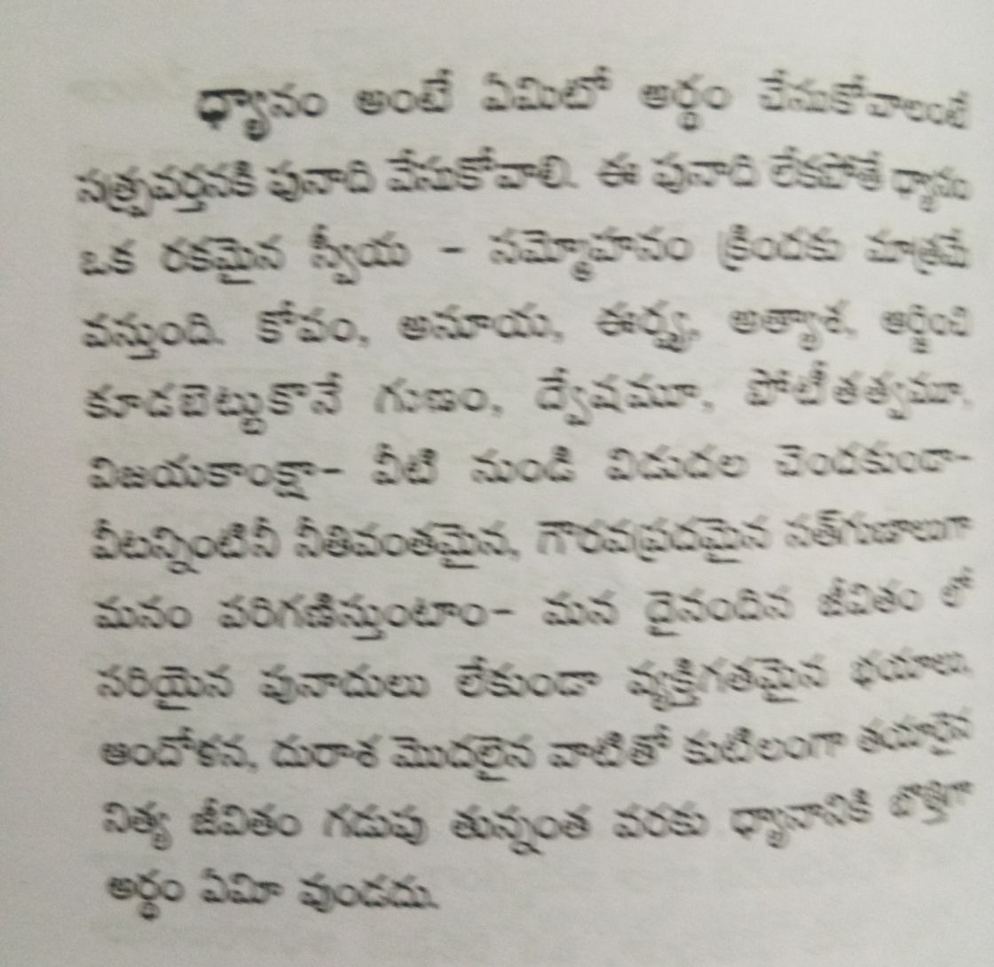

Slide 27
THANK YOU VERY MUCH TO ALL PARTICIPANTS
FOR MAKING THIS EVENT A USEFUL FOR HUMANITY AT LARGE

