Slide 1

Gut Health
Why is it Important?

Slide 2

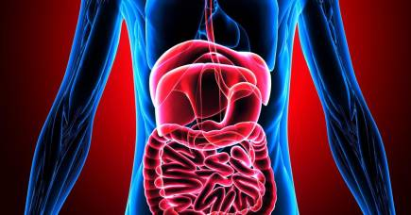
What are some Symptoms of Poor Gut Health?
Bloating or gassy after meals
Bowel Movements per day/Consistency
Fatigue after meals
Rashes or Acne that just won’t go away
Heartburn or acid reflux
Leaky gut
Unexplained sugar cravings

Slide 3

Common Questions
How Many Bowel Movements should I have a day?
Is it normal to have acid reflux as you get older?
Is it normal to not want to eat much protein as you get older?
Is it Normal to be Fatigued after Meals?
Is it Normal to get headaches between meals?

Slide 4
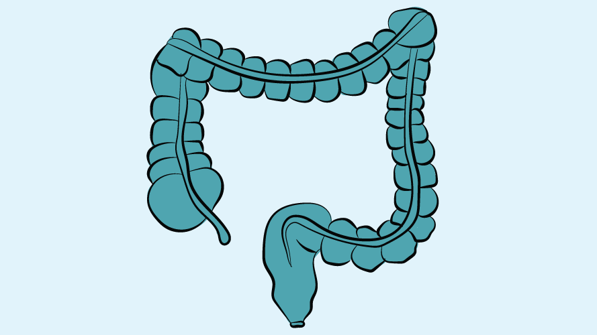
Bowel Movements
While not everyone’s favorite topic it is important:
Are stools loose or hard, greasy or dry, do they float or sink, what color are they? How often do you get a bowel movement and are they consistent?
So why all these questions?
  If your stool floats you are not absorbing your dietary fats
  Stool should be a light-medium brown color
  Should have 2-3 bowel movements per day (less is usually one of three issues Magnesium, Water, or Fiber)
  If stool changes from constipated to diarrhea you likely have a parasitic infection!!

Slide 5
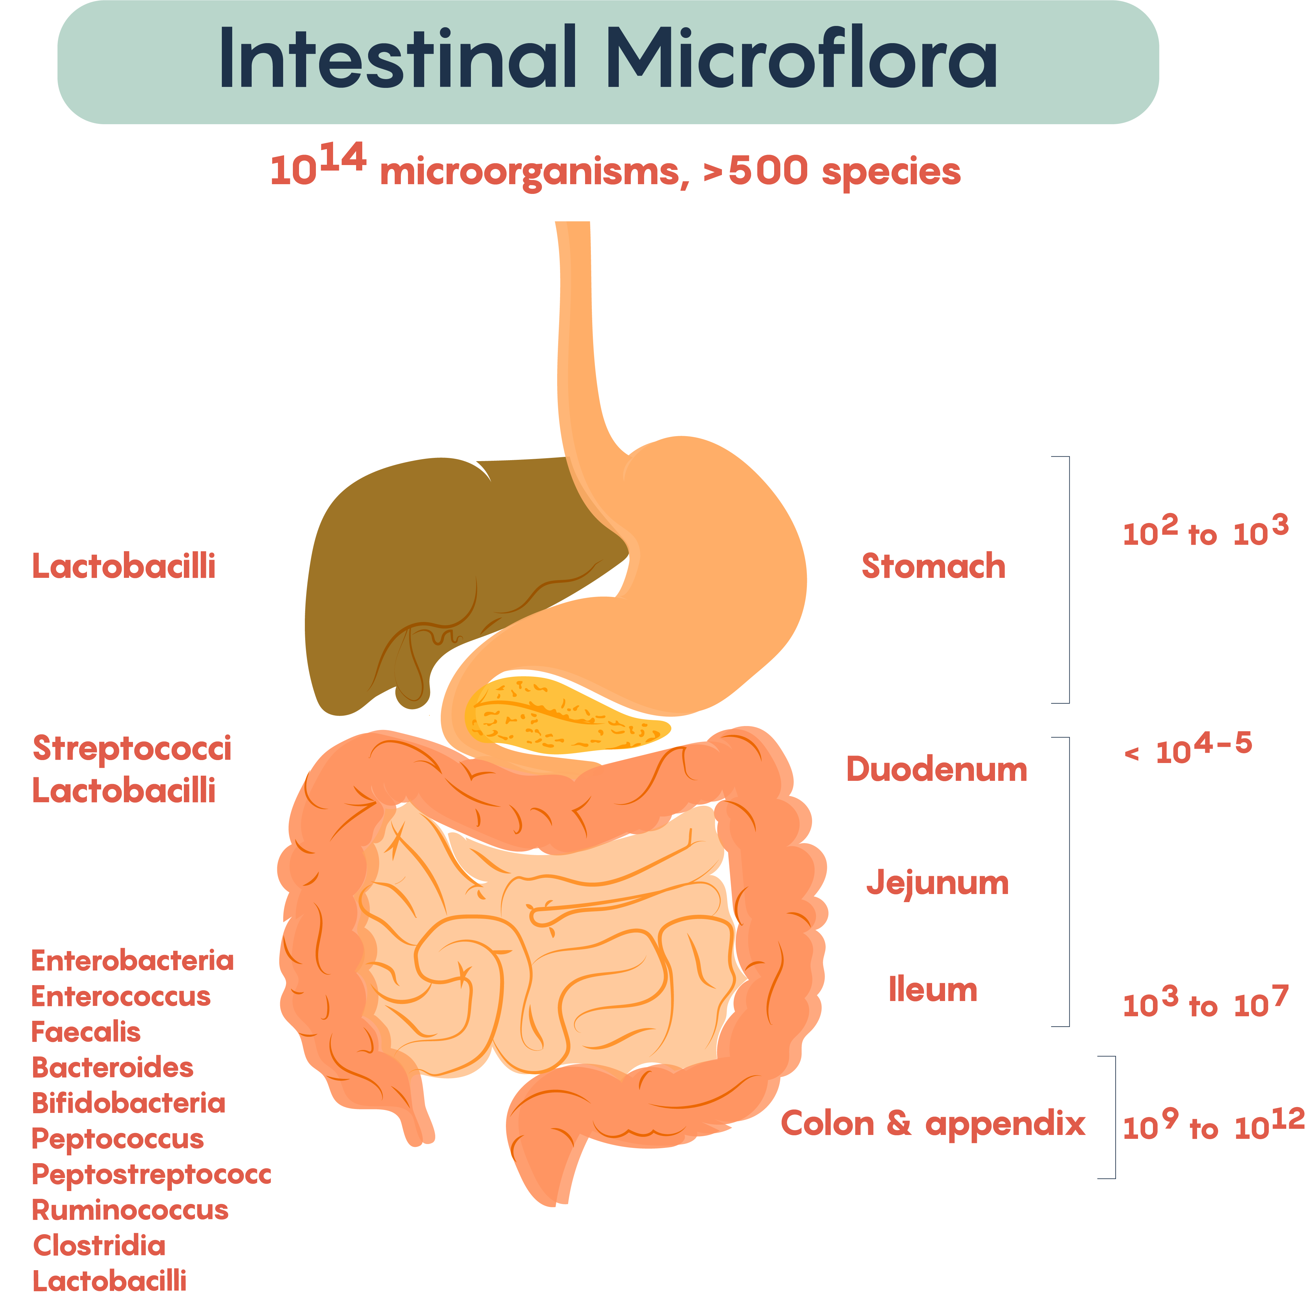
Bloated or Gassy
This often is a sign of a Gut Dysbiosis where your gut microflora is out of balance.
treatment with herbal remedies or antibiotic to clear dysbiosis
Aloe Vera and certain proteins to help heal the gut lining
a good probiotic to regulate normal gut health

Slide 6
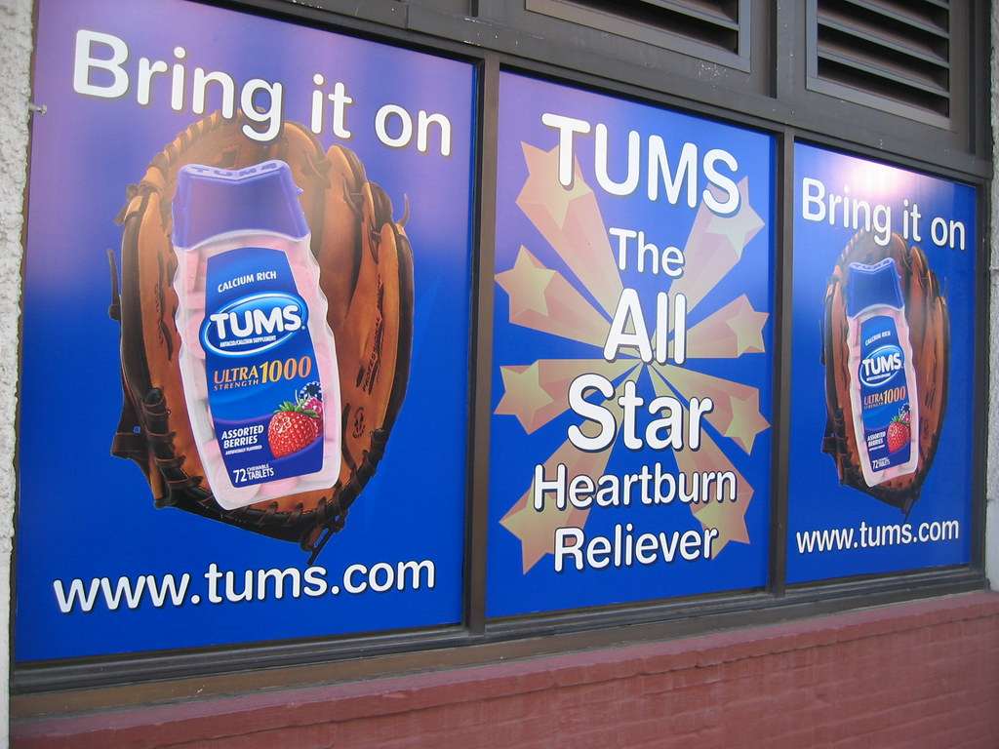
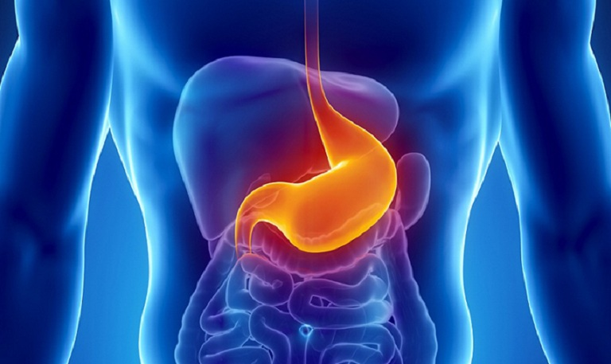
Acid Reflux
The evil of tums
What we really need (more Betaine HCL)
Elderly connection

Slide 7

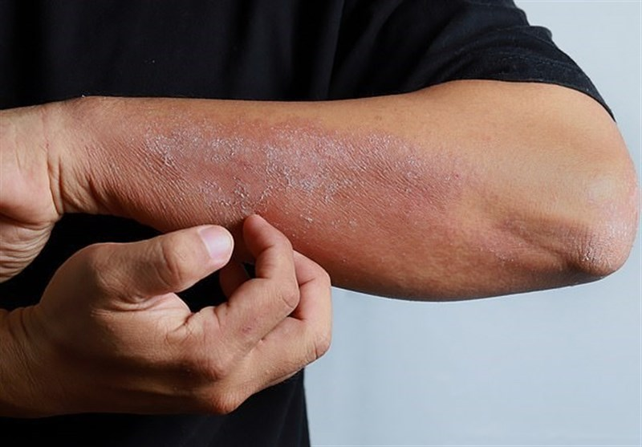

Rashes/Acne
Your skin is a reflection of your health and well being
If you body is trying to get rid of toxins it will usually show it on the skin
Food Sensitivities: M/C Gluten and Dairy

Slide 8
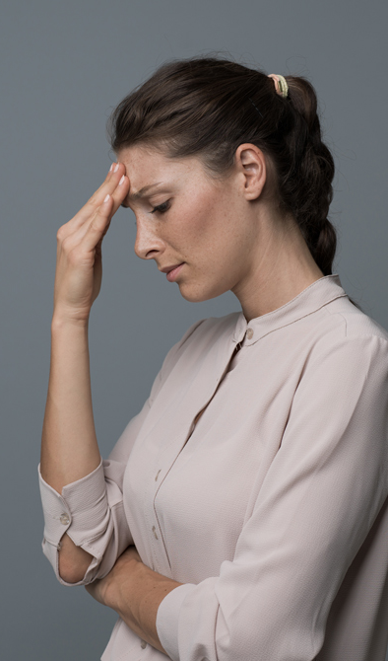
Headaches/Fatigue
5 Main Nutritional Causes:
  Water
  Magnesium
  Iron
  Blood Sugar Handing issues
  Mineral Imbalances

Slide 9
How to promote Good Gut Health
Eating a balanced diet
Monitoring mineral balance
Cooking food thoroughly and freezing meats to avoid infection
Well sourced foods

Slide 10
What if I have Gut Issues?
Try some of the remedies mentioned previously in the PowerPoint
Change your diet and that will change your life

Slide 11
How can I help?
Applied Kinesiology
Herbal Remedies
Chiropractic
Genova Stool Effects Testing

Slide 12
Questions?
Dr. Paul Parrish
Contact Me at: 636-207-6600 parrishchirofunctionalhealth@gmail.com

