Slide 1
Establish Process Governance
Assigning Process Sponsor, Process Owners, Process Managers and establishing a Process Manager Technical Review Council (PMTRC) and Process Owner Architecture Council (POAC)
Thorsten Manthey| Process Governance| Email: Thorsten@tmanthey.com

Slide 2
Establishing Process Governance
How do we define Process & Service Governance?
The organizational structures that need to be put in place, the roles that need to be assigned, responsibilities and accountabilities for each role and the meetings and council to be established in order to operate and govern the IT Services and IT Processes within the IT organization.
The “IT Process Management and Governance Guide” describe the detailed concepts how this is to be accomplished.

Slide 3
What Is Process Governance?
Process Governance IS:
Defining how to operate within the IT organization
Process Sponsor, Process Owner and Process Manager assigned
Reporting structures are in place
Escalation paths have been established
Roles have been identified and assigned
Accountabilities and Responsibilities identified for each role
Meetings and Councils have been established
Process Governance IS NOT:
Organizational HR staffing activities
Day-to-day detailed process execution
A substitute for good management judgment

Slide 4
Establishing Process Governance
Why is Process Governance Important? It provides for …
Clear Ownership of and Accountability for a Process
Clearly defined Roles and Responsibilities
Consistent Execution of a single process across the organization and between our Partners/Vendors
Established Escalation paths to enable speedy and fair resolution
Continuous Strategic and long term Process and IT Service Management
Control over the processes that provide IT Managers with improved levels of control over their IT environment
An opportunity to put ITSM-oriented organizations in a more advanced position to align with IT and business priorities, objectives, and standards

Slide 5
Establishing Process Governance
Roles, Responsibilities and accountabilities?
We need to establish Process Governance to manage, execute and improve our IT processes
Assigning these Roles is imperative for successful Process Governance
Process Sponsor
Process Owner
Process Manager
Process Subject Matter experts

Slide 6
Process Sponsor
The Process Sponsor is a thought leader and defines the IT Service Management vision and strategy and is accountable for the delivery of business value through IT Service Management.
Accountable for the overall performance and results of all IT Service Management process.
Ensure all process roles are assigned have enough time and the right skills to execute their role.
Ensures a smooth on-boarding/off-boarding of a process to/from the Process Governance model
Expected to resolve conflicts over priorities and resources of strategic IT Service Management issues.
Escalation points for Process Owners when required.
Hosts the Process Owner and Architecture Council (POAC) meeting.
Thought Leader & Business value

Slide 7
Process Owner
Accountable for the strategic direction and long term goal of the process
Set short term (12-month rolling) and long term (3 years) process goals
Define current maturity baseline and future process maturity level to be reached
Accountable for the overall performance and results of the process
Set performance goals (SLAs, process output, quality metrics, CSF, KPI)
Define schedule for process maturity assessments (baseline is critical)
Define schedule for process audits (Compliance and execution)
Responsible to define process scope, goals and policies
Define organizational and technical scope of the process (Who and what should be included in the execution scope of the process)
Process specification, documentation and design, define clear Process goals (SMART) and Policies
Accountable to ensure support and commitment of resources
Ensure funds ($), resources (people), vendor relationship (partners) and tools (product) are made available to enable efficient and effective process execution
Assisting the Process Manager
Ensures that a Process Manager can perform his/her responsibilities and the day-to-day execution, monitoring, reporting etc. and is empowered to execute the process
Ensures all process changes and improvements are communicated to the impacted stakeholders
Accountability & Authority

Slide 8
Process Owner
Each process must have only one identified Process Owner
The individual appointed by management who has the accountability and authority for ensuring that the process is effective, efficient, and adaptable.
Accountability
Authority
The Process Owner assumes these duties to his or her ongoing functional or operational duties.
The Process Owner is accountable for the entire process, but does not replace the managers of departments containing one or more process components.
Notes:
nothing

Slide 9
Process Manager Responsibilities
Responsible for planning and coordination of all tactical and operational activities required to carry out, monitor and report on the process
Day-to-day execution, monitors and measures the quality and content of the delivery and output of the process
Responsible for the process / procedure definition, development, documentation, implementation, execution and improvement
Documents the process / procedures according to the ITSM standards and guidelines
Continually improves the process
Custodian of process related documentation and training material and makes sure the process information is published and communicated
Develop and communicate training material for the process; performs training sessions
Store process, procedures, training documentation etc. in a shared repository
Ensures process changes are communicated to impacted stakeholders
Champion for consistent processes and tool usage, and ensures standardization, integration, consistency and harmonization of these activities
Participates in the Process Manager and Technical Review Council (PMTRC) and is responsible to make sure the process is integrated with other ITSM processes
Monitors and measures the quality and content of the delivery and output of the process, KPI and Metrics reporting
Capture process metrics, output quality and creates and distributes process reporting reports
Dedicates time to the process and develops expert process knowledge
Ensures he/she has the capacity and skills to perform the role
Responsibility & Process Champion

Slide 10
Process Manager
Each process must have at least one identified Process Manager
The individual who has the day-to-day execution responsibility and is appointed by and accountable to the Process Owner.
Responsibility
Process Champion
Process Manager
The Process Manager has the responsibility for the day-to-day execution and management of the process and monitors and measures the quality and content of the delivery and output of the process.
Participates in the Process Manager Technical Review Council (PMTRC) and is responsible to make sure the process is integrated with other IT processes.
Notes:
nothing

Slide 11
Process Subject Matter Experts
Role Description
Executes the process within his/her organization/ department/ group or function
Represents their organizational units, functional areas, technology domains or vendors
Provides feedback and improvement suggestions based on their specific environment and needs
Support the Process Manager in the execution, development, documentation, implementation, reporting and continuous process improvements
Dedicates 50-100% of time to the process
Process Execution
SME
SME
SME
SME
Notes:
nothing

Slide 12
Roles - How We All Work Together
Process Sponsor, Owners, Managers and SMEs
The Process Sponsor is a thought leader and defines the IT service management vision & strategy and is accountable for the delivery of business value through IT service management
The Process Owner has the overall accountability, strategic direction and long term vision of the process they own
The Process Manager is responsible for the process definition, development, documentation, implementation, execution and improvement
Process Subject Matter Experts execute the process on a day-to-day basis and identifies process improvements
The Process Manager reports to the Process Owner (dotted line)
The Process Manager leads, supports and co-ordinates the process Subject Matter Experts
The SMEs report to the Process Manager (dotted line)

Slide 13
Process Manager Technical Review Council (PMTRC)
Objectives of the PMTRC
A communication and escalation forum for Process Managers
To resolve process issues across organizations and vendors to ensure that processes are consistently executed
Oversee integration and coordination of process and tool improvements
Identify cross organizational / functional opportunities to improve processes
Become an instrument to implement IT Service Management within the IT organization
Meets regularly (e.g. bi-weekly)
Process
Manager
Technical
Review
Council
Notes:
text

Slide 14
Process Improvement
IT Governance Board
IT and Business
Leadership
Funding
Strategy Change
Add to CSI Register
Strategic
Roadmaps
Change Ticket
Escalation
Process Manager and
Technology Review Council
Process Owner and
Architecture Council
Process SME
Process Manager
1. The Incident Management process would improve if I could modify the Notification Email.
I will ask Aditi, my Process Manager, if we can do that in the tool.
2. John, that is a great idea but I will check with the other processes e.g. Problem and Request Fulfillment if they think it will impact them or if we should work together when updating Email notifications.
4. Aditi, great idea! I think it will improve my process as well.
5. Aditi, I think this will work if we do the following changes to the Email notifications you are proposing…
8. I think this is in line with the ITSM Strategy
9. Platform Strategic direction is validated
6. Change Management.
Wait I will also update my Email notifications…
In the PMTRC 3. Rahul & Isha, How would your processes be affected? Should we work together updating Email notifications?
Request Fulfillment
Process Owner
POAC
Platform Architect
Isha
Mary
Jean
Problem Management
PMTRC
Change Management
Escalation
Rahul
Prerna
SME
Incident Manager
Incident Management
7. ITSM Tool
That should be a simple configuration change. No problem!
Escalation
8. If no resolution can be found in the PMTRC or a thresholds is breached it is escalated to the Process Owner and Architecture Council
John
Aditi
Aditi
David
Platform /
Technology
TACTICAL
STRATEGIC

Slide 15
Process Owner Architecture Council (POAC)
Objectives of the POAC
Drive the strategic direction and long term vision of IT Service Management
Establishes a consolidated Strategic Process/Platform Roadmap that is presented to the IT Governance Board
Establish Process Maturity goals and coordinated process performance goals between ITIL processes
Evaluation of process audits and process maturity assessments, report results to senior management
Identify strategic cross organizational / functional opportunities to improve processes, ITSM tool investments and personnel
Meets regularly (every 4 weeks, quarterly in the future)
Process
Owner
Architecture
Council
Notes:
text

Slide 16
Why Establish a Process Owner Architecture Council (POAC)?
Realization of ITSM Vision – POAC members to help establish and realize the ITSM Vision and Strategic plan (product, process, partners, people) to set clear process ownership and accountability based on customers service needs.
VALUE: A clear long term ITSM Vision and Strategy will deliver better services to our customers and take out cost if we all have the same vision and “pull” in the same direction (no sub optimization across organizations)
Delivery Optimization – IT can staff and allocate resources (FTE, $, tools, time etc.) based on known ITSM Vision, strategic Plan and Process maturity (our priorities).
VALUE: Efficient and effective service delivery through optimized process execution with correct level of investment (maturity goal).
VALUE: Resource are applied where it has the most business value and impact, potentially generating cost take out.
Improved Customer Satisfaction – Consistent and repeatable processes with clear goals (SLA), ownership and accountabilities (Set goals, measure, identify gaps and execute improvements plan).
VALUE: Clear customer expectation results in improved customer satisfaction.

Slide 17
Key differences between the PMTRC and the POAC?
PMTRC
Tactical and Execution
A communication and collaboration forum for addressing operational and tactical process and tool topics
To resolve process issues across organizations and vendors to ensure that processes are consistently executed
Oversee integration and coordination of process and tool improvements
Identify cross organizational and functional opportunities to improve process efficiencies and effectiveness
POAC
Strategic and Set Goals
Drive the strategic direction and long term vision of IT Service Management and process maturity
Establish Process Maturity, Quality and Process Performance goals
Evaluation of process audits, assessments, report results to senior management
Identify strategic cross organizational and functional opportunities, ITSM tool investments and personnel

Slide 18
Process Owner Life Cycle
Six phases a Process Owner must manage and direct
1
Align process vision with the IT, ITSM and business vision
Communicate
Training requirements
2
Process maturity level
Process audit compliance
6
Path To Success
3
Maturity goal (short/long term)
SLA & quality goals
4
Gap analysis & focus areas
Continuous improvement.
5
Reporting
Gap & maturity assessment

Slide 19
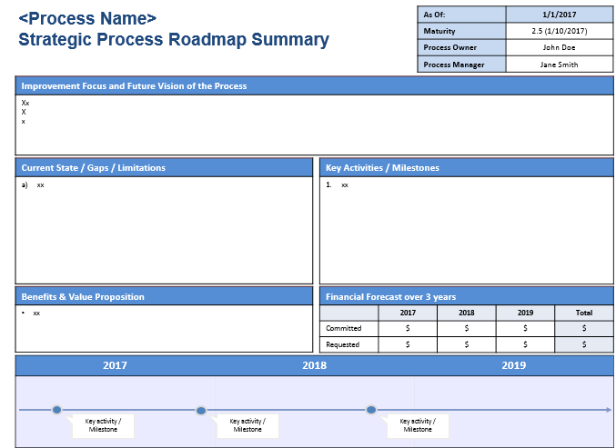
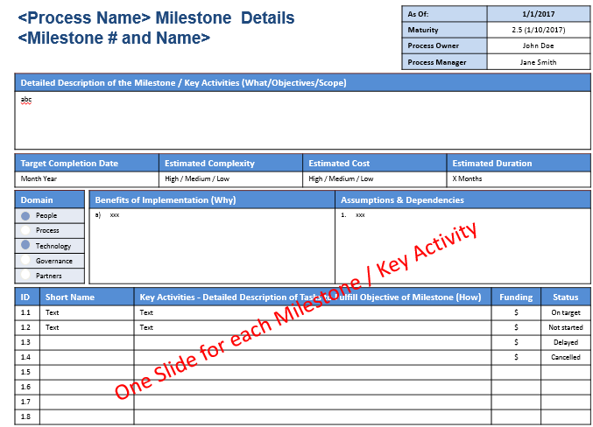
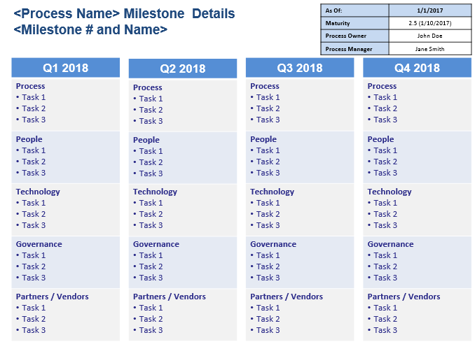
Establish a Strategic Process Roadmap
Understand and Execute the Accountabilities of Process Owners
Answer the Strategic Process Roadmap Questionnaire
Review Process Assessment findings, CSI register, Customer feedback etc.
+
+
1
2
3
Populate
Templates
4
3-year Strategic
outlook plan
Key Activities & Milestones
12-month rolling
Tactical plan

Slide 20
ITIL V3 Lifecycle (2011 edition)
Process within the ITIL V3 Lifecycle?
Service Strategy
Strategy Management for ITSM
Service Portfolio Management
Financial Management for IT Services
Demand Management
Business Relationship Management
Service Design
Design Coordination
Service Catalog Management
Service Level Management
Availability Management
Capacity Management
IT Service Continuity Management
Information Security Management
Supplier Management
Service Transition
Transition Planning and Support
Change Management
Service Asset and Configuration Management
Release and Deployment Management
Service Validation and Testing
Change Evaluation
Knowledge Management
Service Operation
Event Management
Incident Management
Request Fulfillment
Problem Management
Access Management
Continual Service Improvement
The Seven-step Improvement Process
Function
Service Desk
Technical Management
IT Operations Management
Application Management

Slide 21
Questions
Thorsten Manthey
thorsten@tmanthey.com
IT Process Governance web page:
www.tmanthey.com/ProcessGovernance

