Slide 1
Establish a
Strategic Process Roadmap

Slide 2

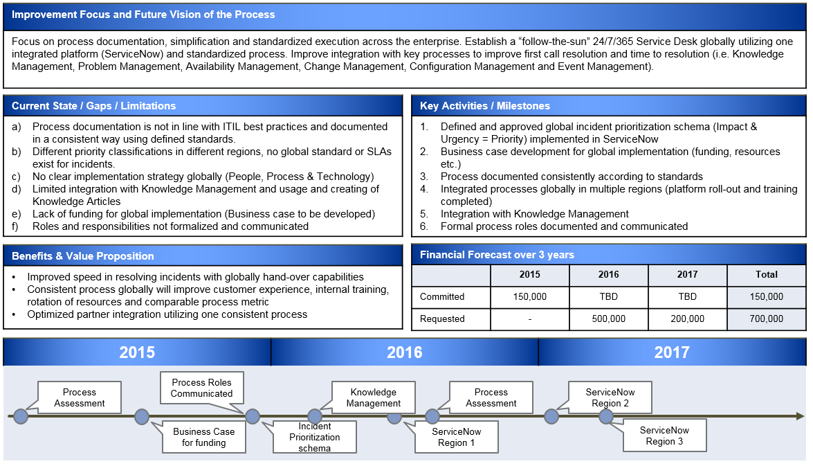


Bridging the Information gap
IT Strategy & Vision
Process Owner
Strategic
Process
Roadmap
Bridging the
Information Gap
Process Managers and Practitioners
Executing the Process day-to-day

Slide 3
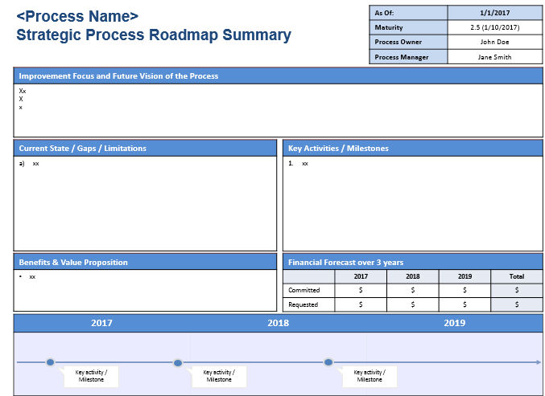
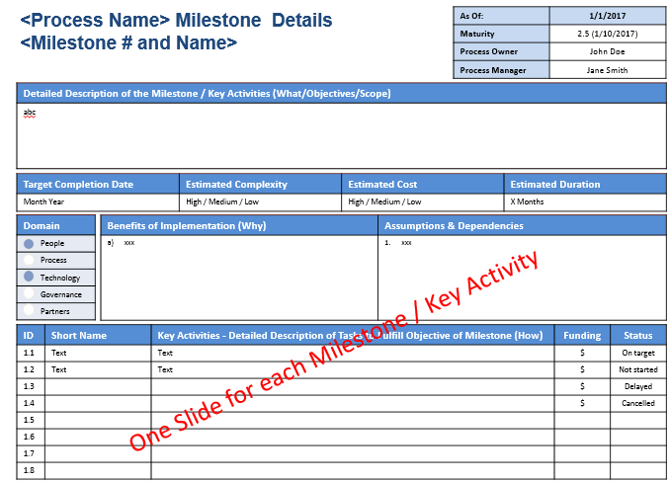
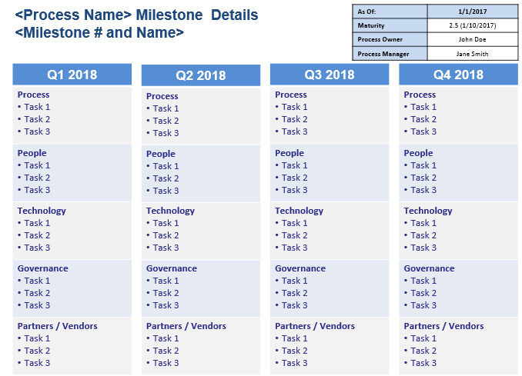
4 Steps to Develop a Strategic Process Roadmap
Understand and Execute the Accountabilities of Process Owners
Answer the Strategic Process Roadmap Questionnaire
Review Process Assessment findings, CSI register, Customer feedback etc.
+
+
1
2
3
Populate
Templates
4
3-year Strategic
outlook plan
Key Activities & Milestones
12-month rolling
Tactical plan

Slide 4

Understand and Execute the Accountabilities of Process Owners
  Accountable for the strategic direction and long term goal of the process
    Set short term (12-month rolling) and long term (3 years) process goals
    Define current maturity baseline and future process maturity level to be reached
  Accountable for the overall performance and results of the process
  Responsible to define process scope and goals
  Accountable to ensure support and commitment of resources
  Assisting the Process Manager

Slide 5
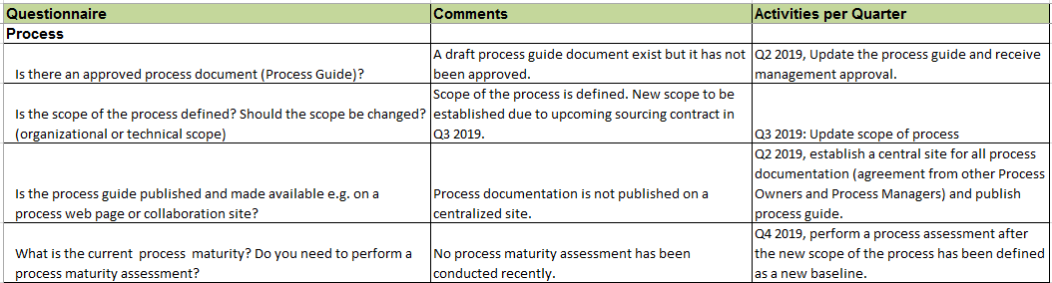
Answer the Strategic Process Roadmap Questionnaire
The Excel workbook consist of questions a Process Owner should ask themselves
This is only a starting point but provides great guidance
Workbook with questions
  Workbook contains detailed instructions
  Questions in five domains: People, Process, Technology, Governance and Partners
  The Process Owner must identify process specific questions for their process

Slide 6



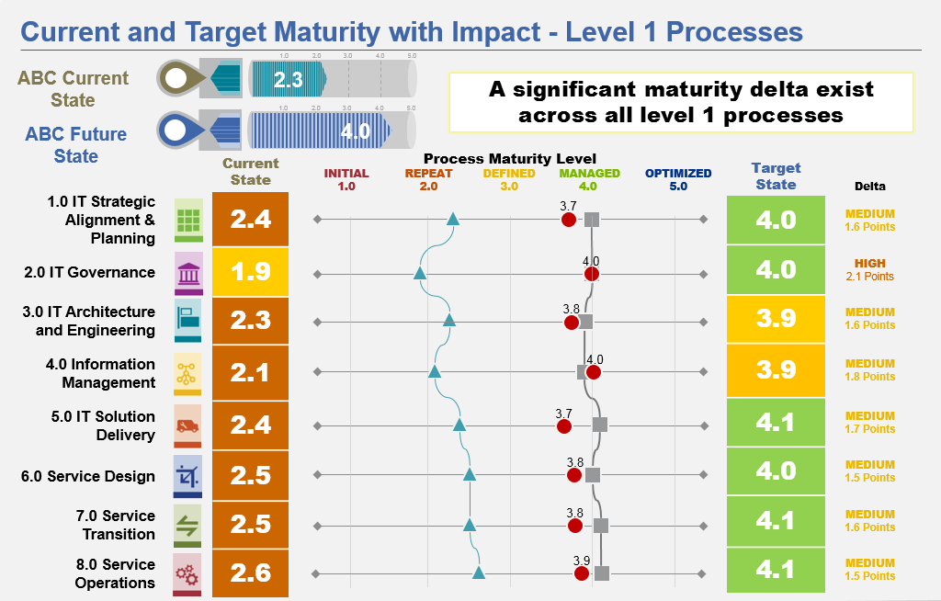


Review Process Artifacts, Information & Data
There is usually a lot of existing information and data a Process Owner can use as input to the Strategic Process Roadmap.
Customer Feedback
Ongoing Initiatives
CSI Register
Process Assessments
Strategy & Vision
Additional Data
IT Strategy & Vision
Business Strategy
BRM feedback

Slide 7
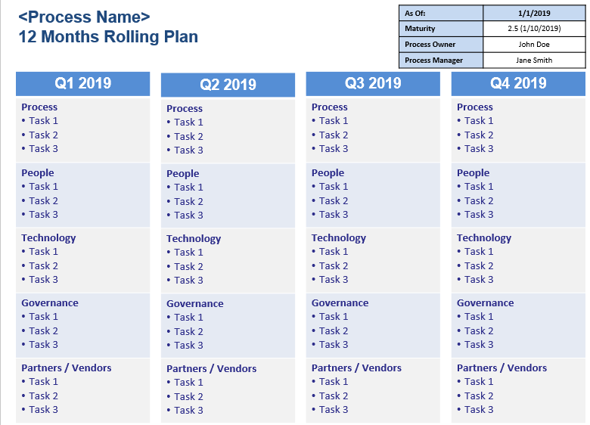
Populate Templates
1-page Summary, 3 year focus
1-Page Milestone Details
1-page 12 Month Rolling Plan

Slide 8
Bridging the ITSM Information Gap
How does a Process Owners develop a Strategic Process Roadmap to bridge the information gap between the operational day-to-day execution and the IT Strategy?
This White Paper and Webinar describes in detail how a Process Owner can develop a long term 3-year Strategic Process Roadmap that is aligned with the IT and ITSM strategy.
White paper:
http://nebula.wsimg.com/09af1101139c4e84cf437de6b86db0a2?AccessKeyId=6EE4EABD40489373FBD6&disposition=0&alloworigin=1
Webinar:
https://www.screencast.com/t/zgfvxzvCGg
Templates: http://nebula.wsimg.com/841c5b5e9faa4541b555d7df7a0b8015?AccessKeyId=6EE4EABD40489373FBD6&disposition=0&alloworigin=1
Presentation: http://nebula.wsimg.com/f7238f160022ad58f040cc372ec034de?AccessKeyId=6EE4EABD40489373FBD6&disposition=0&alloworigin=1

Slide 9
Thank you!

