Slide 1

Establishing IT Service Governance
Transforming IT into a Service Centric Delivery Organization

Slide 2

Agenda
Why should IT be a Service Centric Delivery Organization?
  Problem Statement
  Solution Statement
Vale Proposition of Service Governance
Our Transformation Path
  Six phases
What is a Service?
  Service
  IT Service
IT Service Governance
  Definition
  Structure
  Control Mechanisms
  Roles and Responsibilities
  Measurements and Reporting
IT & Business Partnership

Slide 3
Why should IT be a Service Centric Delivery Organization?
IT is perceived as…
  An organization focusing on delivering tools, hardware and software and it does this very well
  A good technology and support provider but it needs to evolve its maturity towards a better understanding of the customer needs
  A cost center and overhead with expensive “cool technology”
  A “black hole” because the business has limited understanding of what IT delivers and its value
  A financial quagmire because the business has limited visibility into or ability to control its IT budget
  Overpriced – IT should cut cost and “do more with less” but still deliver the same service quality level
Problem Statement

Slide 4
How does IT prepare to become a Service Centric Delivery Organization?
Implement IT Service Management (ITSM) by…
  Manage IT as a viable business partner by defining and delivering IT Services that fulfill customer needs
  Transform IT into a Service Oriented function that provides an interface founded on customer needs defined in business terms
  Deliver IT Services with the right quality and cost based on customer needs rather than our technology capabilities
  Mature from a Silo/Process delivery organization to more of a Service Delivery and Enabler organization
  Create a performance reporting structure that focuses on value to the customer without losing focus on the efficiency of IT’s operation and infrastructure processes
  Align IT strategy with the IT and Business strategies
Solution Statement

Slide 5
Characteristics of a Service Centric Delivery Organization
Nine Key Characteristics of Service Governance
  IT as a Business partner
  IT Services defined in business language
  Continuous dialog and relationship with the business
  Service focus vs. technology focused
  Continuous improvement of Services and processes
  Strong IT governance of ownership and accountabilities
  Value for the money; Service pricing
  Optimized supply chain including vendors and suppliers
  Performance Manage by metrics – Facts not feeling

Slide 6
Value Service Governance Provides
What will be “different” and what Value will be Created?
  Service Focus – IT will be able to discuss in business terms with our customers what IT Services they need. Based on this discussion we can improve and alter the IT Service offerings based on business needs rather than technology capabilities.
    VALUE: Alignment based on business needs and priorities
  Delivery Optimization – IT can now staff and allocate resources (FTE, $, tools, time etc.) based on known IT Service needs and specific Service Level requirements e.g. Uptime and Availability.
    VALUE: IT ‘s Resources are applied where it has the most business value and impact generating cost take out
  Customer Expectations – By associating IT Services with defined and understandable Service Levels and quality the customer expectations can be managed and measured
    VALUE: Clear customer expectation, Improved customer satisfaction.

Slide 7
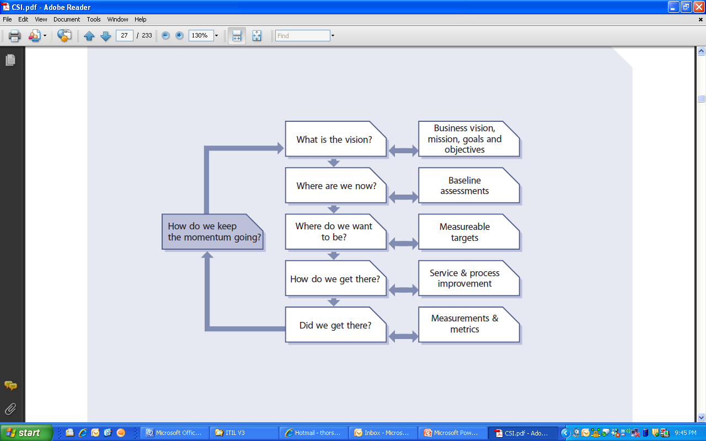
Service Transformation Path
How do we transform ourselves into a Service Centric Delivery organization?
1
2
6
Path To Success
3
4
5

Slide 8
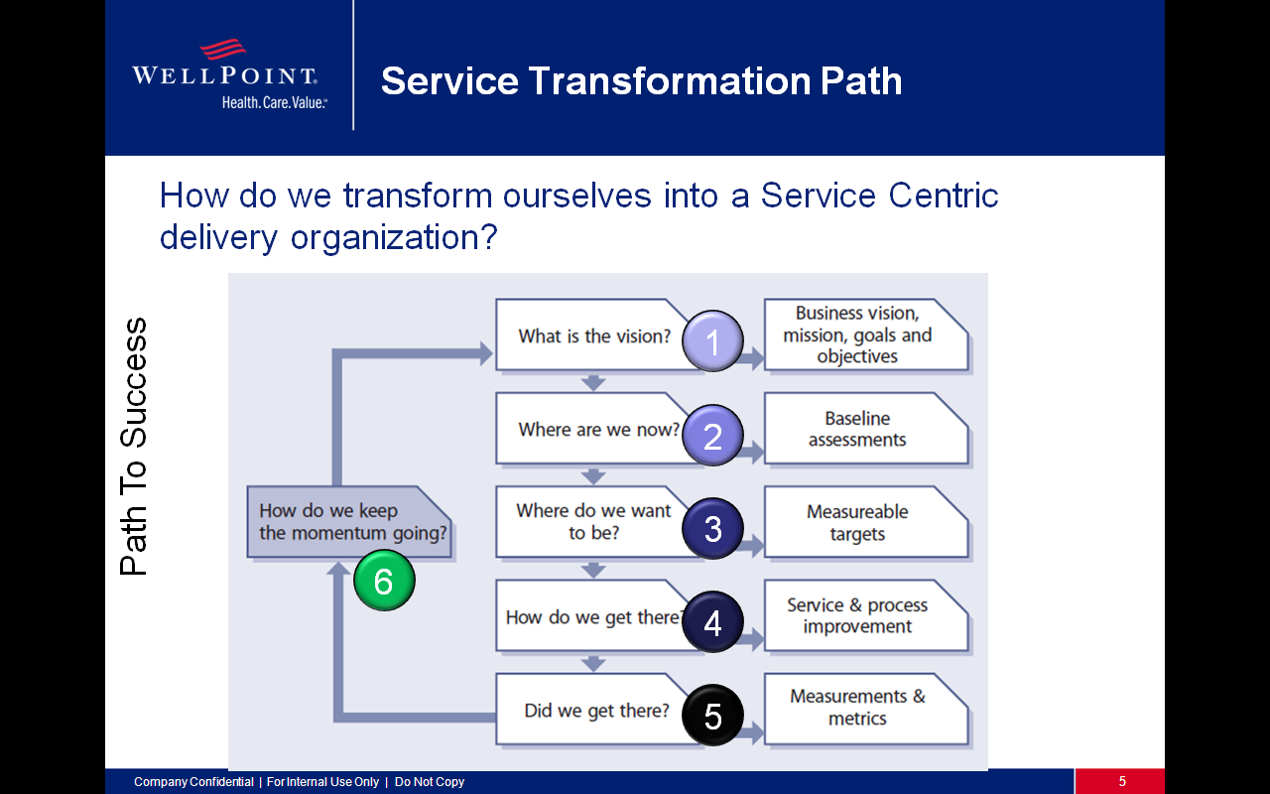

What is IT’s Vision?
IT’s Vision and Strategy must address the business needs?
  Alignment with the Business Strategy
  Implementation of IT’s Strategy
CIO quote
…our IT strategy focus is how the technology solutions we're delivering will support our enterprise goals and will help us create the best value in the industry.

Slide 9
Where are we now?
IT is on a Journey to Maturity?
  Currently the business has an ambivalent relationship with IT
    IT is critical the companies success
    IT is neither understood nor effectively controllable by the business
  IT is a key element of the business
    It is the primary corporate productivity engine
    It is the primary regulatory compliance mechanism
    It is the primary intra-company communication vehicle
  IT is poorly understood by the rest of our company
    IT has not communicated its value proposition to the business
    The technology focus of IT is intimidating
    Historically IT has been poor at business-speak

Slide 10
The IT Service Delivery Models
Service Delivery Models
  There are four choices for IT Service Delivery Models that IT can adopt—Silo, Process, Service, or Enabler.
  The four different IT Service Delivery Models represent a path in maturity of an IT organization.
  Each maturity level builds on the previous levels and one level can not be skipped when moving up the maturity scale.
  Moving from a Silo to a Service Delivery Model will only be possible if the Process maturity level is in place.
Value to Business
  The contribution IT provides “to the bottom line”
  IT capabilities driving business innovation and competitive advantages
  Efficient Service delivery by minimizing effort and FTE required and standardized IT Service Offerings
  Effective Service Delivery by focusing on Service quality and SLA fulfillment
  Aligned IT Services with current and future business needs
Today
IT Service Delivery Models
Source: The Gartner Group

Slide 11
Where do we want to be?
Moving up the Value Chain
The complexity of the IT organization precludes a single delivery model representation.
There may be portions of IT that will always be in the Silo Stage because the cost of moving to a more mature level would exceed any business value from the move.
Likewise, there may be activities or processes that are clearly in the Enabler stage because they, in and of themselves, generate revenue.
The characterization of an organization is based on the level into which the preponderance of an organizations processes, services and activities lie.
Moving up the Value Chain
IT Service Delivery Models
Source: The Gartner Group

Slide 12
IT Service Delivery Models
Delivery Model | Description | Pro’s | Con’s
Silo | This is the traditional internal IT organization, focusing on assets and minimizing cost by organizing itself around technical platforms and functions. | Provides the lowest number of resources and assets More cost efficient through optimization of technology rather than IT Service | No end-to-end IT Service accountability exists IT Service quality low Lack of coordination - silo sub-optimization Reactive model
Process Based | This is becoming a more popular model. Focuses on optimization and end-to-end execution from a process point of view rather than focused on the IT assets. | Processes are documented, understood, measured and monitored Better coordination between functions and organizational units | No end-to-end accountability exists for total IT Service provision Process and activity focused rather than business value and client need focused
Service Based | Focusing on the customer’s experience and their needs by establishing IT Services and Service Levels - quality and cost goals are set. | Focus is on IT Service outcome and customer need rather than technology IT establishes closer relationship and understanding of the business | Complex matrix organizational structure Requires greater alignment/ communication with business
Enabler (profit) | Using IT for clear competitive business advantages and to drive revenue | The IT organization can quantify their contribution by business revenue | Shared risk with business means greater business impact of IT failures IT must remain profitable

Slide 13
How do we get there?
Actions required to reach our goal of establishing a Service Centric Delivery Organization for IT?
  Implement our IT Strategy
  Execute related technology projects
  Implement IT Service Management
  Enhance IT’s communication with the business
  Continue execution of Process Governance
  Define and Implement Service Governance

Slide 14
How do we get there?
Continue to intensify IT focus on effective interfaces to the business and:
  Refocus IT on critical business goals
  Transform IT into a Service Oriented function that provides an interface founded on business needs defined in business terms
  Expand the decision making process to include more participation from the business
  Strengthen the flow and effectiveness of IT communications
  Create a performance reporting structure that focuses on value to the business rather than efficiency of IT operations

Slide 15
Are we there yet?
Service Reporting
  Reporting is essential to successful IT Service execution and will serve to inform and establish accountability for actions required when improving IT Services and IT Processes
  There are four constituencies that will receive reports on IT Service Delivery performance
    Business Customer – This is the consumer of the IT Services and they will receive regular reports on Service Level achievements and value received from the IT organization
    Internal IT – This is the service support staff and they will receive nearly real-time reports on IT Service performance, IT Service effectiveness and IT Service efficiency to identify areas for improvements
    Senior Management – These are the sponsors and ultimate customers of the IT Services and they will receive high level reports on cost and IT Service quality to drive future IT spending and strategic decisions
    External Service Provider – These are the external providers that are integrated with the IT organization delivering IT Services and they will receive the reports they need to be informed about their effectiveness in regard to IT Service delivery

Slide 16
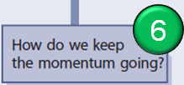
How To Keep The Momentum?
Continuously focusing on IT & Service Improvement
  Communicating to make aware and to make enthusiastic
      IT – instill pride in what we are doing
      Business – set expectations for a new IT relationship
      Suppliers – set expectations for new control requirements
  Educating to create an army of knowledgeable advocates
      Vision, Process, Service and Governance education to IT
      Process and Service education to the business community
      Process and governance education to our suppliers
  Integrating IT and business processes to create a seamless service delivery environment
  Integrating new IT roles and positions into the HR system to ensure proper recognition of associate contributions
  Enforcing policies, processes, and standards to capture the full benefit of the IT Service transformation
  Reporting to the business and IT how we are doing

Slide 17

Service Transformation Summary
How transform IT into a Service Centric Delivery organization?
1
Align with Business strategy
Service Centric Delivery org.
Communicate
Educate
2
Silo / Process maturity level
Project & Technology focus
6
Path To Success
3
Service / Enabler maturity
Service & value focused
4
Strategy implementation
Process & Service Govern.
5
Measurements & Reporting
Dashboards

Slide 18
What is a Service?
IT & Business Partnership

Slide 19
What is an IT Service?
An IT Service is one or more technical or professional IT capabilities which enable a business process and is the coordinated performance of one or more activities by one or more people on behalf of somebody else for the benefit of the corporate enterprise. (ITIL V3)
A means of enabling value co-creation by facilitating outcomes that customers want to achieve, without the customer having to manage specific costs and risks. (ITIL v4)
“A Service represents Value that the Customer wants and for which they are willing to pay”
An IT Service exhibits the following characteristics:
  Fulfils one or more needs of the business
  Supports the organization’s business objectives
  Is perceived by the customer as a coherent whole or consumable product

Slide 20
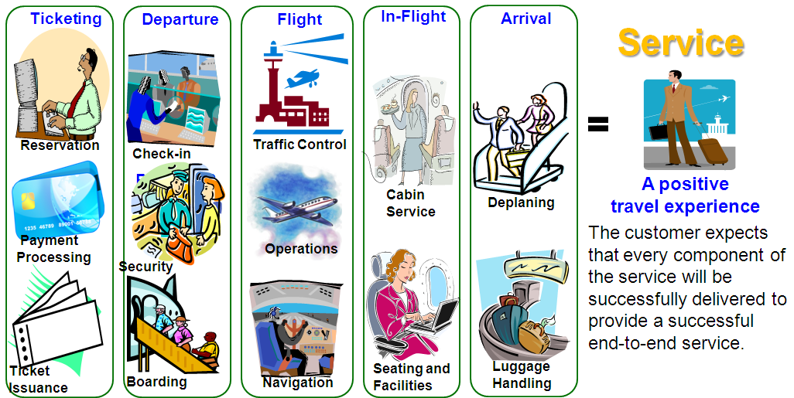
What is a Service?
Customers expects the following from a Service
  Value, Performance, Convenience, and Reliability
  (Independent of the underlying technology, infrastructure, applications, hardware etc.)
Notes:
20

Slide 21
IT Service Governance
Defining and Implementing IT Service Governance

Slide 22
IT Service Governance
Definition
  The organizational structures that need to be put in place, the roles that need to be assigned, responsibilities and accountabilities for each role and the meetings and councils to be established in order to operate and govern the IT Processes and IT Services within the IT organization.
Key focus areas:
Organizational structures
Roles defined and assigned
Responsibilities & Accountabilities
Meetings & Councils

Slide 23
IT Service Governance
IT Governance is key to delivering quality service
  IT Service Governance is the integrated set of activities required to ensure the cost and quality of IT Services valued by our customer.
  It is the management of customer-valued IT capabilities through effective processes, organization, information and technology, including:
    Aligning IT with business objectives
    Managing IT services and solutions throughout their lifecycles
To manage IT Services will require Rules and Roles to ensure the quality of service delivery –> IT Service Governance

Slide 24
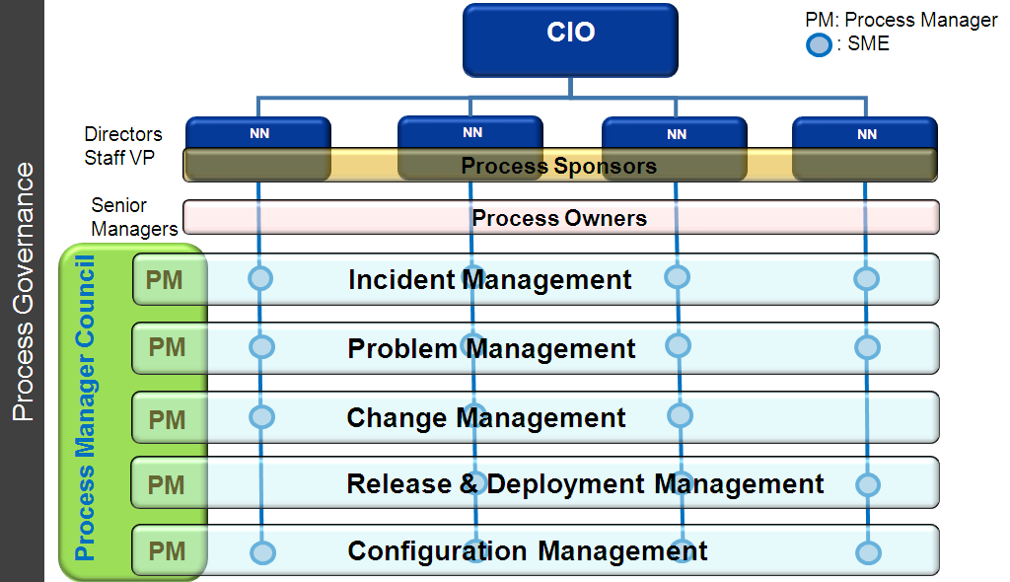
IT Service Governance
Defining and Implementing IT Service Governance requires consistent and operational Process Governance
Process Governance Framework documented
  Process Management and Governance Guide
Process Roles Identified and Assigned
  Process Sponsor
  Process Owner
  Process Manager
  SMEs
Process Manager Council established
  Charter
  Regular meeting schedule

Slide 25
Structure - IT Service Governance
With IT Process Governance as a solid base, IT can make the transition to a Service orientation
  Build on the Process organization model
  Recognize that processes are only one component of services
  Identify additional components of each service, e.g., application functionality, technology platforms, etc.
  Create and implement the management and control structures, e.g., Service Owner Council
  Create and deliver education about being service oriented
  Staff the new service positions and roles
  Implement a service focused measurement and reporting discipline within IT

Slide 26
BU
BU
Business Units
BU
BU
Business Relationship Manager
Business Relationship Manager
Business Relationship Manager
Business Relationship Manager
Account Manager
CIO
Strategic Service Delivery Executive
Service Owner Council (SOC)
Product Manager
Service Owner
Service Owner
Service Owner
NN
NN
NN
NN
Steve Browning
Process Sponsors
IT Service Governance
IT Process Governance
Process Owners
IT Service
IT Service
IT Service
IT Service
IT Service
PMC
Operational Processes
PM
Infrastructure Processes
PM
Application Development
AM
Technology Platforms
TM
Notes:
26

Slide 27
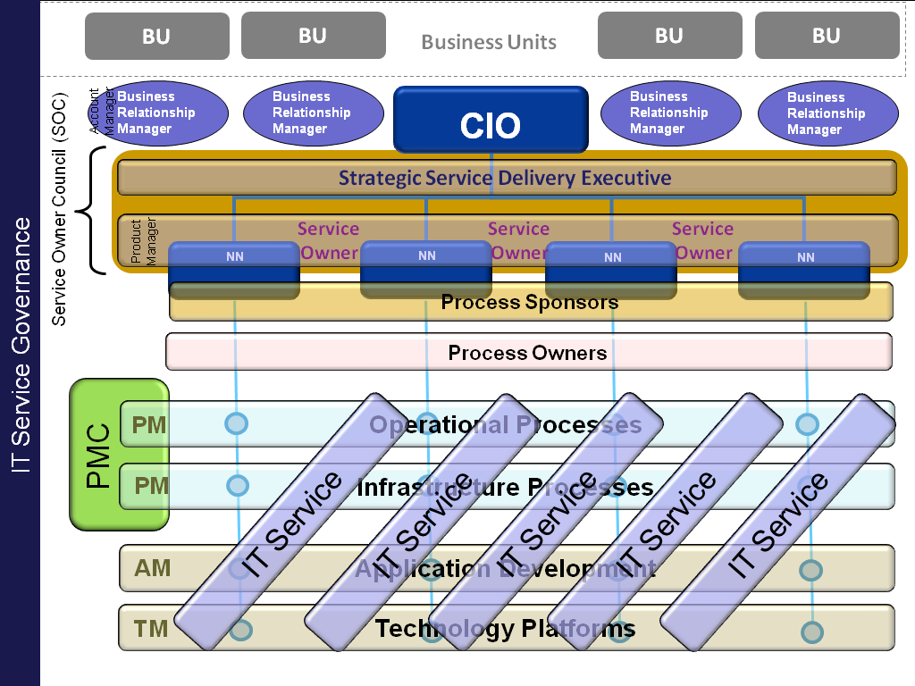
Structure - IT Service Governance
The service structure includes the process structure, its suppliers and the customer through the BRMs
Service looks toward its customers
  Business Relationship Managers
  Strategic Service Delivery Executive
Service is managed by an cross-organizational council
  Service Owner Council
    Process Owner
    Service Owners
    Application Development
    Technology Executives
    Key Customers
Service spans
  IT Operational Processes
  IT Infrastructure Processes
  Application Development
  Technology Platforms
AM: Application Manager; TM: Technology Manager

Slide 28
Structure - IT Service Governance
Logical grouping of services into recognized groups.
The Offered Service!
The detailed description of what we are offering described in business language with SLAs and unit price.
Request
What are the Requestable Offering for a service to enable service delivery and fulfillment
Service Group
Service Offering
Service Levels (Gold, Silver, Bronze)
Service Charges / Budgeting
Business description
Value Proposition & Benefits
Price model / Unit pricing
Requestable Offering
Requestable Offerings
Service Offering
Service Catalog
Requestable Offering
Customer
What value do I get?
What is the SLA?
How much does it cost (Unit cost)?
How can I control my IT budget?
End User
What will I get?
When & how it is delivered to me?
What is the cost?
IT Service Catalog – Business View
Service Request Catalog – End User View

Slide 29

Control - IT Service Governance
The Service Owner Council (SOC):
  Oversees coordination among the IT Services
  Identifies opportunities for IT Service improvements based on
    Feedback from the Business Relationship Managers
    IT Service measurements from the Service Level Manager
The SOC agenda includes:
  Discussion of IT Service measurements
  Reviewing status of IT Service improvements
  Coordinating the work required based upon business priority and IT capabilities
  Evaluating future IT Service requests from the business
  Reviewing and approving IT Service changes
Meeting frequency: Quarterly
Chair: Strategic Service Delivery Manager (SSDE)
Service
Owner
Council

Slide 30
Roles – IT Service Governance
Business Relationship Manager (BRM) IS:
  Responsible for the relationship between IT and the business
  Negotiator of Service Level Agreements for the business
  Expected to resolve conflicts between IT service delivery performance and capabilities and business expectations
  Responsible for capturing, documenting and representing to IT business needs for existing IT Services, for IT Service improvements or for new IT Services
  Business Relationship Manager (BRM) IS NOT:
  Able to make business commitments unless so delegated by the business executive represented
  Able to make IT commitments unless so delegated by the CIO
Business & IT Liaison

Slide 31
Roles – IT Service Governance
Strategic Service Delivery Executive (SSDE) IS:
  A thought leader who defines the IT Service Strategy & Vision
  Accountable for the overall performance and results of all IT services in the Service Portfolio
  Expected to resolve conflicts between IT costs and capabilities and business expectations
  The owner of the IT Service Portfolio
  Expected to dedicate 100% of time to guiding the IT Services
Strategic Service Delivery Executive (SSDE) IS NOT:
  Replacing managers of departments or line management responsibilities
  Responsible for day-to-day HR activities and performance reviews
  Replacing ongoing functional or operating-unit duties
Executive Guidance & Decision

Slide 32
Roles – IT Service Governance
Service Owner (SO) IS:
  The Single Point of Contact (SPOC) for any operational matter regarding his or her IT Service
  Accountable for the Service delivery quality of his or her IT Service
  Provider of service execution oversight, regardless of where the technology, IT Process or professional capabilities reside
  The responsible “customer executive” of the processes and service functions that comprise his or her IT Service
  Service Owner (SO) IS NOT:
  Replacing managers of departments or line management responsibilities
  Responsible for day-to-day HR activities and performance reviews
  Replacing ongoing functional or operating-unit duties
Operational Accountability

Slide 33
Roles – IT Service Governance
Service Manager (SM) IS:
  Responsible for the service development, documentation, execution and improvement and is the repository of service and process knowledge
  The champion for the Service
  The leader and coordinator of the providers of service components
  The custodian of service related documentation and training material
Service Manager (SM) IS NOT:
  Replacing managers of departments or line management responsibilities
  Responsible for day-to-day HR activities and performance reviews
  Replacing ongoing functional or operating-unit duties
Operational Leadership

Slide 34
Roles - How We All Work Together
BRM, SSDE, Service Owner, Service Manager
  The Business Relationship Managers (BRM) are responsible for representing the business to IT and IT to the business. They are accountable for client satisfaction with IT
  The Strategic service Delivery Executive (SSDE) is accountable for the quality of all services IT provides to the business as well as the operational efficiency and effectiveness of providing those services
  The Service Owners (SO) have the overall accountability, strategic direction and long term vision for the services they own
  The Service Managers (SM) are responsible for service definition, development, documentation, implementation, execution and improvement of the service they manage.
  The SMs reports, organizationally to their respective SOs

Slide 35

Measurements - Service Reporting
Service Measurements & Reporting
  IT Service measurements are created and instituted to ensure Critical Success Factors (CSF) are maintained for the Service Offerings.
  Four different types of measurements are required to determine the health of an IT Service
    Compliance – Are we using the service? Are we following the rules?
    Performance – How fast? How many?
    Quality – How well? Are the numbers of errors acceptable?
    Value – Does it matter? Are we adding value?

Slide 36
Summary - IT Service Governance
Process Foundation
Process Governance has been established with assigned roles and responsibilities and regular Process Manager Council meetings.
Business Demand
Our customers are demanding more visibility into IT. This is driving us to move up the value chain to a service orientation.
Next Steps
Implement IT Service Governance to raise IT Maturity and establish a Service Centric Organization
Identify our IT Services and assign ownership and accountabilities by establishing new Service centric roles
Leverage our Process Governance success!

Slide 37

Questions
Thorsten Manthey
thorsten@tmanthey.com
www.tmanthey.com
Cell: (617) 513 0000

