Slide 1
Bridging the ITSM Information Gap
How to Bridge the Information Gap between IT Leadership and Day-to-day Process Execution via Strategic Process Roadmaps!
Thorsten Manthey
Engagement Director, TCS
thorsten@tmanthey.com
April 2019
Public

Slide 2
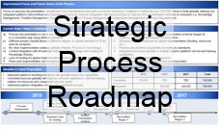
The Information gap between IT leadership and IT operations
IT Strategy & Vision
INFORMATION GAP
A critical component of ITSM Governance
Process Managers and Practitioners
Executing the Process day-to-day

Slide 3
What is ITSM Governance?
If you ask 10 people what ITSM Governance is, you will likely get 11 different answers…
Councils
Boards
Roles
Accountabilities
Responsibilities

Slide 4
Management vs. Governance
Management plans, builds, runs and monitors activities in alignment with the direction set by the governance body to achieve the enterprise objectives.
Governance ensures that stakeholder needs, conditions and options are evaluated to determine balanced, agreed-on enterprise objectives to be achieved; setting direction through prioritization and decision making; and monitoring performance and compliance against agreed-on direction and objectives.
Management
Governance
COBIT 5: A Business Framework for the Governance and Management of Enterprise IT

Slide 5
Process Manager vs. Process Owner
Management
Governance
The Process Manager is concerned with the management of the process (e.g. day-to-day execution, measurements, documentation, training etc.)
The Process Owner is concerned with the governing of the process (e.g. set direction, prioritization, goal setting, scope, decision making etc.).
Both roles are required but can in some cases be executed by the same person.

Slide 6
Responsibilities & Accountabilities
Process Manager
Process Owner
Responsible for planning and coordination of all tactical and operational activities
Responsible for the process / procedure definition, development, documentation, implementation, execution and improvement
Custodian of process related documentation and training material
Champion for consistent processes and tool usage, and ensures standardization, integration, and consistency
Monitors and measures the quality and content of the delivery and output of the process
Dedicates time to the process and develops expert process knowledge
Accountable for the strategic direction and long term goal of the process
Accountable for the overall performance and results of the process
Responsible to define process scope and goals
Accountable to ensure support and commitment of resources
Assisting in assigning a Process Manager
Detailed Role descriptions can be downloaded from my web page: http://www.tmanthey.com/speaker.html

Slide 7
ITSM Governance Framework
Focus
Thresholds for Escalation
(Examples only, organizational specific)
IT Governance Board (ITGB)
IT Strategy & Vision
Strategic Plans
Business Alignment
Vision & Mission
ITGB
IT and Business Leaders
(Business and IT Vision)
Threshold for escalation
New funding e.g. > $25.000
New tools / technology
Organizational changes
Strategic / Roadmaps
Consolidated Strategic Roadmaps
Process Strategy
Strategic Process Roadmap
Strategic Platform Roadmap
12-month rolling plan
Set process / platform goals, scope and future maturity
Prioritization and decisions
Process Owner and Architecture Council (POAC)
POAC
Process Owner / Platform Architect (Strategic & long term goals. Strategic Roadmaps)
Threshold for escalation
Funding request e.g. >$1
New tools / technology
Tool customization
Staff changes / updates
Strategic process impact
Process Manager and Technical Review Council (PMTRC)
Process Manager / Technology Review (Operationally responsible for a consistent execution/integration)
Process Operation
Process Execution
Process Documentation
Process Training
Automation & Technology
Monitoring & Reporting of KPIs and Metrics
PMTRC
Threshold for escalation
Impacting >1 processes
Tool / Process integrations
Process Input / Output
Process Meetings for each Process
Practitioners / Process Engineers
(across organization / functional areas)
Process Owners provide value through the development of the Strategic Process Roadmaps within a well-defined IT Service Management Governance Framework.

Slide 8
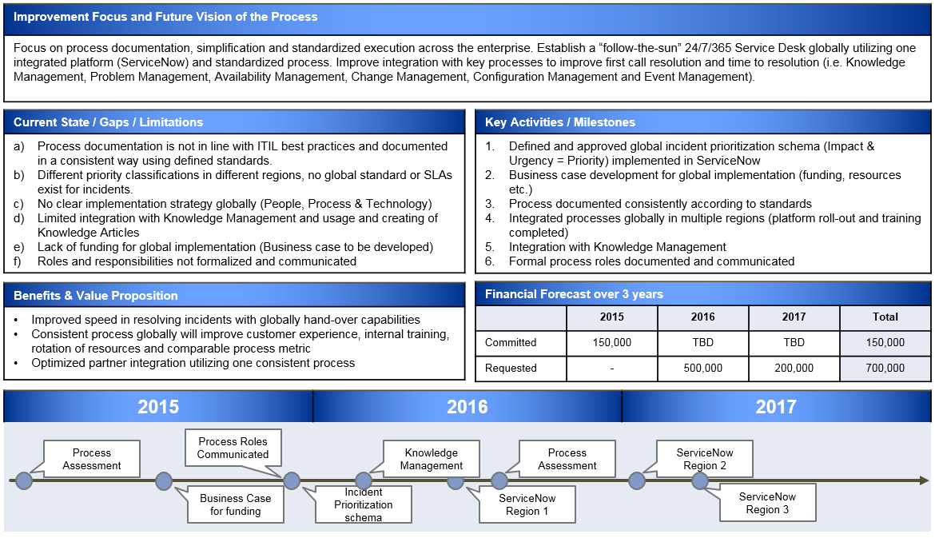
Bridging the Information gap
IT Strategy & Vision
Process Owner
Strategic
Process
Roadmap
Bridging the
Information Gap
Process Managers and Practitioners
Executing the Process day-to-day

Slide 9
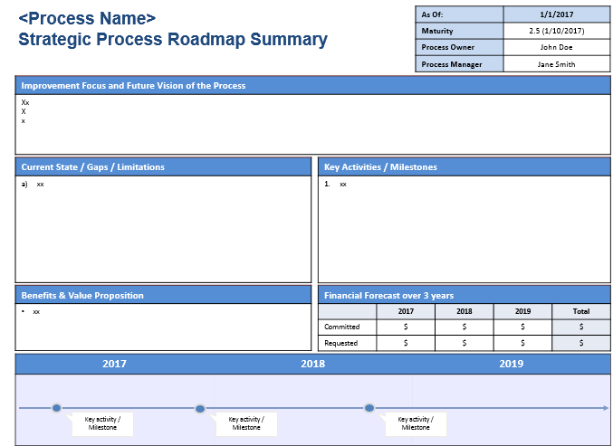
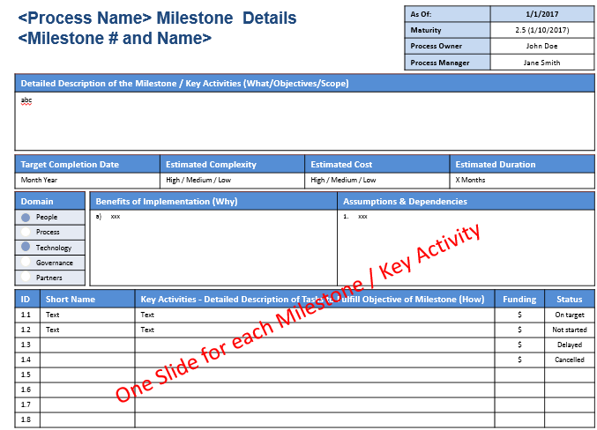
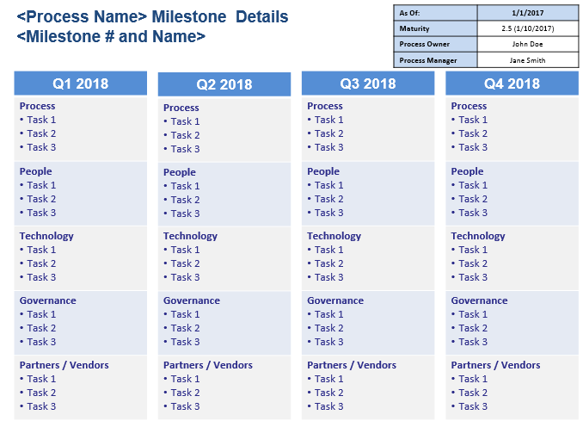
4 Steps to Develop a Strategic Process Roadmap
Understand and Execute the Accountabilities of Process Owners
Answer the Strategic Process Roadmap Questionnaire
Review Process Assessment findings, CSI register, Customer feedback etc.
+
+
1
2
3
Populate
Templates
4
3-year Strategic
outlook plan
Key Activities & Milestones
12-month rolling
Tactical plan

Slide 10
Understand and Execute the Accountabilities of Process Owners
1
Accountable for the strategic direction and long term goal of the process
Set short term (12-month rolling) and long term (3 years) process goals
Define current maturity baseline and future process maturity level to be reached
Accountable for the overall performance and results of the process
Responsible to define process scope and goals
Accountable to ensure support and commitment of resources
Assisting in assigning a Process Manager

Slide 11
Answer the Strategic Process Roadmap Questionnaire
2
The Excel workbook consist of questions a Process Owner should ask themselves
This is only a starting point but provides great guidance
Workbook with questions
Workbook contains detailed instructions
Questions in five domains: People, Process, Technology, Governance and Partners
The Process Owner must identify process specific questions for their process

Slide 12
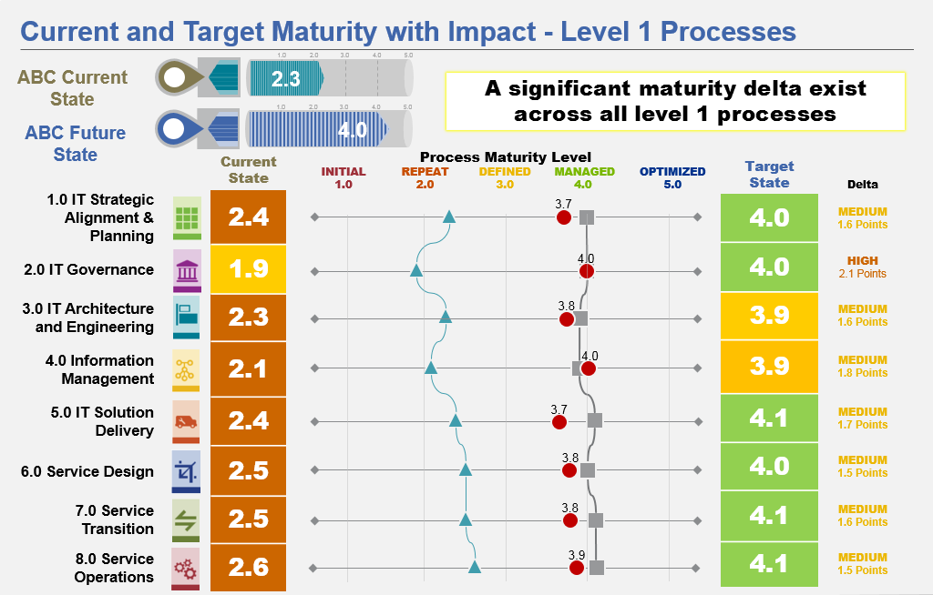
Review Process Artifacts, Information & Data
3
There is usually a lot of existing information and data a Process Owner can use as input to the Strategic Process Roadmap.
Customer Feedback
Ongoing Initiatives
CSI Register
Process Assessments
Strategy & Vision
Additional Data
IT Strategy & Vision
Business Strategy
BRM feedback

Slide 13
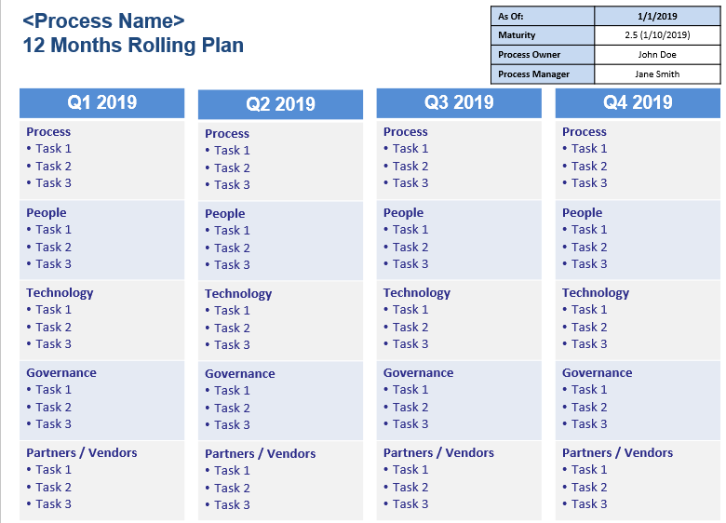
Populate Templates
4
1-page Summary, 3 year focus
1-Page Milestone Details
1-page 12 Month Rolling Plan

Slide 14
Lessons Learned
Define clear Roles and Responsibilities / Accountabilities (RACI)
Process Managers / Platform Manager
Process Owners / Platform Owner / Enterprise Architecture
IT Governance Board / IT Leadership
Define the ITSM Governance Framework
Formalize Roles (empower roles, e.g. formal roles for career path)
Set up Councils (Process Manager Council, Process Owner Council etc.)
Define Escalations (Who do I escalate to?)
Define Thresholds (When do I escalate?)
Agree on Decision Rights (Who can decide? What can they decide on?)
Start with a few processes and adapt… (Crawl, Walk, Run)

Slide 15
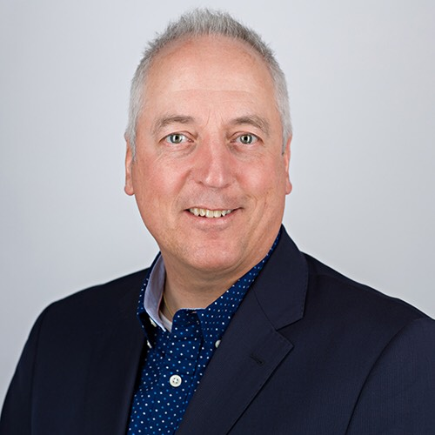
Questions
Add to your tool box:
Strategic Process Roadmap Templates
PPT Templates
Excel questionnaire
Process Manager Responsibilities
Process Owner Accountabilities
White paper - Implement Strategic Process Roadmaps
To download templates go to: http://www.tmanthey.com/speaker.html
Thorsten Manthey
Engagement Director, TCS
thorsten@tmanthey.com

Slide 16
Thank You

