Slide 1
People Change Management: The Keys to a Successful Project
Thorsten Manthey
thorsten@tmanthey.com

Slide 2


PEOPLE – PROCESS - TECHNOLOGY
Why a three legged stool (People, Process & Technology) cannot stand with only two legs
Your Project!
TECHNOLOGY
PEOPLE
PROCESS
Notes:
This presentation is about the importance of People Change Management when delivering successful projects.
I will provide you with multiple arguments and compelling reasons why people change management is important.
You will be able to use many of these slides when you go back home to justify to your leaders why a people change management program is imperative to project success.
People change management is not optional and this presentation will help you tell that story.
The industry recognized convention is to focus on People, Process and Technology during project delivery and we are usually very good as the technology and process part but maybe not so much the people part.
CLICK
Your project is represented by this bowl on top of this three legged chair.
Place PROJECT sign on the bowl.
As project manager you are always juggling many different balls at the same time.
Add items and balls in the bowl.
These balls represent deliverables, activities, budget, deadlines, milestones, project reports, project member and many more things.
And the three legs represent PEOPLE, PROCESS and TECHNOLOGY.

Slide 3




WHY PEOPLE CHANGE MANAGEMENT?
Increase Probability of Project Success
Manage employee Resistance to change
Improve Speed of Adoption (how quick)
Increase Utilization (how many)
Optimize Proficiency (how well)
Research from the Best Practices in Change Management 2014 Edition – Prosci® Benchmarking Report
Notes:
WHY PEOPLE CHANGE MANAGEMENT
So, why are we focusing on PEOPLE change management anyway? What are we trying to accomplish with this?
In short, the key reason is to increase the probability of the project being successful.
How does PEOPLE change management increase the probability of project success?
CLICK
First, people change management is identifying and mitigating resistance to the change. You can assess the organization and take action by developing the Resistance plan.
CLICK
Secondly, it will improve the speed of adoption which means how quick do people get onboard using the new processes and tools.
CLICK
Thirdly, it will increase the Utilization which means how many people engage in the change.
CLICK
And lastly, it is optimizing the Proficiency of how well people are performing, which minimizes costly mistakes and process failures.
So, with less resistance to the change, quicker adoption and embracement, more people using the systems and tools better and smarter – this will substantially increase the probability of project success and expected ROI.

Slide 4



PROCES & TECHNOLOGY IS NOT ENOUGH
Perfectly Designed Process
+
Perfectly Designed Technology
If PEOPLE are not following the new process or not using the new tool very little is changing!
=> Project Goal/Benefits/ROI is NOT realized
Notes:
PROCESS AND TECHNOLOGY IS NOT ENOUGH
When executing a project, just focusing on designing a perfect process and delivering a world class technical solution is NOT enough!
CLICK
Imagine if the people you are designing the solution for are not using the new process or not utilizing the tools correctly - nothing will really change.
It is ultimately the people changing the way they are working that are the key factor for a successful project.
Let’s take another look at this three legged chair.
Most projects are usually great at delivering exceptional technical solutions with superbly designed processes. Organizations usually have droves of senior technical experts and ITIL process gurus supporting the project designing best of class processes.
BUT…
Many projects have limited or no full time engaged people change management experts.
So, let us take a look at what would happen to a project with limited people change management.
As I mentioned, this bowl on top of this three legged stool represent your project so let us simulate that limited people change management experts are part of the project team.
REMOVE PEOPLE LEG
I am representing this by removing the people change management leg.
What happened to the project?
Well, it crashed and was not successfully delivered.
All your project tasks, people, deliverables, resources are no longer to be rescued as they are all over the floor.

Slide 5
PROJECT ROI / OUTCOME
People Dependence
Embraced
Adopted
Used
Embraced
Adopted
Used
Embraced
Adopted
Used
Designed
Developed
Delivered
People driven project
Project Benefit Realization
Designed
Developed
Delivered
Technical driven project
Designed
Developed
Delivered
Notes:
PROJECT OUTCOME
Let’s look at this from the Return on Investment angle for the project.
How much of the project ROI and outcome is dependent on People change management activities?
A project that is very technical in nature, for example replacing some technology components in a data center might not have a huge impact on processes or people doing their jobs differently. In this case the people change management contribution is limited with little impact on the ROI and project outcome.
CLICK
Some projects have a larger dependency on people change management and how people need to change the way they work.
CLICK
But, most projects have a very large dependency on people changing the way they work and project success is dependent on people Embracing, Adopting and Using the new processes and technology.
So, if you think about some of the projects you have been part of or are currently managing.
Are people required to use newly designed processes and tools? If so, your project might be fully dependent on people changing the way they are working.

Slide 6
NULL HYPOTHESIS
Some amount of the Project Benefits / ROI / Outcome depend on that it is Embraced, Adopted and Used.
Null Hypothesis: What would the Project Benefits be if Embracement, Adoption, and Usage are null (0)?
Large People
Contribution
ROI
ROI
ROI
Technical Focus
$400K
$400K
Embraced
Adopted
Used
$400K
Embraced
Adopted
Used
Expected Project
Benefits
Expected Project
Benefits
Expected Project
Benefits
Design
Developed
Delivered
$300K
$300K
$300K
$200K
$200K
Design
Developed
Delivered
$200K
$100K
$100K
$100K
Overall Project
Expected ROI = 90%
Overall Project
Expected ROI = 50%
Overall Project
Expected ROI = 15%
From Prosci® Inc. – Change Management Process
Notes:
NULL HYPOTHESIS
What would happen if we did not do any people change management activities?
This is the Null Hypothesis of People Change Management.
CLICK
The Null Hypothesis asks what would the project benefits and ROI be if NO people change management activities are performed?
No focus on people Embracing, Adopting or Using the new processes or technology.
CLICK
For a purely technical project the ROI would be quite high without any people change management activities. In this example I am estimating this to 90%.
CLICK
For a projected that is not purely a technology project the ROI might reach 50% without any people change management.
CLICK
But, most projects have a significant dependency on people changing the way they work and without any people change management activities, the project will either fail or deliver limited ROI.
In this example you can see that the ROI is only 15% of the expected return as there is a huge dependency on people changing the way they should do their work.
So, for projects that have a large dependency on people changing the way they work it is imperative to perform people change management activities.

Slide 7
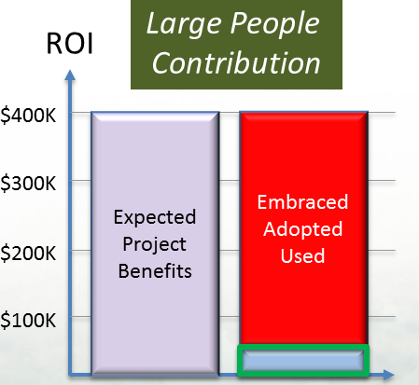
CONTRIBUTION TO PROJECT ROI
Assumptions:
The project has a large People Contribution
Project ROI potential is $400K
Project Benefit (ROI)
Change Management | E, A & U* | Benefit
$400K
$340
$300K
No Change Management | 15% | $60K
$200K
Some Change Management | 35% | $140K
$140
Solid Change Management | 85% | $340K
$100K
$60
*Embracement, Adoption & Usage
20
40
60
80
100
Questions
Can we afford Change Management?
Can we afford NOT doing it?
Embracement, Adoption & Usage %
Invest in People Change Management Experts
Notes:
CONTRIBUTION TO PROJECT ROI
Here is an example of a project with a large people dependency.
The expected ROI is $400 thousand.
CLICK
With almost no people change management activities we can expect that just a few people will Embrace, Adapt and Use the new processes and tools.
The change management activities might be an Email just before going live with some on-the-job training. The expected ROI would maybe be about 15% which in this example is $60 thousand or the project might not success at all.
CLICK
With some change management activities, for example having a sponsor doing a kick-off or sending key people to training would possibly generate an ROI of 35% which is about $140 thousand.
CLICK
If solid change management activities are performed by using a formal and structured change management framework and some people change experts involved, visible and active sponsorship an expected ROI could be 85% or more. This would represent an ROI of $340 thousand.
CLICK
So, ask yourself the question, can we afford not focusing on people change management.
Without people change management the risk of failing is large and the ROI will be limited.
You can use this example on you own project and come up with some realistic numbers that is relevant within your organization.
Organizations invest to develop project management experts, technical experts and process experts and we should do the same for people change management experts.
Remember they three legged chair…

Slide 8
ASKING THE RIGHT QUESTION
We are asking the wrong question
What is the ROI of People Change Management
This is the RIGHT question:
What amount of the Project Benefits (Results, outcome, ROI etc.) depends on employees Embracing, Adopting and Using the new tools, processes or systems?
Notes:
ASKING THE RIGHT QUESTION
When investing in people change management we are asking ourselves the wrong question.
We are asking what is the ROI of people change management but we should instead ask:
CLICK
The RIGHT question to as is:
What amount of the Project Benefits depends on employees Embracing, Accepting and Using the new tools, processes or systems?
It is not about the people change management program itself but rather the overall project success and the activities that contribute to deliver a successful project.
Many of these critical activities are people change management activities.

Slide 9
SUCCESS vs. OBSTACLES
Greatest contributors to success
  Active and visible executive sponsorship
  Structured people change management approach
  Frequent and open communications around the need for change
  Dedicated resources for people change management
  Employee participation
Greatest People Change Management obstacles
  Ineffective change sponsorship from senior leaders
  Resistance to the change from employees
  Poor support and alignment with middle management
  Lack of people change management resources and planning
ACTIVE & VISIBLE Sponsorship
Research from the Best Practices in Change Management 2014 Edition – Prosci® Benchmarking Report
Notes:
SUCCESS VS. OBSTACLES
Industry research has identified the greatest contributors to project success as well as the greatest obstacles for projects to succeed.
The data is from research performed by Prosci®, a leader in People Change Management.
Prosci® has performed 8 comprehensive studies over 16 years with more than 3,400 participants.
Question to Audience: What do you think are the biggest contributors and obstacles to success?
Hand out USB sticks to people that respond.
CLICK
In every study the greatest contributor to success was by far “Active and Visible Executive Sponsorship”. It was cited three times more than any of the other contributors to success.
The other contributors are:
Structured people change management approach
Frequent and open communications around the need for change
Dedicated resources for people change management
Employee participation
CLICK
The greatest obstacles for success are:
Ineffective change sponsorship from senior leaders
Resistance to the change from employees
Poor support and alignment with middle management
Lack of change management resources and planning
CLICK
The interesting finding is that Active and Visible sponsorship is the number 1 contributor to success as well as the number 1 contributor to failure if Active and Visible sponsorship is not available.
Think about a project you are managing or part of, is the Executive sponsor Active and Visible or did they just endorse the project initially?
There are many ways to help the sponsor being Active and Visible by using a structured People Change management approach.

Slide 10
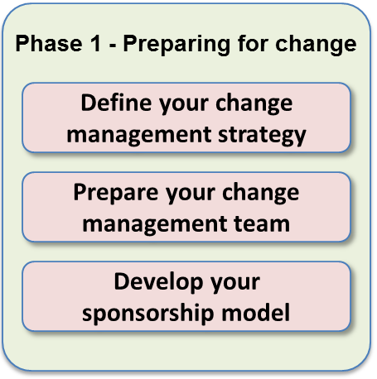
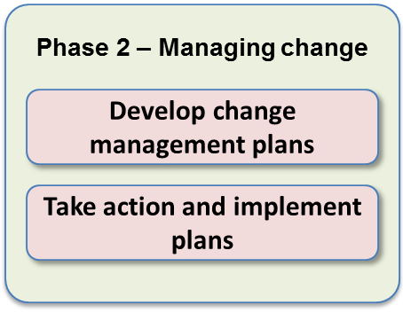
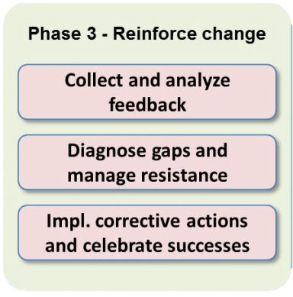
STRUCTURED APPROACH
  Phase 1 – Preparing for change
The first phase of the Change Management process is aimed at getting ready. It answers the question: “How much change management is needed for this specific program/project?" The first phase provides the situational awareness that is critical for effective change management
Phase 2 – Managing change
The second phase focuses on creating the plans that are integrated into the project activities - what people typically think of when they talk about change management. There are typically six plans that should be created to help individuals move through the ADKAR® Model
Phase 3 - Reinforcing change
The third phase helps project teams create specific action plans for ensuring that the change is sustained. In this phase, project teams develop measures and mechanisms to see if the change has taken hold, to see if employees are actually doing their jobs the new way and to celebrate success.
From Prosci® Inc. – Change Management Process
Notes:
STRUCTURED APPROACH
People Change Management requires a structured approach, just like Project Management with different phases and defined deliverables.
There are many industry recognized people change management frameworks out there.
Here I have listed the three phases from the Prosci® methodology.
The three phases are:
Preparing for change, Managing change and Reinforcing change.
CLICK
In the first phase, Preparing for change the focuses is on “How much change management is needed for this specific program/project”?
Remember the technical project replacing equipment in the data center or a highly people dependent project.
CLICK
The second phase, Managing change is where many of the change management plan are developed and implemented. Plans like, communication plan, sponsor roadmap, training plan, resistance management, transition plan and so on.
CLICK
In the third phase, Reinforcing change, project teams create specific action plans to ensure that the change is sustained. This is also where measures and mechanisms are defined to see if the change has taken hold are created.
CLICK
We will look at one deliverable in the 1st phase, which is the change management strategy
CLICK
And we will also look at a deliverable in the second phase – the Communication plan.

Slide 11
PEOPLE CHANGE MANAGEMENT STRATEGY
Change Characteristics Assessment
- What is the scope of the change (Group, department, division or whole company), # of impacted people
- What type of change is it (policy, process, technology, organization, staffing, merger, acquisition etc.)
- What is the amount of change (incremental improvements vs. dramatic reengineering)
Organizational Attributes Assessment
- What is the value system and culture? What is the leadership style and power distribution?
- Capacity for change, is the organization saturated for change or open for change?
- Residual effects past changes?
- Middle management position (advocates, own agenda, unpredictable or sabotage the change)
Proposed sponsorship model, project team and steering committee
- Single sponsor, leadership team, steering committee, executive sponsor, project sponsor
- Project team, program manager, executive steering committee, operational committee
Proposed change management team
- Structure and size of the team (full time vs. part time, reporting structures)
Risk assessment of the change
- High risk, low risk, change resistance, large disruptive change
Recommendations for special tactics
- Special tactics for special circumstances, key identified groups requiring special attention
Notes:
PEOPLE CHANGE MANAGEMENT STRATEGY
A people change management strategy is developed to get an understanding of the change itself and how people will be impacted.
This is the first phase where we should ask “How much change management is needed for this specific program/project”?
The Change Management strategy includes a number of sections.
The initial section describes the change characteristics of the program.
For example, the scope of the change – department, division or is it the whole company.
What type of change is it – Policy, process, technology, merger or acquisition.
The amount of change – incremental improvement or total reengineering.
CLICK
The second section is to assess the organizational attributes. What kind of leadership style exist? Is there capacity for change or is the organization change saturated.
Is there any history of past changes and their success or failure. What is the position of middle management, are they supportive or not?
CLICK
The next section is all about the project organization and sponsorship. Are there multiple sponsors, who are the members of the steering committee, what project structure has been defined? Is there a program manager.
This is to understand the reporting structures, sponsorship and the governance of the project.
CLICK
The fourth section of the people change management strategy is to define the change management team and how it is related to the project organization. For example, are the change management resources full time or part time engaged on the project? Do they report to the Program manager or directly to the steering committee?
CLICK
There is also a section covering a risk assessment of the change, is this s high risk change that is disruptive or a low risk change with little resistance.
CLICK
The last section identifies special tactics for special circumstances, which are key identified groups requiring special attention.
For example, is there a group that is known for resistance to changes or are the cultural differences that must be addressed for an international change effort.

Slide 12


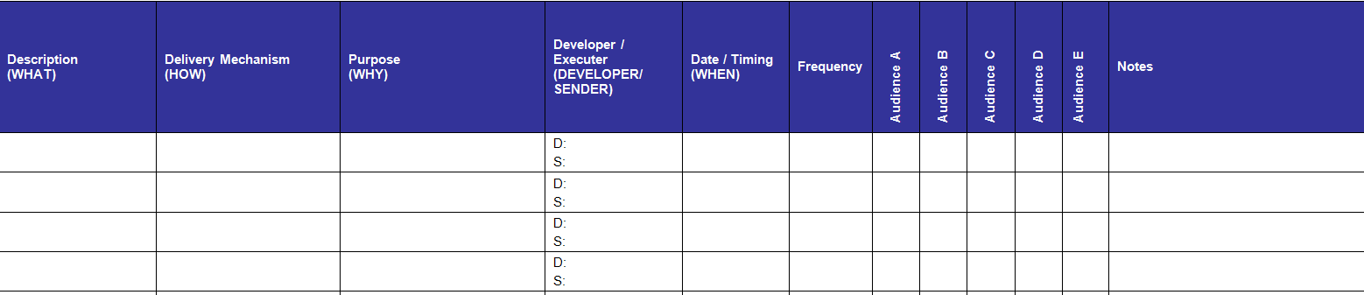
CHANGE MANAGEMENT PLANS
Communication & Training Plan
Description (WHAT)
Delivered mechanism (HOW)
Purpose (WHY)
Developer / Sender (WHO)
Date / Time (WHEN)
Frequency (HOW OFTEN)
Audience(s) (TARGET)
Notes
Can be two separate Plans or combined
Notes:
CHANGE MANAGEMENT PLANS
Here is an example of a key deliverable from the second phase – Manage Change. There are many plans that should be developed in this phase and I have selected to look at the Communications & Training Plan.
The people change management Strategy from the first stage will help identify the scope of this plan.
I have combined the two plans into one consolidated plan.
Depending on the type of change you might have to split this into two separate deliverables.
A Communication and Training plan has the following topics covered:
CLICK
A short description of the activity – WHAT is this all about?
CLICK
How is this delivered? – HOW
CLICK
What is the purpose of this activity – WHY is this done?
CLICK
WHO develops the message and WHO is the sender. It could be the communications team crafting the message that the executive sponsor will be sending.
CLICK
The Date and Time for the activity – WHEN
CLICK
Is the activity repeated, what is the frequency - HOW OFTEN. This column is optional but depending on the type of project there might be many recurring activities.
CLICK
What is the target audience(s) – TARGET
CLICK
Additional information that needs to be captured - Notes

Slide 13
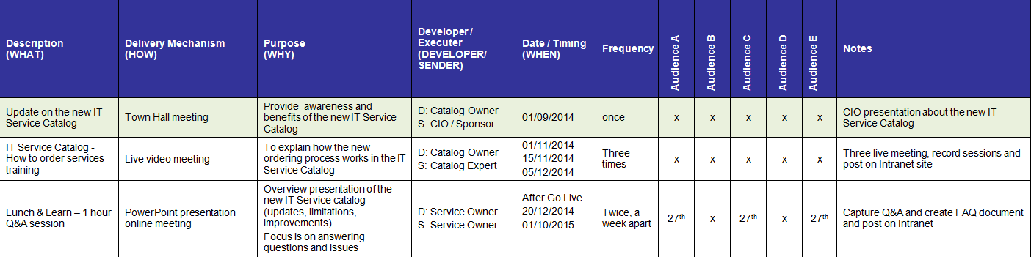
COMMUNICATION & TRAINING PLAN
This plan becomes a permanent record of what was communicated and training provided to whom and when.
Topics & Focus:
Why is this change needed?
Why changing now?
What if we don’t change?
What’s in it for me (WIIFM)
How am I impacted?
How will the change happen?
Communicate to:
Employees
Managers
Senior leaders / sponsors
Any impacted group
Notes:
COMMUNICATION AND TRAINING PLAN
Here is an extract from a Communication and Training plan implementing an IT Service Catalog.
CLICK
When creating the plan the following topics and focus should be addressed:
Why is this change needed?
Why are we changing now?
What will happen if we don’t change?
What’s in it for me (WIIFM) – why should I Embrace the change
How am I impacted? E.g. new process, new organization new location etc.
How will the change happen? E.g. gradually or big bang
CLICK
The key groups you need to communicate to are usually
Employees
Managers
Senior leaders / sponsors
Any impacted group
This plan becomes a permanent record of what was communicated and training provided to whom and when. I usually mark the completed lines with a different color to indicate that this has already been performed.

Slide 14
John P Kotter & ADKAR®
John P Kotter’s 8 Steps
Step 1: Create Urgency
Step 2: Form a Powerful Coalition
Step 3: Create a Vision for Change
Step 4: Communicate the Vision
Step 5: Remove Obstacles
Step 6: Create Short-Term Wins
Step 7: Build on the Change
Step 8: Anchor the Changes in
Culture
Prosci’s® ADKAR®
A: Awareness
D: Desire
K: Knowledge
A: Ability
R: Reinforcement
14
Notes:
JOHN P KOTTER AND ADKAR
When addressing people change management I think the two most known frameworks are John P. Kotter’s 8 steps and Prosci’s ADKAR model.
CLICK
These are the 8 steps in John P. Kotter’s framework:
Step 1: Create Urgency
Step 2: Form a Powerful Coalition
Step 3: Create a Vision for Change
Step 4: Communicate the Vision
Step 5: Remove Obstacles
Step 6: Create Short-Term Wins
Step 7: Build on the Change
Step 8: Anchor the Changes in Culture
CLICK
Prosci’s ADKAR model has 5 steps
A: Awareness of the change
D: Desire to take part in the change
K: Knowledge of how to change
A: Ability to use the new processes and tool
R: Reinforcement of the change
These two model look at first very different but there are many similarities.

Slide 15
COMPARING CHANGE FRAMEWORKS
Different but same…
John P Kotter | Similarities | ADKAR®
Step 1: Create Urgency
Step 2: Form a Powerful Coalition
WHY is the change needed (Awareness & Urgency)
Risk if we do NOTHING
Why Change?
A: Awareness
Step 3: Create a Vision for Change
Step 4: Communicate the Vision
Long term VISION (Desire to be part of the change and future vision)
Future State
D: Desire
Step 5: Remove Obstacles
TRAINING (new knowledge)
EMPOWER people to execute the new process and tools and remove obstacles
K: Knowledge
A: Ability
Enable Change
Step 6: Create Short-Term Wins
Step 7: Build on the Change
Step 8: Anchor the Changes in
Culture
RESISTANCE Management
CELEBRATION of “wins”
Keep the MOMENTUM going
R: Reinforcement
Reinforce
Notes:
COMPARING CHANGE FRAMEWORKS
The idea here is not to be technically correct when comparing these two frameworks but show form a high level perspective that the models have a lot in common.
You can compare any of the industry recognized frameworks and you will see that they are quite similar in many aspects but are using different words or steps.
CLICK
It is imperative to tell WHY a change is happening and what will happen if we don’t change.
For example, a company might need to replace or upgrade their product line or they will go out of business. This creates Urgency and awareness Why the change is needed.
CLICK
To paint a picture of where the organization is heading in the future is very important. A clear and compelling Vision that is communicated and understood will create Desire to help with the transition.
For example, a new and cool product line as a Vision will create desire to be part of the change.
CLICK
It is important to enable to organization to change. Provide training for new skills and knowledge, change organizational structures or maybe redesign the bonus and incentive plans to promote the new behavior.
For example, train people how to be innovative or create an annual innovation award that generates a buzz, status and a monetary reward.
CLICK
Change is always a risk and it is important to reinforce the change, celebrate successes and build a culture that can sustain a change.
For example, celebration of a new product. Highlight market research or audit new processes to stress the importance of process compliance.
CLICK
As you can see the words are different in the two frameworks I have selected to compare but the frameworks are quite similar.
They focus on the WHY, the VISION, ENABLE the organization to change and REINFORCEMENT.

Slide 16
THE IMPACT OF EFFECTIVE CHANGE MANAGEMENT
6x more likely to reach objectives
2x more likely to stay on budget
95%
82%
6X
2X
Strong executive sponsorship:
3x more likely to reach objectives
4x more likely to stay on schedule
78%
75%
3X
4X
Strong executive sponsorship and a structured approach to the people side of change will significantly increase a project’s probability of success.
Research from the Best Practices in Change Management 2014 Edition – Prosci® Benchmarking Report
Notes:
THE IMPACT OF EFFECTIVE CHANGE MANAGEMENT
Prosci has done extensive research over the past 16 years and found some very interesting information.
CLICK
Project with excellent change management compared with poor change management were 6 times more likely to reach their objectives.
95% responded that they met or exceeded project objectives with excellent change management.
CLICK
Project with excellent change management compared with poor change management were 2 times more likely to stay on budget.
82% responded that they were on or under budget with excellent change management.
CLICK
Project with a strong executive sponsor compared with little or no sponsorship were 3 times more likely to reach their objectives.
78% responded that they met or exceeded project objectives with a strong executive sponsor.
CLICK
Project with excellent change management compared with poor change management were 4 times more likely to stay on schedule.
75% responded that they were on or ahead of schedule with excellent change management.
CLICK
So, the big take-away is:
If you have a strong executive sponsor and are using a structured change management approach this significantly increase the project’s probability of success.

Slide 17




THE CASE FOR PEOPLE CHANGE MANAGEMENT
Effective people change management will improve financial performance, strategic goals and project delivery.
Changes are only successful when individuals do their jobs differently and this requires a structured approach for supporting individual change.
A growing body of data shows that with more effective people change management, projects are more likely to meet objectives, finish on time and finish on budget.
Three "people side" factors directly contribute to the ROI of project: 1. Speed of Adoption (how fast) 2. Ultimate Utilization (how many); and 3. Proficiency (how well).
When the “people side of change” is not managed effectively, projects and initiatives experience higher costs and greater risks of failure or delay.
Research from the Best Practices in Change Management 2014 Edition – Prosci® Benchmarking Report
Notes:
THE CASE FOR PEOPLE CHANGE MANAGEMENT
I really hope I have built a strong case for people change management and provided you with some compelling arguments why people change management is not optional.
CLICK
Changes are only successful when individuals do their jobs differently and this requires a structured approach for supporting individual change.
CLICK
Research is showing people change management has a huge impact on project success.
CLICK
People enable the change, and the key drivers are:
Speed of Adoption (how fast)
Ultimate Utilization (how many); and
Proficiency (how well).
CLICK
One of the greatest risks of the project is people not changing. Make sure you have a plan in place to mitigate that risk – that plan is a structured people change management framework with and Active and Visible sponsor.

Slide 18
LESSONS LEARNED
Structured Change Management Approach & Preparation
  Change Management Process – Three Phases (Organizational)
  John P. Kotter – 8 Steps (Organizational)
  ADKAR® - Embrace, Adopt & Use (Individual)
Dedicated Change Management Resources
  Driving Change management within organization / project
Identify Sponsor & Define Sponsor Model
  Alignment of all Sponsors (Executive, Project, Technical - NOT Education)
Start Early
  Project Initiation (People Change Management Strategy)
Communicate Why, Communicate Vision, Communicate….
Did I say start early and engage Sponsors!
Notes:
LESSONS LEARNED
Here are some lessons learned from the many change management program I have established and managed.
CLICK
Use a Structured Change Management Approach.
Don’t forget to perform the preparation phase to create the people change management strategy. Most projects jump right into training without creating the Urgency, Awareness, Vision and Desire.
CLICK
Make sure you have resources that are dedicated to people change management, just like you have technical and process experts on the project team, you need a people change management expert.
CLICK
A Visible and Active Sponsor is the most important factor to deliver a successful project. Identify the sponsor and help them be successful.
CLICK
You can never start too early with people change management activities. Start with the preparation phase and make sure the people change strategy is a very early deliverable.
CLICK
Industry research indicates that a message must be sent 5-7 times in different forms to be understood so it is almost impossible to “over communicate”

Slide 19
BACK HOME – WHAT DO I DO NOW?
“Sell” the value of People Change Management
  Increase Probability of Project Success
  Ask the RIGHT question (see slide 8)
  Funding for people change management / dedicated resource
Identify your Executive Sponsor
  Help Sponsor be ACTIVE and VISIBLE
Identify your Structured Approach
  John P. Kotter’s 8 steps
  Prosci ADKAR® (Prepare, Manage, Reinforce)
Define Change Management Strategy (Prepare)
  How much change management is needed
  Change management and Project management team
Start create your Communication Plan (Execute)
  Who should we communicate to?
  What is the key message? (Why Change?)
Start Today!
Notes:
BACK HOME – WHAT DO I DO NOW?
Ok, so you have attended this presentation and think it might be a great idea – what do you do when you get back home?
If there is limited people change management you need to sell this to the steering committee and line management.
Make sure you ask the right question during those discussions.
What portion of project benefits depend on people change management.
Your objective is to get buy-in for a people change management program with funding and dedicated resources.
CLICK
The most important contributor to success is to have a Visible and Active sponsor. Identify you sponsor and help them be successful.
CLICK
Make sure you use a structured approach – people change management is much more than a communication plan.
CLICK
How much people change management is needed for your project? Assess the project and create the needed team.
CLICK
When you have selected a structured approach and assessed you project you have to start communicating to the PEOPLE that will be impacted why the change is needed and the vision.

Slide 20

Thank you for attending this session.
Questions?
Don’t forget to complete an evaluation form! thorsten@tmanthey.com www.tmanthey.com
Notes:
Thank you for attending the presentation.
On my web page and on the USBs I handed out there are a lot of helpful material.
You can always reach out me via my email.
Thank you and please remember to fill out the evaluation!

