Slide 1
WORKSHOP People Change Management Strategy
You will create the People Change Management Strategy document in this workshop to help you answer the question:
How much People Change Management is needed for my project?
Presented by Thorsten Manthey
1

Slide 2
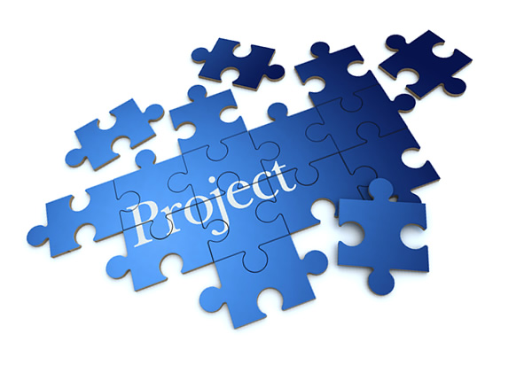
WORKSHOP
You need
Laptop
A Project (your own project)
Document templates (provided by presenter)
2

Slide 3
WORKSHOP APPROACH
People Change Management Strategy Overview
Topic Introduction
Working Session
Short Introduction of the area to be covered (six in total)
Present templates and available artifacts that can be used for this section
Use template material and artifacts provided
Modify / Add project specific data in the template
There is not enough time to complete all the information!

Slide 4
PEOPLE – PROCESS - TECHNOLOGY
Why a three legged stool (People, Process & Technology) cannot stand with only two legs.
Your Project!
Introduction of People Change Management
TECHNOLOGY
PROCESS
PEOPLE
4

Slide 5
WHY PEOPLE CHANG MANAGEMENT
Increase Probability of Project Success!
Manage employee Resistance to change
Improve Speed of Adoption (how quick)
Increase Utilization (how many)
Optimize Proficiency (how well)
Introduction of People Change Management
Research from the Best Practices in Change Management 2014 Edition – Prosci® Benchmarking Report
5
Notes:
Why People Change Management
So, why are we focusing on PEOPLE change management anyway? What are we trying to accomplish with this?
In short, the key reason is to increase the probability of the project being successful.
So what represents project success?
How does PEOPLE change management contribute to a project to be successful?
CLICK
First, people change management is identifying and mitigating resistance to the change.
CLICK
Secondly, it will improve the speed of adoption which means how quick people are using the new processes and tools that are changing.
CLICK
Thirdly, it will increase the Utilization which means that more people will use the delivered solution and processes from the start.
CLICK
And lastly, it is optimizing the Proficiency of how well people are using the new tools and processes which minimizes costly mistakes and process failures.
So, with less resistance to the change, quicker adoption and embracement, more people using the systems and tools better and smarter – this will substantially increase the probability of project success and expected ROI.

Slide 6
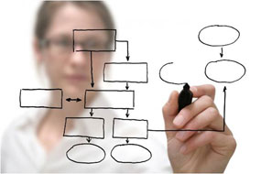
PROCES & TECHNOLOGY IS NOT ENOUGH
Perfectly Designed Process
+
Perfectly Designed Technology
If PEOPLE are not following the new process or not using the new tool very little is changing!
=> Project Goal/Benefits/ROI is NOT realized
Introduction of People Change Management
Notes:
Process and Technology is NOT enough
When executing a project, just focusing on designing a perfect process and delivering a world class technical solution is NOT enough!
CLICK
Imagine if the people you are designing the solution for are not using the new process or not utilizing the tools correctly - nothing will really change.
It is ultimately the people changing the way they are working that are the key factor for a successful project.
Let’s take another look at this three legged chair.
Most projects are usually great at delivering exceptional technical solutions with superbly designed processes. Organizations usually have droves of senior technical experts and ITIL gurus supporting the project designing best of class processes.
BUT…
Many projects have limited or no people change management experts on the project team.
So, let us take a look at what would happen to a project with limited people change management.
As I mentioned, this stool represent your project so let us simulate that limited people change management experts are part of the project team.
REMOVE PEOPLE LEG
I am representing this by removing the people change management leg.
What happened to the project?
Well, it crashed and was not successfully delivered.
All your project tasks, people, deliverables, resources are no longer to be rescued as they are all over the floor.

Slide 7
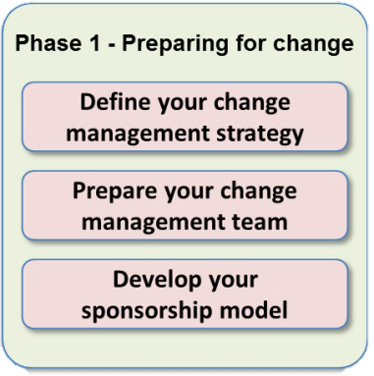
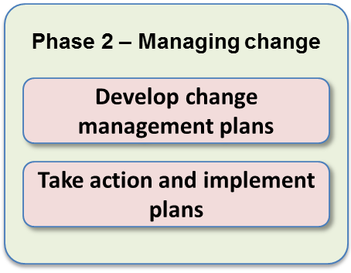
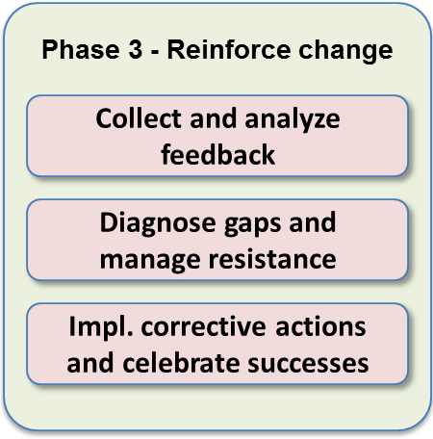
STRUCTURED APPROACH
People Change Management Strategy Overview
Phase 1 – Preparing for Change
The first phase of the Change Management process is aimed at getting ready.
It answers the question: “How much change management is needed for this specific program/project?"
The first phase provides the situational awareness that is critical for effective change management
From Prosci® Inc. – Change Management Process

Slide 8
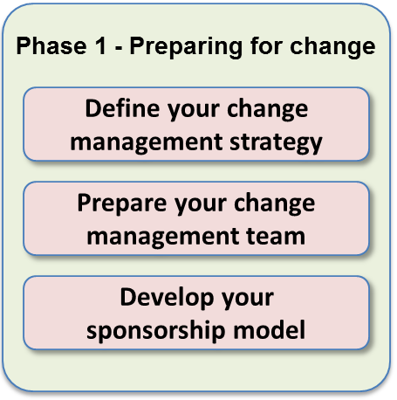
PEOPLE CHANGE MANAGEMENT STRATEGY
Change Characteristics Assessment - What is the scope of the change (Group, department, division or whole company), # of impacted people - What type of change is it (policy, process, technology, organization, staffing, merger, acquisition etc.) - What is the amount of change (incremental improvements vs. dramatic reengineering) - What is the Timeframe of the change and the different project phases
Organizational Attributes Assessment - What is the value system and culture? What is the leadership style and power distribution? - Capacity for change, is the organization saturated for change or open for change? - Residual effects past changes? - Middle management position (advocates, own agenda, unpredictable or sabotage the change)
Proposed sponsorship model, project team and steering committee - Single sponsor, leadership team, steering committee, executive sponsor, project sponsor - Project team, program manager, executive steering committee, operational committee
Proposed change management team - Structure and size of the team (full time vs. part time, reporting structures)
Risk assessment of the change - High risk, low risk, change resistance, large disruptive change
Recommendations for special tactics - Special tactics for special circumstances, key identified groups requiring special attention
People Change Management Strategy Overview
8
Notes:
People Change Management Strategy
A people change management strategy is developed to get an understanding of the change itself and how people will be impacted.
This is the first phase where we should ask “How much change management is needed for this specific program/project”?
To be able to answer that question the people change management strategy is developed.
The Change Management strategy includes a number of sections.
The initial section describes the change characteristics of the program.
For example, the scope of the change – department, division or is it the whole company.
What kind of change is it – Policy, process, technology, merger or acquisition.
The amount of change – incremental improvement or total reengineering.
CLICK
The second section is to assess the organizational attributes. What kind of leadership style exist? Is there capacity for change or is the organization change saturated.
Is there any history of past changes and their success or failure. What is the position of middle management, are they supportive or not?
CLICK
The next section is all about the project organization and sponsorship. Are there multiple sponsors, who are the members of the steering committee, what project structure has been defined? Is there a program manager.
This is to understand the reporting structures, sponsorship and the governance of the project.
CLICK
The fourth section of the change management strategy is to define the change management team and how it is related to the project organization. For example, are the change management resources full time or part time engaged on the project? Do they report to the Program manager or directly to the steering committee?
CLICK
There is also a section covering a risk assessment of the change, is this s high risk change that is disruptive or a low risk change with little resistance.
Click
The last section identifies special tactics for special circumstances, which are key identified groups requiring special attention.
For example, is there a group that is known for resistance to changes or are the cultural differences that must be addressed for an international change effort.

Slide 9
PEOPLE CHANGE MANAGEMENT DEPENDENCE ON PROJECT SUCCESS
What is your Project/Program?
People Change Management Strategy answers:
How much People Change Management is needed for my project?
ROI
100%
Embraced
Adopted
Used
Embraced
Adopted
Used
Limited People Change Management dependency
75%
People Change Management Strategy Overview
Designed
Developed
Delivered
Large People Change Management dependency
People are required to change the way they are working (e.g. new process)
People driven project
Project Benefit Realization
50%
Technical driven project
25%
Designed
Developed
Delivered
0%

Slide 10
TEMPLATE DOCUMENTATION
Use Template provided:
TEMPLATE People Change Management Strategy.pptx
Edit and Update directly in the document
Each section has helpful information you can update or use as “thought triggers” when documenting the details specific for your project.

Slide 11
CHANGE CHARACTERISTICS ASSESMENT
What is the Scope of the change/project?
Group, department, division or whole company
Number of impacted people?
What Type of change is it?
Policy, process, technology, organization, job roles, staffing
Merger, acquisition, downsizing etc.
What is the Amount of change?
Incremental improvements
Dramatic reengineering
What is the Timeframe of the change/project?
Start and end of the different project phases
TEMPLATE
Slide 5-9

Slide 12
ORGANIZATIONAL ATTRIBUTES ASSESMENT
What is the Value System and Culture?
What is the leadership style and power distribution?
What is the Capacity for change?
Is the organization saturated for change or open for change?
What are the Residual effects past changes?
Were past changes successful or failures?
What is the position of Middle Management?
Are they advocates, have their own agenda, unpredictable or sabotage the change?
TEMPLATE
Slide 10-15

Slide 13
SPONSORSHIP MODEL, PROJECT TEAM & STEERING COMMITTEE
What is the Sponsor Model for the project?
Single sponsor, multiple sponsors, Executive sponsor, level of sponsorship
Who are the members of the Leadership Team?
Business leaders, IT leaders, level of seniority etc.
Structure and members of the Steering Committee and Project Team?
Team Structure
Operational committee vs. steering committee
Program Manager vs. Project Managers
TEMPLATE
Slide 16-30

Slide 14
PEOPLE CHANGE MANAGEMENT TEAM
What is the Structure and Size of the People Change Management team?
Full time vs. part time resources
Shared resources
Reporting structure within the project
TEMPLATE
Slide 31

Slide 15
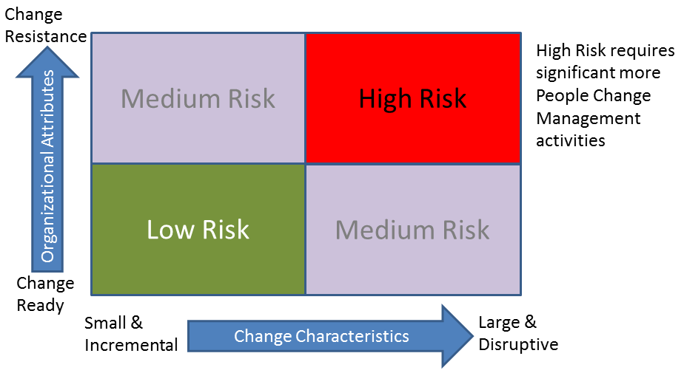
RISK ASSESSMENT
What is the Assessed Risk of the project/change?
High risk vs. Low risk
Change resistant organization
Large disruptive change
Cultural barrier
Other differences
Etc.
TEMPLATE
Slide 32-33

Slide 16
RECOMMENDED SPECIAL TACTICS
What are some of the Recommended Special Tactics for the project/change?
Special circumstances
Resistance (e.g. from middle managers)
Key identified groups requiring special attention
TEMPLATE
Slide 34

Slide 17
NEXT STEPS
Complete People Change Management Strategy document
Review with program/project/change team
Review with Leadership / Sponsor
Present to Steering Committee
OBJECTIVE: Obtain People Change Management funding and resources for phase 2 & 3.
We are not doing this for the sake of People Change Management but for increasing the probability for a successful project!

Slide 18
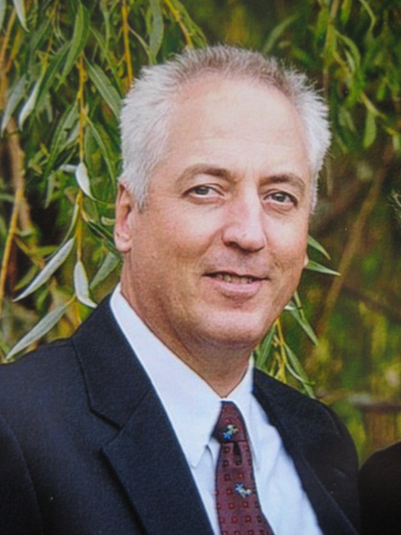
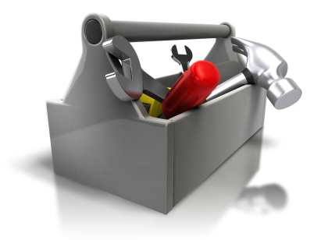
Questions?
Thorsten Manthey
thorsten@tmanthey.com
tmanthey@kpmg.com
Cell: (617) 513 0000

