Slide 1

WHO-HOW-WHAT:
AN APPROACH TO EFFECTIVE PEOPLE CHANGE MANAGEMENT
Thorsten Manthey
Manager, CIO Advisory – KPMG LLP
Version 5

Slide 2



ABOUT THIS WORKSHOP!
Defining your Communication and Training Plan for your project
You will need:
A project (real or imaginary)
Laptop / tablet
Templates (will be provided)
What!?
I have to do something here?
You mean “really” work?
Let’s go!
I am ready!
http://www.tmanthey.com/speaker.html

Slide 3




WHY PEOPLE CHANGE MANAGEMENT?
Increase Probability of Project Success!
Manage employee Resistance to change
Improve speed of Adoption (how quick)
Increase Utilization (how many)
Optimize Proficiency (how well)
Research from the Best Practices in Change Management 2014 Edition – Prosci® Benchmarking Report
3

Slide 4
QUANTIFYING THE NEED
More than 2/3 of large U.S. companies are managing significant change (transformation, global expansion and product launches, and M&A)…
The outcomes are not always as expected:
66% OF MAJOR CHANGE INITIATIVES FAIL TO ACHIVE DESIRED OUTCOME
57% OF COMPANIES FACE A DECLINE IN PRODUCTIVITY
41% OF COMPANIES FACE A DECLINE IN EMPLOYEE MORALE
Source: Business Case for Managing Change, (2007). CEB Corporate Leadership Council.

Slide 5
IMPORTANCE OF CHANGE MANAGEMENT
Pace and frequency of change is increasing
Successful companies manage change well
Lead and manage change - most sought after skills for both leaders and staff
ROI is directly related to the ability to lead and manage change
Leading change is a leadership skill with the highest Return on Investment
Source: Business Case for Managing Change, (2007). CEB Corporate Leadership Council.

Slide 6



PEOPLE - PROCESS - TECHNOLOGY
Three mandatory legs …
My Project!
People Change Management
is NOT optional
PEOPLE
TECHNOLOGY
PROCESS
6

Slide 7



PROCESS & TECHNOLOGY IS NOT ENOUGH
Perfectly Designed Process
+
Perfectly Designed Technology
If PEOPLE are not following the new process or not using the new tool, very little is changing!
=> Project Goal/Benefits/ROI is NOT realized

Slide 8
USE A STRUCTURED APPROACH
People Change Management Approaches/Frameworks
ADKAR (Prosci)
Kotter’s 8 Steps
KPMG’s methodology
Company-specific
People Change Management is much more than a communications & training plan!
Methodology example courtesy of KPMG LLP

Slide 9



WHO - HOW - WHAT
WHO is impacted?
Identify all groups that are being affected in any aspect by this change.
HOW are they impacted?
What is changing?
What is not changing?
WHAT is needed?
Identify the “actions” and how much people change management is needed for the impacted groups?
Methodology example courtesy of KPMG LLP

Slide 10

THE THREE STEPS APPROACH
WHO
HOW
WHAT
STEP 1
STEP 2
STEP 3
Initial meeting
2nd validation meeting
Initial meeting
2nd validation meeting
Separate meetings with each group
After these three steps have been completed you can populate the Communication & Training (C&T) plan
Communication & Training Plan

Slide 11

ACTIVITY: APPLY THE APPROACH
Open the PowerPoint template
  WHO-HOW-WHAT template.pptx
www.tmanthey.com/speaker.html

Slide 12
1. WHO IS AFFECTED?
Group | Contact | Description | # Members / Information
Identify all groups that are being affected in any aspect by the change
  Users of the new system, tool or processes being implemented
  Data consumers (e.g., reporting teams, finance teams, etc.)
  Managers
  Service Desk / 2nd level support / Technical support
  Developers / Designers
  HR / Finance / Procurement
  External Vendors / Partners
Remember to stick to the agenda - WHO Don’t start identifying HOW or WHAT

Slide 13
1. WHO IS AFFECTED?
Group | Contact | Description | # Members / Information
Service Desk | NN | Handles first level phone calls and tickets from customers. USA and India. | +90 customer service rep, multiple locations, 7x24x365
2nd level Support | NN | Handles escalated calls from the Service Desk. Two locations in the US | 15 support staff, two main locations, 7:00-21:00 business days
HR | NN | Supporting with the new roles and organizational changes | 5 HR people supporting the IT organization
Procurement | NN | Internal team plus a number of vendors | 2 people in procurement team. 3 major vendors
Finance | NN | Provides input to the new process via an automated feed from finance system | 2 VPs and their groups, total of 9 people
IT Managers | NN | All IT managers within the Infrastructure organization | All line managers 45 managers + their team, total ~800 people
Customers ordering services | NN | Anyone using the process. | USA: 1,500 people India: 200 people
Reporting team | NN | Extracting data from the system creating monthly reports | 6 individuals
Interfacing process teams | NN | Multiple interfacing processes | 5 process managers and 5 process owners
App. Development | NN | The team leader for the application development team X | 1 team lead and 10 people in the team in total
Example

Slide 14
2. HOW ARE THEY AFFECTED?
Affected Group | How are the affected? / What information do they need?
Ask the following questions for each of the affected groups identified
  What is changing for this group? What will be different?
  What is not changing for this group? What will be the same?
  What is driving the change, why are we changing?
  What is the Vision for the Enterprise / BU / Group?
  What does success look like for this Enterprise / BU / Group?
  WIIFM? (most likely different for each of the groups)
  Who is going to lose / gain what?
  What happens if we do NOT change?

Slide 15
2. HOW ARE THEY AFFECTED?
Affected Group | How are the affected? / What information do they need?
Service Desk | Emails, calls and chat to the Service Desk about the new tools/system/processes Knowledge about the new/updated/deleted tools/system/processes e.g. how to access, use, convert etc. How and where to escalate and route calls to 2nd level support Need to know when the tool/system/process has been released – Go Live date (staffing etc.) Implementation plans e.g. will there be a Hyper Care, phased roll-out etc. Information about Notifications, Approvals, Status Views, Escalations etc. in the new tool (Service Catalog) New support scripts to be developed / New FAQ and knowledge articles / Update existing information
2nd Level Support | Escalations to the 2nd Level Support about the new tools/system/processes How to escalate and route to external vendor Need to know when the tool/system/process has been released – Go Live date (staffing etc.) Implementation plans e.g. will there be a Hyper Care, phased roll-out etc. Information about Notifications, Approvals, Status Views, Escalations etc. in the new tool (Service Catalog) New support scripts to be developed / New FAQ and knowledge articles / Update existing information
Managers | New roles and organizational changes e.g. new and different skills required for staff Operational procedure changes, sourcing model will change (now outsourced) New / different reports or reporting structures Policy updates e.g. approvals, escalation etc.
Process Users | New tools and procures executing the process New or different skills required for the new role
Reporting team | New user interface when extracting data from the tool/system New data fields and values Mapping of old data to new data etc.
Example

Slide 16
3. WHAT ARE THE NEEDED ACTIONS?
# | Actions for <Group Name> | Developer | Timing
1
2
Separate meeting with each affected group with key stakeholders
  Multiple meeting might be required
  One PPT slide for each group
Capture:
  What activity is needed
  The person / role responsible to develop the material / training, etc.
  The timing (a specific date or, for example, “1 week before go live”)

Slide 17
3. WHAT ARE THE NEEDED ACTIONS?
# | Actions for Service Desk | Developer | Timing
1 | Live Demonstration of the End-to-end tool/system/process Train the trainer, live training (NN, NN, NN) Record demonstration and place on web page | Process Expert (NN) | 2 weeks before go live, 1 week before training session
2 | Information - Need to know when the tool/system/process has been released – Go Live date Email sent with release information (2 different emails) | Project Manager (NN) | 4 weeks before go live and also just days before Go Live
3 | Training and some hands on exercise on how to use the tool/system/process and how to escalate any issues the user experiences to 2nd level support. Train the trainer, live training (NN, NN, NN must attend) Record session and place on web page | Process Expert (NN) | 2 week before Go Live and just after Go Live (two sessions)
4 | Information session (Live web meeting and Q&A) about Notifications, Approvals, Status Views, Escalations etc. in the tool/system/process Train the trainer, live training will deliver session | Train the Trainer person (NN) | 1 week before Go Live and just after Go Live (two sessions)
5 | Service Desk Activity – Develop new support scripts / New FAQ and knowledge articles / Update information that exist / review & update what information is on the web | Service Desk Manager | Prepare before go live and release at Go Live
6
Example

Slide 18


OVERALL TIMELINE
Usually takes 3-5 weeks* to complete
Start as soon as possible!
The data you collect is a SOLID START to developing an effective C&T plan
Remember, the C&T plan is a living document
As a facilitator you collect and update the information gathered and distribute prior to the second meeting.
Individual meetings scheduled with each of the affected groups to identify the actions (WHAT).
C&T Plan
Week 1
WHO
Week 2
HOW
Week 3
WHAT
Week 4
Week 5
*Example timeline; may increase per the complexity and size of the change across the organization

Slide 19
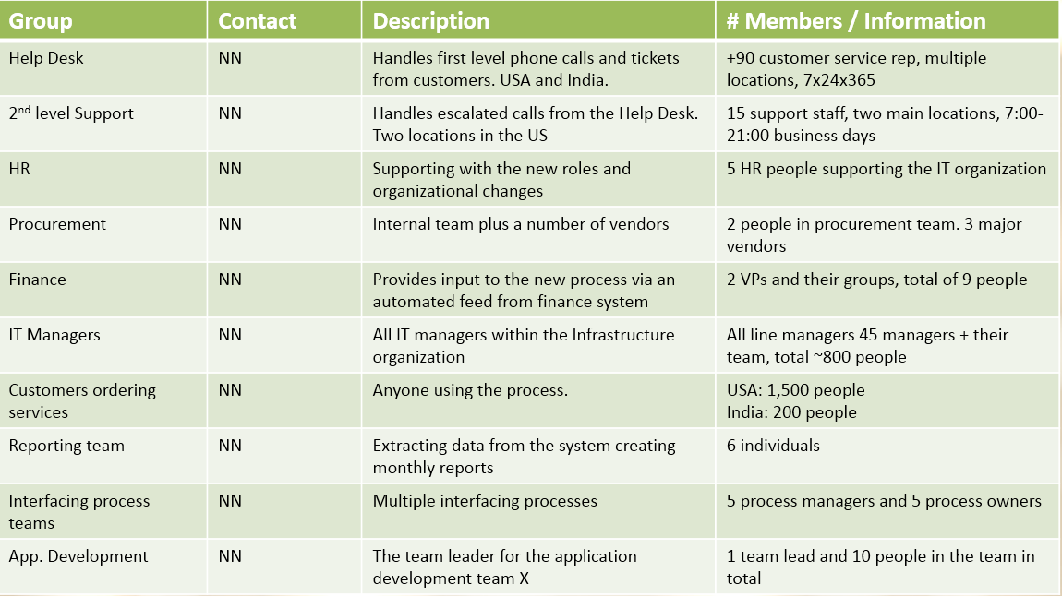
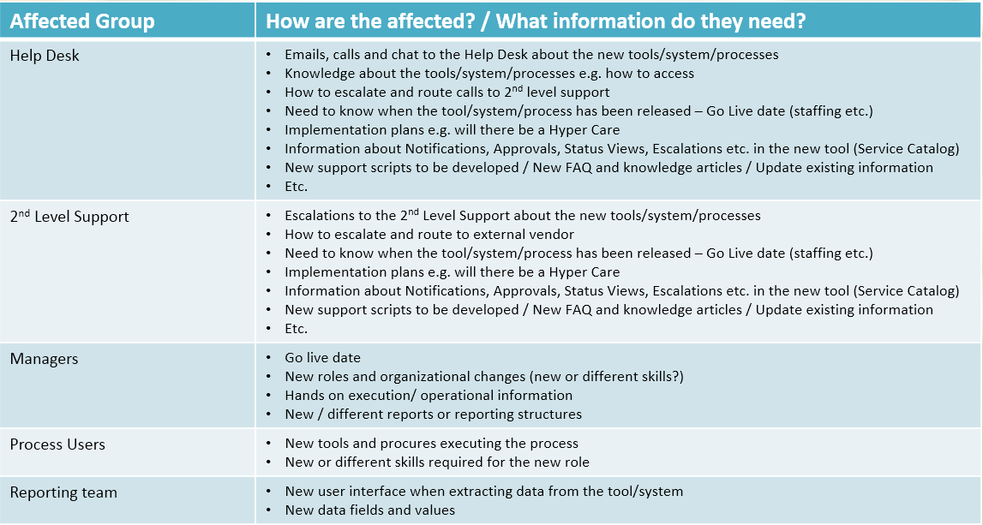
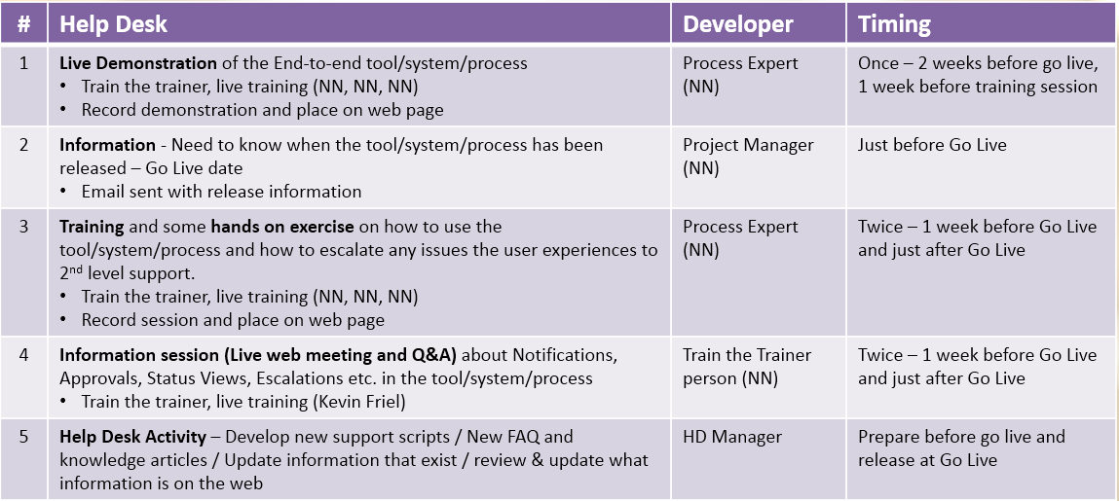

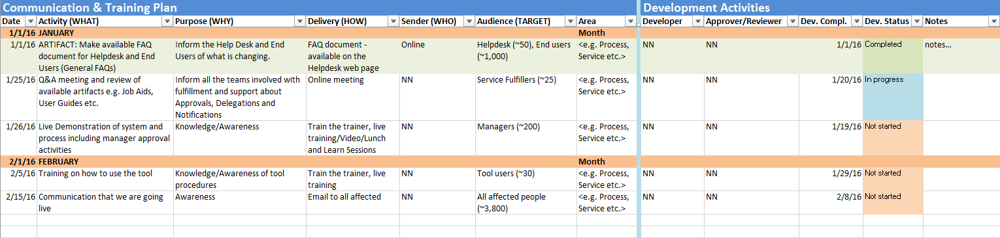
POPULATE THE C&T PLAN
You have captured a lot of solid data
WHO
HOW
WHAT
Communication & Training Plan
http://www.tmanthey.com/speaker.html

Slide 20
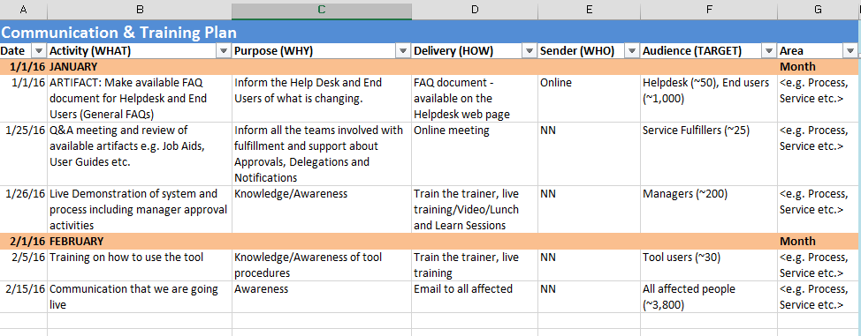
COMMUNICATION & TRAINING PLAN
Filter by TARGET GROUP
Filter by AREA

Slide 21
STAY WITHIN THE STEPS OF THE APPROACH
It is a very simple approach:
WHO – HOW – WHAT, but very effective!
If you stick to the agenda you will have solid data to populate the C&T plan.
  It is very easy to get off track by focusing on the “WHAT” too early – DON’T DO IT

Slide 22
Thank you for attending!
Please don’t forget to complete an evaluation form!
Thorsten Manthey
Manager, CIO Advisory – KPMG LLP
(617) 513 0000
thorsten@tmanthey.com

