Slide 1
ITSM Governance is Imperative to Succeed
Ensuring clear roles, responsibilities, accountabilities, escalation paths and thresholds are defined for IT Service Management.
Establishing a Strategic Process Roadmap.

Slide 2
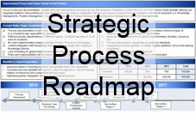
What is ITSM Governance?
If you ask 10 people what ITSM Governance is, you will likely get 11 different answers…
The Beast
Councils
Boards
Roles
Accountabilities
Responsibilities
Notes:
This presentation is about IT Service Management Governance and how to implement this within your organization.
I will cover some of the key process roles and their responsibilities and accountabilities you need to establish as well as the key councils and boards required in the ITSM governance framework.
CLICK
I will also introduce to you one wicked “Governance Beast” I have seen in many organizations. This is a Beast you have to stop feeding and it must be killed!
CLICK
One way of killing this Beast is by implementing ITSM Governance and by using a tool I have developed that I call “Strategic Process Roadmaps”.
I will provide you with the templates and the knowledge how to develop Strategic Process Roadmaps so you can kill this governance Beast!

Slide 3
Governance vs. Management
Management plans, builds, runs and monitors activities in alignment with the direction set by the governance body to achieve the enterprise objectives.
Governance ensures that stakeholder needs, conditions and options are evaluated to determine balanced, agreed-on enterprise objectives to be achieved; setting direction through prioritization and decision making; and monitoring performance and compliance against agreed-on direction and objectives.
COBIT 5: A Business Framework for the Governance and Management of Enterprise IT
Notes:
Governance vs. Management
Many organizations have difficulties to differentiate between Management and Governance.
I think COBIT5 has defined this in a simple enough way to understand the differences.
It is very important to understand the differences as the activities performed by the different roles that are either responsible to “Manage” a process are very different from the roles that is accountable for the “Governance” of a process.
This is what the COBIT5 definitions is for management:
Management plans, builds, runs and monitors activities in alignment with the direction set by the governance body to achieve the enterprise objectives.
This how COBIT5 defines Governance:
Governance ensures that stakeholder needs, conditions and options are evaluated to determine balanced, agreed-on enterprise objectives to be achieved; setting direction through prioritization and decision making; and monitoring performance and compliance against agreed-on direction and objectives.
As you can see I have highlighted some words in bold to stress the differences between Management and Governance. The objectives are quite different.
In short I usually describe Management as the “doer and executer” and Governance is more “strategic” and setting the direction.
So how does this translate to ITSM governance?

Slide 4
Process Manager vs. Process Owner
The Process Manager is concerned with the management of the process (e.g. day-to-day execution, measurements, documentation, training etc.)
The Process Owner is concerned with the governing of the process (e.g. set direction, prioritization, goal setting, scope, decision making etc.).
Both roles are required but can in some cases be executed by the same person.
Notes:
Process Manager vs. Process Owner
Within IT Service Management process context, the Process Manager is concerned with the management of the process and the Process Owner’s main focus should be to govern the process (e.g. set direction, prioritization and decision making).
You need both roles to be assigned and executed within your organization. Some organizations combine the two roles to one person but it is very important to understand the difference.
In many organizations I have also seen one person being the Process Owner for more than one process.

Slide 5
ITSM Governance – An Actionable Definition
The organizational structures that need to be put in place, the roles that need to be assigned, responsibilities and accountabilities for each role, the meetings and councils to be established to manage escalations and defined thresholds in order to operate and govern IT Processes, Technology Platforms and IT Services within our IT organization.
Establish Organizational Structures
Make sure Responsibilities & Accountabilities are clear
Manage Escalations and defined Thresholds
Identify and assign Roles
Set up Meetings & Councils to communicate and share info
Define a clear scope (Processes, Technology & Services)
This is a very “actionable” definition of ITSM Governance I have used in some organizations
Notes:
ITSM Governance – An Actionable Definition
This is the definion I have used for IT Service Governance in many organization that encompasses IT Process Governance.
The key focus of this specific definition is that it is easy to understand and possible to implement.
This might not be the definition you would use.
Make sure your definition is crafted based on your organizations goal, the governance maturity and your culture.
CLICK
This definition focuses on 6 key areas:
Establish Organizational Structures
Identify and assign Roles
Make sure Responsibilities & Accountabilities are clear
Set up Meetings & Councils to communicate and share information
Manage Escalations and defined Thresholds
Define a clear scope (Processes, Technology & Services)
Most important: It should be actionable and easy to understand
READ DEFINITION

Slide 6
ITSM Governance Framework
Focus
Thresholds for Escalation
(Examples only, organizational specific)
IT Governance Board (ITGB)
IT Strategy & Vision
Strategic Plans
Business Alignment
Vision & Mission
ITGB
IT and Business Leaders
(Business and IT Vision)
Threshold for escalation
New funding e.g. > $25.000
New tools / technology
Organizational changes
Strategic / Roadmaps
Consolidated Strategic Roadmaps
Process Strategy
Strategic Process Roadmap
Strategic Platform Roadmap
12-month rolling plan
Set process / platform goals, scope and future maturity
Prioritization and decisions
Process Owner and Architecture Council (POAC)
POAC
Process Owner / Platform Architect (Strategic & long term goals. Strategic Roadmaps)
Threshold for escalation
Funding request e.g. >$1
New tools / technology
Tool customization
Staff changes / updates
Strategic process impact
Process Manager and Technical Review Council (PMTRC)
Process Manager / Technology Review (Operationally responsible for a consistent execution/integration)
Process Operation
Process Execution
Process Documentation
Process Training
Automation & Technology
Monitoring & Reporting of KPIs and Metrics
PMTRC
Threshold for escalation
Impacting >1 processes
Tool / Process integrations
Process Input / Output
Process Meetings for each Process
Practitioners / Process Engineers
(across organization / functional areas)
Notes:
ITSM Governance Framework – Key Building Blocks
This is an overview of the ITSM Governance Framework, the different councils, its focus Areas as well as the triggers for Escalations to the next level in the governance framework.
To design and implement an IT Service Management governance framework is a major initiative for an organization. Here I will just cover the main structures and some of the key concepts.
The lower level of the IT Service Management governance framework is where Process Managers work with the Practitioners executing their process. They focus mostly on:
Process Execution, Process Documentation, Process Training, Automation & Technology, Monitoring & Reporting of KPIs and Metrics, and so on.
CLICK
If the Process Manager is aware that an improvement or change impacts more than their own process they have to communicate and discuss this with the other Process Managers.
I call this the “Process Manager and Technical Review Council” - the PMTRC - that meet weekly to discuss process improvements and integrations.
Threshold for escalation to the PMTRC are:
Impacting more than one of the processes
Tool / Process integrations
Process Input / Output modifications
The Process Managers in the PMTRC discusses process improvements and potential changes to their processes and tools.
CLICK
The Process Owner and Architecture Council - the POAC - is the next level in the IT Service Management Governance framework. This is where the Strategic Process Roadmaps are developed by the Process Owners.
Each Process Owner develops their own Strategic Process Roadmap and they are discussed in the Process Owner and Architecture Council.
CLICK
If any of the suggested improvements discussed in the PMTRC breach a thresholds defined within the IT Service Management Governance framework they have to escalate this to the Process Owner and Architecture Council – the POAC.
Thresholds could be:
Funding request e.g. >$1, New tools / technology, Create, enhance, or retire appl. or processes, Tool customization, Staff changes / updates, Strategic process impact
The thresholds are different and customized for each organization, these listed here are only examples.
CLICK
The next level of the IT Service Management Governance framework is the IT Governance Board - the ITGB. This is where the IT Strategy and Vision is defined to make sure the IT Strategy is aligned with the Business Strategy and focuses on the business needs.
CLICK
If there are initiatives identified by the Process Owners that breach a defined threshold, they have to escalate to the IT Governance Board. The IT Governance Board meet quarterly or when needed.
Thresholds could be:
New funding e.g. > $25.000, New tools / technology, Major customization, Organizational changes, Strategic / Roadmaps
CLICK
The Process Owners prepare consolidated requests to the IT Governance Board based on the individual Strategic Process Roadmaps each Process Owner has developed.
As there is not unlimited funding or resources for the initiatives, the Process Owners in the POAC prepares together a list of improvement initiatives they think are most important and aligned with the IT Strategy.
The IT Governance Board – The ITGB - can now evaluate and prioritize the suggested improvement initiatives and required investments.
In many organizations the Process Managers request tactical investments and improvement without coordination with the other processes or with a strategic long term focus and this makes it very difficult for IT leaders to know what they should approve or postpone.
This is where the Process Owners provide value through the development of the Strategic Process Roadmaps within a well-defined IT Service Management Governance Framework.

Slide 7
Engagement at the correct level within the ITSM Governance Framework
Example: Modifying a CI Attribute
IT Governance Board
IT and Business
Leadership
Funding
Strategy Change
ITSM Roadmap
Change Ticket
Escalation
Process Manager and
Technology Review Council
Process Owner and
Architecture Council
SME
Process Manager
4. Fred, great idea! I think it will improve my process as well.
5. Fred, I think this will work if we do the following changes to the CI Attribute you are proposing…
1. The Configuration Management process would improve if I could modify this Attribute to the ABC CI.
I will ask Fred, my Process Manager, if we can do that in the tool.
2. John, that is a great idea but I must check with the other processes e.g. Change and the Problem process that will be affected by this change / modification of the CI attribute.
8. I think this is in line with the ITSM Strategy
8. Platform Strategic direction is validated
6. Incident Management.
Wait I am also impacted…
In the PMTRC 3. Paul & Erica, How would the modified CI Attribute affect your process? Would you be ok with this improvement?
Change Management
Process Owner
POAC
Platform Architect
Erica
Mary
Jean
Problem Management
PMTRC
Incident Management
Escalation
Paul
Carla
SME
Config Manager
Configuration Management
7. ITSM Tool
That should be a simple configuration change. No problem!
Escalation
8. If no resolution can be found in the PMTRC or a thresholds is breached it is escalated to the Process Owner and Architecture Council
John
Fred
Fred
David
Platform /
Technology
TACTICAL
STRATEGIC
Notes:
Engagement at the correct level within the ITSM Governance Framework
Here is an example how the ITSM Governance Framework deals with escalation and communication of issues that go across processes and organizations.
CLICK
In this example, a Process SME / Practitioner is proposing to modify a CI attribute within the CMDB for a Configuration Item.

Slide 8
Assign Roles – Do We Need To Hire All These People?
Do we have to hire all the people in this new Governance Framework being implemented? (Process Managers, Process Owners, Platform Owners etc.)
We have NO budget for this!!
We are already working at 100% capacity, who is going to do all this work?
I have no extra staff to assign for this!
You are already doing all (or most) of this work in one form or another but not as structured and formal!
You are structuring the work, making it “official”, and individuals will be recognized for their efforts (assigned Process Roles etc.)
Questions I often Receive…
Notes:
Assign Roles – Do We Need To Hira All These People?
When I help organization implement ITSM Governance I usually get these questions in one form or another:
Do we have to hire all the people in this new Governance Framework being implemented?
We are already working at 100% capacity, who is going to do all this work?
CLICK
My response is that most organizations are already doing all (or most) of this work in one form or another but not as structured and formal!
By structuring the work, making it “official”, and recognize individuals for their efforts and assigning them as either Process Managers or Process Owners might even save you on effort and deliver more effective and efficient process results.

Slide 9
Responsibilities & Accountabilities
Process Manager
Process Owner
Responsible for planning and coordination of all tactical and operational activities
Responsible for the process / procedure definition, development, documentation, implementation, execution and improvement
Custodian of process related documentation and training material
Champion for consistent processes and tool usage, and ensures standardization, integration, and consistency
Monitors and measures the quality and content of the delivery and output of the process
Dedicates time to the process and develops expert process knowledge
Accountable for the strategic direction and long term goal of the process
Accountable for the overall performance and results of the process
Responsible to define process scope and goals
Accountable to ensure support and commitment of resources
Assisting in assigning a Process Manager
Detailed Role descriptions can be downloaded from my web page: http://www.tmanthey.com/speaker.html
Notes:
Responsibilities & Accountabilities
I have captured some of the main responsibilities of a Process Manager and the Accountabilities for a Process Owner.
This is a high level description but if you like to get a more detailed description of these responsibilities and accountabilities you can download a PowerPoint deck from my web page.
For example, the Process Owner is accountable for the strategic direction and long term goal of the process. This means that the Process Owner will develop the Strategic Process roadmaps and I have captured this in the detailed PowerPoint.
You will also find a slide with some of the tangible artifacts these roles should produce.

Slide 10
Feeding the Beast…
ITSM
Governance
The beast feeds on anything that is not clear, confusing or lacks structure and guidance.
It will drain the organization of progress and ensure no continuous improvement takes place.
The Information gap between IT leadership and IT operations
You can eliminate (kill) this beast, but how?
Notes:
Feeding the beast…
I will introduce to you one of the beast that are lurking at many organizations.
There is one specific area where I have seen many organizations struggle and where they keep feeding this beast again and again, this Beast is “The Information gap between IT leadership and IT operations” and it is ugly and wicked.
The organization is often not aware that they are feeding the Beast but they sure feel that something is not right. They work hard, put in long hours, create plans, write documents and spend significant time and resources. However, there are still issues, outages, confusion, lack of funding, and no clear decision taking or understanding of the direction – the beast is very much present!
CLICK
So how do you kill this beast and stop feeding it? Well, you guessed it – establish a comprehensive ITSM Governance framework and develop Strategic Process Roadmaps.

Slide 11
The Information gap between IT leadership and IT operations
IT Strategy & Vision
INFORMATION GAP
Process Managers and Practitioners
Executing the Process day-to-day
Notes:
This is the information gap I am talking about.
Most organizations are great at defining their IT Strategy and coming up with a compelling Vision statement.
The execution of processes are also done quite well in most IT organizations on a day-to-day basis.
The Process Manager and Process Practitioners are executing the process. They are in the trenches executing their process, making sure change tickets or incident tickets are managed and that the Service Levels are fulfilled.
This creates an Information Gap between the day-to-day execution and the IT Strategic Planning of the organization.

Slide 12
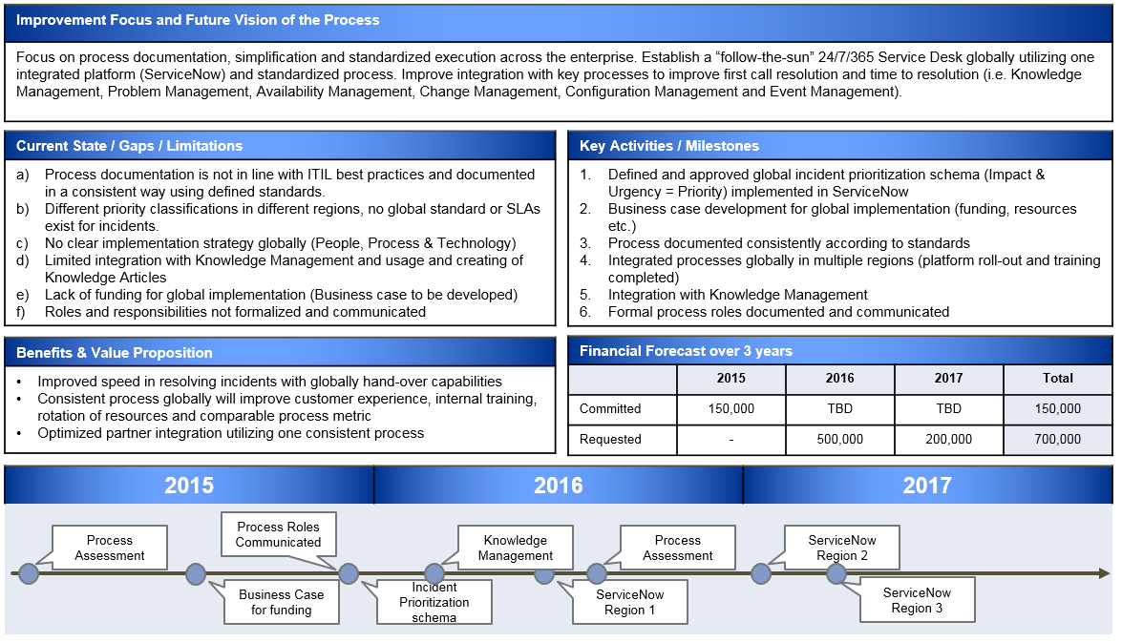
Bridging the Information Gap
IT Strategy & Vision
Process Owner
Strategic
Process
Roadmap
Bridging the
Information Gap
Process Managers and Practitioners
Executing the Process day-to-day
Notes:
Bridging the Information Gap
One of the key reasons why a Strategic Process Roadmap is needed within on IT organization is to bridge the Information Gap between the day-to-day execution and the IT Strategic planning of the IT organization.
The Strategic Process Roadmap, developed by the Process Owners is making sure the Process has a long term strategic focus and that investments and improvements are in alignment with the IT Strategy and the organizations Vision.
In many organization the Process Manager is tasked to develop some sort of long term plan i.e. a Strategic Process Roadmap as there are no Process Owners assigned or their role is not well defined.
We all know that the day-to-day work and the firefighting always takes priority so there is not a lot of time available for the Process Manager to develop these long term plans and sometime there is lack of understanding how to create a Strategic Process Roadmap.
Without a Strategic Process Roadmap the focus is usually on tactical process tools and process execution vs. Business Value and strategic alignment.

Slide 13
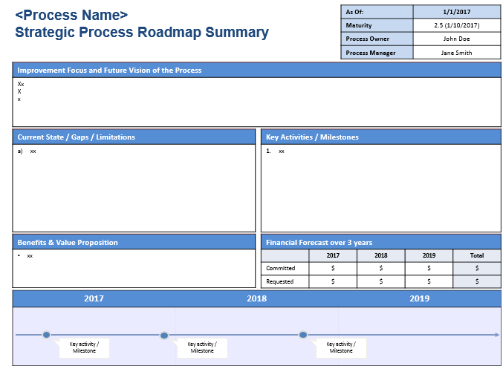
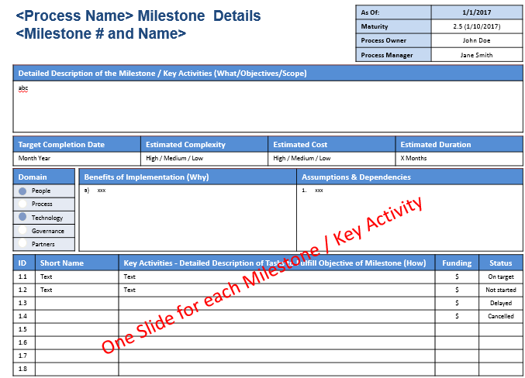
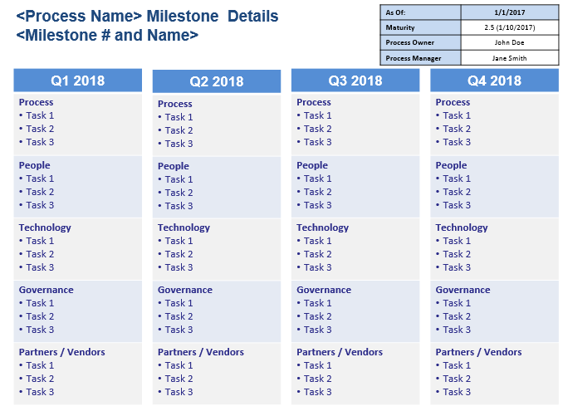
Steps to Develop a Strategic Process Roadmap
Understand and Execute the Accountabilities of Process Owners
Answer the Strategic Process Roadmap Questionnaire
Review Process Assessment findings, CSI register, Customer feedback etc.
+
+
1
2
3
Populate
Templates
4
3-year Strategic
outlook plan
Key Activities & Milestones
12-month rolling
Tactical plan
Notes:
Steps to Develop Strategic Process Roadmaps
There are four key steps when developing a Strategic Process Roadmap.
Step 1 is to make sure the Process Owners understands their role and accountabilities.
CLICK
Step 2 is to answer the Strategic Process Roadmap Questionnaire, this is the first template we will take a look at.
CLICK
Step 3 is to review existing material like Process Assessment findings, CSI register, Customer feedback, ongoing initiatives etc.
CLICK
And step 4 is to populate the templates. When the templates have been populated you have developed a Strategic Process Roadmap.
The Strategic Process Roadmap actually consist of a number of different artifacts, the 3-year Strategic Outlook plan but also the 12-month rolling plan. We will look at both of these templates.

Slide 14
Understand and Execute the Accountabilities of Process Owners
1
Accountable for the strategic direction and long term goal of the process
Set short term (12-month rolling) and long term (3 years) process goals
Define current maturity baseline and future process maturity level to be reached
Accountable for the overall performance and results of the process
Responsible to define process scope and goals
Accountable to ensure support and commitment of resources
Assisting in assigning a Process Manager
Notes:
Step 1 - Understand and Execute the Accountabilities of Process Owners
These are the five key accountabilities of a Process Owner.
I have only added the details of point 1 on this slide. If you like the full details of all 5 areas you should download this from my web page.
The first bullet states that the Process Owner is accountable for the strategic direction of the process both from a short and long term perspective.
The development of the Strategic Process Roadmap will clearly cover this point.

Slide 15
Answer the Strategic Process Roadmap Questionnaire
2
The Excel workbook consist of questions a Process Owner should ask themselves for each process they own.
This is only a starting point but provides great guidance
Workbook with questions
Workbook contains detailed instructions
Questions in five domains: People, Process, Technology, Governance and Partners
The Process Owner must identify process specific questions for their process
Notes:
Step 2 – Answer the Strategic Process Roadmap Questionnaire
This is the first template used for developing the Strategic Process Roadmap.
This is an excel questionnaire.
This is only a starting point for the Process Owners and additional questions must be considered that are specific to the process which a Strategic Process Roadmap is developed.
CLICK
Explain the excel spread sheet.
OPEN THE QUESTIONNAIRE EXCEL FILE

Slide 16
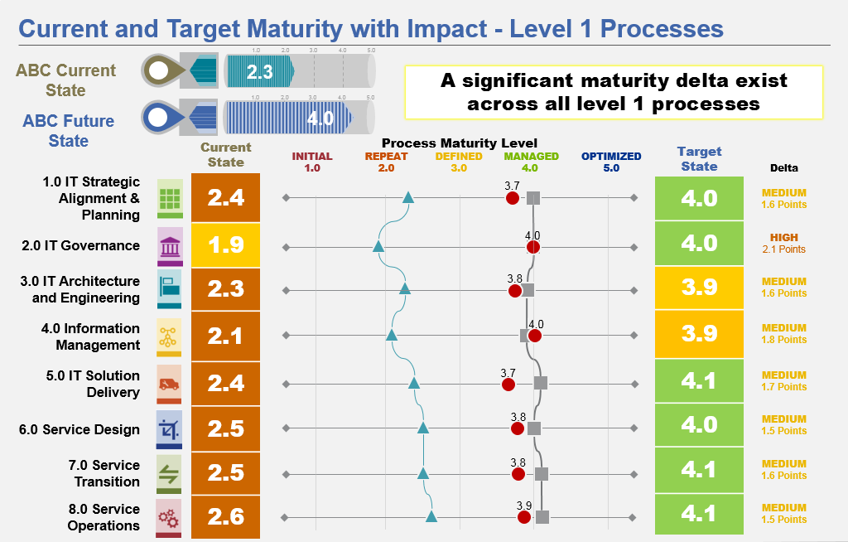
Review Process Artifacts, Information & Data
3
There is usually a lot of existing information and data a Process Owner can use as input to the Strategic Process Roadmap.
Customer Feedback
Ongoing Initiatives
CSI Register
Process Assessments
Strategy & Vision
Additional Data
IT Strategy & Vision
Business Strategy
BRM feedback
Notes:
Step 3 – Review Process Artifacts, Information & Data
To make sure the Strategic Process Roadmaps are considering not only the questionnaire questions, make sure to review any other type of information and data available.
Maybe there is data from a customer survey, what are the ongoing initiatives, the CSI register, IT’s Vision statement and strategy, past process assessment, or any other data like feedback e.g. from the Service Desk or BRMs.
The Process Manager will have a lot of input and valuable information that you can gather.
Make sure to gather as much information and input to the Strategic Process maps as possible. The Process Owner should of course review the IT Strategy and Vision and even the Business strategy.

Slide 17
Populate Templates
4
1-page Summary, 3 year focus
1-page 12 Month Rolling Plan
1-Page Milestone Details
Notes:
Step 4 – Populate Templates
OK, here are the PowerPoint templates that should be populated to create the Strategic Process Roadmap for a Process.
There are three different types of templates I will show you.
The first is the 1-page overview slide of the Strategic Process Roadmap with a 3 year focus.
CLICK
The second template is a drill down of each Milestones and Key Initiatives identified.
This is not to be seen as the project plan or the project charter document but provides additional information to understand the Milestone better.
When the Process Owner is asking for funding for the initiative this Milestone slide will provide the needed details.
To accomplish the Milestone the Process Owner might need funding for new staff or external consultants, maybe some new tools or replacement of existing tools. This Milestone slide will provide the additional details needed for IT Leadership to understand the request and obtain the approval.
CLICK
The third template is the 12-month rolling plan
When developing the 3-year Strategic Process Roadmap it is important to get a good understanding of the upcoming activities for the next 12 months.
This is a very high level plan the Process Owner can develop to work closely with the Process Manager and other impacted areas.
It provides a 1-slide overview of the significant activities for the next 12 month using key-words.
Each quarter the columns move to the left and a new column is added to the right with the next quarter. Activities that have not been completed the last quarter must be moved forward in the plan.
OPEN THE TEMPLARE AND PROVIDE ADDITIONAL DETAIL

Slide 18
Lessons Learned
Define clear Roles and Responsibilities / Accountabilities (RACI)
Process Managers / Platform Manager
Process Owners / Platform Owner / Enterprise Architecture
IT Governance Board / IT Leadership
Define the ITSM Governance Framework
Formalize Roles (empower roles, e.g. formal roles for career path)
Set up Councils (Process Manager Council, Process Owner Council etc.)
Define Escalations (Who do I escalate to?)
Define Thresholds (When do I escalate?)
Agree on Decision Rights (Who can decide? What can they decide on?)
Start with a few processes and adapt… (Crawl, Walk, Run)
Notes:
Lessons Learned
Define clear Roles and Responsibilities / Accountabilities (RACI)
Define the ITSM Governance Framework
Start with a few processes and adapt… (Crawl, Walk, Run)

Slide 19
Questions
Add to your toolbox
Process Manager Responsibilities
Process Owner Accountabilities
Strategic Process Roadmap Templates
This Presentation
Article: Implement Strategic Process Roadmaps or keep feeding the beast
To download templates go to: http://www.tmanthey.com/speaker.html

Slide 20
Thorsten Manthey – Session 804
thorsten@tmanthey.com
Cell: (617) 513 0000

