Slide 1
WORKSHOP Establish a Communication and Training Plan
Effective People Change Management using the WHO-HOW-WHAT approach!
Thorsten Manthey
Engagement Director, TCS
thorsten@tmanthey.com
April 2019
Public

Slide 2
The WHO-HOW-WHAT Approach - What you need for this Workshop
Defining a Communication and Training Plan for your project!
You will need:
A Project (real or imaginary)
Laptop / Tablet
Templates (will be provided to download)
What!?
I have to do something here?
You mean “really” work?
Templates you need:
Let’s go!
I am ready!
or
http://www.tmanthey.com/speaker.html

Slide 3
Agenda for Workshop
Why & Importance of People Change Management?
A three legged chair…
The Approach (WHO-HOW-WHAT)
Time to get to work…

Slide 4
Why People Change Management?
Increase Probability of Project Success!
Manage employee Resistance to change
Improve speed of Adoption (how quick)
Increase Utilization (how many)
Optimize Proficiency (how well)
Research from the Best Practices in Change Management 2014 Edition – Prosci® Benchmarking Report

Slide 5
People - Process - Technology
To be successful the focus the Change Approach must focus on three aspects!
My Project!
PROCESS
People Change Management
is NOT optional!
TECHNOLOGY
PEOPLE

Slide 6
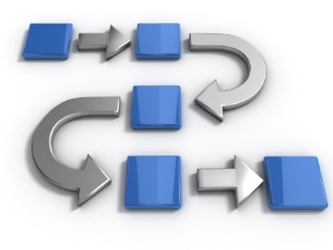
Process and Technology is not enough
Perfectly Designed Process
Perfectly Designed Technology
…is NOT enough.
If PEOPLE are not following the new process or not using the new tool very little is changing!
Project Outcomes/Benefits/ROI is NOT realized

Slide 7
The Approach… WHO-HOW-WHAT: Establish a Communication and Training Plan Download the templates: http://www.tmanthey.com/speaker.html

Slide 8
Overall Approach and Timeline
Usually takes 3-5 weeks* to complete
Start as soon as possible!
The data you collect is a SOLID START to developing an effective C&T plan
Remember, the C&T plan is a living document
As a facilitator you collect and update the information gathered and distribute prior to the second meeting.
Individual meetings scheduled with each of the affected groups to identify the actions (WHAT).
C&T Plan
Week 1
WHO
Week 2
HOW
Week 3
WHAT
Week 4
Week 5
*Example timeline; may increase per the complexity and size of the change across the organization

Slide 9
A 3 Step Approach: WHO - HOW - WHAT
WHO is impacted? Identify all groups that are being affected in any aspect by this change.
Stick to the topic in each meeting!
(WHO-HOW-WHAT)
STEP 1
WHO
HOW are they impacted? What is changing?
What is not changing?
Initial meeting
2nd validation meeting
STEP 2
HOW
WHAT is needed? Identify the “actions” and how much people change management is needed for the impacted groups?
Initial meeting
2nd validation meeting
STEP 3
WHAT
Separate meetings with each group
After these three steps have been completed you can populate the Communication & Training (C&T) plan
Communication & Training Plan

Slide 10
Time to get to work… Use the WHO-HOW-WHAT PPT template

Slide 11
Apply the Approach
Open the PowerPoint template:
WHO-HOW-WHAT_TEMPLATE.pptx
www.tmanthey.com/speaker.html

Slide 12
Step 1: WHO is Impacted and Affected?
Group | Contact | Description | # Members / Information
Identify all groups that are being affected in any aspect by the change
Users of the new system, tool or processes being implemented
Data consumers (e.g., reporting teams, finance teams, etc.)
Managers
Service Desk / 2nd level support / Technical support
Developers / Designers
HR / Finance / Procurement
External Vendors / Partners
Remember to stick to the agenda - WHO Don’t start identifying HOW or WHAT

Slide 13
Step 1: WHO is Affected - Example
Group | Contact | Description | # Members / Information
Service Desk | NN | Handles first level phone calls and tickets from customers. USA and India. | +90 customer service rep, multiple locations, 7x24x365
2nd level Support | NN | Handles escalated calls from the Service Desk. Two locations in the US | 15 support staff, two main locations, 7:00-21:00 business days
HR | NN | Supporting with the new roles and organizational changes | 5 HR people supporting the IT organization
Procurement | NN | Internal team plus a number of vendors | 2 people in procurement team. 3 major vendors
Finance | NN | Provides input to the new process via an automated feed from finance system | 2 VPs and their groups, total of 9 people
IT Managers | NN | All IT managers within the Infrastructure organization | All line managers 45 managers + their team, total ~800 people
Customers ordering services | NN | Anyone using the process. | USA: 1,500 people India: 200 people
Reporting team | NN | Extracting data from the system creating monthly reports | 6 individuals
Interfacing process teams | NN | Multiple interfacing processes | 5 process managers and 5 process owners
App. Development | NN | The team leader for the application development team X | 1 team lead and 10 people in the team in total
Example

Slide 14
Step 2: HOW are they Impacted and Affected?
Affected Group | How are the affected? / What information do they need?
Ask the following questions for each of the affected groups identified
What is changing for this group? What will be different?
What is not changing for this group? What will be the same?
What is driving the change, why are we changing?
What is the Vision for the Enterprise / BU / Group?
What does success look like for this Enterprise / BU / Group?
WIIFM? (most likely different for each of the groups)
Who is going to lose / gain what?
What happens if we do NOT change?
Remember to stick to the agenda – HOW Don’t start identifying WHAT

Slide 15
Step 2: HOW are they Impacted and Affected?
Affected Group | How are the affected? / What information do they need?
Service Desk | Emails, calls and chat to the Service Desk about the new tools/system/processes Knowledge about the new/updated/deleted tools/system/processes e.g. how to access, use, convert etc. How and where to escalate and route calls to 2nd level support Need to know when the tool/system/process has been released – Go Live date (staffing etc.) Implementation plans e.g. will there be a Hyper Care, phased roll-out etc. Information about Notifications, Approvals, Status Views, Escalations etc. in the new tool (Service Catalog) New support scripts to be developed / New FAQ and knowledge articles / Update existing information
2nd Level Support | Escalations to the 2nd Level Support about the new tools/system/processes How to escalate and route to external vendor Need to know when the tool/system/process has been released – Go Live date (staffing etc.) Implementation plans e.g. will there be a Hyper Care, phased roll-out etc. Information about Notifications, Approvals, Status Views, Escalations etc. in the new tool (Service Catalog) New support scripts to be developed / New FAQ and knowledge articles / Update existing information
Managers | New roles and organizational changes e.g. new and different skills required for staff Operational procedure changes, sourcing model will change (now outsourced) New / different reports or reporting structures Policy updates e.g. approvals, escalation etc.
Process Users | New tools and procures executing the process New or different skills required for the new role
Reporting team | New user interface when extracting data from the tool/system New data fields and values Mapping of old data to new data etc.
Ask the following questions for each of the affected groups identified
What is changing for this group? What will be different?
What is not changing for this group? What will be the same?
What is driving the change, why are we changing?
What is the Vision for the Enterprise / BU / Group?
What does success look like for this Enterprise / BU / Group?
WIIFM? (most likely different for each of the groups)
Who is going to lose / gain what?
What happens if we do NOT change?
Example
Remember to stick to the agenda – HOW Don’t start identifying WHAT

Slide 16
Step 3: WHAT are the needed Actions?
# | Actions for <Group Name> | Developer | Timing
1
2
Separate meeting with each affected group with key stakeholders
Multiple meeting might be required
One PPT slide for each group
Capture:
What activity is needed
The person / role responsible to develop the material / training, etc.
The timing (a specific date or, for example, “1 week before go live”)

Slide 17
Step 3: WHAT are the needed Actions?
# | Actions for Service Desk | Developer | Timing
1 | Live Demonstration of the End-to-end tool/system/process Train the trainer, live training (NN, NN, NN) Record demonstration and place on web page | Process Expert (NN) | 2 weeks before go live, 1 week before training session
2 | Information - Need to know when the tool/system/process has been released – Go Live date Email sent with release information (2 different emails) | Project Manager (NN) | 4 weeks before go live and also just days before Go Live
3 | Training and some hands on exercise on how to use the tool/system/process and how to escalate any issues the user experiences to 2nd level support. Train the trainer, live training (NN, NN, NN must attend) Record session and place on web page | Process Expert (NN) | 2 week before Go Live and just after Go Live (two sessions)
4 | Information session (Live web meeting and Q&A) about Notifications, Approvals, Status Views, Escalations etc. in the tool/system/process Train the trainer, live training will deliver session | Train the Trainer person (NN) | 1 week before Go Live and just after Go Live (two sessions)
5 | Service Desk Activity – Develop new support scripts / New FAQ and knowledge articles / Update information that exist / review & update what information is on the web | Service Desk Manager | Prepare before go live and release at Go Live
6
Example

Slide 18
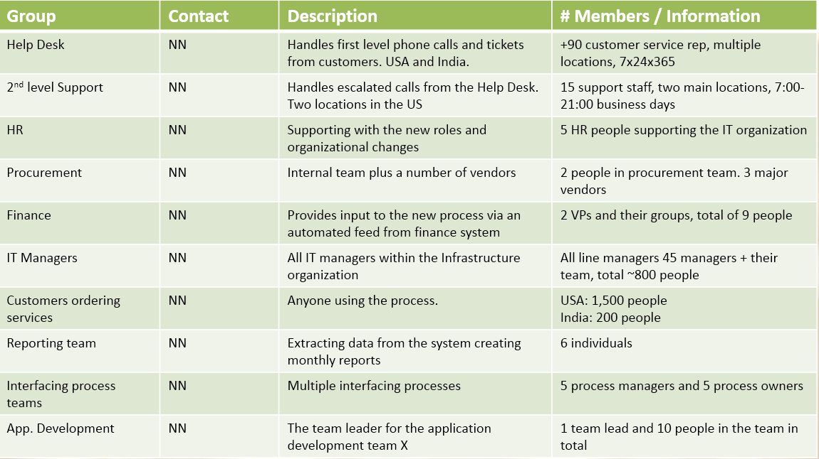
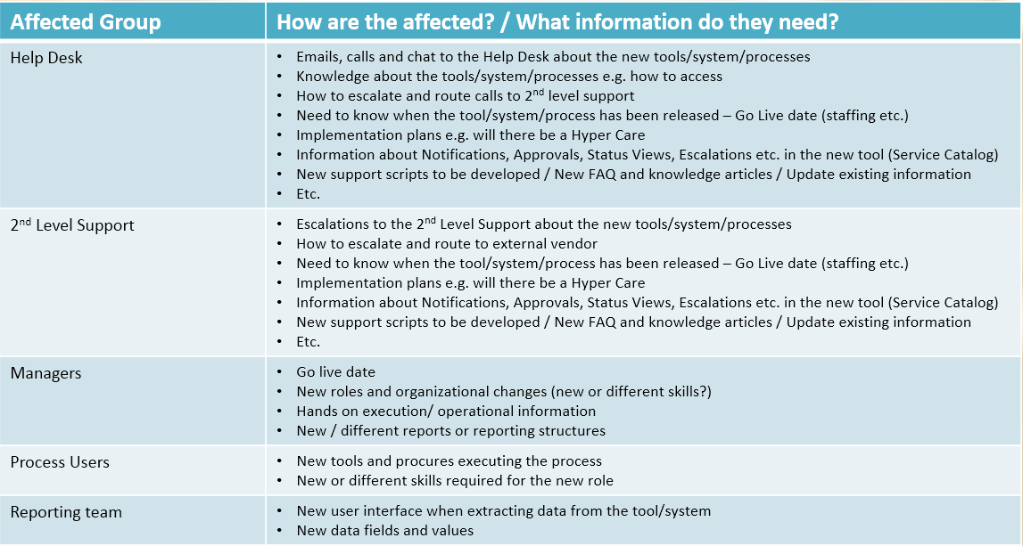
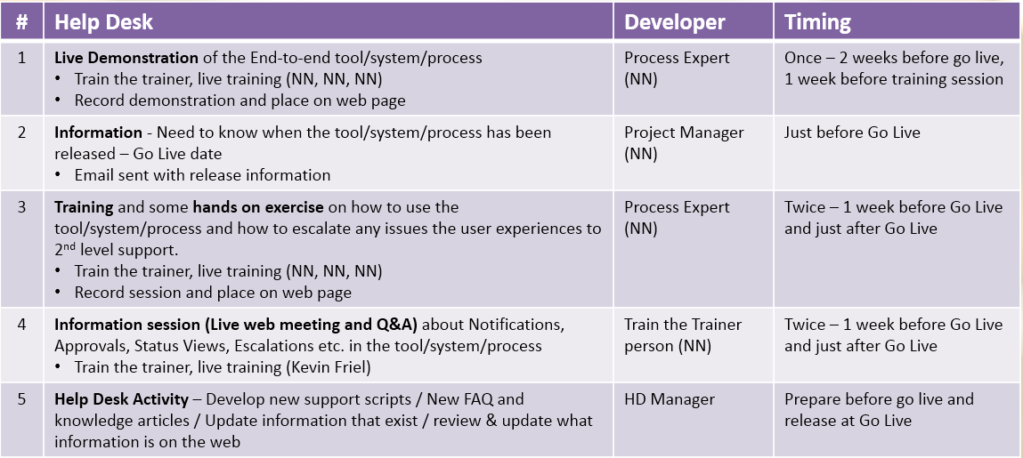
Populate the Communication & Training Plan
You have captured a lot of solid data
WHO
HOW
WHAT
Communication & Training Plan
www.tmanthey.com/speaker.html

Slide 19
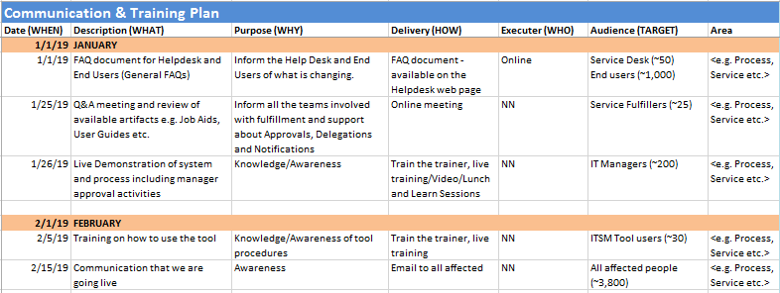
Communication & Training Plan
Filter by TARGET GROUP
Filter by AREA

Slide 20
Stay within each Step of the approach 1 -> 2 -> 3
It is a very simple approach: WHO – HOW – WHAT, but very effective!
If you stick to the agenda you will have solid data to populate the C&T plan.
It is very easy to get off track by focusing on the “WHAT” too early – DON’T DO IT

Slide 21
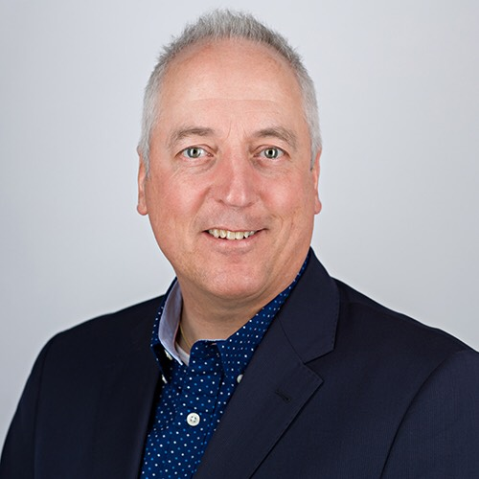
Questions
Add to your tool box:
WHO-HOW-WHAT templates
Communication & Training Plan template
People Change Management reading list
1-page approach WHO-HOW-WHAT
This presentation
To download templates go to: http://www.tmanthey.com/speaker.html
Thorsten Manthey
Engagement Director, TCS
thorsten@tmanthey.com

Slide 22
Thank You

