Slide 1
Establishing Strategic Process Roadmaps
Thorsten Manthey thorsten@tmanthey.com www.tmanthey.com @ThorstenManthey
itSMF Expo, Stockholm, Sweden April 6-7,2016

Slide 2
Information Gap between IT Strategy & Process Execution
IT Strategy & Vision
INFORMATION GAP
Process Managers and Practitioners
Executing the Process day-to-day

Slide 3
Bridging the Information Gap
IT Strategy & Vision
Bridging the gap between IT Strategy & Vision
and
Process Execution
Process Managers and Practitioners
Executing the Process day-to-day

Slide 4
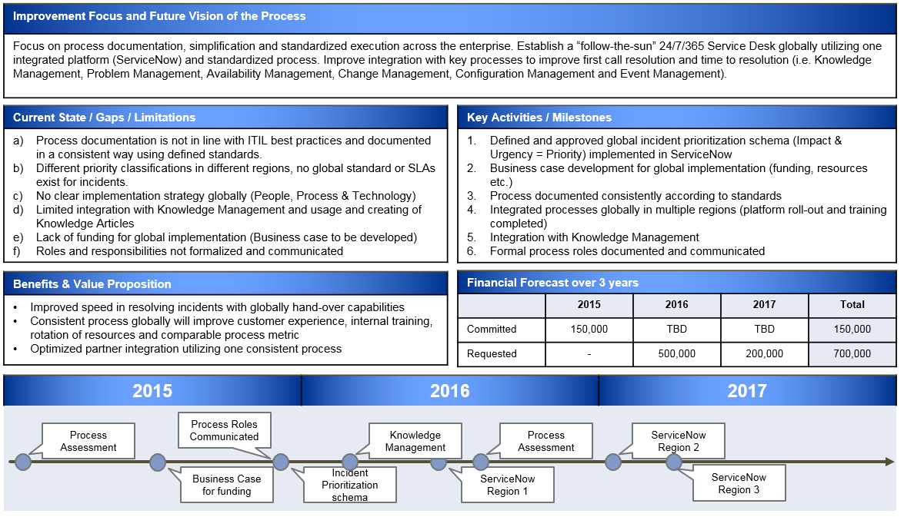
Bridging the Information Gap
IT Strategy & Vision
Strategic
Process
Roadmap
Process Owner
Bridging the
Information Gap
Process Managers and Practitioners
Executing the Process day-to-day

Slide 5
Value Proposition of a Strategic Process Roadmap
Strategic Alignment
Alignment with IT’s Vision and Goals
End-to-end customer and service focus
Long Term Strategic Focus
People: Staffing levels, required skills, training, communications
Process: Execution, improvements, integrations, automations
Technology: Tool changes/updates, new requirements/capabilities
Vendor/Partners: Contracts, SLAs, Strategic relationships
Elimination of “correct” pain points – Business Value
Identifying the most urgent business issue that must be improved
Customer needs vs. tactical tool/process “fixes”
Improve effectiveness (end use and customer value focus)
Improve efficiencies (IT delivers cheaper, better, and faster services)
Optimized Process for Improvements and Investments
Coordinated approach from all Process Owners to focus on the “right” improvements vs. many “one-off” requests from Process Managers (not a holistic approach)
IT Leadership can decide which investments to be prioritized (IT Governance Board) based on IT Strategy and Vision

Slide 6
IT Service Management Governance
Threshold for escalation
New funding e.g. > $25.000
New tools / technology
Major customization
Organizational changes
Strategic / Roadmaps
IT Governance Board (ITGB)
IT Strategy & Vision
Strategic Plans
Business Alignment
Vision & Mission
Consolidated Strategic Process Roadmaps
Process Strategy
Strategic Process Roadmap
Strategic Platform Roadmap
12-month rolling plan
Set process / platform goals, scope and future maturity
Process Owner and Architecture Council (POAC)
Threshold for escalation
Funding request e.g. >$1
New tools / technology
Tool customization
Staff changes / updates
Strategic process impact
Process Owner / Platform Architect (Strategic & long term goals. Strategic Roadmaps)
Process Operation
Process Execution
Process Documentation
Process Training
Automation & Technology
Monitoring & Reporting of KPIs and Metrics
Process Manager and Technical Review Council (PMTRC)
Threshold for escalation
Impacting more than one of the processes
Tool / Process integrations
Process Input / Output modifications
Process Manager / Technology Review (Operationally responsible for a consistent execution/integration)
Process Meetings for each Process
Practitioners / Process Engineers
(across organization / functional areas)

Slide 7
Steps to develop a Strategic Process Roadmap

Slide 8
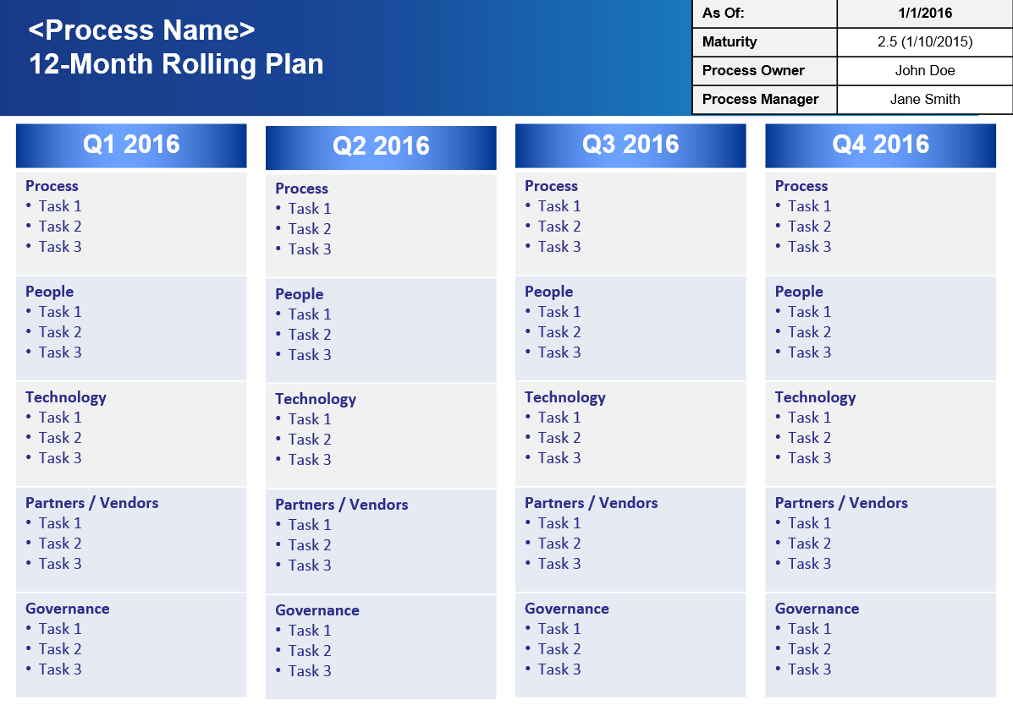
Develop a Strategic Process Roadmap
There are four key steps when developing the Strategic Process Roadmap
Understand and Execute the Accountabilities of Process Owners
Answer the Strategic Process Roadmap Questionnaire
Review Process Assessment findings, CSI register, Customer feedback etc.
+
+
1
2
3
Develop
Strategic
Process
Roadmap
4
3-year Strategic
outlook plan
12-month rolling
Tactical plan

Slide 9
1. Understand Process Owner Accountabilities
Accountable for the strategic direction and long term goal of the process
Set short (6-12 month) and long term (1-3 years) process goals by developing a Strategic Process Roadmap
Define current and future process maturity level to be reached
Accountable for the overall performance and results of the process
Set performance goals (SLAs, process output, quality metrics, CSF, KPI)
Define schedule for process maturity assessments
Define schedule for process audits (Compliance and execution)
Responsible to define process scope and goals
Define organizational and technical scope of process (Who and What should be included in the execution of the process?) Define clear Process goals.
Process specification, documentation and design
Accountable to ensure support and commitment of resources
Ensure funds ($), resources (people), vendor relationship (partners) and tools (product) are made available to enable process execution
Assisting in assigning a Process Manager
Ensures that a Process Manager is assigned who is responsible for the day-to-day execution, monitoring, reporting etc. and empower them to execute the process

Slide 10
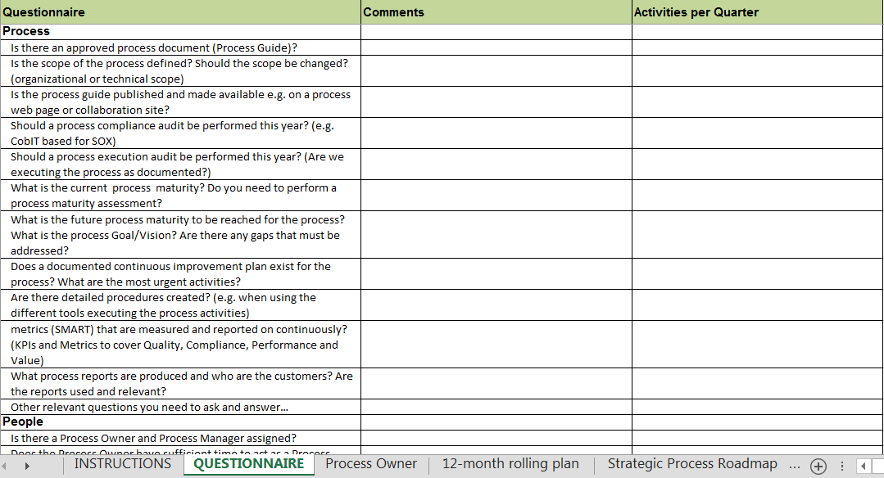
2. Answer Strategic Process Roadmap Questionnaire
The Excel workbook consist of questions a Process Owner should ask themselves for each process they own.
This is only a starting point but provides great guidance
Workbook with questions
Workbook contains detailed instructions
Questions in four domains: People, Process, Technology and Partners
The Process Owner must identify process specific questions for their process

Slide 11
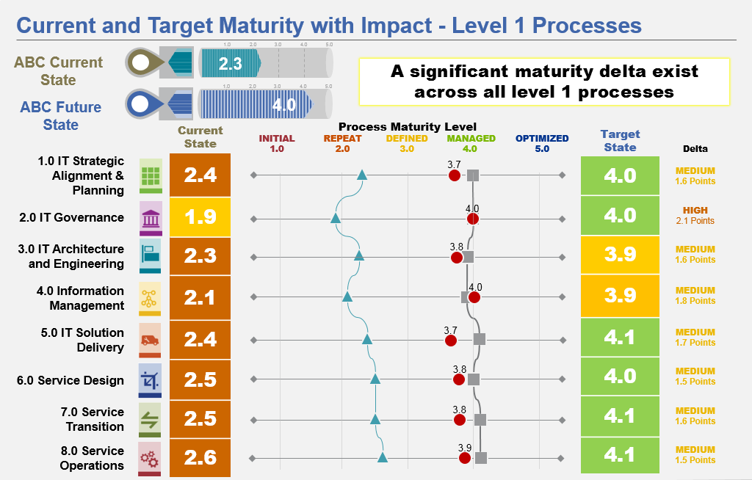
3. Review Process Assessment findings, CSI register, Customer feedback etc.
There is usually a lot of existing information and data a Process Owner can use as input to the Strategic Process Roadmap.
Customer Feedback
Ongoing Initiatives
CSI Register
Process Assessments
Strategy & Vision
Additional Data
IT Strategy & Vision
Business Strategy
BRM feedback

Slide 12
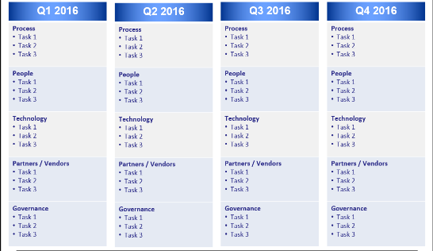
Process Owner
Strategic Process Roadmap Templates
Download at: www.tmanthey.com/speaker.html

Slide 13
Strategic Process Roadmap Questionnaire
The Excel workbook consist of questions a Process Owner should ask themselves for each process they own.
This is only a starting point but provides great guidance
Workbook with questions
Workbook contains detailed instructions
Questions in four domains: People, Process, Technology and Partners
The Process Owner must identify process specific questions for their process

Slide 14
<Process Name>
Strategic Process Roadmap Summary
As Of: | 1/1/2016
Maturity | 2.5 (1/10/2015)
Process Owner | John Doe
Process Manager | Jane Smith
Improvement Focus and Future Vision of the Process
Xx X x
Current State / Gaps / Limitations
xx
Key Activities / Milestones
xx
Benefits & Value Proposition
xx
Financial Forecast over 3 years
 | 2016 | 2017 | 2018 | Total
Committed | $ | $ | $ | $
Requested | $ | $ | $ | $
2016 | 2017 | 2018
text
text
text

Slide 15
Incident Management
Strategic Process Roadmap Summary
As Of: | 1/1/2016
Maturity | 2.5 (1/10/2015)
Process Owner | John Doe
Process Manager | Jane Smith
Example
Improvement Focus and Future Vision of the Process
Focus on process documentation, simplification and standardized execution across the enterprise. Establish a “follow-the-sun” 24/7/365 Service Desk globally utilizing one integrated platform (ServiceNow) and standardized process. Improve integration with key processes to improve first call resolution and time to resolution (i.e. Knowledge Management, Problem Management, Availability Management, Change Management, Configuration Management and Event Management).
Current State / Gaps / Limitations
Process documentation is not in line with ITIL best practices and documented in a consistent way using defined standards. Different priority classifications in different regions, no global standard or SLAs exist for incidents. No clear implementation strategy globally (People, Process & Technology) Limited integration with Knowledge Management and usage and creating of Knowledge Articles Lack of funding for global implementation (Business case to be developed) Roles and responsibilities not formalized and communicated
Key Activities / Milestones
Defined and approved global incident prioritization schema (Impact & Urgency = Priority) implemented in ServiceNow Business case development for global implementation (funding, resources etc.) Process documented consistently according to standards Integrated processes globally in multiple regions (platform roll-out and training completed) Integration with Knowledge Management Formal process roles documented and communicated
Benefits & Value Proposition
Improved speed in resolving incidents with globally hand-over capabilities Consistent process globally will improve customer experience, internal training, rotation of resources and comparable process metric Optimized partner integration utilizing one consistent process
Financial Forecast over 3 years
 | 2016 | 2017 | 2018 | Total
Committed | 150,000 | TBD | TBD | 150,000
Requested | - | 500,000 | 200,000 | 700,000
2016 | 2017 | 2018
Process Assessment
Process Roles Communicated
Knowledge Management
Process Assessment
ServiceNow Region 2
Business Case for funding
Incident Prioritization schema
ServiceNow Region 1
ServiceNow Region 3

Slide 16
<Process Name> Milestone Details
<Milestone # and Name>
As Of: | 1/1/2016
Maturity | 2.5 (1/10/2015)
Process Owner | John Doe
Process Manager | Jane Smith
Detailed Description of the Milestone / Key Activities (What/Objectives/Scope)
Xx X x
Target Completion Date | Estimated Complexity | Estimated Cost | Estimated Duration
Month Year | High / Medium / Low | High / Medium / Low | X Months
Domain
People
Process
Technology
Partners
Benefits of Implementation (Why) | Assumptions & Dependencies
xxx | xxx
ID | Short Name | Key Activities - Detailed Description of Tasks to Fulfill Objective of Milestone (How) | Funding | Status
1.1 | Text | Text | $ | On target
1.2 | Text | Text | $ | Not started
1.3 |  |  | $ | Delayed
1.4 |  |  | $ | Cancelled
1.5
1.6
1.7
One Slide for each Milestone / Key Activity

Slide 17
<Process Name>
12-Month Rolling Plan
As Of: | 1/1/2016
Maturity | 2.5 (1/10/2015)
Process Owner | John Doe
Process Manager | Jane Smith
Q1 2016
Process Task 1 Task 2 Task 3
People Task 1 Task 2 Task 3
Technology Task 1 Task 2 Task 3
Partners / Vendors Task 1 Task 2 Task 3
Q2 2016
Process Task 1 Task 2 Task 3
People Task 1 Task 2 Task 3
Technology Task 1 Task 2 Task 3
Partners / Vendors Task 1 Task 2 Task 3
Q3 2016
Process Task 1 Task 2 Task 3
People Task 1 Task 2 Task 3
Technology Task 1 Task 2 Task 3
Partners / Vendors Task 1 Task 2 Task 3
Q4 2016
Process Task 1 Task 2 Task 3
People Task 1 Task 2 Task 3
Technology Task 1 Task 2 Task 3
Partners / Vendors Task 1 Task 2 Task 3

Slide 18
Lessons Learned
Define clear Roles and Responsibilities / Accountabilities (RACI)
Process Managers / Platform Manager
Process Owners / Platform Owner / Enterprise Architecture
IT Governance Board / IT Leadership
Define the ITSM Governance Framework
Formalize Roles (empower roles, e.g. formal roles for career path)
Set up Councils (Process Manager Council, Process Owner Council etc.)
Define Escalations (Who do I escalate to?)
Define Thresholds (When do I escalate?)
Agree on Decision Rights (Who can decide?)
Start with Process Governance, this is the base for Service Governance (Crawl, Walk, Run)

Slide 19
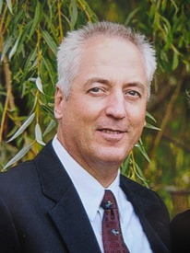
Thank you!
Thorsten Manthey thorsten@tmanthey.com www.tmanthey.com @ThorstenManthey
+1 (617) 513 0000

