Slide 1
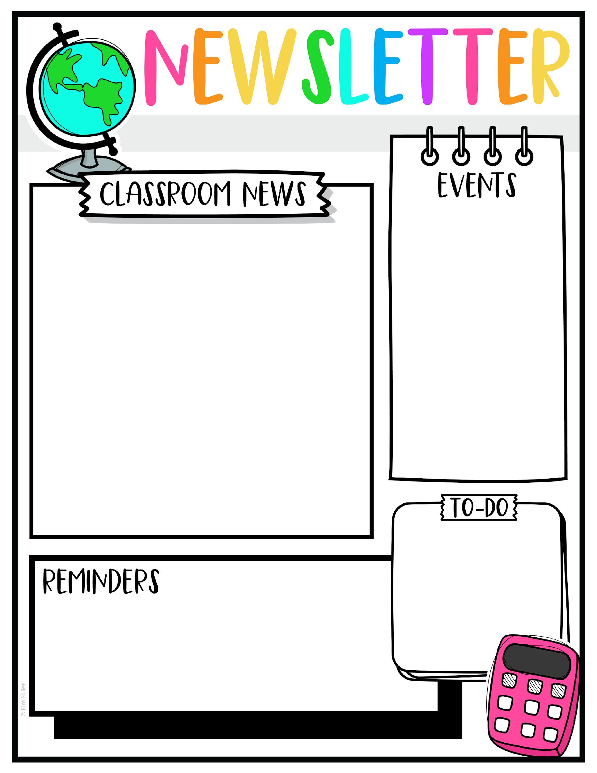
Week of October 6
Math quarter test will be on Thursday.
Spelling Test on Friday.
Topics they will be learning this week:
Math:
Solve word problems to 10
Addition/Subtraction Test
English
Phonics: Connecting sentences to images.
Capitalization
Science
Life Cycle of a Tomato Plant
S. Studies
Why Do We Vote
Spelling Words
hot
not
got
lot
pop
hop
mop
stop
they
walk
Field Trip this Wednesday, October 8. If they are not attending the field trip, they should not come to school.

