Slide 1
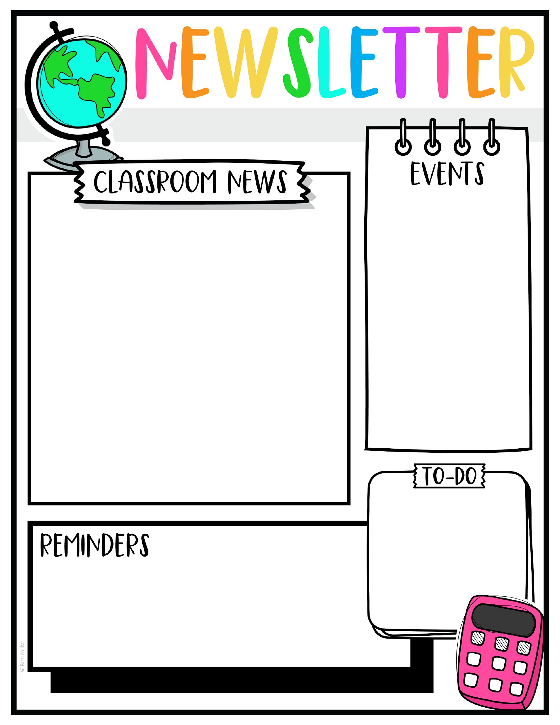
Week of September 29
Reading test on Thursday.
Spelling Test on Friday.
Topics they will be learning this week:
Math:
Use addition to subtract
English
Read story Run! Jump! Swim!
Phonics: Connecting sentences to images.
Science
Root Growth
S. Studies
How Should citizens treat each other?
Spelling Words
his
him
big
pig
wig
kick
pick
sick
play
want
Hot lunch is Monday-Wednesday only. It is $5
They still have to bring a snack everyday, even hot lunch days. Snack and lunch are 2 different timings.

